Slide 1
ALEX: Updatable Adaptive Learned Index
&
Follow-Up Research: Extending ALEX with Precise Positions
Presenter: Shuai Wang
Jingyang He
Jiaoli Yang

Slide 2
Root Paper: Alex:An Updatable Adaptive Learned Index
  Motivation & Background of Alex
    B+Tree: O(log N) lookup, dynamic updates, but high internal-node overhead and memory footprint
    Learned Index (Kraska et al. ’18): replaces internal tree nodes with small ML models → 3× faster lookup & 10× smaller index on static data
    Limitation of Learned Index: static, read‑only — no efficient support for inserts/updates
    Bridging the GAP:
    supports point/range queries + full CRUD
    retains learned-index speed & compactness

Slide 3
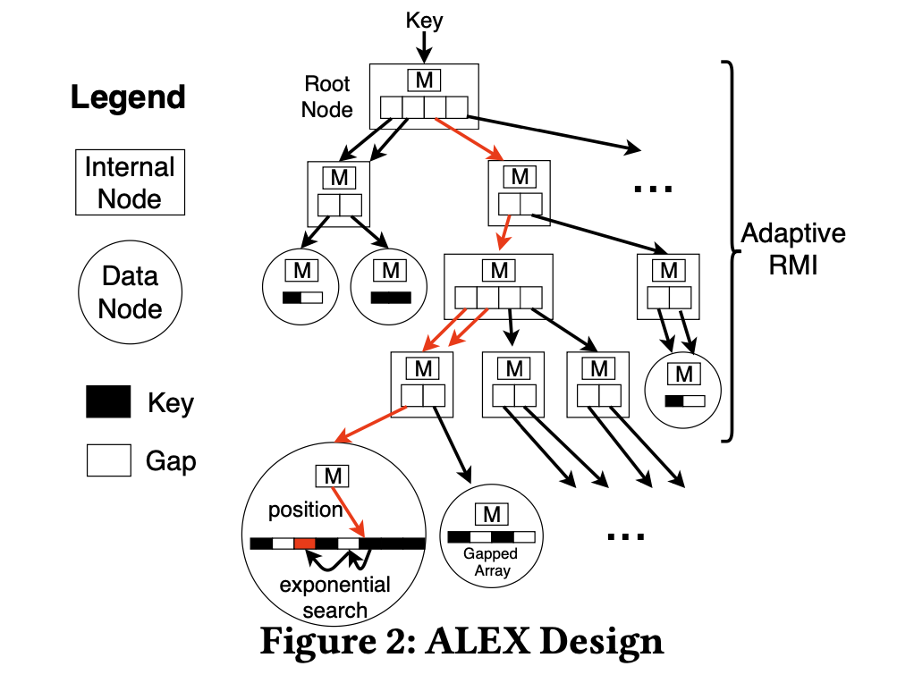
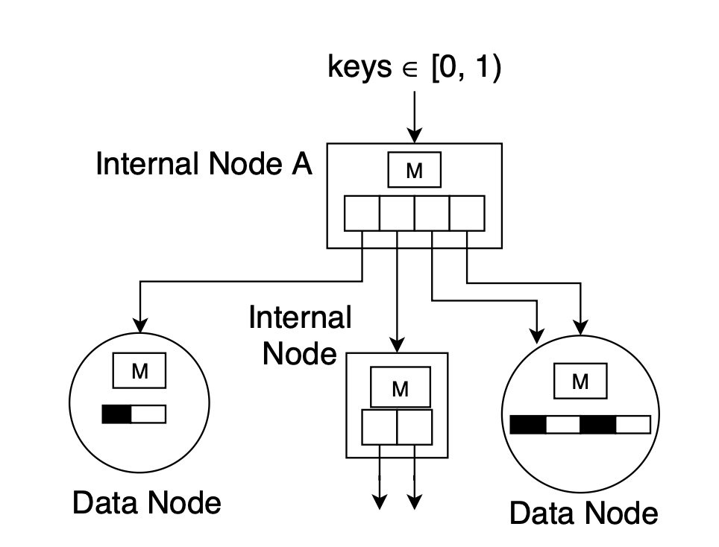
Core Innovations of ALEX
  Gapped Array leaf layout
    Spread “gaps” within each leaf array
    Good robustness against distributional drift
  Adaptive RMI structure
    Dynamically expands or splits data nodes based on simple lookup/insert cost models
    Maintains no tuning knobs: auto‐grows to workload, data skew, insertion patterns

Slide 4
Core Structures & mechanisms of ALEX:
Data Node = (linear model + Gapped Arrays + bitmap)
Model: y = ⌊a × key + b⌋ predicts slot in [0…m–1]
  Keys & payloads stored in two parallel Gapped Arrays
Bitmap tracks “gap vs filled” to skip holes in scans
Key Question: if the node is full, how to CRUD?
SOLUTION: Expand nodes with different strategies

Slide 5
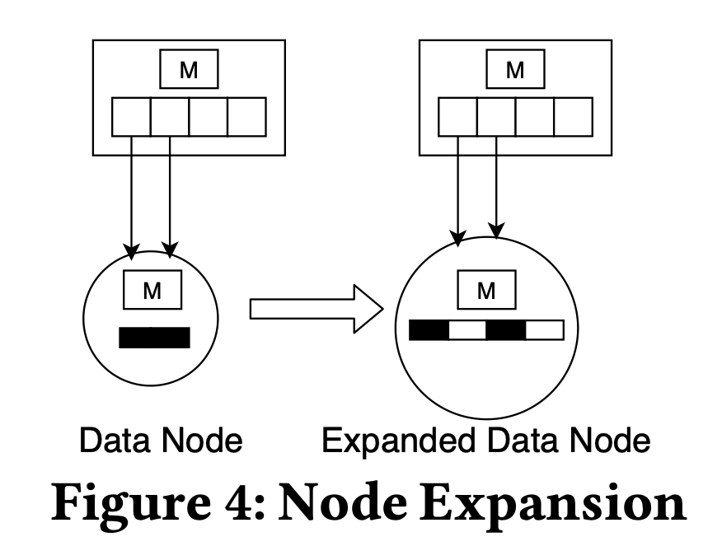
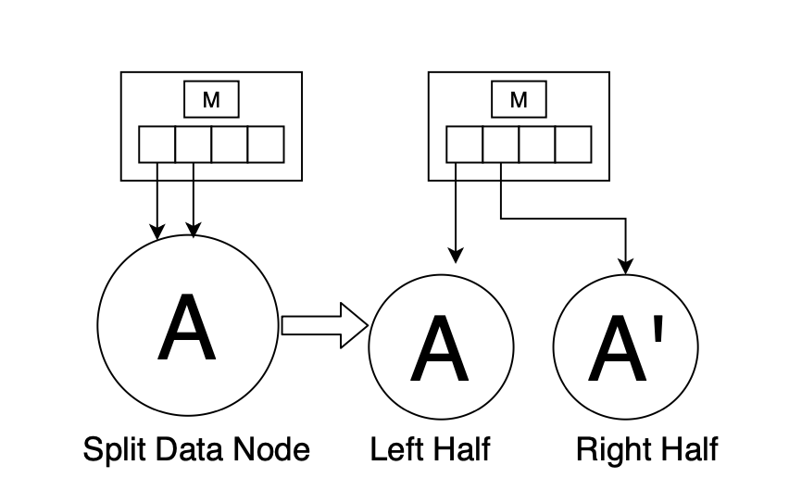
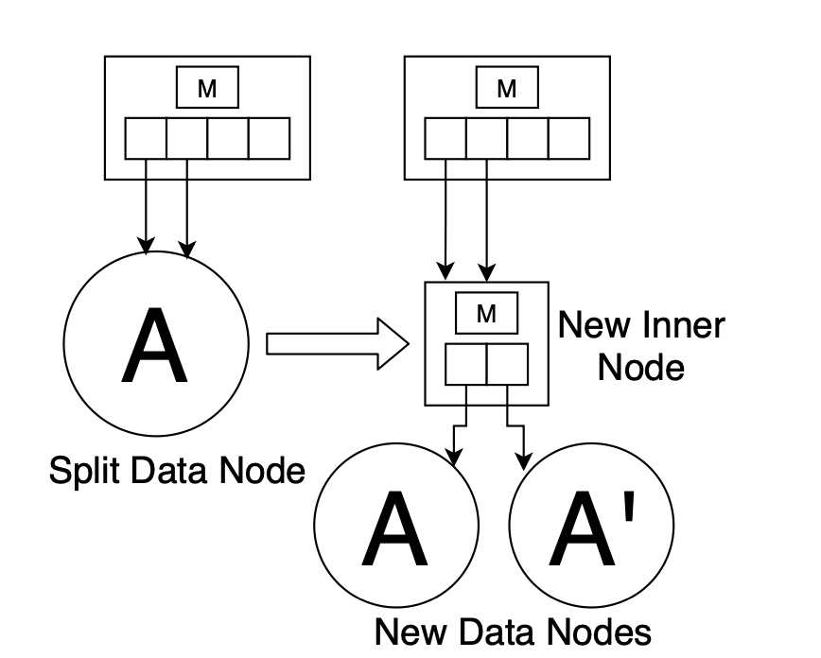
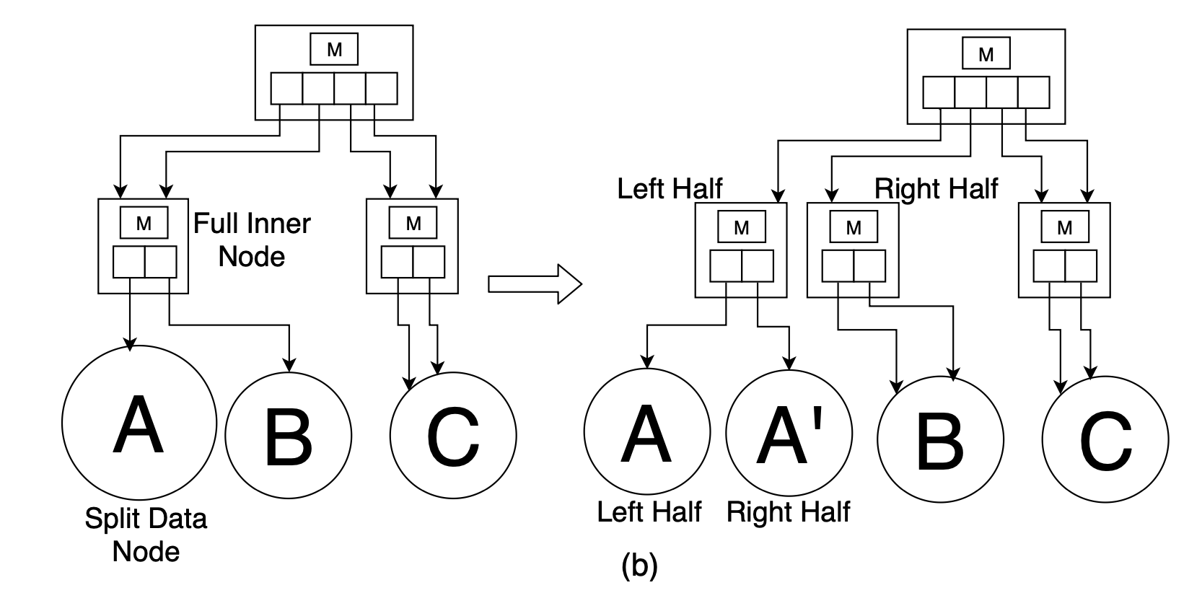
Node full → Expansion or Split
Expansion: allocate larger array, scale or retrain model, re‑insert (model‐based)
Split sideways/down: split key‐space in two, adjust parent pointers (power‑of‑2 fanout)

Slide 6
Why improve ALEX
“Last‑mile” search blow‑up
ALEX uses exponential search around a predicted slot
In worst‑case leaf mispredictions ⇒ O(m) or binary search over entire node
Unbounded structure growth
On heavy inserts or skew, ALEX gaps fill ⇒ frequent node expansions & splits
No worst‑case guarantee on tree height → lookup cost drifts
Shifting overhead
GappedArray shifts O(log m) amortized but still non‑zero per insert
Large payloads amplify copy cost
Our Main Goal:
Supports efficient updates without shifting

Slide 7
Our ideas & attempts
  Exact key→slot mapping
    Replace “model + search” with a single ⌊a·G(k)+b⌋ prediction
    Every prediction is precise: no in‑node search
      With a well-trained "kernelized linear model." p = ⌊a·G(k)+b⌋ , Maps any key k exactly to a slot in the leaf node array, guaranteeing that there are no "misses" or "mismatches". No need for any subsequent search: one model inference, direct hit.

Slide 8
Our ideas & attempts
  Conflict-split leaf slots
    On collision: convert slot → child node, push both keys into the child
    Zero shifting: newly inserted keys never displace existing entries
      In ALEX, if two different keys are predicted by the leaf node model to be at the same array index, the only way to insert is to "make a gap" around the position - or move a bunch of elements left/right, which is costly, and in the worst case do a bisection or linear scan of the whole page, which is uncontrollable in terms of performance. Uncontrollable.

Slide 9
Our ideas & attempts
  Conflict-split leaf slots Strategy
    Model Prediction:
      For a newly inserted key 𝑘, compute its target slot p = ⌊a·G(k)+b⌋ using the node’s monotonic linear model.
    Slot‑Type Check:
      If slot p is NULL (empty) or already holds the same key (rare exact duplicate), simply store 𝑘 there as a DATA entry.
      Otherwise, a conflict has occurred: slot p already contains a different key 𝑘’
    Immediate Split (DATA→NODE):
      Promote the conflicted slot from DATA to NODE.
      Allocate a new child node just for these two keys 𝑘 and 𝑘′.
      Update the original slot to point to this child node.

Slide 10
Our ideas & attempts
  Conflict-split leaf slots Strategy
    iv. Precise Placement in Child:
    i. Inside the newly created child node, rerun the same the exact‑mapping logic (model + slot‑type check).I f more than two keys collide, repeat the split recursively until every key occupies a unique DATA slot.
    v. Zero Shifts, Zero In‑Node Search:
    i. No element shifting ever occurs at the leaf level—conflicts always spawn a new node instead.
    ii. Lookups require only one model inference + one type check (DATA vs. NODE), with at most one pointer chase—no exponential or binary search.

Slide 11
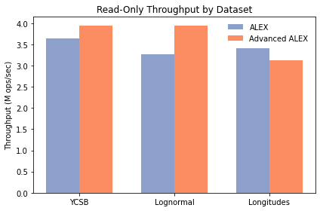
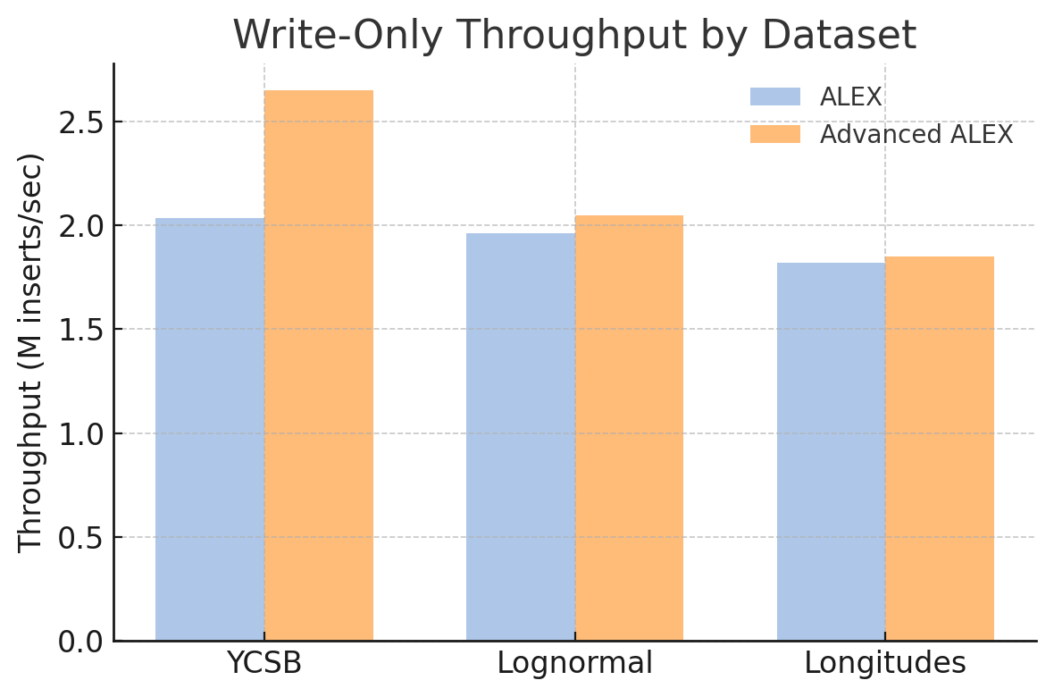
Experiment:
set up:
RTX 4090
14 cores-AMD EPYC 7453
RAM: 64GB
Datasets:
Longitudes (200M 8-byte floats)
Lognormal (190M 8-byte signed ints)
YCSB (200M 8-byte unsigned ints)
  Our resulting “Advanced ALEX” design sustains up to 30 % higher insert rates (e.g. from 2.035 M ops/s to 2.648 M ops/s on YCSB) and up to 21 % higher lookup rates (e.g. from 3.265 M ops/s to 3.952 M ops/s on the Lognormal dataset) under mixed OLTP workloads, all while maintaining sub‐microsecond tail latencies.

Slide 12
Conclusion:
  We studied ALEX and followed the pattern of ALEX using machine learning to improve CRUD efficiency.
  We solved the problem of not being able to query accurately on leaf nodes.
  In our experiments, the optimized ALEX generally achieves better results.

Slide 13
Thank You
Q &A

