Slide 1
COP5725
Advanced Database Systems
Storage and Representation

Slide 2
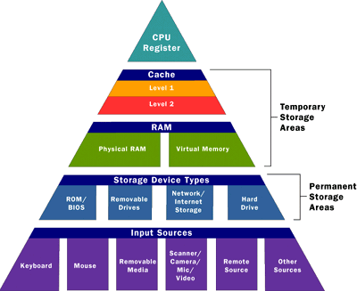
Memory Hierarchy
Increasing
cost and speed
Decreasing
size
Registers
Level one Cache
Level two Cache
Main memory
Hard disk
Tertiary storage
Decreasing cost and speed,
Increasing size

Slide 3
Why Memory Hierarchy
Three questions asked when creating memory:
  How fast
  How much
  How expensive
The purpose of the hierarchy is to allow fast access to large amounts of memory at a reasonable cost

Slide 4
Memory Hierarchy
Cache (volatile)
  Size: in megabytes (10⁶ bytes)
  Speed: between cache and processor: a few nanoseconds (10⁻⁹ seconds)
Main Memory (volatile)
  Size: in gigabytes (10⁹ bytes)
  Speed: between memory and cache: 10-100 nanoseconds
Secondary Storage (nonvolatile)
  Size: in terabytes (10¹² bytes)
  Speed: between disk and main memory: 10 milliseconds (10⁻³ seconds)
Tertiary Storage (nonvolatile)
  Magnetic tapes, optical disks, ……
  Size: in terabytes (10¹² bytes) or petabytes (10¹⁵ bytes)
  Speed: between tertiary storage and disks: seconds or minutes

Slide 5
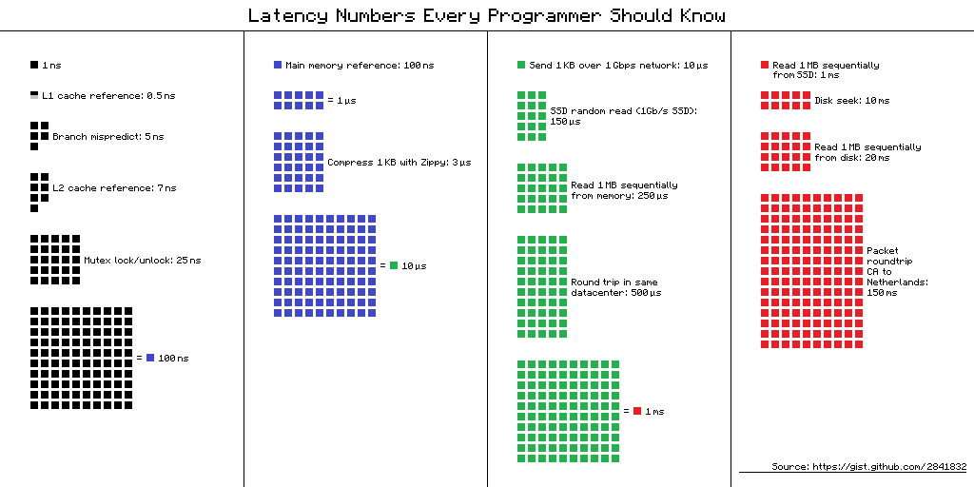
Latency Numbers

Slide 6
Latency Numbers
Let’s multiply all these durations by a billion (10^9)!
Minute
  L1 cache reference 0.5s One heart beat (0.5s)
  L2 cache reference 7s Long yawn
Hour
  Main memory reference 100s Brushing your teeth
Day
  Send 2K bytes over 1 Gbps network 5.5 hours
Week
  SSD random read 1.7 days A normal weekend
  Read 1 MB sequentially from memory 2.9 days A long weekend
  Read 1 MB sequentially from SSD 11.6 days
Year
  Disk seek 16.5 weeks A semester in university
  Read 1 MB sequentially from disk 7.8 months
  The above two together 1 year

Slide 7
Virtual Memory
Virtual memory is not really physical memory!
  Is NOT a level of the memory hierarchy
  It is a technique that gives programs the idea that it has working memory even if physically it may overflow to disk storage
  OS manages virtual memory
It makes programming large applications easier and efficiently uses real physical memory

Slide 8
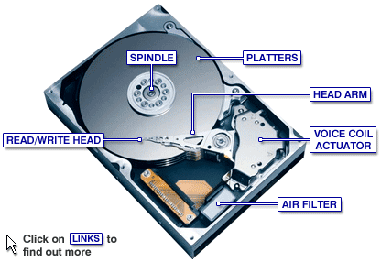
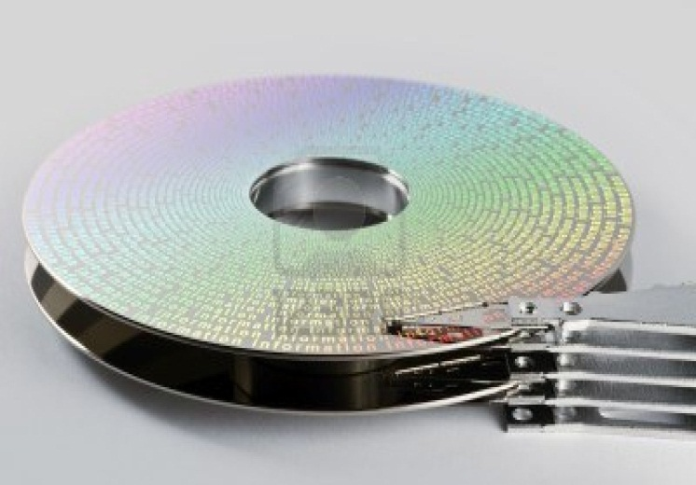
Second Storage
Disk
  Slower, cheaper than main memory
  Persistent!
  The unit of disk I/O = block
    Typically 1 block = 4k
  Mechanical characteristics:
    Rotation speed (7200RPM)
    Number of platters (1-30)
    Number of tracks (<=10000)
    Number of bytes/track(10⁵)
  http://www.youtube.com/watch?v=kdmLvl1n82U

Slide 9
Disk Access Characteristics
Disk latency
  Time between when command is issued and when data is in memory
  = seek time + rotational latency + transfer time
    Seek time = time for the head to reach cylinder: 2ms – 3ms
    Rotational latency = time for the sector to rotate
      rotation time = 0-4ms (15000 RPM)
    Transfer time = typically 0.25ms per 64KB page
  Disks read/write one block at a time

Slide 10
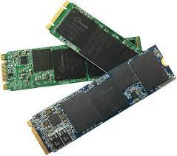
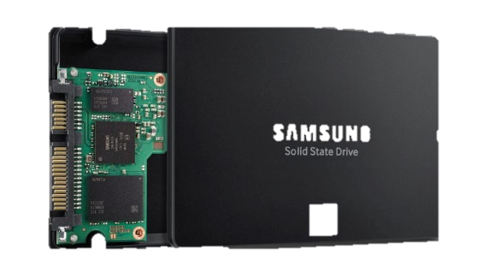
Second Storage
Flash (SSD)
  Organized into “cells”
  Current generation (NAND)
    Random reads and writes
    Fine-grain reads (4-8K reads), fast and predictable
      4KB random reads: 500 MB/sec
    Coarse-grain writes (1-2MB writes), NOT fast!
      4KB random writes: 120 MB/sec
      Only 2k-3k erasures before failure
      Keep moving write units around (wear leveling)
  https://www.youtube.com/watch?v=5Mh3o886qpg&ab_channel=BranchEducation

Slide 11
Disk Storage Management
Terminologies
  Block: unit of transfer for disk read/write
    64KB – 128KB is a good number today
  Page: a common synonym for Block
    Page = a block-sized chunk of RAM
Lowest layer of DBMS
  Physical details hidden from higher levels of system
Purpose
  Map pages to locations on disk
  Load pages from disk to memory
  Save pages back to disk & ensuring write

Slide 12
I/O Model of Computation
Major Implications for Disk APIs
  Read: transfer blocks of data from disk to RAM
  Write: transfer blocks of data from RAM to disk
  Both API calls are very slow, so plan carefully
Dominance of I/O cost
  The time taken to perform a disk access is much larger than the time for manipulating data in main memory
  The number of block accesses (disk I/O’s) is a good approximation to the time of an algorithm and should be minimized
  Throughput: # disk accesses per second the system can accommodate

Slide 13
I/O Model of Computation
Rule of Thumb
  Random I/O: Expensive; sequential I/O: much less (10X)
  Example: 1 KB Block
    Random I/O: ∼ 10 ms
    Sequential I/O: ∼ <1 ms
  Cost for write is similar to read (HDDs)
  To Modify Block
    (1) Read Block, (2) Modify in Memory, (3) Write Block, (4) (optional) Verify
  Maximize usage of data per Read/Write
    Amortize seek delays (HDDs) and writes (SSDs)
If you are going all the way to Pluto, pack the spaceship full!

Slide 14
Files of Pages of Records
Overall
  Each table is stored in one or more OS files
  Each file contains many pages
  Each page contains many records
Pages are the common currency understood by multiple layers
  Managed on disk by the disk space manager: pages read from/written to physical disk/files
  Managed in memory by the buffer manager: higher levels of DBMS only operate in memory

Slide 15
DB File Structures
Information is stored in files in different ways
  Unordered heap files
    Records placed arbitrarily across pages
    As file shrinks/grows, pages (de)allocated
    Suitable when typical access is a full scan of all records
  Clustered heap files
    Group data into blocks to enable fast lookup and efficient modifications
  Sorted files
    Pages and records are in strict sorted order
    Best for retrieval in order, or when a range of records is needed
  Index files
    B+ trees, linear hashing, extensible hashing, ……
    May contain records or point to records in other files

Slide 16
Unordered Heap Files as List
Heap files has one special header page
  Location of the heap file and the header page are saved in DB catalog
  Each page contains two “pointers” plus free space and data
  Weaknesses
    How do I find a page to fit in a two-byte record?
    Need to access many pages (w/ free space) to check

Slide 17
Unordered Heap Files With Page Directories
Page directories, with multiple header pages, each encoding
  A pointer to page
  # free bytes on the page
Header pages are accessed often,
so likely deployed in cache
Finding a page to fit a record can be done efficiently
  One header page load reveals free space of MANY pages
Header page
Header page

Slide 18
Representing Data Elements
Terminology in Secondary Storage
Example:
CREATE TABLE Product (
pid INT PRIMARY KEY,
name CHAR(20),
description VARCHAR(200),
maker CHAR(10) REFERENCES Company(name)
)
 | Data Element | Record | Collection
DBMS | Attribute | Tuple | Relation
File System | Field | Record | File

Slide 19
Representing Data Elements
What we have available: Bytes (8 bits)
(Short) Integer : 2 bytes
  e.g., 35 is
Real, floating point
  n bits for mantissa, m for exponent
  e.g., 1.2345 is 12345*10⁻⁴
Characters
  various coding schemes suggested, most popular is ASCII
  e.g., A: 1000001; a:1100001
Boolean
  True: 11111111; false: 00000000
00000000
00100011

Slide 20
Representing Data Elements
Dates
  e.g.: integer, # days since Jan 1, 1900 or 8 characters, YYYYMMDD
Time
  e.g. : integer, seconds since midnight or characters HHMMSS
String of characters
  Null terminated
  Length given
c
a
t
3
c
a
t

Slide 21
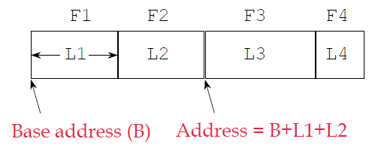
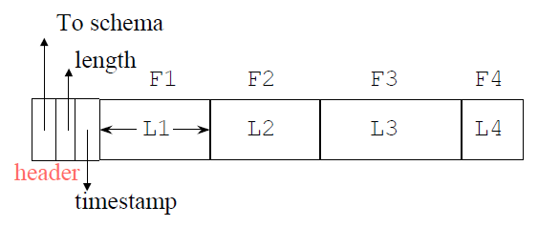
Record Formats: Fixed Length
Information about field types is same for all records in a file
  stored in system catalogs (just another table)
  Finding i’th field requires scan of record
Record Header
  Pointer to the schema: find the fields of the record
  Length: skip over records without consulting the schema
  Timestamps: the record last modified or read

Slide 22
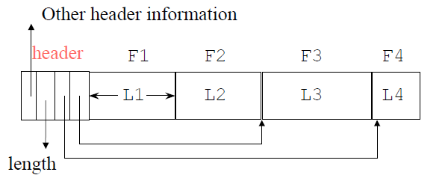
Variable Length Records
Example:
  Place the fixed fields first: F1, F2
  Then the variable-length fields: F3, F4
    Pointers to the beginning of all the variable-length fields
  Null values take 2 bytes only
    sometimes they take 0 bytes (when at the end)

Slide 23
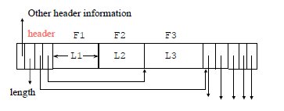
Records With Repeating Fields
A record contains a variable number of occurrences of a field, but the field itself is of fixed length
  e.g., An employee has one or more children
  Group all occurrences of the field together and put in the record header a pointer to the first

Slide 24
Placing Records into Blocks
blocks ...
a file
assume fixed
length blocks
assume a single file

Slide 25
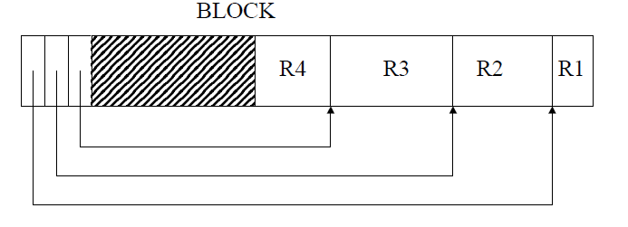
Storing Records in Blocks
Blocks have fixed size (e.g. 64k) and record sizes are smaller than block sizes
  Slots (pointer + record_size) grow from beginning of page inward
  Records grow from end of page inward
  Update counts (# records)

Slide 26
Spanned vs. Unspanned
Unspanned: records must be within one block
  much simpler, but may waste space…
block 1 block 2
...
Spanned
  When records are very large (record size > block size)
  Or even medium size: saves space in blocks
block 1 block 2 ...
R1
R2
R3
R4
R5
R1
R2
R3
(a)
R3
(b)
R4
R5
R6
R7
(a)
need indication of partial record “pointer” to rest
need indication of continuation (+ from where?)

Slide 27
Sequencing
Ordering records in file (and block) by some key value
Why?
  Typically to make it possible to efficiently read records in order
  e.g., to do a merge-join — discussed later
Options:
  Next record physically contiguous
  Linked
R1
Next (R1)
R1
Next (R1)

Slide 28
BLOB
Binary large objects
  Supported by modern database systems
    E.g. images, sounds, etc.
Storage
  attempt to cluster blocks together and store them on a sequence of blocks
    On a cylinder or cylinders of the disk
    On a linked list of blocks
    Stripe (alternate blocks of) BLOB across several disks, such that several blocks of the BLOB can be retrieved simultaneously

Slide 29
Database Addresses
Physical Address: Each block and each record have a physical address that consists of
  The host
  The disk
  The cylinder number
  The track number
  The block within the track
  For records: an offset in the block, sometimes this is in the block’s header
Logical Addresses: Record ID is arbitrary bit string
  More flexible
  But need translation table

Slide 30
Addresses
Header
A block: Free space
R3
R4
R1 R2

Slide 31
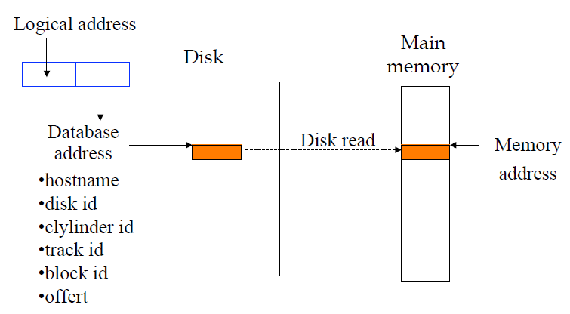
Memory Addresses
Main Memory Address
  When the block is read in main memory, it receives a main memory address

Slide 32
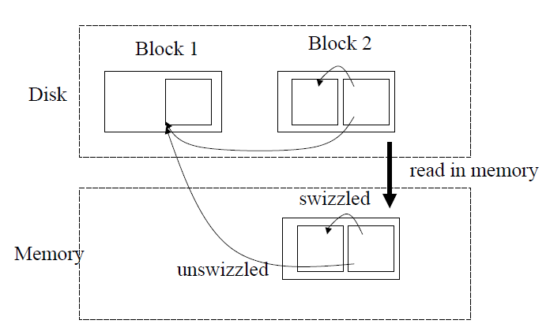
Pointer Swizzling
The process of replacing a physical/logical pointer with a main memory pointer
  need translation table such that subsequent references are faster
Idea:
  When we move a block from secondary to main memory, pointers within the block may be “swizzled”
  Translation from the DB address to memory address

Slide 33
Pointer Swizzling
Automatic Swizzling (Eager)
  when block is read in main memory, swizzle all pointers in the block
On demand
  Leave all pointers unswizzled when the block is first brought into memory, and swizzle only when user requests
No swizzling (Lazy)
  always use translation table
  the pointers are followed in their unswizzled form
  The records cannot be pinned in memory

Slide 34
Pointer Swizzling
When blocks return to disk
  pointers need unswizzled
Danger: someone else may point to this block
  Pinned blocks: we don’t allow it to return to disk
  Keep a list of references to this block

Slide 35
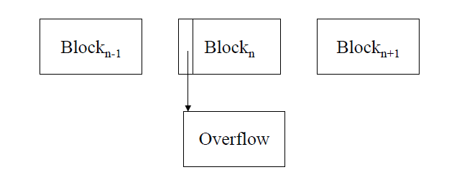
Record Modification: Insertion
File is unsorted (= heap file)
  add it to the end (easy !)
File is sorted
  Is there space in the right block ?
    Yes: we are lucky, store it there
  Is there space in a neighboring block ?
    Look 1-2 blocks to the left/right, shift records
  If anything else fails, create overflow block

Slide 36
Record Modification: Deletion
Free space in block, shift records
  Maybe be able to eliminate an overflow block
Can never really eliminate the record, because others may point to it
  Place a tombstone instead (a NULL record)
Tradeoffs
  How expensive is to move valid record to free space for immediate reclaim?
  How much space is wasted?
    e.g., deleted records, delete fields, free space chains,...

Slide 37
Record Modification: Update
If new record is shorter than previous, easy !
If it is longer, need to shift records, create overflow blocks

Slide 38
Row Store vs. Column Store
So far we assumed that fields of a record are stored contiguously (row store)
Another option is to store like fields together (column store)

Slide 39
Row Store vs. Column Store
Advantages of Column Store
  more compact storage (fields need not start at byte boundaries)
  efficient reads on data mining and OLAP operations
Advantages of Row Store
  writes (multiple fields of one record) more efficiently
  efficient reads for record access (OLTP)

Slide 40
Summary
There are 10,000,000 ways to organize data on disk
  Which is right for me?
Issues:
Flexibility Space Utilization
Complexity Performance

Slide 41
Buffer Management
Goal: create the illusion of addressing and modifying disk pages in memory

Slide 42
Buffer Manager
Buffer pool
  Large range of memory, malloc-ed at DBMS server boot time (MBs - GBs)
Buffer manager metadata
  Small array in memory, malloc-ed at DBMS server boot time
Page pin count keeps track of which pages are in use

Slide 43
When a Page is Requested …
If requested page is NOT in the buffer pool:
  Choose an un-pinned (pin count = 0) frame for replacement
  If frame is dirty, write current page to disk, mark as “clean”
  Read requested page into frame
Pin the page and return its address
If requests can be predicted (e.g., sequential scans), pages can be prefetched
  Several pages at a time
When the buffer pool is full …
  Need to evict an existing page
  Need a page replacement policy

Slide 44
LRU Replacement Policy
Least Recently Used (LRU)
  Pinned frame: not available to replace
  Track time for each frame last unpinned (end of use)
  Replace the frame which was least recently used
    Need to “find min” on the last used attributed (priority queue)
  Very common policy: intuitive and simple
    Good for repeated access to popular pages (temporal locality)
Sequential Scan + LRU
  Lead to sequential flooding
    0% hit rate in cache
  Repeated sequential scan is very common in DB workload
    Nested-loop join

Slide 45
Sequential Scan + LRU
Buffer Pool
Disk Space Manager
Cache hits: 0

Slide 46
Sequential Scan + MRU
Buffer Pool
Disk Space Manager

Slide 47
Sequential Scan + MRU
General case: B buffers and N (N > B) pages in file
  First pass (N attempts): 0 hits
  Next N attempts: B-1 hits for pages 1 → B-1
  Next N attempts: B-1 hits for pages N → B-2
  Next N attempts: B-1 hits for pages N-1 → B-3
  In limit we get about (B-1)/N average hit rate per attempt

Slide 48
We Need a Hybrid Policy
LRU wins for random access (hot vs. cold)
MRU wins for repeated sequential
Lots of other replacement policies
  Random, not recently used, neural network
  The cost of replacement policy algorithms could be a concern

