Slide 1
COP5725
Advanced Database Systems
Query Processing

Slide 2
Why Do We Learn This?
How to implement (efficiently) SQL queries in a relational database system?
As a DBA, how to tune your database system in order to have better performance?
Must-know knowledge if you want to get a job in Oracle, Microsoft, IBM, Google, ……

Slide 3
Outline
Logical/physical operators
Cost parameters and sorting
One-pass algorithms
Nested-loop joins
Two-pass algorithms

Slide 4
Query Processing
Query
or update
Query compiler
User/Application
Query execution
plan
Execution engine
Record, index
requests
Index/record mgr.
Page
commands
Buffer manager
Read/write
pages
Storage manager
storage

Slide 5
Logical vs. Physical Operators
Logical operators
  what they do
  e.g., union, selection, projection, join, grouping, ……
Physical operators
  how they do it
  e.g., nested loop join, sort-merge join, hash join, index join

Slide 6
Query Execution Plans
SELECT S.sname
FROM Purchase P, Person Q
WHERE P.buyer=Q.name AND
Q.city=‘tallahassee’ AND
Q.phone > ‘5430000’
buyer
σ
City=‘tallahassee’
phone>’5430000’
Query Plan:
logical tree
implementation choice at every node
scheduling of operations
Buyer=name
(Simple Nested Loops)
Purchase
Person
(Table scan)
(Index scan)
Some operators are from relational
algebra, and others (e.g., sort, scan, group) are not

Slide 7
How do We Combine Operators?
The iterator model: Each operator is implemented by three functions:
  Open: sets up the data structures and performs initializations
  Next: returns the next tuple of the result, or NotFound if there are no more tuples to return
  Close: ends the operations and cleans up the data structures
Enables pipelining!

Slide 8
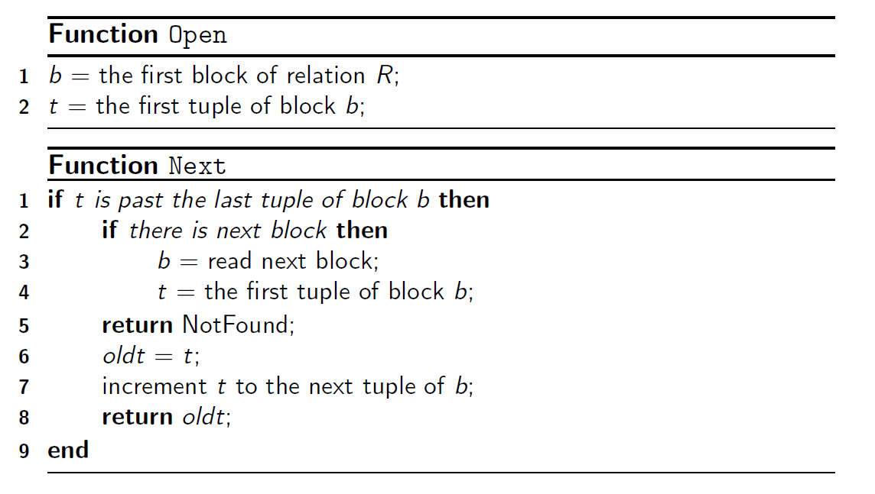
Example: Table Scan

Slide 9
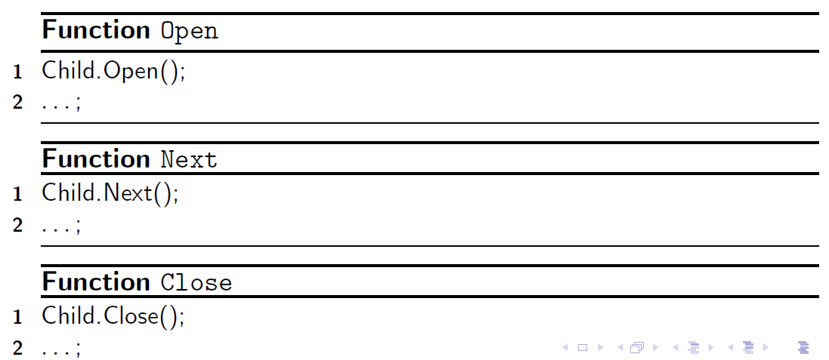
The Iterator Model
Query execution always begins with the root iterator
  Parent.Open() invokes Child.Open() and sometimes Child.Next()
  Parent.Next() invokes Child.Next() or nothing
  Parent.Close() invokes Child.Close()

Slide 10
Query Execution: Materialization vs. Pipelining
Materialization - result of each operator is stored on disk until it is needed by another operator
  high disk I/O
  one operation at time
Pipelining - result of each operator is created in the main memory and passed directly to operator that uses it
  save disk I/O
  operations are performed simultaneously
  fails when the size of results and intermediate data structures exceed the limits of the main memory

Slide 11
Cost Parameters
Cost parameters
  M = number of blocks that fit in main memory
  B(R) = number of blocks holding R
  T(R) = number of tuples in R
  V(R,a) = number of distinct values of the attribute a
Estimating the cost:
  Important in optimization (next lecture)
  Compute I/O cost only (memory ←→ disk)
    accesses to disks are much slower than accesses to RAM!
  We compute the cost to read the tables
    We don’t compute the cost to write the result (because pipelining)

Slide 12
Classification of Algorithms
One-Pass algorithms read the data from disk only once. Work when at least one of the relations fits in the main memory
  Exception: projection and selection
Two-Pass algorithms read the data from disc twice. Work for the data which does not fit in the main memory, but not for the largest imaginable data
  Sorting-based
  Hash-based
Multi-Pass algorithms read the data three or more times, and are natural, recursive generalizations of the two-pass algorithms. Work without limit on the size of the data

Slide 13
Table Scanning
If the table is clustered (blocks consists only of records from this table):
  Table-scan: if we know where the blocks are
    Cost: B(R)
  Index scan: if we have index to find the blocks
    Cost: B(R)
If the table is unclustered (its records are placed on blocks with other tables)
  May need one read for each record
  Cost: T(R)

Slide 14
One-pass Algorithms
Selection σ(R) , projection π(R)
  Both are tuple-at-a-time algorithms
    Read a block at a time, use one memory buffer and produce the output
  Cost
    B(R) if R is clustered
    T(R) if R is unclustered
  Assumption: M ≥1 for the input buffer, regardless of B
Unary
operator
Input buffer
Output buffer

Slide 15
One-pass Algorithms
Duplicate elimination: δ(R)
  Need to keep a dictionary in memory in order to maintain one copy of every tuple we have seen:
    balanced search tree O(n logn)
    hash table O(n)
  Memory Requirements
    1 buffer to store one block of input tuples
    M − 1 buffers to store one copy of each distinct tuple
    Cost: B(R)
    Assumption: B(δ(R)) <= M

Slide 16
One-pass Algorithms
Grouping: γ_{city, sum(price)} (R)
  Need to keep a dictionary in memory
  Also store the sum(price) for each city
  Cost: B(R)
  Assumption: number of cities fits in memory
Binary operations: R ∩ S, R U S, R – S
  Assumption: min(B(R), B(S)) <= M
  One buffer used to read the blocks of the larger relation, while M-1 buffers needed to house the entire smaller relation and its main memory-data structures
  Cost: B(R)+B(S)

Slide 17
Nested Loop Joins
Tuple-based nested loop R S
  R=outer relation, S=inner relation
for each tuple r in R do
for each tuple s in S do
if r and s joinable then output (r, s)
Cost: T(R) T(S), sometimes T(R) B(S)

Slide 18
Nested Loop Joins
Block-based Nested Loop Join
for each (M-1) blocks bs of S do
for each block br of R do
for each tuple s in bs do
for each tuple r in br do
if r and s joinable then output(r, s)

Slide 19
Nested Loop Joins
R & S
Join Result
Blocks of S
(k < M-1 pages)
. . .
. . .
. . .
Input buffer for R
Output buffer

Slide 20
Nested Loop Joins
Block-based Nested Loop Join
Cost:
  Read S once: cost B(S)
  Outer loop runs B(S)/(M-1) times, and each time need to read R: costs B(S)B(R)/(M-1)
  Total cost: B(S) + B(S)B(R)/(M-1)
Notice: it is better to iterate over the smaller relation first– i.e., S smaller

Slide 21
Summary of One-pass Algorithms
Operators | M Required | Disk I/O
σ, π | 1 | B
γ, δ | B | B
U, ∩, -, X | Min(B(R), B(S)) | B(R)+B(S)
join | any M≥2 | B(R)B(S)/M

Slide 22
Two-pass Algorithm
Relations are larger than what the one-pass algorithms can handle
Philosophy
  Pass 1: organize the data properly into a group of sub-relations, and write out to disk again
    Sorting
    Indexing
  Pass 2: reread each sub-relation, do the operation

Slide 23
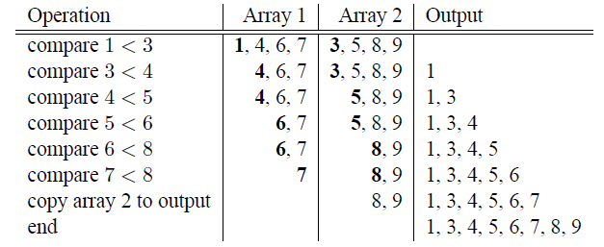
Review: Main-Memory Merge Sort
http://www.youtube.com/watch?v=GCae1WNvnZM

Slide 24
Sorting τ
2 Pass Multi-way Merge Sort (2PMMS)
  Step 1:
    Read M blocks at a time, sort, write
    Result: ┌B/M┐ runs of length M on disk (the last run may be shorter)
  Step 2:
    Merge M-1 at a time, write to disk
    (M-1): input buffer
    1: output buffer
Cost: 3B(R)
  One read and one write for step 1
  One read for merging at step 2
Assumption: B(R) ≤ M²

Slide 25
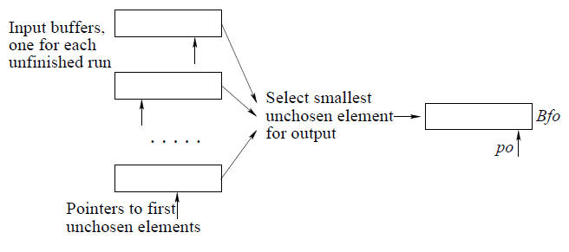
Example

Slide 26
Example
1G Memory, Block size 64K
  M = 2^30/ 2^16 = 16K
A relation fitting in B blocks can be sorted if
  B ≤ (16K)^2 = 2^28
  Each block is 64K
  Then the largest table affordable is 2^28 * 2^16 = 2^42 bytes = 4 Terabytes!
Even on a modest machine, 2PMMS is sufficient to sort all but an incredibly large relation in two passes

Slide 27
Two-Pass Algorithms Based on Sorting
Duplicate elimination δ(R)
Simple idea: like sorting, but include no duplicates
Step 1: sort runs of size M, write
  Cost: 2B(R)
Step 2: merge M-1 runs, but include each tuple only once
  Cost: B(R)
Total cost: 3B(R), Assumption: B(R) <= M²

Slide 28
Two-Pass Algorithms Based on Sorting
Grouping: γ_{city, sum(price)} (R)
Same as before: sort based on city, then compute the sum(price) for each group
As before: compute sum(price) during the merge phase
Total cost: 3B(R)
Assumption: B(R) <= M²

Slide 29
Two-Pass Algorithms Based on Sorting
Binary operations: R ∩ S, R U S, R – S
Idea: sort R, sort S, then do the right thing
A closer look:
  Step 1: split R into runs of size M, then split S into runs of size M. Cost: 2B(R) + 2B(S)
  Step 2: merge all x runs from R; merge all y runs from S; ouput a tuple on a case by cases basis (x + y <= M)
Total cost: 3B(R)+3B(S)
Assumption: B(R)+B(S)<= M²

Slide 30
Two-Pass Algorithms Based on Sorting
Join R S
Start by sorting both R and S on the join attribute:
  Cost: 4B(R)+4B(S) (because need to write to disk)
Read both relations in sorted order, match tuples
  Cost: B(R)+B(S)
Difficulty: many tuples in R may match many in S
  If at least one set of tuples fits in M, we are OK
  Otherwise need nested loop, higher cost
Total cost: 5B(R)+5B(S)
Assumption: B(R) <= M², B(S) <= M²

Slide 31
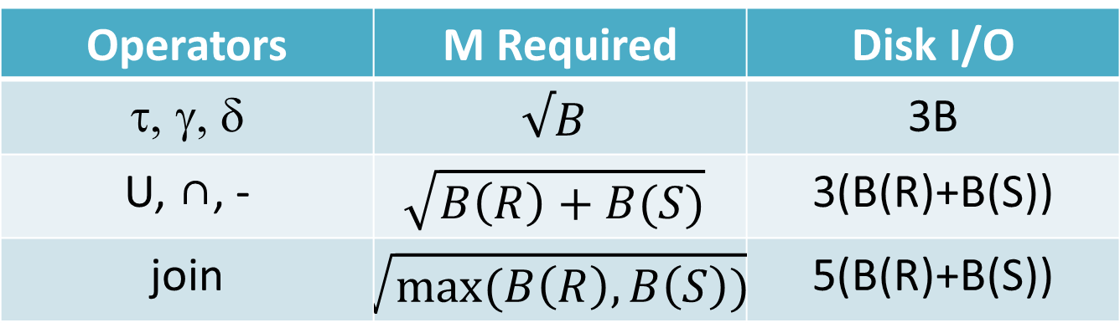
Summary of Two-pass Algorithms Based on Sorting
Operators | M Required | Disk I/O
τ, γ, δ | $$√B$$ | 3B
U, ∩, - | $$\sqrt{B\left(R\right)+B(S)}$$ | 3(B(R)+B(S))
join | $$\sqrt{max⁡(B\left(R\right),B\left(S\right))}$$ | 5(B(R)+B(S))

Slide 32
Two Pass Algorithms Based on Hashing
Idea: partition a relation R into buckets, on disk
Each bucket has size approx. B(R)/M
Does each bucket fit in main memory ?
  Yes if B(R)/M <= M, i.e. B(R) <= M²
Relation R
OUTPUT
Partitions
1
1
1
INPUT
2
2
hash
function
h
2
. . .
M-1
B(R)
M-1
Disk
M main memory buffers
Disk

Slide 33
Hash Based Algorithms for δ
δ(R) = duplicate elimination
  Step 1. Partition R into buckets
  Step 2. Apply δ to each bucket (may read in main memory and apply one-pass algorithm)
Cost: 3B(R)
Assumption: B(R) <= M²

Slide 34
Hash Based Algorithms for γ
γ(R) = grouping and aggregation
  Step 1. Partition R into buckets
    Choose the hash function depending only on the grouping attributes
  Step 2. Apply γ to each bucket (may read in main memory)
Cost: 3B(R)
Assumption: B(R) <= M²

Slide 35
Hash-based Join
R S
Simple version: main memory hash-based join
  Scan S, build buckets in main memory
  Then scan R and join
Requirement: min(B(R), B(S)) <= M

Slide 36
Partitioned Hash Join
R S
  Step 1:
    Hash S into M buckets
    send all buckets to disk
  Step 2
    Hash R into M buckets (the same hash function on join attributes)
    Send all buckets to disk
  Step 3
    Join every pair of buckets
  Cost: 3B(R) + 3B(S)
  Assumption: At least one full bucket of the smaller relation must fit in memory: min(B(R), B(S)) <= M²

Slide 37
Partitioned Hash Join
Partition both relations using hash function h
  R tuples in partition i will only match S tuples in partition i
Read in a partition of S, hash it using h2 (<> h!). Scan matching partition of R, search for matches
Original
Relation
OUTPUT
Partitions
1
1
INPUT
2
hash
function
h
2
. . .
M-1
M-1
Disk
main memory buffers
Disk
Partitions
of R & S
Join Result
Hash table for partition
Si ( < M-1 pages)
hash
fn
h2
h2
Input buffer
for Ri
Output
buffer
Disk
main memory buffers
Disk

Slide 38
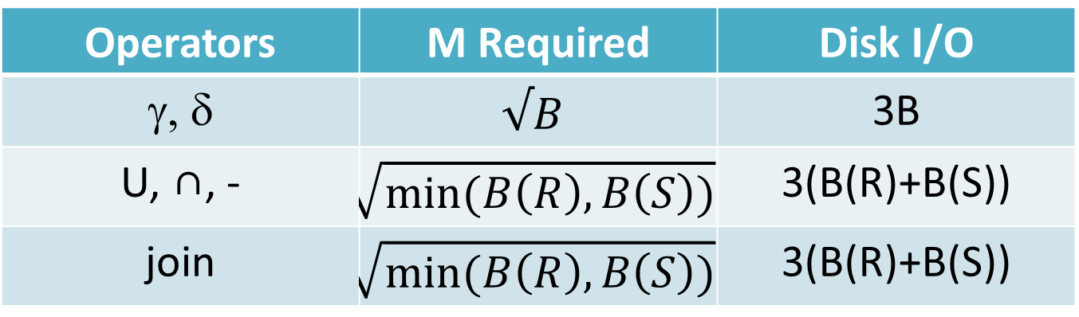
Summary of Two-pass Algorithms Based on Hashing
Operators | M Required | Disk I/O
γ, δ | $$√B$$ | 3B
U, ∩, - | $$\sqrt{min⁡(B\left(R\right),B\left(S\right))}$$ | 3(B(R)+B(S))
join | $$\sqrt{min⁡(B\left(R\right),B\left(S\right))}$$ | 3(B(R)+B(S))

Slide 39
Indexed Based Algorithms
Zero-pass!
In a clustering index all tuples with the same value of the key are clustered on as few blocks as possible
a a a
a a a a a
a a

Slide 40
Index Based Selection
Selection on equality: σ_{a=v}(R)
  Clustered index on a: cost B(R)/V(R,a)
  Unclustered index on a: cost T(R)/V(R,a)
Example: B(R) = 2000, T(R) = 100,000, V(R, a) = 20, compute the cost of σ_{a=v}(R)
Cost of table scan:
  If R is clustered: B(R) = 2000 I/Os
  If R is unclustered: T(R) = 100,000 I/Os
Cost of index based selection:
  If index is clustered: B(R)/V(R,a) = 100
  If index is unclustered: T(R)/V(R,a) = 5000
Notice: when V(R,a) is small, then unclustered index is useless

Slide 41
Index Based Join
R S
Assume S has an index on the join attribute
  Iterate over R, for each tuple fetch corresponding tuple(s) from S
  Assume R is clustered. Cost:
    If index is clustered: B(R) + T(R)B(S)/V(S,a)
    If index is unclustered: B(R) + T(R)T(S)/V(S,a)
Assume both R and S have a sorted index (B+ tree) on the join attribute
  Then perform a merge join (called zig-zag join)
  Cost: B(R) + B(S)

Slide 42
Have Fun!

