Slide 1
COP5725
Advanced Database Systems
Introduction

Slide 2
Welcome to COP5725!
COP5725: Advanced Database Systems
  Course website: syllabus, schedule, project info, resources http://www.cs.fsu.edu/~zhao/cop5725/main.html
  Canvas: announcements, grades, files
  Time: 9:45am—11am Tuesdays and Thursdays
  Venue: HWC 2401
Please go over the course syllabus carefully before taking the class!
FSU first-day attendance policy

Slide 3
Welcome to COP5725!
Instructor
  Prof. Peixiang Zhao http://www.cs.fsu.edu/~zhao
  Office hours:
    Tuesday/Thursday right after class
  Office: LOV 361
  Research interest:
    Database, data mining, data-intensive computation and analytics
TA
  TBA
You!
  Master or Ph.D.? CS or other majors? Graduating?
  Am I qualified for this class? What are my expectations?

Slide 4
The Goal of COP5725
Reflection of the foundation:
  Climb up to the shoulders
  the foundational (relational) database models, representations, systems, and techniques, by way of reading and lectures
Projection on the outlook:
  And look out from here! Be inspired
  what’s the next advanced database systems?
  by way of reading, summarizing, and presenting the classics and the state of the art (SOTA)
  by way of doing projects!
    “We can do it!”

Slide 5
The Contents of COP5725!
Relational Database Internals
  Data storage and representation
  Indexing
  Query processing and execution
  Query optimization
  ……
Advanced Database Topics
  Parallel/Distributed databases
  Data mining
  Data on the Web
  ……

Slide 6
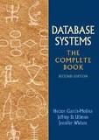
Welcome to COP5725!
Textbook
  Database Systems: The Complete Book 2nd edition
  Hector Garcia-Molina, Jeff Ullman and Jennifer Widom
Recommended reading
  Database Management Systems 3rd edition, by Raghu Ramakrishnan and Johannes Gehrke
  Readings in Database Systems 5th edition, by Peter Bailis, Joseph Hellerstein and Michael Stonebraker
  The Web
Prerequisites
  COP4530: Data Structures and Algorithms
  COP4710: Database Systems (You will be tested on this)
  Good programming skills (C++ or Java)

Slide 7
Welcome to COP5725!
Components of the course
  Two lectures every week
  Three(Two) assignments (15%)
  A series of (5 or 6?) papers to be read and summarized (15%)
    One- or two-page paper summary (Details later…)
  Paper presentation (5%)
    Every group/student will present one paper related to her/his project in the class for 15(?) minutes (Details later…)
  Semester-long project (Details later…) (30%)
    Implementation-flavor
    Research-flavor
  Final exam (35%)

Slide 8
Paper Summaries
Every paper will be assigned early in the course website, and can be downloaded within the campus network
One to two pages summary includes
  What is the problem?
  Why is this problem important and worthy of a thorough study?
  Why is this problem difficult or not well solved?
  What are the innovative ideas and technical merits?
    Technical meat (Please elaborate on them)
  How to evaluate? Experimental findings (if any)
  Any drawbacks and potential improvement?
Summarize based on your own understanding
  Verbatim copying from the papers or ChatGPT results in low scores

Slide 9
Paper Presentation
Every group/student will have a chance to select one paper to present in the class
  The paper should be related to the project you are conducting
  The slides (pptx/pdf) should be sent to the instructor at least one day prior to the class you will be presenting
  The slides organization should be similar to the requirement of the paper summary
  15(?) minutes presentation and Q&A
Student will sign up for the presentation in the near future

Slide 10
Project
Theme: choose either of the two
  Implementation-flavor
    find interesting methods/algorithms in a data management paper in the designated conferences/journals on or after 2015, implement it, and perform experimental studies
    by a group of at most three students (?)
  Research-flavor
    find an interesting, nontrivial data management problem, propose a novel and effective solution to it
    by a group of at most three students
The project is partitioned into multiple milestones, each of which requires deliverables

Slide 11
How to Get the Most out of COP5725?
Read and think before class
  read the textbooks for related concepts
  read the papers
Use lectures as road map for studying
  Lecture notes won’t cover all the material
Use your peers in learning
  discuss in/out of classes to enhance understanding
Explore interesting projects creatively
  learning by doing

Slide 12
COP5725 =
How DB Knowledge is created + How to create more
In terms of topics, COP5725 is NOT:
  about Linux + Apache + PHP + MySQL (LAMP)
  about designing DBs that are in BCNF or 3NF
  about SQL3 and stored procedures
  about Oracle tuning and implementation
In terms of methodology, COP5725 is NOT
  by reading textbook and acing it
  by implementing a well-specified DB algorithm, e.g., B+tree

Slide 13
Any questions so far?

Slide 14
Why Database Systems? --- Utility
Ubiquitous and incredibly useful
  Book a hotel, a flight, an Uber car
  Like a post on Twitter (now X) or Facebook
  Find out where to eat from Yelp, TripAdvisor, or GrubHub
  Transfer money, or make a stock trade
  Find a movie to watch on Netflix
  Make a purchase on Amazon, or at local Walmart store
  Virtually every app is backed by such systems
Backbone of modern science, where massive volumes of data are generated and a need to make sense of it
  Genomics, astronomy, meteorology, economy, social studies, ……

Slide 15
Why Database Systems? --- Centrality
Data is at the center of modern society
  Huge promise, but many potential concerns
    Use and misuse
  Timely debates, and potential research frontiers, about the use of data, privacy, security, ethics, fairness, ……
Data infrastructure (i.e., database systems)
  determines what’s possible and what is feasible
  As data is central, the infrastructure to manage data is just as central

Slide 16
Why Database Systems? --- The Core of Computing
Data growth will continue to outpace computation
  Key bottleneck in the future: data ingestion, processing, and understanding
  Systems for data at scale: the core of computing
Techniques you learn in this class underlie many topics in computing
  Abstraction, representation & modeling, reuse, rapid access, declarativity, optimization, ……

Slide 17
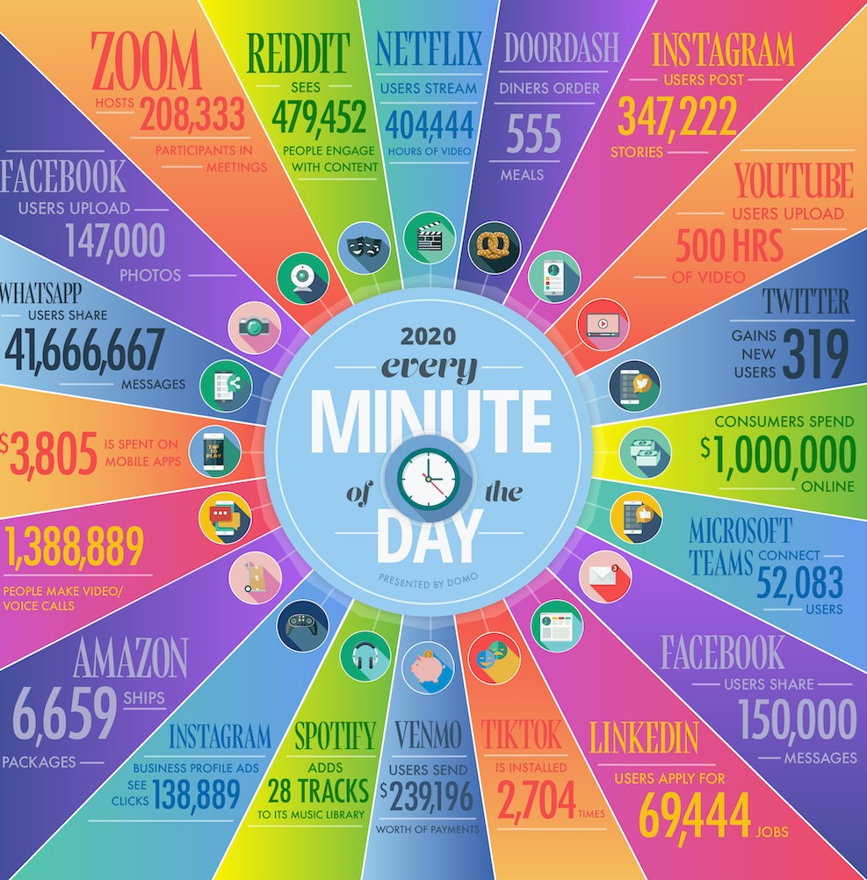
Every Minute in Our World! https://www.domo.com/learn/infographic/data-never-sleeps-8

Slide 18
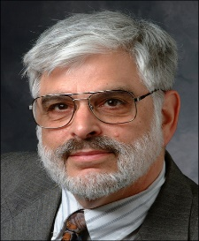
Why Database Systems? Opportunities in Research
Jeffrey Ullman, 2020
Information Integration,
Data Warehouses, Data Mining

Slide 19
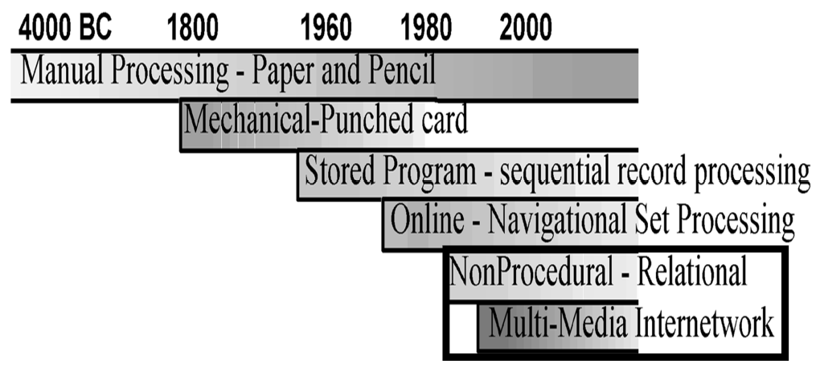
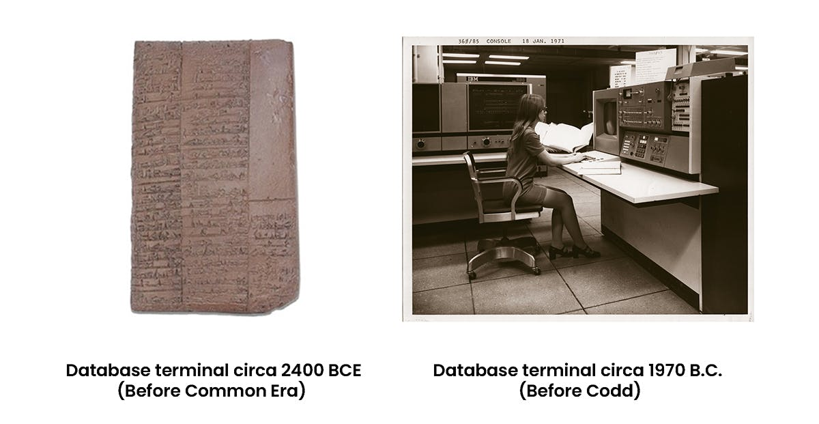
Evolution of Data Management
Jim Gray: Evolution of Data Management. IEEE Computer 29(10): 38-46 (1996)

Slide 20
Evolution of Data Management
After computers were invented, data was far from automated
  “flat file” system – a simple consecutive list of records that required search sequentially
  IBM IMS (1960s)
    Inverted hierarchical tree structure
  GE Network Model
E. F. Codd: “A relational Model of Data for Large Shared Data Banks” (1970)
  Separating data from compute and from applications
  Framework for storing and retrieving data using simple tables
  Initial query language for relational DBs

Slide 21
Prehistory Thoughts: Emergence of the Notion of DBMS
William C. McGee: Generalization: Key to Successful Electronic Data Processing. J. ACM 6(1): 1-23 (1959)
When data processing was mostly ad-hoc programs --- Need generalization, e.g.,
  sorting
  file maintenance
  data access
  modification and update
  report generation
  ……

Slide 22
How Did We Get Here?
The dominating relational database system, which we take for granted now, was deemed impossible to implement and difficult to use in its early days
But-- Quoting Jim Gray:
  These innovations give one of the best examples of research prototypes turning into products. The relational model, parallel database systems, active databases, and object-relational databases all came from the academic and industrial research labs. The development of database technology has been a textbook case of successful collaboration between academy and industry.
  -- Evolution of Data Management

Slide 23
The Grand Challenges of Data Management
Relational DBMS was invented in early 70’s, and now 60+ billion mature industry
  What are we still working on?
  NoSQL, NewSQL, Data lakes, Temporal DB, Graph DB, Data streams, Blockchain DB, Vecter DB, ……
  http://www.youtube.com/watch?v=LrNlZ7-SMPk
What is the ultimately advanced DB?
  Data of all sorts--- Prevalent on the Web!
  What have you been searching lately?
New challenges naturally arise
  structured vs. unstructured data
  querying vs. analysis vs. searching
  Integration and interplay with AI and Deep Learning

Slide 24
Have fun!

