Slide 1
COP5725
Advanced Database Systems
Indexing

Slide 2
Why Do We Learn This?
An index is data structure that enables fast lookup and modification of data entries by search
Goal: Find out the desired information (e.g., by value) from the database (very) quickly!
  Declarative
  No/less physical dependency
  Different types of queries: equality, 1d range, 2d range, top-k, similarity, …

Slide 3
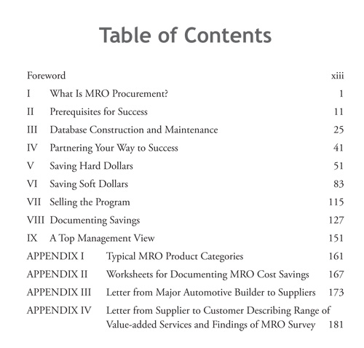
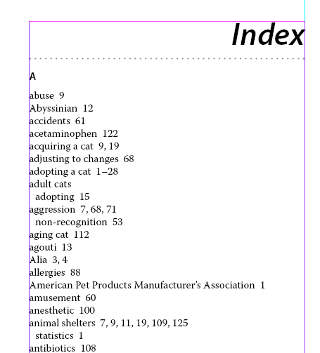
What is Indexing?
  A “labeled” pointer to an (a collection of) item that satisfies some common property
  Examples in the Real World?

Slide 4
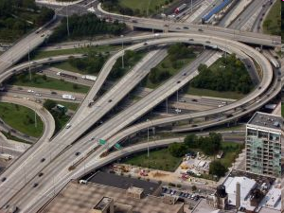
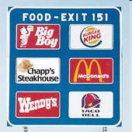
What is Indexing?
  A “labeled” pointer to an (a collection of) item that satisfies some common property
  Examples in the Real World?

Slide 5
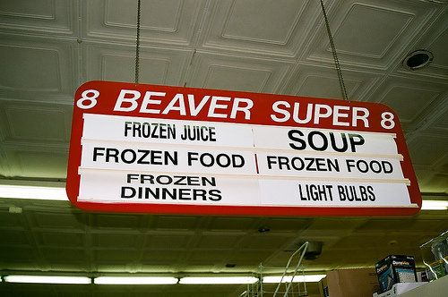
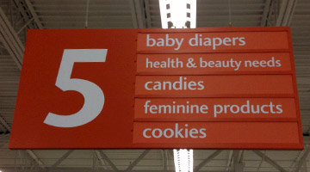
What is Indexing?
  A “labeled” pointer to an (a collection of) item that satisfies some common property
  Examples in the Real World?

Slide 6
Theoretically, Indexes is …
An index on a file speeds up selections on the search key attributes or values
Search key = any subset of the attributes of a relation
  Search key is not the same as key (minimal set of attributes that uniquely identify a tuple (record) in a relation)
Entries in an index: (K, R), where:
  K: the key
  R: the record OR record id OR record ids

Slide 7
Types of Indexes
Clustered/Unclustered
  Clustered = records sorted in the key order
  Unclustered = no
Dense/sparse
  Dense = each record has an entry in the index
  Sparse = only some records have
Primary/secondary
  Primary = on the primary key
  Secondary = on any key
  Some textbooks interpret these differently
B+ tree / Hash table / …

Slide 8
Clustered, Dense Index
Clustered: File is sorted on the index attribute
Dense: sequence of (key, pointer) pairs
Index
Data
10
20
30
40
10
20
30
40
50
60
70
80
50
60
70
80

Slide 9
Clustered, Sparse Index
Sparse index: one key per data block
  Save more space
  Sacrifice efficiency
Index
Data
10
30
50
70
10
20
30
40
90
110
130
150
50
60
70
80

Slide 10
Clustered Index with Duplicate Keys
Dense index: point to the first record with that key
10
20
30
40
10
10
10
20
50
60
70
80
20
20
30
40

Slide 11
Clustered Index with Duplicate Keys
Sparse index: pointer to lowest search key in each block
  Try search for 20
Additional pointer doesn’t help
10
10
20
30
10
10
10
20
Check
Backward?
20
20
30
40

Slide 12
Clustered Index with Duplicate Keys
Better: pointer to lowest new search key in each block
  Search for 20
10
20
30
40
10
10
10
20
50
60
70
80
30
30
40
50

Slide 13
Unclustered Indexes
Often for indexing other attributes than primary key
Always dense (why ?)
  The locality of values has been broken!
10
10
20
20
20
30
30
20
20
30
30
30
10
20
10
30

Slide 14
Clustered vs. Unclustered Index
Index entries
Index entries
(Index File)
(Data file)
Data Records
Data Records
CLUSTERED
UNCLUSTERED

Slide 15
Composite Search Keys
Composite Search Keys: search on a combination of fields.
  Equality query: Every field value is equal to a constant value, e.g., w.r.t. <sal,age> index:
    age=20 and sal =75K
  Range query: Some field value is not a constant, e.g.,
    age =20; or age=20 and sal > 10K
Examples of composite key
11,80
11
12,10
12
12,20
name
age
sal
12
13,75
bob
12
10
13
<age, sal>
cal
11
80
<age>
joe
12
20
10,12
sue
13
75
10
20,12
Data records
sorted by name
20
75,13
75
80,11
80
<sal, age>
<sal>
Data entries in index
sorted by <sal,age>
Data entries
sorted by <sal>
14

Slide 16
Example: Our Textbook
How many indexes? Where?
  ToC
  Topic words
  Author index, ……
What are keys? What are records?
  Chapter no./title
  Topic words
Clustered? ToC (Yes); T.W. (No)
Dense? ToC (Yes); T.W. (No)
Primary? It depends!

Slide 17
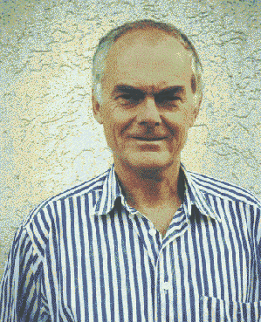
B+ Trees
What’s wrong with sequential index?
  Pros: easy/fast to access
  Cons: hard to maintain the sequential property upon updates
B+ Tree Intuition:
  Give up sequentiality of index
  Try to get “balance” by dynamic reorganization
Behind the Scene: Prof. Rudolf Bayer
  Professor of Informatics at the Technical University of Munich since 1972
  Inventor of B-tree, UB-tree and red-black tree
  Recipient of 2001 ACM SIGMOD Edgar F. Codd Innovations Award

Slide 18
B+ Tree Basics
Dynamic Tree-structured Index
  Always balanced with the height of log_{F}N
    N: number of data entries
    F: fanout of the tree
  High fanout
    Height rarely more than 3 or 4
  Higher levels stays in cache, avoiding expensive disk I/O
  Support efficient insertion and deletion
What does it mean for “+” in B+ Tree?
  B-tree that stores data entries in leaves only

Slide 19
B+ Tree Basics
Parameter d = the degree (order)
Each node has [d, 2d] keys (except root)
  Internal node:
  Leaf:
d=2
30 |  | 120 |  | 240
[X , 30)
[30, 120)
[120, 240)
[240, Y)
40 |  | 50 |  | 60
next leaf
40
50
60

Slide 20
Searching a B+ Tree
Procedure
  Find split on each node
    Binary search
  Follow pointer to next node
Point queries with exact key values:
  Start at the root
  Proceed down, to the leaf
Range queries:
  As above
  Then sequential traversal
  Benefit: no need to go back up the tree! Save I/Os
Select name
From people
Where age = 25
Select name
From people
Where 20 <= age
and age <= 30

Slide 21
B+ Tree Example
Select name
From person
Where age = 30
(Where age >=30)
Root (d=1)
d = 2
80
20 |  | 60
100 |  | 120 |  | 140
10 |  | 15 |  | 18
20 |  | 30 |  | 40 |  | 50
60 |  | 65
80 |  | 85 |  | 90
10
15
18
20
30
40
50
60
65
80
85
90

Slide 22
B+ Tree Design
How large is d?
Example:
  Key size = 4 bytes
  Pointer size = 8 bytes
  Block size = 4096 byes
2d x 4 + (2d+1) x 8 <= 4096
So, d = 170

Slide 23
B+ Trees in Practice
Typical order: 100. Typical fill-factor: 67%.
  average fan-out = 133
Typical capacities:
  Height 4: 133⁴ = 312,900,700 records
  Height 3: 133³ = 2,352,637 records
Can often hold top levels in buffer pool:
  Level 1 = 1 page = 8 Kbytes
  Level 2 = 133 pages = 1 Mbyte
  Level 3 = 17,689 pages = 133 MBytes

Slide 24
Inverted Index
Boolean retrieval
  Queries on unstructured text data
  arguably the simplest model to base an information retrieval system on
  Primary commercial retrieval tool for 3 decades
  queries are Boolean expressions, e.g., CAESAR AND BRUTUS
  the search engine returns all documents that satisfy the Boolean expression
  Does Google use the Boolean model?

Slide 25
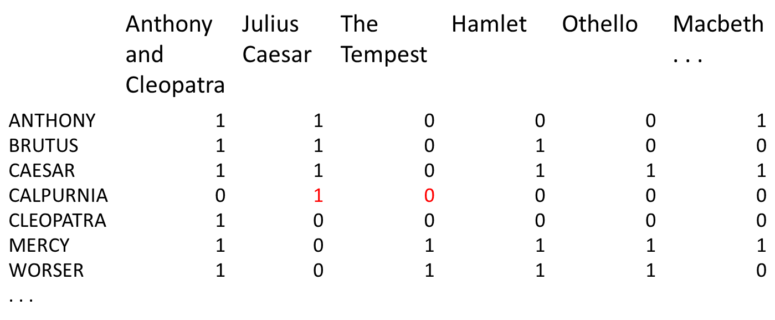
Term-document Incidence Matrix
Entry is 1 if term occurs. Example: CALPURNIA occurs in Julius Caesar. Entry is 0 if term doesn’t occur. Example: CALPURNIA doesn’t occur in The tempest.

Slide 26
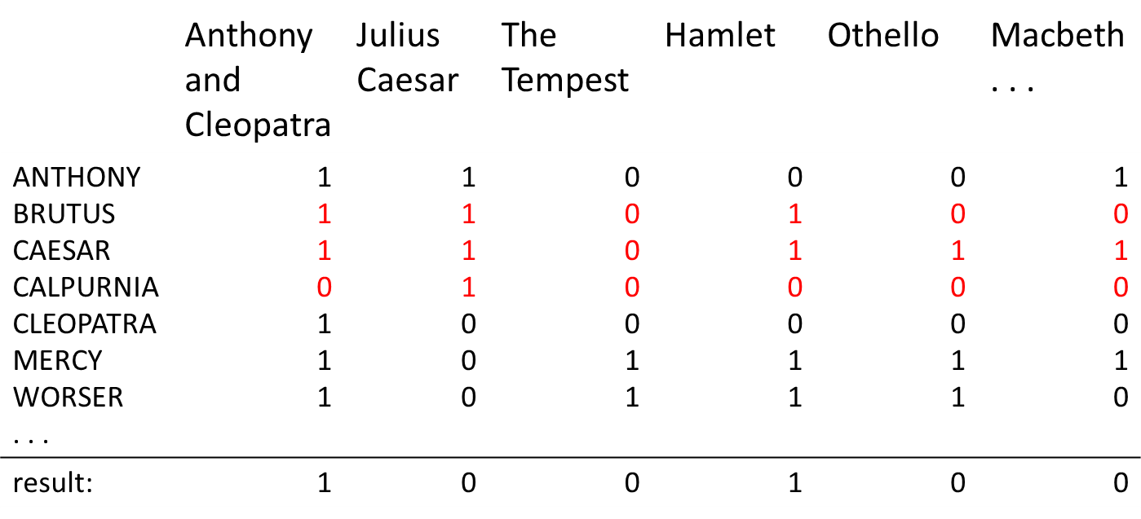
Incidence Vectors
So we have a 0/1 vector for each term
To answer the query BRUTUS AND CAESAR AND NOT CALPURNIA
  Take the vectors for BRUTUS, CAESAR and CALPURNIA
  Complement the vector of CALPURNIA
  Do a (bitwise) and on the three vectors
    110100 AND 110111 AND 101111 = 100100

Slide 27
Answers to query
Anthony and Cleopatra, Act III, Scene ii
Agrippa [Aside to Domitius Enobarbus]:
  Why, Enobarbus, When Antony found Julius Caesar dead, He cried almost to roaring; and he wept When at Philippi he found Brutus slain.
Hamlet, Act III, Scene ii
Lord Polonius: I did enact Julius Caesar: I was killed by the Capitol; Brutus killed me.

Slide 28
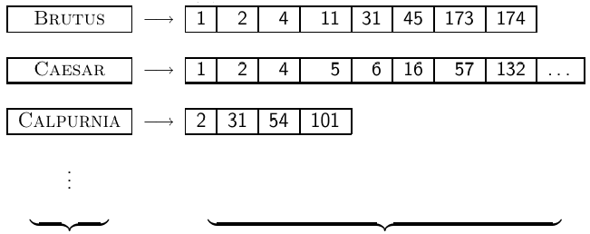
Inverted Index
Problem:
  The incidence matrix is extremely large
  The incidence matrix is extremely sparse
  What is a better representations?
    We only record the 1s
Inverted Index
  For each term t, we store a list of all documents (ids) that contain t
dictionary postings

Slide 29



Inverted index construction
Collect the documents to be indexed
Tokenize the text, turning each document into a list of tokens
Do linguistic preprocessing, producing a list of normalized tokens, which are the indexing terms:
Index the documents that each term occurs in by creating an inverted index, consisting of a dictionary and postings

Slide 30
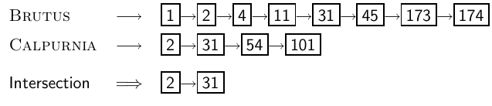
Processing Boolean queries
Consider the query: BRUTUS AND CALPURNIA, to find all matching documents using inverted index:
  Locate BRUTUS in the dictionary
  Retrieve its postings list from the postings file
  Locate CALPURNIA in the dictionary
  Retrieve its postings list from the postings file
  Intersect the two postings lists
  Return intersection to user

Slide 31
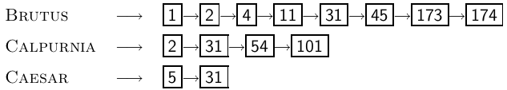
Query Optimization
Consider a query with n terms, n > 2
  For each of the terms, get its postings list, then intersect them together
  What is the best order for processing this query?
    Example query: BRUTUS AND CALPURNIA AND CAESAR
  Simple and effective optimization: Process in order of increasing frequency
    Start with the shortest postings list, then keep cutting further
    In this example, first CAESAR, then CALPURNIA, then BRUTUS

Slide 32
Multidimensional Indexes
When we see attributes of relations as coordinates, a database stores a point set in higher dimensions
Indexing with multiple keys
  Spatial databases and Geographic information system (GIS)
  Multimedia databases
  Medical applications
The queries to be supported:
  partial-match queries: specify values for a subset of the dimensions
  range queries: give the range for each dimension
  nearest-neighbor queries: ask for the closest point to the given point

Slide 33
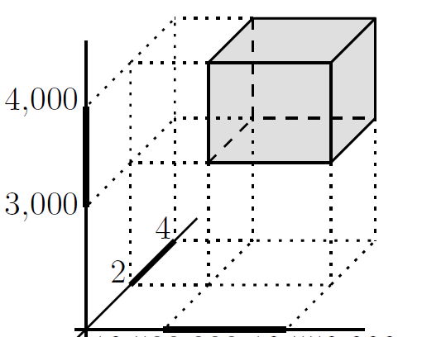
Example
SQL Query:
Select *
From Customers
Where 3K<Salary<4K
AND 2<Children<4
AND 25<Age<40
25 40

Slide 34

KD-Tree
kd-Tree (k-dimensional search tree)
  Jon Bentley, 1975, author of Programming Pearls
  Idea: Split the point set alternatingly by x-coordinate and by y-coordinate
  split by x-coordinate: split by a vertical line that has half the points left and half right
  split by y-coordinate: split by a horizontal line that has half the points below and half above

Slide 35
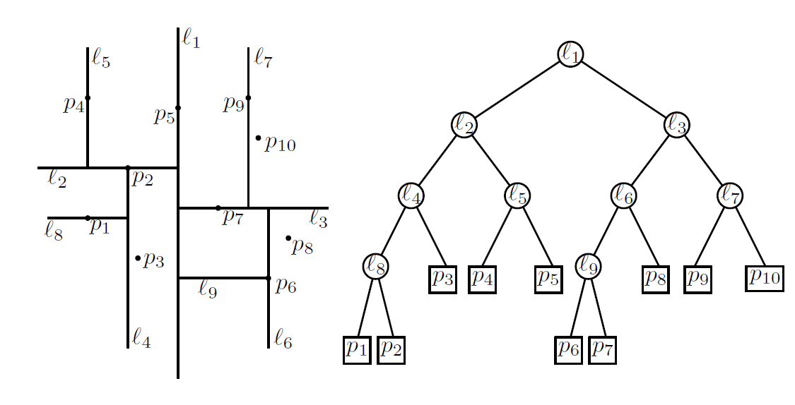
KD-Tree: Example

Slide 36
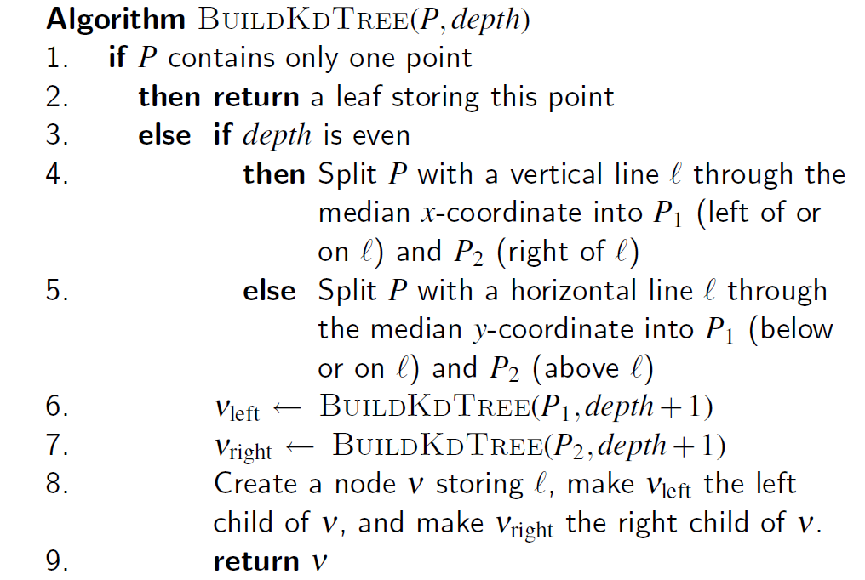
KD-Tree Construction Algorithm

Slide 37
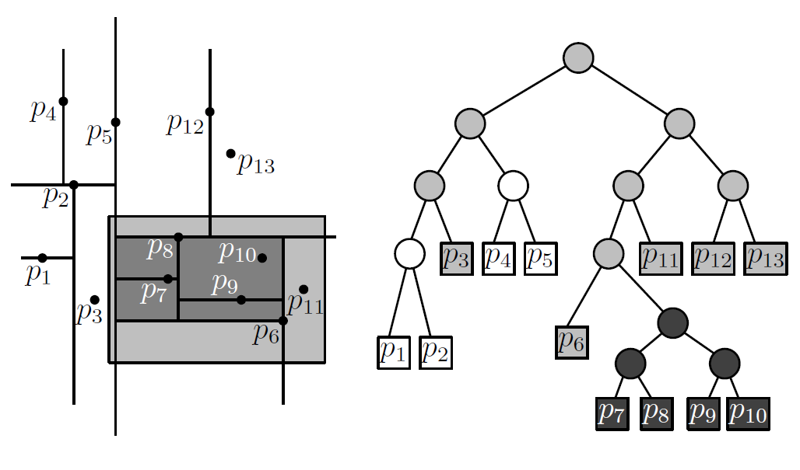
Range Queries in KD-Tree

Slide 38
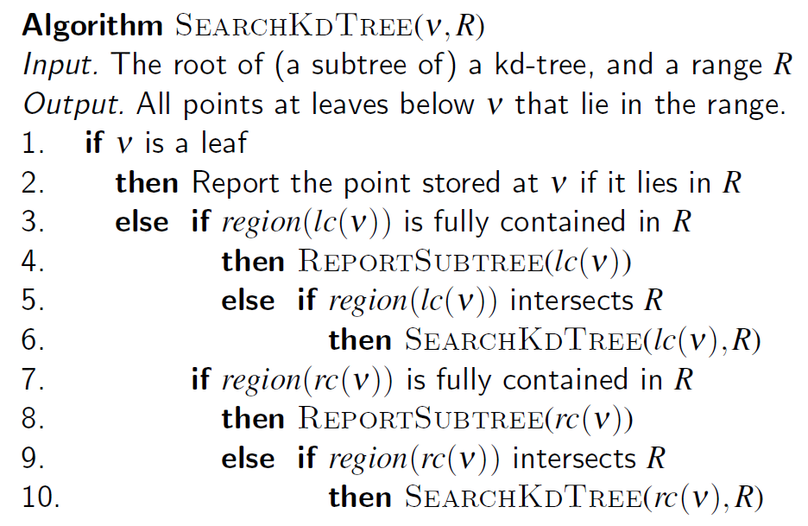
KD-Tree Querying Algorithm

Slide 39
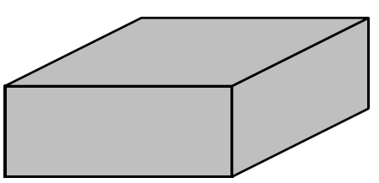
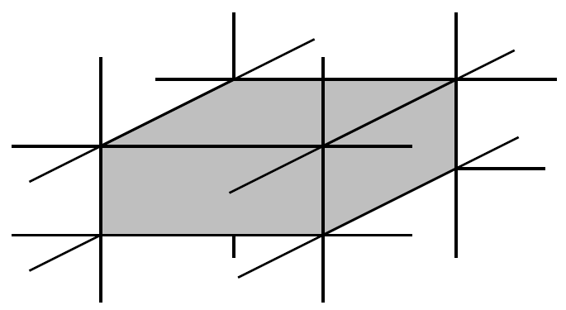
Higher Dimensions
A 3-dimensional kd-tree alternates splits on x-, y-, and z-coordinate
  A 3D range query is performed with a box
Query Processing
  Intersection of B and region(v) depends on intersection of facets of B → analyze by axes-parallel planes

Slide 40

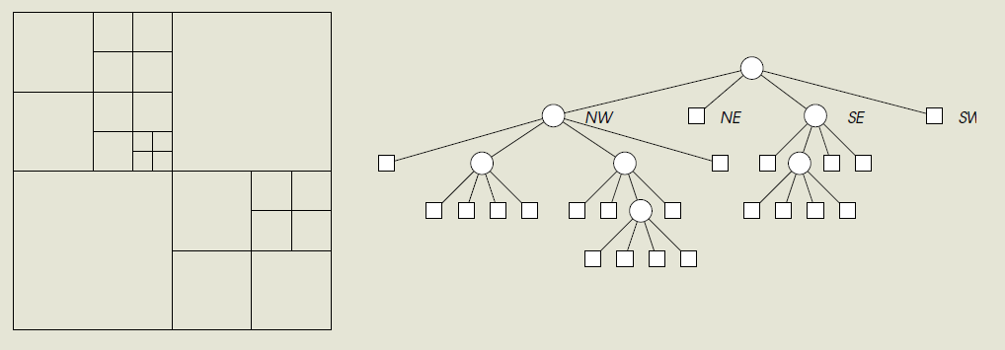
Quad Trees
Quad trees are space-partition trees whose nodes are associated with squares
  Raphael Finkel and Jon Bentley in 1974
  If a node is not a leaf, its square is partitioned into four equal-sized squares associated with its children

Slide 41
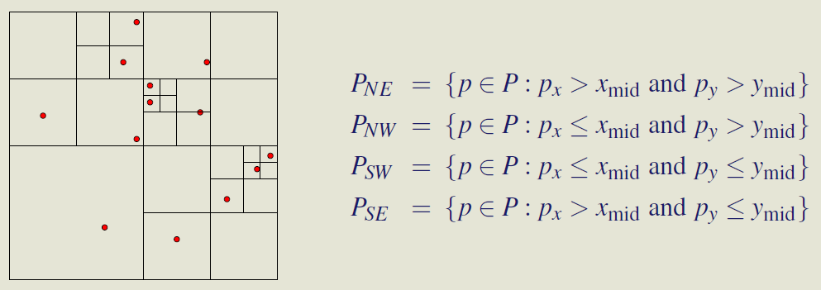
Quad Trees
The square associated with the root contains all points in point set P
  Recursive splitting is continued until there is at most one (or k) point left in a square
  Demo: http://closure-library.googlecode.com/svn/trunk/closure/goog/demos/quadtree.html

Slide 42
R Tree
R (Range, Rectangle) Tree
  A tree data structure mainly used for spatial access methods, i.e., for indexing multidimensional information such as geographical coordinates, rectangles or polygons
  A height balanced tree like the B+ Tree
    B+ tree: balanced hierarchy of 1-d ranges
  R-tree represents data objects in intervals (MBR, minimum bounding rectangle) in several dimensions
    Exact-point and range lookups!
      Show me all Pizza places within 2 miles of James Love building
  Antonin Guttman in 1984

Slide 43
R Tree Structure
R2
M : maximum number of entries
m : minimum number of entries (>= M/2)
R6
K
L
R1
Every node contains between m and M index records unless it is the root.
Each leaf node has the smallest rectangle that spatially contains the n-dimensional data objects.
Each non-leaf node has the smallest rectangle that spatially contains the rectangles in the child node.
The root node has at least two children unless it is a leaf.
All leaves appear on the same level.
R3
A
R5
G
B
H
R4
E
D
I
F
R1
R2
<MBR, Pointer to a child node>
R3
R4
R5
R6
<MBR, Pointer to a spatial object>
A
B
D
E
F
G
H
I
K
L

Slide 44
R Tree Search
R2
R6
Query: Find all objects whose rectangles are overlapped with a search rectangle S
K
L
R1
R3
A
R5
G
B
H
S
R4
E
D
I
F
R1
R2
R3
R4
R5
R6
A
B
D
E
F
G
H
I
K
L

Slide 45
R Tree Search
R2
R6
K
L
R1
R3
A
R5
G
B
H
S
R4
E
D
I
F
R1
R2
R3
R4
R5
R6
A
B
D
E
F
G
H
I
K
L

Slide 46
R Tree Search
R2
R6
K
L
R1
R3
A
R5
G
B
H
S
R4
E
D
I
F
R1
R2
R3
R4
R5
R6
A
B
D
E
F
G
H
I
K
L

Slide 47
R Tree Search
R2
R6
K
L
R1
R3
A
R5
G
B
H
S
R4
E
D
I
F
R1
R2
R3
R4
R5
R6
A
B
D
E
F
G
H
I
K
L

Slide 48
R Tree Search
R2
R6
K
L
R1
R3
A
R5
G
B
H
S
R4
E
D
I
F
R1
R2
R3
R4
R5
R6
A
B
D
E
F
G
H
I
K
L

Slide 49
R Tree Search
R2
R6
K
L
R1
R3
A
R5
G
B
H
S
R4
E
D
I
F
R1
R2
R3
R4
R5
R6
A
B
D
E
F
G
H
I
K
L

Slide 50
R Tree Search
R2
R6
K
R1
L
R3
A
R5
B
G
S
R4
H
E
D
I
F
R1
R2
Answer:
B and D → overlapped objects with S
R3
R4
R5
R6
A
B
D
E
F
G
H
I
K
L

Slide 51
R-Tree Insertion
R2
R6
K
L
R1
R3
A
R5
G
B
X
H
R4
E
Insert a new spatial object X
D
I
F
R1
R2
R3
R4
R5
R6
A
B
D
E
F
G
H
I
K
L

Slide 52
R-Tree Insertion
R2
R6
K
L
Find the proper child node
- least enlargement
- smallest MBR if child nodes
contains a new object
R1
R3
A
R5
G
B
X
H
R4
E
D
I
F
R1
R2
R3
R4
R5
R6
A
B
D
E
F
G
H
I
K
L

Slide 53
R-Tree Insertion
R2
R6
K
L
R1
R3
A
R5
G
B
X
H
R4
E
D
I
F
R1
R2
R3
R4
R5
R6
A
B
D
E
F
G
H
I
K
L

Slide 54
R-Tree Insertion
R2
R6
K
L
R1
R3
A
R5
G
B
X
H
R4
E
D
I
F
R1
R2
R3
R4
R5
R6
A
B
D
E
F
G
H
I
K
L

Slide 55
R-Tree Insertion
R2
R6
K
L
R1
R3
A
R5
G
B
R4
H
X
E
D
I
F
R1
R2
R3
R4
R5
R6
A
B
D
E
F
G
H
I
K
L

Slide 56
R-Tree Insertion
R2
R6
K
L
R1
R3
A
R5
G
B
X
H
R4
E
D
I
F
R1
R2
R3
R4
R5
R6
A
B
X
D
E
F
G
H
I
K
L
Empty Spot

Slide 57
Split After Insertion
R2
R2
R6
R6
K
K
L
L
R1
R1
R3
R3
A
A
R5
R5
G
G
B
X
H
B
X
H
R4
E
Y
E
D
I
D
R4’’
I
F
F
R4’
→
R1
R2
R1
R2
R3
R4
R5
R6
R3
R4’
R4’’
R5’
R6
A
B
X
D
E
F
G
H
I
K
L
A
B
X
D
Y
E
F
G
H
I
K
L

Slide 58
Split
The bad split may cause multiple paths for searching
A
A
VS.
B
B
E
E
F
F
Objective: Minimize the total area of the two covering rectangles

Slide 59
A Quadratic Split Algorithm
Split S into S1 and S2
Initial step: choose two candidates far apart most
  Choose max{MBR(a,b)– area(a)– area(b)} for all a, b
Iteration step
  Choose max{|MBR(S1, a)|-|MBR(S2, a)|} for the remaining entry a
  Add to the group whose covering rectangle will have to be enlarged least
A
B
E
F

Slide 60
R Tree Deletion
Performed unlike a B-Tree deletion
Eliminate the node if it has too few entries (≤ m/2)
  propagate node elimination upward as necessary
Re-insert its entries using insertion method
  easier to implement
  prevent gradual deterioration

Slide 61
Bitmap Index
A special kind of index that stores the bulk of its data as bit arrays (commonly called "bitmaps")
Answers most queries by performing bitwise logical operations on these bitmaps
  bitwise logical operations are fast!
Designed for cases where number of distinct values is low, in other words, the values repeat very frequently
  Index sizes are small for categorical attributes with low cardinality

Slide 62
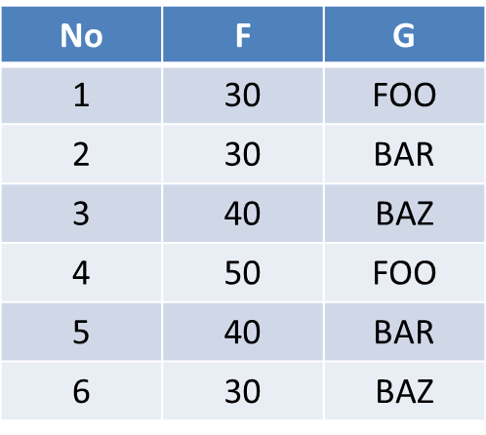
Example
Suppose a file consists of records with two fields, F and G, of type integer and string, respectively. The current file has six records, numbered 1 through 6, with the following values in order:

Slide 63
Example
A bitmap index for the first field, F, would have three bit-vectors, each of length 6 as shown in the table
  In each case, the 1's indicate in which records the corresponding value appears
No | 30(F) | 40(F) | 50(F)
1 | 1 | 0 | 0
2 | 1 | 0 | 0
3 | 0 | 1 | 0
4 | 0 | 0 | 1
5 | 0 | 1 | 0
6 | 1 | 0 | 0

Slide 64
Example
A bitmap index for the second field, G, would have three bit-vectors, each of length 6 as shown in the table
  In each case, the 1's indicate in which records the corresponding string appears
No | FOO (G) | BAR (G) | BAZ (G)
1 | 1 | 0 | 0
2 | 0 | 1 | 0
3 | 0 | 0 | 1
4 | 1 | 0 | 0
5 | 0 | 1 | 0
6 | 0 | 0 | 1

Slide 65
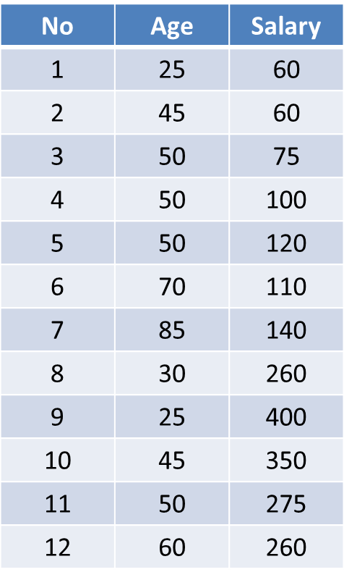
Motivation for Bitmap Indexes
Bitmap indexes can help answer range queries
Example:
  Given is the data of a jewelry stores, and the attributes considered are age and salary

Slide 66
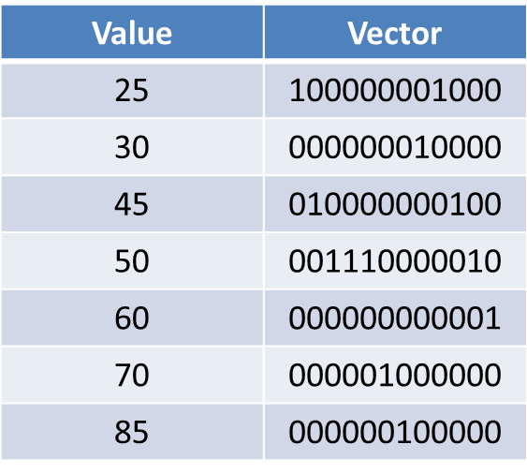
Example
A bitmap index for the first field Age, would have seven bit-vectors, each of length 12 as shown in the table
In each case, the 1's indicate in which records the corresponding string appears

Slide 67
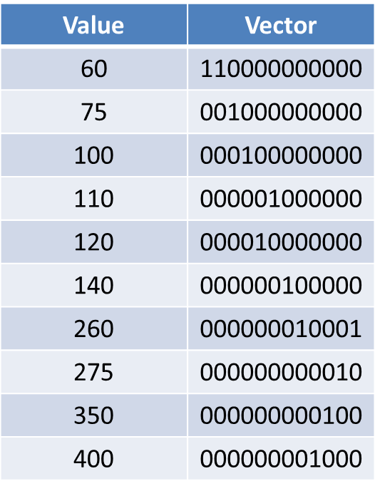
Example
A bitmap index for the second field Salary, would have ten bit-vectors, each of length 12 as shown in the table
In each case, the 1's indicate in which records the corresponding string appears

Slide 68
Example
Suppose we want to find the jewelry buyers with an age in the range 45-55 and a salary in the range 100-200
  We first find the bit-vectors for the age values in this range; in this example there are only two: 010000000100 and 001110000010, for 45 and 50, respectively
  If we take their bitwise OR, we have a new bit-vector with 1 in position i if and only if the i^{th} record has an age in the desired range
  This bit-vector is 011110000110

Slide 69
Example
Suppose we want to find the jewelry buyers with an age in the range 45-55 and a salary in the range 100-200
  Next, we find the bit-vectors for the salaries between 100 and 200 thousand
  There are four, corresponding to salaries 100, 110, 120, and 140; their bitwise OR is 000111100000
The last step is to take the bitwise AND of the two bit-vectors we calculated by OR
  011110000110
  AND 000111100000
  -----------------------------------
  000110000000
(50,100)
(50,100)

