Slide 1
COP4710
Database Systems
Introduction

Slide 2
Welcome to COP4710
Course Website:
  http://www.cs.fsu.edu/~zhao/cop4710/main.html
  Syllabus, policies, schedules, slides, projects, resource…
Canvas
  Announcements, homework, grades, submissions
Please read the class syllabus, policies, and lecture schedule carefully; ask now if you have questions
  No recitations for this class
    Please make good use of office hours of TAs’/Instructor’s
  FSU first day attendance policy

Slide 3
Teaching Staff
Instructor: Peixiang Zhao (zhao@cs.fsu.edu)
  Research interest
    Generally, data science including database systems and data mining
    Specifically, graph data, information network analysis, large-scale data-intensive computation and analytics
  Brief history
    Illinois (Ph.D. from UIUC, 2012)
    FSU (Professor, at FSU since 2012)
TA:
  Exceptional graduate students here at FSU
    ???

Slide 4
You Tell Me --
Why Are You Taking this Course?
  CS or Non-CS? Any experiences in RDBs, NoSQL?
Are you interested more in being
  An IT guru at Goldman-Sachs or Boeing?
  A system developer at Oracle or Google?
  A data scientist at Meta or Uber?
  A DB pro or researcher in Microsoft research?
  A professor exploring one of the most exciting, and fastest growing areas in CS?

Slide 5
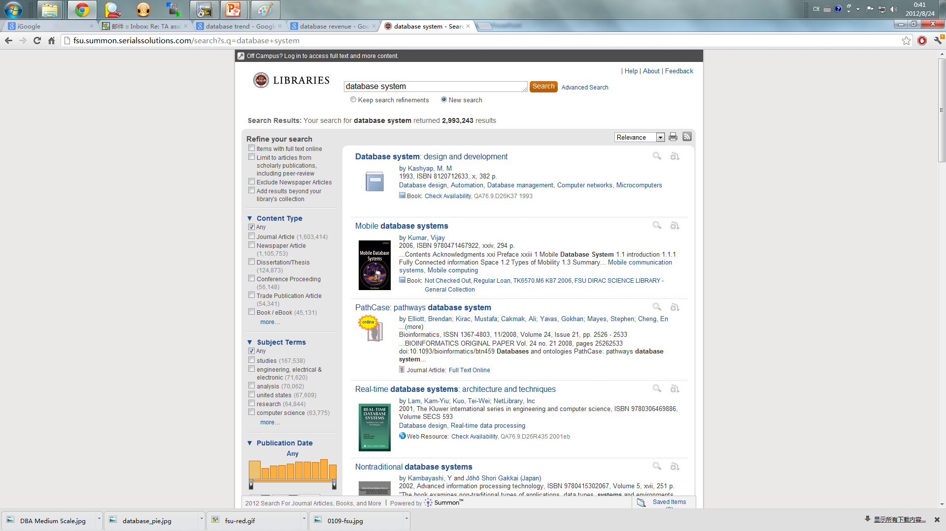
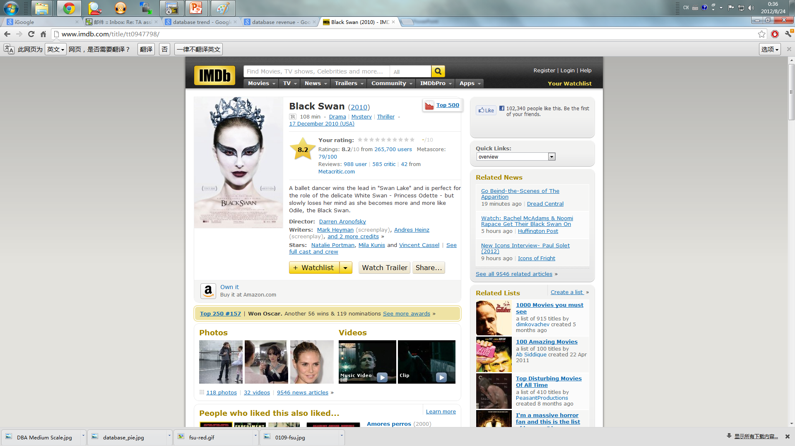
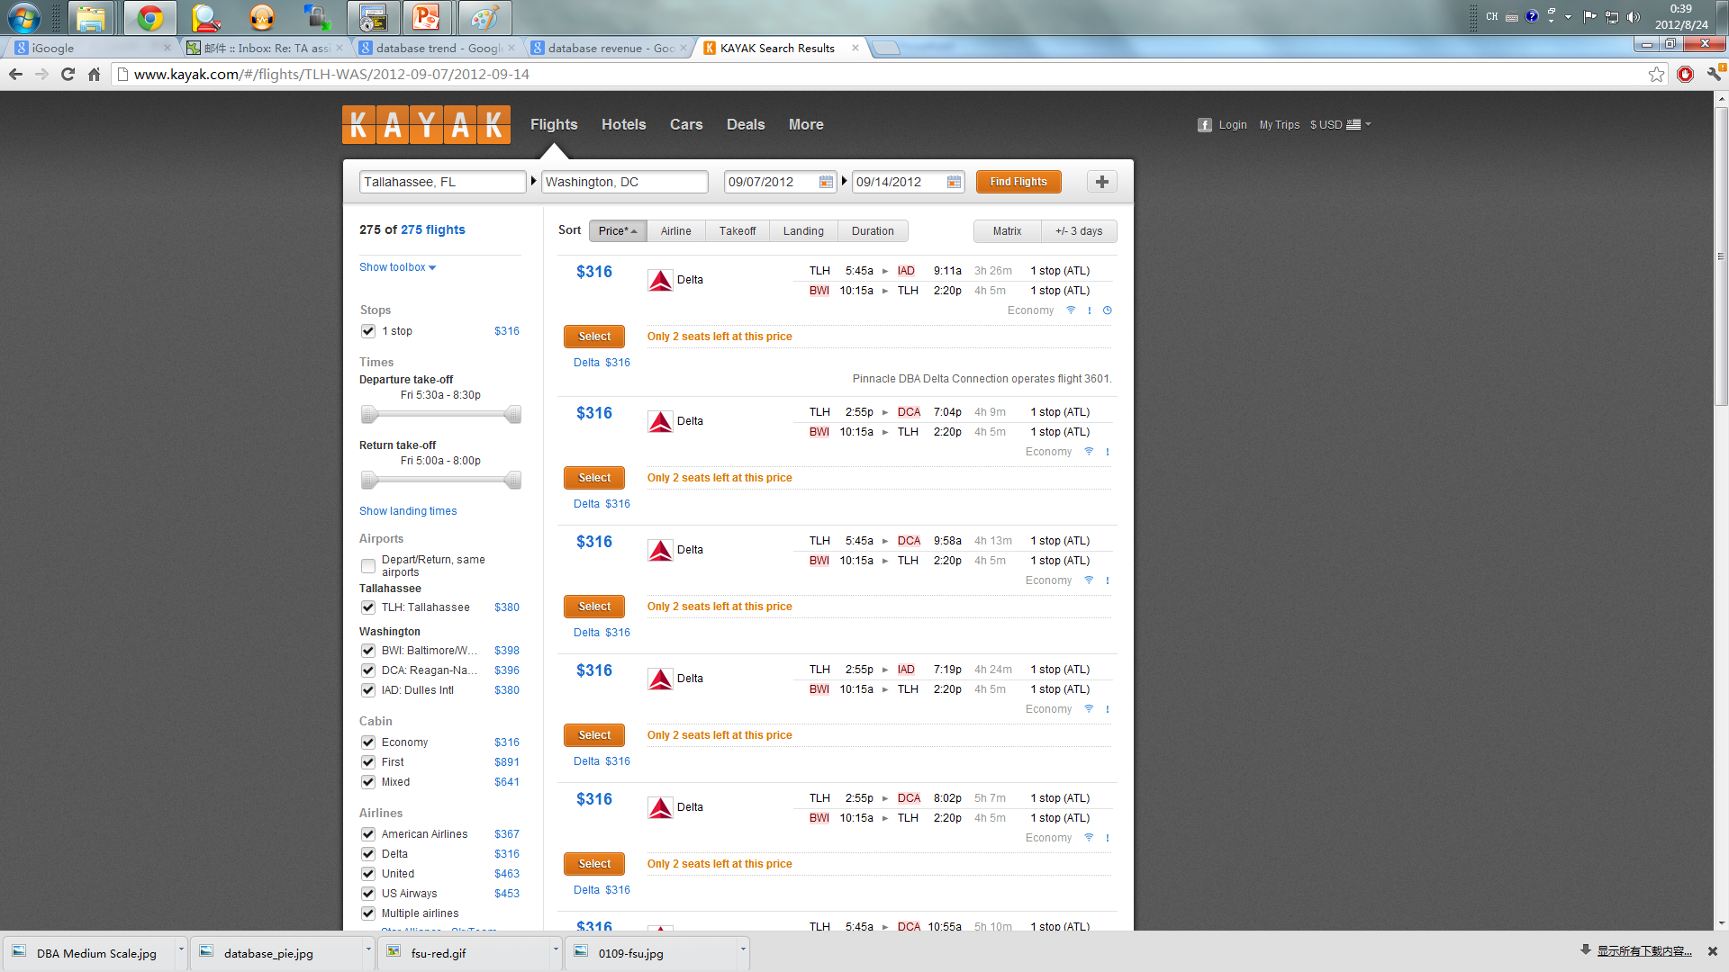
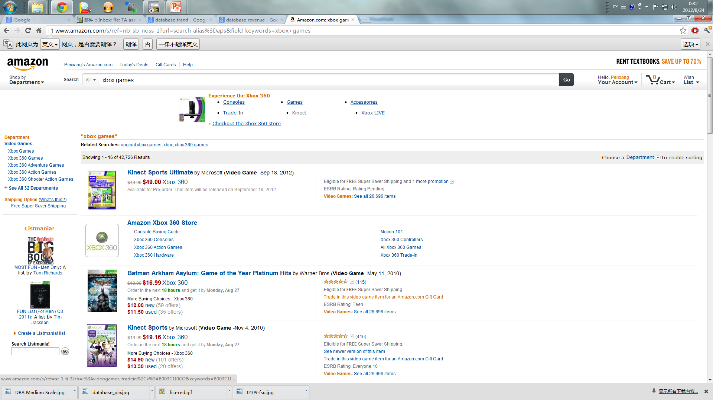
Examples

Slide 6
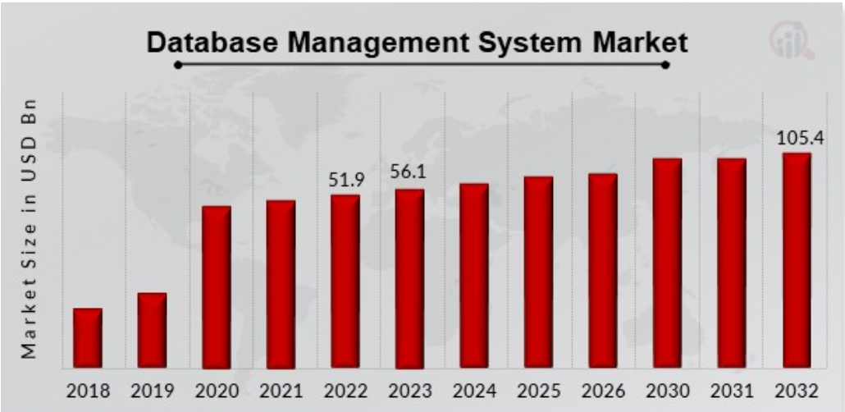
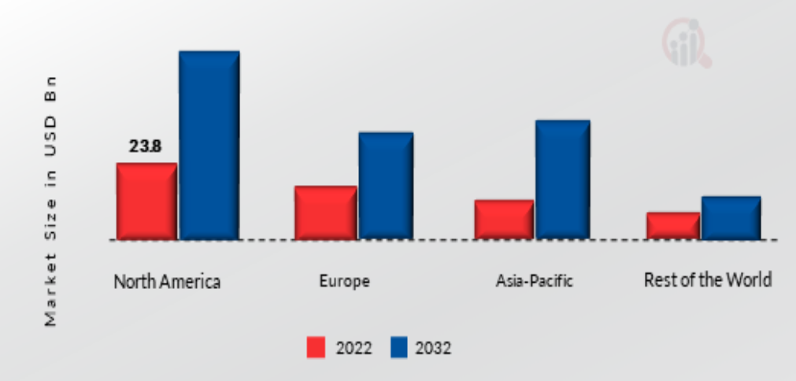
In Industry
Source: www.marketresearchfuture.com

Slide 7
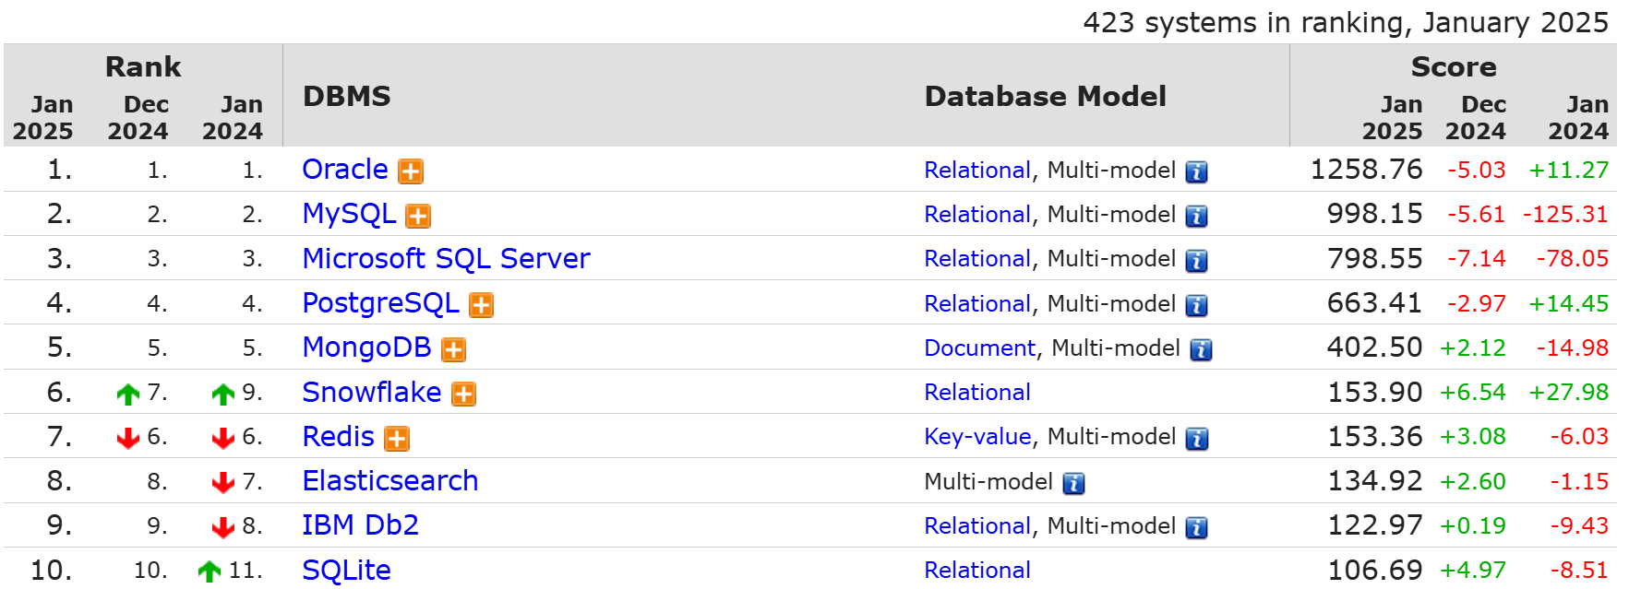
In Industry
Source: https://db-engines.com/en/ranking

Slide 8
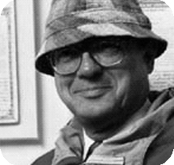
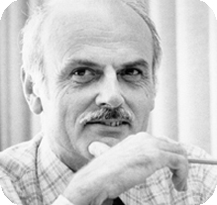
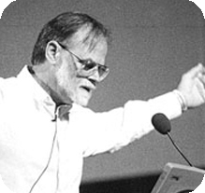

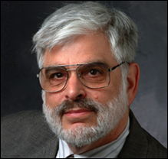
In Science – Turing Awardees
CHARLES BACHMAN, 1973
Edgar codd, 1981
James Gray, 1998
Michael stonebraker, 2014
Jeffrey Ullman, 2020

Slide 9
COP4710 Goal
How to use a database system?
  Conceptual data modeling, the relational and other data models, database schema design, relational algebra, and the SQL query language
  ……
How to design and implement a database system?
  Indexing, transaction processing, and crash recovery
  ……

Slide 10
Prerequisite
Must have data structure and algorithm background
  COP3330: Object-oriented Programming and MAD2104: Discrete Mathematics
  or equivalent
Good programming skill
  Project will require lots of programming
  Need C++, Java, PHP, Python, … to do a good job at talking with DB
  You or your project group picks the topic and language

Slide 11
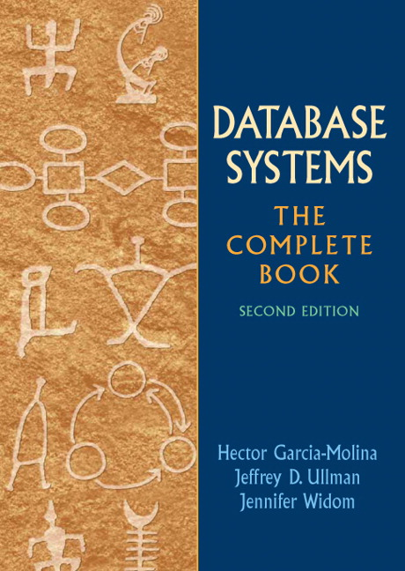

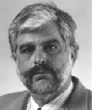

Textbook
Database Systems: The Complete Book. 2nd edition
  http://infolab.stanford.edu/~ullman/dscb.html
References
  Database Management Systems
  Database system concepts
  Fundamentals of Database Systems

Slide 12
Course Format
Two 75-min lectures/week
  Lecture slides are used to complement the lectures, not to substitute the textbook
Four assignments planed (30%)
  Individual work
  No late homework will be accepted
A programming project (30%)
  Teamwork (at most 3 students)
  Multi-stage tasks involving a lot of programming
One midterm (10%) and one final (30%)
  Check dates and make sure no conflict!

Slide 13
Project
An RDB-driven Web-based information system
  Select a real-world application that needs databases as backend systems
  Design and build it from start to finish
  Your choice of topic: useful, realistic, database-driven, Web-based
Requirement
  Teamwork (at most three students)
    all members receive the same scores, and if one drops out, the others pick up the work
  Will be done in stages
    you will submit some deliverables at the end of each stage
  Will show a demo and submit a report near the semester end

Slide 14
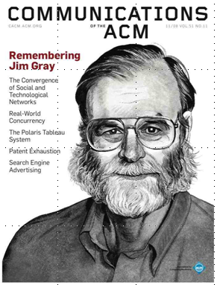
Data Management Evolution
Jim Gray: Evolution of Data Management.
IEEE Computer 29(10): 38-46 (1996):
  Manual processing: 4000BC --
  Mechanical punched-cards: 1900-1955
  Stored-program computer -- sequential record processing: 1955-1970
  Online navigational network DBs: 1965-1980
    many applications still run today!
  Relational DB: 1970-
  Post-relational and the Internet: 1995-

Slide 15
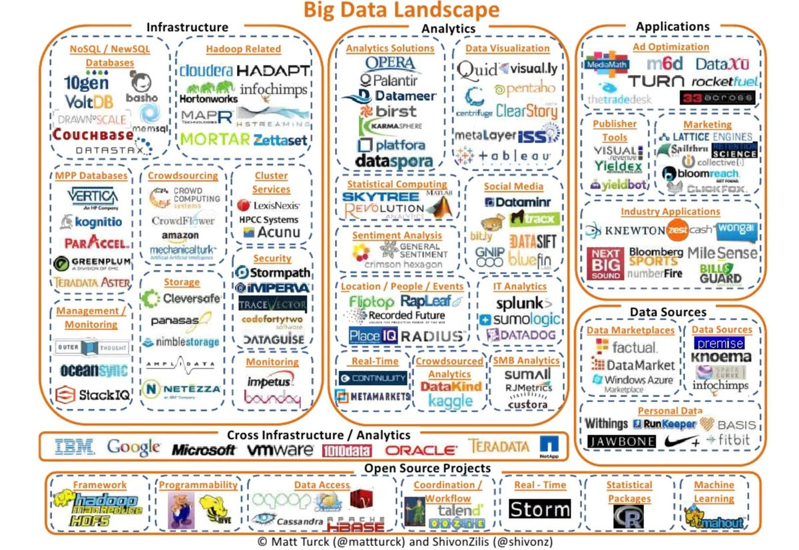
Big Data Landscape 2021

Slide 16
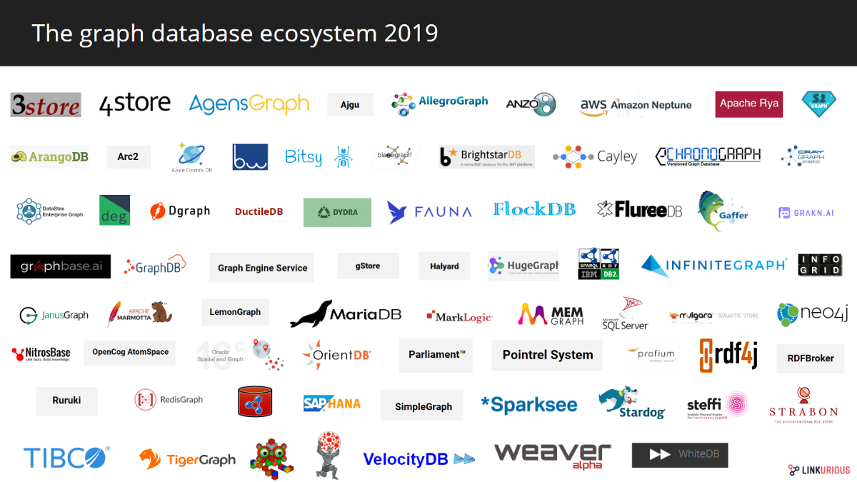
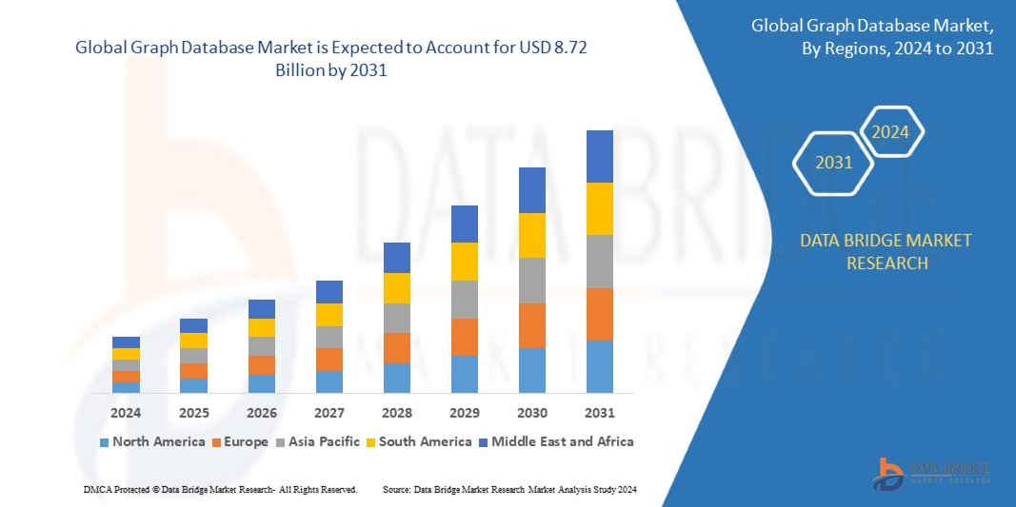
Graph Databases

Slide 17
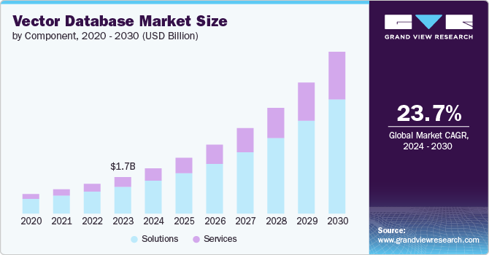
Vector Databases

Slide 18
Database Management System (DBMS)
System for providing EFFICIENT, CONVENIENT, and SAFE MULTI-USER storage of and access to MASSIVE amounts of PERSISTENT data

Slide 19
Example: Banking System
Data
  Information on accounts, customers, balances, current interest rates, transaction histories, etc.
MASSIVE
  many gigabytes at a minimum for big banks, more if keep history of all transactions, even more if keep images of checks -> Far too big for memory
PERSISTENT
  data outlives programs that operate on it

Slide 20
Example: Banking System
SAFE:
  from system failures
  from malicious users
CONVENIENT:
  simple commands to - debit account, get balance, write statement, transfer funds, etc.
  also unpredicted queries should be easy
EFFICIENT:
  don't search all files in order to get the balance of one account, get all accounts with low balances, get large transactions, etc.
  massive data! -> DBMS's carefully tuned for performance

Slide 21
Multi-user Access
Many people/programs accessing same database, or even same data, simultaneously -> Need careful controls
  Alex @ ATM1 (New York): withdraw $100 from account #007
    get balance from database;
  if balance >= 100 then balance := balance - 100;
  dispense cash;
  put new balance into database;
  Bob @ ATM2 (Tallahassee): withdraw $50 from account #007
  get balance from database;
  if balance >= 50 then balance := balance - 50;
  dispense cash;
  put new balance into database;
  Initial balance = 200. Final balance = ??

Slide 22
Why File Systems Won’t Work
Storing data: file system is limited
  size limit by disk or address space
  when system crashes we may lose data
  Password/file-based authorization insufficient
Query/update:
  need to write a new C++/Java program for every new query
  need to worry about performance
Concurrency: limited protection
  need to worry about interfering with other users
  need to offer different views to different users (e.g. registrar, students, professors)
Schema change:
  entails changing file formats
  need to rewrite virtually all applications
That’s why the notion of DBMS was motivated!

Slide 23
DBMS Architecture
User/Web Forms/Applications/DBA
query
transaction
DDL commands
Query Parser
Transaction Manager
DDL Processor
Query Rewriter
Query Optimizer
Concurrency Control
Logging &
Recovery
Query Executor
Records
Indexes
Lock Tables
Buffer:
data, indexes, log, etc
Buffer Manager
Main Memory
Storage Manager
Storage
data, metadata, indexes, log, etc
CS411

Slide 24
Data Structuring: Model, Schema, Data
Data model
  conceptual structuring of data stored in database
  ex: data is set of records, each with student-ID, name, address, courses, photo
  ex: data is graph where nodes represent cities, edges represent airline routes
Schema versus data
  schema: describes how data is to be structured, defined at set-up time, rarely changes (also called "metadata")
    Otherwise, you have random bits with no meaning
  data is actual "instance" of database, changes rapidly
  vs. types and variables in programming languages

Slide 25
Data Models
Relational
Key/Value
Graph
Document/Json/XML/Object
Wide-column/Column-family
Array(Vector, Matrix, Tensor)
Hierarchical
Network
Semantic
Entity-Relationship
Most DBMSs
Simple Apps / Caching
NoSQL
ML / Science
Obsolete / Legacy
Conceptual Modelling

Slide 26
Schema vs. Data
Schema: name, name of each field, the type of each field
  Students (Sid:string, Name:string, Age: integer, GPA: real)
  A template for describing a student
Data: an example instance of the relation
Sid | Name | Age | GPA
0001 | Alex | 19 | 3.55
0002 | Bob | 22 | 3.10
0003 | Chris | 20 | 3.80
0004 | David | 20 | 3.95
0005 | Eugene | 21 | 3.30

Slide 27
Data Structuring: Model, Schema, Data
Data definition language (DDL)
  commands for setting up schema of database
Data Manipulation Language (DML)
  Commands to manipulate data in database:
    RETRIEVE, INSERT, DELETE, MODIFY
  Also called "query language"

Slide 28
People
DBMS user: queries/modifies data
DBMS application designer
  set up schema, loads data, …
DBMS administrator
  user management, performance tuning, …
DBMS implementer: builds systems

Slide 29
How to Get the Most out of COP4710?
Read and think before class
  welcome to ask questions before/during/after class!
Study and discuss with your peers
  discuss readings to enhance understanding
  discuss assignments but write your own solution!
Use lectures to guide your study
  use it as a roadmap for what’s important
  lectures are starting points– they do not cover everything you should read
Participate actively in your project

Slide 30

Questions

