Slide 1
COP4710 Database Systems
Indexing

Slide 2
Why Do We Learn This?
Find out the desired information (by value) from the database (very) quickly!
Declarative
No/less physical dependency
Indexing
Common properties of indexes
B+ trees
Hash tables

Slide 3
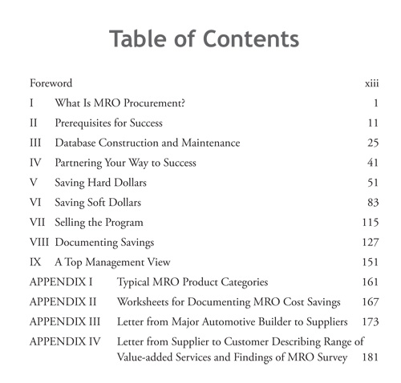
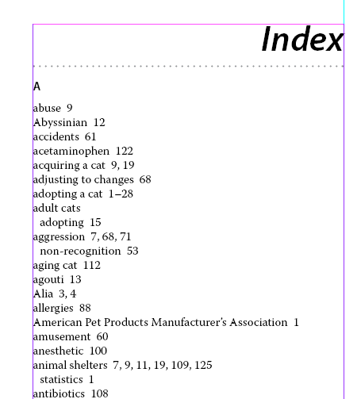
What is Indexing?
A “labeled” pointer to an (a collection of) item that satisfies some common property
Examples in the Real World?

Slide 4
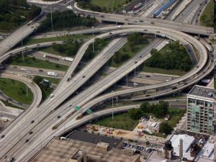
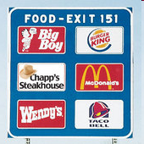
What is Indexing?
A “labeled” pointer to an (a collection of) item that satisfies some common property
Examples in the real world?

Slide 5
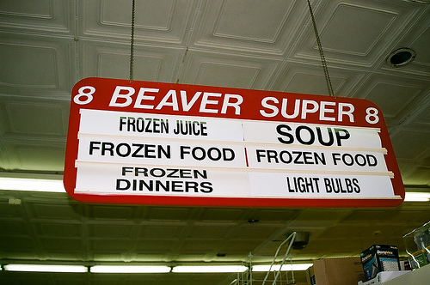
What is Indexing?
A “labeled” pointer to an (a collection of) item that satisfies some common property
Examples in the Real World?

Slide 6
Theoretically, Indexes is …
An index on a file speeds up selections on the search key attributes(s)
Search key = any subset of the attributes of a relation
Search key is not the same as key (minimal set of attributes that uniquely identify a tuple (record) in a relation)
Entries in an index: (K, R), where:
K: the key
R: the record OR record id OR record ids

Slide 7
Types of Indexes
Clustered/Unclustered
Clustered = records sorted in the key order
Unclustered = no
Dense/sparse
Dense = each record has an entry in the index
Sparse = only some records have
Primary/secondary
Primary = on the primary key
B+ tree / Hash table / …

Slide 8
Clustered, Dense Index
Clustered: File is sorted on the index attribute
Dense: sequence of (key, pointer) pairs
10
20
30
40
10
20
30
40
50
60
70
80
50
60
70
80

Slide 9
Clustered, Sparse Index
Sparse index: one key per data block
Save more space
Sacrifice efficiency
10
30
50
70
10
20
30
40
90
110
130
150
50
60
70
80

Slide 10
Clustered Index with Duplicate Keys
Dense index: point to the first record with that key
10
20
30
40
10
10
10
20
50
60
70
80
20
20
30
40

Slide 11
Clustered Index with Duplicate Keys
Sparse index: pointer to lowest search key in each block
Try search for 20
Additional pointer doesn’t help
10
10
20
30
10
10
10
20
Check
Backward?
20
20
30
40

Slide 12
Clustered Index with Duplicate Keys
Better: pointer to lowest new search key in each block
Search for 20
10
20
30
40
10
10
10
20
50
60
70
80
30
30
40
50

Slide 13
Unclustered Indexes
Often for indexing other attributes than primary key
Always dense (why ?)
The locality of values has been broken!
10
10
20
20
20
30
30
20
20
30
30
30
10
20
10
30

Slide 14
Clustered vs. Unclustered Index
Index entries
Index entries
(Index File)
(Data file)
Data Records
Data Records
CLUSTERED
UNCLUSTERED

Slide 15
Composite Search Keys
Composite Search Keys: search on a combination of fields.
Equality query: Every field value is equal to a constant value, e.g., w.r.t. <sal,age> index:
age=20 and sal =75K
Range query: Some field value is not a constant, e.g.,
age =20; or age=20 and sal > 10K
Examples of composite key
indexes using lexicographic order
11,80
11
12,10
12
12,20
name
age
sal
12
13,75
bob
12
10
13
<age, sal>
cal
11
80
<age>
joe
12
20
10,12
sue
13
75
10
20,12
Data records
sorted by name
20
75,13
75
80,11
80
<sal, age>
<sal>
Data entries in index
sorted by <sal,age>
Data entries
sorted by <sal>
14

Slide 16
Example: Our Textbook
How many indexes? Where?
ToC
Topic words
Author index, ……
What are keys? What are records?
Chapter no./title
Topic words
Clustered? ToC (Yes); T.W. (No)
Dense? ToC (Yes to some extent); T.W. (No)
Primary? It depends!

Slide 17
B+ Trees
What’s wrong with sequential index?
Pros: easy/fast to access
Cons: hard to maintain the sequential property upon updates
B+ Tree Intuition:
Give up sequentiality of index
Try to get “balance” by dynamic reorganization
Behind the Scene: Prof. Rudolf Bayer
Professor of Informatics at the Technical University of Munich since 1972
Inventor of B-tree, UB-tree and red-black tree
Recipient of 2001 ACM SIGMOD Edgar F. Codd Innovations Award

Slide 18
B+ Trees Basics
Parameter d = the degree (order)
Each node has [d, 2d] keys (except root)
Internal node:
Leaf:
30 |  | 120 |  | 240
[X , 30)
[30, 120)
[120, 240)
[240, Y)
40 |  | 50 |  | 60
next leaf
40
50
60

Slide 19
Searching a B+ Tree
Point queries with exact key values:
Start at the root
Proceed down, to the leaf
Range queries:
As above
Then sequential traversal at the leaf level
Select name
From people
Where age = 25
Select name
From people
Where 20 <= age
and age <= 30

Slide 20
B+ Tree Example
Select name
From person
Where age = 30
(Where age >=30)
Root (d=1)
d = 2
80
20 |  | 60
100 |  | 120 |  | 140
10 |  | 15 |  | 18
20 |  | 30 |  | 40 |  | 50
60 |  | 65
80 |  | 85 |  | 90
10
15
18
20
30
40
50
60
65
80
85
90

Slide 21
B+ Tree Design
How large is d?
Example:
Key size = 4 bytes
Pointer size = 8 bytes
Block size = 4096 byes
2d x 4 + (2d+1) x 8 <= 4096
So, d = 170

Slide 22
B+ Trees in Practice
Typical order: 100. Typical fill-factor: 67%.
average fan-out = 133
Typical capacities:
Height 4: 133⁴ = 312,900,700 records
Height 3: 133³ = 2,352,637 records
Can often hold top levels in buffer pool:
Level 1 = 1 page = 8 Kbytes
Level 2 = 133 pages = 1 Mbyte
Level 3 = 17,689 pages = 133 MBytes

Slide 23
Insertion in a B+ Tree
Insert (K, P): Find leaf where K belongs, insert
If no overflow (2d keys or less), halt
If overflow (2d+1 keys), split node, insert in parent:
If leaf, keep K3 too in right node
When root splits, new root has 1 key only
that’s why root is special for degree satisfaction
(K3, ) to parent
K1 |  | K2 |  | K3 |  | K4 |  | K5
P0 | P1 |  | P2 |  | P3 |  | P4 |  | p5
K1 |  | K2
P0 | P1 |  | P2
K4 |  | K5
P3 | P4 |  | p5

Slide 24
Insertion in a B+ Tree
Insert K=19
80
20 |  | 60
100 |  | 120 |  | 140
10 |  | 15 |  | 18
20 |  | 30 |  | 40 |  | 50
60 |  | 65
80 |  | 85 |  | 90
10
15
18
20
30
40
50
60
65
80
85
90

Slide 25
Insertion in a B+ Tree
After Insertion
80
20 |  | 60
100 |  | 120 |  | 140
10 |  | 15 |  | 18 |  | 19
20 |  | 30 |  | 40 |  | 50
60 |  | 65
80 |  | 85 |  | 90
10
15
18
19
20
30
40
50
60
65
80
85
90

Slide 26
Insertion in a B+ Tree
Now Insert K=25
80
20 |  | 60
100 |  | 120 |  | 140
10 |  | 15 |  | 18 |  | 19
20 |  | 30 |  | 40 |  | 50
60 |  | 65
80 |  | 85 |  | 90
10
15
18
19
20
30
40
50
60
65
80
85
90

Slide 27
Insertion in a B+ Tree
After Insertion
80
20 |  | 60
100 |  | 120 |  | 140
10 |  | 15 |  | 18 |  | 19
20 |  | 25 |  | 30 |  | 40 |  | 50
60 |  | 65
80 |  | 85 |  | 90
10
15
18
19
20
25
30
40
50
60
65
80
85
90

Slide 28
Insertion in a B+ Tree
Now Split
80
20 |  | 60
100 |  | 120 |  | 140
10 |  | 15 |  | 18 |  | 19
20 |  | 25 |  | 30 |  | 40 |  | 50
60 |  | 65
80 |  | 85 |  | 90
10
15
18
19
20
25
30
40
50
60
65
80
85
90

Slide 29
Insertion in a B+ Tree
After the Split
80
20 |  | 30 |  | 60
100 |  | 120 |  | 140
10 |  | 15 |  | 18 |  | 19
20 |  | 25
30 |  | 40 |  | 50
60 |  | 65
80 |  | 85 |  | 90
10
15
18
19
20
25
30
40
50
60
65
80
85
90

Slide 30
Deletion from a B+ Tree
Delete 30
80
20 |  | 30 |  | 60
100 |  | 120 |  | 140
10 |  | 15 |  | 18 |  | 19
20 |  | 25
30 |  | 40 |  | 50
60 |  | 65
80 |  | 85 |  | 90
10
15
18
19
20
25
30
40
50
60
65
80
85
90

Slide 31
Deletion from a B+ Tree
After Deleting 30
May change to 40, or not
80
20 |  | 30 |  | 60
100 |  | 120 |  | 140
10 |  | 15 |  | 18 |  | 19
20 |  | 25
40 |  | 50
60 |  | 65
80 |  | 85 |  | 90
10
15
18
19
20
25
40
50
60
65
80
85
90

Slide 32
Deletion from a B+ Tree
Delete 25
80
20 |  | 30 |  | 60
100 |  | 120 |  | 140
10 |  | 15 |  | 18 |  | 19
20 |  | 25
40 |  | 50
60 |  | 65
80 |  | 85 |  | 90
10
15
18
19
20
25
40
50
60
65
80
85
90

Slide 33
Deletion from a B+ Tree
After deleting 25, Need to rebalance: Rotate
80
20 |  | 30 |  | 60
100 |  | 120 |  | 140
10 |  | 15 |  | 18 |  | 19
20
40 |  | 50
60 |  | 65
80 |  | 85 |  | 90
10
15
18
19
20
40
50
60
65
80
85
90

Slide 34
Deletion from a B+ Tree
Now Delete 40
80
19 |  | 30 |  | 60
100 |  | 120 |  | 140
10 |  | 15 |  | 18
19 |  | 20
40 |  | 50
60 |  | 65
80 |  | 85 |  | 90
10
15
18
19
20
40
50
60
65
80
85
90

Slide 35
Deletion from a B+ Tree
After deleting 40, Rotation not possible. Need to merge nodes
80
19 |  | 30 |  | 60
100 |  | 120 |  | 140
10 |  | 15 |  | 18
19 |  | 20
50
60 |  | 65
80 |  | 85 |  | 90
10
15
18
19
20
50
60
65
80
85
90

Slide 36
Deletion from a B+ Tree
Final Tree
80
19 |  | 60
100 |  | 120 |  | 140
10 |  | 15 |  | 18
19 |  | 20 |  | 50
60 |  | 65
80 |  | 85 |  | 90
10
15
18
19
20
50
60
65
80
85
90

Slide 37
B Tree
Idea:
Avoid duplicate keys
Have record pointers in non-leaf nodes
to record to record to record
with K1 with K2 with K3
to keys to keys to keys to keys
< K1 K1<x<K2 K2<x<k3 >k3
K1 P1
K2 P2
K3 P3

Slide 38
B-Tree Example
D = 2
Sequence pointers not useful now!
65
125
25
45
85
105
145
165
10
20
30
40
50
60
70
80
90
100
110
120
130
140
150
160
170
180

Slide 39
Hash Tables
Secondary storage hash tables are much like main memory ones
Recall basics
There are n buckets
A hash function f(k) maps a key k to {0, 1, …, n-1}
Store in bucket f(k) a pointer to record with key k
Secondary storage: bucket = block, use overflow blocks when needed

Slide 40
Hash Table Example
Assume 1 bucket (block) stores 2 keys + pointers
h(e)=0
h(b)=h(f)=1
h(g)=2
h(a)=h(c)=3
e
b
f
g
a
c
0
1
2
3

Slide 41
Searching in a Hash Table
Search for a:
Compute h(a)=3
Read bucket 3
1 disk access
e
b
f
g
a
c
0
1
2
3

Slide 42
Insertion in Hash Table
Place in right bucket, if there exists space
E.g. h(d)=2
e
b
f
g
d
a
c
0
1
2
3

Slide 43
Insertion in Hash Table
Create overflow block, if no space
E.g. h(k)=1
More overflow blocks may be needed
e
b
f
g
d
a
c
0
1
k
2
3

Slide 44
Hash Table Performance
Excellent, if no overflow blocks
Degrades considerably when number of keys exceeds the number of buckets (i.e. many overflow blocks)
Other problems:
Memory requirement
Dynamic maintenance
Equality queries only!

Slide 45
Extensible Hash Table
Allows hash table to grow, to avoid performance degradation
Assume a hash function h that returns numbers in {0, …, 2^{k} – 1}
Start with n = 2^{i} << 2^{k} , only look at first i most significant bits (MSBs)
E.g. i=1, n=2, k=4
The first i bits (i = 1)
i=1
0(010)
1
0
1
1(011)
1

Slide 46
Insertion in Extensible Hash Table
Insert 1110
i=1
0(010)
1
0
1
1(011)
1(110)
1

Slide 47
Insertion in Extensible Hash Table
Now insert 1010
Need to extend table, split blocks
i becomes 2
i=1
0(010)
1
0
1
1(011)
1(110), 1(010)
1

Slide 48
Insertion in Extensible Hash Table
Now insert 1010
i=2
0(010)
1
00
01
10(11)
10(10)
2
Doubling the hash table
10
11
11(10)
2

Slide 49
Insertion in Extensible Hash Table
Now insert 0000, then 0101
Need to split block
i=2
0(010)
0(000), 0(101)
1
00
01
10(11)
10(10)
2
10
11
11(10)
2

Slide 50
Insertion in Extensible Hash Table
After splitting the block
00(10)
00(00)
2
i=2
01(01)
2
00
01
10(11)
10(10)
2
10
11
11(10)
2

Slide 51
Performance Extensible Hash Table
No overflow blocks: access always one read
BUT:
Extensions can be costly and disruptive
After an extension, the hash table may no longer fit in memory

Slide 52
Linear Hash Table
Idea: extend only one entry at a time
Problem: n= no longer a power of 2
Let i be #bits necessary to address n buckets
2^{i-1} < n <= 2^{i}
After computing h(k), use the last i bits:
If last i bits represent a number >= n, change msb from 1 to 0 (get a number < n)

Slide 53
Linear Hash Table Example
N=3
Bit flip: 11 → 01
(01)00
(11)00
i=2
(01)11 BIT FLIP
00
01
(10)10
10

Slide 54
Linear Hash Table Example
Insert 1000: overflow blocks…
(01)00
(11)00
(10)00
i=2
(01)11
00
01
(10)10
10

Slide 55
Linear Hash Tables
Extension: independent on overflow blocks
Extend n→n+1 when the average number of records per block exceeds a threshold, say 70%

Slide 56
Linear Hash Table Extension
From n=3 to n=4
Only need to touch one block (which one ?)
(01)00
(11)00
(01)00
(11)00
i=2
(01)11
00
(01)11
01
i=2
(10)10
10
(10)10
00
01
(01)11
10
11

Slide 57
Linear Hash Table Extension
From n=3 to n=4 finished
Extension from n=4 to n=5 (new bit)
Need to touch every single block
(01)00
(11)00
i=2
(10)10
00
01
(01)11
10
11

