Slide 1
COP4710
Database Systems
Final Review

Slide 2
Final Exam
Time: Thursday 5/1/2025, 12:30pm --- 2:30pm
Venue: BEL 102, in-class exam
Closed book/note, but you can bring one page of cheat sheet (US letter, double side)
  Plan your strategy well
  Submit your cheat sheet after the exam
No calculators or other electronic devices
  Laptops, IPADs, smart phones, etc. are prohibited

Slide 3
Final Exam
Bring you FSU ID to attend the final exam
Coverage
  Accumulative, all materials taught in the class and on the textbook

Slide 4
Format
One set of true/false questions with brief explanation
  Any relation in 3NF is in BCNF as well
  Answer: False. Because ……
Several more detailed questions
60 points
I believe you should have enough time (120 minutes)

Slide 5
Suggested Method for Study
Go over the lecture slides and study the textbook
Work independently on problems in HW/lectures/exercises in the textbook
Discuss with people in the class. Contact me and TAs
Any practice – work it out before looking at solutions

Slide 6
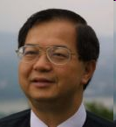
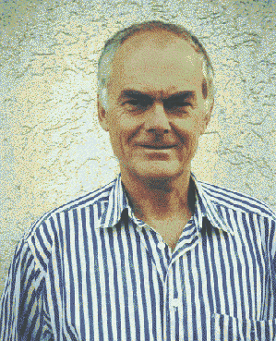
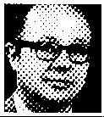
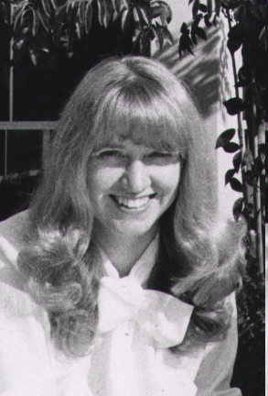



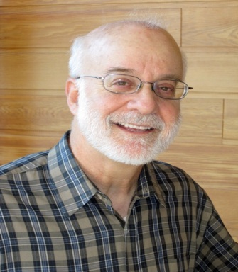


Why Such Great Achievements?

Slide 7
And Many More Behind the Scene
The next one is
You!

Slide 8
ER Model
Entities
  Attributes
Relationships
  Key constraints: many-one, many-many
  Roles
Subclasses
Constraints
  Keys, referential integrity, etc.
Weak Entity Set: Why & How?
Question: Given a real-world application, model it into an ER model

Slide 9
Relational Model
Schema and instances
  DDL and DML
Primary key, Foreign key, Unique, NULL, Default
Translating ER to Relations
  Entities
  Relationships (many-many, many-one, one-one)
  Weak entity set
  Subclass
Question: Given an ER diagram, translate it into a set of relations (primary, foreign keys; SQL)

Slide 10
Relational Algebra
Operators and operands
  Set-based operators
  Other basic operators
  Derived operators
Cartesian product, theta-join, equi-join, natural join
Relational algebra expressions and expression trees
Question: Given a database, answer queries using relational algebra

Slide 11
Relational Design
Motivation
Functional dependencies & keys
  Armstrong axioms
  Closures
Normal forms and decomposition algorithms
  BCNF
    Lossless or lossy?
  3NF
    Functional-dependency preserving or not?
Don’t overdo it
Question: Given a relation and a set of functional dependencies, decompose it into BCNF or 3NF

Slide 12
SQL
What is SQL?
Why SQL?
  DDL & DML in SQL
Select-From-Where
  String pattern matching
  3-value logic
  Sub-queries
Aggregate queries
  Select-From-Where-GroupBy-Having
Question: given a database, answer queries using SQL

Slide 13
Indexing
Indexing Basics
  Clustered/unclustered index
  Dense/sparse index
  Primary/secondary index
  Sequential index
B/B+ Trees
  Definition
  Querying/Insertion/Deletion
Hashing
  Extensible hashing
  Linear hashing
Question: Given a B+ tree/hash index, search/insert/delete a series of (key, records)

Slide 14
Transactions Management and Crash Recovery
What are transactions?
Properties of transactions: ACID
Crash recovery
  Undo logging
  Redo logging
Question: Given an undo/redo log file, try to recover from crashes

Slide 15

Break a Leg!

