Slide 1
COP4710
Database Systems
E-R Model

Slide 2

Why should we study this?

Slide 3
Key Steps in Building DB Applications
Step 0: pick an application domain
  We will talk about this later
Step 1: conceptual design
  Discuss with your teammates what to model in the application domain
  Need a modeling language to express what you want
    ER model is the most popular such language
  Output: an ER diagram of the application domain

Slide 4
Key Steps in Building DB Applications
Step 2: pick a type of DBMS’s
  Relational DBMS is most popular and is our focus
Step 3: translate ER design to a relational schema
  Use a set of rules to translate from ER to relational schema
  Use a set of schema refinement rules to transform the above relational schema into a good relational schema
At this point
  You have a good relational schema on paper

Slide 5
Key Steps in Building DB Applications
Subsequent steps include
  Implement your relational DBMS using a "database programming language" called SQL
  Ordinary users cannot interact with the database directly and the database also cannot do everything you want, hence write your application program in C++, Java, PHP, etc. to handle the interaction and take care of things that the database cannot do
So, the first thing we should start with is to learn ER model ...

Slide 6

ER Model
A language to specify
  what information a database must hold
  what are the relationships among components of that information
What we will cover
  basic constructs, constraints, weak entity sets, and design principles
Proposed by Peter Chen in 1976
  "The Entity-Relationship Model --- Toward a Unified View of Data". in ACM transactions on database systems (TODS)
    One of the most cited CS papers

Slide 7
Entities and Attributes
Entities
  Real-world objects distinguishable from other objects
  Described using a set of attributes
Attributes
  each has an atomic domain: string, integers, reals, etc.
Entity set: a collection of similar entities

Slide 8
(Binary) Relationship
A mathematical definition:
  if A, B are sets, then a relation R is a subset of A x B (Cartesian product)
A={1,2,3}, B={a, b, c, d},
  R = {(1,a), (1,c), (3,b)}
makes is a subset of Product x Company:
1
a
2
b
A=
c
3
B=
d
makes
Product
Company

Slide 9
Multiplicity of E/R Relationships
one-one:
many-one
many-many
1
2
3
a
b
c
1
2
3
a
b
c
d
1
2
3
a
b
c
d

Slide 10
Example
An employee can work in many departments; a department can have many employees
In contrast, each department has at most one manager
name
dname
ssn
lot
did
budget
Employees
Manages
Departments
Works_In

Slide 11
Multiway Relationships
How do we model a purchase relationship between buyers,
products and stores?
Product
Purchase
Store
Person
Can still be modeled as a mathematical set (how ?)

Slide 12
Arrows in Multiway Relationships
Q: what does the arrow mean ?
Studios
Contract
Movies
Stars

Slide 13
Roles in Relationships
What if we need an entity set twice in one relationship?
name
ssn
lot
Employees
since
dname
super-visor
subor-dinate
did
budget
Reports_To
Departments
Works_In

Slide 14
Attributes on Relationships
date
Product
Purchase
Store
Person

Slide 15
Converting Multiway Relationships to Binary
ProductOf
Product
Purchase
StoreOf
Store
date
BuyerOf
Person

Slide 16
Relationships: Summary
Modeled as a mathematical set
Binary and multiway relationships
Converting a multiway one into many binary ones
Constraints on the degree of the relationship
  many-one, one-one, many-many
Attributes of relationships

Slide 17
Subclasses

Slide 18
Subclasses
Subclass = special case = fewer entities = more properties
Example: Ales are a kind of beer
  Not every beer is an ale, but some are
  Let us suppose that in addition to all the properties (attributes and relationships) of beers, ales also have the attribute color
Assume subclasses form a tree
  No multiple inheritance
Isa triangles indicate the subclass relationship
  Point to the superclass

Slide 19
Example
name
Beers
manf
isa
Ales
color

Slide 20
ER vs. Object Oriented Subclasses
In the object-oriented world, objects are in one class only
  Subclasses inherit properties from super-classes
In contrast, E/R entities have components in all subclasses to which they belong
  Matters when we convert to relations
name
Beers
manf
isa
Pete’s Ale
Ales
color

Slide 21
Constraints
Constraint: an assertion about the database that must be true at all times
  Part of the database schema
  Very important in database design
Finding constraints is part of the modeling process
  Keys: social security number uniquely identifies a person
  Single-value constraints: a person can have only one father
  Referential integrity constraints: if you work for a company, it must exist in the database
  Domain constraints: peoples’ ages are between 0 and 150
  General constraints: all others (at most 60 students enrolled in the class COP4710)

Slide 22
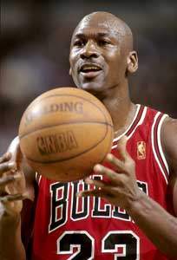

Why Constraints
Give more semantics to the data
  Help us better understand it
Allow us to refer to entities (e.g., using keys)
Enable efficient storage, data lookup, etc.
Michael Jordan, Chicago Bulls
Michael Jordan, UC Berkeley

Slide 23
Keys in E/R Diagrams
price
name
category
Underline:
Product
No formal way
to specify multiple
keys in E/R diagrams
Person
address
name
ssn

Slide 24
More about Keys
Every entity set must have a key
  why?
A key can consist of more than one attribute
There can be more than one key for an entity set
  Among all candidate keys, one key will be designated as primary key

Slide 25
Referential Integrity Constraint
Ref. int. constraint for entities: exactly one value exists in a given role
  An attribute has a non-null, single value
However, we more commonly use such constraints to refer to relationships
  In some formalisms we may refer to other object but get garbage instead
    e.g. a dangling pointer in C/C++
  The Referential integrity constraint on relationships explicitly requires a reference to exist

Slide 26
Referential Integrity Constraint
makes
Product
Company
makes
Product
Company

Slide 27
Weak Entity Sets
Entity sets are weak when their key attributes come from other entities to which they are related
  This happens if:
    part-of hierarchies
    splitting n-ary relations to binary
name
ssn
lot
cost
pname
age
Employees
)
Policy
Dependents

Slide 28
Weak Entity Sets
The entity set E is said to be weak if
  in order to identify entities of E uniquely, we need to follow one or more many-one relationships from E and include the key of the related entities from the owner entity sets: one owner, many weak entities
name
ssn
lot
cost
pname
age
Employees
)
Policy
Dependents

Slide 29
Design Principles: Be Faithful
Purchase
Product
Person
President
Country
Person
Teaches
Instructor
Course

Slide 30
Avoiding Redundancy
Redundancy occurs when we say the same thing in two different ways
Redundancy wastes space and (more importantly) encourages inconsistency
  The two instances of the same fact may become inconsistent if we change one and forget to change the other, related version
name
name
addr
ManfBy
Beers
Manfs
manf
This design states the manufacturer of a beer twice: as an attribute and as a related entity

Slide 31
Another Possible Design
name
manf
manfAddr
Beers
This design repeats the manufacturer’s address once for each beer; loses the address if there are temporarily no beers for a manufacturer

Slide 32
A Good Design
name
name
addr
ManfBy
Beers
Manfs
This design gives the address of each manufacturer exactly once

Slide 33
Entity Sets vs. Attributes
An entity set should satisfy at least one of the following conditions:
  It is more than the name of something; it has at least one non-key attribute.
  or
  It is the “many” in a many-one or many-many relationship
name
name
addr
ManfBy
Beers
Manfs

Slide 34
Which One is Good?
name
manf
Beers
name
name
ManfBy
Beers
Manfs

Slide 35
Don’t Overuse Weak Entity Sets
Database designers often doubt that anything could be a key by itself
  They make all entity sets weak, supported by all other entity sets to which they are linked
In reality, we usually create unique ID’s for entity sets.
  Examples include social-security numbers, automobile VIN’s etc
When Do We Need Weak Entity Sets?
  The usual reason is that there is no global authority capable of creating unique ID’s
    Example: it is unlikely that there could be an agreement to assign unique player numbers across all football teams in the world

Slide 36
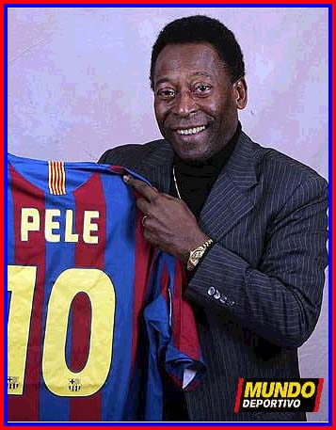

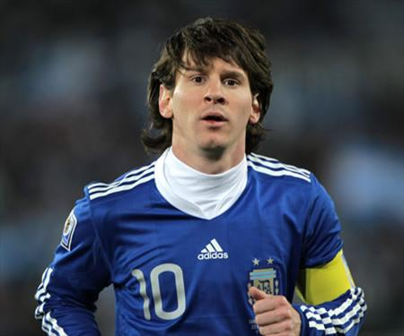



How to Identify Them by #10

Slide 37
ER Review
Basic constructs
  entity, attribute, entity set
  relation: binary, multi-way, converting from multi-way
  relationship roles, attributes on relationships
  subclasses (is-a)
Constraints
  on relations
    many-one, one-one, many-many
  keys, single-valued, ref. integrity, domain & general constraints
Weak Entity Set
Design principles

