Slide 1
Efficient Personalized PageRank Computation
FLORIDA STATE UNIVERSITY
Preetham Ganumpalli Mekala (PG23A)
Vijaya Chandra Reddy Dorala (VD23)
Guru Prasad Reddy Malla (MG23M)

Slide 2
PRESENTATION OVERVIEW
01
05
PROBLEM STATMENT
POWER ITERATION
02
06
INTRODUCTION
PUSH BASED TECHNIQUES
03
07
RANDOM WALK IN PERSONALIZED PAGERANK
SET-PUSH
04
08
MONTE CARLO SAMPLING
DYNAMIC GRAPH HANDLING

Slide 3
Problem Definition: Challenges of calculating Personalized PageRank in large and dynamic graphs.
Motivation: Optimizing PPR computation is crucial due to the high computational demands and its practical impact on recommendation systems and personalized search.
PROBLEM
STATMENT

Slide 4
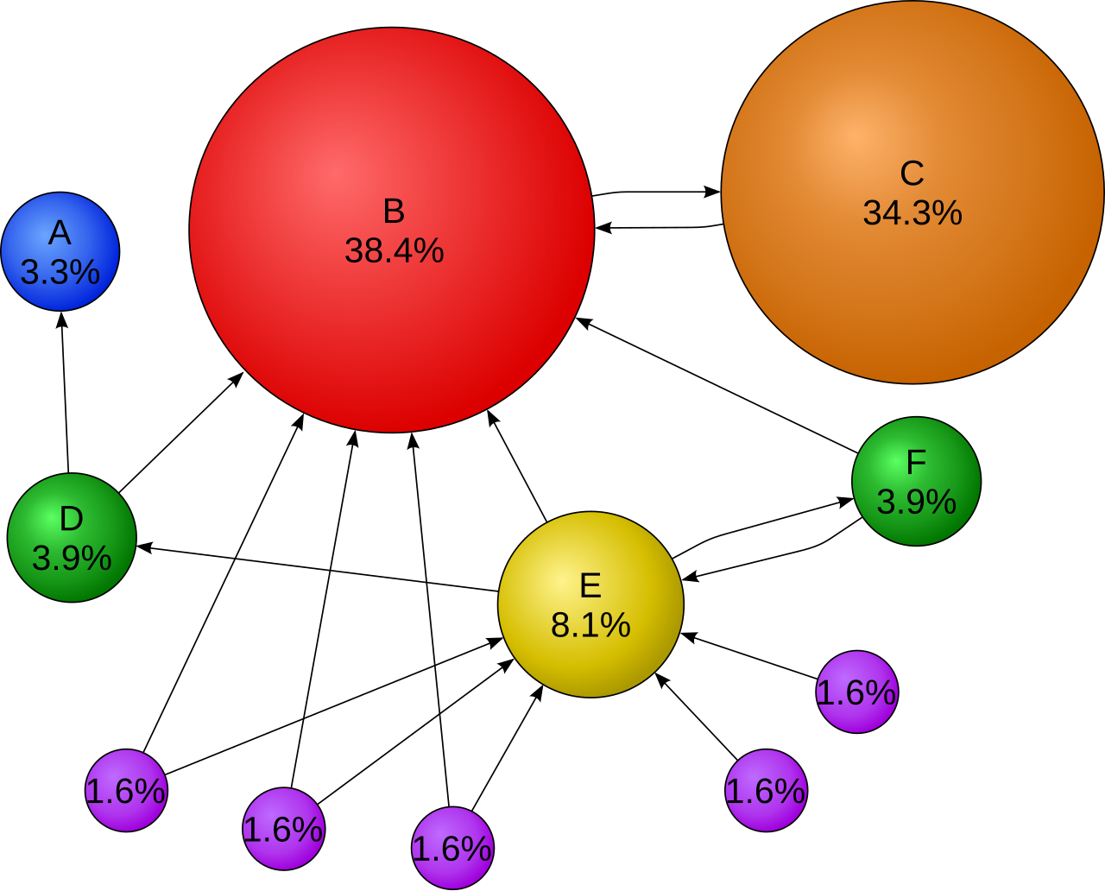
INTRODUCTION TO PERSONALIZED PAGERANK COMPUTATION
PageRank: Algorithm originally developed by Google to measure the importance of web pages and rank websites based on relevance.
Personalized PageRank (PPR): Extension of PageRank to measure the closeness of nodes within a graph relative to specific starting nodes, useful for personalized search and recommendations.
Applications of PPR:
  Recommendation systems
  Network analysis
  Web search personalization
Challenges in PPR Computation:
  Computationally intensive for large-scale or dynamic graphs.
  Requires efficient computation to handle graphs with millions of nodes and edges.

Slide 5
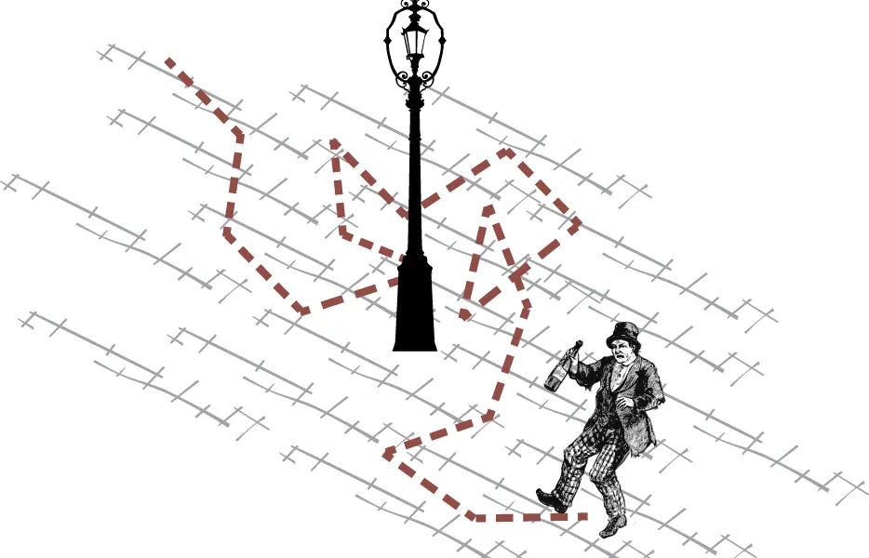
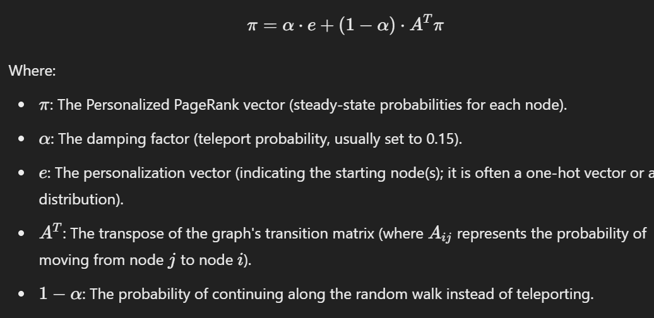
RANDOM WALK IN PERSONALIZED PAGERANK
A random walk begins at a specific node in the graph and moves to one of its neighbors at each step with equal probability.
During each step, with probability α, the walker restarts at the initial node, creating a bias towards certain nodes.
This process continues for a predefined number of steps or until a stopping condition is met.
The probability of visiting a node during a random walk is influenced by the graph's structure and the restart mechanism.
Mathematically, the expected length of a random walk follows a geometric distribution with an expectation of , where α is the restart probability.
The Personalized PageRank value of a node is the steady-state probability of being at that node after many random walks.

Slide 6
RANDOM WALK IN PERSONALIZED PAGERANK
Efficiency: Random walks are efficient for approximating Personalized PageRank, especially on large-scale graphs, as they focus on local neighborhoods rather than the entire graph.
Flexibility: Random walks are adaptable to dynamic graph updates, as they only require localized changes when nodes or edges are modified.
Challenges: Random walks can have high variance, requiring many samples for accurate estimation. The number of walks (W) significantly impacts the accuracy and computational time.
Use Case: Random walks are used in Monte Carlo Sampling to estimate node importance in large graphs, providing a basis for personalization in web search and recommendation systems.

Slide 7
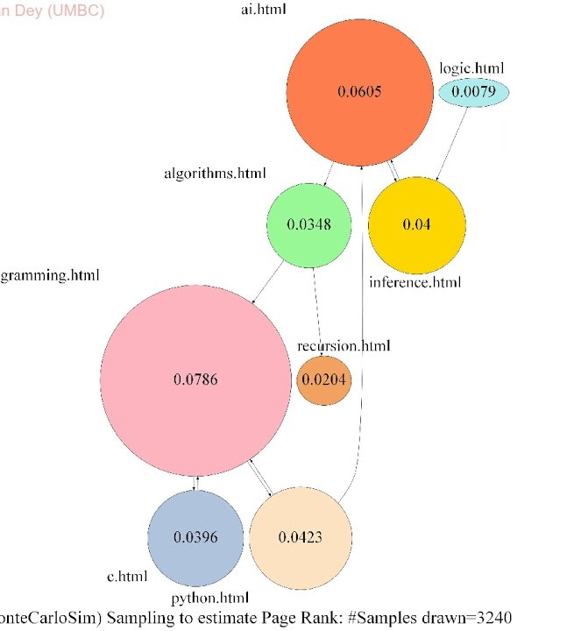
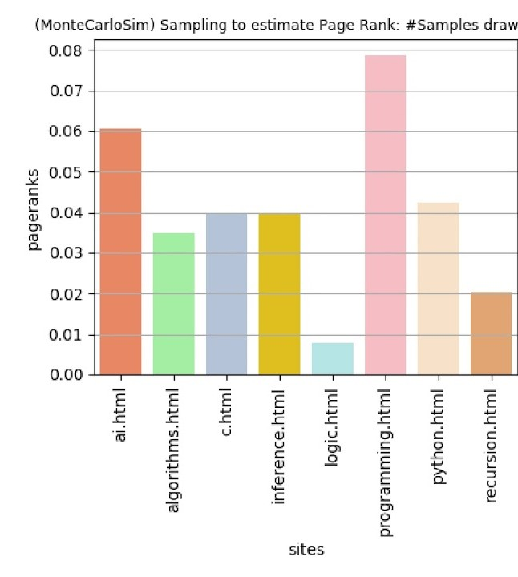
Monte Carlo Sampling for Personalized PageRank (PPR)
Monte Carlo Sampling estimates PPR values through random walks on the graph.
The process involves initiating multiple random walks from the source node or nodes and tracking how often other nodes are visited. The frequency of visits for each node serves as an estimate of that node's Personalized PageRank value.
During each random walk:
  With probability α, the walk restarts at the original source node, simulating a "teleport" action.
  With probability 1 - α, the walk continues to a randomly selected neighboring node.
Purpose: Monte Carlo Sampling aims to determine the relative importance of nodes from a personalized perspective.

Slide 8

Start
Monte Carlo Sampling for Personalized PageRank (PPR)
Input Graph and
Parameters: G, α,N, source mode s.
Initialize PPR Scores: PPR[v] = 0 for all nodes v
Random Walk Estimate:
  Let W be the number of random walks initiated from the source node.
  For each node s, the Personalized PageRank value π(s) is approximated as:
  Here, W_i(s) is an indicator function equal to 1 if walk i ends at node s and 0 otherwise.
Expected Length of Walk :
  The expected length of a random walk is 1/𝛼​ , where α is the restart probability. This geometric distribution defines how often a walk restarts, impacting accuracy and convergence.
Set Current Node to Source Node s
Random Walk Process
1.With prob. α, teleport to s
2.Else move to a random neighbor
Update PPR Scores
Increment PPR[v] for visited nodes
Output Results: Final PPR Scores
END

Slide 9
Monte Carlo Sampling for Personalized PageRank (PPR)
Efficiency:
  Monte Carlo Sampling is particularly efficient for large-scale graphs, as it focuses on local neighborhoods, avoiding the need to traverse the entire graph
  It is also well-suited for dynamic graphs since changes in the graph only impact the local regions where the walks occur
Challenges:
  Results can exhibit high variance, meaning that more random walks are required for greater accuracy, which increases computation time.
  It does not guarantee exact results; it produces approximate values, with accuracy depending on the number of random walks (W)

Slide 10
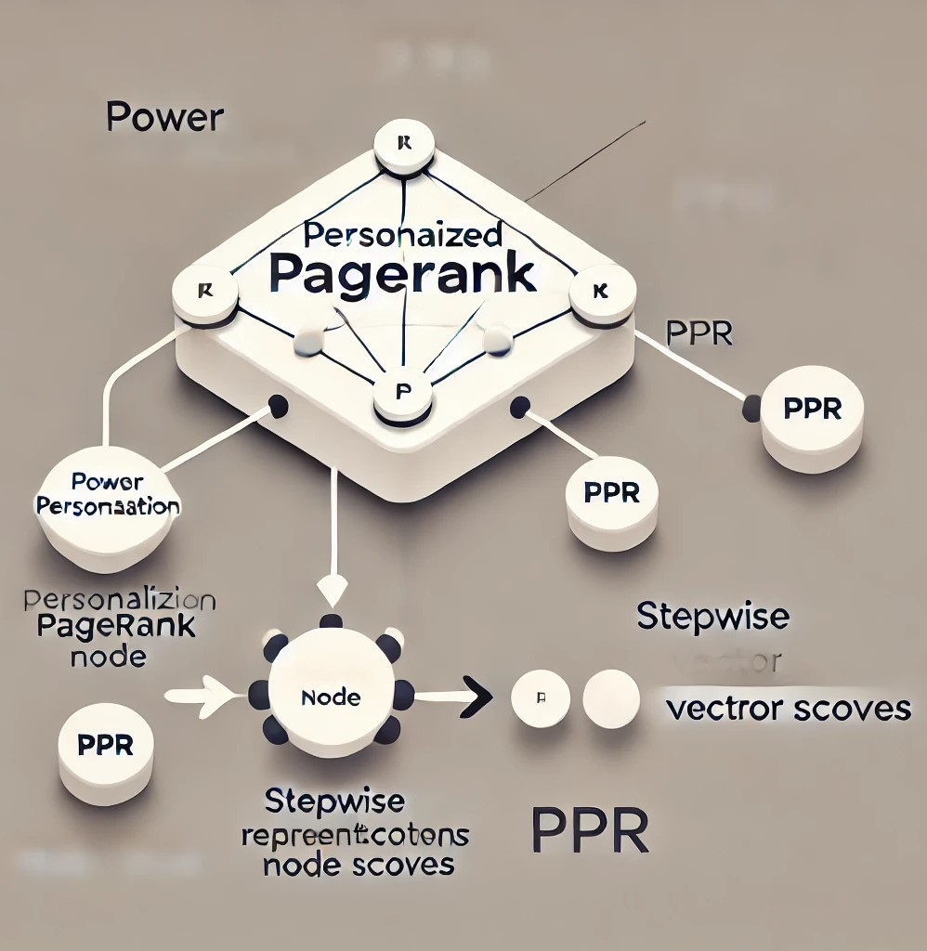
Power Iteration for Personalized PageRank (PPR)
Power Iteration is an iterative approach to calculate the PPR vector.
It begins with an initial vector representing the estimated PPR scores for each node.
At each step, the new vector is obtained by multiplying the transition matrix by the current vector and adding a personalization component.
The algorithm continues iterating until the values in the PPR vector stabilize (converge) within a defined threshold.

Slide 11


Power Iteration for Personalized PageRank (PPR)
Start
Input Graph and Parameters: G, α, ε, and e
Iteration Update:
  Let A be the transition matrix representing the graph, where A_ij is the probability of moving from node i to node j.
  The PPR vector at iteration k+1 is updated as:
Where :
  α is the damping factor or teleport probability (commonly 0.15).
  e is the personalization vector, often with uniform values (indicating an equal probability of restarting from any node).
  π_k represents the current PPR values.
Convergence:
  Iteration continues until the difference between π_k+1 and π_k is below a threshold (ε), often using the L1 norm to measure this difference:
Initialize PPR
Vector: π_0 with uniform values
Compute Transition Matrix A:
A_ij is the prob. of moving from node i to j
Iteration Update:
Compute π_k+1 = αe +(1 - α) A π_k
Convergence Check: Is |π_k+1 - π_k|_1 < ε?
Yes
No
Output Results: Final PPR Vector
END

Slide 12
Power Iteration for Personalized PageRank (PPR)
Efficiency:
  Simple and easy to implement, as it only involves repeated multiplications of the current vector by the transition matrix.
  Suitable for dense graphs with relatively fewer nodes.
Challenges:
  It is computationally intensive, particularly for large graphs, because each iteration involves a complete multiplication of the transition matrix.
  The convergence rate can be slow, which means that many iterations might be required, especially for large or complex graphs.
Time Complexity:
  The time complexity is generally O(n*m), where n is the number of nodes and m is the number of edges, due to matrix-vector multiplication.

Slide 13
Push-Based Techniques for Personalized PageRank (PPR)
Push-Based Techniques work by maintaining two components for each node: reserve (π_b(v)) and residue (r_b(v)).
The reserve tracks the accumulated PPR value, while the residue represents the probability mass left to be distributed.
The algorithm pushes the residue outwards from each node to its neighbors, distributing its mass and updating the reserve of connected nodes.
The process continues until the residue is below a threshold (ε).

Slide 14


Push-Based Techniques for Personalized PageRank (PPR)
Initialize r_b(t) = 1, π_b(t) = 0 for target t
Residue and Reserve Update:
  Initially, for each target node t, the residue r_b(t) is set to 1 and the reserve π_b(t) to 0.
Push Operation:
  A fraction α is added to the reserve
  The remainder (1 - α) is distributed to neighbors
  After the push, r_b(v) is set to 0
Termination Condition:
  The process continues until the residue for each node falls below the specified threshold (ε), ensuring that the computation has sufficiently converged.
Yes
Check r_b(v) for all nodes: is it < ε?
No
Terminate (If yes, π_b is final PPR vector)
Perform Push
π_b(v) += α * r_b(v)
r_b(u) += (1 - α) * r_b(v) / |N(v)|
Set r_b(v) = 0
Go Back to check if r_b(v)<ε

Slide 15
Push-Based Techniques for Personalized PageRank (PPR)
Efficiency:
  Localized Computation: Push-based techniques allow for efficient computation focused on a subset of nodes, which is useful for applications that require local analysis or quick single-node queries.
  Effective for dynamic graph updates, as the residue can quickly adapt to small changes without recalculating from scratch.
Time Complexity:
  The complexity depends on the graph structure and the number of nodes processed.
  For nodes where computation is needed, push-based methods often achieve sublinear time complexity, particularly for single-node PPR calculations on sparse graphs.
Scalability:
  Works well on sparse and large graphs because it focuses computational effort only on nodes that contribute significantly to the PPR value.
  However, it requires careful residue management to avoid excessive propagation, which can lead to inefficiency in some graph structures.

Slide 16
SetPush: Extension of Push-Based Techniques
SetPush is a hybrid extension of traditional push-based techniques. It builds on the concept of push operations that propagate values from specific nodes to neighbors but introduces additional randomization to enhance computational efficiency for single-node PageRank computation.
SetPush retains the residue and reserve value mechanism from traditional push-based methods:
  Residue represents the amount of value that still needs to be distributed.
  Reserve represents the accumulated PageRank value.
The algorithm is specifically designed for single-node computations, meaning it targets the Personalized PageRank for one node without calculating it for the entire graph.
Backward Push with Randomized Sampling: SetPush employs backward push operations to incrementally distribute values while using Monte Carlo sampling to handle high-degree nodes more efficiently, making it a powerful approach for dense graphs.

Slide 17


SetPush: Extension of Push-Based Techniques
Initialize residue r(v) and reserve π(v):
- r(v) = 1 for target node, 0 for others
- π(v) = 0 for all nodes
Initialization:
  Residue and Reserve: For each node v, SetPush maintains:A residue (r(v)), initially set to 1 for the target node and 0 for all other nodes.
  A reserve (π(v)), initially 0 for all nodes.
Push Operation:
  During each iteration, a fraction α of the residue at node v is added to the reserve
  The remaining (1 - α) of the residue is distributed among node v's neighbors
This process continues until the residue values fall below a predefined threshold (ε).
Yes
Check r(v) for all nodes: is r(v) < ε?
No
Terminate (If yes, π(v) is final PPR vector)
Perform Push
π(v) += α * r(v)
r(u) += (1 - α) * r(v) / |N(v)| for each neighbor u Set r(v) = 0
Repeat until r(v) < ε for all nodes

Slide 18

SetPush: Extension of Push-Based Techniques
Efficiency and Scalability:
  Single-Node Focus: Unlike traditional push-based techniques that may be used to calculate PPR for multiple nodes, SetPush targets individual nodes, significantly reducing the computation required.
  Hybrid Approach: The combination of deterministic push and randomized sampling provides a balanced approach that is both efficient and scalable, especially for dense graphs or graphs with many nodes and edges.
  Localized Computation: By focusing on local neighborhoods around the target node and leveraging residue propagation, SetPush ensures that the computation remains localized, which is particularly useful for graphs with changing structures.
Time Complexity:
  The time complexity of SetPush is:
    Where d_t is the degree of the target node, and m is the number of edges in the graph.
  This complexity means SetPush can operate efficiently even in high-degree or large graphs, providing faster single-node computation compared to full graph traversal methods.

Slide 19
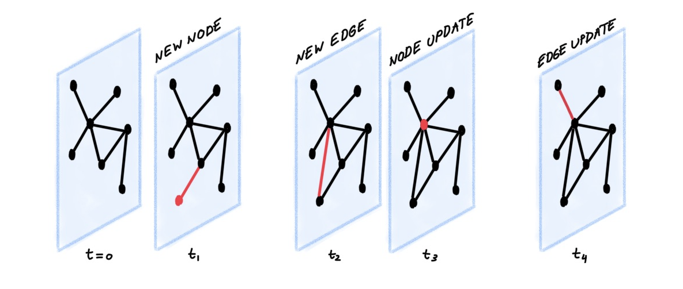
Dynamic Graph Handling:
Dynamic graph handling refers to the ability of an algorithm to efficiently adapt to changes in the graph structure, such as adding or removing nodes or edges. This is crucial in many real-world applications where graphs are constantly evolving.
In real-world applications like social networks or recommendation systems, the underlying graph can change frequently due to user interactions, content updates, or new connections. Efficient dynamic graph handling ensures that computations, such as Personalized PageRank, remain up-to-date without recalculating everything from scratch, saving both time and computational resources.
Constant updates to nodes and edges make recalculating PPR from scratch computationally expensive. Efficient handling of these updates is crucial for real-time applications.

Slide 20
Method | Uses Cases | Computation Time | Accuracy | Suitability | Advantages | Challenges
Monte Carlo Sampling | 1.Recommendation systems 2.Social network analysis | Fast for large graphs, high variance | Approximate, varies with sample size | Large-scale, approximate results | 1.Quick approximations for large graphs 2.Handles dynamic changes efficiently by adjusting random walks locally | 1.Accuracy depends on the number of samples 2.May not converge to exact values in limited time
Power Iteration | 1.Web search ranking 2.Applications requiring high accuracy | High computational cost, accurate | Highly accurate | High-precision applications | High accuracy for static graphs | 1.Computationally expensive for large graphs 2.Not suitable for dynamic graphs with frequent updates
Push-Based Techniques | 1.Personalized search 2.Dynamic updates in recommendation systems | Efficient for localized computations | Moderate | Localized or dynamic graphs | 1.Efficient for localized computations 2.Propagates changes locally in dynamic graphs | Less efficient for full-graph computations
SetPush | 1.Personalized PageRank 2.Applications like personalized recommendations and local clusterin | Lower time complexity | Comparable to best existing methods | Undirected graphs, clustering, GNNs | 1.Efficient for high-degree nodes 2.Focuses on incremental updates for dynamic graphs | Limited to specific use cases requiring localized updates

Slide 21
Key Takeaways Personalized PageRank (PPR) Essentials:
PPR extends the traditional PageRank algorithm to focus on specific nodes, enabling personalized search and recommendation systems. Practical applications include web search, recommendation engines, and network analysis.
Challenges in PPR Computation: PPR is computationally expensive for large-scale graphs with millions of nodes and edges. Handling dynamic graphs requires efficient updates to avoid re-computation.
Techniques Explored: Monte Carlo Sampling: Provides efficient approximations by focusing on local neighborhoods. Power Iteration: Effective for dense graphs but computationally intensive for large-scale applications.
Push-Based Methods: Ideal for sparse graphs with scalability for single-node PPR computation.
SetPush: A hybrid approach that combines deterministic and randomized techniques for improved efficiency.
Dynamic Graph Adaptability: Efficiently handles graph updates, making these methods suitable for real-time applications in dynamic systems like social networks and online platforms.
Scalability and Efficiency: The methods discussed focus on balancing computational cost with accuracy, ensuring feasibility for both large-scale and dynamic graph scenarios.

Slide 22
Personalized PageRank demonstrates its utility across multiple domains such as recommendation systems, network analysis, and personalized search. Its adaptability to user-defined preferences makes it a robust framework for solving graph-based problems.
By optimizing PPR computation, the techniques discussed enhance the scalability and efficiency of personalized graph analytics, making real-time applications feasible even for massive datasets.
CONCLUSION

Slide 23
THANK YOU

