Slide 1
Advanced Graph Neural Networks for Financial Crime Detection: Uncovering Individual and Organized Fraud Patterns
By:
Niveda Giridharan
Rique Rio Orozco
Likhith Kumar Yaramala

Slide 2
Paper Introduction: Anti-Money Laundering by Group-Aware Deep Graph Learning
The detection of suspicious money laundering activities is a crucial task for financial institutions to prevent fraud and abide by regulation requirements. In this paper, the authors propose a Group-Aware Graph Neural Network (GAGNN) approach for detecting organized money laundering activities. This approach dives into the power of deep graph learning techniques, through the usage of community-centric encoders and group representation layers, to effectively model the behaviors typical of money laundering schemes. The paper and its model aim to improve detection accuracy for both individual suspicious transactions and organized criminal groups who may be engaging in money laundering.

Slide 3
Paper Introduction: Mutual Information based Dual Level GNN for Transaction Fraud Complaint Verification
MIDLG (Mutual Invariant Dual-level Graph Learning) is an approach introduced in this paper, it’s designed to address the problem of complaint verification in the context of transaction fraud when it comes to financial issues. As online platforms and financial services grow, handling fraud complaints efficiently and accurately has become challenging. Current systems struggle with two main issues: individual entities may appear under multiple identities across complaints and fraud schemes constantly evolve, making it difficult for models to generalize correctly. MIDLG is meant to overcome these challenges by using a dual-level graph neural network (GNN) and leverage advanced techniques such as Invariant Risk Minimization and adversarial forgetting. These innovations help the model achieve a more stable performance across shifting data distributions, ensuring better handling of evolving fraud patterns.

Slide 4
Problem Statement
Both papers focus on detecting complex financial fraud using graph neural networks (GNNs). One targets organized money laundering by identifying group-level behaviors, while the other verifies fraudulent complaints by capturing identity-related patterns. Together, they emphasize the need for scalable GNN models to detect both individual and group fraud across diverse financial systems.

Slide 5
Motivation
The money intended for the growth and stability of nations is often lost to laundering and fraud, affecting honest citizens and undermining economic progress. By addressing even a portion of these activities, advanced detection methods can drive a positive change, strengthening financial security and public trust.

Slide 6
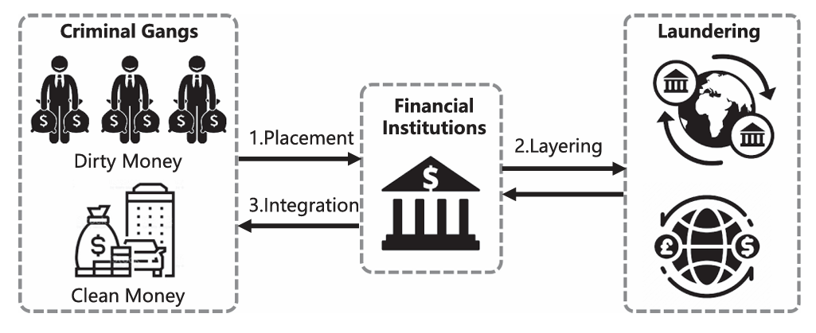
Deep Dive: Anti-Money Laundering by Group-Aware Deep Graph Learning

Slide 7
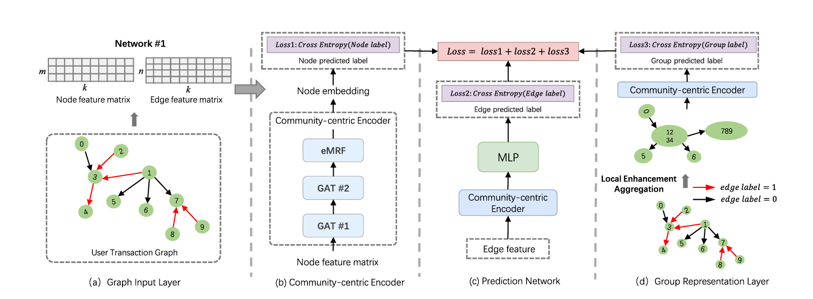
Implementation of Anti-Money Laundering by Group-Aware Deep Graph Learning

Slide 8
Input Layer: Nodes and edges construct the transaction graph
Nodes: Represent individual users
Edges: Represent transactions between users
Node Count (n): Total number of nodes
Edge Count (m): Total number of edges
Features (k): Combined node and edge features matrix

Slide 9
Community-Centric Encoder:
GATs: Learn node embeddings, focusing on relevant neighboring nodes.
eMRF Layer: Applies smoothness constraints for similar community labels.
Groups users with similar patterns based on topological and attribute similarities.
Node embedding with user characteristics and network relationships.

Slide 10
Grouping users with similar suspicious patterns.
Edge Colors:
  Red (1): Suspicious transactions.
  Black (0): Normal transactions.
Example Grouping:
  Suspicious Group: Nodes 4, 3, 2, 1, 7, 8, 9.
  Normal Users: Nodes 0, 5, and 6

Slide 11
Prediction Network Layer: Classifies nodes, edges, and groups.
MLP (Multi-Layer Perceptron): Fully connected network for node classification.
Binary Classification Scores: Each score represents the probability of suspicious activity for a user.

Slide 12
Node Classification: Measures accuracy in classifying users as money launderers; uses cross-entropy to compare predicted probability with actual labels.
Transaction Classification: Evaluates accuracy in classifying transactions as suspicious or legitimate; uses cross-entropy to compare predicted and actual labels, helping the model learn laundering patterns.
Group Detection Loss: Unique to GAGNN, assesses accuracy in identifying groups involved in money laundering; helps detect coordinated actions across accounts.

Slide 13
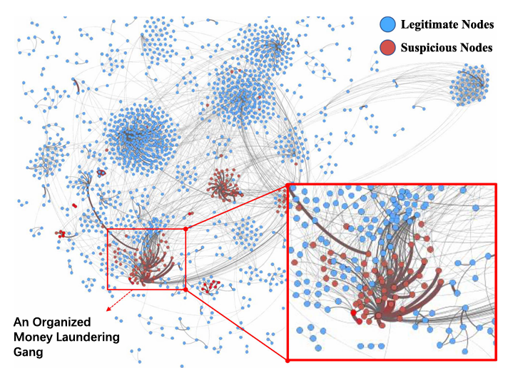

Slide 14
MIDLG (Mutual Information based Dual Level Graph Neural Network)
The frequent terms used in this papers – Nodes, Edges
The model address the challenges of transaction fraud complaint verification. Here are the key methods employed:
Dual Level Propagation Module
  The MIDLG model employs a dual-level graph structure: Individual level and super-node level graph.
This module utilizes message passing between nodes to propagate information across the graph.
  For the individual-level graph, the module would aggregate information from neighboring nodes.
  This aggregated information would then be used to update the node's representation.
  The super-node level would similarly aggregate information from the connected individual-level nodes, learning a representation of the overall fraud way distribution.

Slide 15
Specific fraud Forget Model
This module aims to improve stability by minimizing the mutual information between the model's predictions and specific fraud patterns, preventing overfitting to transient patterns.
  It introduces a discriminator that attempts to classify whether a representation was generated from a real fraud case or a synthetic one.
  By training the model to minimize the discriminator's ability to distinguish between these two types of representations, the module encourages the model to learn more generalizable features that are not overly reliant on specific fraud patterns.

Slide 16
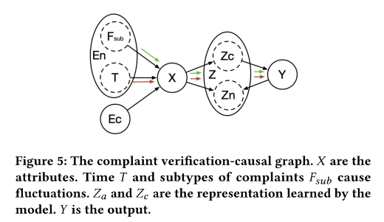

Slide 17
Model Training And optimization
The entire MIDLG model would be trained end-to-end.
The model would be trained to minimize a loss function that measures the difference between the predicted complaint labels (fraudulent or non-fraudulent) and the true labels.
The authors mention using cross-entropy loss for this purpose.
The training process involves iteratively updating the model parameters using an optimization algorithm, such as stochastic gradient descent (SGD), to minimize the loss.

Slide 18
Visualization Analysis of MIDLG Model
Separate Representations for Different Subtypes:
  The key observation is that different fraud subtypes, represented by different colors (yellow triangles), tend to cluster together, forming distinct groups.
  This separation indicates that the model successfully learns to capture unique characteristics associated with each fraud subtype.
Effectiveness of SFFLM:
  The comparison highlights the importance of the SFFLM in achieving better separation between fraud subtypes. Without the SFFLM, the representations are more mixed, making it harder for the model to discriminate effectively.

Slide 19
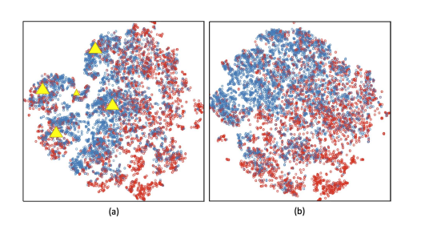

Slide 20
Similarities
Dissimilarities
Layered Network Structure: Both models refine node and edge embeddings; MIDLG uses mutual information, GAGNN uses attention and Markov Fields.
Multi-Level Classification: MIDLG targets node and graph levels; GAGNN classifies nodes, edges, and groups.
Graph Neural Network (GNN) Approach: Both use GNNs to map users and transactions, capturing complex fraud patterns.
Core Methodology:
  GAGNN uses a community-centric approach with GATs and eMRF to create node and group representations, capturing group similarities for detecting coordinated money laundering.
  MIDLG leverages mutual information (MI) for feature selection, reducing noise and improving accuracy in fraud detection by focusing on relevant data.
Levels of Representation:
  GAGNN operates on node, edge, and group levels, using a group layer to detect organized money laundering rings.
  MIDLG employs dual-level representation, with node-level embeddings for local details and graph-level embeddings for a global view, suited for general fraud detection.
Loss Optimization Strategy:
  GAGNN optimizes three loss functions (node, transaction, and group) to improve detection across users, transactions, and groups.
  MIDLG uses a mutual information loss function to guide feature selection, enhancing focus on informative features, primarily for accuracy in high-dimensional data.

Slide 21
Our Key Insights
Graph Neural Networks (GNNs) are Powerful for Financial Crime Detection:
  Both models demonstrate how GNNs capture complex relationships, making them effective for detecting hidden patterns in transaction networks.
Different Approaches for Different Types of Financial Crimes:
  GAGNN focuses on organized money laundering by identifying group behaviors.
  MIDLG, targets general fraud with noise reduction and feature selection, useful for high-dimensional data.
Multi-Level Detection Enhances Model Robustness:
  Both use multi-level representations to improve accuracy. GAGNN adds group analysis for coordinated crimes, while MIDLG focuses on node and graph levels for isolated fraud detection.
Importance of Feature Selection and Noise Reduction:
  MIDLG uses mutual information for relevant feature selection in noisy datasets.
  GAGNN applies community-centric encoders and Markov Fields for smooth, group-level analysis..
Future Potential in Financial Crime Prevention:
  Both models highlight AI’s potential to improve anti-fraud efforts, supporting proactive and sophisticated financial crime prevention.

Slide 22
Conclusion
In conclusion, both GAGNN and MIDLG showcase the power of graph neural networks in detecting financial crimes, each tailored to different types of fraud detection. GAGNN excels in identifying organized money laundering by focusing on group behaviors, while MIDLG enhances general fraud detection through noise reduction and feature selection. Together, these models provide a comprehensive approach to tackling complex, evolving financial crime.

Slide 23
Thank you

