Slide 1
CAP5778
Advanced Data Mining
Data Streams
Peixiang Zhao
Florida State university
Part of the course materials are adapted or revised from Mining of Massive Datasets (mmds.org)

Slide 2
Infinite Data
High dim. data
Locality sensitive hashing
Clustering
Graph
data
PageRank, SimRank
Network Analysis
Infinite
data
Filtering data streams
Web advertising
Dimensionality reduction
Spam Detection
Queries on streams
Machine learning
SVM
Decision Trees
Perceptron, kNN
Apps
Recommender systems
Association Rules
Duplicate document detection

Slide 3
Data Streams
In many data mining situations, we do not know the entire data set in advance
Stream Management is important when the input rate is controlled externally. For instance,
  Google queries
  Twitter or Facebook status updates
We can think of the data as infinite and non-stationary (the distribution changes over time)

Slide 4
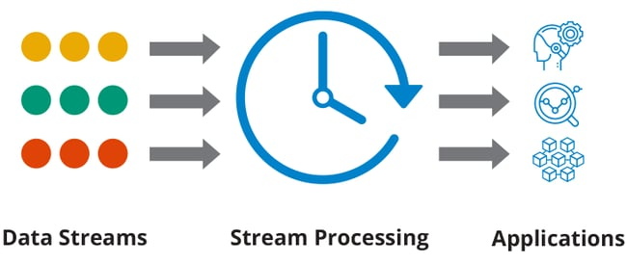
The Data Stream Model
Input elements enter at a rapid rate, at one or more input ports (i.e., streams)
The system cannot store the entire stream accessibly!
  Typically, one-scan, sketch-based solutions
Research Question:
  How do you make critical calculations about the stream using a limited amount of (secondary) memory?

Slide 5
The Data Stream Model
Ad-Hoc Queries
Processor
. . . 1, 5, 2, 7, 0, 9, 3
. . . a, r, v, t, y, h, b
. . . 0, 0, 1, 0, 1, 1, 0
time
Each stream is
composed of
elements/tuples
Standing
Queries
Output
Limited
Working
Storage
Archival
Storage

Slide 6
Problems on Data Streams
Types of operations one wants to perform on a data stream
  Filtering a data stream
    Select elements with property x from the stream
  Counting distinct elements
    Number of distinct elements (in the last k elements) of the stream
  Sampling data from a stream
    Construct a random sample
  Queries over sliding windows
    Number of items of type x in the last k elements of the stream

Slide 7
Applications
Mining query streams
  Google wants to know what queries are more frequent today than yesterday
Mining click streams
  Amazon wants to know which of its pages are getting an unusual number of hits in the past hour
Mining social network news feeds
  Looking for trending topics on Twitter, Facebook
IP packets monitored at a switch
  Gather information for optimal routing
  Detect denial-of-service attacks

Slide 8
Filtering Data Streams: Definition
Each element of data stream is a tuple
Given a list of keys S
Determine which tuples of stream are in S
  Membership query: e ∈ S or not
Baseline solution: Hash table
  But suppose we do not have enough memory to store all of S in a hash table
    E.g., we might be processing millions of filters on the same stream

Slide 9
Applications
Email spam filtering
  We know 1 billion “good” email addresses
  If an email comes from one of these, it is NOT spam
Publish-subscribe systems
  You are collecting lots of messages (news articles)
  People express interest in certain sets of keywords
  Determine whether each message matches user’s interest

Slide 10
First Cut Solution
Input: given a set of keys S that we want to filter
Algorithm
  Create a bit array B of n bits, initially all 0’s
  Choose a hash function h with range [0,n)
  Insertion: Hash each member of s∈ S to one of n buckets, and set that bit to 1:
    B[h(s)]=1
  (Online step) Hash each element a of the stream and output only those that hash to bit that was set to 1
Output a if B[h(a)] == 1

Slide 11
First Cut Solution
Filter
Output the element since it MAY be in S.
Item hashes to a bucket that at least
one of the elements in S hashed to.
Element
Hash
function h
001000101001000000100110000000010010100
Bit array B
Drop the element:
It hashes to a bucket set to 0 so it is surely NOT in S
Creates false positives but NO false negatives
  If the element is in S we surely output it, if not we may still output it

Slide 12
First Cut Solution
Example:
  S = 1 billion email addresses
  |B|= 1GB = 8 billion bits
  If the email address is in S, then it surely hashes to a bucket that has the bit set to 1, so it always gets through (NO false negatives)
  Approximately 1/8 of the bits are set to 1, so about 1/8th of the addresses NOT in S get through to the output (false positives)
    Actually, less than 1/8th, because more than one address might hash to the same bit

Slide 13

Analysis
More accurate analysis for the number of false positives
  How likely we will make mistakes?
Consider If we throw m darts into n equally likely targets, what is the probability that a target gets at least one dart?
  In our case:
    Targets = bits/buckets
    Darts = hash values of elements

Slide 14
Analysis
We have m darts, n targets
What is the probability that a target gets at least one dart?
Equals 1/e
as n →∞
Equivalent
n(
m
/ n)
1 -
(1 – 1/n)
1 – e^{–m/n}
Probability some
target X not hit
by a dart
Probability at
least one dart
hits target X

Slide 15
Analysis
Fraction of 1s in the array B =
the probability of false positive = 1 – e^{-m/n}
Example:
  m=10⁹ darts, n=8∙10⁹ targets
  Fraction of 1s in B = 1 – e^{-1/8} = 0.1175
    Compare with our earlier estimate: 1/8 = 0.125

Slide 16
Bloom Filter
Consider: |S| = m, |B| = n
Idea: Use k independent hash functions h₁ ,…, h_{k}
Initialization:
  Set B to all 0s
  Hash each element s∈ S using each hash function h_{i}, set B[h_{i}(s)] = 1 (for each i = 1,.., k)
Runtime: When a stream element with key x arrives
  If B[h_{i}(x)] = 1 for all i = 1,..., k then declare that x is in S
    That is, x hashes to a bucket set to 1 for EVERY hash function h_{i}(x)
  Otherwise discard the element x

Slide 17
Bloom Filter - Analysis
What fraction of the bit vector B are 1s?
  Throwing k∙m darts at n targets, so fraction of 1s is (1 – e^{-km/n})
Note we have k independent hash functions and we only let the element x through if ALL k hash element x to a bucket of value 1
  So, the false positive probability = (1 – e^{-km/n})^{k}
When m = 1 billion, n = 8 billion
  k = 1: (1 – e^{-1/8}) = 0.1175
  k = 2: (1 – e^{-1/4})² = 0.0493
  “Optimal” value of k = n/m ln(2)
    k = 8 ln(2) = 5.54 ≈ 6
    Error at k = 6: (1 – e^{-1/6})² = 0.0235
False positive prob.
Number of hash functions, k

Slide 18
Bloom Filter: Wrap-up
Bloom filters guarantee no false negatives, and use limited memory
  Great for pre-processing before more expensive checks
  Candidate generation and (potentially costly) exact verification
Suitable for hardware implementation
  Hash function computations can be parallelized

Slide 19
Counting Distinct Elements
Problem:
  Data stream consists of a collection of elements chosen from a universal set U of size |U|=N
  Maintain a count of the number of distinct elements seen so far
    SELECT COUNT(DISTINCT(*)) FROM Data Stream;
Straightforward approach: Maintain the set of elements seen so far
  Keep a hash table of all the distinct elements seen so far
What if the hash table is larger than the main memory size?
  Estimate #distinct elements in an unbiased way by limiting the prob. of estimation errors

Slide 20
Applications
How many different words are found among the webpages being crawled at a website?
  Usually low or high numbers could indicate artificial pages (spam?)
How many different webpages does each customer request in a week?
How many distinct products have we sold in the last week?

Slide 21
Flajolet-Martin (FM) Algorithm
Pick a hash function h that can map each of the N elements to a sufficiently long bitstring (at least log₂ N bits)
For each stream element a, let r(a) be the number of trailing 0s in h(a)
  r(a) = position of first 1 counting from the right
    h(a) = 12, then 12 is 1100 in binary, so r(a) = 2
    h(a) = 32, then 32 is 100000 in binary, so r(a) = 5
Record R = the maximum r(a) seen
  R = max_{a} r(a), over all the stream elements a seen so far
Estimated number of distinct elements = 2^{R}

Slide 22
Flajolet-Martin (FM) Algorithm
Intuition
  h(a) hashes a with equal prob. to any of N values
  h(a) is a sequence of log₂ N bits, where 2 ^{-r} fraction of all a’s have a tail of r zeros
    About 50% of a’s hash to ***0
    About 25% of a’s hash to **00
    So, if we saw the longest tail of r=2 (i.e., element hash ending *100) then we have probably seen about 4 distinct items so far (Equal prob.!)
  So, it takes to hash about 2^{r} items before we see one with zero-suffix of length r

Slide 23
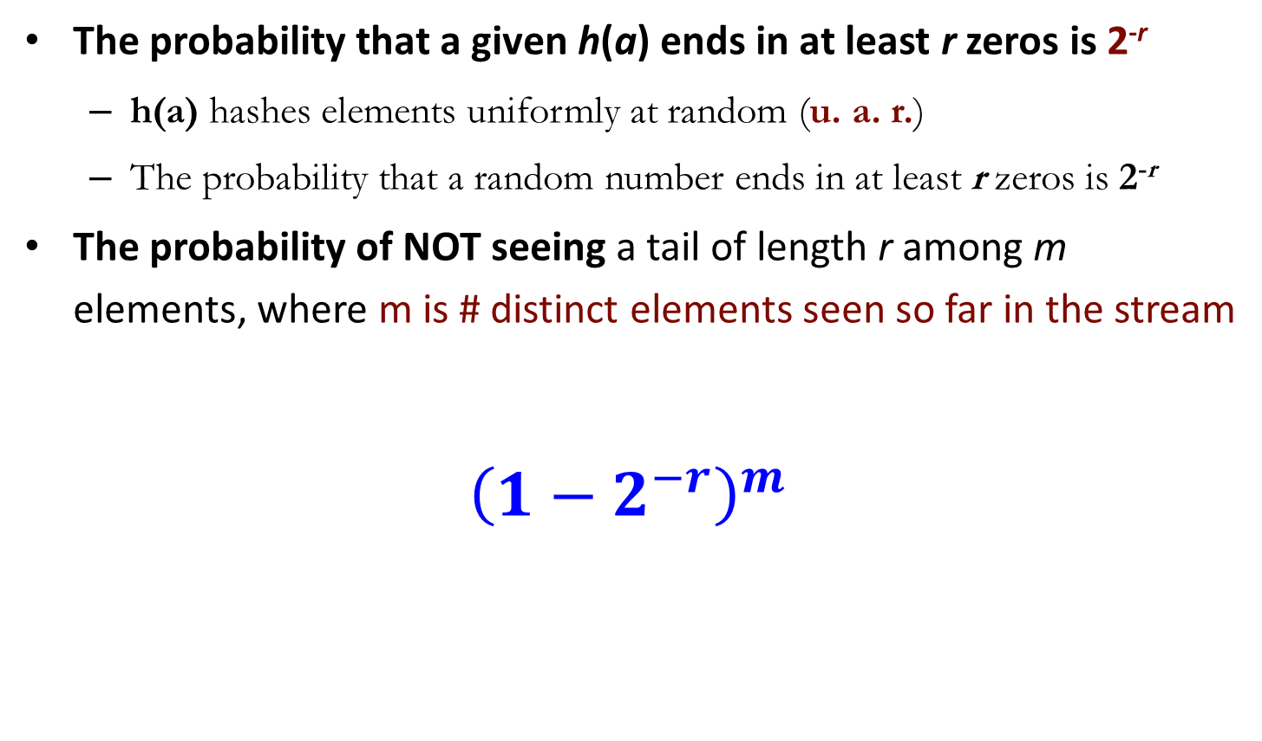
Analysis
The probability that a given h(a) ends in at least r zeros is 2^{-r}
  h(a) hashes elements uniformly at random (u. a. r.)
  The probability that a random number ends in at least r zeros is 2^{-r}
The probability of NOT seeing a tail of length r among m elements, where m is # distinct elements seen so far in the stream
$${\left(1−2^{−r}\right)}^{m}$$
Prob. all end in
fewer than r zeros.
Prob. that given h(a) ends in fewer than r zeros

Slide 24
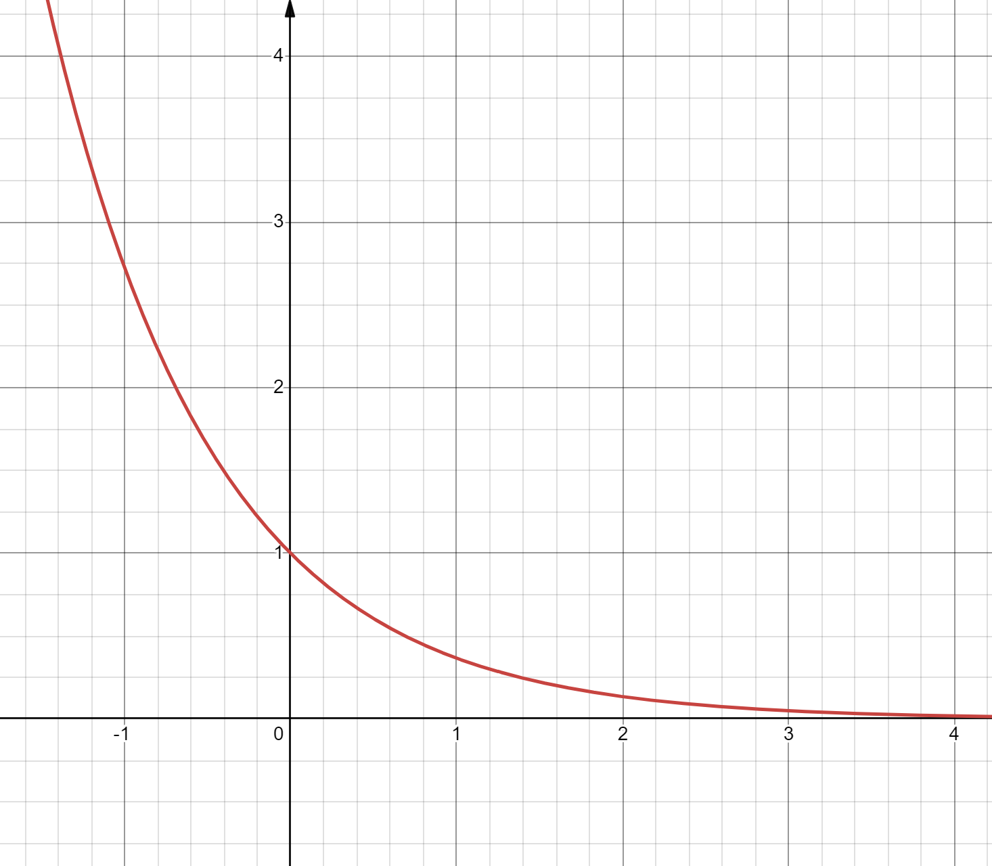

Analysis
Note:
Prob. of NOT finding a tail of length r is:
  If m << 2 ^{r}, then the prob. tends to 1
    as m/2^{r}→ 0
    So, the probability of finding a tail of length r tends to 0
  If m >> 2 ^{r}, then the prob. tends to 0
    as m/2^{r} → ∞
    So, the probability of finding a tail of length r tends to 1
Thus, 2^{R} will almost always be around m
$${y= e}^{−x}$$

Slide 25
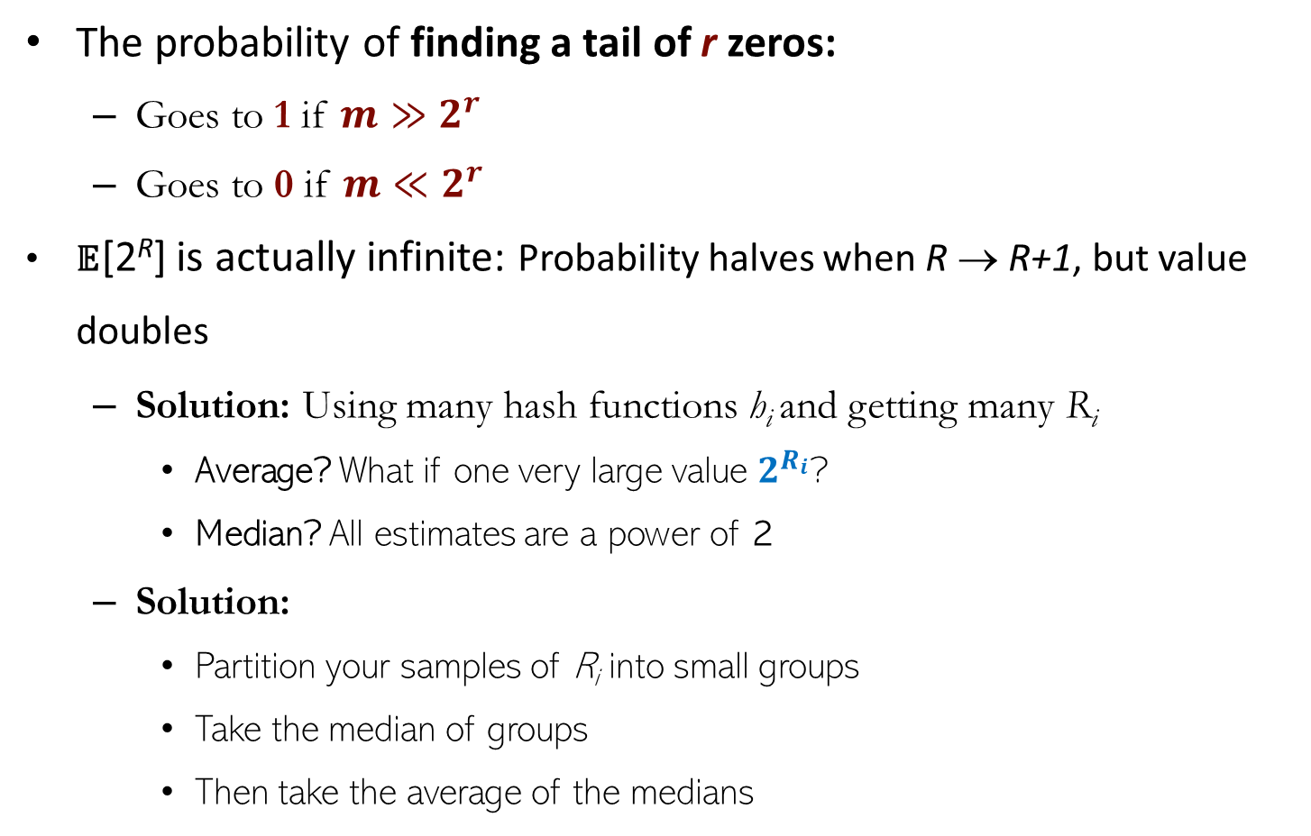
Flajolet-Martin (FM) Algorithm
The probability of finding a tail of r zeros:
  Goes to 1 if $m≫2^{r}$
  Goes to 0 if $m≪2^{r}$
𝔼[2^{R}] is actually infinite: Probability halves when R → R+1, but value doubles
  Solution: Using many hash functions h_{i} and getting many R_{i}
    Average? What if one very large value $2^{R_{i}}$?
    Median? All estimates are a power of 2
  Solution:
    Partition your samples of R_{i} into small groups
    Take the median of groups
    Then take the average of the medians
2^{R} will almost always be around m

Slide 26
Sampling From a Data Stream
Since we cannot store the entire stream, one obvious approach is to store a sample
Two different sampling methods:
  Sample a fixed proportion of elements in the stream (say 1 out of 10)
  Maintain a random sample of fixed size over a potentially infinite stream
    At any time, we would like a random sample of s elements
    For all time-steps k, each of k elements seen so far has equal prob. of being sampled

Slide 27
Sampling a Fixed-size Sample
Suppose we need to maintain a random sample S of size exactly s tuples
  For instance, the main memory size constraint
  Why? We don’t know the length of the data stream in advance
Suppose at time n we have seen n items
  Each item is in the sample S with equal prob. s/n
  For example, s = 2 and the stream: a x c y z k c d e g…
    when n= 7, each of the first 7 tuples is included in the sample S with equal prob.
Impractical solution would be to store all the n tuples seen
so far and out of them pick s at random

Slide 28
Solution: Fixed Size Sample
Reservoir Sampling Algorithm
  Store all the first s elements of the stream to S
  Suppose we have seen n-1 elements, and now n^{th} element arrives (n > s)
    With probability s/n, keep the n^{th} element, else discard it
    If we picked the n^{th} element, then it replaces one of the s elements in the sample S, picked uniformly at random (u. a. r.)
Claim: This algorithm maintains a sample S with the desired property
  After n elements, the sample contains each element seen so far with probability s/n

Slide 29
Why Is It Correct?
Proof by induction
  Assume that after n elements, the sample contains each element seen so far with probability s/n
  Goal: We need to show that after seeing element n+1 the sample maintains the property
    Sample contains each element seen so far with probability s/(n+1)
Base case:
  After we see n=s elements the sample S has the desired property
    Each out of n=s elements is in the sample with probability s/s = 1

Slide 30
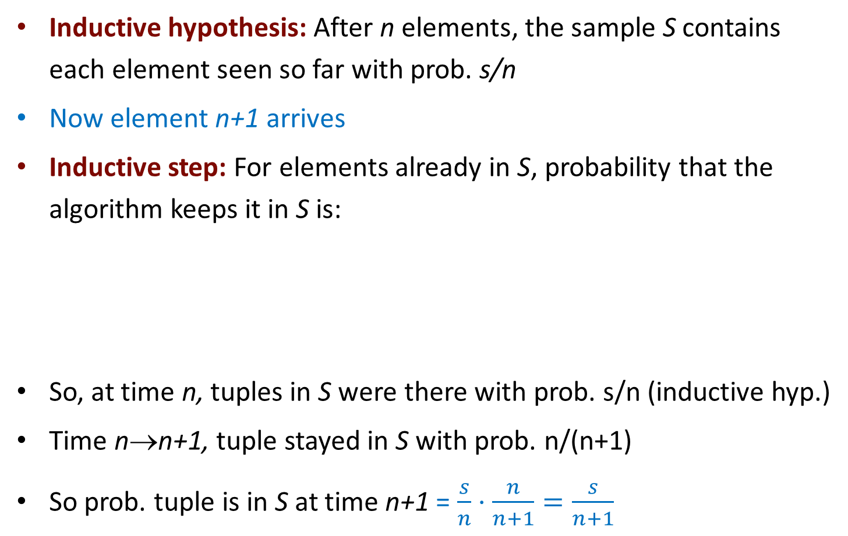
Why Is It Correct?
Inductive hypothesis: After n elements, the sample S contains each element seen so far with prob. s/n
Now element n+1 arrives
Inductive step: For elements already in S, probability that the algorithm keeps it in S is:
So, at time n, tuples in S were there with prob. s/n (inductive hyp.)
Time n→n+1, tuple stayed in S with prob. n/(n+1)
So prob. tuple is in S at time n+1 = $\frac{s}{n}⋅\frac{n}{n+1}=\frac{s}{n+1}$
Element n+1 discarded
Element n+1
not discarded
Element in the
sample not picked

Slide 31

Thank you

