Slide 1
CAP5778
Advanced Data Mining
Finding Similar Items
Peixiang Zhao
Florida State university
Part of the course materials are adapted or revised from Mining of Massive Datasets (mmds.org)

Slide 2
High Dimensional Data
High dim. data
Locality sensitive hashing
Clustering
Graph
data
PageRank, SimRank
Network Analysis
Infinite
data
Filtering data streams
Web advertising
Dimensionality reduction
Spam Detection
Queries on streams
Machine learning
SVM
Decision Trees
Perceptron, kNN
Apps
Recommender systems
Association Rules
Duplicate document detection

Slide 3
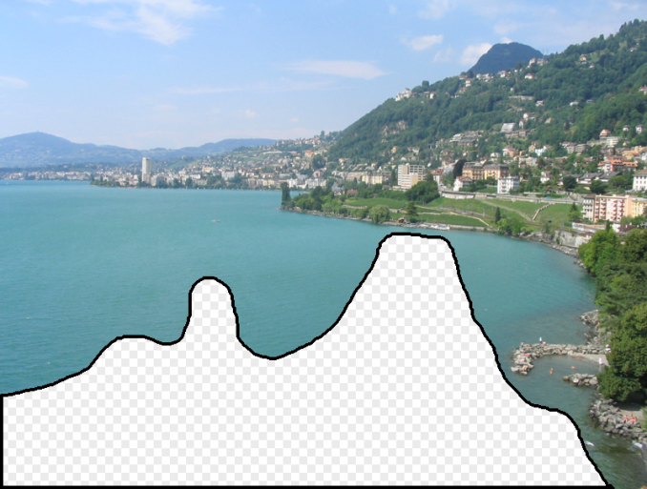

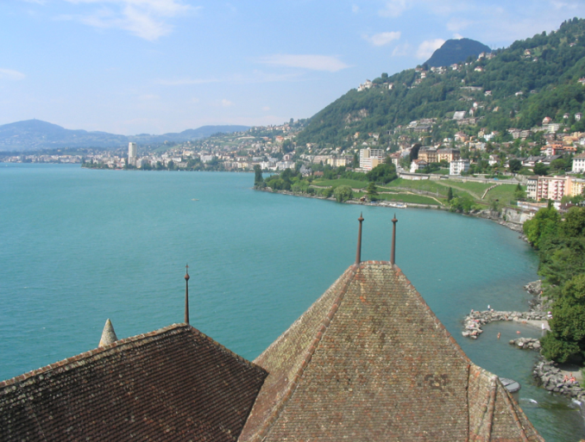
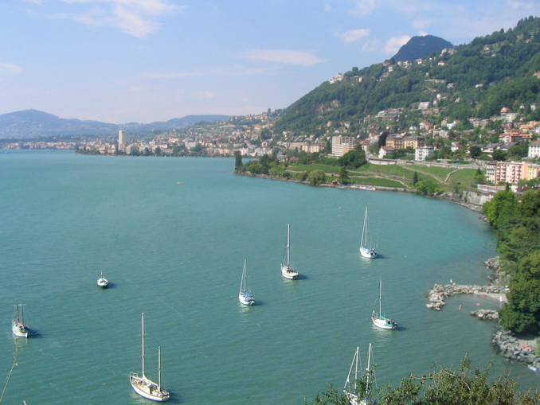
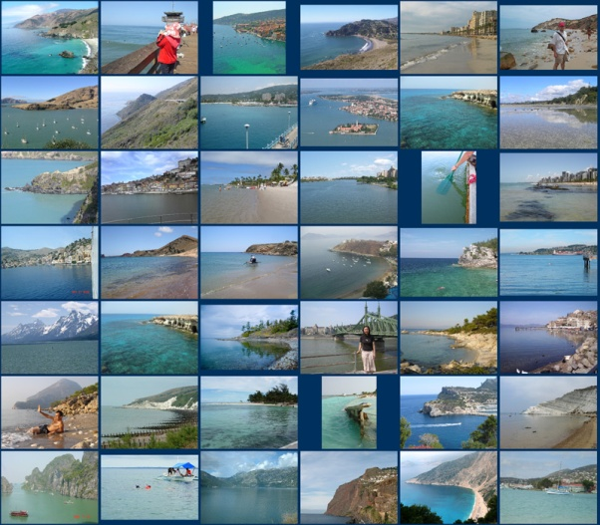
Scene Completion Problem

Slide 4
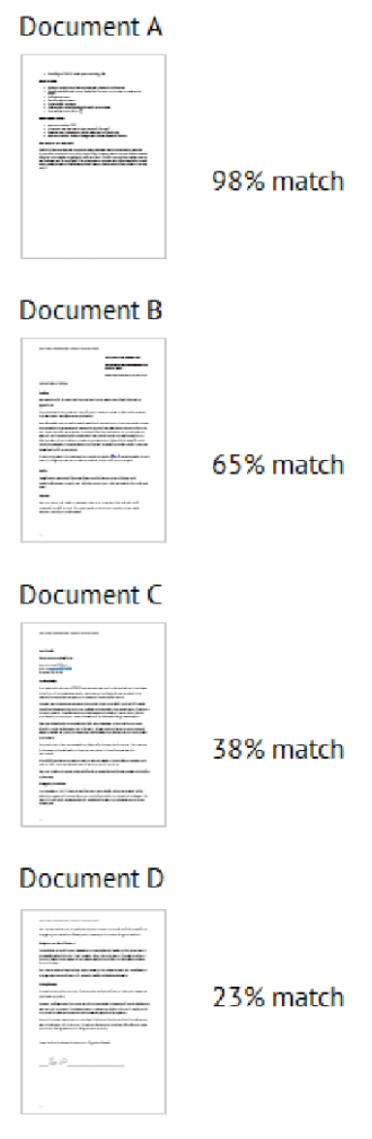
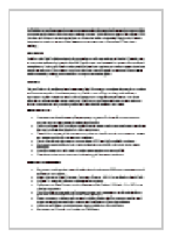
Document Similarity Search
Reference Document
as a query

Slide 5
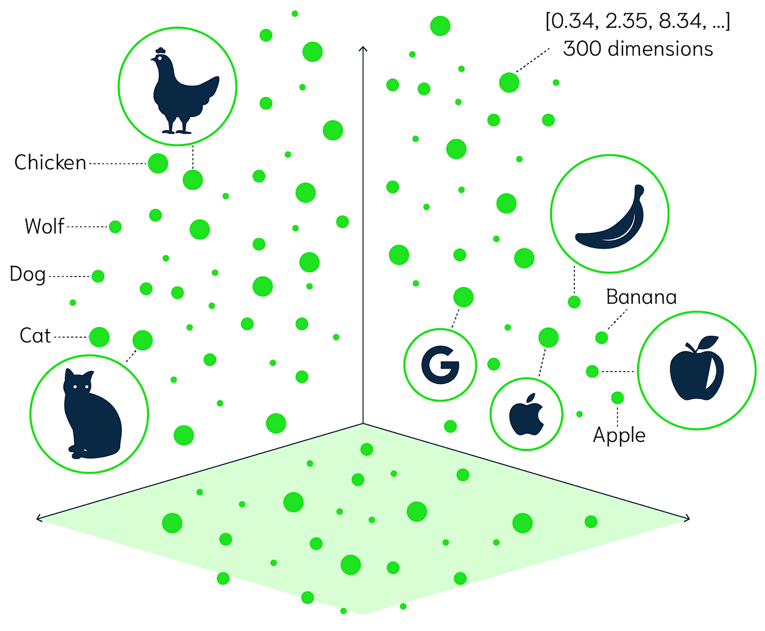
Vector Similarity Search

Slide 6
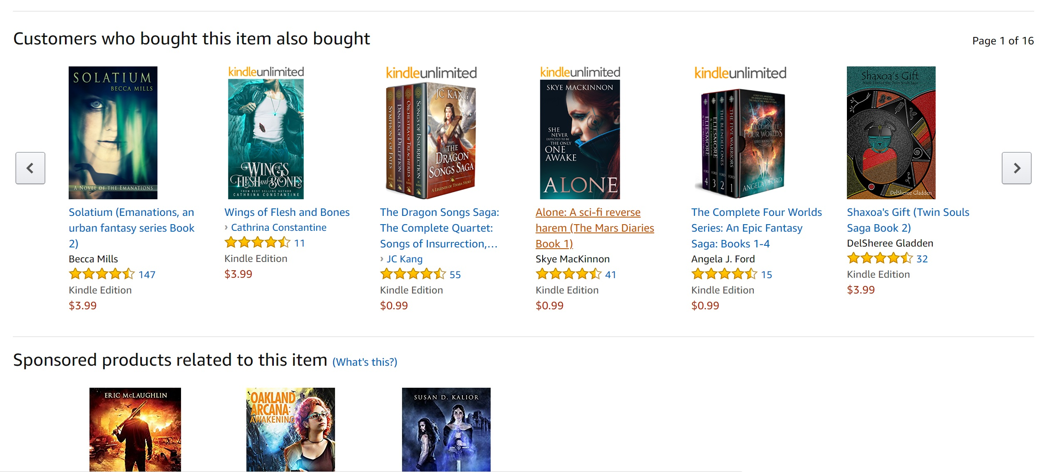
Recommendation

Slide 7
A Common Metaphor
Many problems can be expressed as finding “similar” sets:
  Find near-neighbors in high-dimensional space
Examples
  Pages with similar words
    For duplicate detection, classification by topic
  Customers who purchased similar products
    Products with similar customer sets
  Images with similar features
    Users who visited similar websites

Slide 8
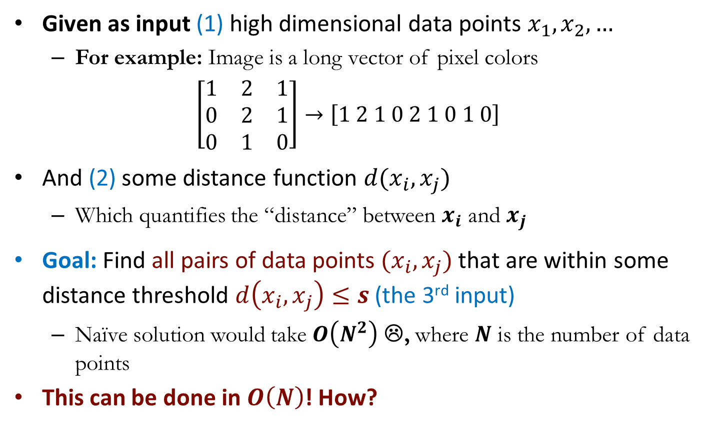
Problem Definition
Given as input (1) high dimensional data points $x_{1}, x_{2}, …$
  For example: Image is a long vector of pixel colors
  $$\left[\begin{matrix}1 & 2 & 1 \\ 0 & 2 & 1 \\ 0 & 1 & 0\end{matrix}\right]→\left[1 2 1 0 2 1 0 1 0\right]$$
And (2) some distance function $d(x_{i},x_{j})$
  Which quantifies the “distance” between $x_{i}$ and $x_{j}$
Goal: Find all pairs of data points $(x_{i},x_{j})$ that are within some distance threshold $d\left(x_{i},x_{j}\right)≤s$ (the 3rd input)
  Naïve solution would take $O\left(N^{2}\right)$ ☹, where $N$ is the number of data points
This can be done in $O\left(N\right)$! How?

Slide 9
Distance Measures
  Goal: Find near-neighbors in high-dim. space
  We define “near neighbors” as points that are a “small distance” apart from a given query point
For each application, we start off by defining what “distance” means
Today: Jaccard distance/similarity
  The Jaccard similarity of two sets is the size of their intersection divided by the size of their union:
  sim(C₁, C₂) = |C₁∩C₂|/|C₁∪C₂|
  Jaccard distance: d(C₁, C₂) = 1 - |C₁∩C₂|/|C₁∪C₂|

Slide 10
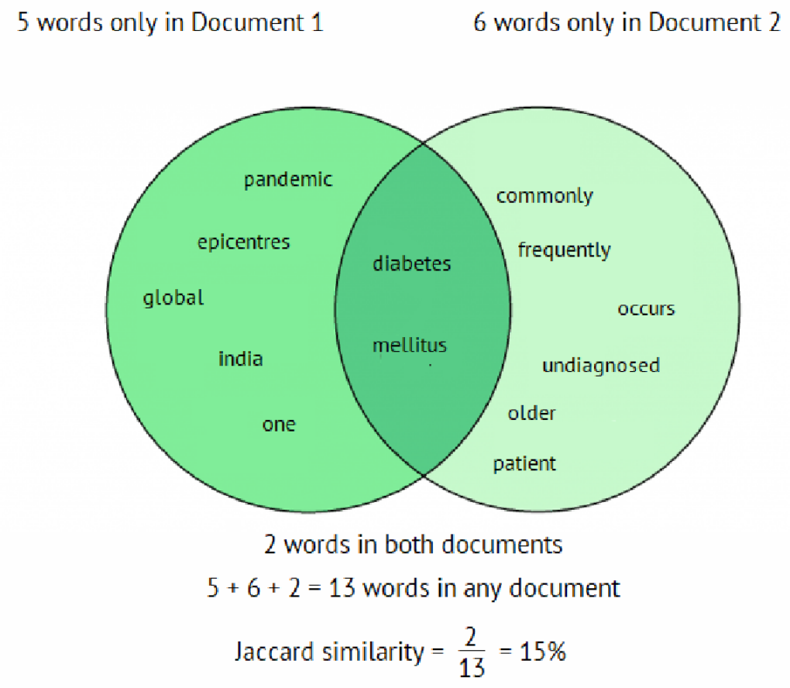
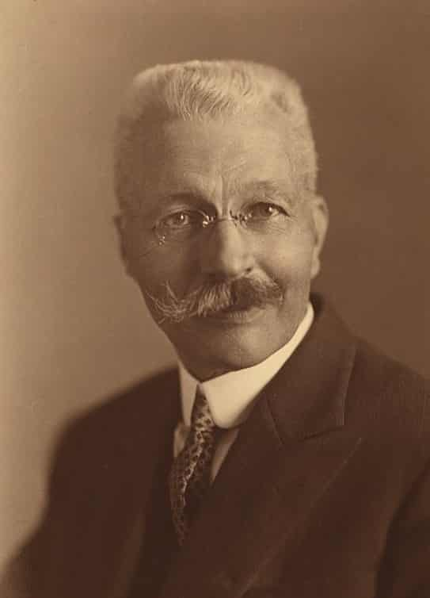
Jaccard Similarity
Paul Jaccard
(1868-1944)

Slide 11
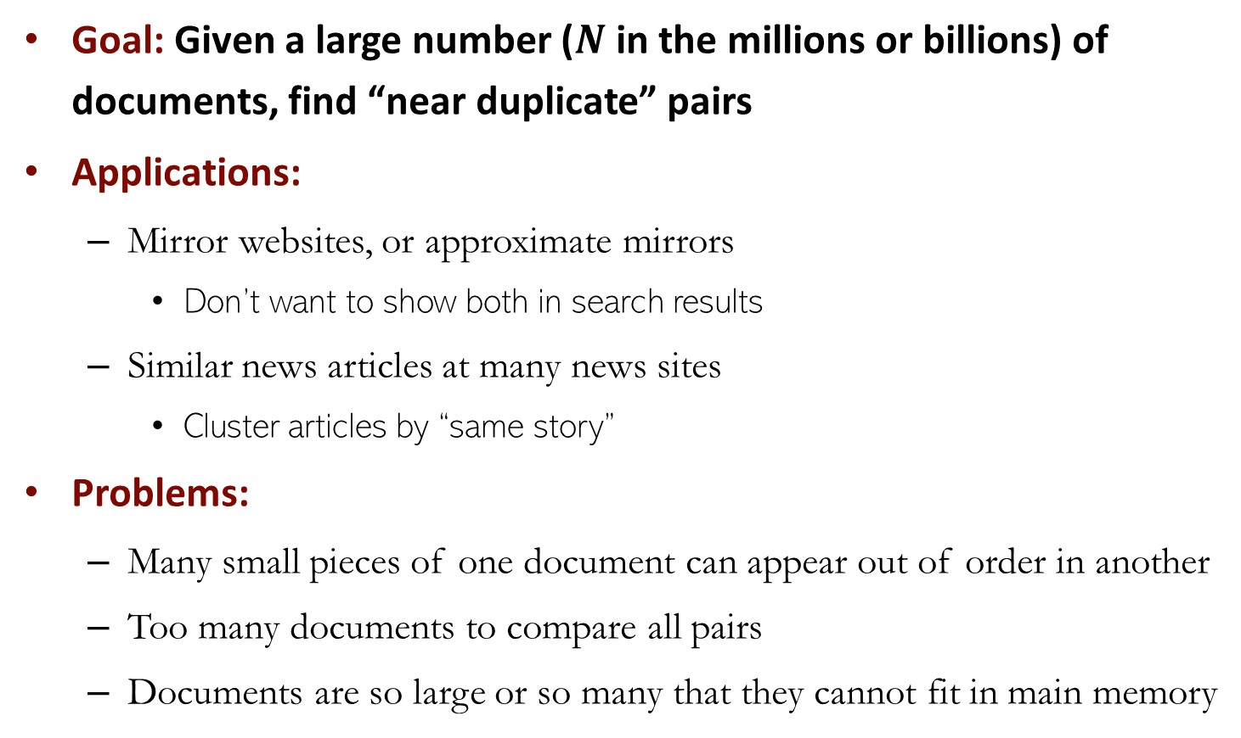
Finding Similar Documents
Goal: Given a large number ($N$ in the millions or billions) of documents, find “near duplicate” pairs
Applications:
  Mirror websites, or approximate mirrors
    Don’t want to show both in search results
  Similar news articles at many news sites
    Cluster articles by “same story”
Problems:
  Many small pieces of one document can appear out of order in another
  Too many documents to compare all pairs
  Documents are so large or so many that they cannot fit in main memory

Slide 12
Three Essential Steps
Shingling: Convert documents to sets
Min-Hashing: Convert large sets to short signatures, while preserving similarity
Locality-Sensitive Hashing: Focus on pairs of signatures likely to be from similar documents
  Candidate pairs

Slide 13
Three Essential Steps
Candidate
pairs:
those pairs
of signatures
that we need
to test for
actual
similarity
Shingling
Min
Hashing
Locality-
Sensitive
Hashing
Docu-
ments
The set
of strings
of length k
that appear
in the doc-
uments
Signatures:
short integer
vectors that
represent the
sets, and
reflect their
similarity

Slide 14
Step 1: Shingling
Shingling: Convert documents to sets
Other naive approaches:
  Document = set of words appearing in documents
  Document = set of “important” words
    Don’t work well for this application. Why?
Need to account for ordering of words!
A different way: Shingles

Slide 15
Shingling
Definition
  A k-shingle (or k-gram) for a document is a sequence of k tokens that appears in the document
    Tokens can be characters, words or something else, depending on the application
    Assume tokens = characters for examples
Example
  When k=2, document D₁ = abcab, the set of 2-shingles: S(D₁) = {ab, bc, ca}
  Option: shingles can be bag (multiset), where the token ab is counted twice S’(D₁) = {ab: 2, bc:1, ca:1}

Slide 16
Shingling: Example
Document
Mary had a little lamb; Its fleece was white as snow.
3-shingles
{Mary had a; had a little; a little lamb; little lamb its; lamb its fleece; Its fleece was; fleece was white; was white as; white as now}

Slide 17
Compressing Shingling
To compress long shingles, we can hash them to, say, 4-byte integers
Represent a document by the set of hash values of its k-shingles
  Idea: Two documents could (rarely) appear to have shingles in common, when in fact only the hash-values were shared
Example:
  k=2; document D₁= abcab
  Set of 2-shingles: S(D₁) = {ab, bc, ca}
  Hash the singles: h(D₁) = {1, 5, 7}

Slide 18
Shingling
To this end, each document d is represented by its k-shingles
  Equivalently, each document is a 0/1 vector in the space of k-shingles
    Each unique shingle is a dimension (#dimensions can be extremely high)
    Vectors are very sparse
  Given a collection D of documents, it can be represented as a shingle-document incident matrix M
    M is a huge, sparse matrix
    Each row represents a unique shingle, and each column represents a document of D
Jaccard similarity is used as a similarity measure

Slide 19
Shingling
Working assumption
  Documents that have lots of shingles in common have similar text, even if the text appears in different order
Caveat
  You must pick k large enough, or most documents will have most shingles
    k = 5 is OK for short documents
    k = 10 is better for long documents

Slide 20
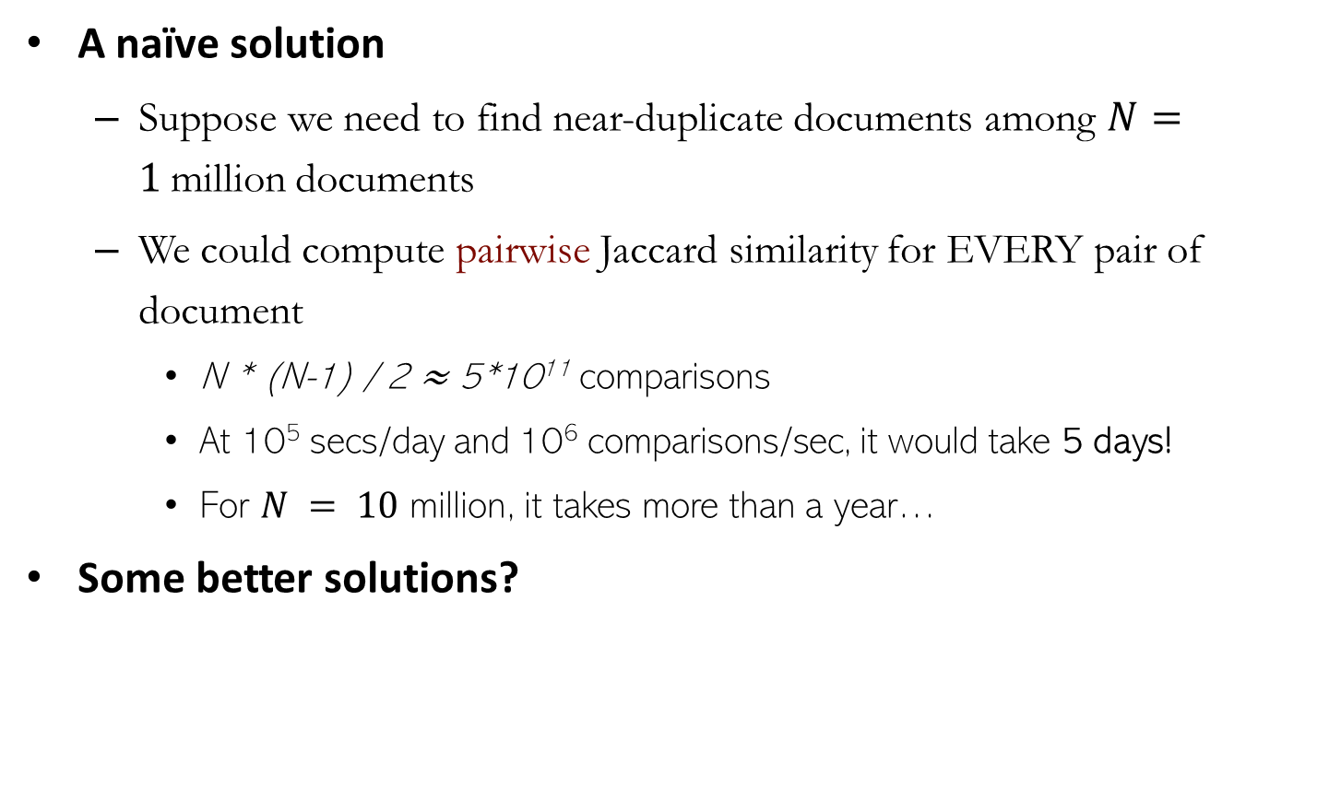
Shingling
A naïve solution
  Suppose we need to find near-duplicate documents among $N=1$million documents
  We could compute pairwise Jaccard similarity for EVERY pair of document
    N * (N-1) / 2 ≈ 5*10¹¹ comparisons
    At 10⁵ secs/day and 10⁶ comparisons/sec, it would take 5 days!
    For $N = 10$ million, it takes more than a year…
Some better solutions?

Slide 21
Step 2: MinHashing
Idea: Convert large sets to short signatures, while preserving similarity
  Signatures: short integer vectors that represent the sets, and reflect their similarity
Shingling
MinHash-
ing
Documents
The set
of strings
of length k
that appear
in the doc-
uments
Signatures:
short integer
vectors that
represent the
sets, and
reflect their
similarity

Slide 22
MinHashing
Shingle-document incident matrix
  Rows: elements (shingles)
  Columns: sets (documents)
  1 in row e and column s if and only if e is a member of s
  Column similarity is Jaccard similarity of the corresponding sets (rows with value 1)
Example: sim(C₁ ,C₂) = ?
  Size of intersection = 3; size of union = 6,
  Jaccard similarity = 3/6
  d(C₁,C₂) = 1 – (Jaccard similarity) = 3/6
Documents
1
1
1
0
1
1
0
1
0
1
0
1
0
0
0
1
Shingles
1
0
0
1
1
1
1
0
1
0
1
0

Slide 23
MinHashing
Goal: Find similar columns (documents) with small signatures
  Signatures of columns: small summaries of columns
  Similarities of signatures and those of columns are related!
  Optional: Crosscheck the columns with similar signatures are really similar
  Warning: Such methods can produce false negatives and false positives, if the optional crosscheck is not made
Predicted
Confusion Matrix | Positive | Negative
True
False
Actual

Slide 24
Hashing Columns for Signatures
Key idea: hash each column C to a small signature h(C), such that:
  Space-efficient: h(C) is small enough that the signature fits in RAM
  Similarity-preservation: The similarity of C₁ and C₂ is the same as the similarity of their signatures h(C₁) and h(C₂)
sim(C₁, C₂) = sim(h(C₁), h(C₂))
Goal: Find a hash function h(·) such that
  If sim(C₁,C₂) is high, then with high prob. h(C₁) = h(C₂)
  If sim(C₁,C₂) is low, then with high prob. h(C₁) ≠ h(C₂)
  Hash docs into buckets. Expect that “most” pairs of near duplicate docs hash into the same bucket

Slide 25
MinHashing
The desired hash function depends on the similarity metric
  Not all similarity metrics have a suitable hash function
  There is one for Jaccard similarity: MinHashing
Idea
  Imagine rows of the matrix permuted under a random permutation π
  Define a “hash” function h_{π}(C) = the index of the first (in the permuted order π) row in which column C has value 1
h_{π} (C) = min_{π} π(C) = min _{π:row(C)} {row(C)=1}
  Use several (e.g., 100) independent hash functions (that is, permutations) to create a signature of a column

Slide 26
MinHashing Example
2nd element of the permutation is the first to map to a 1
Permutation π
Matrix (Shingles x Documents)
Signature matrix M
2
4
3
4
7
2
6
1
5
1
0
1
0
2
1
2
1
3
2
1
0
0
1
2
1
4
1
7
1
0
1
0
1
1
2
1
2
6
3
0
1
0
1
1
6
0
1
0
1
4th element of the permutation is the first to map to a 1
5
7
1
0
1
0
4
5
1
0
1
0

Slide 27
The MinHashing Property
Consider a random permutation π. We have the claim:
  Pr[h_{π}(C₁) = h_{π}(C₂)] = sim(C₁, C₂)
Proof sketch
  Let X be a set of shingles, y∈X is a shingle (or row)
  Then Pr[π(y) = min(π(X))] = 1/|X|
    It is equally likely that any y∈X is mapped to the min element
  Let y* be a shingle s.t. π(y*) = min(π(C₁∪C₂))
  Then either: π(y*) = min(π(C₁)) if y* ∈ C₁
  or π(y*) = min(π(C₂)) if y* ∈ C₂
  So the prob. that both are true is the prob. y* ∈ C₁ ∩ C₂
  Pr[min(π(C₁))=min(π(C₂))]=|C₁∩C₂|/|C₁∪C₂|= sim(C₁, C₂)
C₁
C₂
0
0
0
0
1
1
0
0
0
1
1
0
Notes:
Proof by contradiction

Slide 28
Similarity for Signatures
We now know that
Pr[h_{π}(C₁) = h_{π}(C₂)] = sim(C₁, C₂)
Now generalize to multiple hash functions
  Note: Because of the MinHashing property, the similarity of columns is the same as the expected similarity of their signatures
  The similarity of two signatures is the fraction of the hash functions in which they agree
Notes:
Proof by contradiction

Slide 29
MinHashing Example
Permutation π
matrix (Shingles x Documents)
Signature matrix M
2
4
3
4
7
2
6
1
5
1
0
1
0
2
1
2
1
3
2
1
0
0
1
2
1
4
1
7
1
0
1
0
1
1
2
1
2
6
3
0
1
0
1
1
6
0
1
0
1
Similarities
 | 1 vs. 3 | 2 vs. 4 | 1 vs. 2 | 3 vs. 4
Col/Col | 0.75 | 0.75 | 0 | 0
Sig/Sig | 0.67 | 1 | 0 | 0
5
7
1
0
1
0
4
5
1
0
1
0

Slide 30
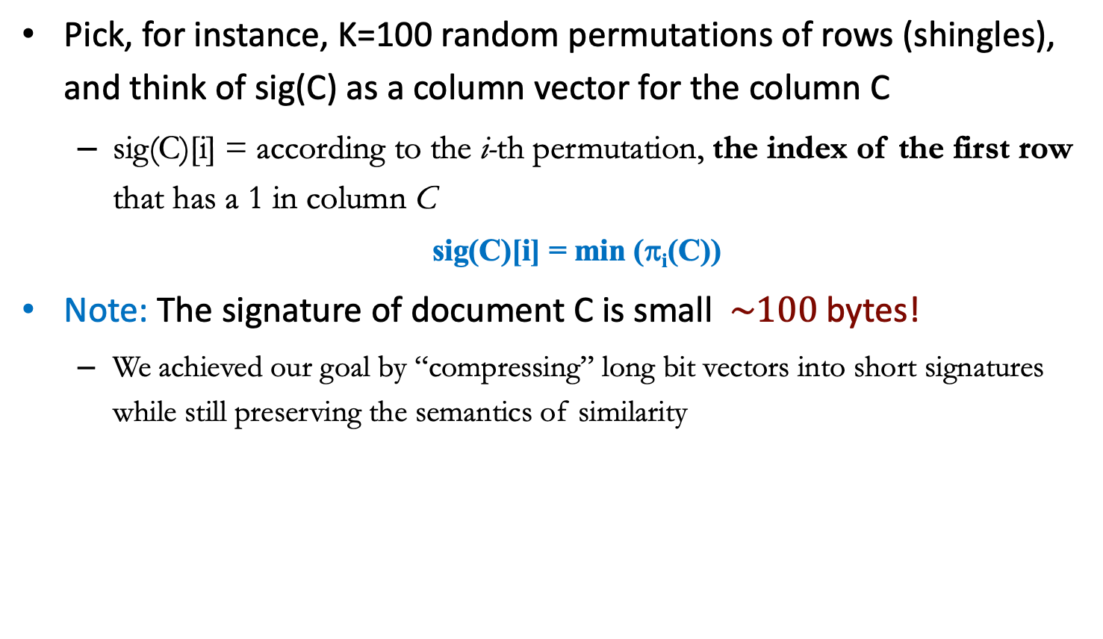
MinHashing Signatures
Pick, for instance, K=100 random permutations of rows (shingles), and think of sig(C) as a column vector for the column C
  sig(C)[i] = according to the i-th permutation, the index of the first row that has a 1 in column C
  sig(C)[i] = min (π_{i}(C))
Note: The signature of document C is small $\sim 100$ bytes!
  We achieved our goal by “compressing” long bit vectors into short signatures while still preserving the semantics of similarity

Slide 31
Step 3: Locality Sensitive Hashing
Idea: Focus on pairs of signatures likely to be from similar documents
  Scope down the search space by filtering unsimilar signature-pairs
Candidate
pairs:
those pairs
of signatures
that we need
to test for
similarity
Shingling
Min-
Hashing
Locality-
Sensitive
Hashing
Docu-
ment
The set
of strings
of length k
that appear
in the doc-
ument
Signatures:
short integer
vectors that
represent the
sets, and
reflect their
similarity

Slide 32
The LSH Idea
Goal: Find documents with Jaccard similarity no less than a user-specified similarity threshold, s (e.g., s=0.8)
General idea: Given two documents, x and y, consider a function f(x,y), that tells whether x and y is a candidate pair: they are highly likely to be similar and whose (exact) similarity must be further evaluated
  The filtering-verification approach
  Search in the vast ocean → search in your backyard pool
For MinHashing matrices:
  Hash columns of signature matrix M to many buckets
  Each pair of documents that hashes into the same bucket is likely, to some extent, similar

Slide 33
LSH for MinHashing
Columns x and y of M are a candidate pair if their signatures agree on at least a fraction s of their rows
  M (i, x) = M (i, y) for at least a fraction s values of all different i
How to?
  Idea: Hash columns of the signature matrix M multiple times
  Candidate pairs are those hashing to the same bucket
  The idea of multiple hashing consolidates our belief that x and y are similar w.h.p.

Slide 34
LSH for MinHashing
Partition matrix M into b bands of r rows
  For each band, hash its portion of each column to a hash table with k buckets
    Make k as large as possible
Candidate column pairs are those that hash to the same bucket for ≥ 1 band
Tune b and r to catch most similar pairs (true positives), but few non-similar pairs (false positives)

Slide 35
Partition M into b Bands
2
1
4
1
1
2
1
2
2
1
2
1
r rows
per band
b bands
One
signature
Signature matrix M

Slide 36
Hashing Bands
Buckets
Columns 2 and 6
are probably identical
(candidate pair)
Columns 6 and 7 are
surely different.
Matrix M
r rows
b bands

Slide 37
Example
Assume the following case:
  Suppose 100,000 columns of M (100k docs)
  Signatures of 100 integers (rows)
  Therefore, signatures take 40Mb
  Choose b = 20 bands of r = 5 integers/band
Goal: Find pairs of documents that are at least s = 0.8 similar

Slide 38
Case 1: C₁, C₂ are 80% Similar
Problem: Find pairs of similarity ≥ s=0.8; set b=20, r=5
Assume: sim(C₁, C₂) = 0.8
  Since sim(C₁, C₂) ≥ s, we want C₁, C₂ to be a candidate pair: We want them to hash to at least 1 common bucket (at least one band is identical)
  Probability C₁, C₂ identical in one particular band: (0.8)⁵ = 0.328
  Probability C₁, C₂ are not similar in all of the 20 bands: (1-0.328)²⁰ = 0.00035
    i.e., about 1/3000th of the 80%-similar column pairs are false negatives (we miss them)
  We would find 99.965% pairs of truly similar documents

Slide 39
Case 2: C₁, C₂ are 30% Similar
Problem: Find pairs of similarity ≥ s=0.8; set b=20, r=5
Assume: sim(C₁, C₂) = 0.3
  Since sim(C₁, C₂) < s, we want C₁, C₂ to hash to NO common buckets (all bands should be different)
  Probability C₁, C₂ identical in one particular band: (0.3)⁵ = 0.00243
  Probability C₁, C₂ identical in at least 1 out of 20 bands: 1 - (1-0.00243)²⁰ = 0.0474
    i.e., approximately 4.74% pairs of docs with similarity 0.3% end up becoming candidate pairs
    They are false positives since we will have to examine them (they are candidate pairs) but then it will turn out their similarity is below threshold s

Slide 40
Theoretically, b bands, r rows/band
Columns C₁ and C₂ have similarity t
When picking any band (r rows)
  Prob. that all rows in band equal = t^{r}
  Prob. that some row in band unequal = 1 - t^{r}
    C₁ and C₂ are NOT equal in that band
Prob. that no band identical for C₁ and C₂ = (1 - t^{r})^{b}
Prob. that at least 1 band identical =
1 - (1 - t^{r})^{b}
  C₁ and C₂ are a candidate pair!

Slide 41
Theoretically, b bands, r rows/band
No bands
identical
At least
one band
identical
Probability ≈ 1
if t > s
1 -
(
)^{b}
Probability
of sharing
a bucket
Almost no chance
if t < s
s ~ (1/b)^{1/r}
1 -
t ^{r}
All rows
of a band
are equal
Some row
of a band
unequal
Similarity t=sim(C₁, C₂) of two sets

Slide 42
When b = 1 and r = 1
Probability
of sharing
a bucket
Remember:
Probability of
equal hash-values
= similarity
Similarity t =sim(C₁, C₂) of two sets

Slide 43
When b = 20 and r = 5
S = Similarity threshold
Prob. that at least 1 band is identical:
s | 1-(1-s^{r})^{b}
.2 | .006
.3 | .047
.4 | .186
.5 | .470
.6 | .802
.7 | .975
.8 | .9996

Slide 44
Picking r and b: The S-curve
Picking r and b to get the best S-curve
  50 hash-functions (r=5, b=10)
Prob. sharing a bucket
Red area: False Negative rate
Purple area: False Positive rate
Similarity

Slide 45
LSH Summary
Fine tune M, b, r to get almost all pairs with similar signatures, but eliminate most pairs that do not have similar signatures
  Goal: Find a hash function h(·) such that
    If sim(C₁,C₂) is high, then with high prob. h(C₁) = h(C₂)
    If sim(C₁,C₂) is low, then with high prob. h(C₁) ≠ h(C₂)
In another pass through data, check that the remaining candidate pairs indeed represent similar documents
  Check in main memory that candidate pairs really do have similar signatures
  Exact computation of Jaccard similarity between candidate pairs

Slide 46
Summary
Shingling: Convert documents to sets
  We used hashing to assign each shingle an ID
Min-Hashing: Convert large sets to short signatures, while preserving similarity
  We used similarity preserving hashing to generate signatures with property Pr[h_{π}(C₁) = h_{π}(C₂)] = sim(C₁, C₂)
  We used hashing to get around generating random permutations
Locality-Sensitive Hashing: Focus on pairs of signatures likely to be from similar documents
  We used hashing to find candidate pairs of similarity ≥ s

Slide 47

Thank you

