Slide 1
CAP5778
Advanced Data Mining
Link Analysis
Peixiang Zhao
Florida State university
Part of the course materials are adapted or revised from Mining of Massive Datasets (mmds.org)

Slide 2
Graph Data
High dim. data
Locality sensitive hashing
Clustering
Graph
data
PageRank, SimRank
Network Analysis
Infinite
data
Filtering data streams
Web advertising
Dimensionality reduction
Spam Detection
Queries on streams
Machine learning
SVM
Decision Trees
Perceptron, kNN
Apps
Recommender systems
Association Rules
Duplicate document detection

Slide 3
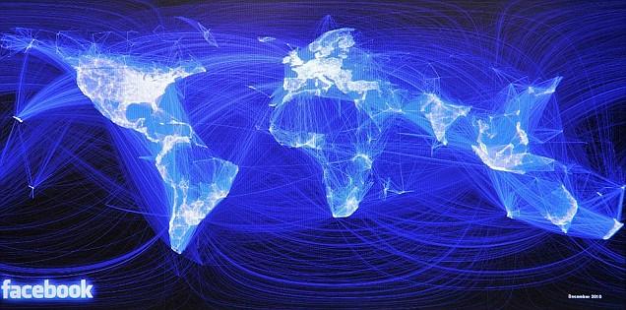
Social Networks
Facebook social graph
4-degrees of separation [Backstrom-Boldi-Rosa-Ugander-Vigna, 2011]

Slide 4
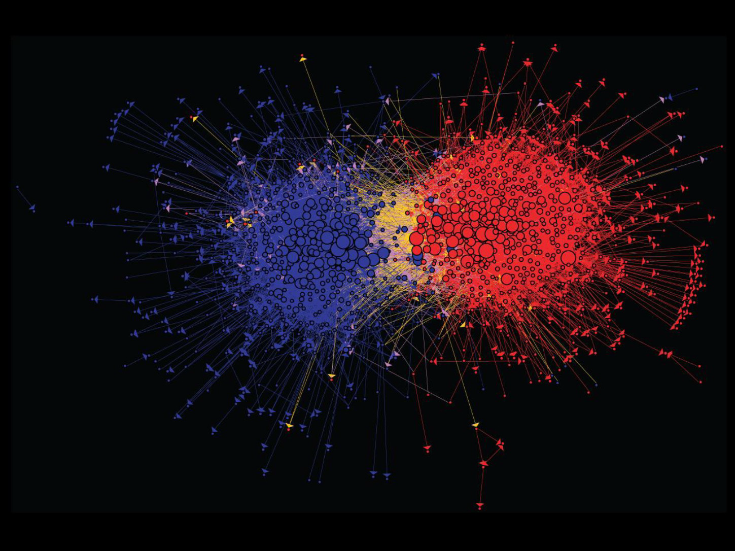
Media Networks
Connections between political blogs
Polarization of the network [Adamic-Glance, 2005]

Slide 5
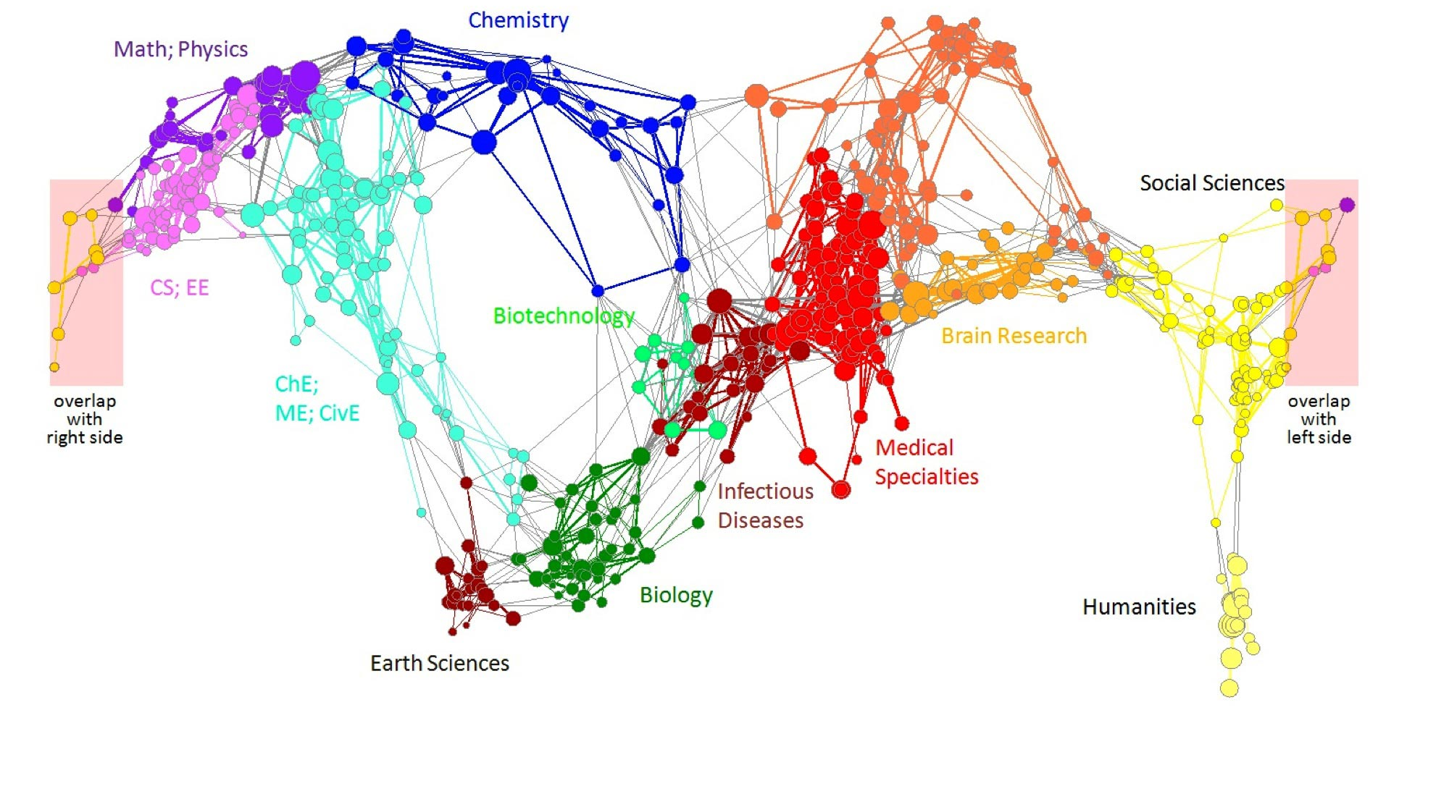
Information Networks
Citation networks and Maps of science
[Börner et al., 2012]

Slide 6
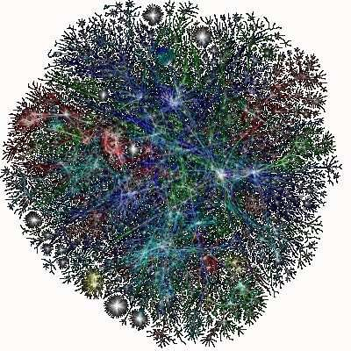
Communication Networks
A visualization of the network structure of the Internet.
Vertices represent servers, and edges represent fiber-optic links.
Image by the OPTE corporation.

Slide 7
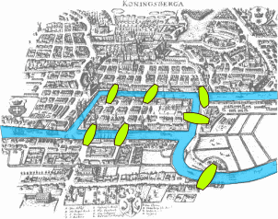
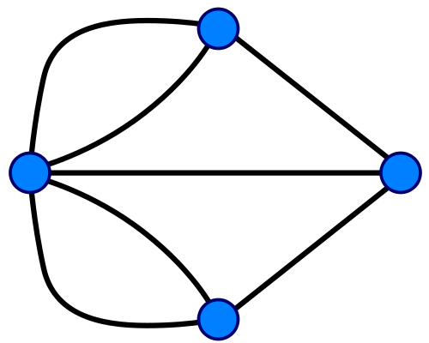
Technological Networks
Seven Bridges of Königsberg
[Euler, 1735]
Return to the starting point by traveling each link of the graph once and only once.

Slide 8
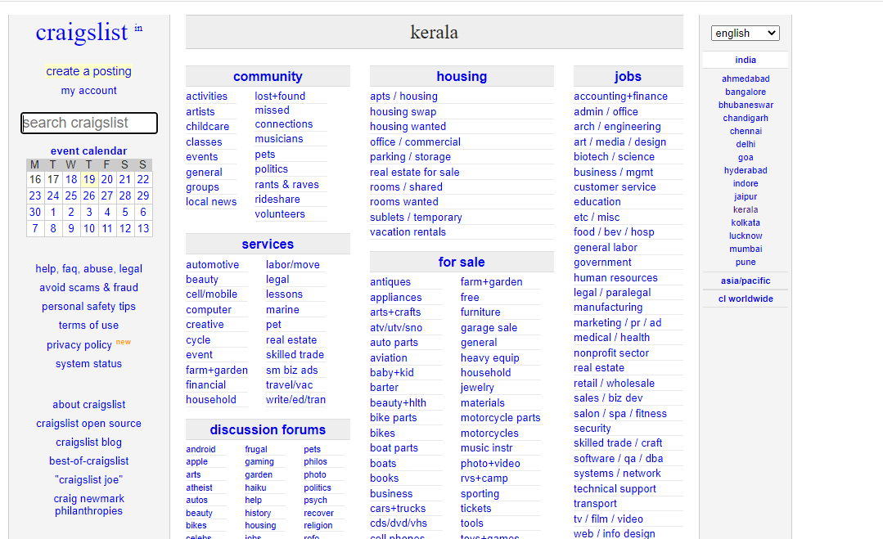

The Web
Web as a (directed) graph
  Nodes: webpages
  Edges: hyperlinks
How to organized the Web?
  Human curated Web directories
  Web search
    Find relevant web documents in a small and trusted set
However, Web is huge, full of untrusted documents, random things, web spams, etc.

Slide 9
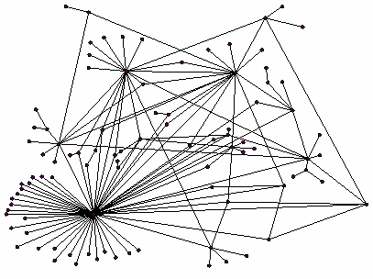
Web Search
Two main challenges
  Web contains many sources of information. Who to “trust”?
    Trick: Trustworthy pages may point to each other
  What is the “best” answer to given queries?
    No single right answer
    Trick: Pages that actually know about the query “newspapers” might all be pointing to many newspapers
Ranking nodes on the Web graph
  All webpages are NOT equally “important”
  There is large diversity in node connectivity
  Let’s rank the pages by the link structure

Slide 10
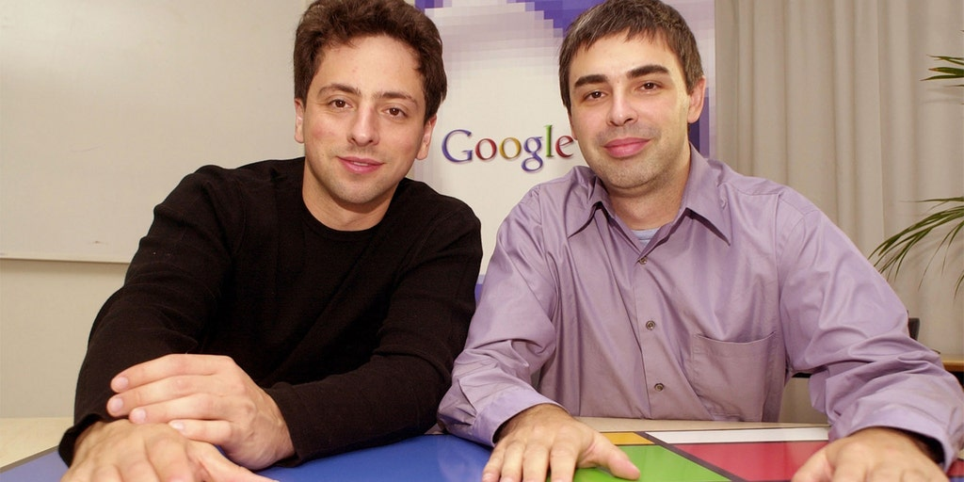
PageRank
[Brin&Page‘98]
PageRank is a Google algorithm that measures the importance of a web page by evaluating the number and quality of links to it
  It is named after both the term "web page" and co-founder Larry Page
  Idea: links as votes
    Page is more important if it has more important in-links
    Not all in-links are equal; links from
    important pages count more
    A recursive question!

Slide 11
Example: PageRank Scores
B
38.4
C
34.3
A
3.3
D
3.9
E
8.1
F
3.9
1.6
1.6
1.6
1.6
1.6

Slide 12
Simple Recursive Formulation
Each link’s vote is proportional to the importance of its source page
If page j with importance r_{j} has n out-links, each link gets r_{j} / n votes
Page j’s own importance is the sum of the votes on its in-links
i
k
Define a “rank” r_{j} for page j
r_{i}/3
r_{k}/4
j
r_{j}/3
r_{j} = r_{i}/3+r_{k}/4
r_{j}/3
r_{j}/3

Slide 13
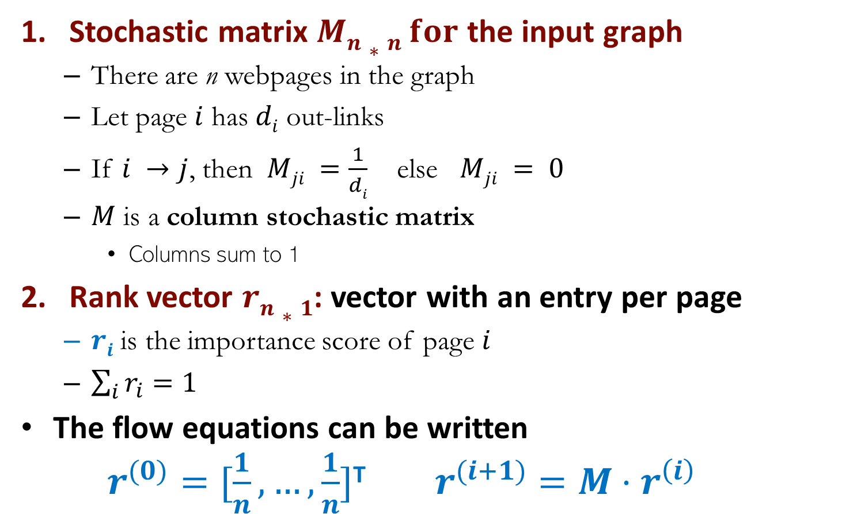
PageRank: Matrix Formulation
Stochastic matrix $Mn∗n for$ the input graph
  There are n webpages in the graph
  Let page $i$ has $di$ out-links
  If $i →j$, then $Mji =\frac{1}{di}$ else $Mji = 0$
  $M$ is a column stochastic matrix
    Columns sum to 1
Rank vector $rn∗1$: vector with an entry per page
  $ri$ is the importance score of page $i$
  $\sum_{i}{r_{i}=1}$
The flow equations can be written
$r^{(0)}=[\frac{1}{n}, …,\frac{1}{n}]\text{T}$ $r^{(i+1)}=M⋅r^{\left(i\right)}$

Slide 14
Example
M
 | y | a | m
y | ½ | ½ | 0
a | ½ | 0 | 1
m | 0 | ½ | 0
y
a
m
r = M∙r
  r_{y} = r_{y} /2 + r_{a} /2
  r_{a} = r_{y} /2 + r_{m}
  r_{m} = r_{a} /2
y ½ ½ 0 y
a = ½ 0 1 a
m 0 ½ 0 m
r =

Slide 15
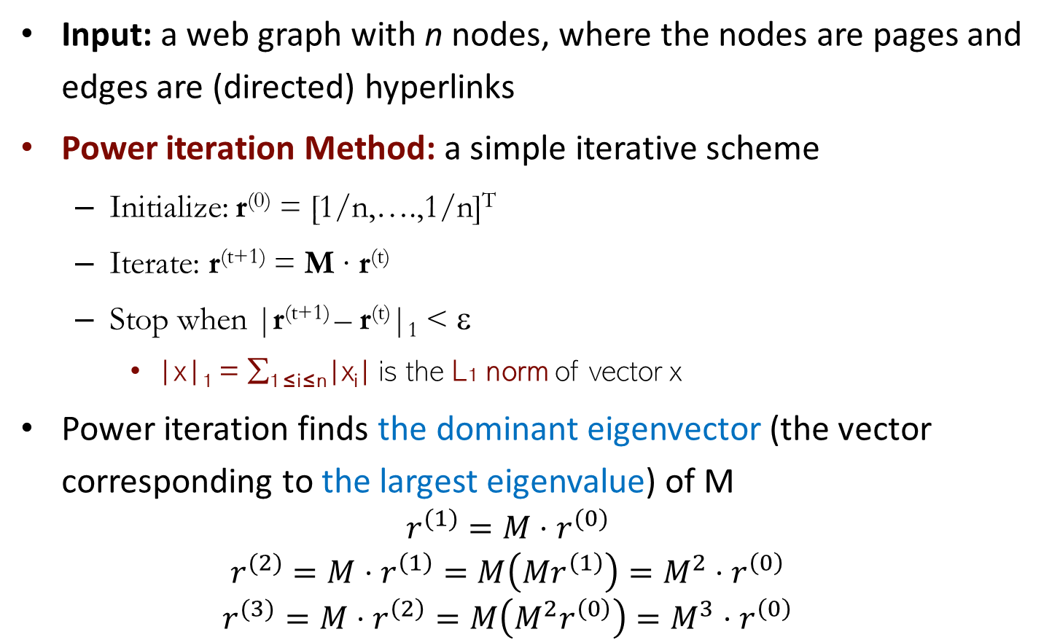
PageRank: How to Solve?
Input: a web graph with n nodes, where the nodes are pages and edges are (directed) hyperlinks
Power iteration Method: a simple iterative scheme
  Initialize: r⁽⁰⁾ = [1/n,….,1/n]^{T}
  Iterate: r^{(t+1)} = M ∙ r^{(t)}
  Stop when |r^{(t+1)} – r^{(t)}|₁ < ε
    |x|₁ = ∑_{1≤i≤n}|x_{i}| is the L1 norm of vector x
Power iteration finds the dominant eigenvector (the vector corresponding to the largest eigenvalue) of M
  $$r^{(1)}=M⋅r^{(0)}$$
  $$r^{(2)}=M⋅r^{\left(1\right)}=M\left(Mr^{\left(1\right)}\right)=M^{2}⋅r^{\left(0\right)}$$
  $$r^{(3)}=M⋅r^{\left(2\right)}=M\left(M^{2}r^{\left(0\right)}\right)=M^{3}⋅r^{\left(0\right)}$$
d_{i}: out-degree of node i

Slide 16

Example
M
Power Iteration:
  Set $r_{j}=1$/n
  1: ${r′}_{j}=\sum_{i→j}{\frac{r_{i}}{d_{i}}}$
  2:$r=r′$
  Goto 1
r_{y} 1/3 1/3 5/12 9/24 6/15
r_{a} = 1/3 3/6 1/3 11/24 … 6/15
r_{m} 1/3 1/6 3/12 1/6 3/15
 | y | a | m
y | ½ | ½ | 0
a | ½ | 0 | 1
m | 0 | ½ | 0
y
a
m
  r_{y} = r_{y} /2 + r_{a} /2
  r_{a} = r_{y} /2 + r_{m}
  r_{m} = r_{a} /2
r =
Iteration 0, 1, 2, …

Slide 17

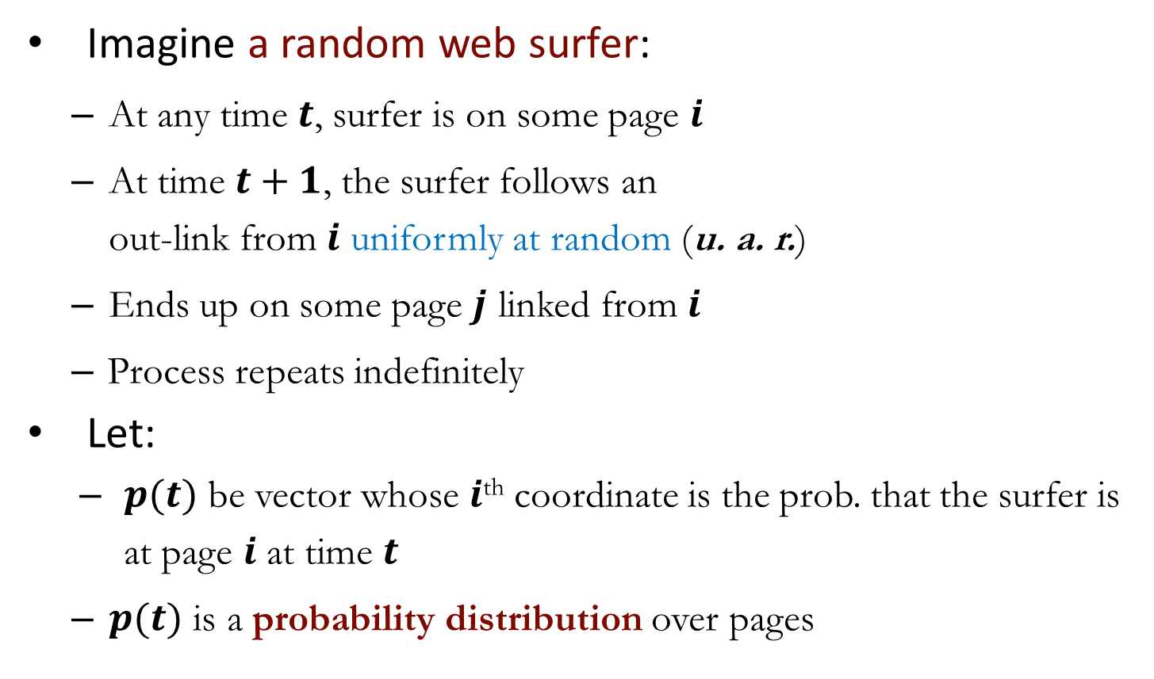
PageRank: Random Walk Interpretation
Imagine a random web surfer:
  At any time $t$, surfer is on some page $i$
  At time $t+1$, the surfer follows an
  out-link from $i$ uniformly at random (u. a. r.)
  Ends up on some page $j$ linked from $i$
  Process repeats indefinitely
Let:
  $p(t)$ be vector whose $i$^{th} coordinate is the prob. that the surfer is at page $i$ at time $t$
  $p(t)$ is a probability distribution over pages
i₁
i₂
i₃
j

Slide 18
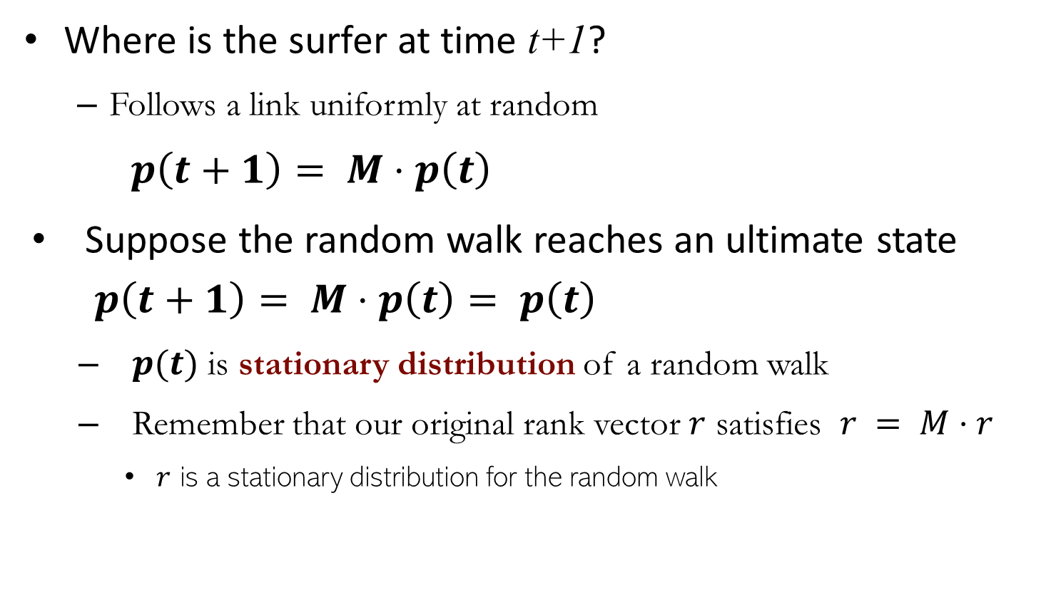
PageRank: Random Walk Interpretation
Where is the surfer at time t+1?
  Follows a link uniformly at random
$p\left(t+1\right)= M⋅p\left(t\right)$
Suppose the random walk reaches an ultimate state $p\left(t+1\right)= M⋅p\left(t\right)= p\left(t\right)$
  $p(t)$ is stationary distribution of a random walk
  Remember that our original rank vector $r$ satisfies $r = M⋅r$
    $r$ is a stationary distribution for the random walk
i₁
i₂
i₃
j

Slide 19
PageRank: Problems
Some pages are dead ends (have no out-links)
  Random walk has “nowhere” to go to
  Such pages cause importance to “leak out”
Spider traps (all out-links are within the group)
  Random walked gets “stuck” in a trap
  And eventually spider traps absorb all importance
Dead end
Spider trap

Slide 20
Problem: Dead Ends
Example:
r_{a} 1/2 0 0 0
r_{b} 1/2 1/2 0 0
M
a
b
a
b
a
0 | 0
1 | 0
b
r =
Iteration 0, 1, 2, …

Slide 21
Problem: Spider Traps
Example:
r_{y} 1/3 2/6 3/12 5/24 0
r_{a} = 1/3 1/6 2/12 3/24 … 0
r_{m} 1/3 3/6 7/12 16/24 1
M
y
 | y | a | m
y | ½ | ½ | 0
a | ½ | 0 | 0
m | 0 | ½ | 1
a
m
m is a spider trap
Iteration 0, 1, 2, …
r =
All the PageRank score gets “trapped” in node m

Slide 22
Solution: Teleports
The Google solution: At each time step, the random surfer has two options
  With prob. β, follow a link at random
  With prob. 1-β, jump to some random page
  Common values for β are in the range 0.8 to 0.9
Surfer will teleport out of spider trap within a few time steps
y
y
a
m
a
m

Slide 23
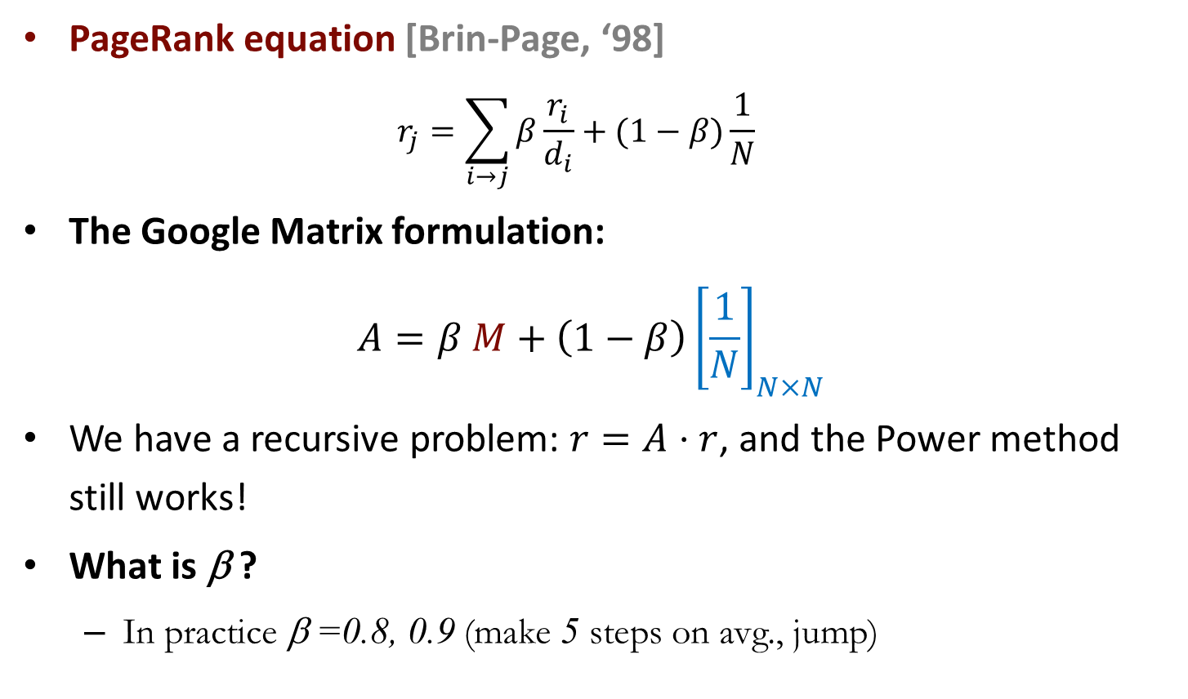
Solution: Teleports
PageRank equation [Brin-Page, ‘98]
$r_{j}=\sum_{i→j}{β\frac{r_{i}}{d_{i}}}+(1−β)\frac{1}{N}$
The Google Matrix formulation:
$$A=β M+\left(1−β\right){\left[\frac{1}{N}\right]}_{N×N}$$
We have a recursive problem: $r=A⋅r$, and the Power method still works!
What is β ?
  In practice β =0.8, 0.9 (make 5 steps on avg., jump)
N by N matrix
where all entries are 1/N

Slide 24
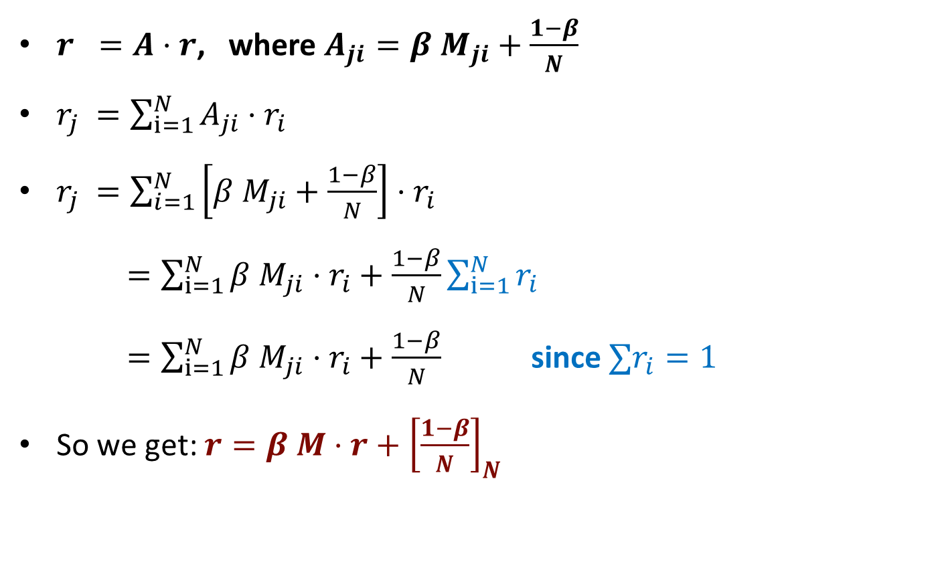
Solution: Teleports
$r =A⋅r$, where $A_{ji}=β{ M}_{ji}+\frac{1−β}{N}$
$r_{j} =\sum_{i=1}^{N}{A_{ji}⋅r_{i}}$
$r_{j} =\sum_{i=1}^{N}{\left[β{ M}_{ji}+\frac{1−β}{N}\right]⋅r_{i}}$
$=\sum_{i=1}^{N}{β{ M}_{ji}⋅r_{i}+\frac{1−β}{N}}\sum_{i=1}^{N}{r_{i}}$
$=\sum_{i=1}^{N}{β{ M}_{ji}⋅r_{i}+\frac{1−β}{N}}$ since $∑r_{i}=1$
So we get: $r=β M⋅r+{\left[\frac{1−β}{N}\right]}_{N}$
[x]_{N}: a vector of length N with all entries x

Slide 25
Random Teleports (β = 0.8)
M
7/15
y
1/2 1/2 0
1/2 0 0
0 1/2 1
1/3 1/3 1/3
1/3 1/3 1/3
1/3 1/3 1/3
0.8
+ 0.2
7/15
1/15
7/15
1/15
y 7/15 7/15 1/15
a 7/15 1/15 1/15
m 1/15 7/15 13/15
13/15
a
7/15
m
1/15
1/15
A
y
a =
m
1/3
1/3
1/3
0.33
0.20
0.46
0.24
0.20
0.52
0.26
0.18
0.56
7/33
5/33
21/33
r =
. . .

Slide 26
Some Problems with PageRank
Measures generic popularity of a page
  Biased against topic-specific authorities
  Solution: Topic-Specific PageRank
Uses a single measure of importance
  Other models of importance
  Solution: Hubs-and-Authorities
Susceptible to link spam
  Artificial link topographies created to boost PageRank
  Solution: TrustRank

Slide 27

HITS: Hubs and Authorities
[Kleinberg ‘98]
HITS (Hypertext-Induced Topic Selection)
  A measure of importance of pages similar to PageRank
  Proposed at around same time as PageRank (‘98)
Each page i has two scores
  Hub: Quality as an expert
    Total sum of authority scores for the nodes pointed to by i
  Authority: Quality as a content
    Total sum of hub scores for the nodes pointing to i
Mutually recursive definition
  A good hub links to many good authorities
  A good authority is linked from many good hubs

Slide 28
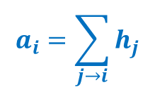


Hubs and Authorities
[Kleinberg ‘98]
Each page $i$ (1 ≤$i$≤N) has 2 scores:
  Authority score: $a_{i}$
  Hub score: $h_{i}$
HITS algorithm:
  Initialize: $a_{j}^{(0)}=1/\sqrt{N}, h_{j}^{(0)}=1/\sqrt{N}$
  Then keep iterating until convergence:
    $∀i:$Authority: $a_{i}^{(t+1)}=\sum_{j→i}{h_{j}^{(t)}}$
    $∀i:$Hub: $h_{i}^{(t+1)}=\sum_{i→j}{a_{j}^{(t)}}$
    $∀i:$ Normalize:
    $\sum_{i}{{\left(a_{i}^{\left(t+1\right)}\right)}^{2}}=1$, $\sum_{j}{{\left(h_{j}^{\left(t+1\right)}\right)}^{2}}=1$
j₁
j₂
j₃
j₄
i
$$a_{i}=\sum_{j→i}{h_{j}}$$
i
j₁
j₂
j₃
j₄
$$h_{i}=\sum_{i→j}{a_{j}}$$

Slide 29
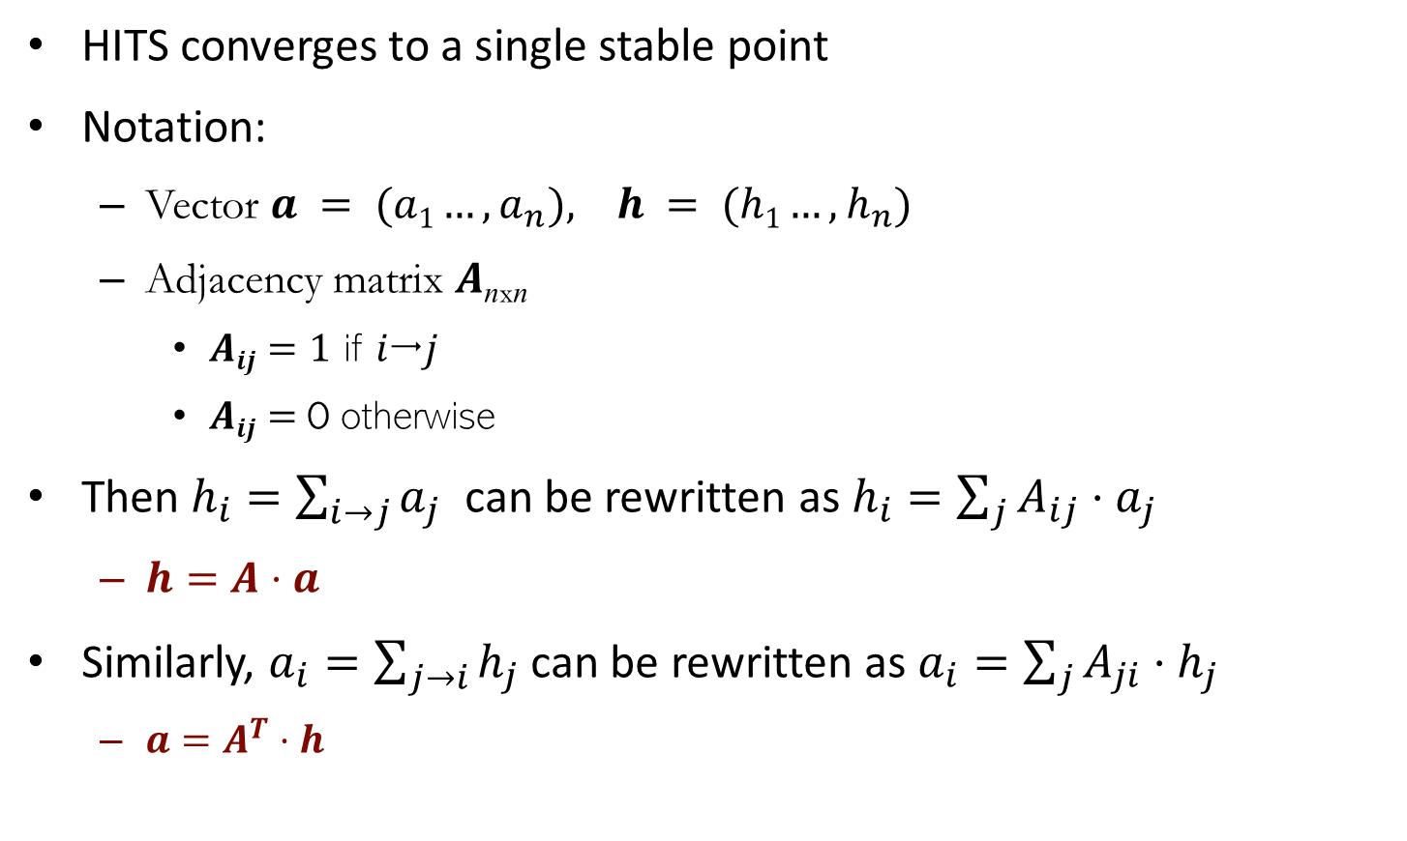
Hubs and Authorities
HITS converges to a single stable point
Notation:
  Vector $a = (a1…,a_{n}), h = (h1…,h_{n})$
  Adjacency matrix $A$_{nxn}
    $Aij=1$ if $ij$
    $Aij=$0 otherwise
Then $h_{i}=\sum_{i→j}{a_{j}}$ can be rewritten as $h_{i}=\sum_{j}{A_{ij}⋅a_{j}}$
  $h=A⋅a$
Similarly, $a_{i}=\sum_{j→i}{h_{j}}$ can be rewritten as $a_{i}=\sum_{j}{A_{ji}⋅h_{j}}$
  ${a=A}^{T}⋅h$

Slide 30
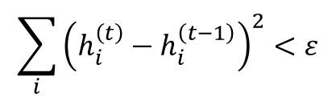
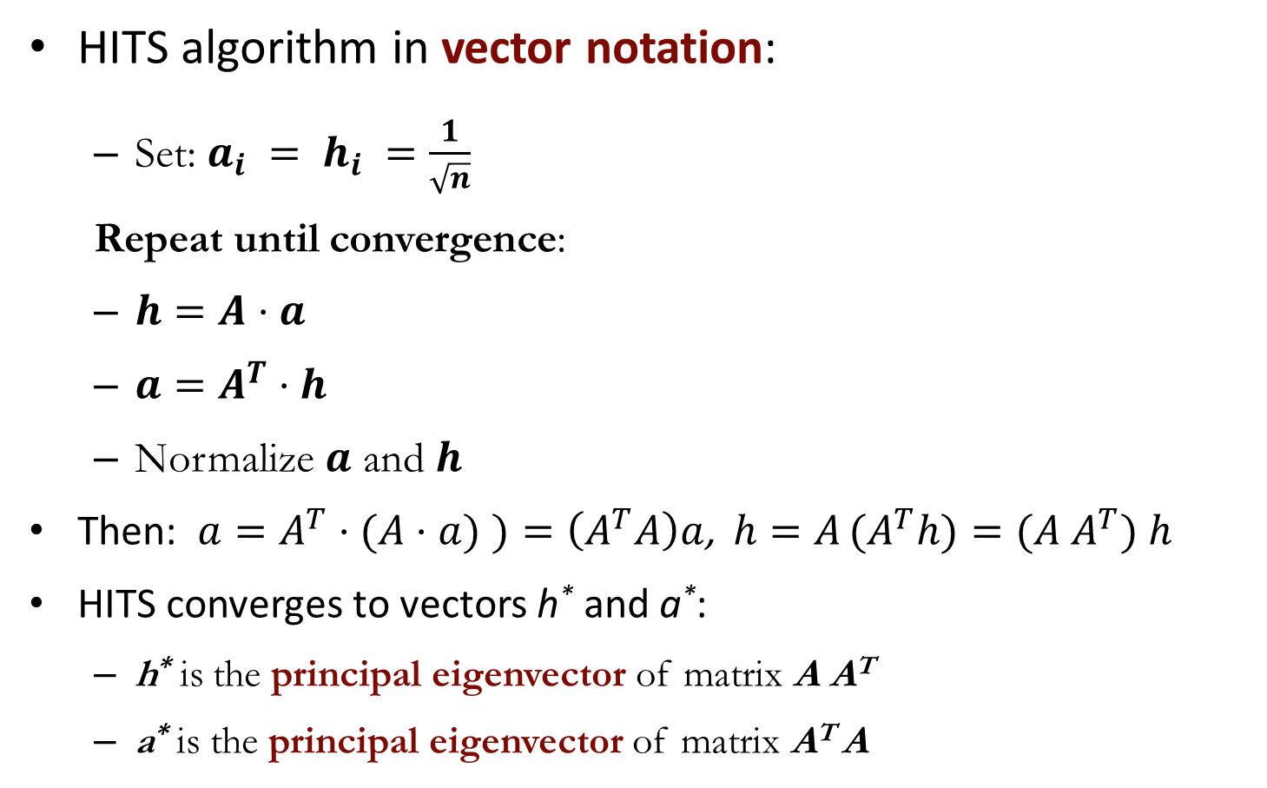
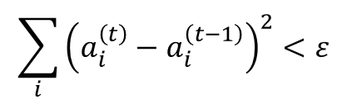
Hubs and Authorities
HITS algorithm in vector notation:
  Set: $a_{i} = h_{i} =\frac{1}{\sqrt{n}}$
  Repeat until convergence:
  $h=A⋅a$
  $a=A^{T}⋅h$
  Normalize $a$ and $h$
Then: $a=A^{T}⋅(A⋅a)$ $)=\left(A^{T}A\right)a$, $h=A (A^{T}h)=(A{ A}^{T}) h$
HITS converges to vectors h* and a*:
  h* is the principal eigenvector of matrix A A^{T}
  a* is the principal eigenvector of matrix A^{T} A
Convergence criterion:
$$\sum_{i}{{\left(h_{i}^{\left(t\right)}−h_{i}^{\left(t−1\right)}\right)}^{2}}<ε$$
$$\sum_{i}{{\left(a_{i}^{\left(t\right)}−a_{i}^{\left(t−1\right)}\right)}^{2}}<ε$$

Slide 31
Example
 | Yahoo | Amazon | Microsoft
Yahoo | 1 | 1 | 1
Amazon | 1 | 0 | 1
Microsoft | 0 | 1 | 0
A =
Yahoo
1 | 1 | 0
1 | 0 | 1
1 | 1 | 0
Amazon
M’soft
A^{T} =
h(yahoo)
h(amazon)
h(m’soft)
=
=
=
.58
.58
.58
.80
.53
.27
.80
.53
.27
.79
.57
.23
. . .
. . .
. . .
.788
.577
.211
a(yahoo) = .58
a(amazon) = .58
a(m’soft) = .58
.58
.58
.58
.62
.49
.62
.62
.49
.62
. . .
. . .
. . .
.628
.459
.628

Slide 32
PageRank vs. HITS
Both algorithms are used to rank webpages on the link structure of the web graph
PageRank
  Emphasizes hyperlink weight normalization and random walk models
  A single importance score per document
  Excutes at indexing time
HITS
  Emphasizes mutual reinforcement between authority and hub webpages
  Two scores per document: hub and authority
  Execute at query time

Slide 33

Thank you

