Slide 1
CAP5778
Advanced Data Mining
Introduction
Peixiang Zhao
Florida State university
Part of the course materials are adapted or revised from Mining of Massive Datasets (mmds.org)

Slide 2
Welcome to CAP5778
Course website:
  https://www.cs.fsu.edu/~zhao/cap5778/main.html
  Syllabus, Schedules, Projects, Resources
Canvas
  Announcements, Homework, Grades
Textbook: Mining of Massive Datasets (3rd edition)
  Free online: www.mmds.org
The FSU First-day Attendance Policy

Slide 3
Welcome to CAP5778
Instructor:
  Peixiang Zhao (zhao @ cs)
  Research in database systems and data mining
  Office: LOV 361
  Office hours: Tuesday/Thursday right after classes
TAs
  TBA
  Office hours: TBA

Slide 4
Welcome to CAP5778
Prerequisites:
  Data structures, algorithms
  Probability, linear algebra
  Programming (C/C++, Python)
    The programming details won’t be covered in this class
  CAP5771 Intro. to Data Mining is recommended, but not required
Structures
  Lectures, (roughly) 4 homework, project, final exam

Slide 5
Welcome to CAP5778
Projects:
  Goal: get early exposure to classic and cutting-edge DM research
  Format: a group of (at most) three members
  Select a research topic, and two or three scientific publications from the leading DM conferences/journals, such as KDD, WWW, WSDM, VLDB, SIGMOD, ICDE, ……
    The topics need to be approved by the instructor/TA
  Deliverables: proposals, in-class presentations, and final research survey throughout this semester

Slide 6
Welcome to CAP5778
Any questions thus far?

Slide 7
What is Data Mining?
Knowledge discovery from databases/data (KDD)
  Data → Information → Knowledge → Decision-making
Data mining is the use of algorithms, machine learning, and statistical analysis to uncover patterns and other valuable information from large data sets
Data mining ≈ Big Data ≈ Predictive Analytics ≈ Data Science

Slide 8
What is Data Mining?
Starting from lots of data
Discover nontrivial and potentially interesting patterns and models that are
  Valid: hold on new data with some certainty
  Useful: should be possible to act on the item
  Unexpected: non-obvious to the system
  Understandable: humans should be able to interpret the pattern

Slide 9
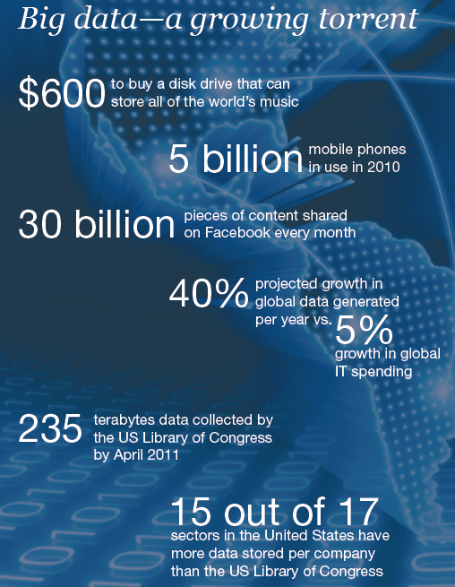
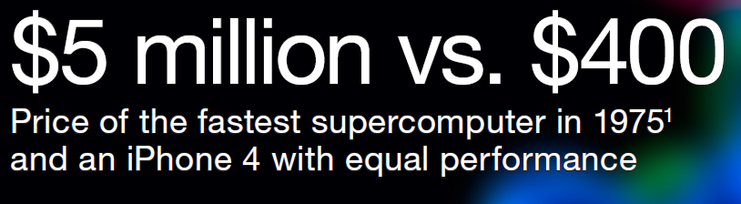
The Big Data Era
Big Data in Five Minutes.
What does Big Data actually mean?

Slide 10
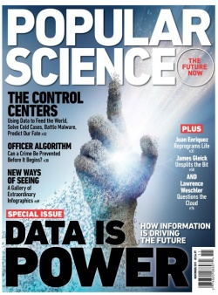
The Big Data Era
Data contains value and knowledge

Slide 11
The Big Data Era
IDC predicts that by 2025, worldwide data will grow to 175 zettabytes
  10²¹ (1,000,000,000,000,000,000,000) bytes, or, one zettabyte is equal to a trillion (10¹²) gigabytes (10⁹ bytes)
The end of Moore’s law
  Shrinking transistors have powered 50 years of advances in computing until 2003
  improvements in processor performance slowed down: now processing power doubles every 20 years rather than 1.5
Notes:
Here is .., in this paper, …

Slide 12
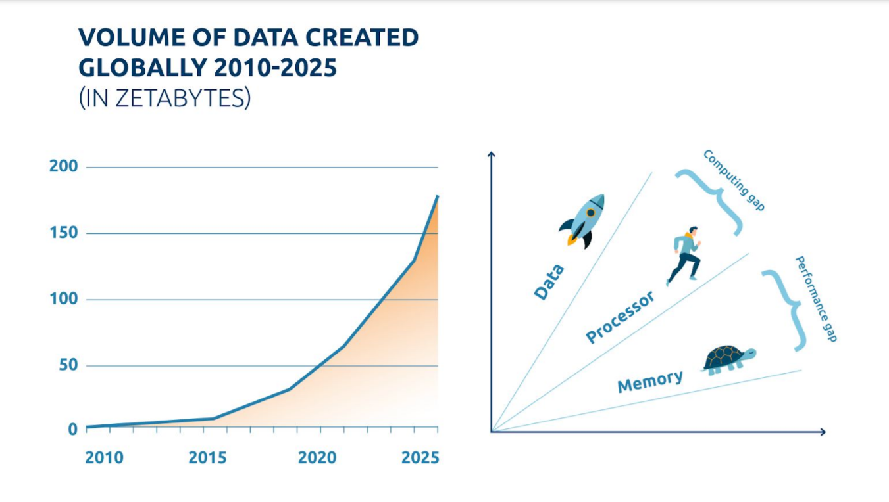
The Big Data Era

Slide 13
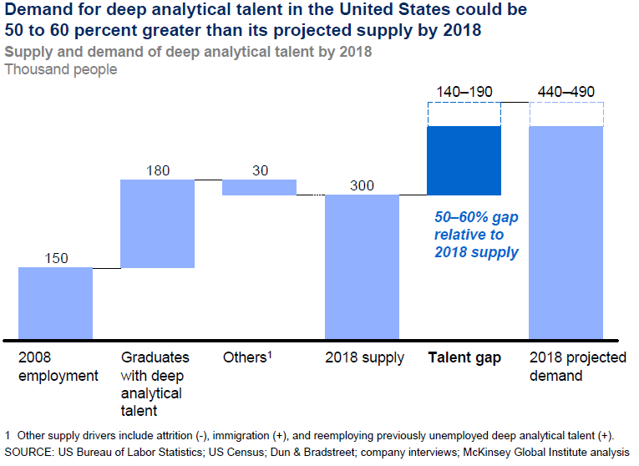
Demand for Data Mining

Slide 14
Data Mining Tasks
Descriptive methods
  Find human-interpretable patterns that better describe the data
    Example: Clustering, frequent patterns, summarization, dimensionality reduction, ……
Predictive methods
  Use variables to predict unknown or future values of other variables
    Examples: Classification, regression, link prediction, similarity search, recommendation, ……

Slide 15
Data Mining: Cultures
Data mining overlaps with:
  Databases: Large-scale data, simple queries
  Machine learning: Small data, complex models
  CS Theory: (Randomized) Algorithms
Different cultures:
  To DB, data mining is an extreme form of analytic processing
    queries that examine large amounts of data
    result is the query answer
  To ML, data mining is inference of models
    Result is the parameters of the model
  To Theory, data mining is scalable algorithm design
  for big data
Theory
ML
DM
DB

Slide 16
What Matters in Data Mining?
Challenges
Usage
Quality
Context
Streaming
Scalability
Collect
Prepare
Text
Signals
Data
Modalities
Ontologies
Networks
Represent
Structured
Multimedia
Model
Reason
Visualize
Data Operators

Slide 17
Meaningfulness of Analytic Answers
A risk with “data mining” is that an analyst can “discover” patterns that are meaningless
Statisticians call it Bonferroni’s principle:
  Calculate the expected number of occurrences of the events on the assumption that data is random
  If this number is significantly larger than the number of real instances, you must expect almost anything you find to be bogus
    they have no cause other than that random data will always have some number of unusual features that look significant but aren’t

Slide 18
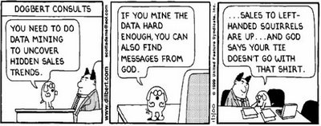
Meaningfulness of Analytic Answers

Slide 19
Meaningfulness of Analytic Answers
Example
  We want to find (unrelated) people who at least twice have stayed at the same hotel on the same day
    10⁹ people being tracked in 1,000 days
    Each person stays in a hotel 1% of time (1 day out of 100)
    Each Hotel holds 100 people
    #hotels (?)
  If everyone behaves randomly (i.e., no terrorists) will the data mining detect anything suspicious?
    Expected number of “suspicious” pairs of people ?
Notes:
#hotels = 10^5
Prob. = (10^-2 * 10^-2 * 10^-5)^2 = 10^-18
Expected # pairs of people = 250,000 = (10^9 * 10^9 /2) * (10^3 * 10^3)/2 * 10^-18 = 25* 10^4

Slide 20
What Will We Learn?
Mining different types of data
  High-dimensional, graph-structured, streaming, labeled, ……
Mining using different models of computation
  Single machine in-memory, data streams, ……
Mining to solve real-world problems
  Recommender systems, market basket analysis, spam detection, duplication detection and elimination, ……
Mining by different tools
  Linear algebra (SVD, PCA), optimization (stochastic gradient descent), dynamic programming, hashing (LSH, Bloom filters), ……
Notes:
Here is .., in this paper, …

Slide 21
How It All Fits Together
High dim. data
Locality sensitive hashing
Clustering
Graph
data
PageRank, SimRank
Community Detection
Infinite
data
Filtering data streams
Web advertising
Dimensionality reduction
Spam Detection
Queries on streams
Machine learning
SVM
Decision Trees
Perceptron, kNN
Apps
Recommender systems
Association Rules
Duplicate document detection

Slide 22

Thank you

