Slide 1
CAP5778
Advanced Data Mining
Dimensionality Reduction
Peixiang Zhao
Florida State university
Part of the course materials are adapted or revised from Mining of Massive Datasets (mmds.org)

Slide 2
High Dimensional Data
High dim. data
Locality sensitive hashing
Clustering
Graph
data
PageRank, SimRank
Network Analysis
Infinite
data
Filtering data streams
Web advertising
Dimensionality reduction
Spam Detection
Queries on streams
Machine learning
SVM
Decision Trees
Perceptron, kNN
Apps
Recommender systems
Association Rules
Duplicate document detection

Slide 3
Introduction
Curse of dimensionality
  When dimensionality increases, data becomes increasingly sparse
  Density and distance between points becomes less meaningful
  The possible combinations of subspaces will grow exponentially
Dimensionality reduction
  Avoid the curse of dimensionality
  Help eliminate irrelevant features and reduce noise
  Reduce time and space costs in data mining
  Allow easier visualization
Dimensionality reduction techniques
  Principal Component Analysis (PCA)
  Singular Vector Decomposition (SVD)

Slide 4
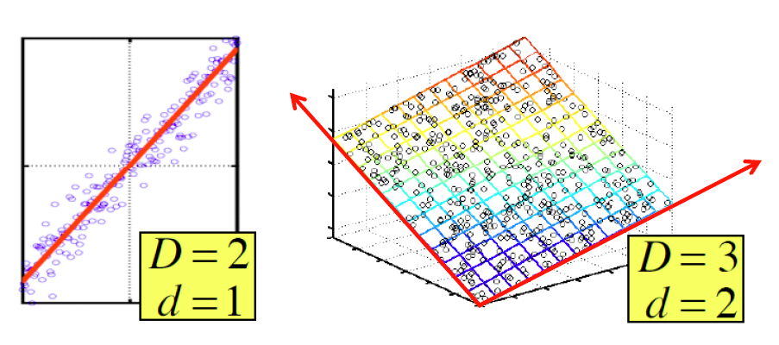
Dimensionality Reduction
Assumptions
  Data lies on or near a low d-dimensional subspace
  Axes of this subspace are effective representation of the data

Slide 5

Rank of A Matrix
What is rank of a matrix A?
  Number of linearly independent columns of A
Example
  Matrix A =
  Rank r = 2
What do we care about low rank?
  New coordinates to represent the original data
    We can write A as two “basis” vectors: [1 2 1] [-2 -3 1]
Notes:
The first two rows are linearly independent, so the rank is at least 2, but all three rows are linearly dependent (the first is equal to the sum of the second and third) so the rank must be less than 3.

Slide 6
Rank is Dimensionality
Cloud of points 3D space:
  Think of point positions
  as a matrix:
We can rewrite coordinates more efficiently!
  Old basis vectors: [1 0 0] [0 1 0] [0 0 1]
  New basis vectors: [1 2 1] [-2 -3 1]
  Then A has new coordinates: [1 0]. B: [0 1], C: [1 1]
    Notice: We reduced the number of coordinates
A
B
C
A
One row per point:

Slide 7
Principle Component Analysis
Goal: To find a projection of data that captures the largest amount of variation in data
The original data are projected onto a much smaller space, resulting in dimensionality reduction
  The direction with the largest projected variance is called the first principal component
  The orthogonal direction that captures the second largest projected variance is called the second principal component
  and so on…
  The direction that maximizes the variance is also the one that minimizes the mean squared error

Slide 8
A Motivating Example
A dataset resulting from a survey of pilots for radio-controlled helicopters
  x₁ is a measure of the piloting skill of a pilot
  x₂ captures how much he/she enjoys flying
  The two attributes x₁ and x₂ are strongly correlated!
    The data actually lie along
    some diagonal axis (u₁)
  Question: how can we
  automatically compute u₁ ?

Slide 9
Problem Formulation
Reduce data from d-dimension to k-dimension (k << d)
  Find k vectors u₁, u₂, …,u_{k} onto which to project data so as to
    maximize the variance of the projected data
    minimize the projection error (squared projection distance)

Slide 10
PCA: General Procedure
Given n data vectors from d-dimensions, find k ≤ d orthogonal vectors (principal components) that can represent data
  Normalize input data: Each attribute falls within the same range
  Compute k orthonormal (unit) vectors, i.e., principal components
  Each input data (vector) is a linear combination of the k principal component vectors
  The principal components are sorted in order of decreasing “significance” or strength
  Since the components are sorted, the size of the data can be reduced by eliminating the weak components, i.e., those with low variance (using the strongest k principal components, it is possible to reconstruct a good approximation of the original data)

Slide 11
PCA: Input
Input: an n*d data matrix D
  Rows: also called instances, examples, records, transactions, objects, points, feature-vectors, etc. Given as a d-tuple
    x_{i} = (x_{i1}, x_{i2}, . . . , x_{id})
  Columns: also called attributes, properties, features, dimensions, variables, fields, etc. Given as an n-tuple
    x_{j} = (x_{1j}, x_{2j}, . . . , x_{nj})

Slide 12
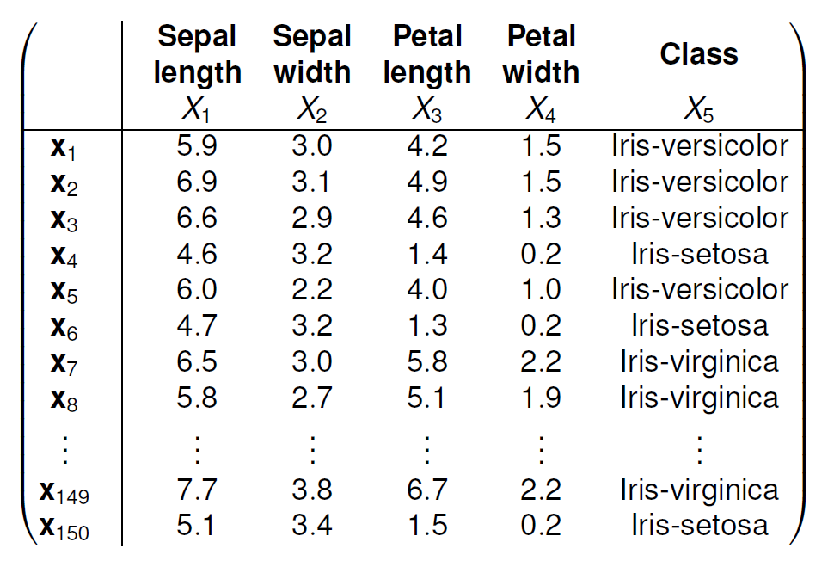
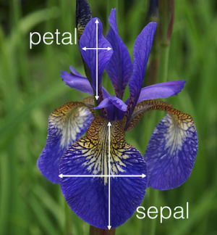
An Example

Slide 13
PCA: Algorithm
Preprocessing the data to normalize its mean and variance
  The mean of the data matrix D is the average of all the points
  Replace each x_{i} with x_{i} – μ to get the centered data matrix Z
Steps 1-2 zero out the mean of the data

Slide 14
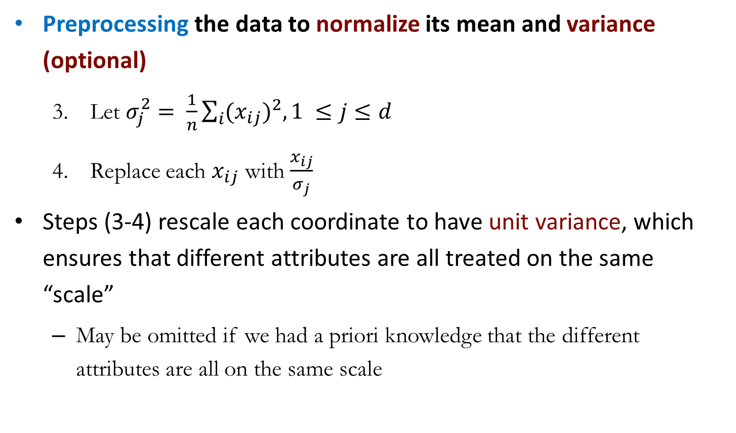
PCA: Algorithm
Preprocessing the data to normalize its mean and variance (optional)
  Let $σ_{j}^{2}= \frac{1}{n}\sum_{i}{{{(x}_{ij})}^{2}, 1 ≤j≤d}$
  Replace each $x_{ij}$ with $\frac{x_{ij}}{σ_{j}}$
Steps (3-4) rescale each coordinate to have unit variance, which ensures that different attributes are all treated on the same “scale”
  May be omitted if we had a priori knowledge that the different attributes are all on the same scale

Slide 15
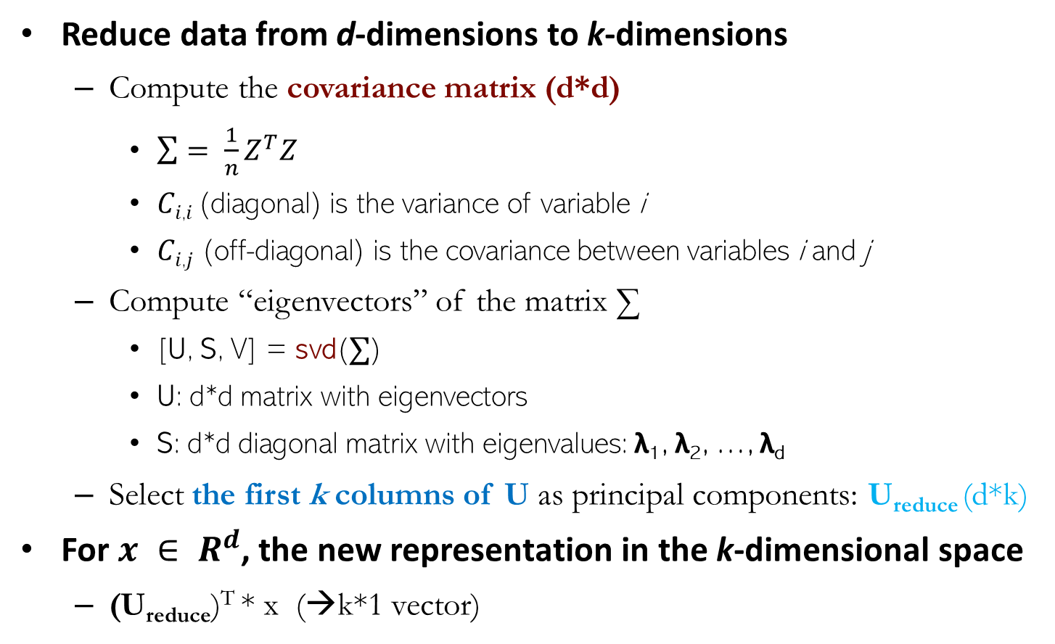
PCA: Algorithm
Reduce data from d-dimensions to k-dimensions
  Compute the covariance matrix (d*d)
    $\sum{= \frac{1}{n}Z^{T}Z}$
    𝐶_{𝑖,𝑖} (diagonal) is the variance of variable i
    𝐶_{𝑖,𝑗} (off-diagonal) is the covariance between variables i and j
  Compute “eigenvectors” of the matrix ∑
    [U, S, V] = svd(∑)
    U: d*d matrix with eigenvectors
    S: d*d diagonal matrix with eigenvalues: λ₁, λ₂, …, λ_{d}
  Select the first k columns of U as principal components: U_{reduce} (d*k)
For $x ∈ R^{d}$, the new representation in the k-dimensional space
  (U_{reduce})^{T} * x (→k*1 vector)

Slide 16
How to Choose the Dimensionality
One criteria for choosing k is to compute the fraction of the total variance captured by the first k principal components
Given a certain desired variance threshold, say α, starting from the first principal component, we keep on adding additional components, and stop at the smallest value k, for which f (k) ≥ α
  we select the fewest number of dimensions such that the subspace spanned by those k dimensions captures at least α fraction of the total variance

Slide 17
PCA: Algorithm

Slide 18
PCA: Example

Slide 19
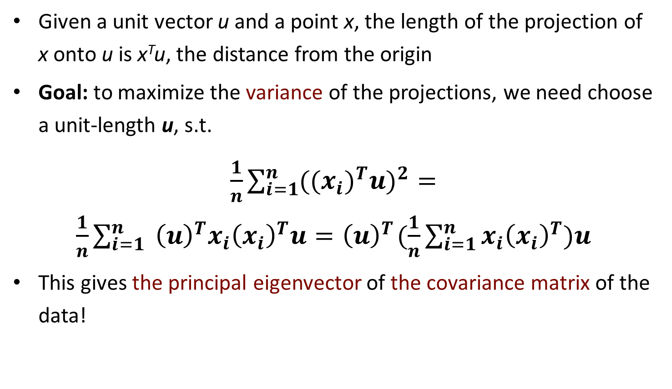
PCA: In Theory
Given a unit vector u and a point x, the length of the projection of x onto u is x^{T}u, the distance from the origin
Goal: to maximize the variance of the projections, we need choose a unit-length u, s.t.
$\frac{1}{n}\sum_{i=1}^{n}{{{((x_{i})}^{T}u)}^{2}=}$ $\frac{1}{n}\sum_{i=1}^{n}{{{ \left(u\right)}^{T}x_{i}\left(x_{i}\right)}^{T}u=}{ \left(u\right)}^{T}(\frac{1}{n}\sum_{i=1}^{n}{{x_{i}\left(x_{i}\right)}^{T})u}$
This gives the principal eigenvector of the covariance matrix of the data!

Slide 20
Optimal and Non-optimal 2D Approximations
The optimal subspace maximizes the variance, and minimizes the squared error, whereas the non-optimal subspace captures less variance, and has a high mean squared error value, as seen from the lengths of the error vectors (line segments)

Slide 21
Singular Vector Decomposition
A_{[m x n]} = U_{[m x r]} Σ _{[ r x r]} (V_{[n x r]})^{T}
  A: Input data matrix
    m x n matrix (e.g., m documents, n terms)
  U: Left singular vectors
    m x r matrix (m documents, r concepts)
  Σ: Singular values
    r x r diagonal matrix (strength of each ‘concept’)
    (r : rank of the matrix A)
  V: Right singular vectors
    n x r matrix (n terms, r concepts)

Slide 22
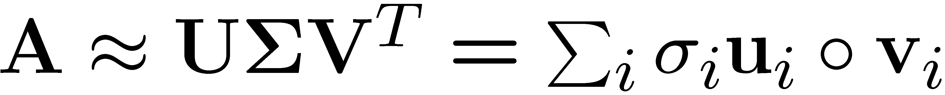
SVD
T
n
r
r
n
r
A
≈
Σ
V^{T}
m
m
U
σ_{i}: singular values
u_{i}: orthonormal vector
v_{i}: orthonormal vector

Slide 23
SVD - Properties
It is always possible to decompose a real matrix A into A = U Σ V^{T} , where
  U, Σ,V: unique
  U, V: column orthonormal
    U^{T} U = I; V^{T} V = I (I: identity matrix)
    (Columns are orthogonal unit vectors)
  Σ: diagonal
    Entries (singular values) are positive, and sorted in decreasing order (σ₁ ≥ σ₂ ≥ ... ≥ 0)

Slide 24
SVD: Example
A = U Σ V^{T}: Users to Movies
Matrix
Alien
Star Wars
Casablanca
Titanic
n
Alex
Bob
Chris
Dave
Eason
Frank
Gil
1 1 1 0 0
3 3 3 0 0
4 4 4 0 0
5 5 5 0 0
0 2 0 4 4
0 0 0 5 5
0 1 0 2 2
Σ
V^{T}
=
m
U
“Concepts”
a.k.a. Latent dimensions

Slide 25
SVD: Example
A = U Σ V^{T}: Users to Movies
Matrix
Alien
Star Wars
Casablanca
Titanic
Alex
Bob
Chris
Dave
Eason
Frank
Gil
1 1 1 0 0
3 3 3 0 0
4 4 4 0 0
5 5 5 0 0
0 2 0 4 4
0 0 0 5 5
0 1 0 2 2
0.13 0.02 -0.01
0.41 0.07 -0.03
0.55 0.09 -0.04
0.68 0.11 -0.05
0.15 -0.59 0.65
0.07 -0.73 -0.67
0.07 -0.29 0.32
12.4 0 0
0 9.5 0
0 0 1.3
=
x
x
0.56 0.59 0.56 0.09 0.09
0.12 -0.02 0.12 -0.69 -0.69
0.40 -0.80 0.40 0.09 0.09

Slide 26
SVD: Example
A = U Σ V^{T}: Users to Movies
Matrix
Alien
Star Wars
Casablanca
Titanic
U is the “user-to-concept”
similarity matrix
Sci. Fiction
Romance
Alex
Bob
Chris
Dave
Eason
Frank
Gil
1 1 1 0 0
3 3 3 0 0
4 4 4 0 0
5 5 5 0 0
0 2 0 4 4
0 0 0 5 5
0 1 0 2 2
0.13 0.02 -0.01
0.41 0.07 -0.03
0.55 0.09 -0.04
0.68 0.11 -0.05
0.15 -0.59 0.65
0.07 -0.73 -0.67
0.07 -0.29 0.32
12.4 0 0
0 9.5 0
0 0 1.3
=
x
x
0.56 0.59 0.56 0.09 0.09
0.12 -0.02 0.12 -0.69 -0.69
0.40 -0.80 0.40 0.09 0.09

Slide 27
SVD: Example
A = U Σ V^{T}: Users to Movies
Matrix
Alien
Star Wars
Casablanca
Titanic
“Strength” of the concept for Sci. Fiction
Sci. Fiction
Alex
Bob
Chris
Dave
Eason
Frank
Gil
1 1 1 0 0
3 3 3 0 0
4 4 4 0 0
5 5 5 0 0
0 2 0 4 4
0 0 0 5 5
0 1 0 2 2
0.13 0.02 -0.01
0.41 0.07 -0.03
0.55 0.09 -0.04
0.68 0.11 -0.05
0.15 -0.59 0.65
0.07 -0.73 -0.67
0.07 -0.29 0.32
12.4 0 0
0 9.5 0
0 0 1.3
=
x
x
0.56 0.59 0.56 0.09 0.09
0.12 -0.02 0.12 -0.69 -0.69
0.40 -0.80 0.40 0.09 0.09

Slide 28
SVD: Example
A = U Σ V^{T}: Users to Movies
Matrix
Alien
Star Wars
Casablanca
Titanic
V is the “movie-to-concept”
similarity matrix
Sci. Fiction
Alex
Bob
Chris
Dave
Eason
Frank
Gil
1 1 1 0 0
3 3 3 0 0
4 4 4 0 0
5 5 5 0 0
0 2 0 4 4
0 0 0 5 5
0 1 0 2 2
0.13 0.02 -0.01
0.41 0.07 -0.03
0.55 0.09 -0.04
0.68 0.11 -0.05
0.15 -0.59 0.65
0.07 -0.73 -0.67
0.07 -0.29 0.32
12.4 0 0
0 9.5 0
0 0 1.3
=
x
x
Sci. Fiction
0.56 0.59 0.56 0.09 0.09
0.12 -0.02 0.12 -0.69 -0.69
0.40 -0.80 0.40 0.09 0.09

Slide 29
Dimensionality Reduction
Question: How exactly is the dimensionality reduction done based on SVD?
  Set the smallest singular values to ZERO
1 1 1 0 0
3 3 3 0 0
4 4 4 0 0
5 5 5 0 0
0 2 0 4 4
0 0 0 5 5
0 1 0 2 2
0.13 0.02 -0.01
0.41 0.07 -0.03
0.55 0.09 -0.04
0.68 0.11 -0.05
0.15 -0.59 0.65
0.07 -0.73 -0.67
0.07 -0.29 0.32
12.4 0 0
0 9.5 0
0 0 1.3
≈
=
x
x
0.56 0.59 0.56 0.09 0.09
0.12 -0.02 0.12 -0.69 -0.69
0.40 -0.80 0.40 0.09 0.09

Slide 30
Dimensionality Reduction
Question: How exactly is the dimensionality reduction done based one SVD?
  Set the smallest singular values to ZERO
1 1 1 0 0
3 3 3 0 0
4 4 4 0 0
5 5 5 0 0
0 2 0 4 4
0 0 0 5 5
0 1 0 2 2
0.13 0.02
0.41 0.07
0.55 0.09
0.68 0.11
0.15 -0.59
0.07 -0.73
0.07 -0.29
12.4 0
0 9.5
≈
x
x
0.56 0.59 0.56 0.09 0.09
0.12 -0.02 0.12 -0.69 -0.69

Slide 31

Dimensionality Reduction
Frobenius Norm: ${||M||}_{F}=\sqrt{\sum_{ij}{{M_{ij}}^{2}}}$
Goal: to find an approximation matrix B in order to minimize the reconstruction error: ${||A−B||}_{F}=\sqrt{\sum_{ij}{{{(A}_{ij}−B_{ij})}^{2}}}$
1 1 1 0 0
3 3 3 0 0
4 4 4 0 0
5 5 5 0 0
0 2 0 4 4
0 0 0 5 5
0 1 0 2 2
0.92 0.95 0.92 0.01 0.01
2.91 3.01 2.91 -0.01 -0.01
3.90 4.04 3.90 0.01 0.01
4.82 5.00 4.82 0.03 0.03
0.70 0.53 0.70 4.11 4.11
-0.69 1.34 -0.69 4.78 4.78
0.32 0.23 0.32 2.01 2.01
≈

Slide 32
SVD: Best Low-rank Approximation
A
U
Sigma
=
V^{T}
B is best approximation of A
B
U
Sigma
=
V^{T}

Slide 33
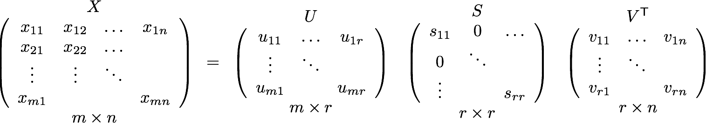
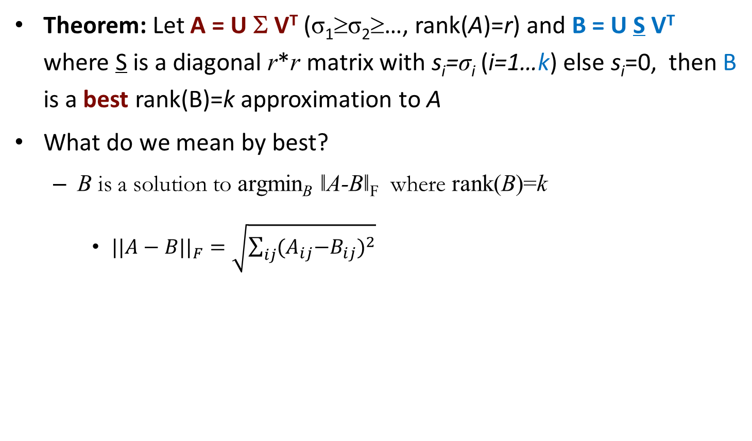
SVD: Best Low-rank Approximation
Theorem: Let A = U Σ V^{T} (σ₁≥σ₂≥…, rank(A)=r) and B = U S V^{T} where S is a diagonal r*r matrix with s_{i}=σ_{i} (i=1…k) else s_{i}=0, then B is a best rank(B)=k approximation to A
What do we mean by best?
  B is a solution to argmin_{B} ǁA-Bǁ_{F} where rank(B)=k
    ${||A−B||}_{F}=\sqrt{\sum_{ij}{{{(A}_{ij}−B_{ij})}^{2}}}$

Slide 34
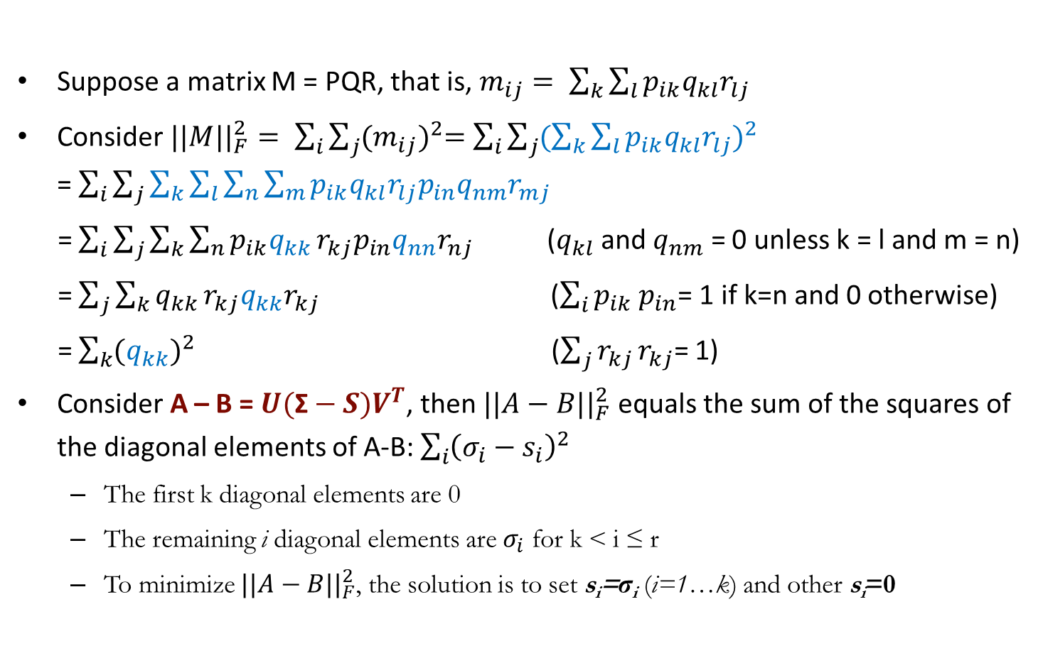
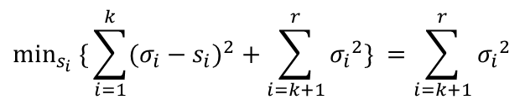
SVD: Best Low-rank Approximation
Suppose a matrix M = PQR, that is, $m_{ij}= \sum_{k}{\sum_{l}{p_{ik}q_{kl}r_{lj}}}$
Consider ${||M||}_{F}^{2}= \sum_{i}{\sum_{j}{{(m_{ij})}^{2}=}}$ $\sum_{i}{\sum_{j}{{(\sum_{k}{\sum_{l}{p_{ik}q_{kl}r_{lj}}})}^{2}}}$ =$\sum_{i}{\sum_{j}{\sum_{k}{\sum_{l}{\sum_{n}{\sum_{m}{p_{ik}q_{kl}r_{lj}p_{in}q_{nm}r_{mj}}}}}}}$
= $\sum_{i}{\sum_{j}{\sum_{k}{\sum_{n}{p_{ik}q_{kk}}}}}r_{kj}p_{in}q_{nn}r_{nj}$ ($q_{kl}$ and $q_{nm}$ = 0 unless k = l and m = n)
= $\sum_{j}{\sum_{k}{q_{kk}}}r_{kj}q_{kk}r_{kj}$ ($\sum_{i}{p_{ik}}$ $p_{in}$= 1 if k=n and 0 otherwise)
= $\sum_{k}{{(q_{kk})}^{2}}$ ($\sum_{j}{r_{kj}}r_{kj}$= 1)
Consider A – B = $U(\text{Σ}−S)V^{T}$, then ${||A−B||}_{F}^{2}$ equals the sum of the squares of the diagonal elements of A-B: $\sum_{i}{{\left(σ_{i}−s_{i}\right)}^{2}}$
  The first k diagonal elements are 0
  The remaining i diagonal elements are $σ_{i}$ for k < i ≤ r
  To minimize ${||A−B||}_{F}^{2}$, the solution is to set s_{i}=σ_{i} (i=1…k) and other s_{i}=0
$$\min_{s_{i}} \{{\sum_{i=1}^{k}{(σ_{i}−s_{i})^{2}}}+\sum_{i=k+1}^{r}{{σ_{i}}^{2}}\} =\sum_{i=k+1}^{r}{{σ_{i}}^{2}}$$

Slide 35
SVD vs. PCA
Consider A = U Σ V^{T} , and let’s calculate
  AA^{T}= UΣ V^{T}(UΣ V^{T})^{T} = UΣ V^{T}(VΣ^{T}U^{T}) = UΣΣ^{T} U^{T}
    The columns of U are orthonormal eigenvectors of AA^{T}
  A^{T}A = V Σ^{T} U^{T} (UΣ V^{T}) = V ΣΣ^{T} V^{T}
    The columns of V are orthonormal eigenvectors of A^{T}A
    We use D^{T}D as the covariance matrix in PCA
  Σ is a diagonal matrix containing the square roots of eigenvalues from U or V in descending order
If A = A^{T} is a symmetric matrix
  Its singular values are the absolute values of nonzero eigenvalues: σi = | λi| > 0
  Its singular vectors coincide with the associated non-null eigenvectors

Slide 36
SVD: Summary
SVD: A= U Σ V^{T}: unique
  U: user-to-concept similarities
  V: movie-to-concept similarities
  Σ : strength of each concept
Complexity
  Min{O(nm²), O(n²m)}
  In practice it needs much less work, if we only want singular values, or the first k singular vectors, or the matrix is sparse
Optimal low-rank approximation of A in terms of Frobenius norm

Slide 37

Thank you

