Slide 1
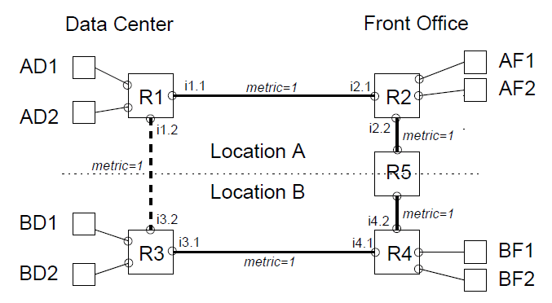
Local configuration global effect
A company has two locations: A and B
Both A and B have front offices and data centers
Security policy: front office computers can talk to front office computers and its own data centers, but not other office’s data center; data center computers can talk to each other.

Slide 2
Local configuration global effect
Security policy implementation
Drop all packets
From BF subnet
Drop all packets
From AF subnet

Slide 3
Local configuration global effect
The two datacenter wants to be the backup of each other, add a link. What happen next?
Drop all packets
From BF subnet
Drop all packets
From AF subnet

Slide 4
Local configuration global effect
The security policy is broken: it requires routing and packet filtering to work in concert; but the routing automatically adapts to topology change.
Much nicer to use global network view to do the function
Drop all packets
From BF subnet
Drop all packets
From AF subnet

