Slide 1
Research Activities at
Florida State Deep Learning Group
Laboratory of Cyber Physical Systems
Florida State University
Xiuwen Liu
Department of Computer Science
Florida State University
Slides available at
http://www.cs.fsu.edu/~liux/courses/intro-seminar-18.pptx

Slide 2
Marriott discloses massive data breach affecting up to 500 million guests

Slide 3
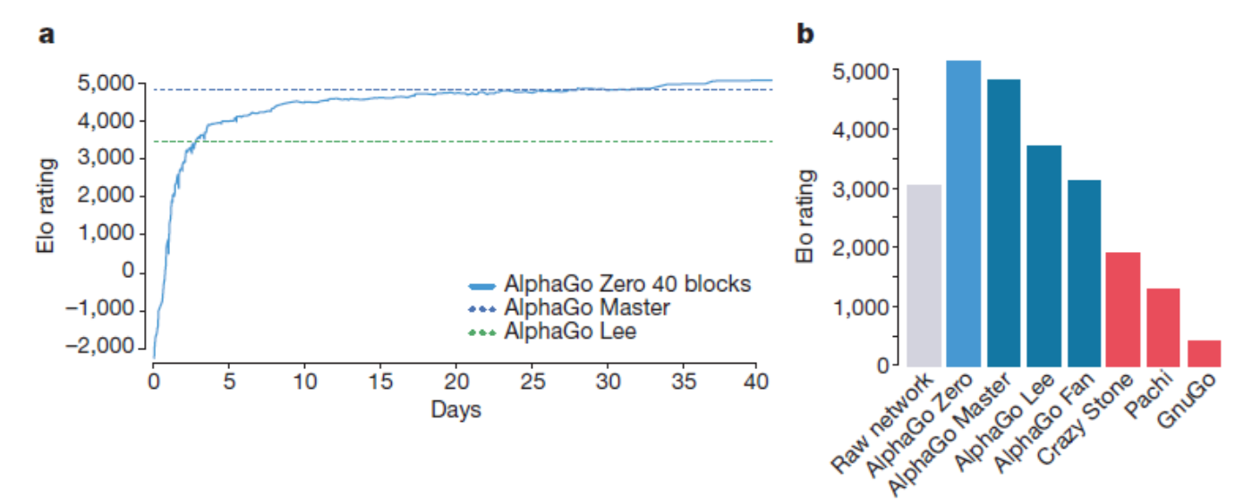
Superhuman Performance

Slide 4
AlphaFold

Slide 5
AlphaFold
Notes:
55.2330
42.8597
36.2531
36.0202
33.4427
31.8520

Slide 6
A Very Recent Study

Slide 7
The Task

Slide 8
Results

Slide 9
My Research Goals
Creating Computational Models for Predicting Spatiotemporal Processes
  In computer vision to create machines that can “see” with similar and super human performance and their applications
  In computer security to create original solutions to secure cyber-physical and other systems
  In computational biology to understand chromatin organization and its roles in cell functions
  In high frequency finance to create models that can capture and use high-dimensional features
  In machine learning to develop better and more effective representations and approximation algorithms

Slide 10
Deep Cyber Warriors
A reinforcement learning approach to analyzing malware and binary programs
  Why analysts can analyze malicious and binary programs, they often spend a long time to analyze them
    Some of them require multiple-year efforts
  Using reinforcement learning techniques, we want to learn effective heuristics so that we can create the most capable cyber warriors
    Without hard work
    Why? Because our algorithms will figure out by learning through their experience

Slide 11
ε-Resource Speech and Language Modeling
One of the fundamental problems in machine learning and artificial intelligence is to model and understand natural languages
  Significant improvements have been achieved recently using deep learning techniques
  However, the performance for challenging problems is still limited
  How can we utilize the huge amount data for speech and texts in natural languages?

Slide 12
ε-Resource Speech and Language Modeling
One of the fundamental problems in machine learning and artificial intelligence is to model and understand natural languages
  Significant improvements have been achieved recently using deep learning techniques
  However, the performance for challenging problems is still limited
  How can we utilize the huge amount data for speech and texts in natural languages?
    By integrating unsupervised learning and supervised techniques to improve the performance

Slide 13
Word Representations Based on Embeddings

Slide 14
A Fundamental Limitation of Vector Word Representations
Note that the word representations are derived based on word co-occurrences
  While many words have multiple senses (meanings), word co-occurrences are sense-blind
    The advantage of being sense-blind is that they can be used easily
    While not perfect, they capture some aspects of the conflated meanings of polysemous words
One obvious way to improve that is to determine the senses of words and therefore make the vector representations for the words sense-sensitive
  The problem of determining the senses of words is not a new problem
    It is one of the few early problems for machine translation in 1949
    It is still an open problem
Notes:
WSD was first formulated into as a distinct computational task during the early days of machine translation in the 1940s, making it one of the oldest problems in computational linguistics.

Slide 15
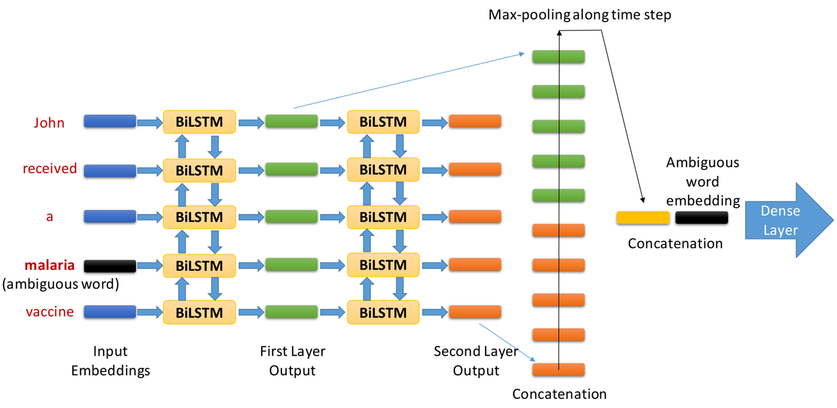
Layered Multistep Bidirectional Long Short-Term Memory Networks for Biomedical Word Sense Disambiguation

Slide 16
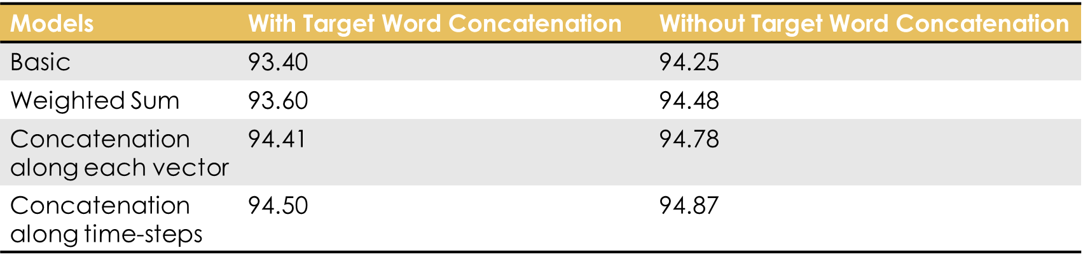
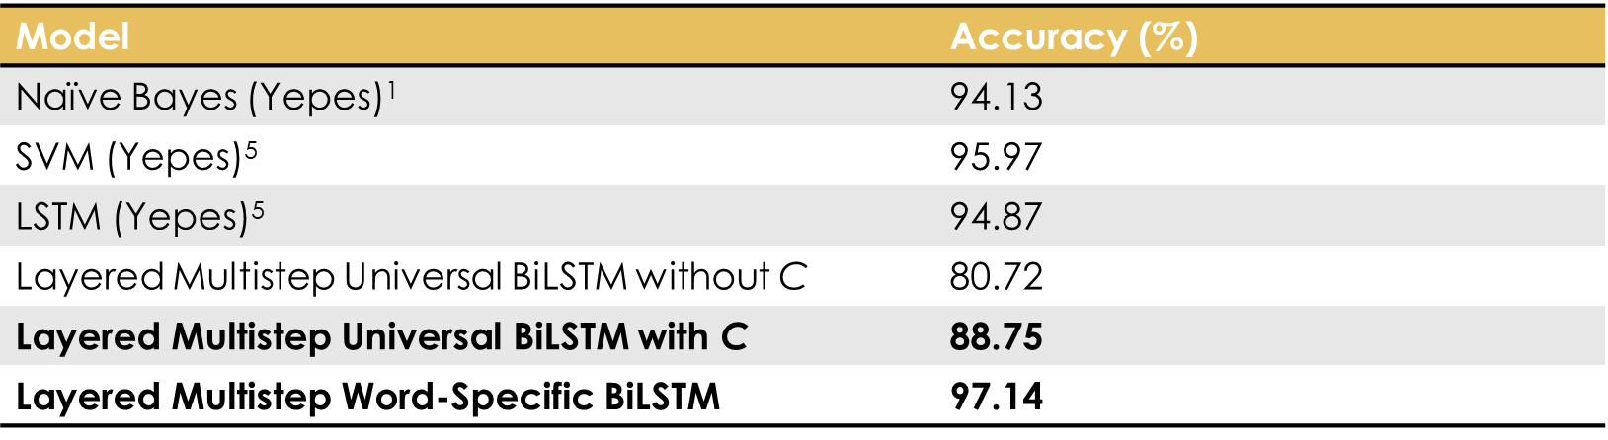
Results

Slide 17
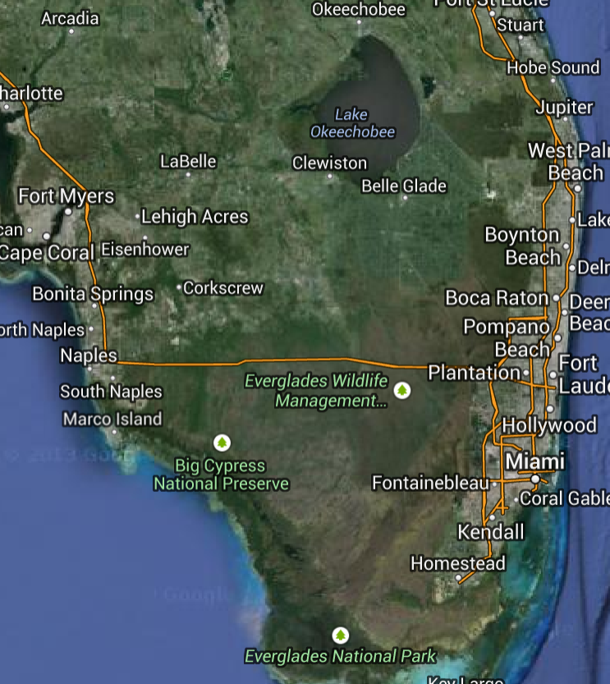
Everglade Ecosystem Modeling

Slide 18
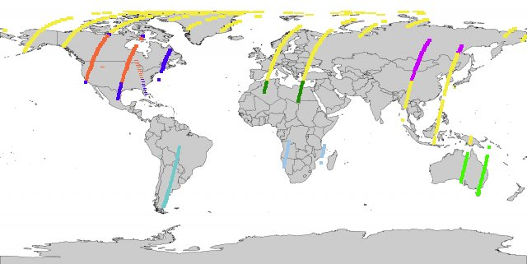
Everglade Ecosystem Modeling
Source: https://landsat.usgs.gov/tools_acq.php

Slide 19
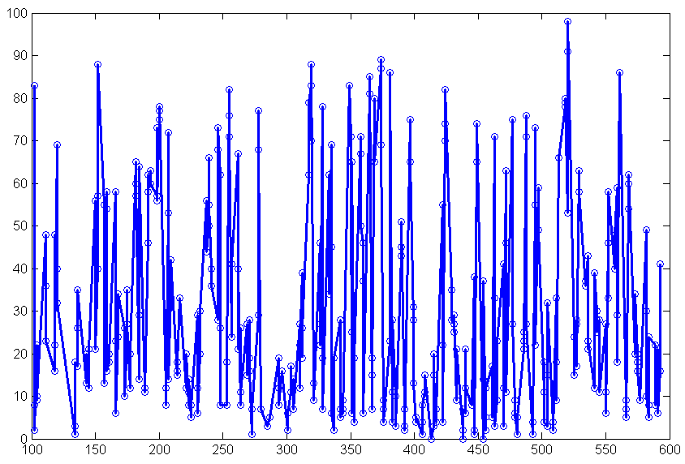
Everglade Ecosystem Modeling via Remote Sensing
Notes:
Cloud

Slide 20
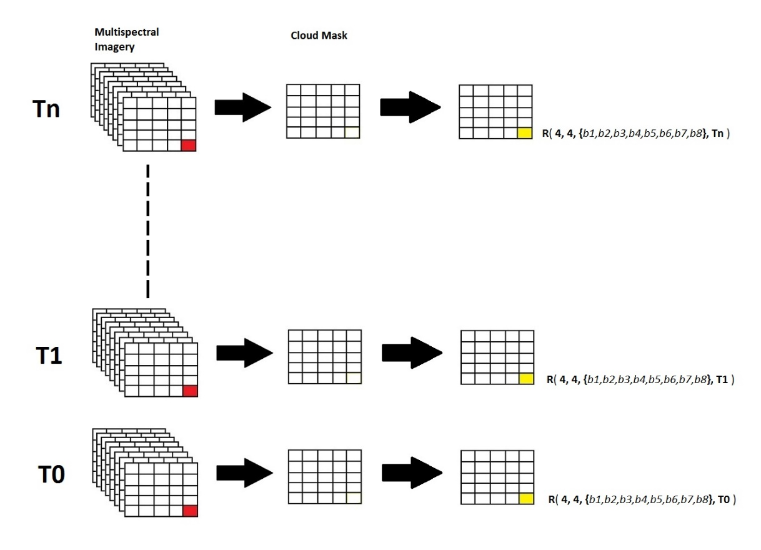
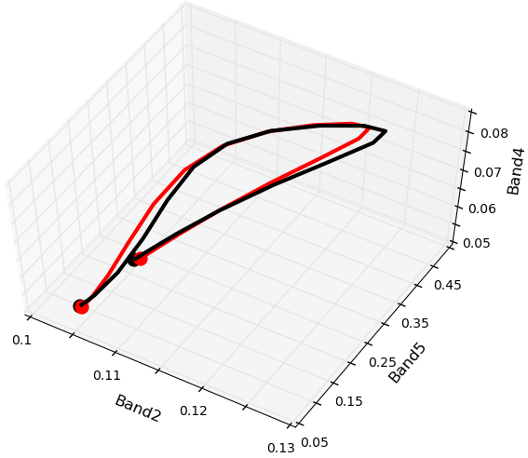
Spectral-time Curve

Slide 21
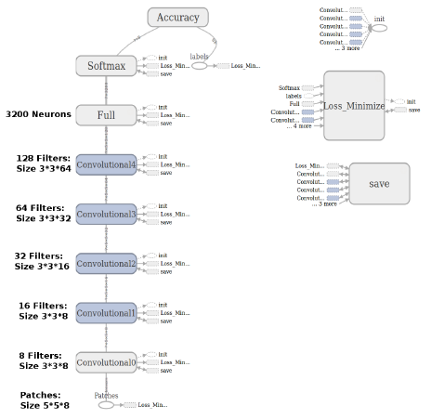
Classification Using Deep Networks

Slide 22
Comparisons

Slide 23
Comparisons

Slide 24
Patch-Based Recurrent Neural Networks

Slide 25
Patch-Based Recurrent Neural Networks

Slide 26
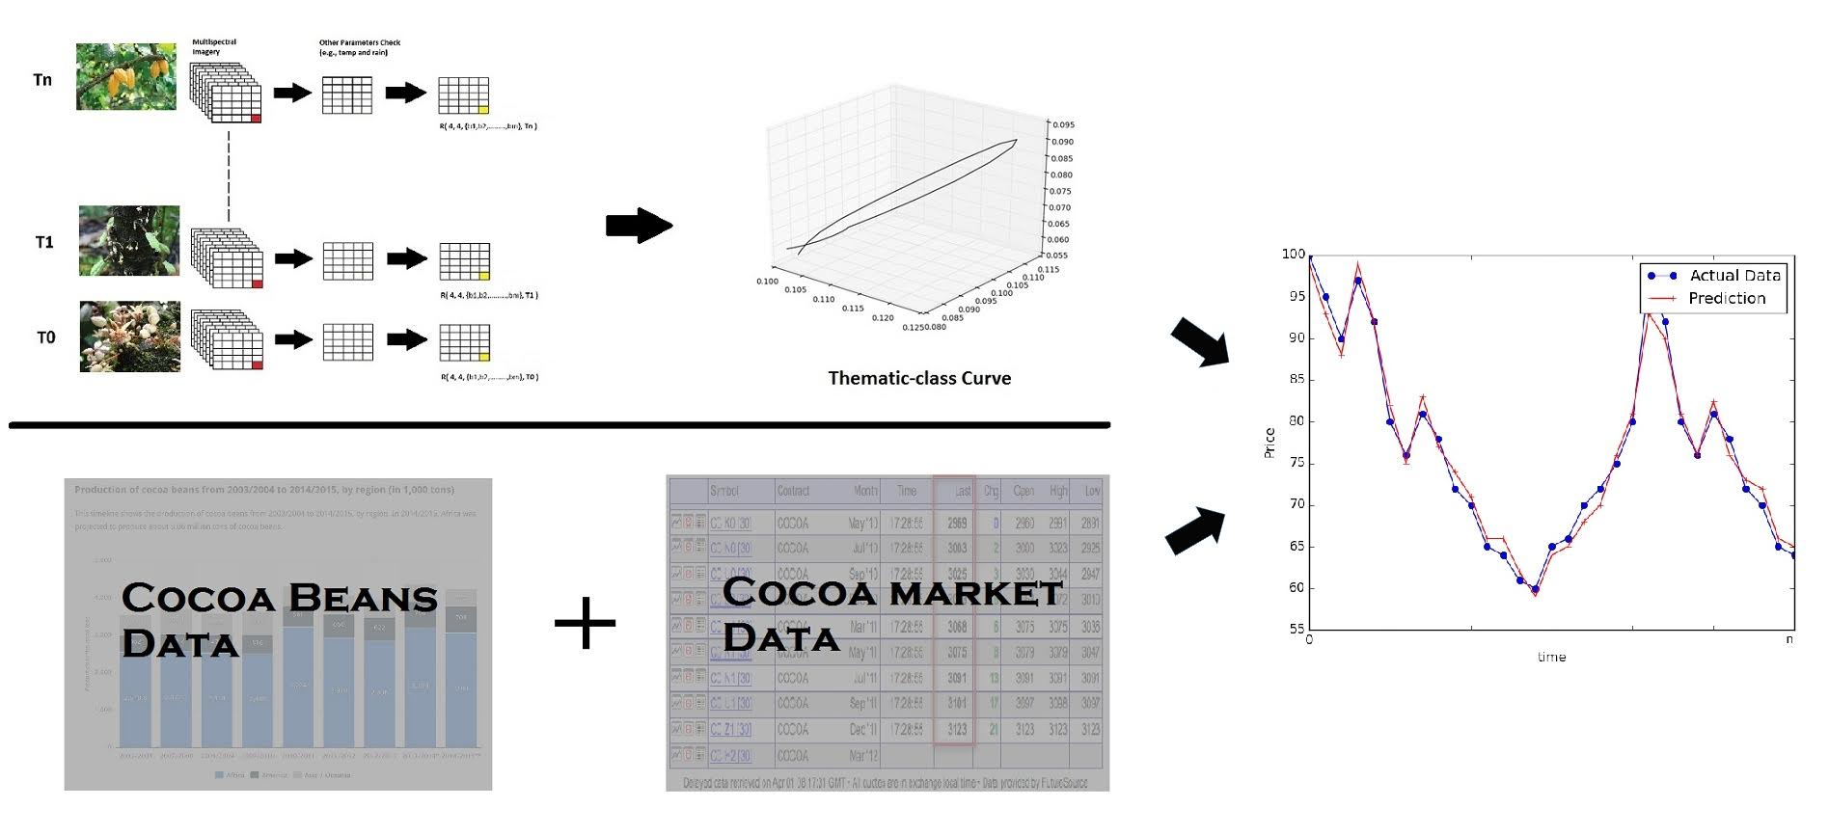
Informed Trading Strategies from Space

Slide 27
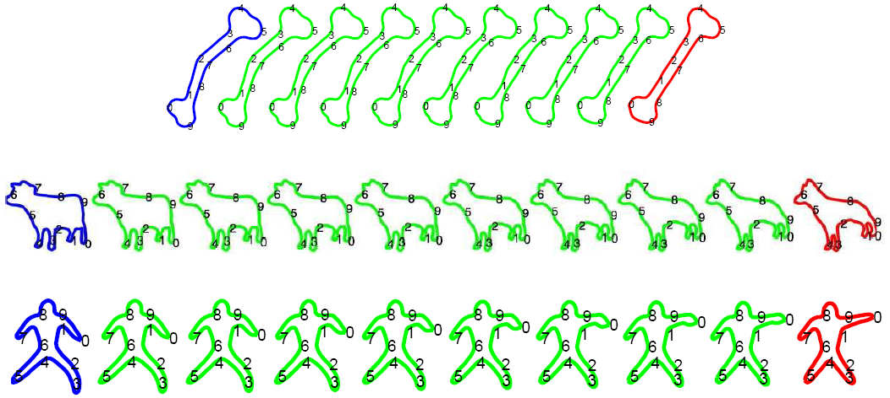
Shape Theory
We want to quantify the difference between two shapes in a principled way
  We do this by constructing a shape space and then use the geodesic distance of two shapes on the shape manifold as the metric

Slide 28
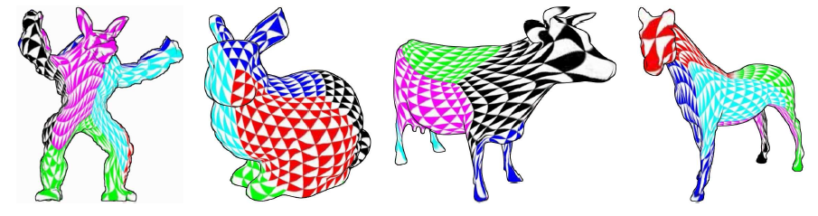

Surface Parametrization

Slide 29
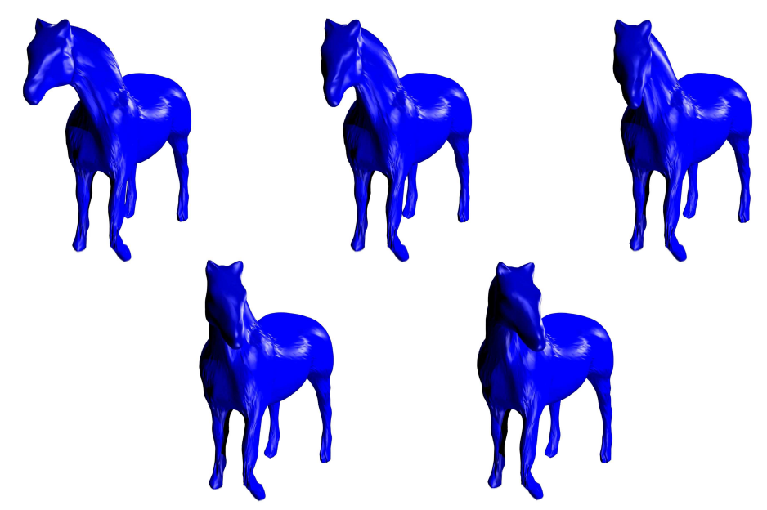
Geodesic Interpolation Between Surfaces

Slide 30
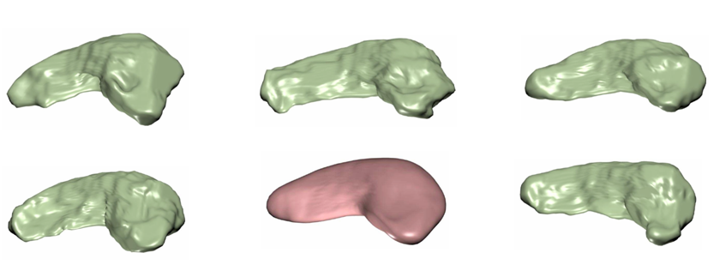
Atlas for Hippocampus

Slide 31
Characterizing Alzheimer’s via Shape Change

Slide 32
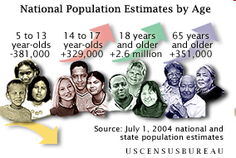
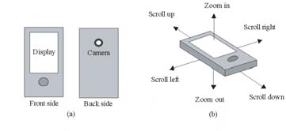
Computer Vision for Gerotechnology
As mobile devices become more powerful, they may serve as an efficient interface to make up visual, memory, and other deficiencies due to aging
  The society is aging
    For example, people of 65 and older are 16.8% of Florida’s population (US Census Bureau, 2005)
  By modifying and enhancing environments, vision technology can be critical for helping people stay active and be independent

Slide 33
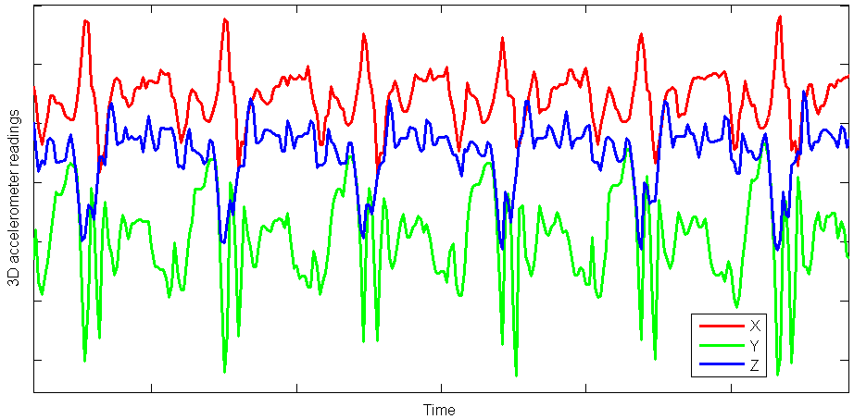
Early Detection of Alzheimer’s Using Smartphones

Slide 34
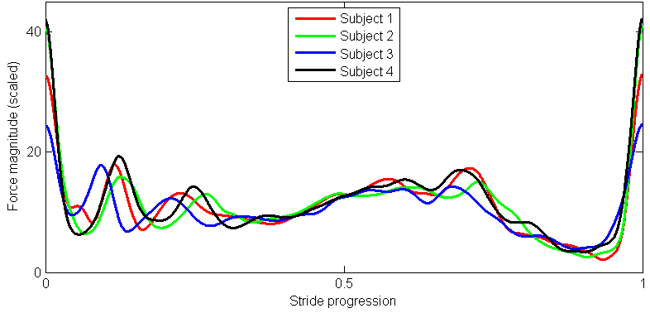
Early Detection of Alzheimer’s Using Smartphones

Slide 35
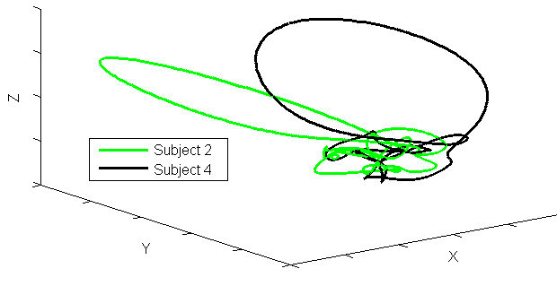
Early Detection of Alzheimer’s Using Smartphones

Slide 36
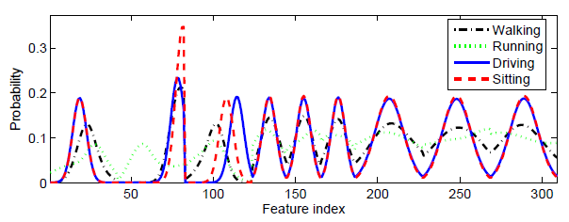
Activity Recognition Using Accelerometers

Slide 37
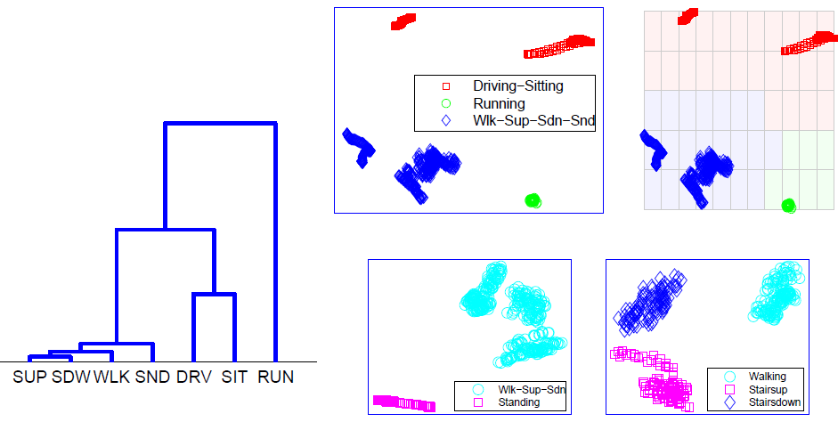
Activity Recognition Using Accelerometers

Slide 38
Deep Neural Networks for Amino Acid Prediction
A group of us have been using convolutional neural networks to predict amino acid prediction

Slide 39
Cross Entropy and Accuracy
How could the following happen?
  Here there are twenty different classes

Slide 40
Overfitting, Generalization, and Overgeneralization
Training dynamics provide useful information about samples

Slide 41
Protein Prediction Results – cont.

Slide 42
Identifying Extrinsically Classified Samples
Samples are extrinsically classified if they are classified due to extrinsic factors
  Such as randomness of weight initialization, softmax outputs, and so on
  Note that randomness factors cannot happen consistently in multiple models
    In other words, by examining classification results of multiple models, we can identify samples that are overgeneralized
    Therefore we can improve the performance on the remaining samples

Slide 43
Experimental Results on Protein Classification
For amino acid type classification, we have the following results, considering only the intrinsically classified samples

Slide 44
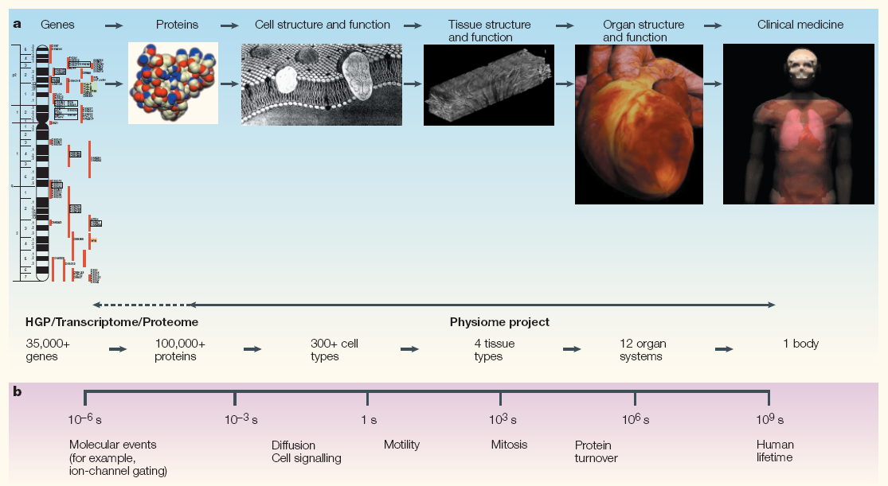
Computer Vision for Computational Systems Biology
The goal of systems biology is to link the molecular and cellular events and properties to physiological functions
Source: “Integration from proteins to organs: The Physiome Project”, Nature Review, Vol. 4, 2007.

Slide 45
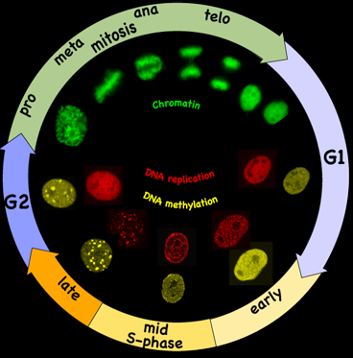
QUEST Project
Quantitative Elastic Spatial-Temporal Atlases for Subcellular Structures

Slide 46
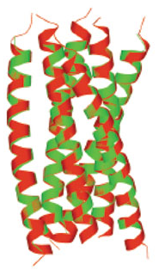
Atomic Tomography for Electron Microscopy
As life is digital, the ultimate necessary resolution for modeling biological processes is atomic resolution
  The ultimate models will be discrete rather continuous
  It appears that atomic reconstruction is almost within reach using a two-stage tomography algorithm – to be named ATomo

Slide 47
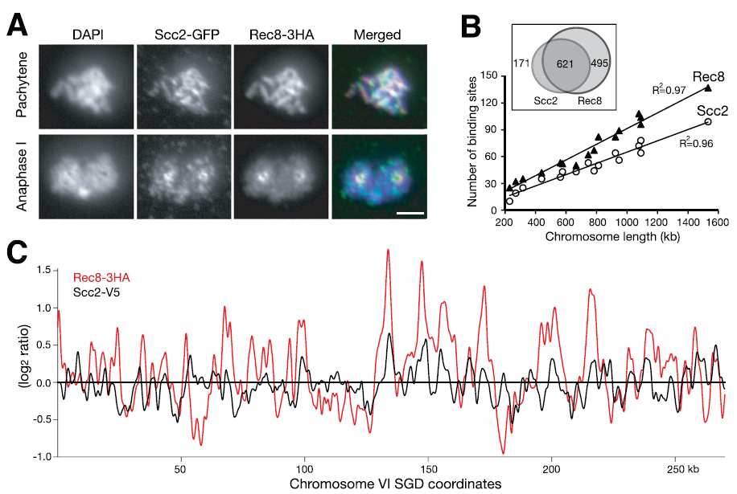
Analysis for Computational Biology
Computational biology – analysis for gene regulation

Slide 48
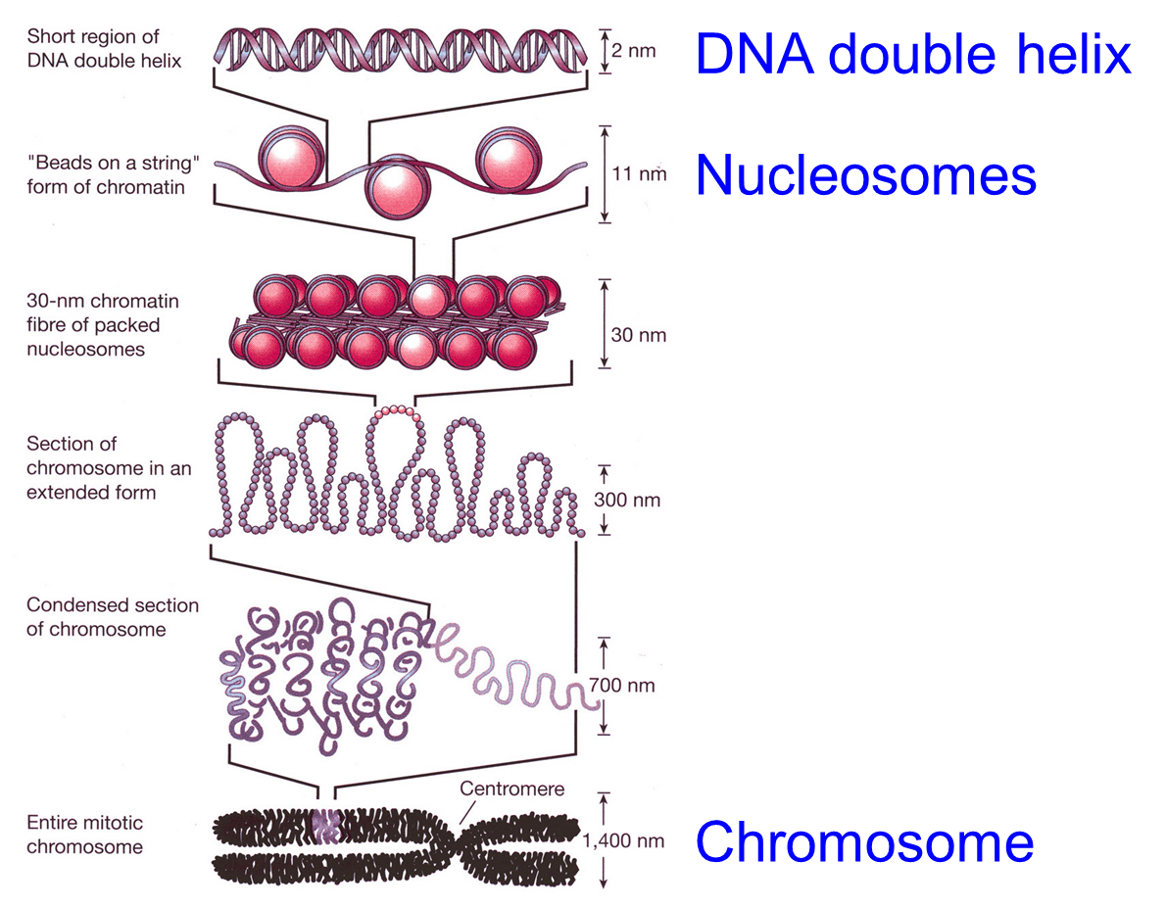

Background

Slide 49
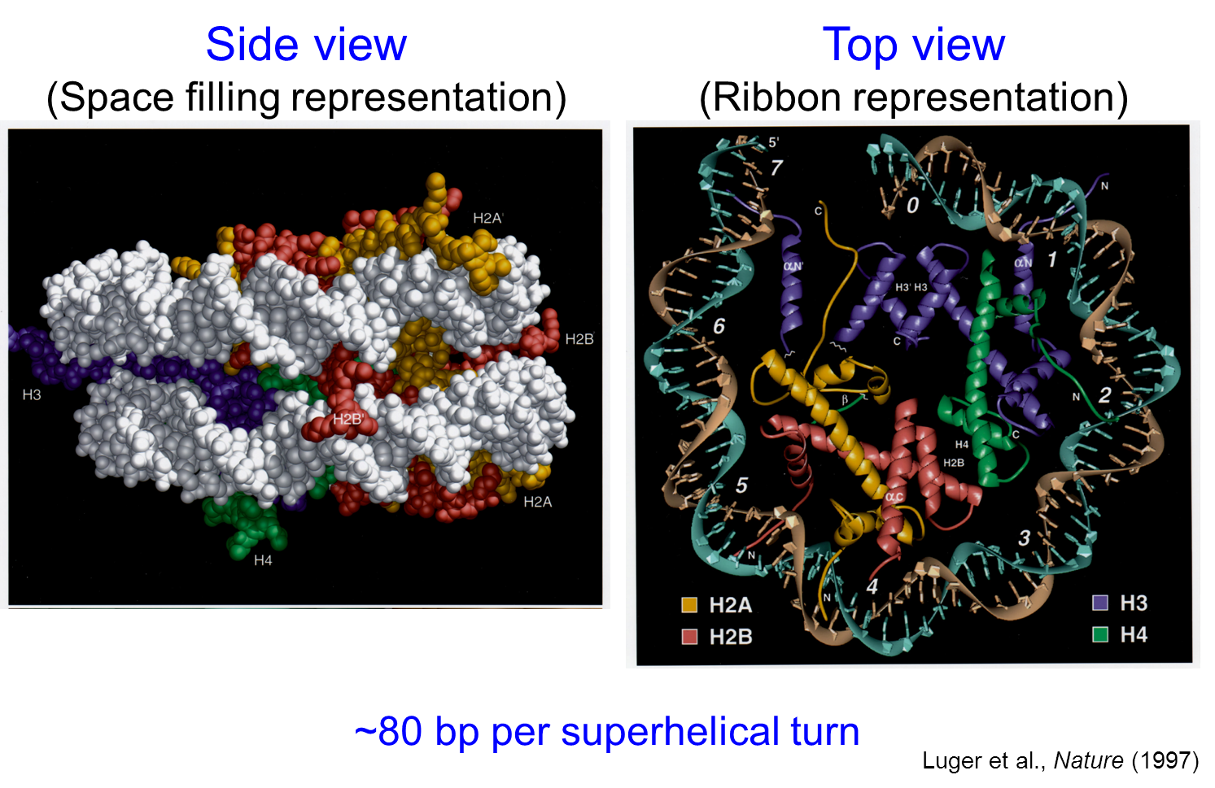
Background

Slide 50
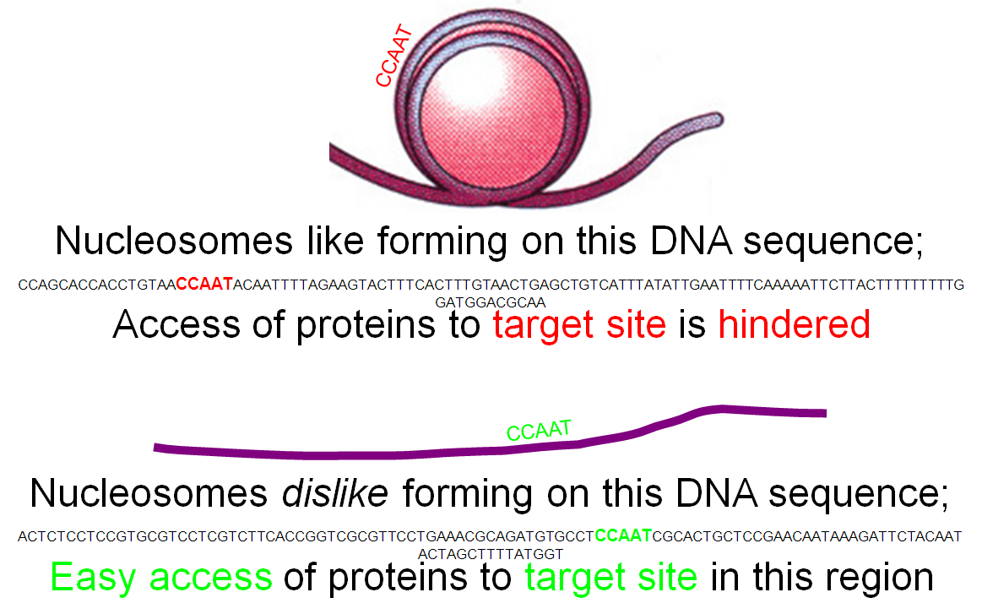
Classification-based Models
Most of the earlier computational models are based on classification

Slide 51
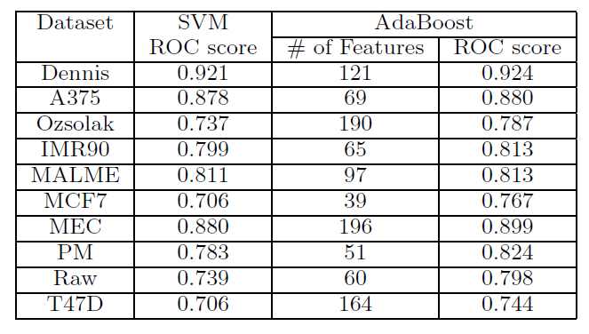
AdaBoost to Select Features

Slide 52
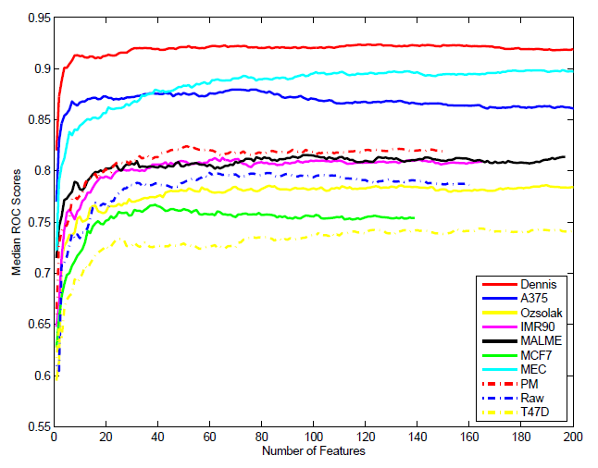
Median ROC Score

Slide 53
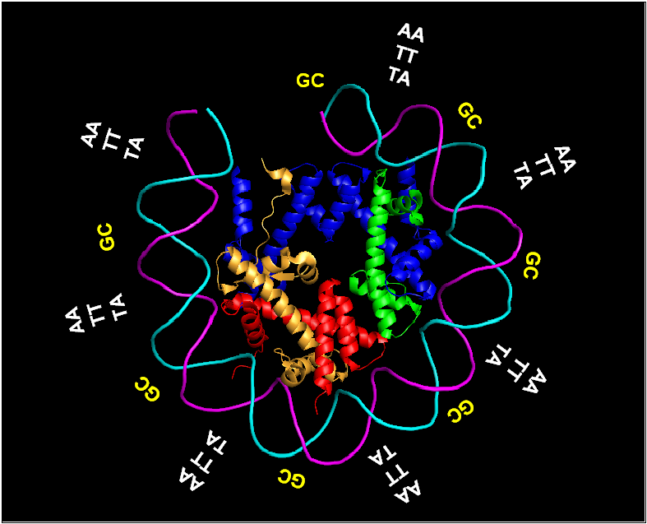
Computational Models for Nucleosome Occupancy
Chemistry and Physics Based Models
  As DNA needs to bend and wrap around nucleosomes, it is known that some sequences are more bendable, leading to curvature and bendability models
    One example is the bendability model by Trifonov’s group

Slide 54
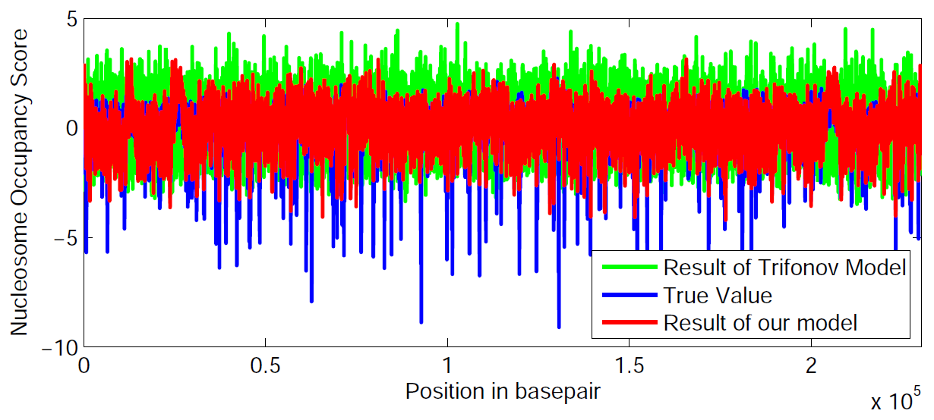
Dinucleotide Matching Model
Here are the comparisons with the bendability model on several chromosomes
  Cross correlation between our model and the ground truth is 0.5005 while it is -0.1104 for the Trifonov model

Slide 55
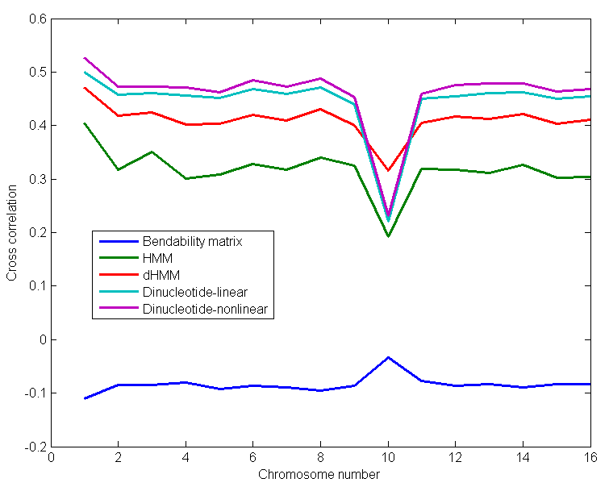
Dinucleotide Matching Model

Slide 56
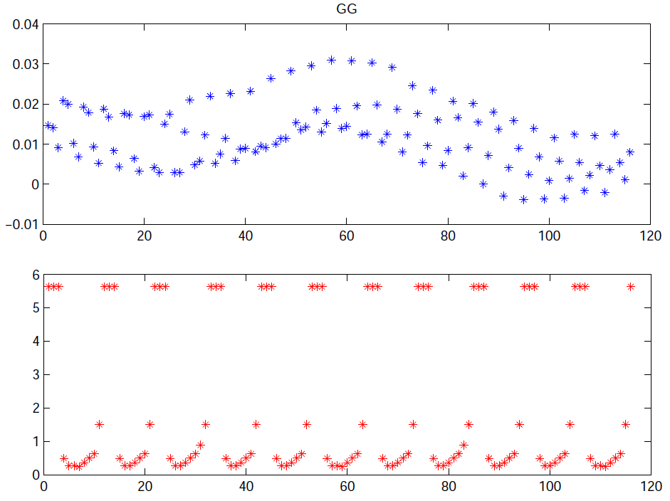
Dinucleotide Matching Model
Here are comparisons of the weights for dinucleotides

Slide 57
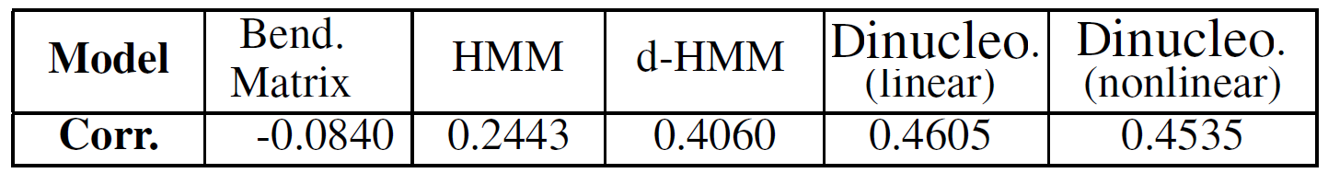
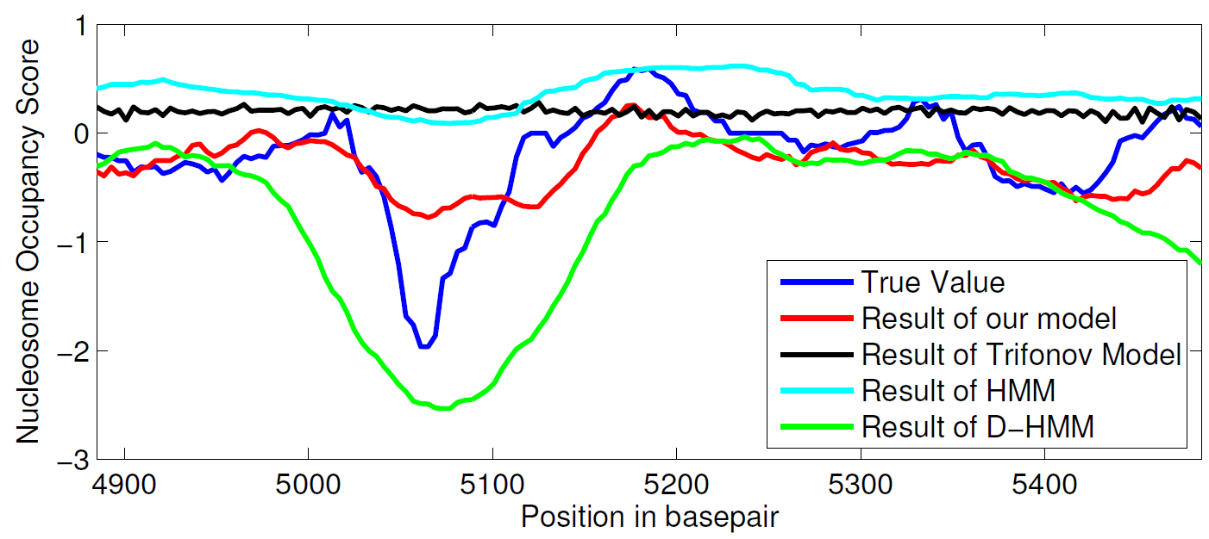
Comparisons of the Models

Slide 58
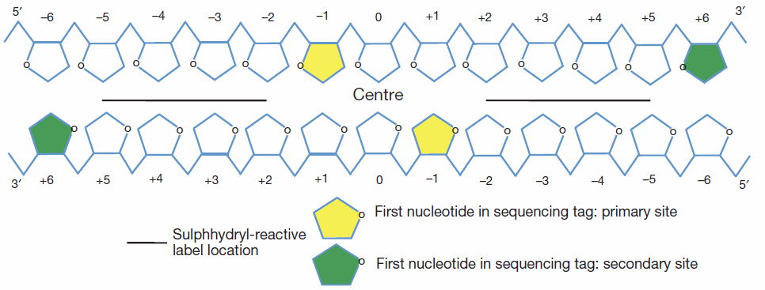
Ultimate Nucleosome Positioning Problem
In order to study the dynamics of nucleosomes, one needs to estimate their position accurately with the ultimate single-basepair resolution

Slide 59
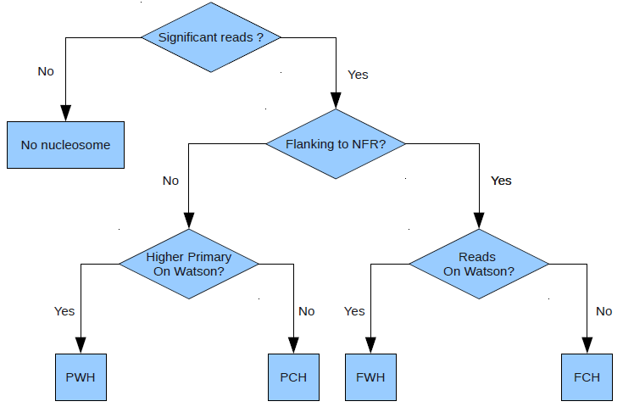
Classification Tree

Slide 60
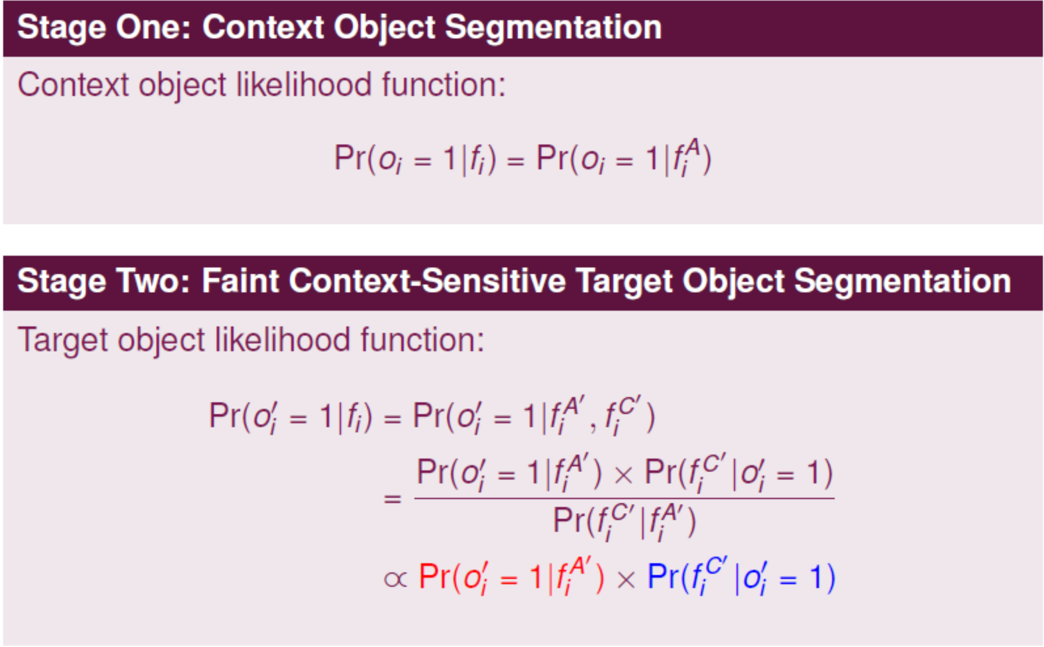
Two-Stage Context-Sensitive Semantic Segmentation

Slide 61
Microvillus spike segmentation

Slide 62
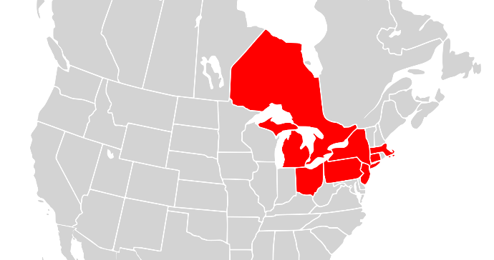
Events/Contingencies Led to 2003 Blackout
Several events contributed to the blackout
  Including heavy load (but still expected), erroneous state estimator, and several faults due to tree contacts
  Keep in mind that the number of contingencies that triggered the cascading event was small even though the 2003 blackout covered a large area
Source: http://en.wikipedia.org/wiki/File:Map_of_North_America,_blackout_2003.svg
62
Notes:
CAP5415 Harris-06-21-2010.ppt
62

Slide 63
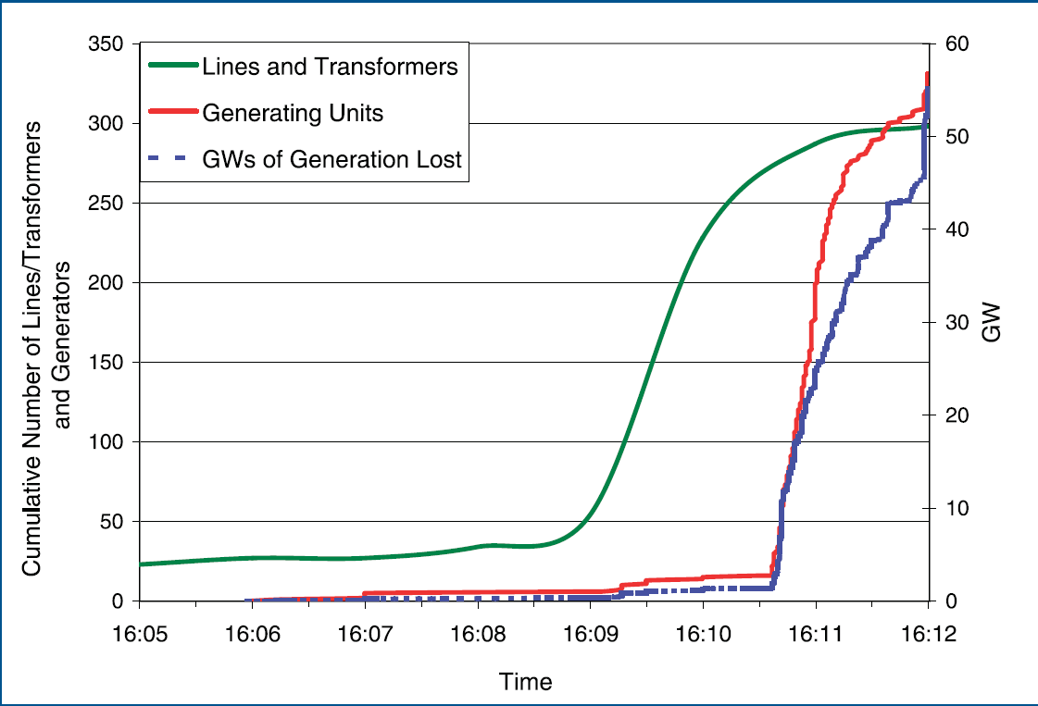
2003 Blackout – cont.
63
Notes:
CAP5415 Harris-06-21-2010.ppt
63

Slide 64
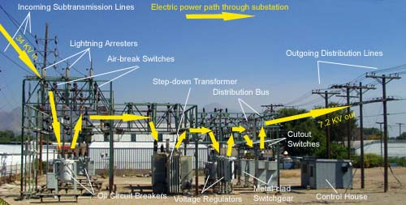
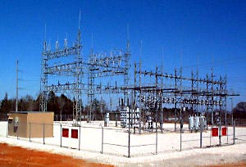
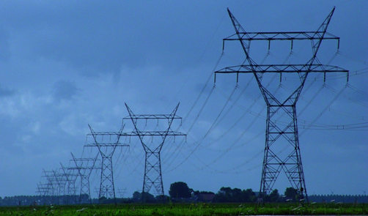
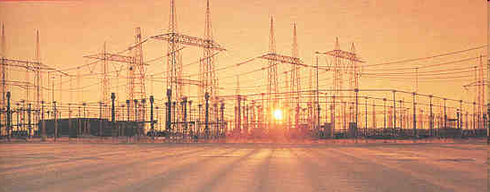
Intrinsic Vulnerabilities of the Grid
64
Notes:
Top left: substation
Top right: distribution station
Bottom left: stepping up
Transmission line in the open field
CAP5415 Harris-06-21-2010.ppt
64

Slide 65
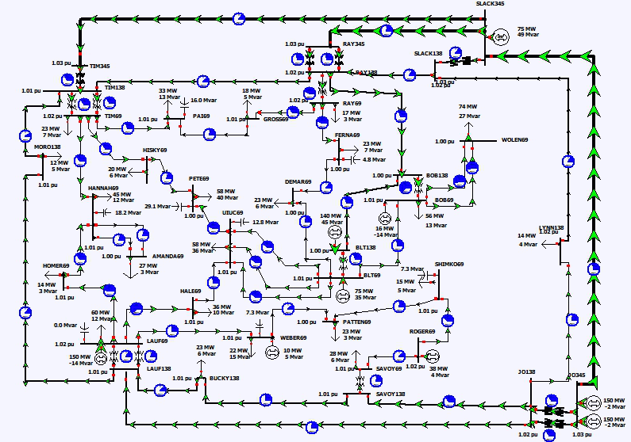
Notes:
65

Slide 66
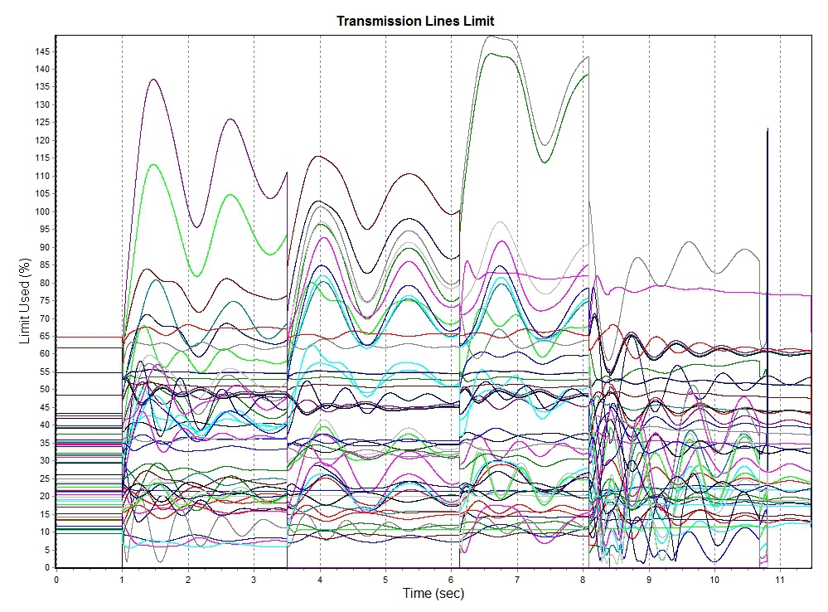
3rd & 4th trips
1st trip
2nd trip
Sync Attack Started
Notes:
66

Slide 67
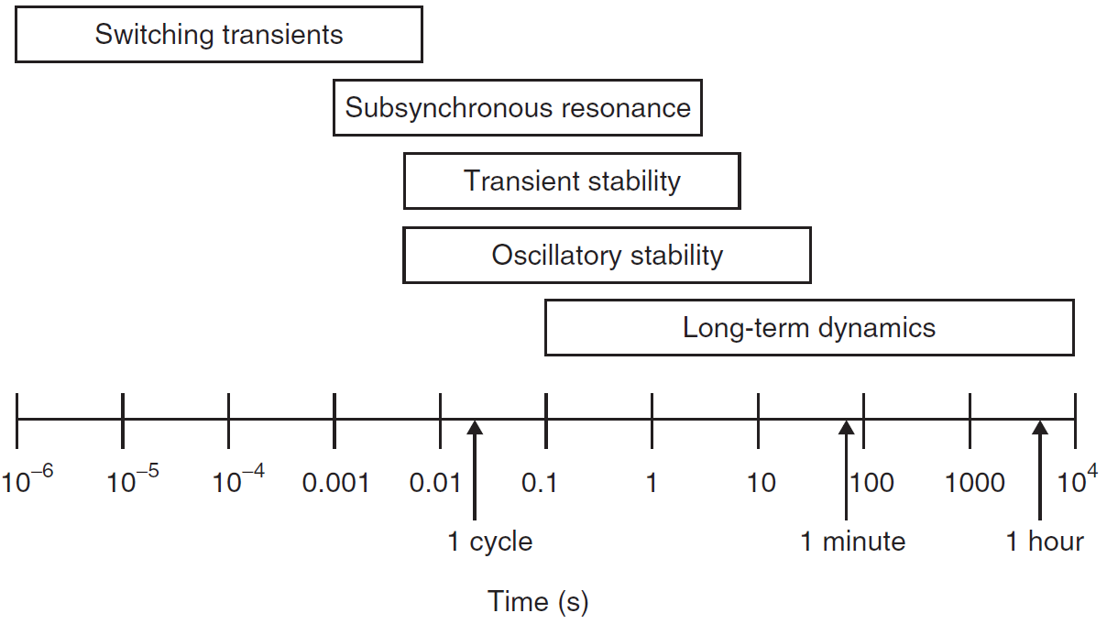
Timescale of Dynamic Phenomena in Power Systems
67
Notes:
We are concerns about fast occurring events that happen very quickly; human operators do not have enough time to react and they can cause a lot of problems.
CAP5415 Harris-06-21-2010.ppt
67

Slide 68
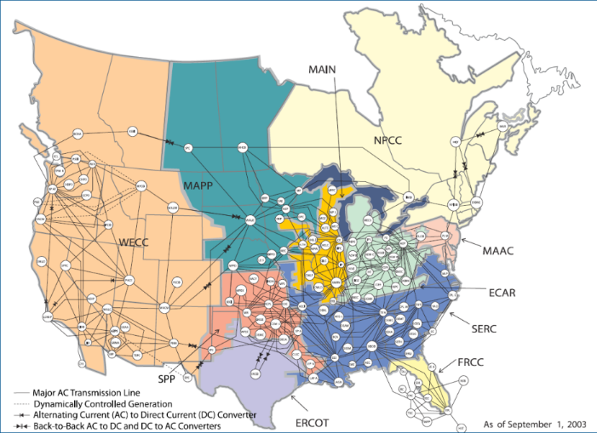
Cyber-Physical Modeling is the Key
The key requirement to defend against cascading events is fast detection and then control computation
  The method must be
    Robust to achieve high accuracy
    Fast enough so that the system can react before it is too late
    Able to handle all instability types
    Scalable to handle an entire interconnection
68
Notes:
CAP5415 Harris-06-21-2010.ppt
68

Slide 69

Scalability Is the Bottleneck to Deployable Solutions
6/20/2010 10:20:08 AM
Harris-06-21-2010.ppt
69
Notes:
CAP5415 Harris-06-21-2010.ppt
69

Slide 70

Our Approach: Overview
We divide the grid into resilient zones
  Each zone will have several resilient nodes
    There will be resilient node connected to each neighboring zone
  The nodes inside one zone are identical in that they have all the measurements in the zone
  We assume that class A data from NASPInet are available within each zone
70
Notes:
CAP5415 Harris-06-21-2010.ppt
70

Slide 71

Generating Resilience Zones
We can compute resilience zones using a graphics cut algorithm to minimize the power flow
  There are also defined control zones that can be candidates
71
Notes:
CAP5415 Harris-06-21-2010.ppt
71

Slide 72

K-hop Tree for Each Resilient Zone
72
Notes:
CAP5415 Harris-06-21-2010.ppt
72

Slide 73
Cascading Events Detection Method
Note that while cascading events can happen under practically infinite number of scenarios, it always involves (dramatic) power transfer increases along certain transmission lines
  With the Class A data from NASPInet we can detect the propagation trend
  One algorithm is to estimate the power flow increase along paths that go through the current resilient zone
73
Notes:
CAP5415 Harris-06-21-2010.ppt
73

Slide 74
Detecting Cascading Events – cont.
74
Notes:
CAP5415 Harris-06-21-2010.ppt
74

Slide 75
Detecting Cascading Events – cont.
It can be done by modeling the power flow along each path and evaluating the thermal limits along the path
This can also be posed as a machine learning problem
  We can train decision trees, support vector machines, or other classifiers
  A key problem is to ensure generalization of the classifiers
  My group proposed optimal component analysis algorithm to maximize “generalization” (in the leave-one-out sense)

Slide 76
Can We Prevent Cyber-Induced Physical Damages?
Why could Stuxnet happen?
Trusted security modules
  The idea is to place a trusted security module at the interface between cyber and physical components to make sure that no cyber commands that could lead to physical damages are allowed

Slide 77
Our Approach

Slide 78
A Prototype System

Slide 79
Zero-day Vulnerabilities for CPS
How to detect zero-day vulnerabilities in cyber-physical systems?
  Content-based approaches
  Network-based approaches
  Host-based approaches
We are building a comprehensive system to secure cyber-physical systems
  Using a style-based model via topic modeling
  While malware instances change substantially, malware styles do not change quickly

Slide 80
Instrusieve System

Slide 81
Instrusieve System

Slide 82
Datasets

Slide 83

Cyber-Physical System Approach to Active Flow Control
How can an airplane lift itself up?
  Newton got it wrong
80% of the hurricane damages are initiated by single point failures
  What kind of point and why?

Slide 84
High Frequency Finance Data Modeling
As computers and storage become inexpensive, saving trading data is being done at a much higher resolution
  For example, working with Prof. Ramo Gencay in the Department of Economics at Simon Fraser University, we have 40 gigabytes of foreign exchange data
    With order books of depth 10, sampled every 0.1 second

Slide 85

High Frequency Finance Data Modeling
As computers and storage become inexpensive, saving trading data is being done at a much higher resolution
  For example, working with Prof. Ramo Gencay in the Department of Economics at Simon Fraser University, we have 40 gigabytes of foreign exchange data
    With order books of depth 10, sampled every 0.1 second

Slide 86
High Frequency Finance Data Modeling
Order book flow representation
  Financial market can change very quickly in reaction to news and other items

Slide 87

Instance on April 23, 2013
Notes:
Source: http://www.telegraph.co.uk/finance/markets/10013768/Bogus-AP-tweet-about-explosion-at-the-White-House-wipes-billions-off-US-markets.html
Dow Jones dropped 145 points, Standard & Poor’s 500 Index lost $136 billion in value, and blue chip
names like Exxon Mobil, Apple, Johnson & Johnson and Microsoft lost about 1% of their value.
On April 23, 2013
“Breaking: Two Explosions in the White House and Barrack Obama is injured,” said the fake “alert” from one of America’s most trusted news sources, briefly fooling some news outlets and sending the Dow Jones plunging 145 points in the space of two minutes — or 1pc.
The benchmark S&P 500 index also fell nearly 1pc in the space of three minutes as the tweet hit the markets. With the S&P valued at roughly $14.6 trillion at the moment of the false tweet, that three-minute plunge briefly wiped out $136.5bn (£92.2bn) of the index's value, according to Reuters.

Slide 88
High Frequency Finance Data Modeling
With high frequency trading data, low dimensional models such as mean and variance are no longer sufficient
  However, how to take advantage of such huge high dimensional datasets under real time constraints is not a trivial problem
  For example, how to find the clusters such datasets?

Slide 89
High Frequency Finance Data Modeling
There are generally two approaches
  Product quantization
    Divide the high dimensional vector into subgroups
    We can cluster each subgroup
    The clusters in the high dimensional space can be generated as the Cartesian product of the clusters in subgroups
  Residual vector quantization
    We cluster the data into small clusters and then recursively cluster the residual vectors
    The clusters in the high dimensional space can be generated as the Cartesian product of the clusters in the stages

Slide 90

High Frequency Finance Data Modeling
Transform Residual K-means Trees for Scalable Clustering

Slide 91

High Frequency Finance Data Modeling

Slide 92

High Frequency Finance Data Modeling

Slide 93

What Is the Potential?
Notes:
Source: from http://www.ritholtz.com/blog/wp-content/uploads/2010/10/flash-crash-dow-popup.png .
From http://en.wikipedia.org/wiki/2010_Flash_Crash
The May 6, 2010 Flash Crash[1] also known as The Crash of 2:45, the 2010 Flash Crash or just simply, the Flash Crash, was a United States stock market crash on Thursday May 6, 2010 in which the Dow Jones Industrial Average plunged about 1000 points (about 9%) only to recover those losses within minutes. It was the second largest point swing, 1,010.14 points, and the biggest one-day point decline, 998.5 points, on an intraday basis in Dow Jones Industrial Average history .

Slide 94
Courses
Most Relevant Courses
  CAP 5638 Pattern Recognition
  CAP 5415 Principles and Algorithms of Computer Vision
  CAP 6417 Theoretical Foundations of Computer Vision
  CAP 5619 Deep and Reinforcement Learning
  CAP 5726 Computer Graphics
  CIS 5627 Offensive Computer Security
  CIS 6628 Offensive Network Security
  CAP 5137 Software Reverse Engineering and Malware Analysis
  CIS 5XXX Practical Cyber SecuriTy Fundamentals
  Cyber-Physical Systems and Security
  Seminars and advanced studies
Related Courses
  CAP 5600 Artificial Intelligence

Slide 95
Summary
My group offers interesting research topics/projects
  Effective and intrinsic represents for images and videos
  Real-time detection and recognition of objects
  Computational models for object recognition and image classification
  Medical/biological image analysis
  Motion/video sequence analysis and modeling
  Program analysis and cyber-physical security solutions
  They are challenging, interesting, and exciting
  Now it is a productive and fruitful area to be in

Slide 96
Contact Information
Name Xiuwen Liu
Web sites http://cavis.fsu.edu
http://www.cs.fsu.edu/~liux
Email liux@cs.fsu.edu
Offices LOV 168
Phone 850-644-0050

Slide 97
Thank you!
Any questions?
Slides are available from http://www.cs.fsu.edu/~liux/courses/intro-seminar-18.pptx

Slide 98
Here Is a Question for You
After I compile and run the following program on a Linux machine, what would happen and why?

Slide 99
Here Is a Question for You
After I compile and run the following program on a Linux machine, what would happen and why?

