Slide 1
Research Activities at
Florida State Vision and Learning Group
Laboratory of Cyber Physical Systems
Florida State University
Xiuwen Liu
Department of Computer Science
Florida State University
Slides available at http://www.cs.fsu.edu/~liux/courses/intro-seminar-17.pptx

Slide 2
Equifax Announces Cybersecurity Incident Involving Consumer Information

Slide 3
Equifax Announces Cybersecurity Incident Involving Consumer Information
Why would this and many other examples illustrate the dominance of computer science now and in the (near) future?

Slide 4
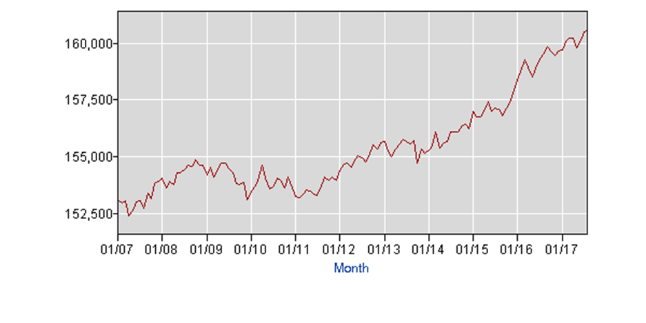
Labor Force Statistics from the Current Population Survey

Slide 5


Slide 6
My Research Goals
Creating Computational Models for Predicting Spatiotemporal Processes
  In computer vision to create machines that can “see” with similar and super human performance and their applications
  In computer security to create original solutions to secure cyber-physical and other systems
  In computational biology to understand chromatin organization and its roles in cell functions
  In high frequency finance to create models that can capture and use high-dimensional features
  In machine learning to develop better and more effective representations and approximation algorithms

Slide 7
Deep Cyber Warriors
Remember DeepBlue?
Remember AlphaGo?
A reinforcement learning approach to analyzing malware and binary programs
  Why analysts can analyze malicious and binary programs, they often spend a long time to analyze them
    Some of them require multiple-year efforts
  Using reinforcement learning techniques, we want to learn effective heuristics so that we can create the most capable cyber warriors
    Without hard work
    Why?

Slide 8
Deep Cyber Warriors
A reinforcement learning approach to analyzing malware and binary programs
  Why analysts can analyze malicious and binary programs, they often spend a long time to analyze them
    Some of them require multiple-year efforts
  Using reinforcement learning techniques, we want to learn effective heuristics so that we can create the most capable cyber warriors
    Without hard work
    Why? Because our algorithms will figure out by learning through their experience

Slide 9
ε-Resource Speech and Language Modeling
One of the fundamental problems in machine learning and artificial intelligence is to model and understand natural languages
  Significant improvements have been achieved recently using deep learning techniques
  However, the performance for challenging problems is still limited
  How can we utilize the huge amount data for speech and texts in natural languages?

Slide 10
ε-Resource Speech and Language Modeling
One of the fundamental problems in machine learning and artificial intelligence is to model and understand natural languages
  Significant improvements have been achieved recently using deep learning techniques
  However, the performance for challenging problems is still limited
  How can we utilize the huge amount data for speech and texts in natural languages?
    By integrating unsupervised learning and supervised techniques to improve the performance

Slide 11
Word Representations based on Embedding

Slide 12
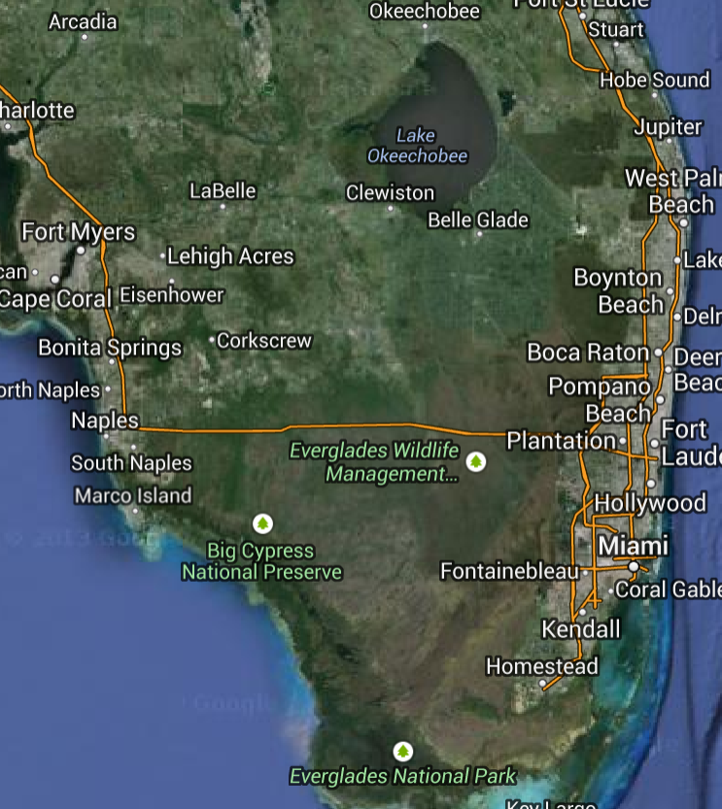
Everglade Ecosystem Modeling

Slide 13
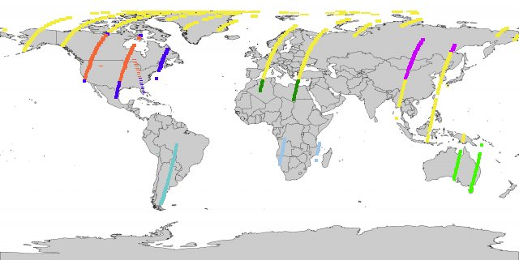
Everglade Ecosystem Modeling
Source: https://landsat.usgs.gov/tools_acq.php

Slide 14
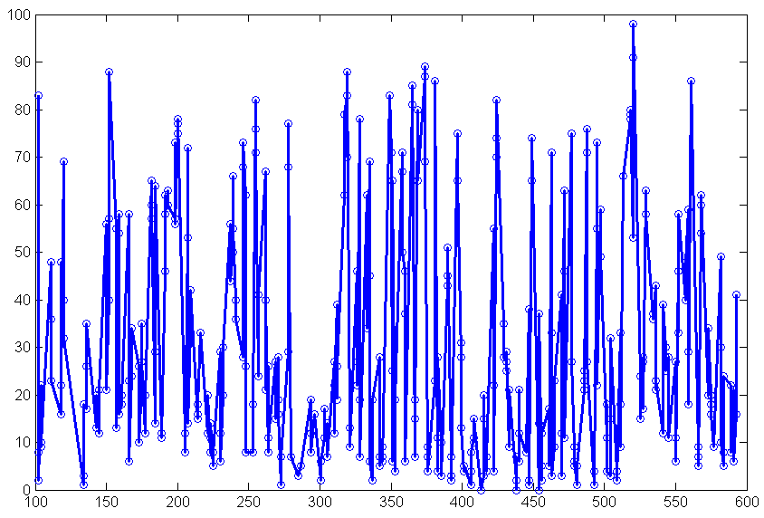
Everglade Ecosystem Modeling via Remote Sensing
Notes:
Cloud

Slide 15
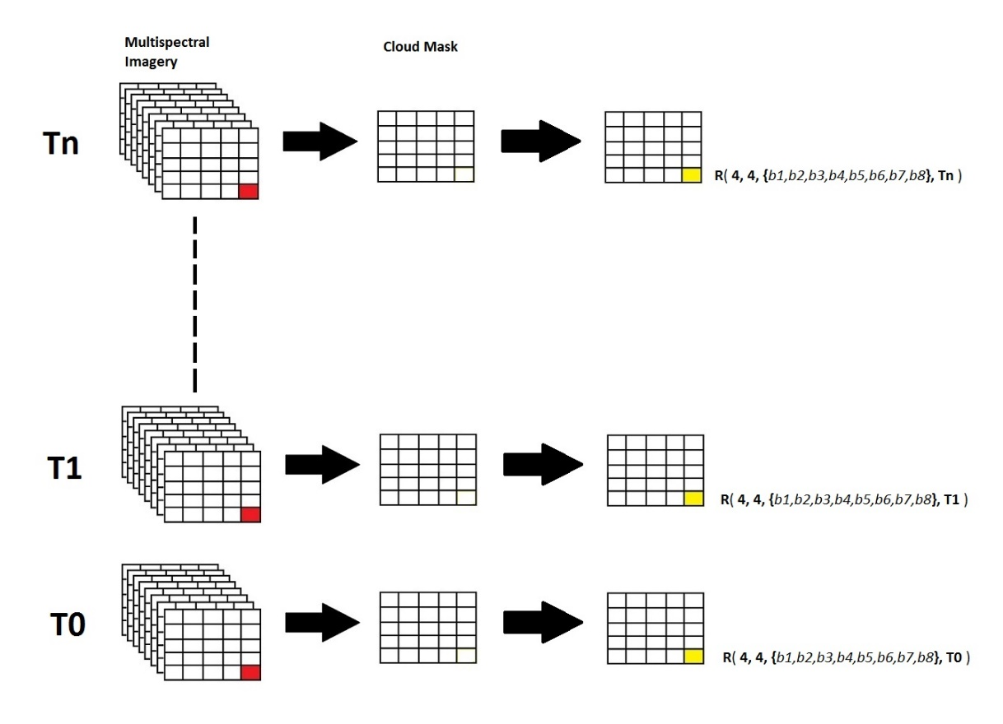
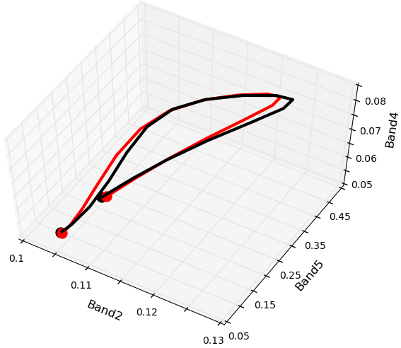
Spectral-time Curve

Slide 16
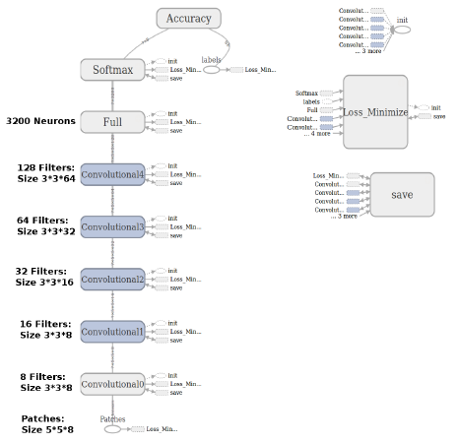
Classification Using Deep Networks

Slide 17
Comparisons

Slide 18
Comparisons

Slide 19
Patch-Based Recurrent Neural Networks

Slide 20
Patch-Based Recurrent Neural Networks

Slide 21
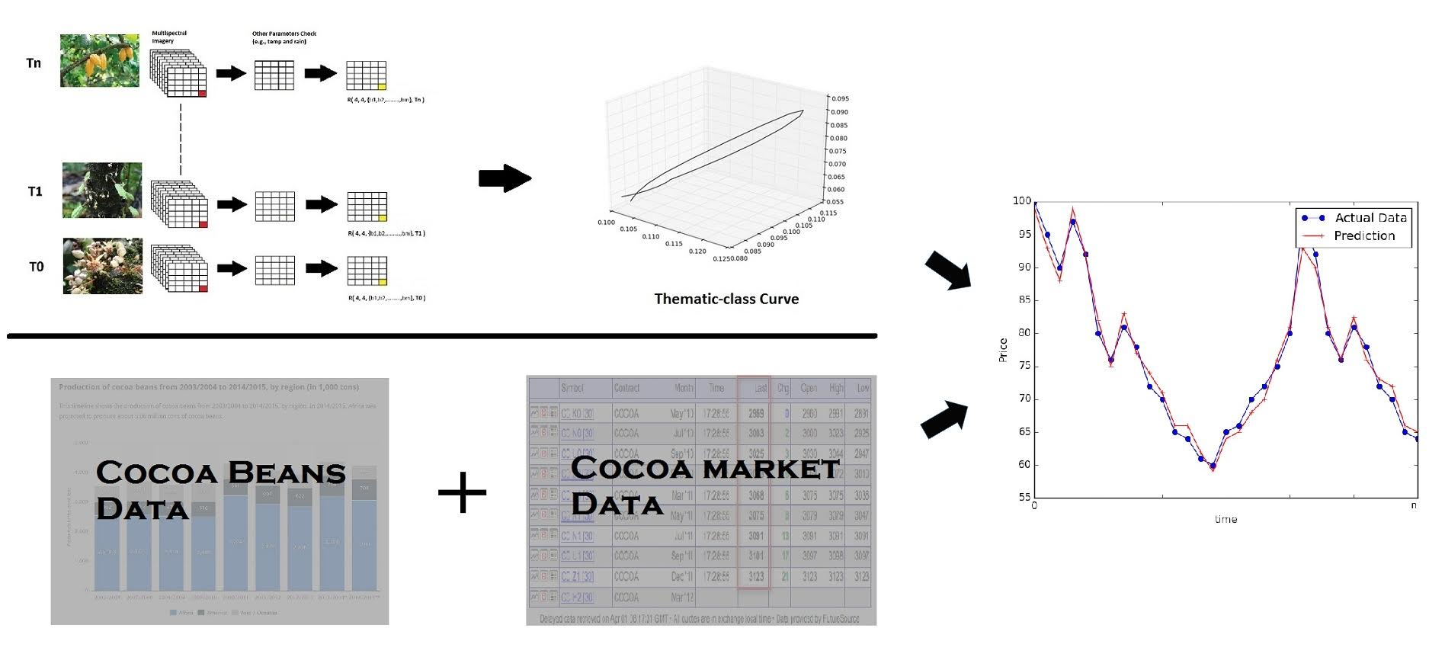
Informed Trading Strategies from Space

Slide 22
Content-based Video Representation, Indexing and Retrieval
A video is an extrinsic 3D representation of a 4D volume
  3D spatial space + 1D temporal space = 4D volume
  For video, 2D image space + 1D temporal space = 3D volume
Our group is working an intrinsic 4D representation for video
  By first reconstructing the scene using SLAM (Simultaneous localization and mapping) and stereopsis

Slide 23
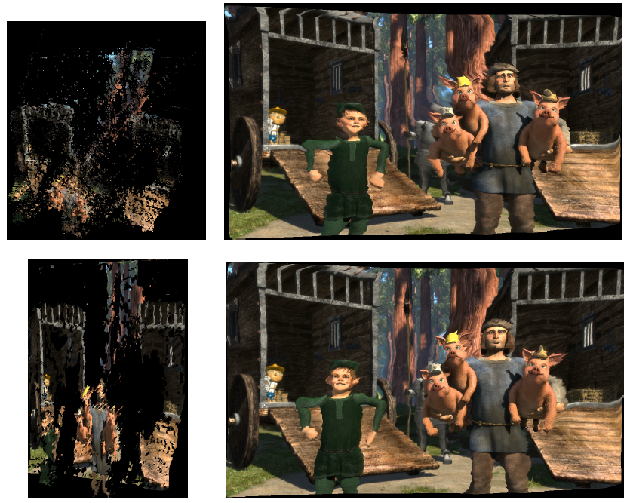
4D Video Representation Example

Slide 24
VeScene System
VeScene – Voiced Scene System
Illustration by Nan Zhao

Slide 25
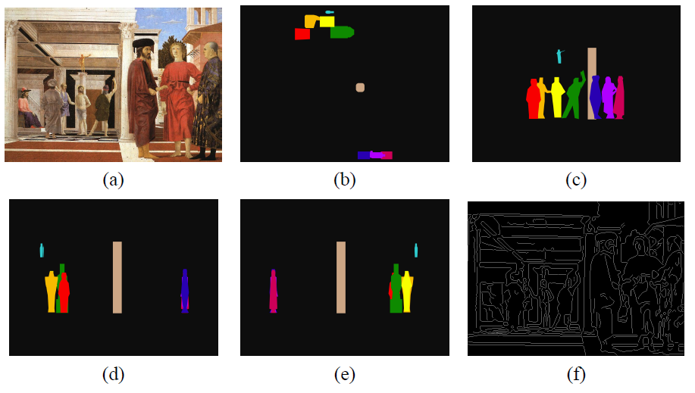
Multiple-view Representation for Painting Appreciation
Results by Nigel Nye

Slide 26
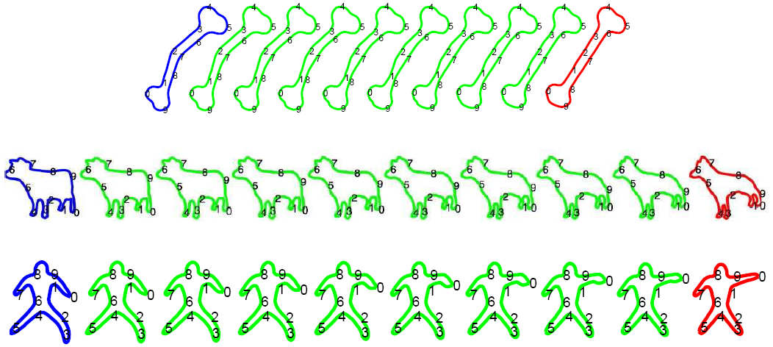
Shape Theory
We want to quantify the difference between two shapes in a principled way
  We do this by constructing a shape space and then use the geodesic distance of two shapes on the shape manifold as the metric

Slide 27
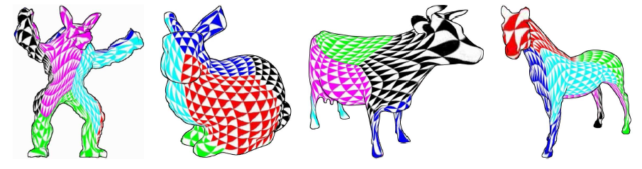

Surface Parametrization

Slide 28
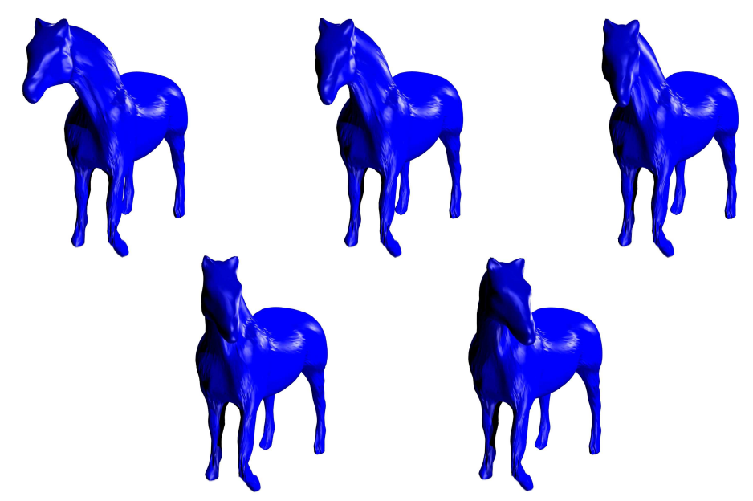
Geodesic Interpolation Between Surfaces

Slide 29
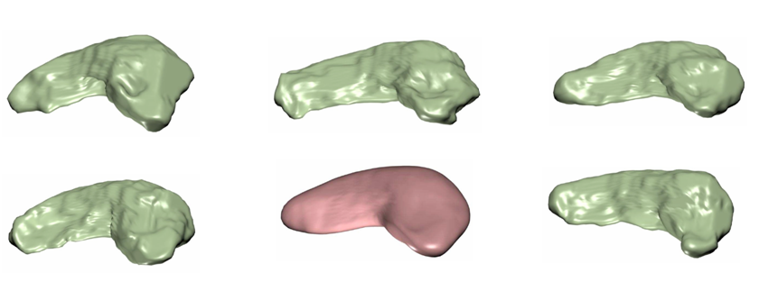
Atlas for Hippocampus

Slide 30
Characterizing Alzheimer’s via Shape Change

Slide 31
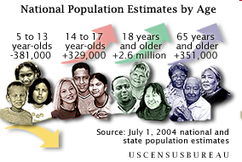
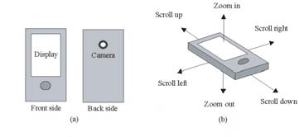
Computer Vision for Gerotechnology
As mobile devices become more powerful, they may serve as an efficient interface to make up visual, memory, and other deficiencies due to aging
  The society is aging
    For example, people of 65 and older are 16.8% of Florida’s population (US Census Bureau, 2005)
  By modifying and enhancing environments, vision technology can be critical for helping people stay active and be independent

Slide 32
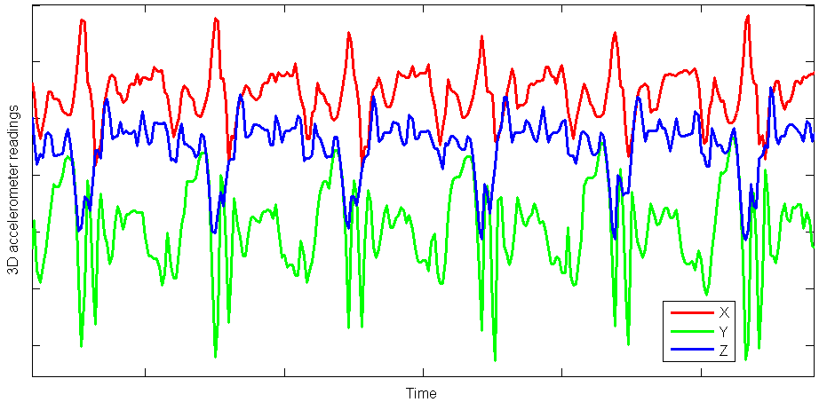
Early Detection of Alzheimer’s Using Smartphones

Slide 33
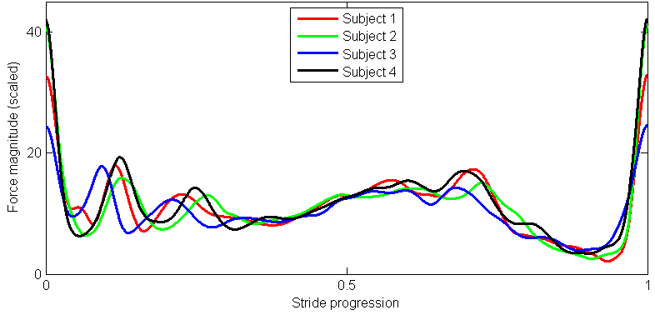
Early Detection of Alzheimer’s Using Smartphones

Slide 34
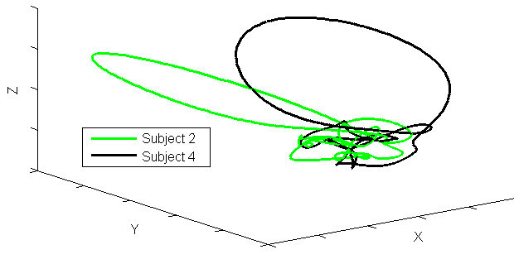
Early Detection of Alzheimer’s Using Smartphones

Slide 35
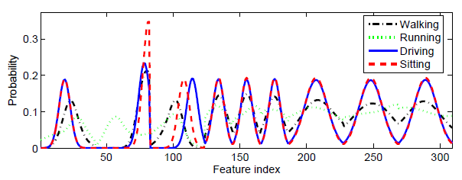
Activity Recognition Using Accelerometers

Slide 36
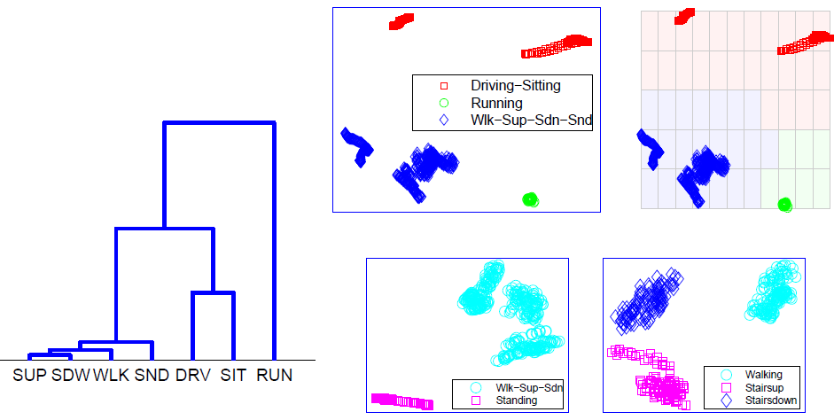
Activity Recognition Using Accelerometers

Slide 37
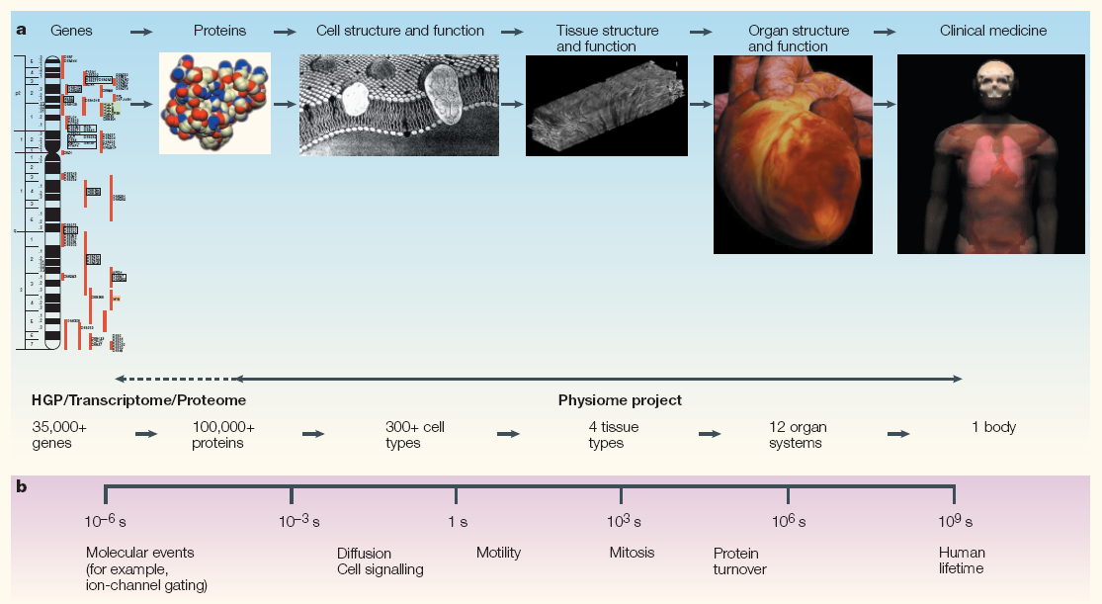
Computer Vision for Computational Systems Biology
The goal of systems biology is to link the molecular and cellular events and properties to physiological functions
Source: “Integration from proteins to organs: The Physiome Project”, Nature Review, Vol. 4, 2007.

Slide 38
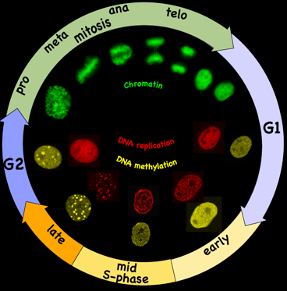
QUEST Project
Quantitative Elastic Spatial-Temporal Atlases for Subcellular Structures

Slide 39
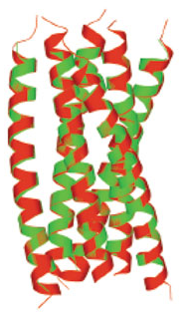
Atomic Tomography for Electron Microscopy
As life is digital, the ultimate necessary resolution for modeling biological processes is atomic resolution
  The ultimate models will be discrete rather continuous
  It appears that atomic reconstruction is almost within reach using a two-stage tomography algorithm – to be named ATomo

Slide 40
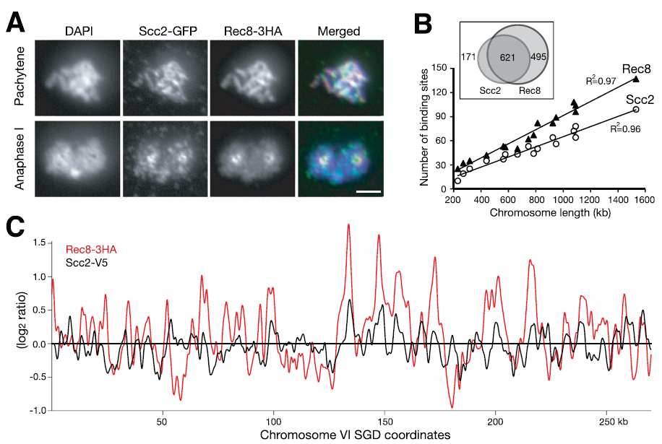
Analysis for Computational Biology
Computational biology – analysis for gene regulation

Slide 41
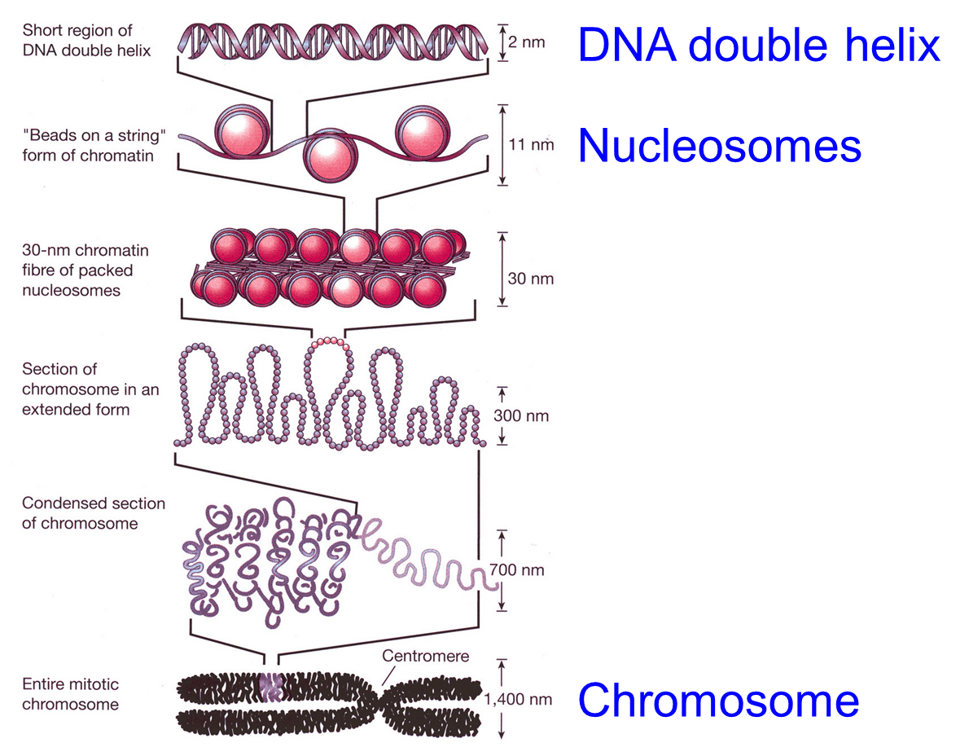

Background

Slide 42
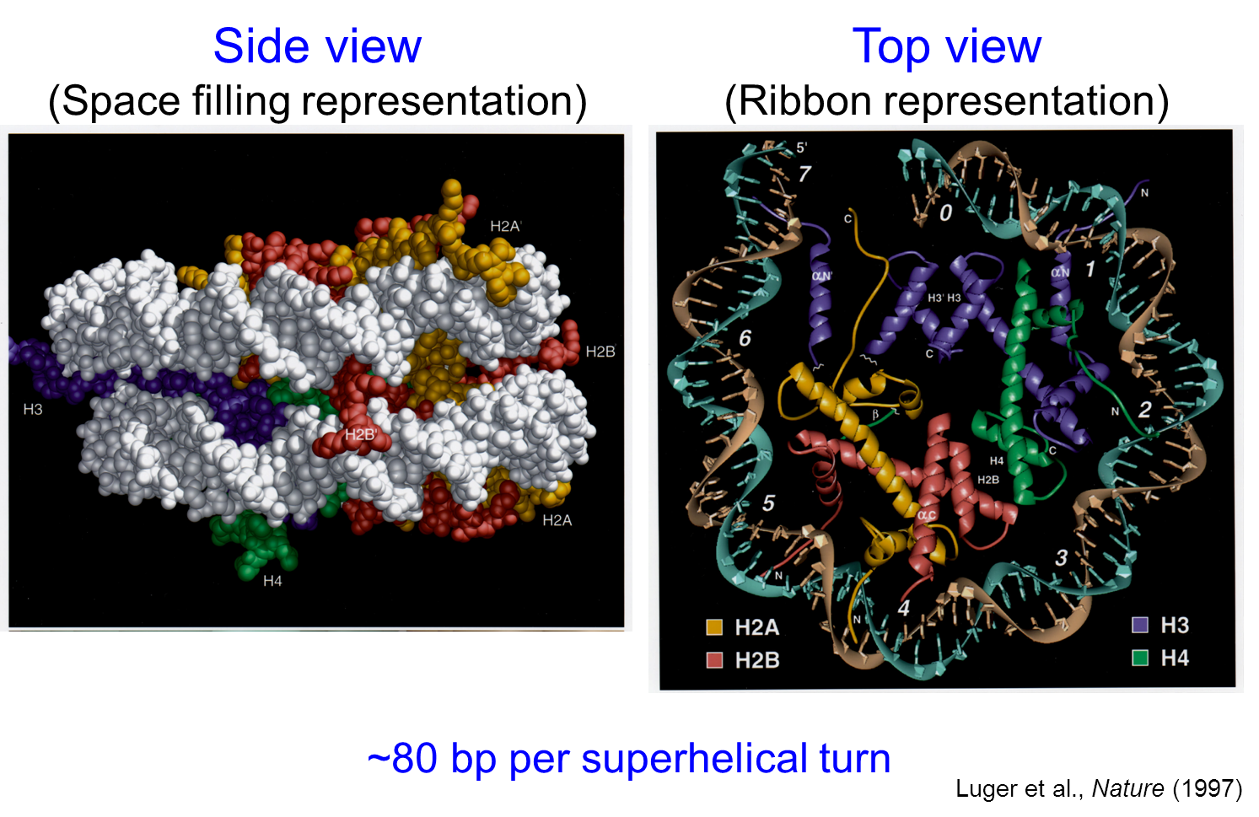
Background

Slide 43
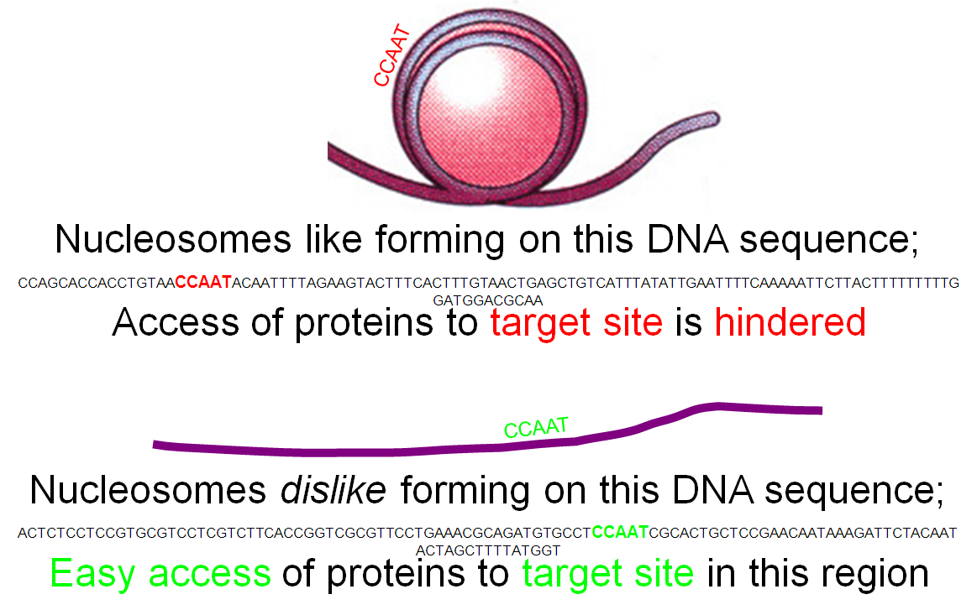
Classification-based Models
Most of the earlier computational models are based on classification

Slide 44
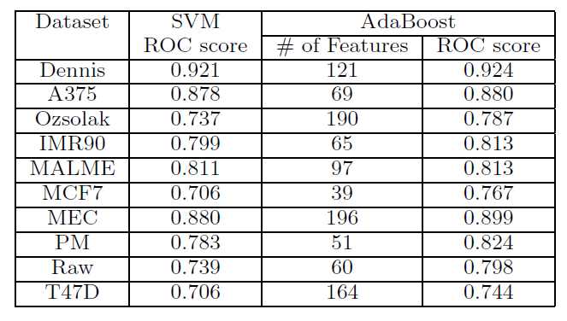
AdaBoost to Select Features

Slide 45
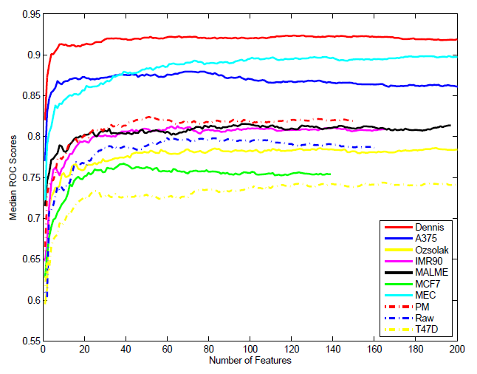
Median ROC Score

Slide 46
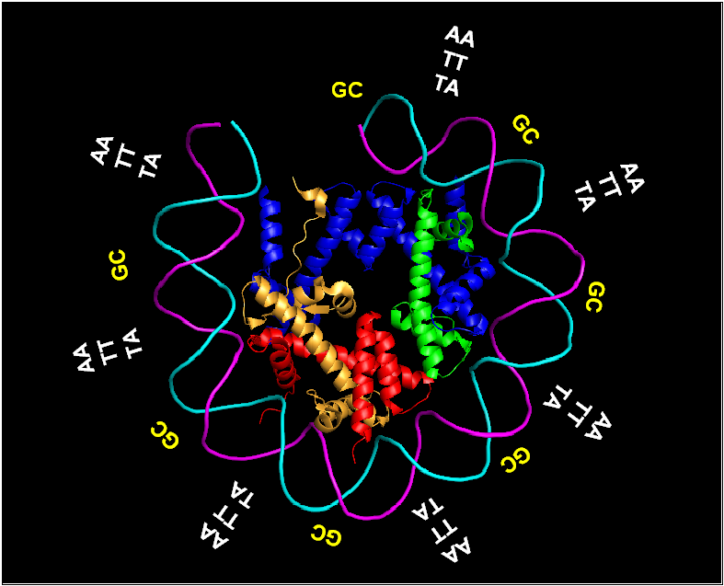
Computational Models for Nucleosome Occupancy
Chemistry and Physics Based Models
  As DNA needs to bend and wrap around nucleosomes, it is known that some sequences are more bendable, leading to curvature and bendability models
    One example is the bendability model by Trifonov’s group

Slide 47
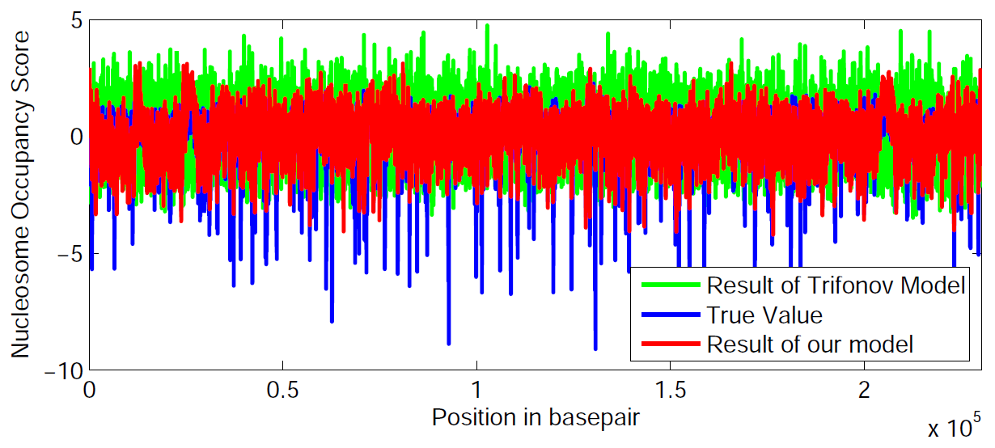
Dinucleotide Matching Model
Here are the comparisons with the bendability model on several chromosomes
  Cross correlation between our model and the ground truth is 0.5005 while it is -0.1104 for the Trifonov model

Slide 48
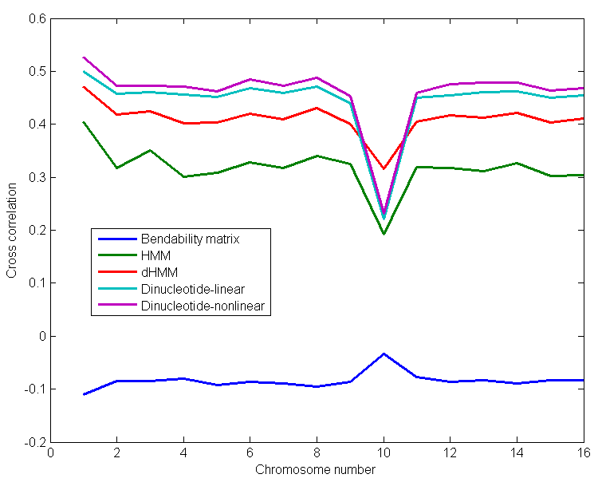
Dinucleotide Matching Model

Slide 49
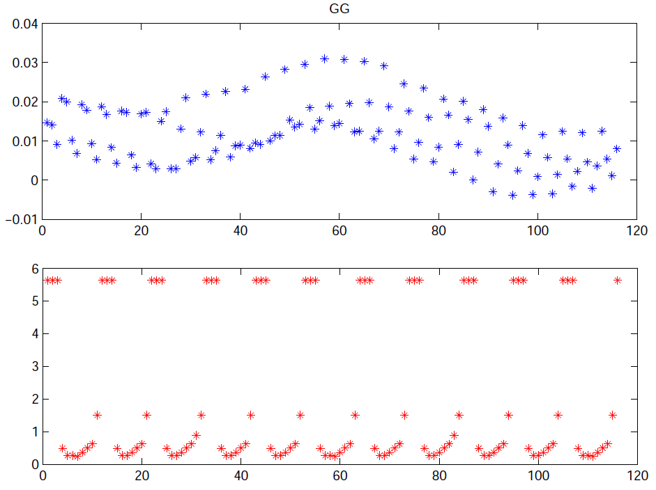
Dinucleotide Matching Model
Here are comparisons of the weights for dinucleotides

Slide 50
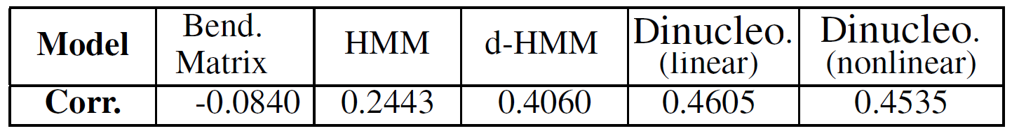
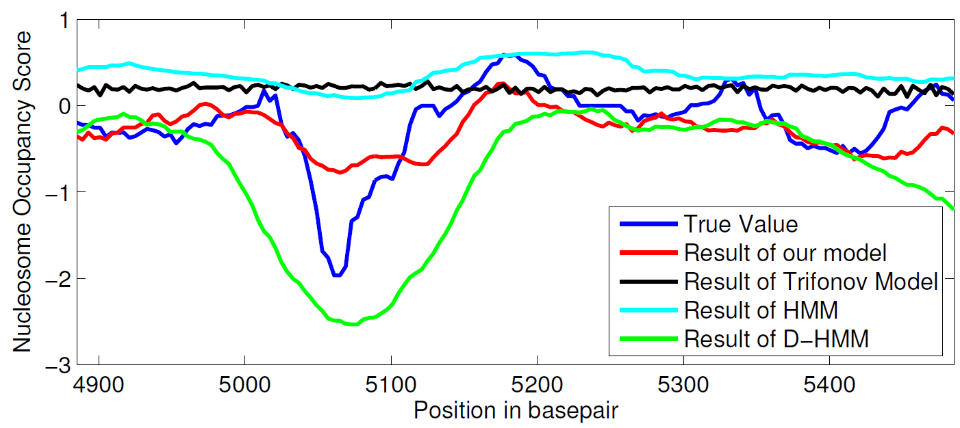
Comparisons of the Models

Slide 51
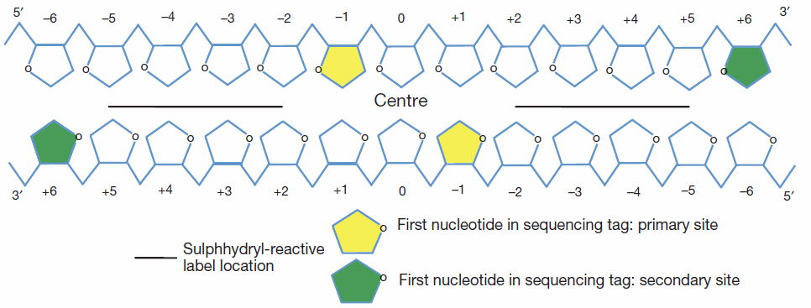
Ultimate Nucleosome Positioning Problem
In order to study the dynamics of nucleosomes, one needs to estimate their position accurately with the ultimate single-basepair resolution

Slide 52
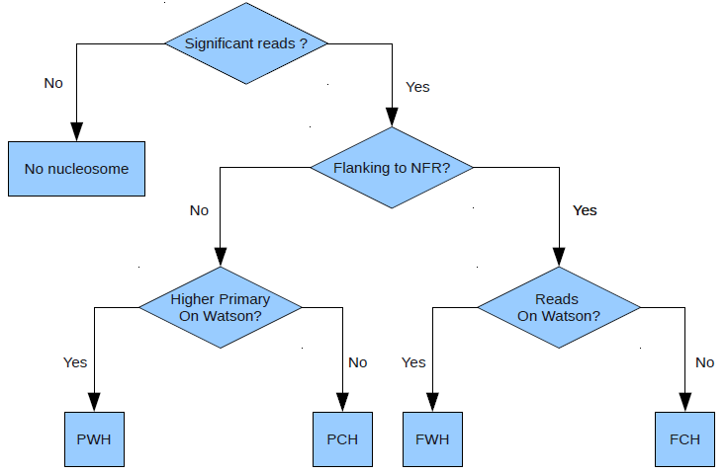
Classification Tree

Slide 53
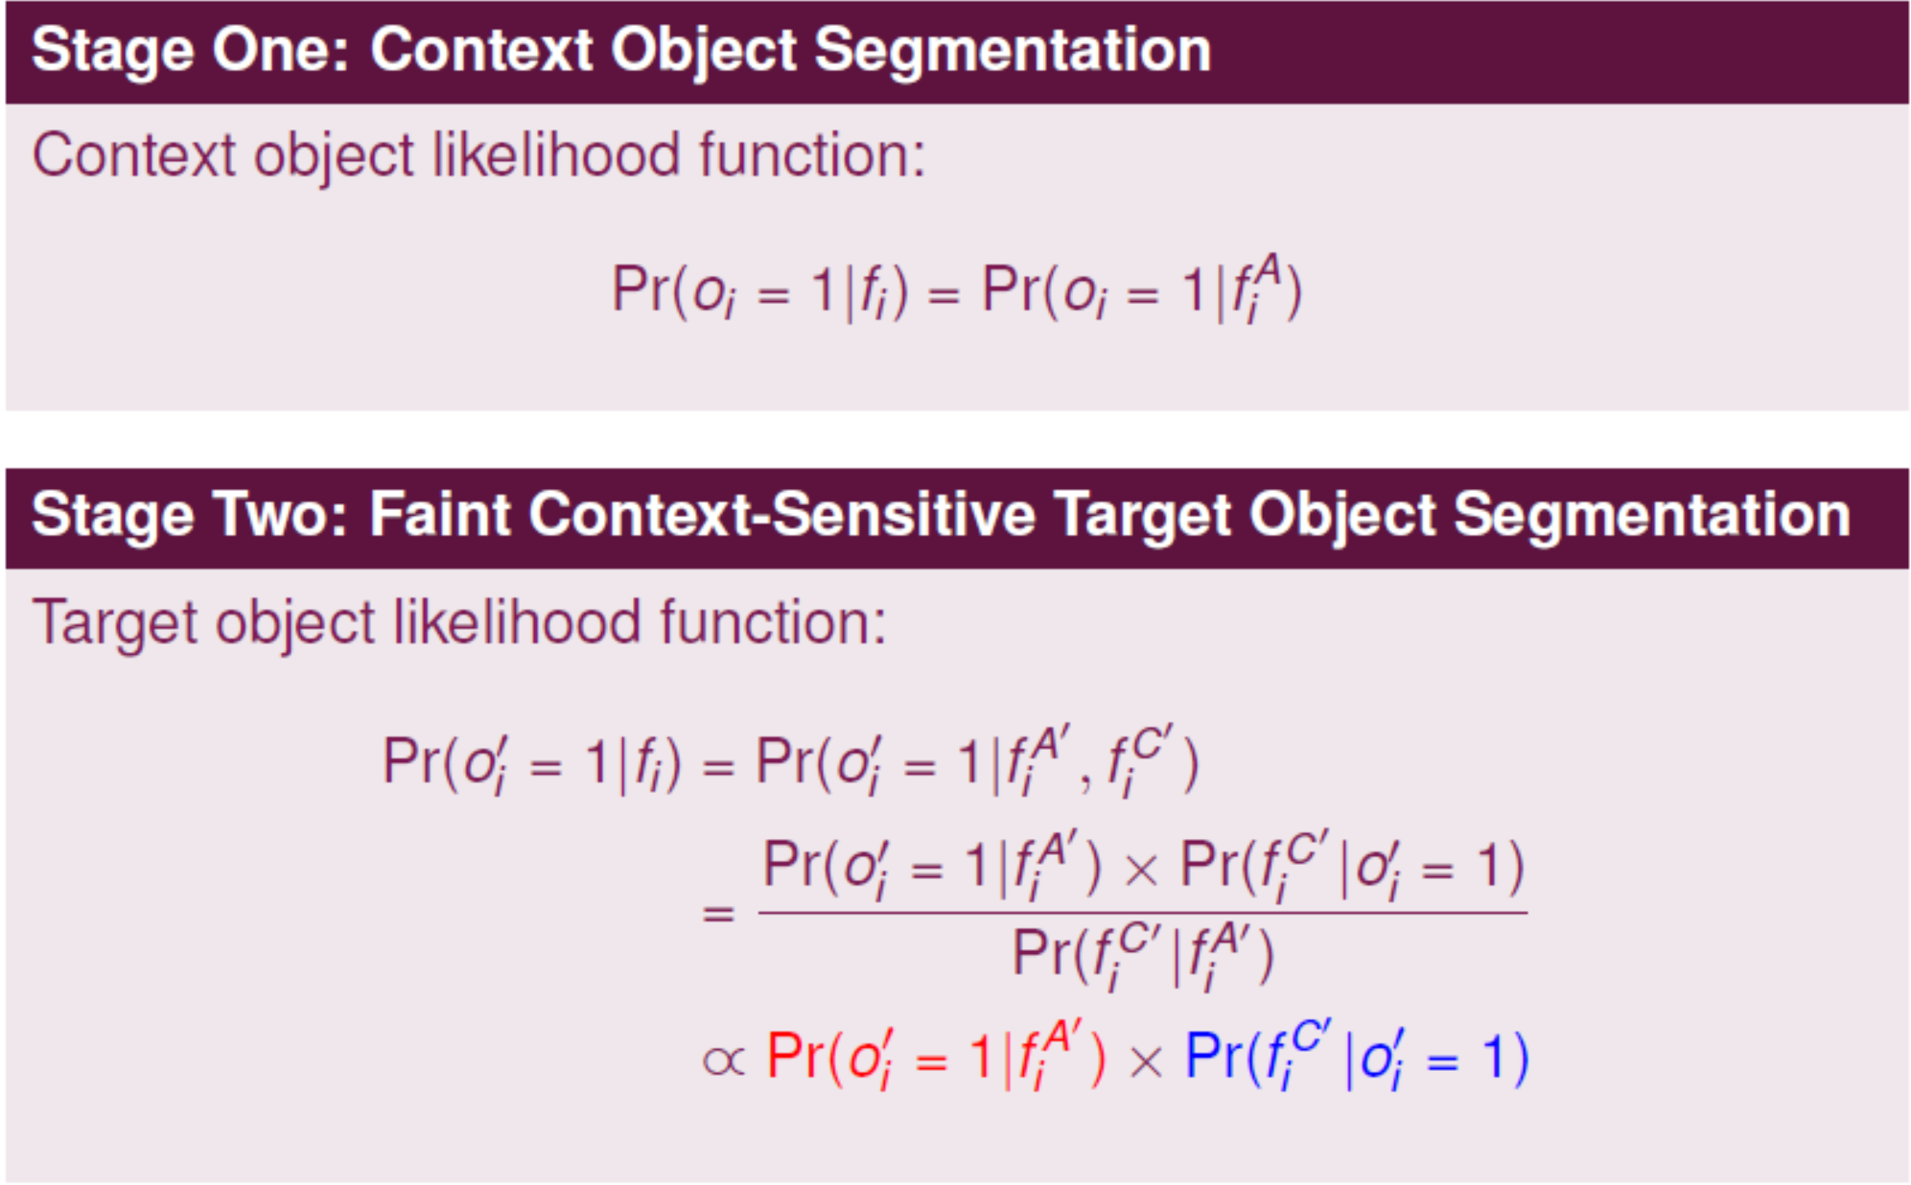
Two-Stage Context-Sensitive Semantic Segmentation

Slide 54
Microvillus spike segmentation

Slide 55
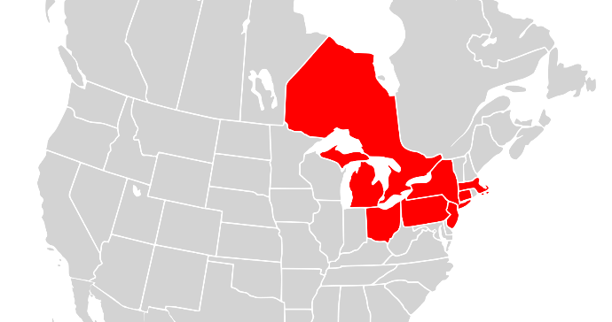
Events/Contingencies Led to 2003 Blackout
Several events contributed to the blackout
  Including heavy load (but still expected), erroneous state estimator, and several faults due to tree contacts
  Keep in mind that the number of contingencies that triggered the cascading event was small even though the 2003 blackout covered a large area
Source: http://en.wikipedia.org/wiki/File:Map_of_North_America,_blackout_2003.svg
55
Notes:
CAP5415 Harris-06-21-2010.ppt
55

Slide 56
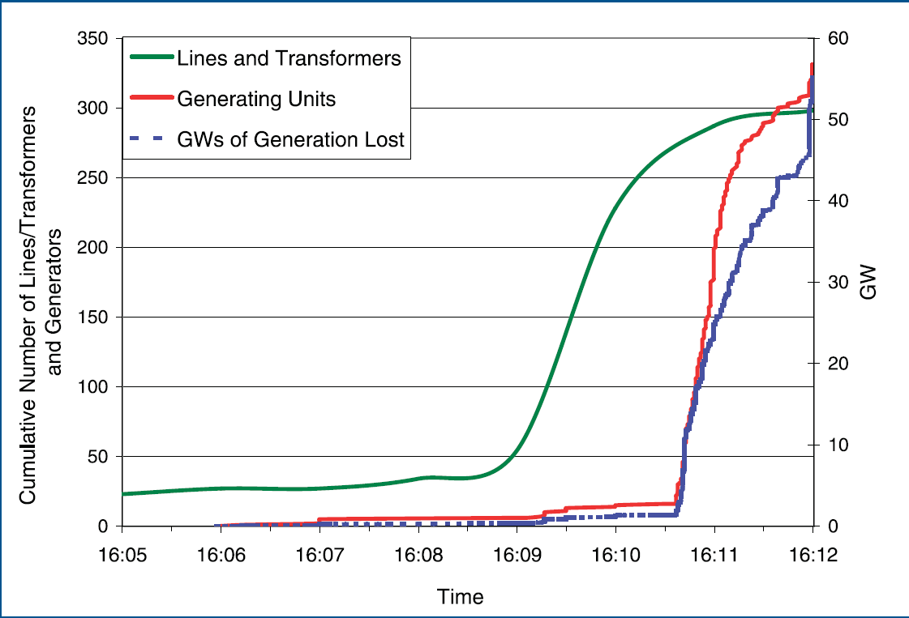
2003 Blackout – cont.
56
Notes:
CAP5415 Harris-06-21-2010.ppt
56

Slide 57
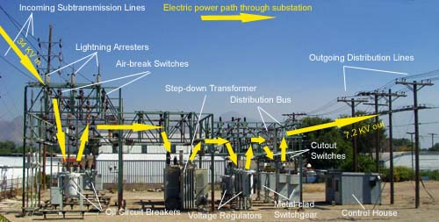
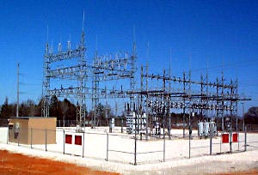
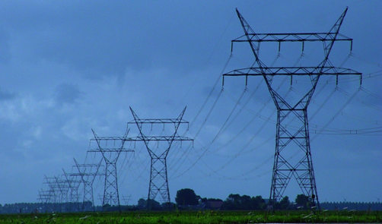
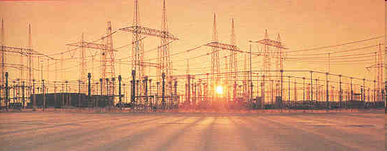
Intrinsic Vulnerabilities of the Grid
57
Notes:
Top left: substation
Top right: distribution station
Bottom left: stepping up
Transmission line in the open field
CAP5415 Harris-06-21-2010.ppt
57

Slide 58
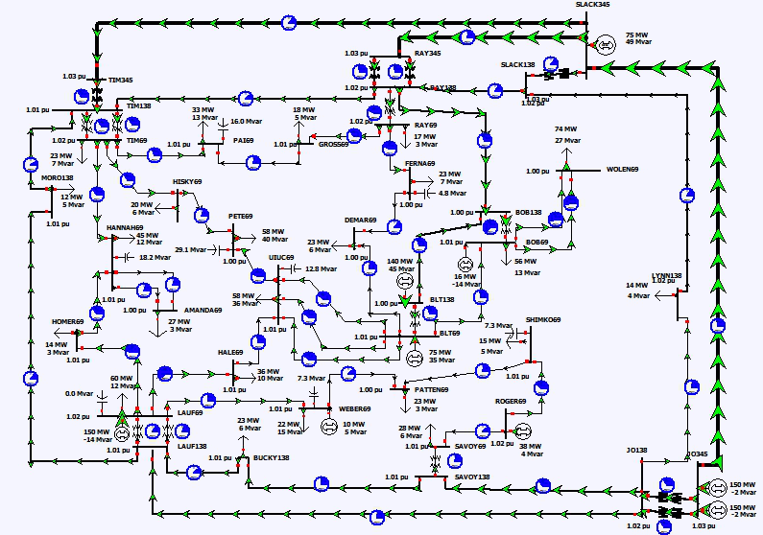
Notes:
58

Slide 59
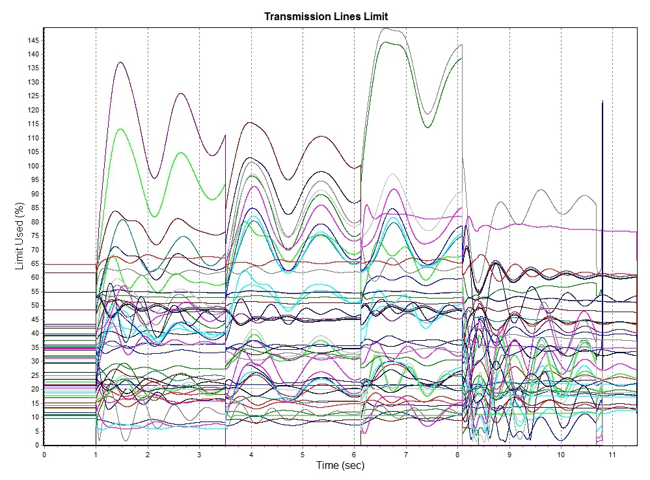
3rd & 4th trips
1st trip
2nd trip
Sync Attack Started
Notes:
59

Slide 60
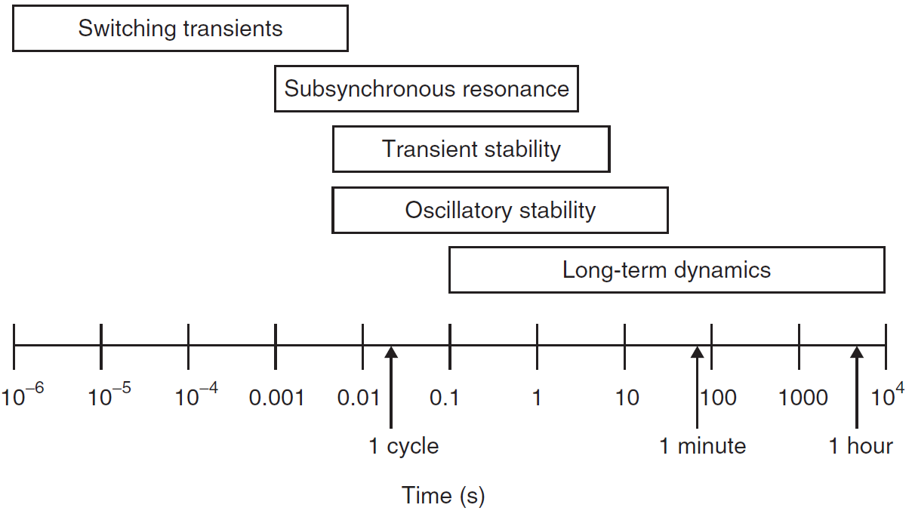
Timescale of Dynamic Phenomena in Power Systems
60
Notes:
We are concerns about fast occurring events that happen very quickly; human operators do not have enough time to react and they can cause a lot of problems.
CAP5415 Harris-06-21-2010.ppt
60

Slide 61
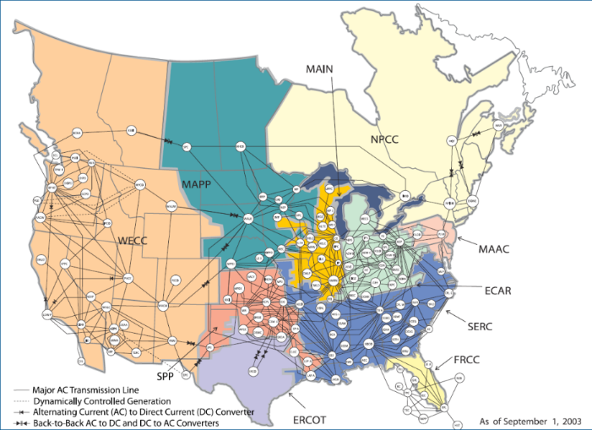
Cyber-Physical Modeling is the Key
The key requirement to defend against cascading events is fast detection and then control computation
  The method must be
    Robust to achieve high accuracy
    Fast enough so that the system can react before it is too late
    Able to handle all instability types
    Scalable to handle an entire interconnection
61
Notes:
CAP5415 Harris-06-21-2010.ppt
61

Slide 62

Scalability Is the Bottleneck to Deployable Solutions
6/20/2010 10:20:08 AM
Harris-06-21-2010.ppt
62
Notes:
CAP5415 Harris-06-21-2010.ppt
62

Slide 63
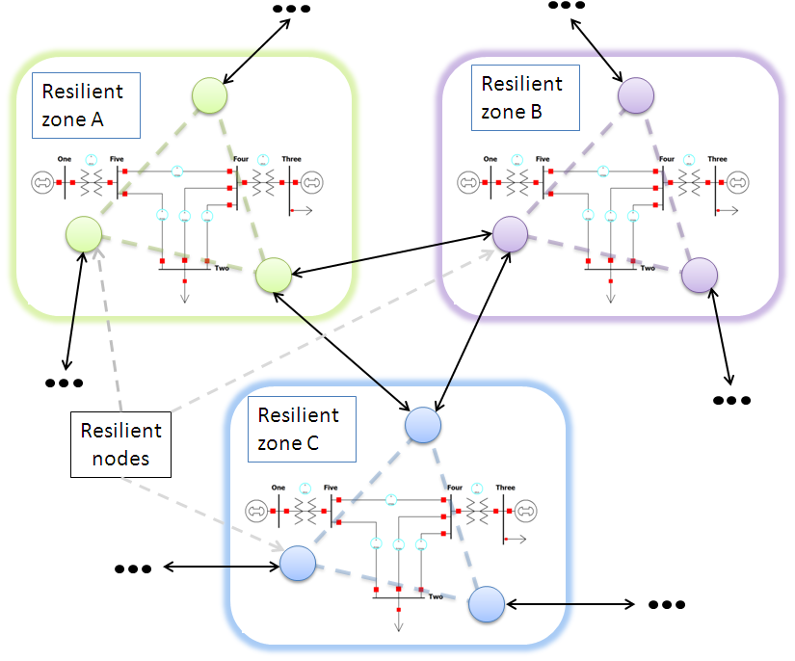
Our Approach: Overview
We divide the grid into resilient zones
  Each zone will have several resilient nodes
    There will be resilient node connected to each neighboring zone
  The nodes inside one zone are identical in that they have all the measurements in the zone
  We assume that class A data from NASPInet are available within each zone
63
Notes:
CAP5415 Harris-06-21-2010.ppt
63

Slide 64

Generating Resilience Zones
We can compute resilience zones using a graphics cut algorithm to minimize the power flow
  There are also defined control zones that can be candidates
64
Notes:
CAP5415 Harris-06-21-2010.ppt
64

Slide 65

K-hop Tree for Each Resilient Zone
65
Notes:
CAP5415 Harris-06-21-2010.ppt
65

Slide 66
Cascading Events Detection Method
Note that while cascading events can happen under practically infinite number of scenarios, it always involves (dramatic) power transfer increases along certain transmission lines
  With the Class A data from NASPInet we can detect the propagation trend
  One algorithm is to estimate the power flow increase along paths that go through the current resilient zone
66
Notes:
CAP5415 Harris-06-21-2010.ppt
66

Slide 67
Detecting Cascading Events – cont.
67
Notes:
CAP5415 Harris-06-21-2010.ppt
67

Slide 68
Detecting Cascading Events – cont.
It can be done by modeling the power flow along each path and evaluating the thermal limits along the path
This can also be posed as a machine learning problem
  We can train decision trees, support vector machines, or other classifiers
  A key problem is to ensure generalization of the classifiers
  My group proposed optimal component analysis algorithm to maximize “generalization” (in the leave-one-out sense)

Slide 69
Can We Prevent Cyber-Induced Physical Damages?
Why could Stuxnet happen?
Trusted security modules
  The idea is to place a trusted security module at the interface between cyber and physical components to make sure that no cyber commands that could lead to physical damages are allowed

Slide 70
Our Approach

Slide 71
A Prototype System

Slide 72
Zero-day Vulnerabilities for CPS
How to detect zero-day vulnerabilities in cyber-physical systems?
  Content-based approaches
  Network-based approaches
  Host-based approaches
We are building a comprehensive system to secure cyber-physical systems
  Using a style-based model via topic modeling
  While malware instances change substantially, malware styles do not change quickly

Slide 73
Instrusieve System

Slide 74
Instrusieve System

Slide 75
Datasets

Slide 76

Cyber-Physical System Approach to Active Flow Control
How can an airplane lift itself up?
  Newton got it wrong
80% of the hurricane damages are initiated by single point failures
  What kind of point and why?

Slide 77
High Frequency Finance Data Modeling
As computers and storage become inexpensive, saving trading data is being done at a much higher resolution
  For example, working with Prof. Ramo Gencay in the Department of Economics at Simon Fraser University, we have 40 gigabytes of foreign exchange data
    With order books of depth 10, sampled every 0.1 second

Slide 78

High Frequency Finance Data Modeling
As computers and storage become inexpensive, saving trading data is being done at a much higher resolution
  For example, working with Prof. Ramo Gencay in the Department of Economics at Simon Fraser University, we have 40 gigabytes of foreign exchange data
    With order books of depth 10, sampled every 0.1 second

Slide 79
High Frequency Finance Data Modeling
Order book flow representation
  Financial market can change very quickly in reaction to news and other items

Slide 80

Instance on April 23, 2013
Notes:
Source: http://www.telegraph.co.uk/finance/markets/10013768/Bogus-AP-tweet-about-explosion-at-the-White-House-wipes-billions-off-US-markets.html
Dow Jones dropped 145 points, Standard & Poor’s 500 Index lost $136 billion in value, and blue chip
names like Exxon Mobil, Apple, Johnson & Johnson and Microsoft lost about 1% of their value.
On April 23, 2013
“Breaking: Two Explosions in the White House and Barrack Obama is injured,” said the fake “alert” from one of America’s most trusted news sources, briefly fooling some news outlets and sending the Dow Jones plunging 145 points in the space of two minutes — or 1pc.
The benchmark S&P 500 index also fell nearly 1pc in the space of three minutes as the tweet hit the markets. With the S&P valued at roughly $14.6 trillion at the moment of the false tweet, that three-minute plunge briefly wiped out $136.5bn (£92.2bn) of the index's value, according to Reuters.

Slide 81
High Frequency Finance Data Modeling
With high frequency trading data, low dimensional models such as mean and variance are no longer sufficient
  However, how to take advantage of such huge high dimensional datasets under real time constraints is not a trivial problem
  For example, how to find the clusters such datasets?

Slide 82
High Frequency Finance Data Modeling
There are generally two approaches
  Product quantization
    Divide the high dimensional vector into subgroups
    We can cluster each subgroup
    The clusters in the high dimensional space can be generated as the Cartesian product of the clusters in subgroups
  Residual vector quantization
    We cluster the data into small clusters and then recursively cluster the residual vectors
    The clusters in the high dimensional space can be generated as the Cartesian product of the clusters in the stages

Slide 83

High Frequency Finance Data Modeling
Transform Residual K-means Trees for Scalable Clustering

Slide 84

High Frequency Finance Data Modeling

Slide 85

High Frequency Finance Data Modeling

Slide 86

What Is the Potential?
Notes:
Source: from http://www.ritholtz.com/blog/wp-content/uploads/2010/10/flash-crash-dow-popup.png .
From http://en.wikipedia.org/wiki/2010_Flash_Crash
The May 6, 2010 Flash Crash[1] also known as The Crash of 2:45, the 2010 Flash Crash or just simply, the Flash Crash, was a United States stock market crash on Thursday May 6, 2010 in which the Dow Jones Industrial Average plunged about 1000 points (about 9%) only to recover those losses within minutes. It was the second largest point swing, 1,010.14 points, and the biggest one-day point decline, 998.5 points, on an intraday basis in Dow Jones Industrial Average history .

Slide 87
Courses
Most Relevant Courses
  CAP 5638 Pattern Recognition
  CAP 5415 Principles and Algorithms of Computer Vision
  CAP 6417 Theoretical Foundations of Computer Vision
  CAP 5726 Computer Graphics
  CIS 5XXX Offensive Computer Security
  CIS 5XXX Offensive Network Security
  CIS 5XXX Software Reverse Engineering and Malware Analysis
  CIS 4XXX/CIS 5XXX Practical Cyber SecuriTy Fundamentals
  Cyber-Physical Systems and Security
  Seminars and advanced studies
Related Courses
  CAP 5600 Artificial Intelligence

Slide 88
Summary
My group offers interesting research topics/projects
  Effective and intrinsic represents for images and videos
  Real-time detection and recognition of objects
  Computational models for object recognition and image classification
  Medical/biological image analysis
  Motion/video sequence analysis and modeling
  Program analysis and cyber-physical security solutions
  They are challenging, interesting, and exciting
  Now it is a productive and fruitful area to be in

Slide 89
Contact Information
Name Xiuwen Liu
Web sites http://cavis.fsu.edu
http://www.cs.fsu.edu/~liux
Email liux@cs.fsu.edu
Offices LOV 166
Phone 850-644-0050

Slide 90
Thank you!
Any questions?
Slides are available from http://www.cs.fsu.edu/~liux/courses/intro-seminar-17.pptx

Slide 91
Here Is a Question for You
After I compile and run the following program on a Linux machine, what would happen and why?

Slide 92
Here Is a Question for You
After I compile and run the following program on a Linux machine, what would happen and why?

