Slide 1
Detecting Spam Zombies by Monitoring Outgoing Messages
Zhenhai Duan
Department of Computer Science
Florida State University

Slide 2
Outline
Motivation and background
SPOT algorithm on detecting compromised machines
Performance evaluation
Summary

Slide 3
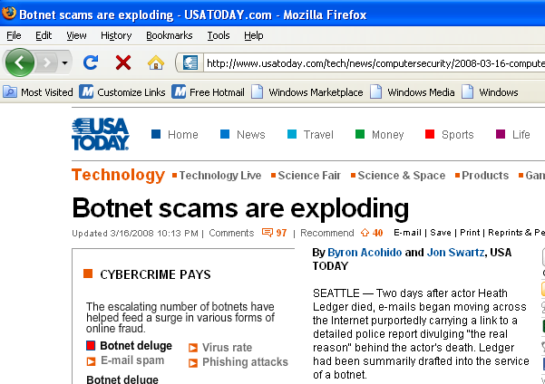
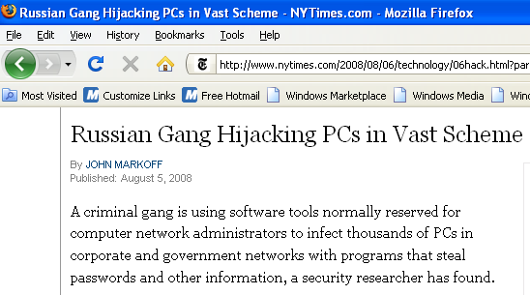
Motivation
Botnet becoming a major security issue
Spamming, DDoS, and identity theft
Hard to defend botnet based attacks
Sheer volume, wide spread
Lack of effective method to detect bots in local networks

Slide 4
Motivation
Utility-based online detection method
SPOT
Detecting subset of compromised machines involved in spamming
Bots increasingly used in sending spam
70% - 80% of all spam from bots in recent years
In response to blacklisting
Spamming provides key economic incentive for controller

Slide 5
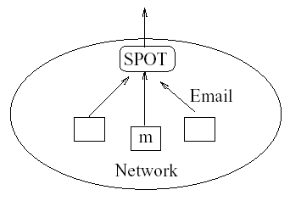
Network Model
Machines in a network
Either compromised H₁ or normal H₀
How to detect if a machine compromised as msgs pass SPOT sequentially?
Sequential Probability Ratio Test (SPRT)

Slide 6
Sequential Probability Ratio Test
Statistical method for testing
Null hypothesis against alternative hypothesis
One-dimensional random walk
With two boundaries corresponding to hypotheses
A
B

Slide 7
SPRT
Advantages
Online algorithm
Applying to observations arriving sequentially
Fast detection
Minimizing average number of observation required
Controlled results
False positive and false negative errors can be bounded by user-specified thresholds

Slide 8
SPRT
X denote a Bernoulli random variable with unknown parameter θ
SPRT tests null hypothesis H₀ θ = θ₀ against alternative hypothesis H₁ θ = θ₁

Slide 9
SPRT
How likely to have sequence of X₁, X₂, …, X_{n}, under H₁ and H₀, respectively?

Slide 10
SPRT Test Process
Given two constant A and B, where A < B, at each step n, compute
How to determine A and B
Let α and β be user-desired false positive and negative rates

Slide 11
SPRT Bounds
Relationship between actual false positive α’ and false negative β’ and desired ones α and β
Average number of observation to reach decision

Slide 12
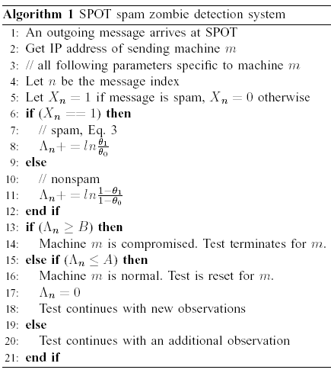
SPOT Detection Algorithm
Based on SPRT
H₁: machine is compromised
H₀: machine is normal
Maintain Λ_{n} for each IP observed
Update Λ_{n} in each step
Compare Λ_{n} to A and B
Terminate when B is approached
Restart when A is approached
after resetting Λ_{n}

Slide 13
Determining SPOT Parameters
Four parameters: α, β, θ₀, θ₁
α, β are user desired error rates, normally in range 0.01 to 0.05
Ideally, θ₀ and θ₁ should be probability a normal and compromised machine send spam
SPOT does not require precise knowledge of θ₀ and θ₁
An imprecise (but reasonably) knowledge of θ₀ and θ₁ will only affect N
In practice, they can model the false positive and detection rate of spam filter

Slide 14
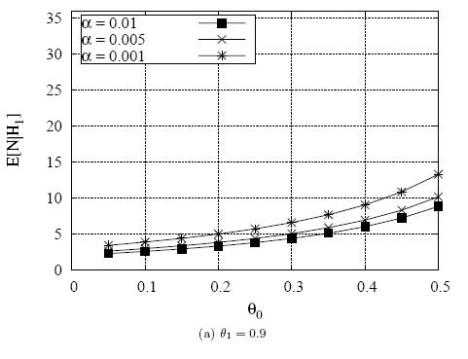
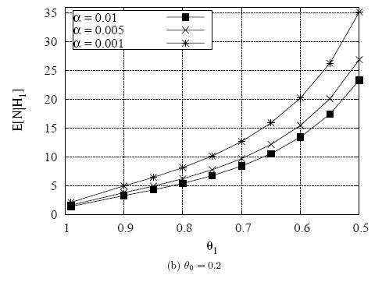
Averaged Number of Observations Required
β = 0.01

Slide 15
Trace-based Performance Evaluation
Two month email trace received on FSU campus net
SpamAssassin and anti-virus software
About 73% of all emails are spam

Slide 16
Sending IP Addresses
FSU has higher percentage of mixed IP addresses
FSU has higher percentage of IP addresses sending virus

Slide 17
Performance of SPOT
Α = 0.01, β = 0.01, θ₀ = 0.2, θ₁ = 0.9
110 confirmed by virus information
16 confirmed by high spam sending percentage (> 98%)
62.5% of these are dynamic IP
6 cannot be confirmed by either way
7 machines SPOT identified as normal carried virus

Slide 18
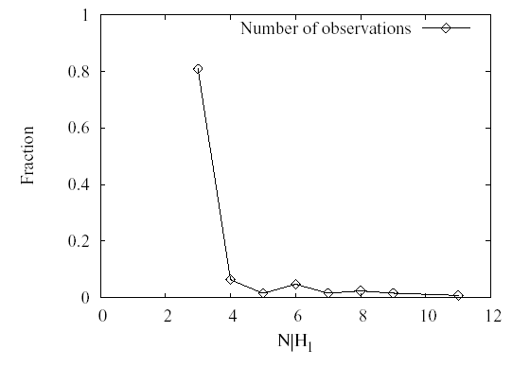
Number of Actual Observations

Slide 19
Impacts of Dynamic IP Addresses
SPOT assumes one-to-one mapping between IP address and machine
Intuitively, dynamic IP will not have any major impacts, given fast detection of SPOT

Slide 20
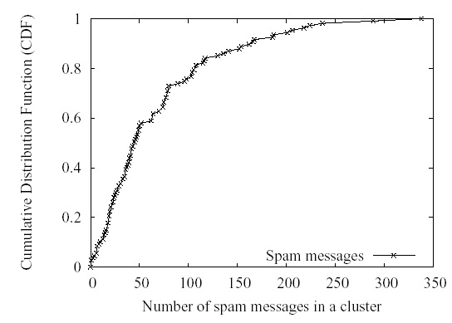
Distribution of Spam in Each Cluster
T = 30 minutes
90% of clusters >= 10 spam
96% of clusters >= 3 spam

Slide 21
Discussions
Practical deployment issues
Msgs may pass a few relay servers before leaving network
Method 1: deploy SPOT at each relay server
Method 2: identify originating machine by Received header
Limitation
IID assumption of message arrivals

Slide 22
Summary
SPOT
Effective and efficient spam zombie detection system
Based Sequential Probability Ratio Test
A utility-based detection scheme
How to generalize the idea to detect compromised machines used for other purposes?

