Slide 1
Understanding Forgery Properties of Spam Delivery Paths
Fernando Sanchez, Zhenhai Duan Florida State University | Yingfei Dong University of Hawaii

Slide 2
Problem Statement
Email header forgery
But to what degree and how well they do it?
Why this is important?
Investigating email-based crimes such as phishing and threats
Email sender accountability
Spam control
Focus of this study
Received: header fields
Sequence of servers in Received: fields shows (claimed) spam delivery path

Slide 3
Outline
Background on Received: header fields
Data set and methodology
Results and implications of this study
Summary and future work

Slide 4
Received: Header Fields
Prepended by each mail server into email header
Received: from xhtuah.vsahd.com
(ppp89-110-22-1.pppoe.avangarddsl.ru [89.110.22.1])
by mail.cs.umn.edu (Postfix) with SMTP id 9C6714DE89
From-from: xhtuah.vsahd.com
From-address: 89.110.22.1
From-domain: ppp89-110-22-1.pppoe.avangarddsl.ru
By-domain: mail.cs.umn.edu

Slide 5

Data Sets
Two complementary data sets
3 year spam archive
MX records of about 1.2M network domains
Interpret and confirm findings from first data set
Spam archive
Untroubled.org spam archive
2007 – 2009, totaling about 1.84M spam messages
Bait addresses and domains obtained from Delivered-To: field
Notes:
About 90.5% of messages in spam archive contain the delivered-to field, which was used to extract the bait addresses and domains.

Slide 6
Data Set: MX Records
MX records of about 1.2M network domains
Domains extracted from 15 day email trace
Collected on FSU campus network in 2008
Sender’s envelope email addresses (MAIL FROM)
About 53M msgs, about 47M or 88.7% are spam
Representative of the domains
247 top-level domain (TLD)
Containing all major email service providers
Notes:
Data: 2008.
Mx lookup: july 2009.

Slide 7
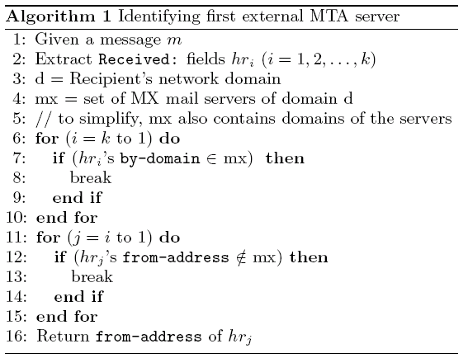
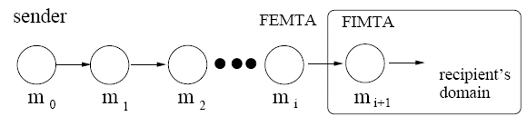
Methodology
Length of spam delivery paths
Different internal mail server structures of recipient’s domain
First external and internal MTA servers
MX of untroubled.org
mx.futureequest.net
Notes:
D: recipient’s network domain.
Take from delivered-to: field, if the field exists.
Otherwise, take the domain of the last MTA.

Slide 8
Spam Delivery Paths
Raw path
From (claimed) origin to first internal MTA server (inclusive)
Network-level consistent (NLC) path
f_{i} and b_{i-1} belong to the same network
Same /16 network prefix
Same domain name
R: from f_{i} by b_{i}
R: from f_{i-1} by b_{i-1}

Slide 9
MX Dataset Analyses
Two types of mail servers
Load balancing servers: servers within same domain
fsu.edu has 11 mail servers all in fsu.edu
Backup servers: servers in different domains
Bemac.com mail servers in two domains: bemac.com and psi.net
Total number of mail servers in each domain
Total number of mail server clusters in each domain
Group all mail servers in one domain into a cluster
fsu.edu only has one mail server cluster
bemac.com has two mail server clusters

Slide 10
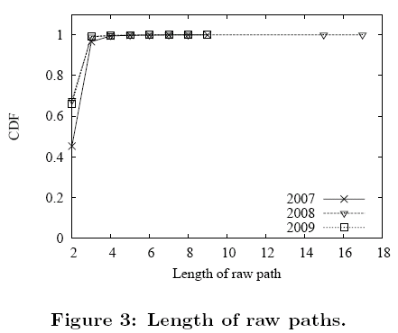
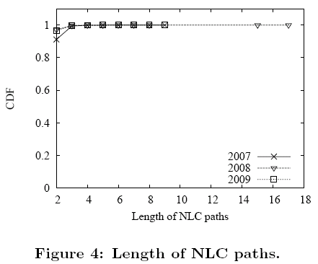
Results: Spam Delivery Paths
Average length of raw paths
2007: 2.57, 2008, 2009: 2.34
Pattern of inconsistency
Confused from-domain and by-domain
Pretending to be already received by recipient’s domain D
R: from A by B
R: from A by C
R: from A by B
R: from C by D
Notes:
Raw path: 45%, 68%, 66% of spam emails with two hops, for 2007, 2008, and 2009, respectively.
NLC path: 91%, 97.1%, 96.7%.

Slide 11
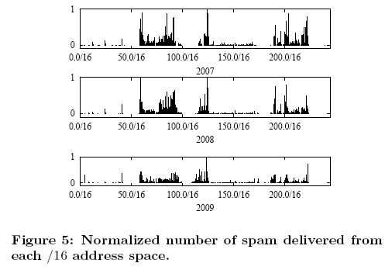
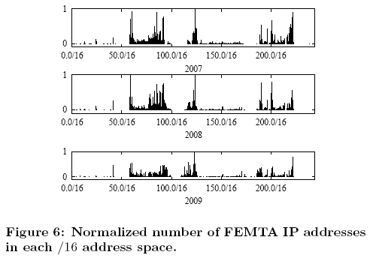
Spam Source Network-Level Distribution
Consistent with previous study based on FSU email trace
To a degree, indicating representativeness of spam archive

Slide 12
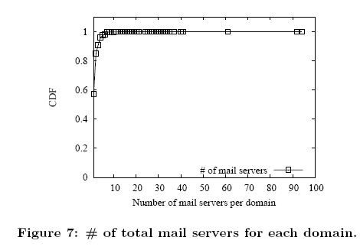
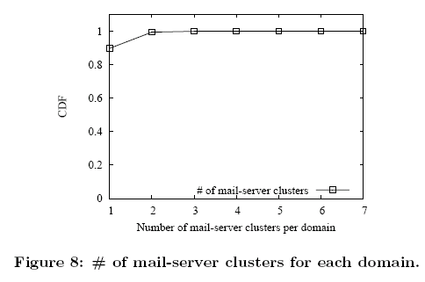
MX Records
57% of domains have one mail server
90% of domains have one mail server cluster
Emails should be directly delivered to recipient mail servers
Helps shorten email delivery path

Slide 13
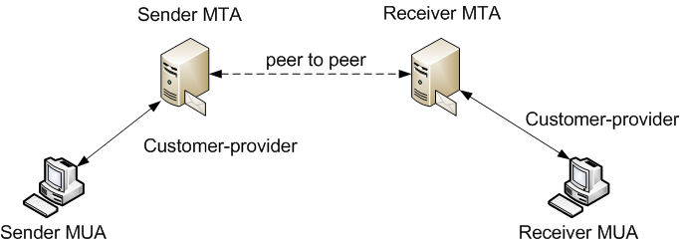
Email Delivery Model
Borrowing idea of AS relationship in BGP routing
A mail server on email delivery path must be a provider of either sender domain or receiver domain (ignoring open-relays)
Forged mail server
Email delivery path of normal messages should be of 3 hops

Slide 14
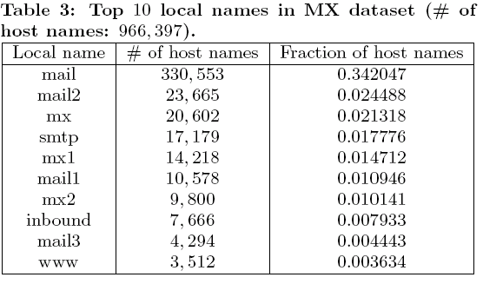
Name Structure of Mail Servers
Extracting local name from domain name of mail servers

Slide 15
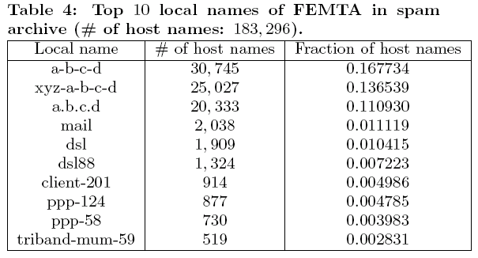
Naming Structure of First External MTA Servers
a-b-c-d: e.g. 83-131-12-156.adsl.net.t-com.hr
xyz-a-b-c-d: e.g. oh-71-50-221-149.dyn.embarqhsd.net
a.b.c.d: e.g. 154.88.218.87.dynamic.jazztel.es

Slide 16
Implications
Sender authentication schemes
Many spam traversed two hops, likely sent from spamming bot
SPF-like can be of great help
Hard to fake a compromised machine as a legitimate server
Majority emails sent directly from sender to receiver domain
DKIM-like really needed?
Spam control
Detecting forged trace records
Email delivery path length
Mail servers vs. end-user machines
Helps detect forged Received: (if end-user machine appears in middle of delivery path)
Common naming structure of mail servers?

Slide 17
Summary and Future Work
Empirical study on trace record structure of spam messages
Based on two complementary data sets
Majority spam delivery paths are short, without any attempts to fake
We can detect a large part of forged trace records, even if they do so
Implications on various spam control efforts
Sender authentication schemes
Spam control
Value of Received: header fields in detecting spam
Future Work
Detailed study on patterns of inconsistent spam delivery paths
Larger and more diverse spam archives
Non-spam email traces

