Slide 1
Computer Networks and Network Security
Zhenhai Duan
Department of Computer Science
08/30/2018

Slide 2
Research Area
Computer networks, in particular, Internet protocols, architectures, and systems
  Internet inter-domain routing
  Internet systems security
  Cyber-physical system
  Network measurement and monitoring
  Overlay and peer-to-peer systems
  Quality of Service (QoS) provisioning
Details and publications
  http://www.cs.fsu.edu/~duan
Notes:
My research area is computer networks, in particular, anything related to the Internet, such as Internet protocols, architectures, and systems. In the past I have worked on a number of research projects in the topics ranging from … Given the time constraint, I will present a few research projects on the first two topics, namely Internet inter-domain routing and Internet systems security. All the details can be found on my homepage.

Slide 3
A Few Projects that I will Discuss
Improving Internet inter-domain routing performance
Controlling IP spoofing
Detecting compromised machines (botnets)
Traceback attack on Freenet
Notes:
I will briefly present four specific research projects. The first one is on … The second is on,

Slide 4
P1: Internet Inter-Domain Routing
Consists of large number of network domains (ASes)
  Each owns one or multiple network prefixes
  FSU campus network: 128.186.0.0/16
Intra-domain and inter-domain routing protocols
  Intra-domain: OSPF and IS-IS
  Inter-domain: BGP, a path-vector routing protocol
BGP
  Used to exchange network prefix reachability information
    Network prefix, AS-level path to reach network prefix
  Path selection algorithm

Slide 5
BGP: an Example
[3210]*
[4210]
[7610]
NLRI=128.186.0.0/16
ASPATH=[0]
NLRI=128.186.0.0/16
ASPATH=[10]
NLRI=128.186.0.0/16
ASPATH=[210]
NLRI=128.186.0.0/16
ASPATH=[3210]
NLRI=128.186.0.0/16
ASPATH=[4210]
128.186.0.0/16
NLRI=128.186.0.0/16
ASPATH=[210]
NLRI=128.186.0.0/16
ASPATH=[10]
NLRI=128.186.0.0/16
ASPATH=[53210]
NLRI=128.186.0.0/16
ASPATH=[7610]
NLRI=128.186.0.0/16
ASPATH=[610]
NLRI=128.186.0.0/16
ASPATH=[610]
Notes:
ellipse

Slide 6
Network Dynamics
Internet has about 61K ASes and 733K network prefixes (as of 08/27/2018)
In a system this big, things happen all the time
  Fiber cuts, equipment outages, operator errors.
Direct consequence on routing system
  Recomputing/propagating best routes
  Events may propagated through entire Internet
  Large number of BGP updates exchanged between ASes
Effects on user-perceived network performance
  Long network delay
  Packet loss and forwarding loops
  Even loss of network connectivity
An interesting read
  Can You Hear Me Now?!: It Must Be BGP | acm sigcomm
Notes:
http://www.cidr-report.org/as2.0/

Slide 7
Causes of BGP Poor Performance
Protocol artifacts of BGP
Constraints of physical propagation
  Internet is a GLOBAL network
Complex interplay between components and policies of Internet routing
[3210]*
[4210]
[7610]
NLRI=128.186.0.0/16
ASPATH=[54210]
128.186.0.0/16
NLRI=128.186.0.0/16
ASPATH=[57610]
NLRI=128.186.0.0/16
Withdrawal

Slide 8
Improving BGP Convergence and Stability
BGP protocol artifacts
  EPIC: Carrying event origin in BGP updates
  Propagation delays on different paths
  Inter-domain failure vs. intra-domain failure
  Multi-connectivity between ASes
  Scalability and confidentiality
“Limiting Path Exploration in BGP”
Physical propagation constraints
  Transient failures
  TIDR: Localize failure events
“Traffic-Aware Inter-Domain Routing for Improved Internet Routing Stability”

Slide 9
P2: Controlling IP Spoofing
What is IP spoofing?
  Act to fake source IP address
  Used by many DDoS attacks
Why it remains popular?
  Hard to isolate attack traffic from legitimate one
  Hard to pinpoint the true attacker
  Many attacks rely on IP spoofing
An interesting read
  The DDoS That Knocked Spamhaus Offline (And How We Mitigated It)
d
d
c
s
d
s
c
d
b
a
s
Notes:
Many DDoS attacks fake the source addresses of the attack traffic, this is called IP spoofing. For example, most recently, a high-profile DDoS attack on root DNS servers in early February 2006 used IP spoofing. The figure shows an example. An attacker in node c trying to attack node d, but claims the traffic is from node s by faking the source address of the attack traffic.
Although there are many advanced techniques available to attackers, but IP spoofing remains popular for a number of reasons. First, IP spoofing makes it very hard for victim to distinguish attack traffic from legitimate traffic, attack traffic may appear to come from all around the world. Second, IP spoofing makes it hard to pinpoint the true origin of the attackers. Many complicated traceback techniques were proposed over the years. Third, and possibly most importantly, many ddos attacks rely on IP spoofing. For example, the man-in-the-middle attacks such as TCP hijacking and DNS poisoning requires to fake the source address, the reflector based ddos attacks also requires faking the source address.
So how we should control the IP spoofing problem?

Slide 10
Filtering based on Route
A key observation
  Attackers can spoof source address,
  But they cannot control route packets take
Requirement
  Filters need to compute best path from src to dst
  Filters need to know global topology info
  Not available in path-vector based Internet routing system
d
s
c
d
s
d
b
a
s
Notes:
One promising technique is route-based packet filtering. It is based on the following observation, although attackers can fake the source address of attack traffic, they cannot control the route that the attack packets take from the source to the destination. Based on this observation, route-based packet filters only allows packets to be forwarded along the best route from the source to the destination. If a packet appears at a router that is not on the best route from source to destination, the packet is believed to have a faked source address and is dropped by the filter.
However, in order for a route-based packet filter to work correctly, it must knows the best routes from any source to any destination, in principle, it needs to know the global topology information. Routing systems that employ link-state routing protocol like can satisfy this requirement. However, in the routing systems that use distance vector or path vector, this requirement can not be satisfied. The current Internet uses a path vector routing protocol, border gateway protocol (BGP), therefore, route-based packet filtering cannot be supported in the current Internet.
In this work, we tried to answer a basic question: can we use the similar idea to construct packet filters but without the requirement of global topology information? And if so, what is the performance of the packet filter?

Slide 11
Internet AS Relationship
Consists of large number of network domains,
Two common AS relationships
  Provider-customer
  Peering
AS relationships determine routing policies
A net effect of routing policies limit the number of routes between a pair of source and destination
AS 174
Cogent
AS 3356 Level 3
AS2828
XO Comm
AS 11537
Internet2
AS 11096
FloridaNet
AS 2553
FSU
Notes:
First we need to introduce some basic background on Internet inter-domain routing. The Internet consists of a large number of network domains, or autonomous systems (ASes).Ases provides Internet access server to one another based on the relationships between the ASes. Currently there are three major relationships on the Internet. The first one is a provider-customer relationship, where a customer pays a provider for carrying traffic to and from the customer. Normally providers are much larger than the customers. The second is a peering relationship, where two networks (two peers) agree to carry traffic from each other and their customers. Normally two peers are of similar size, they do not pay each other. In sibling relationship, two Ases provides transit services to each others. Normally two sibling Ases are under the same administration domain, for example, resulting from company merging.

Slide 12


Topological Routes vs. Feasible Routes
Topological routes
  Loop-free paths between a pair of nodes
Feasible routes
  Loop-free paths between a pair of nodes that not violate routing policies
Topological routes
Feasible routes
c
d
s a d
s b d
s a b d
s a c d
s b a d
s b c d
s a b c d
s a c b d
s b a c d
s b c a d
s a d
s b d
c
d
b
a
b
a
s
s
Notes:
To see this more clearly, we compare the topological routes and feasible routes between source and destination on the Internet. In the figure, each node represents a single AS.
We say a loop-free path between each pair of nodes a topological routes. Topological routes are determined by the network topology. We call a topological route a feasible route, if the construction of the route does not violate the routing policies imposed by the AS relationship.
Consider the example network. It is easy to check that there are 10 topological routes from source s to destination node d. However, there are only two routes are feasibly, assuming a, b, c, d, have a mutual peering relationship, and a and b are providers of s. To see this, simply note that c is not a provider of either s or d, so that c should not forward any packets from s to d.

Slide 13
Inter-Domain Packet Filter
Identifying feasible upstream neighbors
  Instead of filtering based on best path, based on feasible routes
Findings based on real AS graphs
  IDPFs can effectively limit the spoofing capability of attackers
    From 80% networks attackers cannot spoof source addresses
  IDPFs are effective in helping IP traceback
    All ASes can localize attackers to at most 28 Ases
“Controlling IP Spoofing Through Inter-Domain Packet Filters”

Slide 14
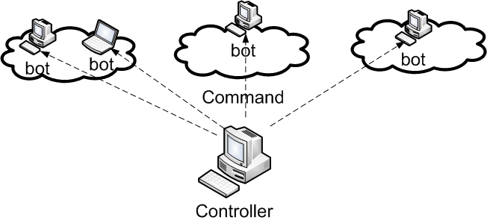
P3: Detecting Compromised Computers in Networks
Botnet
  Network of compromised machines, with a bot program installed to execute cmds from controller, without owners knowledge.
Notes:
The Web sites of the Treasury Department, Secret Service, Federal Trade Commission and Transportation Department were all affected at some point over the weekend and into this week, The Associated Press reported Tuesday, citing American officials.
The Web site of the New York Stock Exchange also came under attack, as well as the sites of Nasdaq, Yahoo’s finance section and The Washington Post.

Slide 15
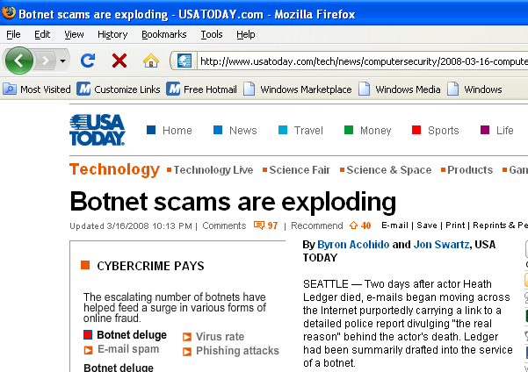
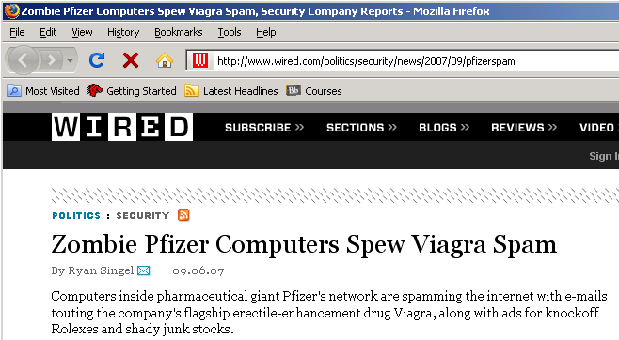
Motivation and Problem
Botnet becoming a major security issue
  Spamming, DDoS, identity theft
  sheer volume and wide spread
  Lack of effective tools to detect bots in local networks
Notes:
First, let us see what is exactly the problem that we try to tackle or what motivate our project. Botnet, or the network of compromised machines, is becoming a critical security problem on the Internet. It has attracted the attention of not only security professionals, but also average users, as evidenced by news coverage of popular news papers. For example, USA Today reported a botnet was used to send out phishing emails. NYTimes reported thousands of PC were controlled by criminals to steal the identity information of users. Wired reported that 12 million new IP addresses were controlled by botnet. So why botnet has attracted so much attention?
Well, nowadays, botnet is essentially behind of almost all security attacks on the Internet. The combined power of compromised computers, when they work together, is simply enormous. They are frequently used for sending spam or phishing messages, launching distributed denial of services attacks, and stealing user identity information. Two properties of botnet make it extremely hard to deal with attacks involving botnet. First, there are a lot of them, and second, they are wide spread. If we only have a small number of compromised machines, or if they are only located within a small number of networks, we can simply block the traffic from such machines or such networks. But when they are a lot of them and wide spread, we simply cannot take that approach.
Dealing with botnet costs billions to the US economy. A study shows that the average cost to large US companies is about 2 million per year. On the other hand, we do not have an effective means to detect and clean the compromised machines.

Slide 16
Motivation
Utility-based online detection method
SPOT
  Detecting subset of compromised machines involved in spamming
Bots increasingly used in sending spam
  70% - 80% of all spam from bots in recent years
  In response to blacklisting
  Spamming provides key economic incentive for controller

Slide 17
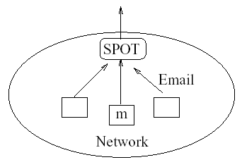
Network Model
Machines in a network
  Either compromised H₁ or normal H₀
How to detect if a machine compromised as msgs pass SPOT sequentially?
  Sequential Probability Ratio Test (SPRT)

Slide 18
Sequential Probability Ratio Test
Statistical method for testing
  Null hypothesis against alternative hypothesis
One-dimensional random walk
  With two boundaries corresponding to hypotheses
A
B
Notes:
This figure shows the system model. All outgoing messages will go through the SPOT system. As messages pass through, they are classified as either spam or non-spam. As the messages pass through the SPOT system sequentially, the key question is how to determine if a sending machine is compromised. The underlying math model we used in the system is sequential probability ratio test SPRT. SPRT is statistical tool used to test a null hypothesis against an alternative hypothesis. As in our case, a machine is compromised or it is normal non-compromised. At the high level, SPRT can be considered as a random walk with two used defined boundaries A and B, corresponding to the two hypotheses. As messages come, depending it is a spam or non-spam, the random walk moves to the left or right. And when the random walk go across either of the boundary points A or B, the test stops and one of the hypotheses is concluded.

Slide 19

Performance of SPOT
Two month email trace received on FSU campus net
SpamAssassin and anti-virus software
“Detecting Spam Zombies by Monitoring Outgoing Messages”
Notes:
SPRT has a number of important properties. One is that it has proven false positive and false negative error rates. Second, it can minimize the number of observations in reaching a conclusion, which means that it detect compromised machines fast.
We used an FSU email trace to study the performance of the SPOT system. We collected two month worth emails destined to FSU campus network and extracted the messages generated inside FSU, because we want to use the outgoing messages. As a result, we observed 440 FSU IP addresses, of which, 132 were identified as being compromised, and we can confirmed 126 of them, that is 94.7% detection rate. Among the 440 IP addresses, we missed 7 compromised machines, that is, about 5%.
Overall, SPOT showed pretty good performance. Currently we are expanding the efforts to identify the compromised machines involved in other types of malicious activities, such as port scanning.

Slide 20
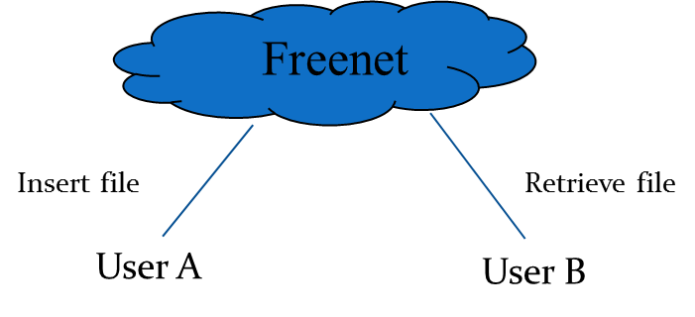
P4: A Traceback Attack on Freenet
Freenet is an anonymous peer to peer content-sharing system
  Each node contributes a part of storage space.
  Nodes can join and depart from Freenet at any moment.
Aims to support anonymity of content publishers and retrievers.

Slide 21
High-Level Security Mechanisms Used
Per-hop source address rewriting
Per-hop traffic encryption
End-to-end file encryption is also used
HTL is only decreased with a probability

Slide 22
Traceback Attack on Freenet
Goal: find which node issued a file request message
Two critical components of the attack
  Connect an attacking node to a suspect node
  Check if a suspect node has seen a particular message before.
Identifying all nodes seeing a message
Uniquely determining originating machine
“A Traceback Attack on Freenet”

Slide 23
Identifying All Nodes Seeing Msg
N_{k}
N_{k-2}
N_{k-1}
Monitor Node
Attack Nodes

Slide 24
Uniquely determining originator
We can uniquely determine originating machine if forwarding path of message satisfies certain conditions
  A few lemmas developed to specify conditions
  In essence, relying on routing algorithm of Freenet and relationship among neighbors

Slide 25
Performance Evaluation
Set | Total | Successful
 |  | Number | Percentage
S1 | 100 | 43 | 43%
S2 | 100 | 24 | 24%
S3 | 100 | 41 | 41%
Experiment results
S1 | 1000 | 432 | 43.2%
S2 | 1000 | 429 | 42.9%
S3 | 1000 | 441 | 44.1%
S4 | 1000 | 472 | 47.2%
S5 | 1000 | 474 | 47.4%
S6 | 1000 | 492 | 49.2%
Simulation results
Notes:
Emulab result shows that our success rate is between 24% and 43%. This shows that our attack is effective and feasible.
Simulation result shows that our success rate is between 42.9% to 49.2%. Even with large network sizes and node degree, our traceback attack is still effective and feasible.

Slide 26
Summary
Discussed a number of research projects
  Improving BGP convergence
  Controlling IP spoofing
  Detecting spam zombies
  Traceback attack on Freenet
Details and other projects at my homepage
  http://www.cs.fsu.edu/~duan

