Slide 1
CIS4930/CIS5930 Practical Cyber Security the need for such a course and other details
Spring 2020

Slide 2
CIS4930/CIS5930 Practical Cyber Security
… do we need such a course?
SANS Institute
“Purely technical skills can be readily acquired via classroom instruction, books, certifications and on-the-job training. Technical skill alone, however, is of limited utility when attempting to detect, assess and respond to live threats to an organization's production systems. IT support personnel - from the warehouse to the server room - need to be trained on how to perceive threats as they manifest. That requires hands-on, mentored, and nuanced instruction.”

Slide 3
CIS4930/CIS5930 Practical Cyber Security
… do we need such a course?
Major 2019 cyber security threats
Cybercrime, Fraud, DDoS
Ransomware
Business Email Compromise
Jihadist Cyber Threats
Hacktivism
Nation-State Threats
… and many more

Slide 4
CIS4930/CIS5930 Practical Cyber Security
… do we need such a course?
Vulnerabilities . . .
a weakness which allows an attacker to reduce the functionality of a system.
Involves: a system susceptibility or flaw, and an attacker who
has access to the flaw, and the capability to exploit the flaw.
Why not eliminate vulnerabilities?
. . . a good design by definition should not have vulnerabilities
Impossible (humans are not infallible)
Cyberwarfare vs. Cybercrime

Slide 5
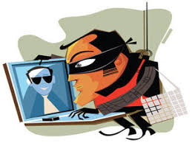
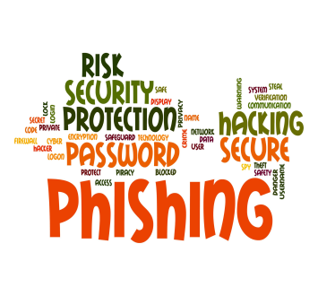
CIS4930/CIS5930 Practical Cyber Security
… a hands-on lab exercises course
Do we need such a course?
a good security analyst is a good hacker
… it takes a thief to catch a thief …
we need
an interdisciplinary approach (across different
cyber security disciplines)
crypto + forensics + reverse engineering +
binary exploitation + the supporting theory …

Slide 6
CIS4930/CIS5930 Practical Cyber Security
… outline of course
Three experienced instructors, one enthusiastic coordinator
Two versions
CIS 4930 undergraduate
CIS 5930 graduate
Requirements
Class attendance and participation
Homework assignments
Final CTF competition

