Slide 1
Cis 4360
COMPUTER SECURITY FUNDAMENTALS
In 60 minutes ….

Slide 2
Definitions
Cryptography: the study of secret (κρυπτο) writing (γραφω)
  Something cryptographers (security analysts) do …
Cryptanalysis: the analysis of secret writing
  Something cryptographers must do and hackers love doing
Cryptology: embraces cryptography an cryptanalysis
Steganography: the study of concealing (covering= στεγανος) messages/files/images, typically within other messages/files/ images/videos.

Slide 3
hOW does cryptography WORK?
Develop algorithms that
  conceal the context of messages from all except the sender and recipient (encryption for confidentiality or privacy),
  verify the correctness of the message of the recipient (integrity and authentication)
  and much more …

Slide 4
Threat model
Alice, Bob: honest
Malory: adversary
Alice
Bob
CIA
Confidentiality
Integrity
Availability
message
Alice
Bob
message
Confidentiality (privacy)
Malory
Alice
Bob
message → message’
Integrity
& authentication
Malory

Slide 5
Basic Concepts, glossary
cryptography: the art or science encompassing the principles and methods of transforming an intelligible message into one that is unintelligible, and then retransforming that message back to its original form
cryptanalysis: the study of principles and methods of transforming an unintelligible message back into an intelligible message without knowledge of the key. Also called codebreaking
cryptology: both cryptography and cryptanalysis
code: an algorithm for transforming an intelligible message into an unintelligible one using a code-book
plaintext: the original intelligible message
ciphertext: the transformed message
cipher: an algorithm for transforming an intelligible message into one that is unintelligible by transposition and/or substitution methods
key: some critical information used by the cipher, known only to the sender& receiver
encipher (encode): the process of converting plaintext to ciphertext using a key
decipher (decode): the process of converting ciphertext back into plaintext using a key
Confidentiality, Integrity and Authentication, abbreviated to: CIA

Slide 6
cipher Attacks
Involve several different types of attacks
ciphertext only
  access only to some enciphered messages
  use statistical analysis
known plaintext
  know (or strongly suspect) some plaintext-ciphertext pairs
  use this knowledge in attacking cipher
chosen plaintext
  can select plaintext and obtain corresponding ciphertext
  use knowledge of algorithm structure in attack
chosen plaintext-ciphertext
  can select plaintext and obtain corresponding ciphertext, or select ciphertext and obtain plaintext
  allows further knowledge of algorithm structure to be used
Passive vs active attacks
  Ciphertext only attacks are passive attacks: the adversary is an eavesdropper.
  Chosen plaintext-ciphertexts attacks are active attacks: the adversary sends selected messages or gets dencrypted selected ciphertexts.

Slide 7
Unconditional & Computational Security
There are two fundamentally different ways ciphers may be secured
unconditionally
  no matter how much computer power is available, the cipher cannot be broken
computationally
  given limited computing resources (e.g. the time needed for calculations is greater than age of universe), the cipher cannot be broken

Slide 8
Secret Key Cryptography
Symmetric Encryption
encryption key ≈ decryption key
ciphertext = same length as plaintext
substitution ciphers, DES, AES, IDEA
Message transmission
agree on key (how?), communicate over insecure channel
Secure key storage: how?

Slide 9
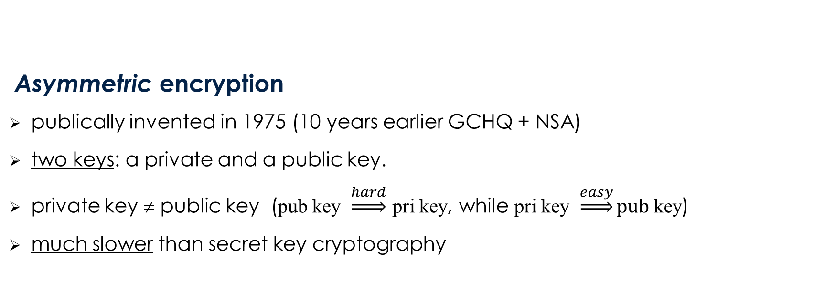
Public Key Cryptography
Asymmetric encryption
publically invented in 1975 (10 years earlier GCHQ + NSA)
two keys: a private and a public key.
private key ≠ public key (pub key $\underset{⇒}{hard}$ pri key, while pri key $\underset{⇒}{easy}pub$key)
much slower than secret key cryptography

Slide 10
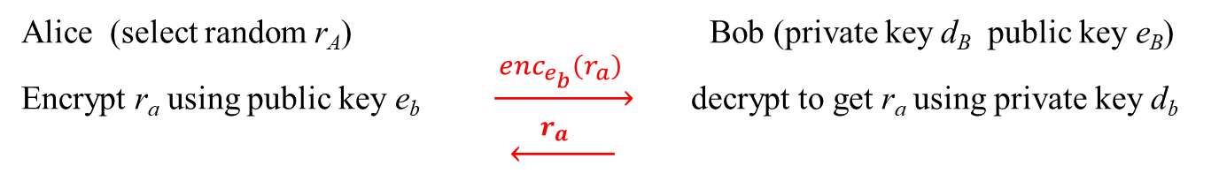
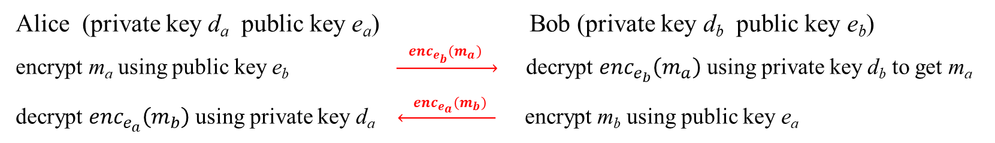
Public key cryptography
Privacy
Alice (private key d_{a} public key e_{a}) Bob (private key d_{b} public key e_{b})
encrypt m_{a} using public key e_{b} $\underset{→}{ {enc}_{e_{b}}\left(m_{a}\right) }$ decrypt ${enc}_{e_{b}}\left(m_{a}\right)$ using private key d_{b} to get m_{a}
decrypt ${enc}_{e_{a}}\left(m_{b}\right)$ using private key d_{a} $\underset{←}{ {enc}_{e_{a}}\left(m_{b}\right) }$ encrypt m_{b} using public key e_{a}
Authentication
secret keys: no need to share secret keys for secure communication
public key: Alice may share Bob’s public key e_{B} with his enemies
need to store safely secret keys
Alice (select random r_{A}) Bob (private key d_{B} public key e_{B})
Encrypt r_{a} using public key e_{b} $\underset{→}{ {enc}_{e_{b}}\left(r_{a}\right) }$ decrypt to get r_{a} using private key d_{b}
$\underset{←}{ r_{a} }$

Slide 11
Digital signatures
Alice digitally signs the hash of a message h(m_{A}) with private signature key d_{A}
Bob verifies the digital signature by using the public verifying key e_{A} of Alice
Digital signatures guarantee,
  authorship
  integrity
  non-repudiation: can’t do with this with secret key cryptography

Slide 12
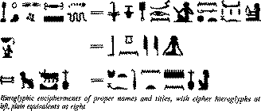
A Brief History of classical cryptography
Ancient Ciphers
  history of at least 4000 years
ancient Egyptians enciphered some of their hieroglyphs
2000 years ago Julius Caesar used a simple substitution cipher
Roger Bacon described several methods in 1200s
Geoffrey Chaucer included several ciphers in his works
Blaise de Vigenère published a book on cryptology in 1585, & described the polyalphabetic substitution cipher
increasingly used, especially in diplomacy & war over centuries

Slide 13

Machine ciphers
Jefferson cylinder, developed in 1790s, comprised 36 disks, each with a random alphabet, order of disks was key, message was set, then another row became cipher

Slide 14
Classical Cryptographic Techniques
have two basic components: substitution and transposition
  in substitution cipher’s letters are replaced by other letters
  in transposition ciphers the letters are arranged in a different order
Classical cryptographic ciphers may be:
  monoalphabetic - only one substitution/transposition is used
  polyalphabetic - several substitutions/transpositions are used
several such ciphers may be concatenated together to form a product cipher

Slide 15
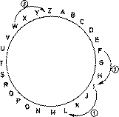
Caesar Cipher - a monoalphabetic cipher
replace each letter of message by a letter a fixed distance away e.g. use the 3rd letter on
reputedly used by Julius Caesar
example
I CAME I SAW I CONQUE R E D
L F D P H L VDZ L F R Q T XHUHG

Slide 16
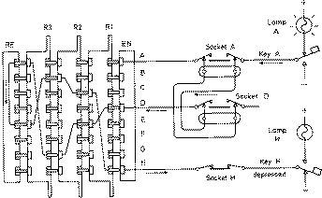
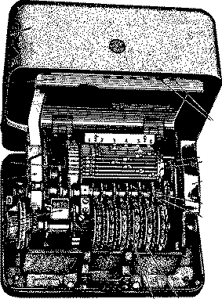
enigma
Enigma Rotor machine, one of a class of cipher machines, used during WWII, comprised a series of rotor wheels with internal cross-connections, providing a substitution using a continuously changing alphabet

Slide 17
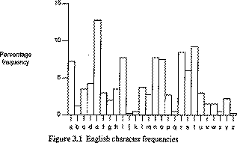
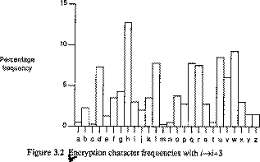
Cryptanalysis of the Caesar Cipher
only 26 possible ciphers
could simply try each in turn - exhaustive key search
also can use letter frequency analysis

Slide 18
Polyalphabetic Substitution, Vigenère Cipher
basically multiple Caesar ciphers
i-th letter specifies i-th alphabet to use
use each alphabet in turn, repeating from start after d letters in message
Plaintext T H I S P R O C E S S C A N A L S O B E E X P R E S S E D
Keyword C I P H E R C I P H E R C I P H E R C I P H E R C I P H E
Plaintext V P X Z T I Q K T Z W T C V P S W F D M T E T I G A H L H

Slide 19
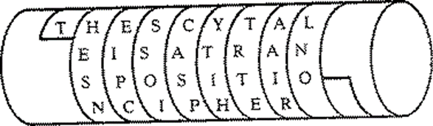
Transposition Ciphers
Transposition or permutation ciphers hide the message contents by rearranging the order of the letters
Scytale cipher
an early Greek transposition cipher
a strip of paper was wound round a staff
message written along staff in rows, then paper
removed leaving a strip of seemingly random letters
not very secure as key was width of paper & staff

Slide 20
Row Transposition ciphers
Write message in a number of columns and use some rule to read off from these columns
Key could be a series of numbers being the order to: read off the cipher, or write in the plaintext
Plain: THESIMPLESTPOSSIBLETRANSPOSITIONSXX
Key (R): 2 5 4 1 3
Key (W): 4 1 5 3 2
T H E S I S T I E H
M P L E S E M S L P
T P O S S S T S O P
I B L E T E I T L B
R A N S P S R P N A
O S I T I T O I I S
O N S X X X O X S N
Cipher: STIEH EMSLP STSOP EITLB SRPNA TOIIS XOXSN

Slide 21
Cryptanalysis of Row Transposition ciphers
a frequency count will show a normal language profile
hence know have letters rearranged
basic idea is to guess period, then look at all possible permutations in period, and search for common patterns
use lists of common pairs & triples & other features

Slide 22
Product ciphers
In general ciphers based on just substitutions or just transpositions are not secure
What about combining several ciphers?
  two substitutions are really only one more complex substitution
  two transpositions are really only one more complex transposition
  but a substitution followed by a transposition makes a new much harder cipher
PRODUCT CIPHERS consist of chained substitution-transposition combinations
In general these are far too hard to do by hand
One famous Product Cipher, the 'ADFGVX' cipher, was used in WW1
However this could easily be broken with calculating machines.
One had to wait for the invention of the Cipher Machine, particularly the rotor machines (eg the Enigma mentioned earlier) to get codes that needed computers to be broken

Slide 23
ADFGVX Product Cipher
Named so, because only the letters ADFGVX are used
Chosen since they have very distinct Morse codes
Uses:
  a fixed substitution table to map each plaintext letter to a letter pair, then
  a keyed block transposition

Slide 24
ADFGVX Product Cipher, substitution table
A D F G V X
A K Z W R 1 F
D 9 B 6 C L 5
F Q 7 J P G X
G E V Y 3 A N
V 8 O D H 0 2
X U 4 I S T M
Plaintext: P R O D U C T C I P H E R S
Intermediate Text:
FG AG VD VF XA DG XV DG XF FG VG GA AG XG

Slide 25
ADFGVX Product Cipher, Keyed Transposition
2 3 7 6 5 1 4 Sorting Order Key
F G A G V D V
F X A D G X V
D G X F F G V
G G A A G X G
Intermediate Text: FG AG VD VF XA DG XV DG XF FG VG GA AG XG
Ciphertext: DXGX FFDG GXGG VVVG VGFG CDFA AAXA

Slide 26
Wireless & Cellular Communication Networks from 1G to 5G

Slide 27
1G Advanced Mobile Phone Services (AMPS) architecture
Public Switching Telephone Network
Mobile Telephone Switching Office

Slide 28
2G Global System for Mobile Communication (GSM) architecture
(base and switching interface)
(B,C,D,H,F,G,H
other interfaces)
(air interface)
Public Swit Tel Netw
Integr Serv Digit Netw
Mobile Stat Subsystem
Base Stat Subsystem
Network Switching System

Slide 29

3G Universal Mobile Telecommunications Service (UMTS) architecture
Mobile Serv Center/
Visitor Locat Register
Home Location Service
Radio Net Contr
Serving GPRS
Support Network
Gateway GPRS
Support Network
Mob Stat Subsystem
(Core Network)
(Universal Terrestrial Radio Access Network)

Slide 30
4G Long Term Evolution (LTE) Network architecture
Mob Manage Entity
enhanced Node B

Slide 31
5G Non-standalone architecture (NSA)

Slide 32
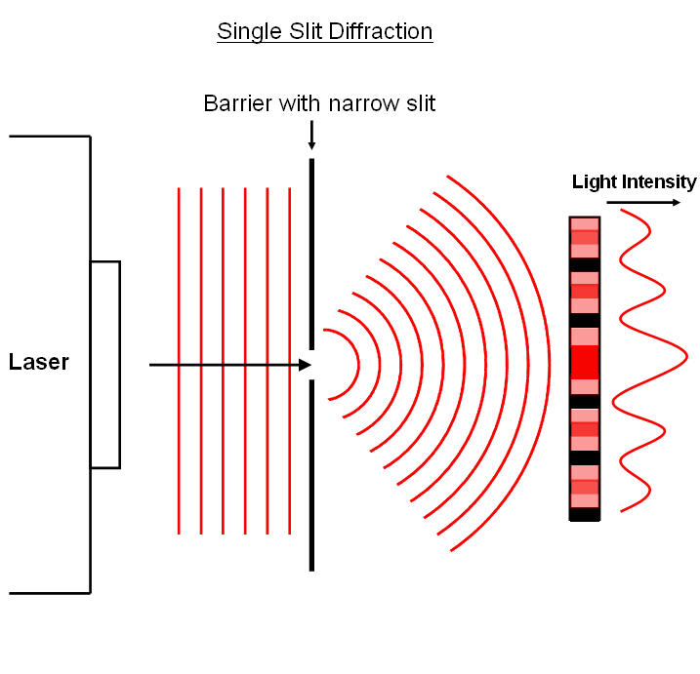
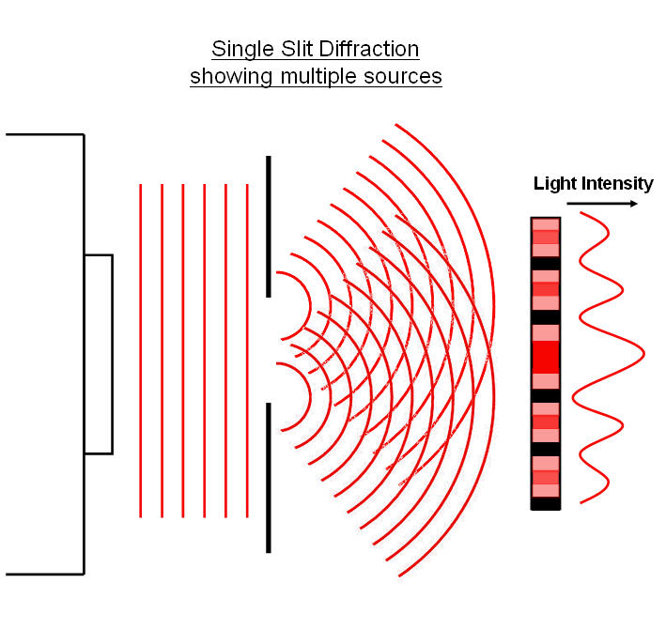
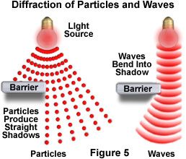
CaBle or wireless
The Wave-Particle Duality Principle & the Uncertainty Principle
Wave-Particle Duality Principle: light behaves both like
  a wave (diffraction) and
  a particle (photon = bundle of energy)
  Does not need a medium to travel

Slide 33
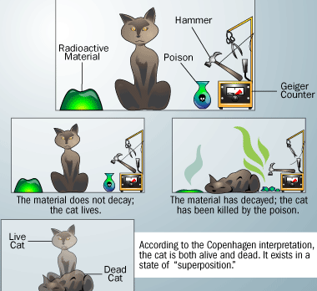
CaBle or wireless
The Wave-Particle Duality Principle & the Uncertainty Principle
Entanglement between particle and wave state
  Heisenberg’s duality principle
      there is a natural tradeoff between knowing an particle's position and its momentum. The greater the uncertainty in it's position, the smaller the uncertainty in its momentum.
      It is impossible to predict, measure, or know both the exact position of a particle and its exact momentum (speed) at the same time. In fact, a particle does not have an exact position and momentum at the same time!
  Schrodinger’s Cat (thought experiment)
    A cat is locked in a steel box along with a Geiger counter a tiny bit of radioactive substance, and some poison. You would not know if the cat is alive or dead until you open the box. In this sense the cat is dead and alive and its state can only be determined until “tested”.

