Slide 1
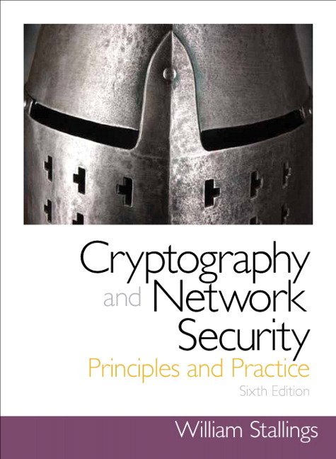
Introduction to Cryptography
Based on: William Stallings, Cryptography and Network Security

Slide 2
Chapter 9
Public Key Cryptography and RSA

Slide 3
Misconceptions Concerning
Public-Key Encryption
Public-key encryption is more secure from cryptanalysis than symmetric encryption
Public-key encryption has made symmetric encryption obsolete

Slide 4
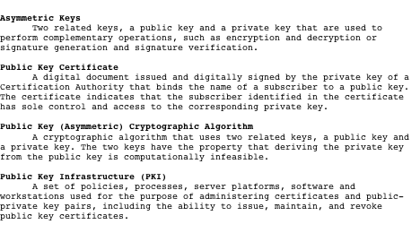
Asymmetric Encryption Terminology

Slide 5
Principles of Public-Key Cryptosystems
Public-key cryptography evolved from an attempt to address the two basic limitations of symmetric encryption:
Whit Diffie and Martin Hellman proposed a method that addressed both problems and was radically different from all previous approaches to cryptography
Key distribution
How to have secure communication without having to trust a KDC with your key
Digital signatures
How to verify that a message comes intact from the claimed sender

Slide 6
Public-Key Cryptosystems
Plaintext
The input data
Encryption algorithm
Performs various transform-ations on the plaintext
Public key
Used for encryption
Private key
Used for decryption
Ciphertext
The output data
Decryption algorithm
Used for decryption

Slide 7
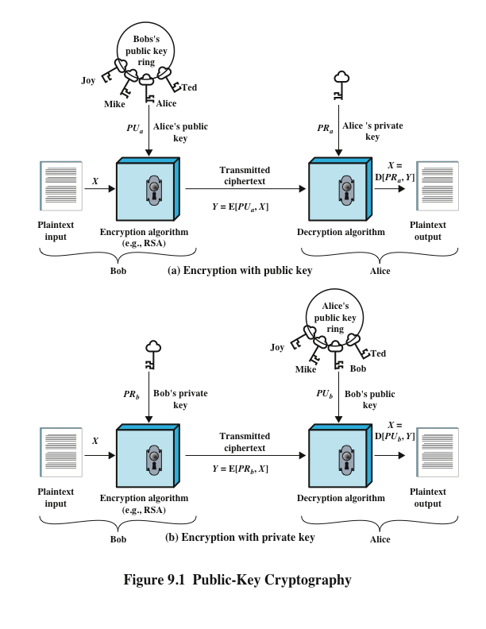
Public-Key Cryptography

Slide 8
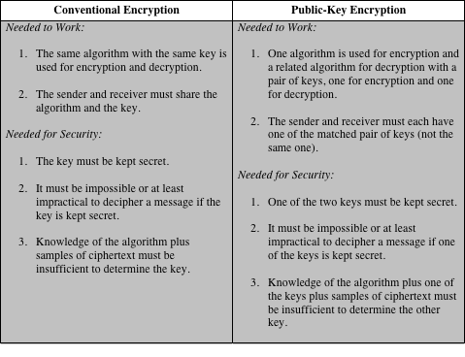
Table 9.2
Conventional and Public-Key Encryption

Slide 9
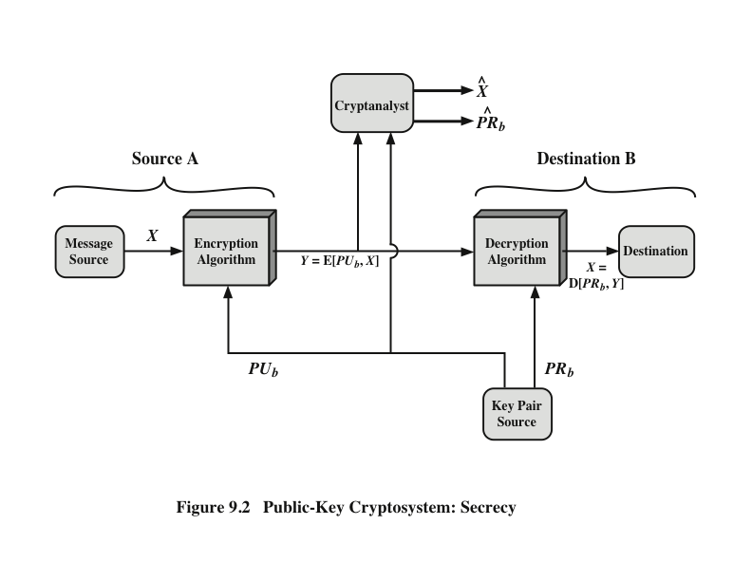
Public-Key Cryptosystem: Secrecy

Slide 10
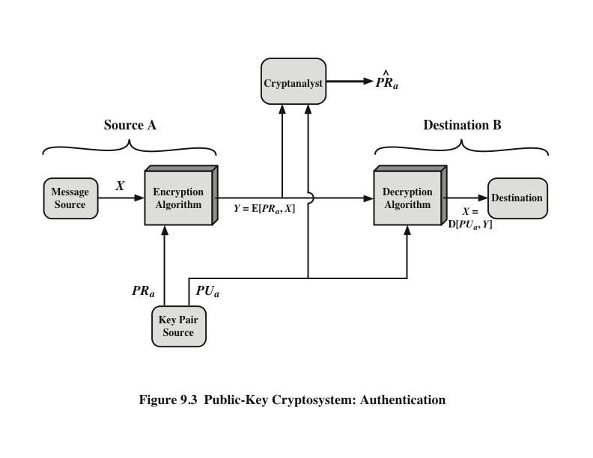
Public-Key Cryptosystem: Authentication
Decryption
Algorithm
Decryption
Algorithm
Encryption
Algorithm

Slide 11
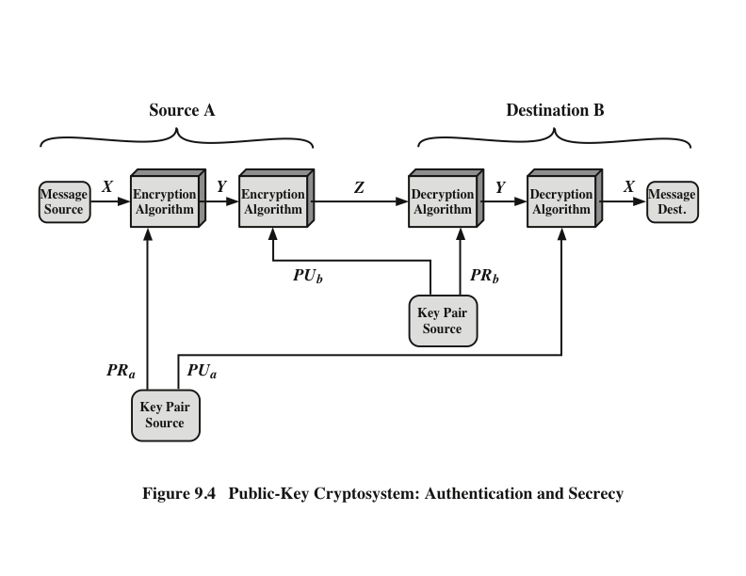
Public-Key Cryptosystem: Authentication and Secrecy
Authentication
Algorithm
Authentication
Algorithm

Slide 12
Applications for Public-Key Cryptosystems
Public-key cryptosystems can be classified into three categories:
Some algorithms are suitable for all three applications, whereas others can be used only for one or two
Encryption/decryption
The sender encrypts a message with the recipient’s public key
Digital signature
The sender “signs” a message with its private key
Key exchange
Two sides cooperate to exchange a session key

Slide 13
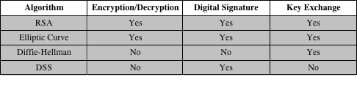
Applications for Public-Key Cryptosystems

Slide 14
Public-Key Requirements
Computationally easy
  for party B to generate a pair (public-key PU_{b}, private key PR_{b})
  for sender A, knowing the public key and the message, to generate the corresponding ciphertext
  for receiver B to decrypt the resulting ciphertext using the private key to recover the original message
Computationally infeasible for an adversary
  knowing the public key, to determine the private key
  knowing the public key and a ciphertext, to recover the original message

Slide 15
Public-Key Requirements
Need a trap-door one-way function
  f : {0,1}^{n} → {0,1}^{n} is a one-way function if
    Y = f(X) can easily be computed for X in {0,1}^{n}
    X = f^{–1}(Y) infeasible for Y in {0,1}^{n}
A trap-door one-way function is a family of invertible functions f_{k}, such that computing
  Y = f_{k}(X) is easy, if k and X are is known
  X = f_{k}^{–1}(Y) is easy, if k and Y are known
  X = f_{k}^{–1}(Y) infeasible, if Y is known but k not known
A practical public-key scheme depends on a suitable trap-door one-way function

Slide 16
Rivest-Shamir-Adleman (RSA) Scheme
Developed in 1977 by Ron Rivest, Adi Shamir & Len Adleman
Most widely used general-purpose public-key encryption
A cipher for which the plaintext and ciphertext are integers between 0 and n – 1 for some n
  A typical size for n is 1024 bits, or 309 decimal digits

Slide 17
RSA Algorithm
Plaintext is encrypted in blocks with whose value less than some number n
Encryption and decryption are of the following form, for plaintext block M and ciphertext block C
C = Me mod n
M = C^{d} mod n = (Me)^{d} mod n = M^{ed} mod n
Both sender and receiver must know the value of n
The sender knows the value of e, and only the receiver knows the value of d
This is a public-key encryption algorithm with a public key of PU={e,n} and a private key of PR={d,n}

Slide 18
Algorithm Requirements
It should be possible to find values of e, d, n such that
M^{ed} mod n = M for all M < n
It should be relatively easy to calculate Me mod n and C^{d} mod n
for all values of M < n
It should be infeasible to determine d given e and n

Slide 19
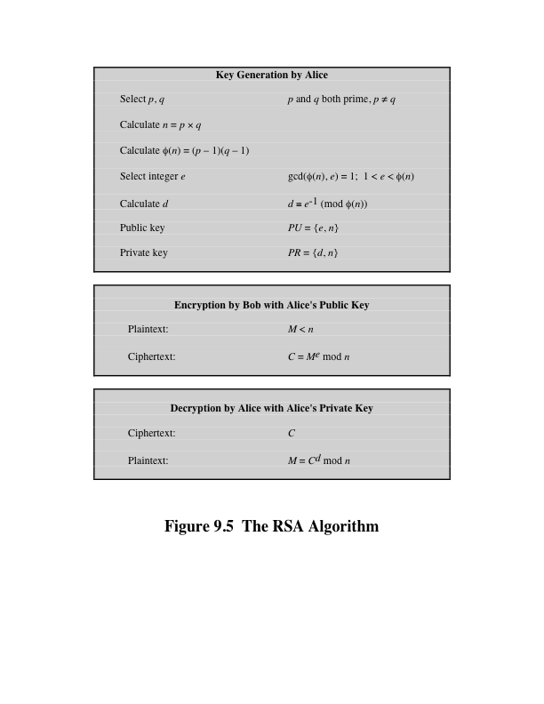

Slide 20
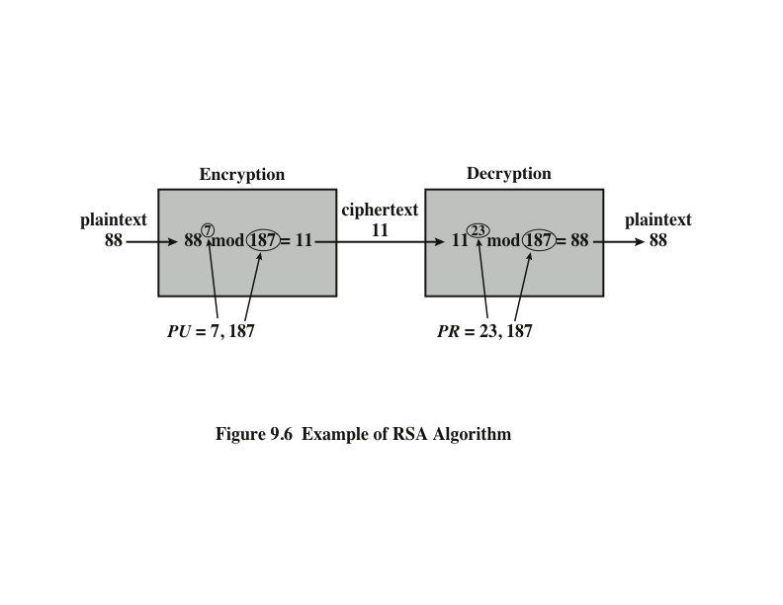
Example of RSA Algorithm

Slide 21
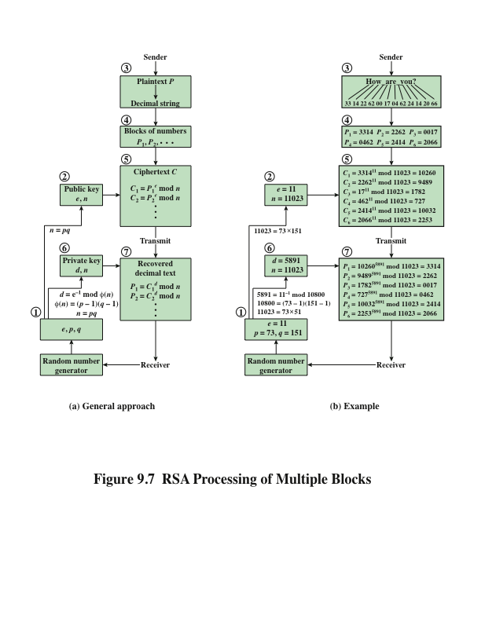

Slide 22
Exponentiation in Modular Arithmetic
Both encryption and decryption in RSA involve raising an integer to an integer power, mod n
Can make use of a property of modular arithmetic:
[(a mod n) x (b mod n)] mod n =(a x b) mod n
With RSA you are dealing with potentially large exponents so efficiency of exponentiation is a consideration

Slide 23
Efficient Operation Using the Public Key
To speed up the operation of the RSA algorithm using the public key, a specific choice of e is usually made
The most common choice is 65537 (2¹⁶ + 1)
  Two other popular choices are e=3 and e=17
  Each of these choices has only two 1 bits, so the number of multiplications required to perform exponentiation is minimized

Slide 24
Efficient Operation Using the Private Key
Decryption uses exponentiation to power d
  A small value of d is vulnerable to a brute-force attack and to other forms of cryptanalysis
Can use the Chinese Remainder Theorem (CRT) to speed up computation
  The quantities d mod (p – 1) and d mod (q – 1) can be precalculated
  End result is that the calculation is approximately four times as fast as evaluating M = C^{d} mod n directly

Slide 25
Key Generation
Before the application of the public-key cryptosystem each participant must generate a pair of keys:
  Determine two prime numbers p and q
  Select either e or d and calculate the other
Because the value of n = pq will be known to any potential adversary, primes must be chosen from a sufficiently large set
  The method used for finding large primes must be reasonably efficient

Slide 26
Procedure for Picking a Prime Number
Pick an odd integer n at random
Pick an integer a < n at random
Perform the probabilistic primality test with a as a parameter. If n fails the test, reject the value n and go to step 1
If n has passed a sufficient number of tests, accept n; otherwise, go to step 2

Slide 27
The Security of RSA
Five possible approaches to attacking RSA
Brute force
Exploits properties of the RSA algorithm
Chosen ciphertext attacks
Inducing hardware faults in the processor that is generating digital signatures
Hardware fault-based attack
Depend on the run time of the decryption algorithm
Timing attacks
Several approaches, all equivalent in effort to factoring the product of two primes
Mathematical attacks
Try all possible private keys

Slide 28
Factoring Problem
We can identify three approaches to attacking RSA mathematically:
  Factor n into its two prime factors. This enables calculation of φ(n) = (p – 1) x (q – 1), which in turn enables determination of d = e⁻¹ (mod φ(n))
  Determine φ(n) directly without first determining p and q. Again this enables determination of d = e⁻¹ (mod φ(n))
  Determine d directly without first determining φ(n)

Slide 29
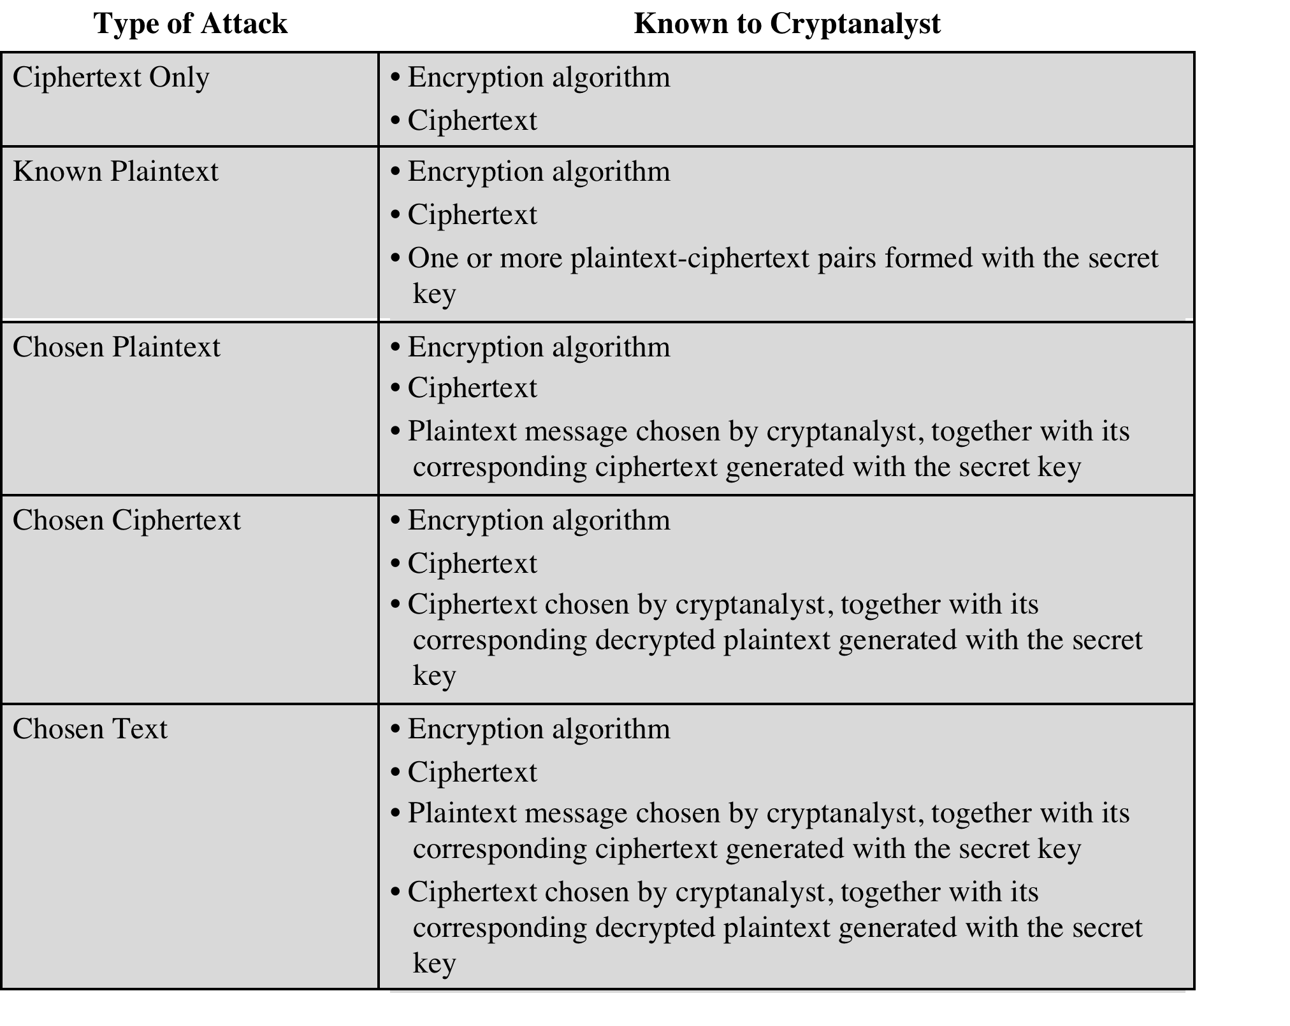

Slide 30
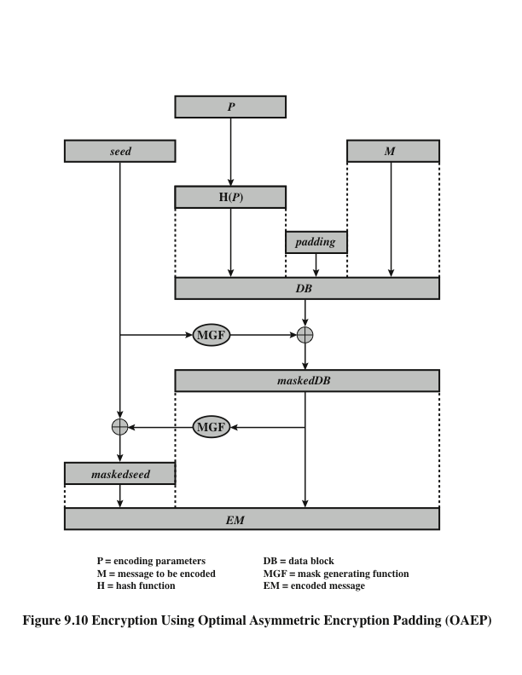
Optimal Asymmetric Encryption Padding (OAEP)

Slide 31
Summary
Public-key cryptosystems
Applications for public-key cryptosystems
Requirements for public-key cryptography
Public-key cryptanalysis
The RSA algorithm
  Description of the algorithm
  Computational aspects
  Security of RSA

