Slide 1
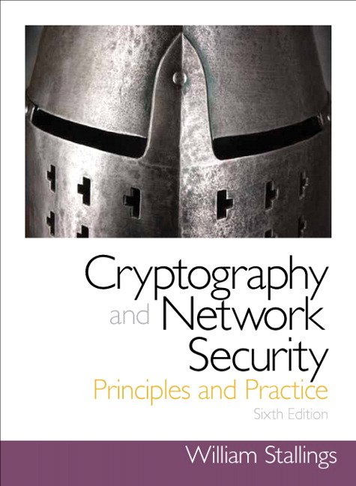
Introduction to Cryptography
Based on: William Stallings, Cryptography and Network Security..

Slide 2
Chapter 6
Block Cipher Operation Modes

Slide 3
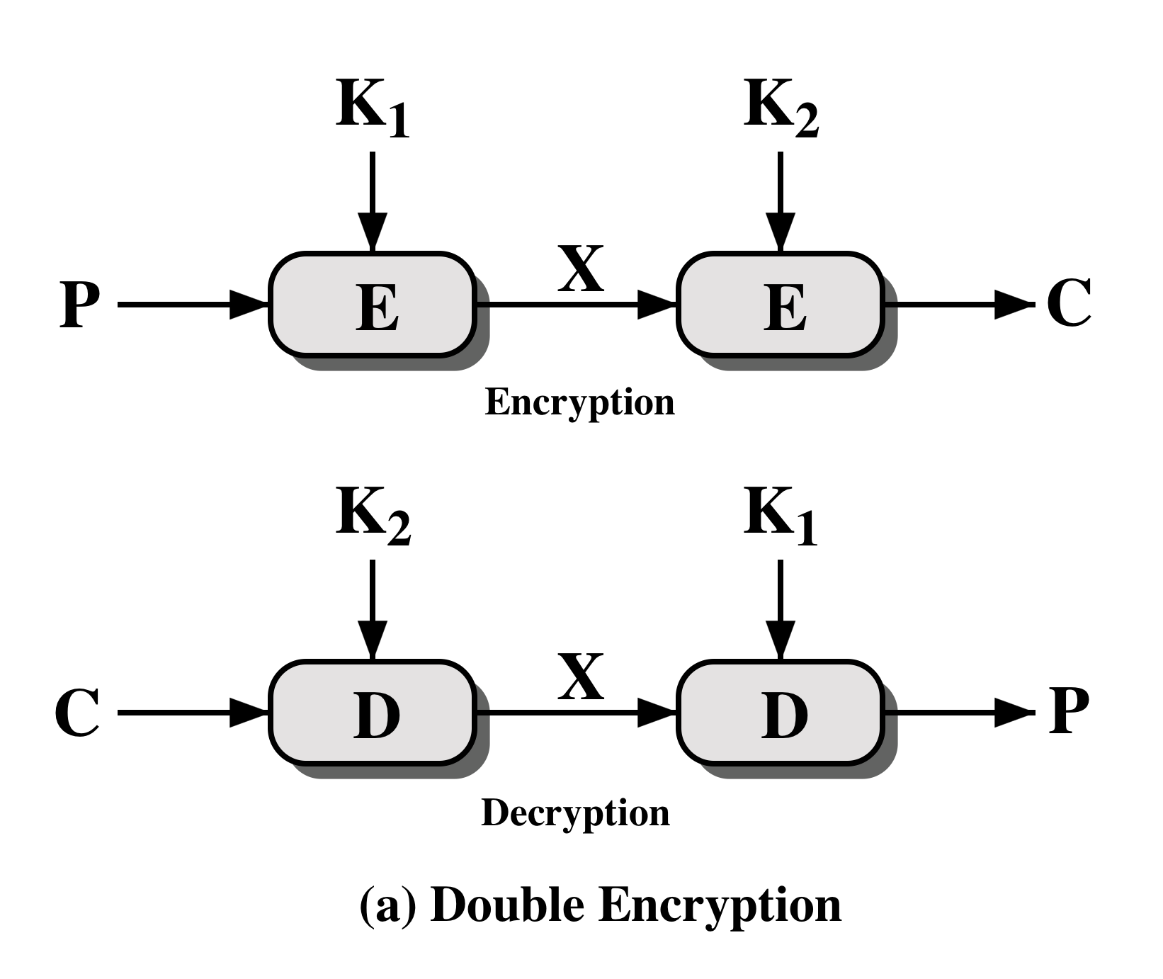
Double DES

Slide 4
Meet-in-the-Middle Attack
The use of double DES results in a mapping that is not equivalent to a single DES encryption
The meet-in-the-middle attack algorithm defeats double DES by reducing it to single DES

Slide 5
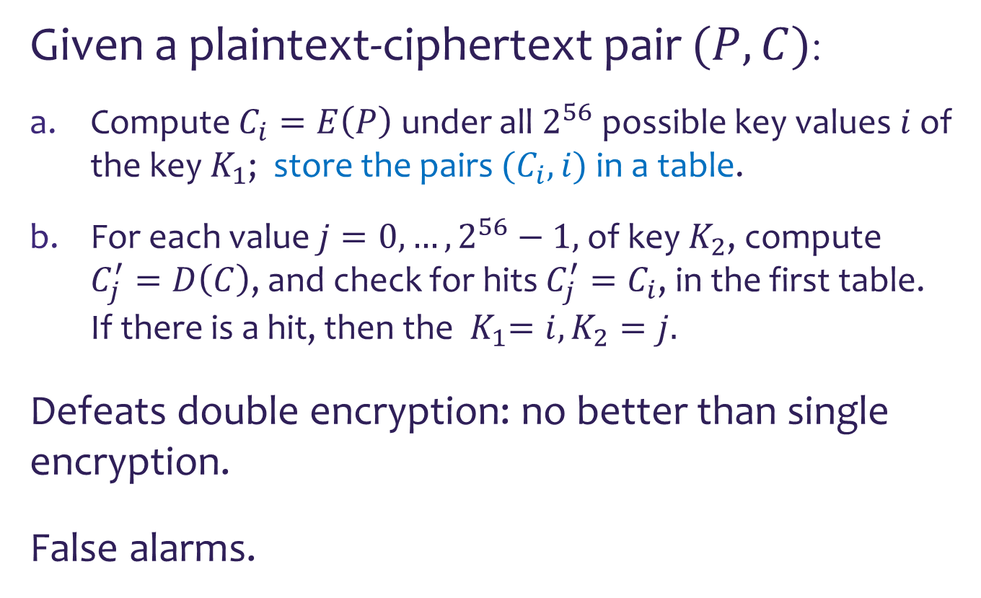
Meet-in-the-Middle Attack
Given a plaintext-ciphertext pair $(P,C)$:
Compute $C_{i}=E\left(P\right)$ under all $2^{56}$ possible key values $i$ of the key${ K}_{1}$; store the pairs ${(C}_{i},i)$ in a table.
For each value $j=0,…,2^{56}−1,$of key $K_{2}$, compute $C_{j}^{′}=D\left(C\right)$, and check for hits $C_{j}^{′}=C_{i}$, in the first table. If there is a hit, then the ${ K}_{1}=i,K_{2}=j.$
Defeats double encryption: no better than single encryption.
False alarms.

Slide 6
Triple-DES with Two-Keys
Counters the meet-in-the-middle attack by using three stages of encryption with three different keys
  Raises the cost of the meet-in-the-middle attack to 2¹¹², which is beyond what is practical
  Has the drawback of requiring a key length of 56 x 3 = 168 bits.
An alternative is two use triple encryption with two keys
  3DES with two keys is a relatively popular and has been adopted for use in the key management standards ANSI X9.17 and ISO 8732

Slide 7
Multiple Encryption

Slide 8
Triple DES with Three Keys
Many researchers now feel that three-key 3DES is the preferred alternative
A number of Internet-based applications have adopted three-key 3DES including PGP and S/MIME
Three-key 3DES has an effective key length of 168 bits and is defined as:
C = E( K₃, D( K₂, E( K₁, P)))
Backward compatibility with two key 3DES is provided by putting:
K₃ = K1

Slide 9
Modes of Operation of Block Ciphers
A technique for enhancing the effect of a cryptographic algorithm or adapting the algorithm for an application
Five modes of operation have been defined by NIST
  Intended to cover a wide variety of applications of encryption for which a block cipher could be used
  Intended for use with any symmetric block cipher, including triple DES and AES

Slide 10
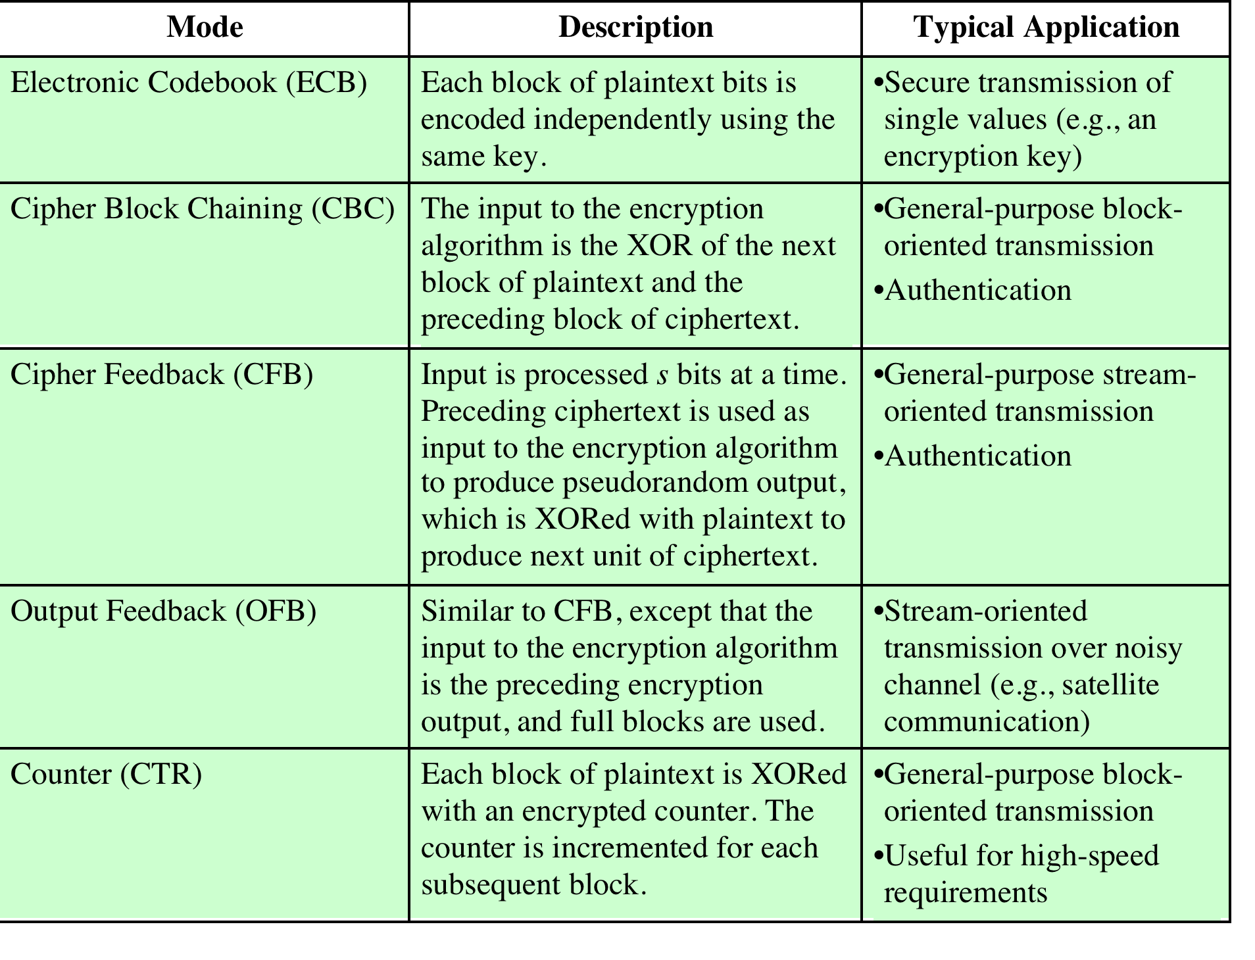

Slide 11
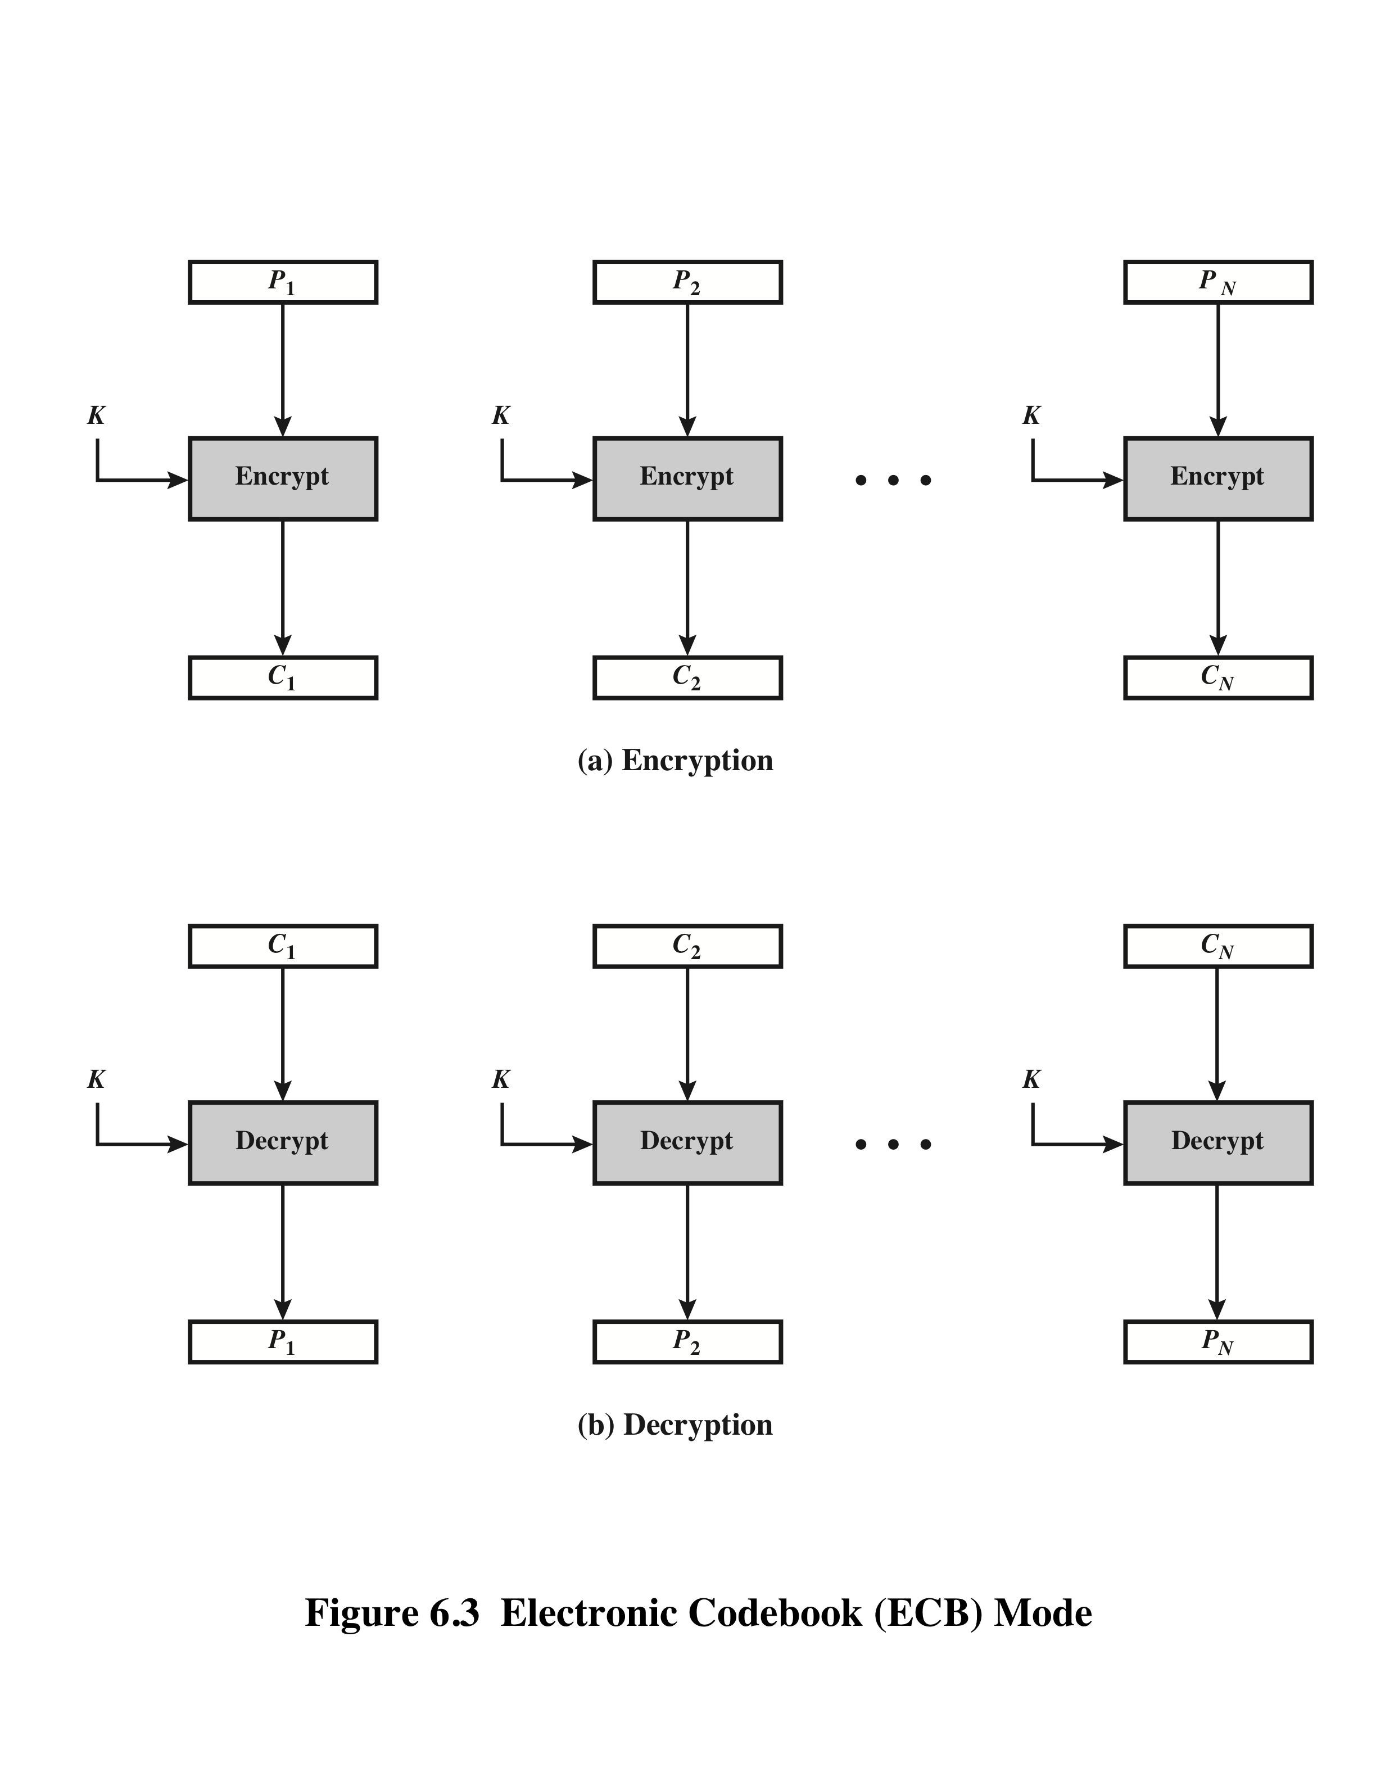
Electronic Codebook Mode (ECB)

Slide 12

Overhead
Error recovery
Error propagation
Diffusion
Security

Slide 13
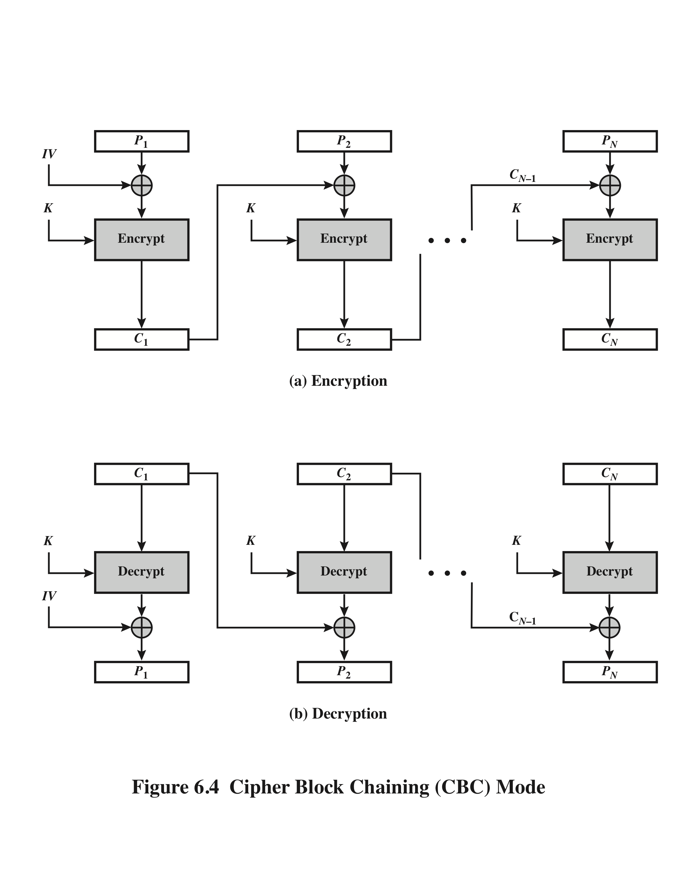
Cipher Block Chaining (CBC)
The initial vector IV
must not be predictable

Slide 14
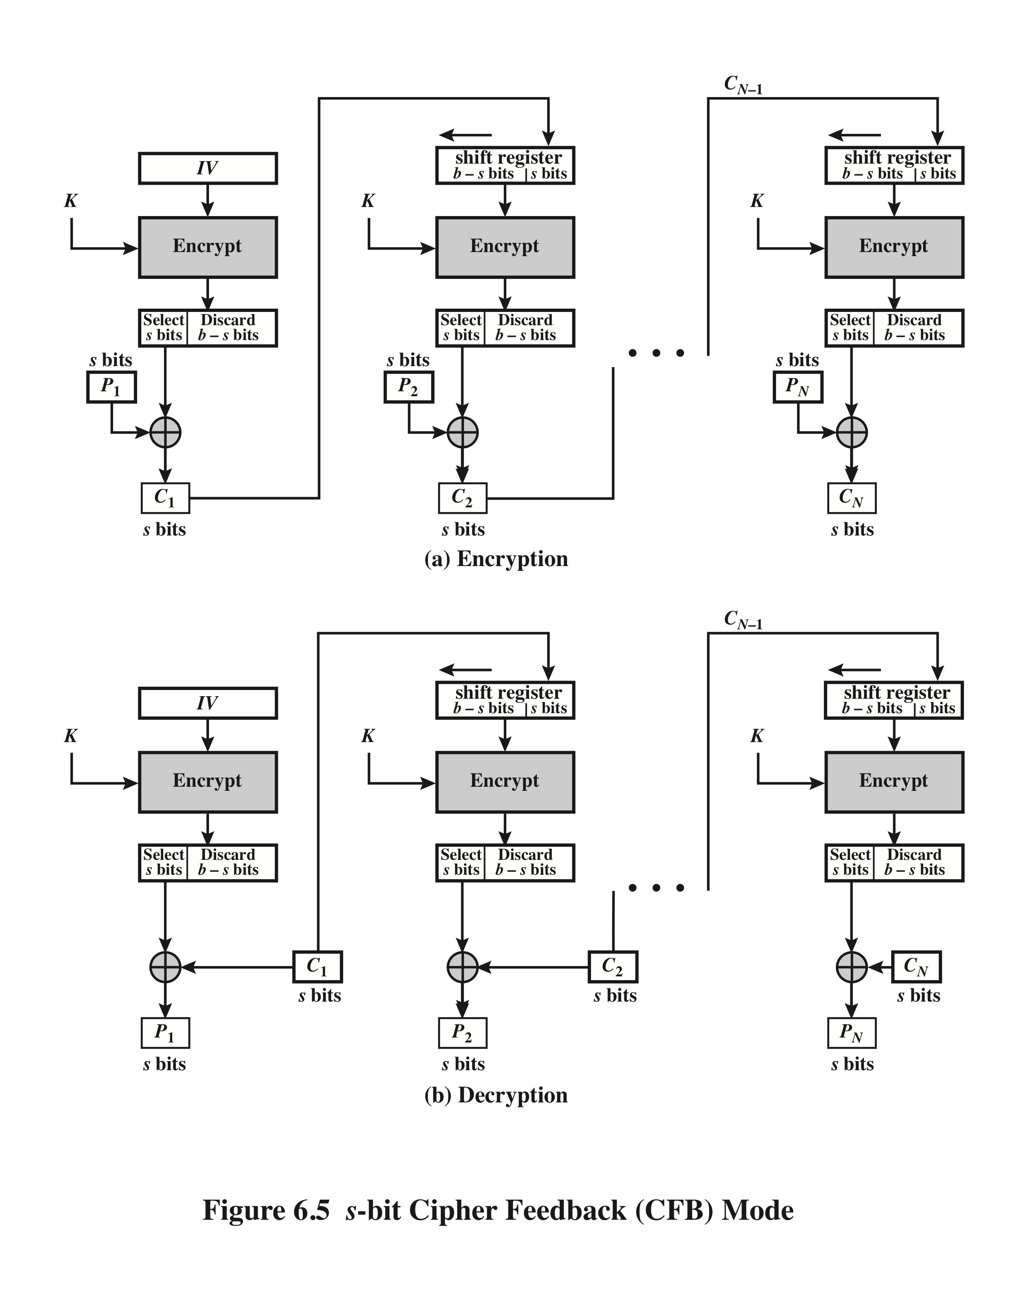
s-bit Cipher Feedback Mode (CFB)

Slide 15
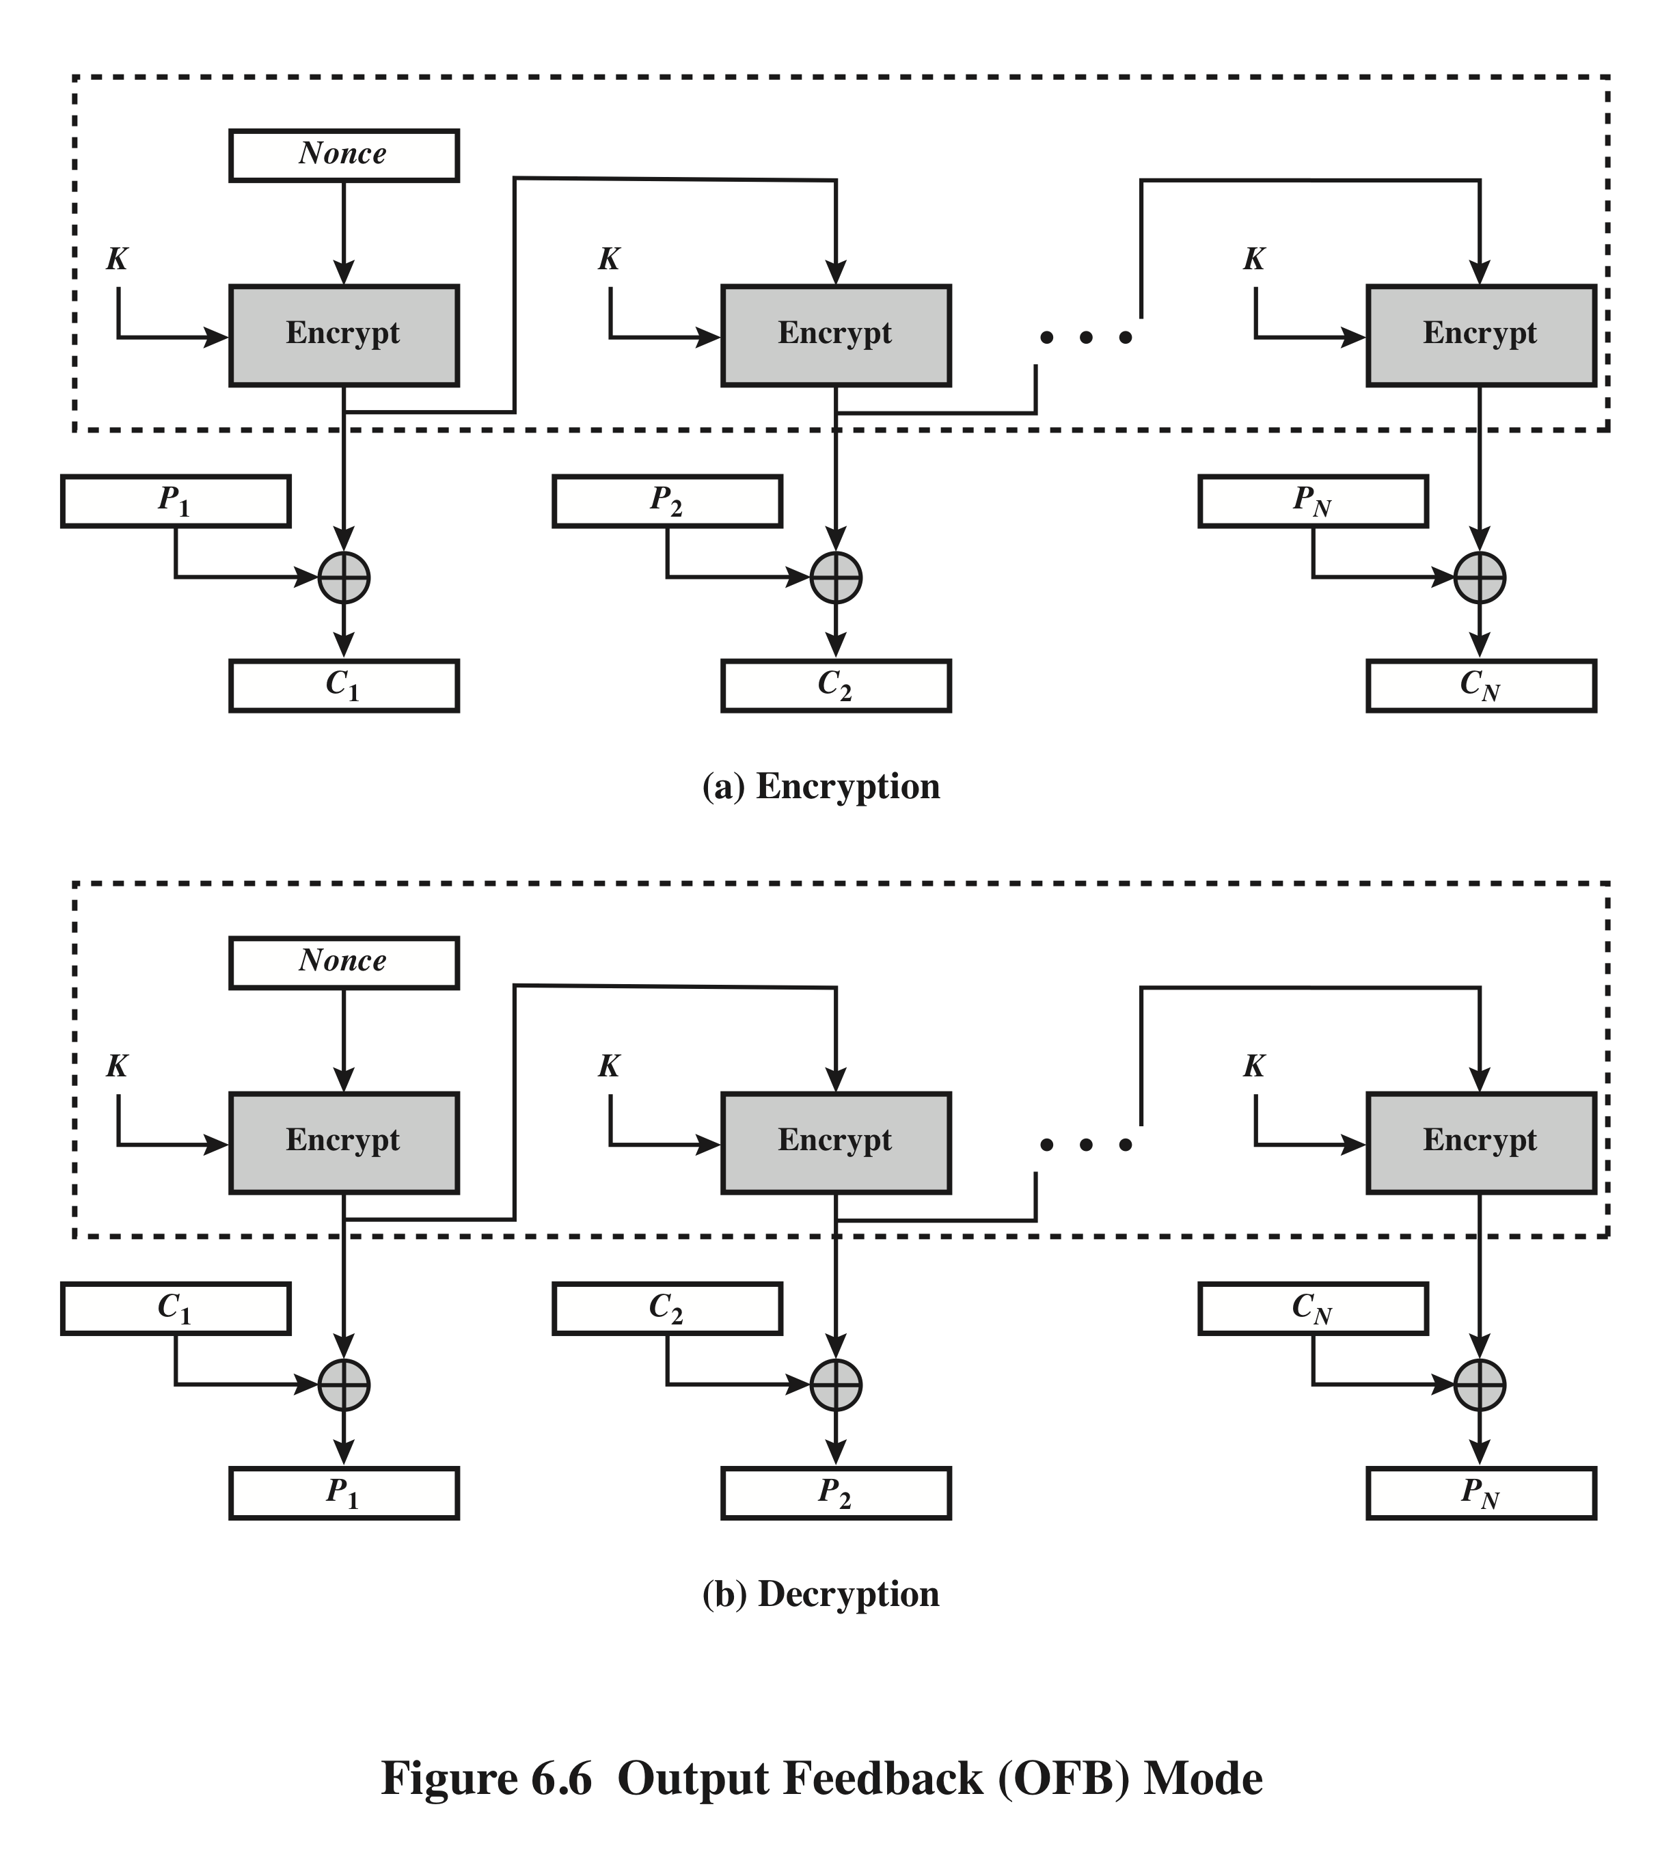
Output Feedback Mode (OFB)

Slide 16
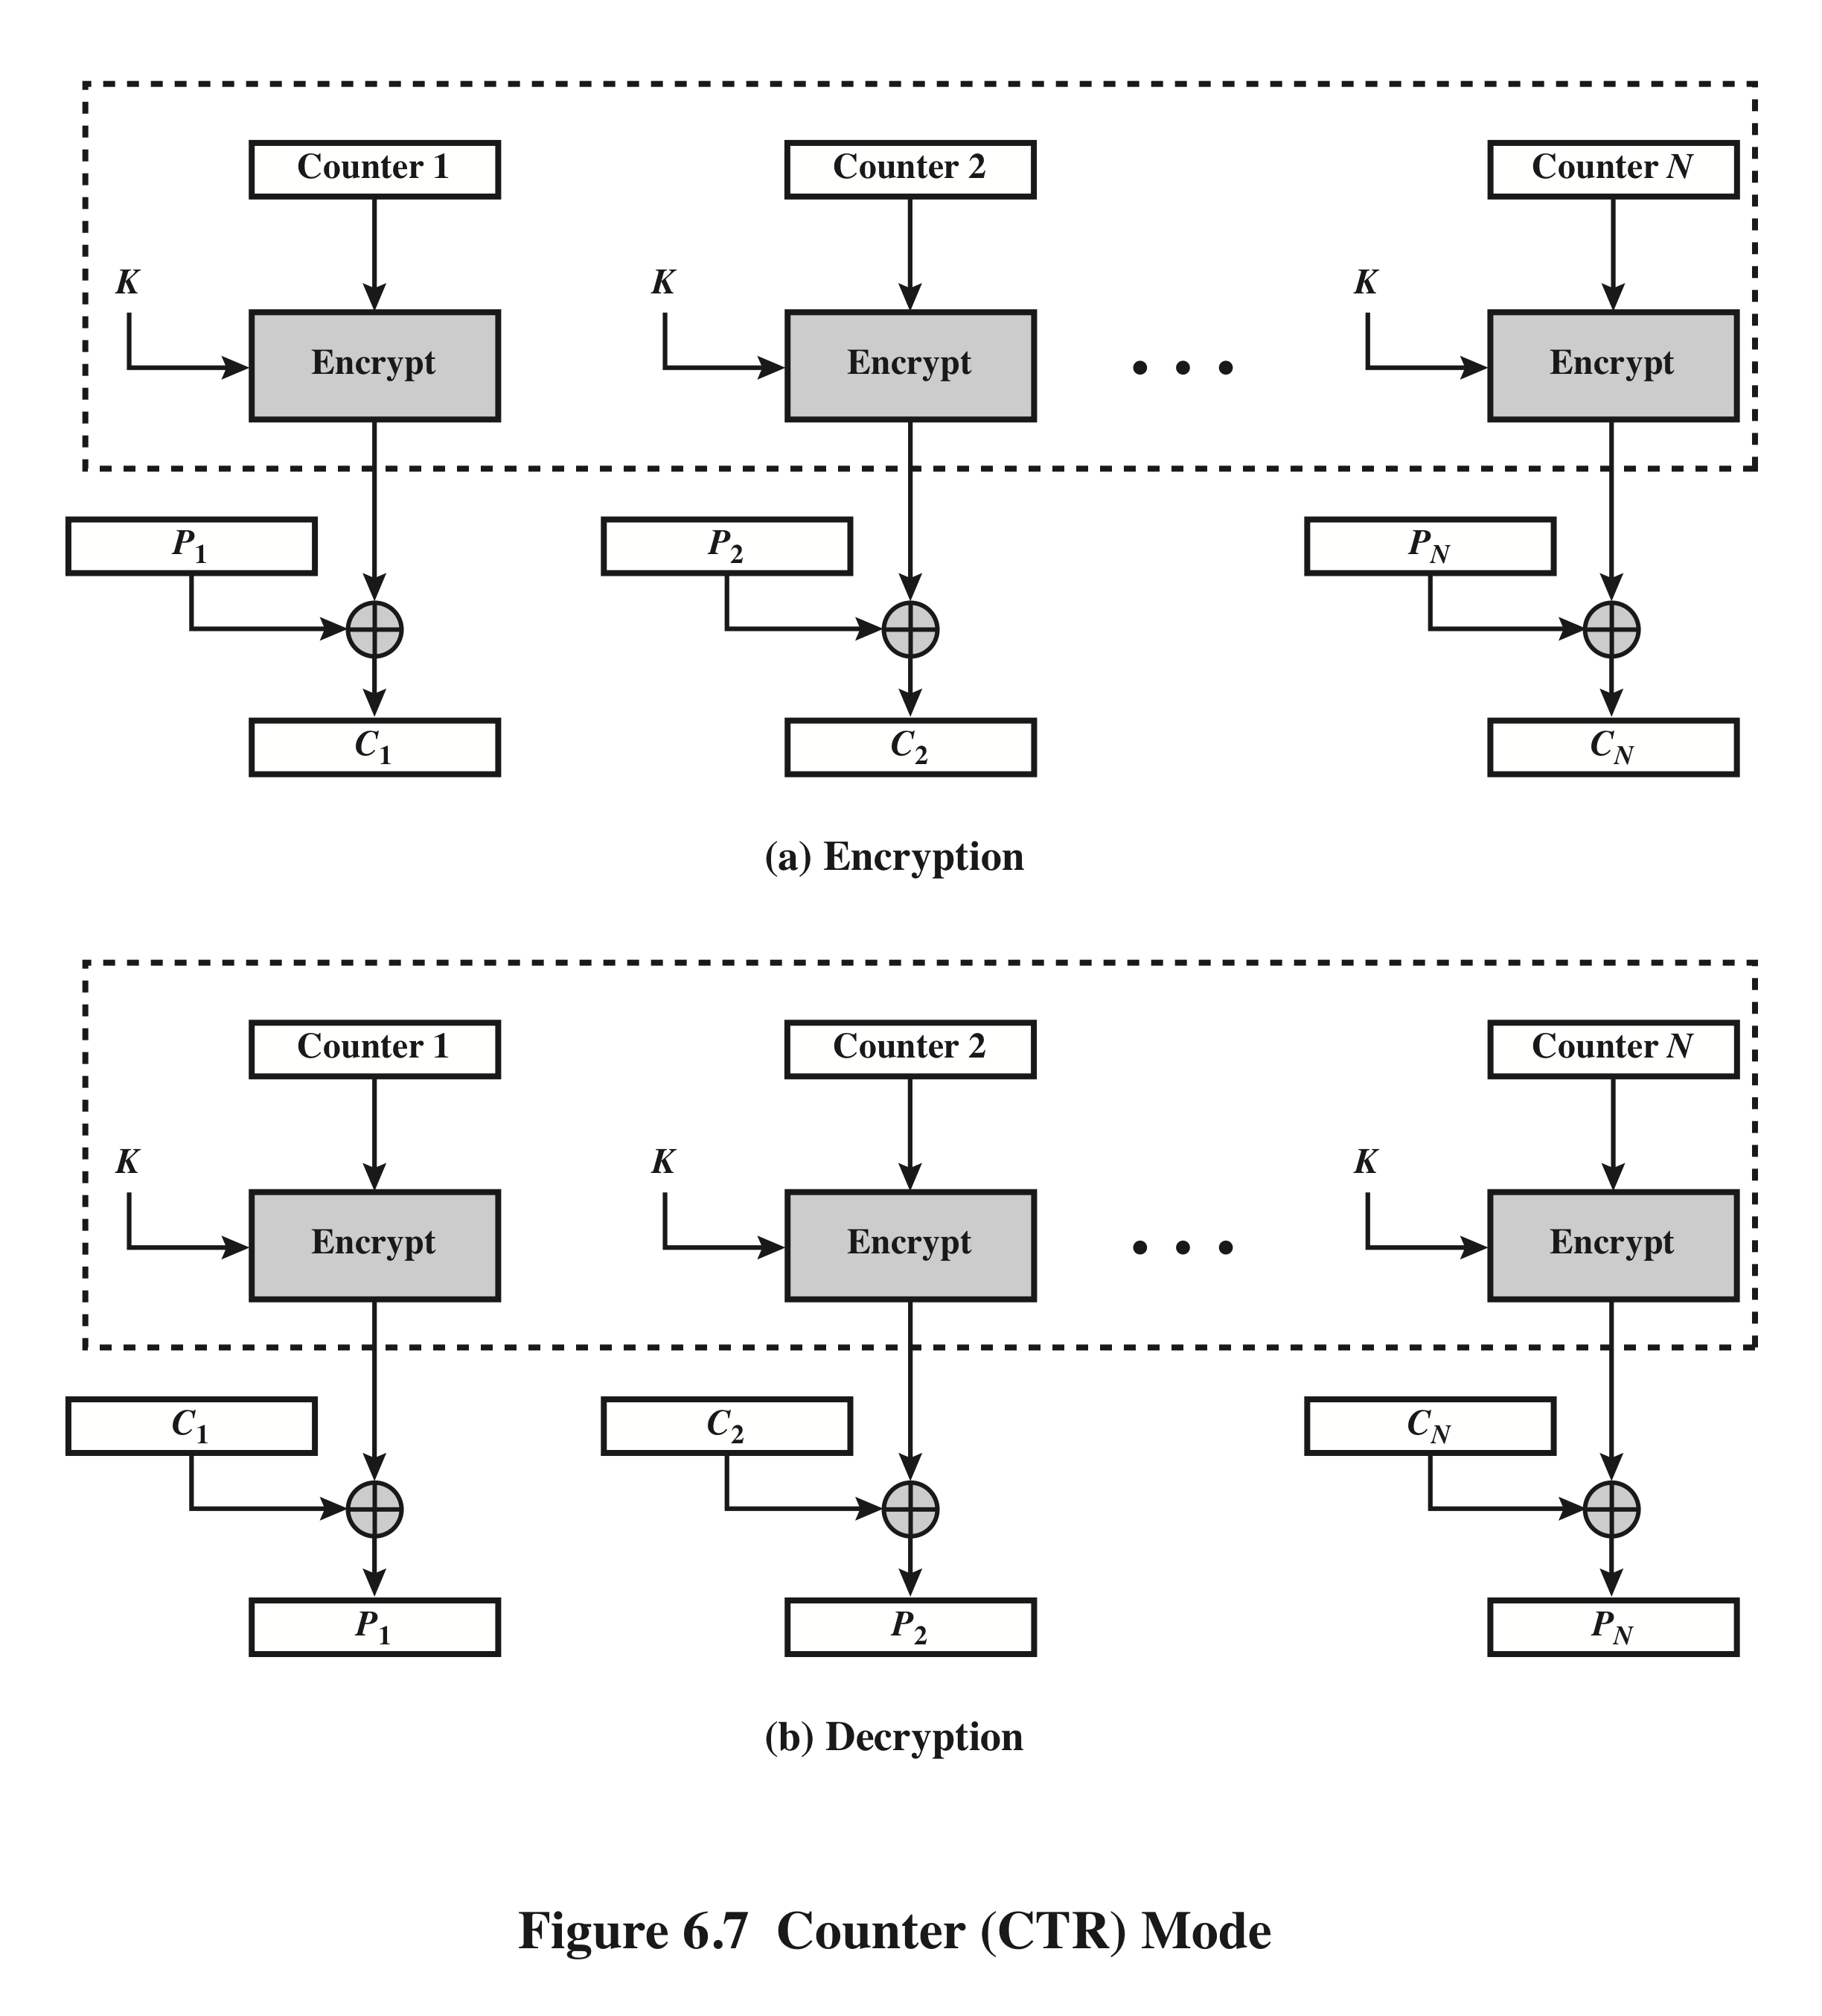
Counter Mode (CTR)

Slide 17
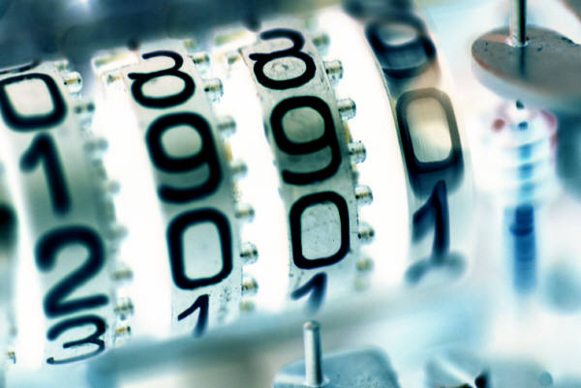
Advantages of
CTR
Hardware efficiency
Software efficiency
Preprocessing
Random access
Provable security
Simplicity

Slide 18
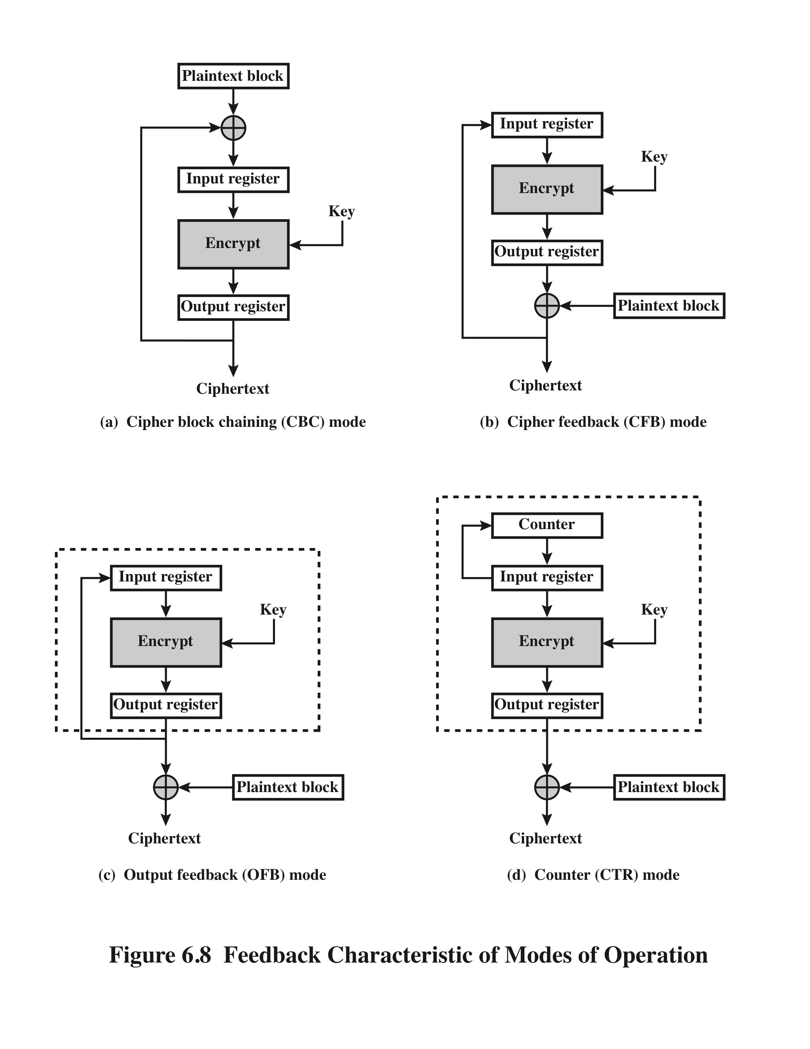
Feedback Characteristics of Modes of Operation

Slide 19
Block Chaining for Stream Ciphers
There are three modes that make it possible to convert a block cipher into a stream cipher:
Cipher feedback (CFB) mode
Output feedback (OFB) mode
Counter (CTR) mode
For AES, DES, or any block cipher, encryption is performed on a block of b bits
  for DES: b = 64
  for AES: b = 128

Slide 20
Summary
Multiple encryption and triple DES
  Double DES
  Triple DES with 2 keys
  Triple DES with 3 keys
Electronic code book
Cipher block chaining mode
Cipher feedback mode
Output feedback mode
Counter mode

