Slide 1

Introduction to Cryptography
Based on: William Stallings, Cryptography and Network Securityy

Slide 2
Chapter 4
Basic Concepts in Number Theory and Finite Fields

Slide 3
Divisibility
We say that a nonzero b divides a if a = mb for some m, where a, b, and m are integers
The notation b | a means b divides a
If b | a we say that b is a divisor of a
The positive divisors of 24 are 1, 2, 3, 4, 6, 8, 12, and 24
13 | 182; - 5 | 30; 17 | 289; - 3 | 33; 17 | 0

Slide 4
Properties of Divisibility
If a | 1, then a = ±1
If a | b and b | a, then a = ±b
Any b ≠ 0 divides 0
If a | b and b | c, then a | c
If b | g and b | h, then b | (mg + nh) for arbitrary integers m and n
11 | 66 and 66 | 198 ⇒ 11 | 198

Slide 5
Division Algorithm
Given any positive integer n and any nonnegative integer a, if we divide a by n we get an integer quotient q and an integer remainder r such that:
  a = qn + r, 0 ≤ r < n; q = [a/n]

Slide 6
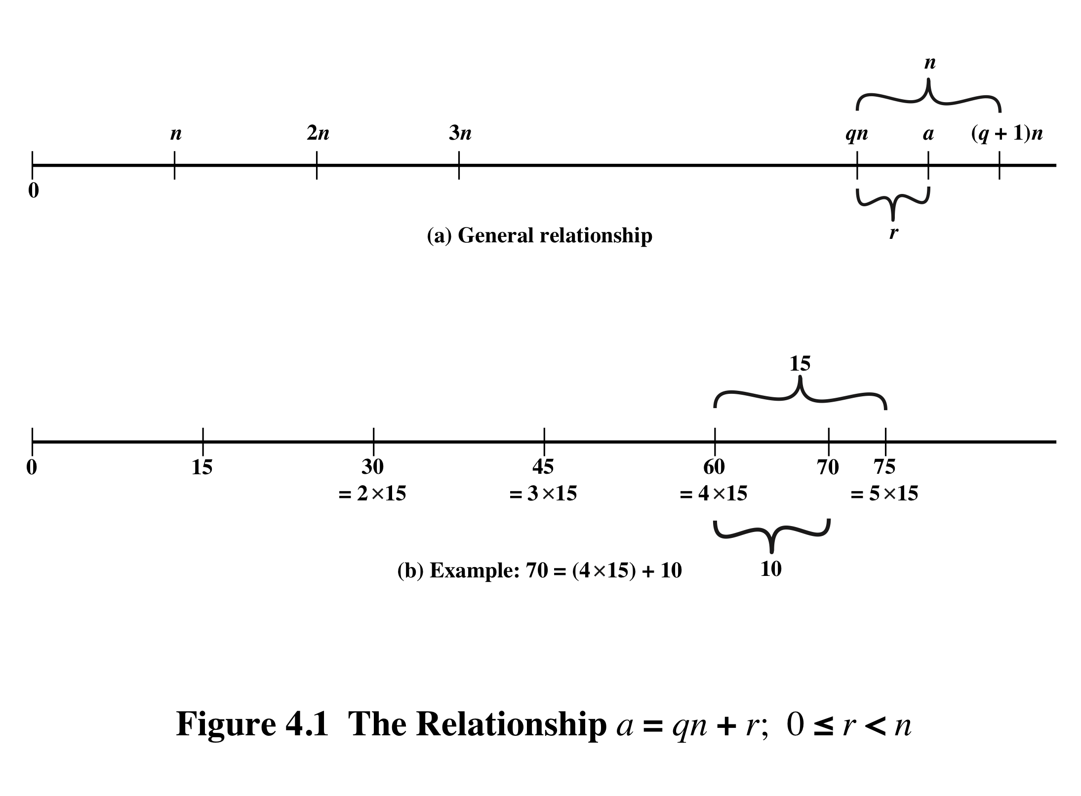
q is the quotient
r is the remainder

Slide 7
Euclidean Algorithm
Procedure to determine the greatest common divisor of two positive integers
Two integers are relatively prime if their only common positive integer factor is 1

Slide 8
Greatest Common Divisor (GCD)
The greatest common divisor of a and b denoted by gcd(a,b) is the largest positive integer that divides both a and b
We define gcd(0,0) = 0
A positive integer c is the gcd of a and b if:
  c is a divisor of a and b
  any divisor of a and b is a divisor of c

Slide 9
GCD
Because the gcd positive,
gcd(a,b) = gcd(a,-b) = gcd(-a,b) = gcd(-a,-b)
Also, gcd(a,0) = | a |
Integers a and b are relatively prime if gcd(a,b) = 1
gcd(60, 24) = gcd(60, - 24) = 12
8 and 15 are relatively prime because:
the positive divisors of 8 are 1, 2, 4, and 8, and
the positive divisors of 15 are 1, 3, 5, and 15.

Slide 10
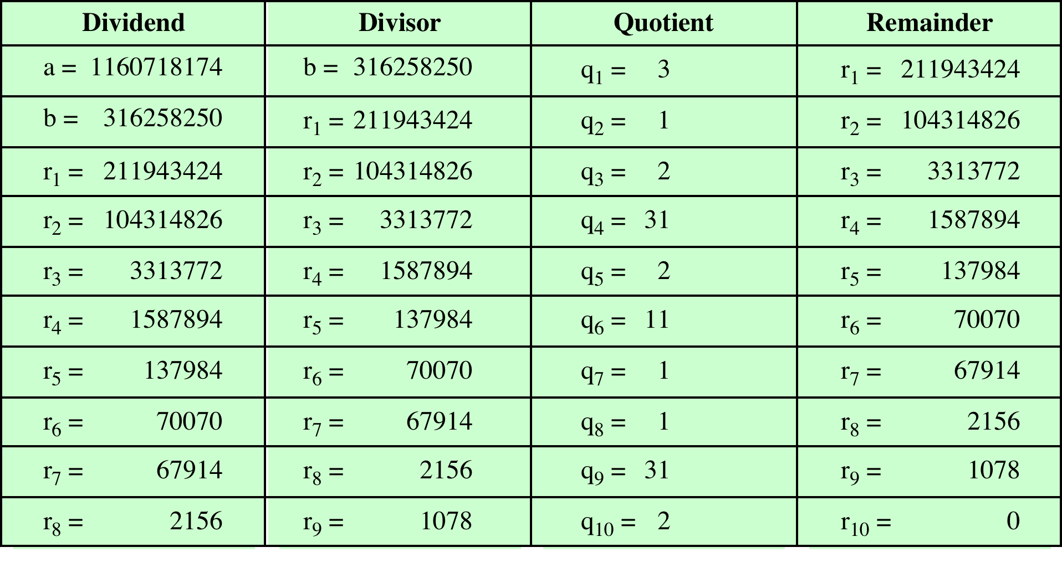
Euclidean Algorithm Example
Find the greatest common divisor of a = 1160718174 and b = 316258250

Slide 11
Modular Arithmetic
The modulus
  If a and n are positive integer, we define a mod n to be the remainder when a is divided by n; the integer n is called the modulus
  That is:
  r = a mod n, when a = qn + r with 0 ≤ r < n
11 mod 7 = 4; - 11 mod 7 = 3

Slide 12
Modular Arithmetic
Congruence modulo n
  Integers a and b are congruent modulo n if (a mod n) = (b mod n)
  This is written as a ≡ b (mod n)
  N. B. a ≡ b (mod n) if n |(a – b)
73 ≡ 4 (mod 23); 21 ≡ -9 (mod 10)

Slide 13
Properties of Congruences
Congruences have the following properties:
1. a ≡ b (mod n) if n |(a – b)
2. a ≡ b (mod n) implies b ≡ a (mod n)
3. a ≡ b (mod n) and b ≡ c (mod n) imply a ≡ c (mod n)
23 ≡ 8 (mod 5) because 23 - 8 = 15 = 5 * 3
-11 ≡ 5 (mod 8) because -11 - 5 = -16 = 8 * (-2)
81 ≡ 0 (mod 27) because 81 - 0 = 81 = 27 * 3

Slide 14
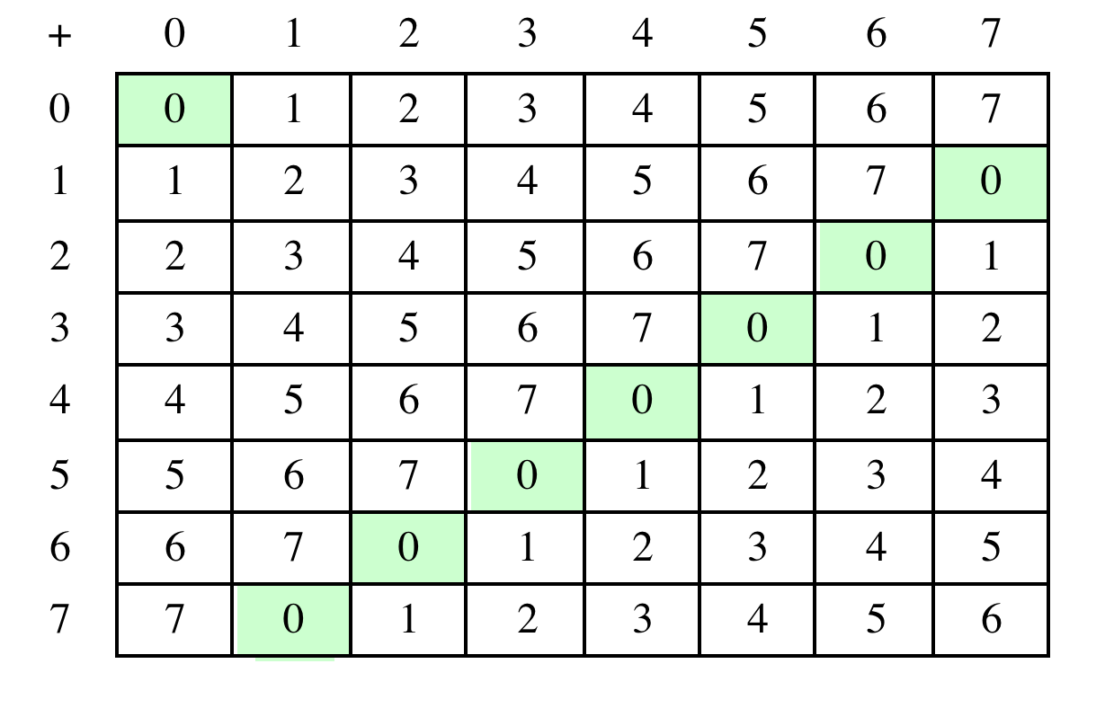
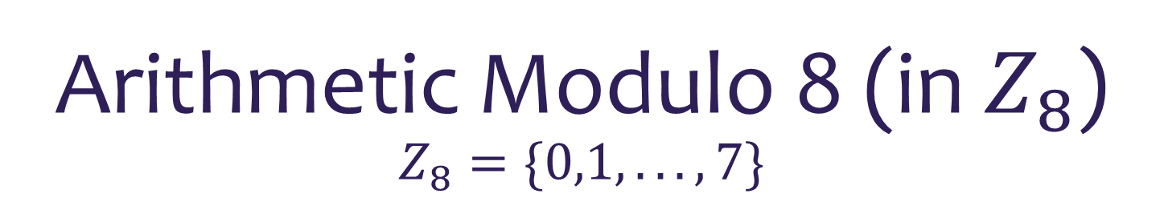
  Arithmetic Modulo 8 (in $Z_{8}$)
  $$Z_{8}=\{0,1, . . . , 7\}$$

Slide 15
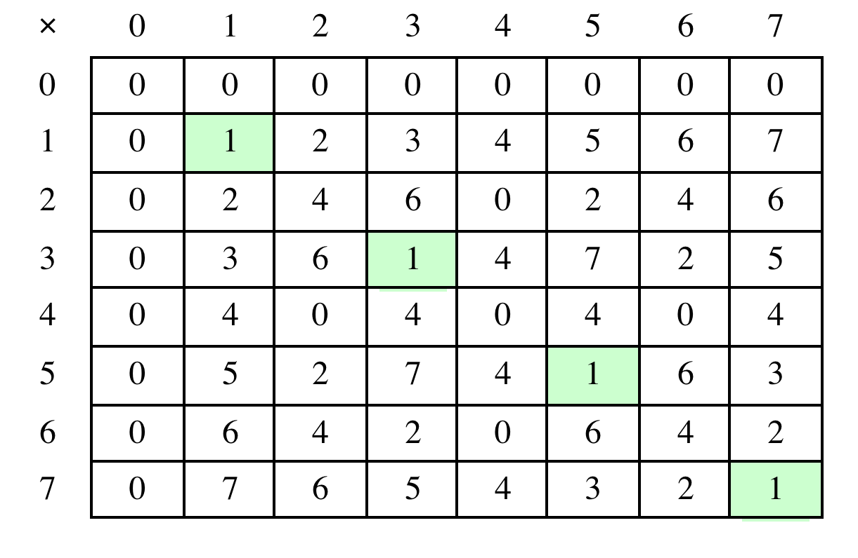
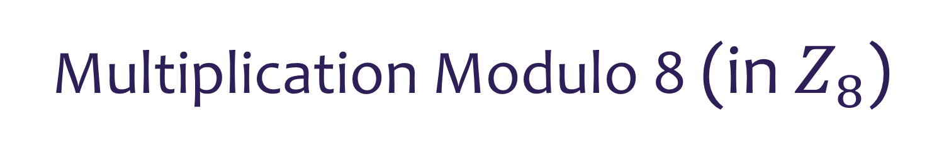
Multiplication Modulo 8 (in $Z_{8}$)

Slide 16
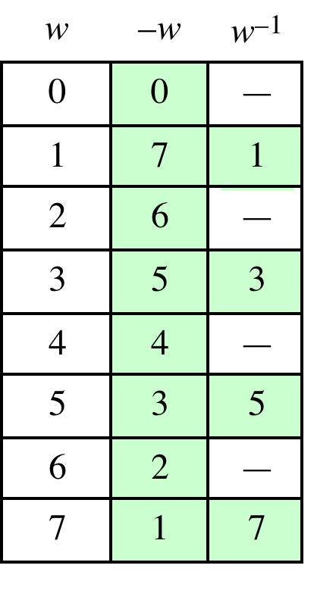
Additive and
Multiplicative Inverses
Modulo 8

Slide 17
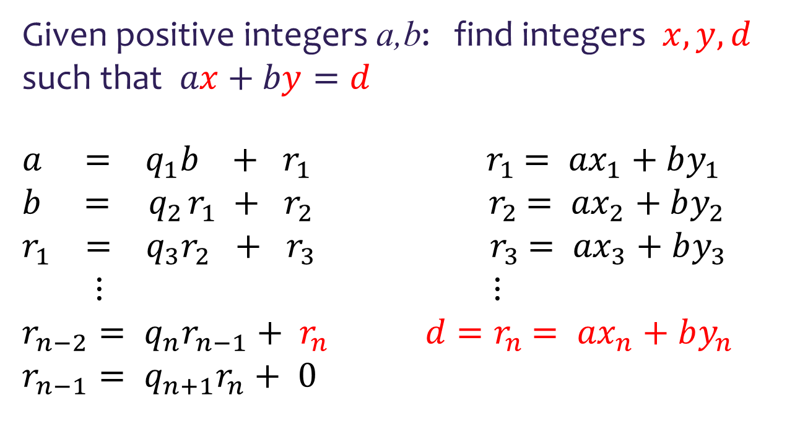
Extended Euclidean Algorithm Example
Given positive integers a,b: find integers $x, y, d$ such that $ax+by=d$
$a = q_{1}b + r_{1}$ ${ r}_{1} = {ax}_{1}+by_{1}$
$b = { q}_{2}r_{1} + r_{2}$ ${ r}_{2} = {ax}_{2}+by_{2}$
$r_{1} = q_{3}r_{2} + { r}_{3}$ ${ r}_{3} = {ax}_{3}+by_{3}$
$$⋮ ⋮$$
$r_{n−2}= q_{n}r_{n−1}+ r_{n}$ ${ d=r}_{n} = {ax}_{n}+by_{n}$
$$r_{n−1}= q_{n+1}r_{n}+ 0$$

Slide 18
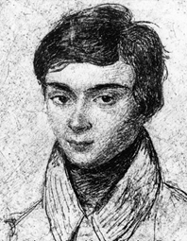
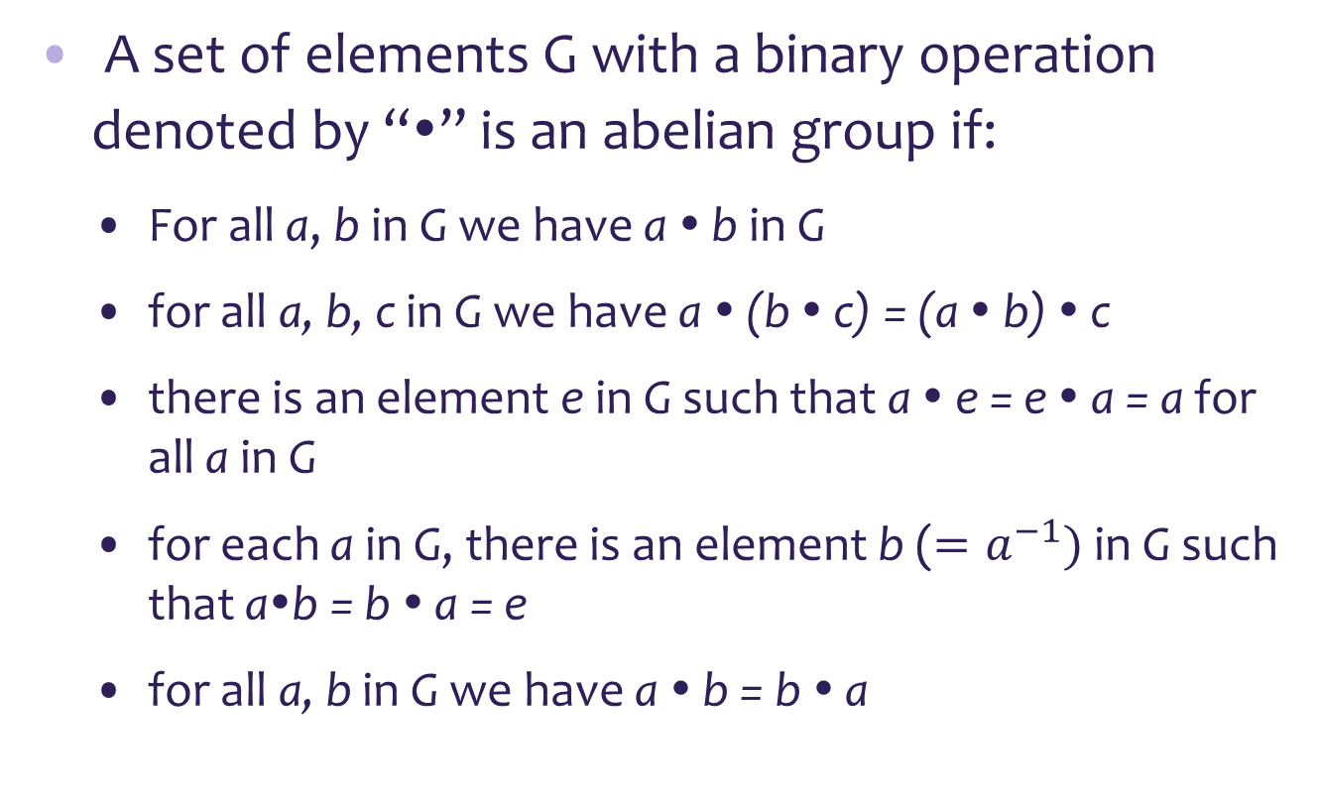
Groups
A set of elements G with a binary operation denoted by “•” is an abelian group if:
  For all a, b in G we have a • b in G
  for all a, b, c in G we have a • (b • c) = (a • b) • c
  there is an element e in G such that a • e = e • a = a for all a in G
  for each a in G, there is an element b ($=a^{−1})$ in G such that a•b = b • a = e
  for all a, b in G we have a • b = b • a

Slide 19
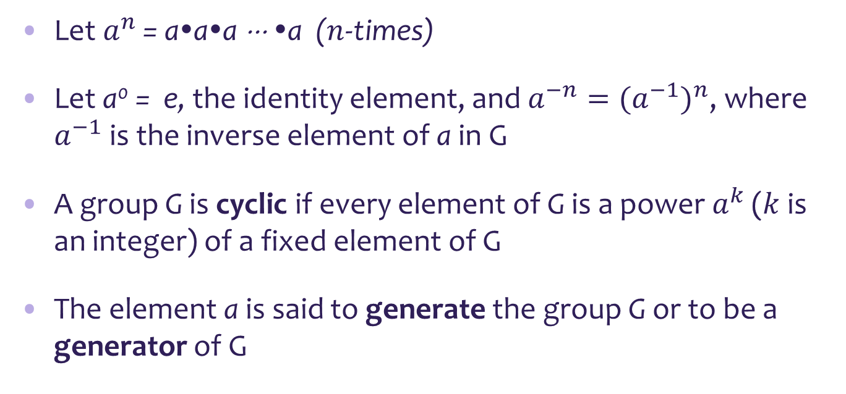
Cyclic Group
Let $a^{n }$= a•a•a ⋅⋅⋅ •a ($n$-times)
Let a⁰ = e, the identity element, and $a^{−n}={(a^{−1})}^{n}$, where $a^{−1}$ is the inverse element of a in G
A group G is cyclic if every element of G is a power $a^{k}$ ($k$ is an integer) of a fixed element of G
The element a is said to generate the group G or to be a generator of G

Slide 20
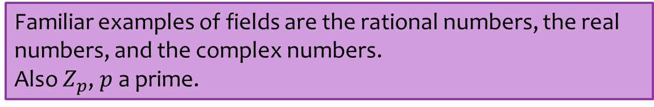
Fields
A field is a set F of elements with two binary operations, called addition (+) and multiplication (⋅), such that for all a , b , c in F:
  F is an commutative group with respect to addition
  a⋅ b is in F
  a⋅ b = b⋅ a
  a⋅ (b⋅c ) = (a⋅ b)⋅ c
  a⋅ (b + c) = a⋅ b + a⋅ c and (a + b )⋅ c = a⋅ c + b⋅ c
  there is an element 1 in F such that: a⋅ 1 = 1⋅ a = a for all a in F
In particular, we can do addition, subtraction and multiplication without leaving F.

Slide 21
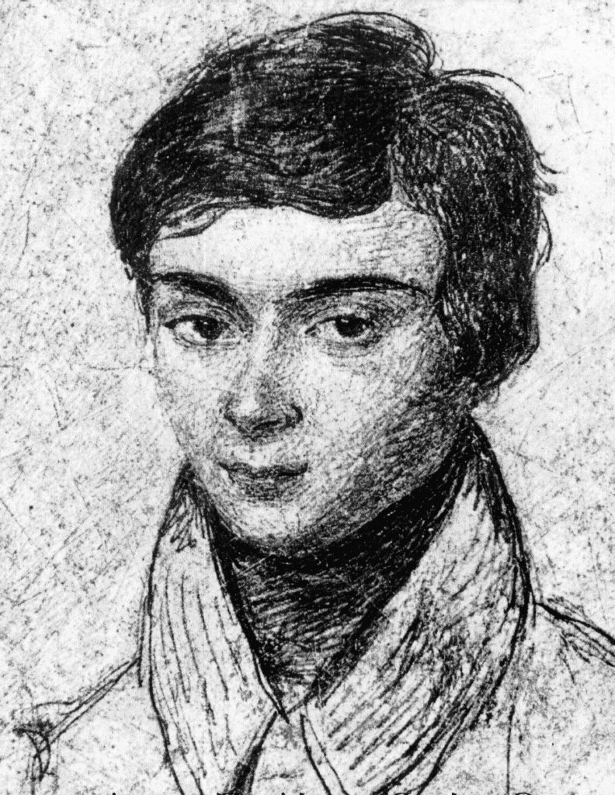

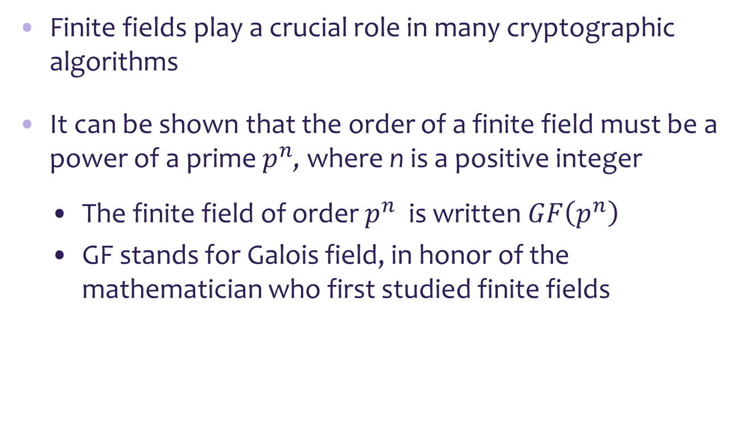
Finite Fields $GF\left(p^{n}\right), p$a prime
Finite fields play a crucial role in many cryptographic algorithms
It can be shown that the order of a finite field must be a power of a prime $p^{n}$, where n is a positive integer
  The finite field of order $p^{n}$ is written $GF\left(p^{n}\right)$
  GF stands for Galois field, in honor of the mathematician who first studied finite fields

Slide 22
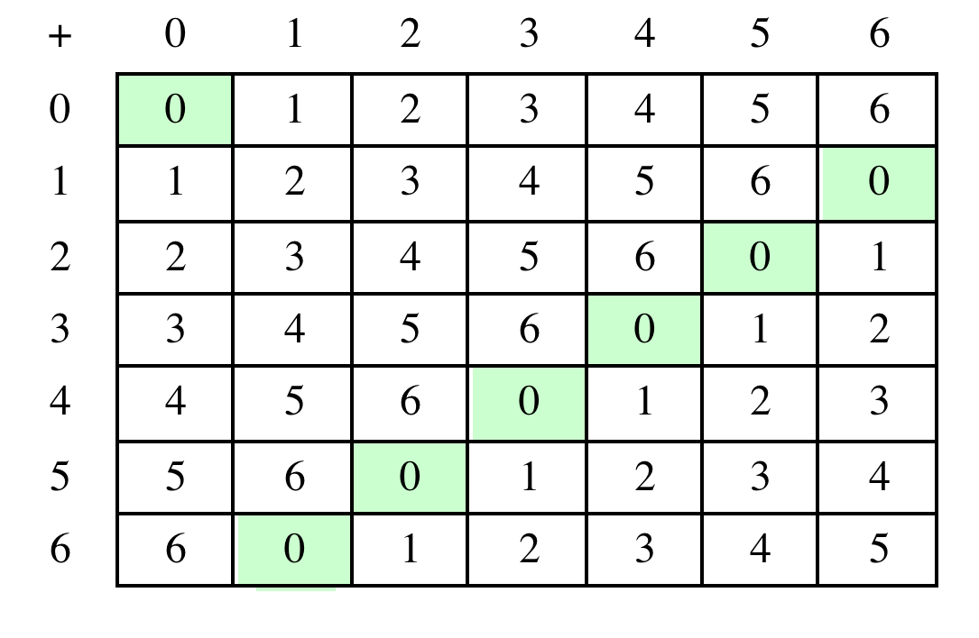

Arithmetic in GF(7) = $Z_{7}$
(a) Addition modulo 7

Slide 23
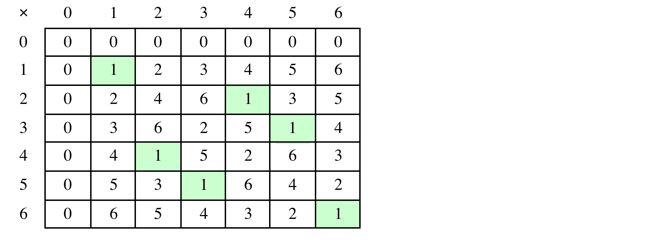
Arithmetic in GF(7) = $Z_{7}$
(b) Multiplication modulo 7

Slide 24
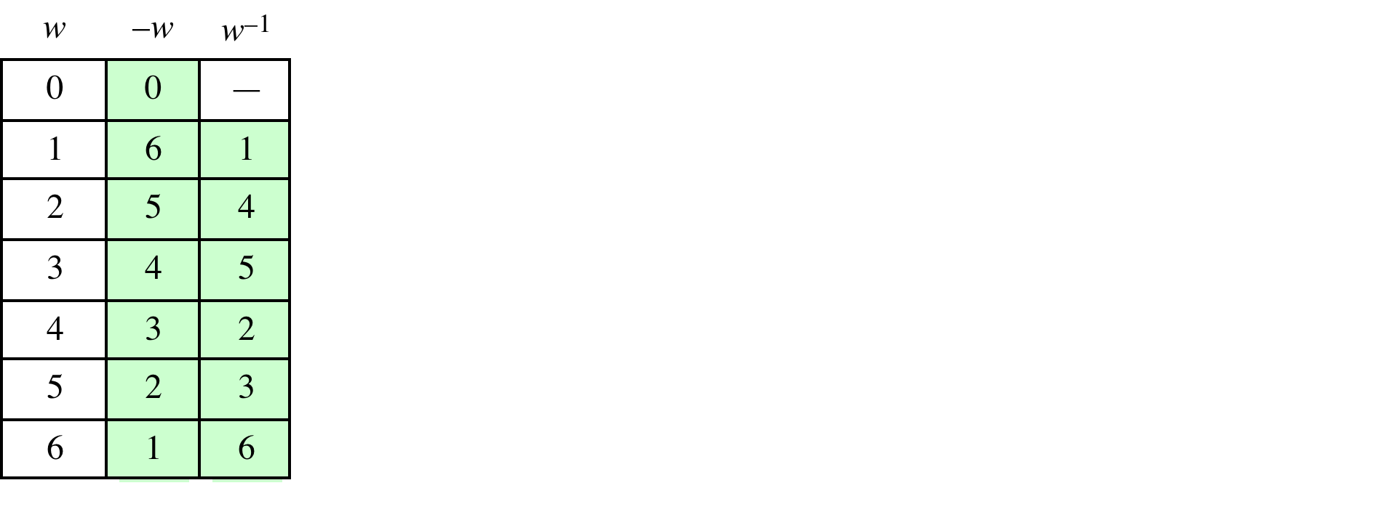
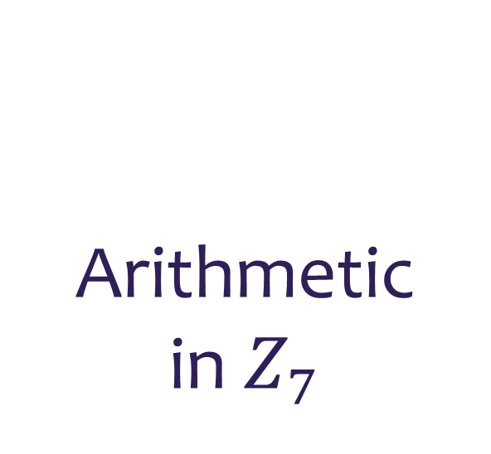
Arithmetic in $Z_{7}$

Slide 25
GF(p), p a prime is a finite field of order p, with the following properties:
1. GF(p) = {0, 1, . . . , p – 1}
2. GF(p) has two binary operations addition (+) and multiplication (⋅) .
The operations of addition, subtraction, multiplication, and division can be performed without leaving the set.
Each non-zero element of the GF(p) has a multiplicative inverse

Slide 26
Polynomial Arithmetic
We distinguish three classes of polynomial arithmetic:
• Polynomial arithmetic, using the basic rules of algebra
• Polynomial arithmetic in which the arithmetic on the coefficients is performed modulo p (in GF(p))
• Polynomial arithmetic in which the coefficients are in GF(p ),
and the polynomials are defined modulo a polynomial m (x).

Slide 27
Ordinary Polynomial Arithmetic
Example
Let f(x) = x³ + x² + 2 and g(x) = x² - x + 1, be polynomials with integer coefficients
Then:
f(x) + g(x) = x³ + 2x² - x + 3
f(x) - g(x) = x³ + x + 1
f(x)⋅ g(x) = x⁵ + 3x² - 2x + 2

Slide 28
Polynomial Arithmetic with coefficients modulo p, Example
Let f(x) = x³ + 2x² + 5 and g(x) = 6x² + 5x + 3, be polynomials with coefficients modulo 7
Then:
f(x) + g(x) = x³ + x² + 5x + 1
f(x) - g(x) = x³ + 3x² + 2x + 2
f(x)⋅ g(x) = 6x⁵ + 3x⁴ +6x³ + 4x + 1

Slide 29

Polynomial Arithmetic with coefficients in $Z_{p}$
When polynomial arithmetic is performed on polynomials over a field, modulo an “irreducible” or prime polynomial then division is possible
    If we attempt to perform polynomial division over a coefficient set that is not a field, we find that division is not always defined

Slide 30
Polynomial Division
We can write any polynomial in the form:
  f(x) = q(x) g(x) + r(x)
  r(x) can be interpreted as being a remainder
  So r(x) = f(x) mod g(x)
If there is no remainder we can say g(x) divides f(x)
  Written as g(x) | f(x)
  We can say that g(x) is a factor of f(x), or g(x) is a divisor of f(x)
A polynomial f(x) over a field F is called irreducible if and only if f(x) cannot be expressed as a product of two polynomials, both over F, and both of degree lower than that of f(x)
  An irreducible polynomial is also called a prime polynomial

Slide 31
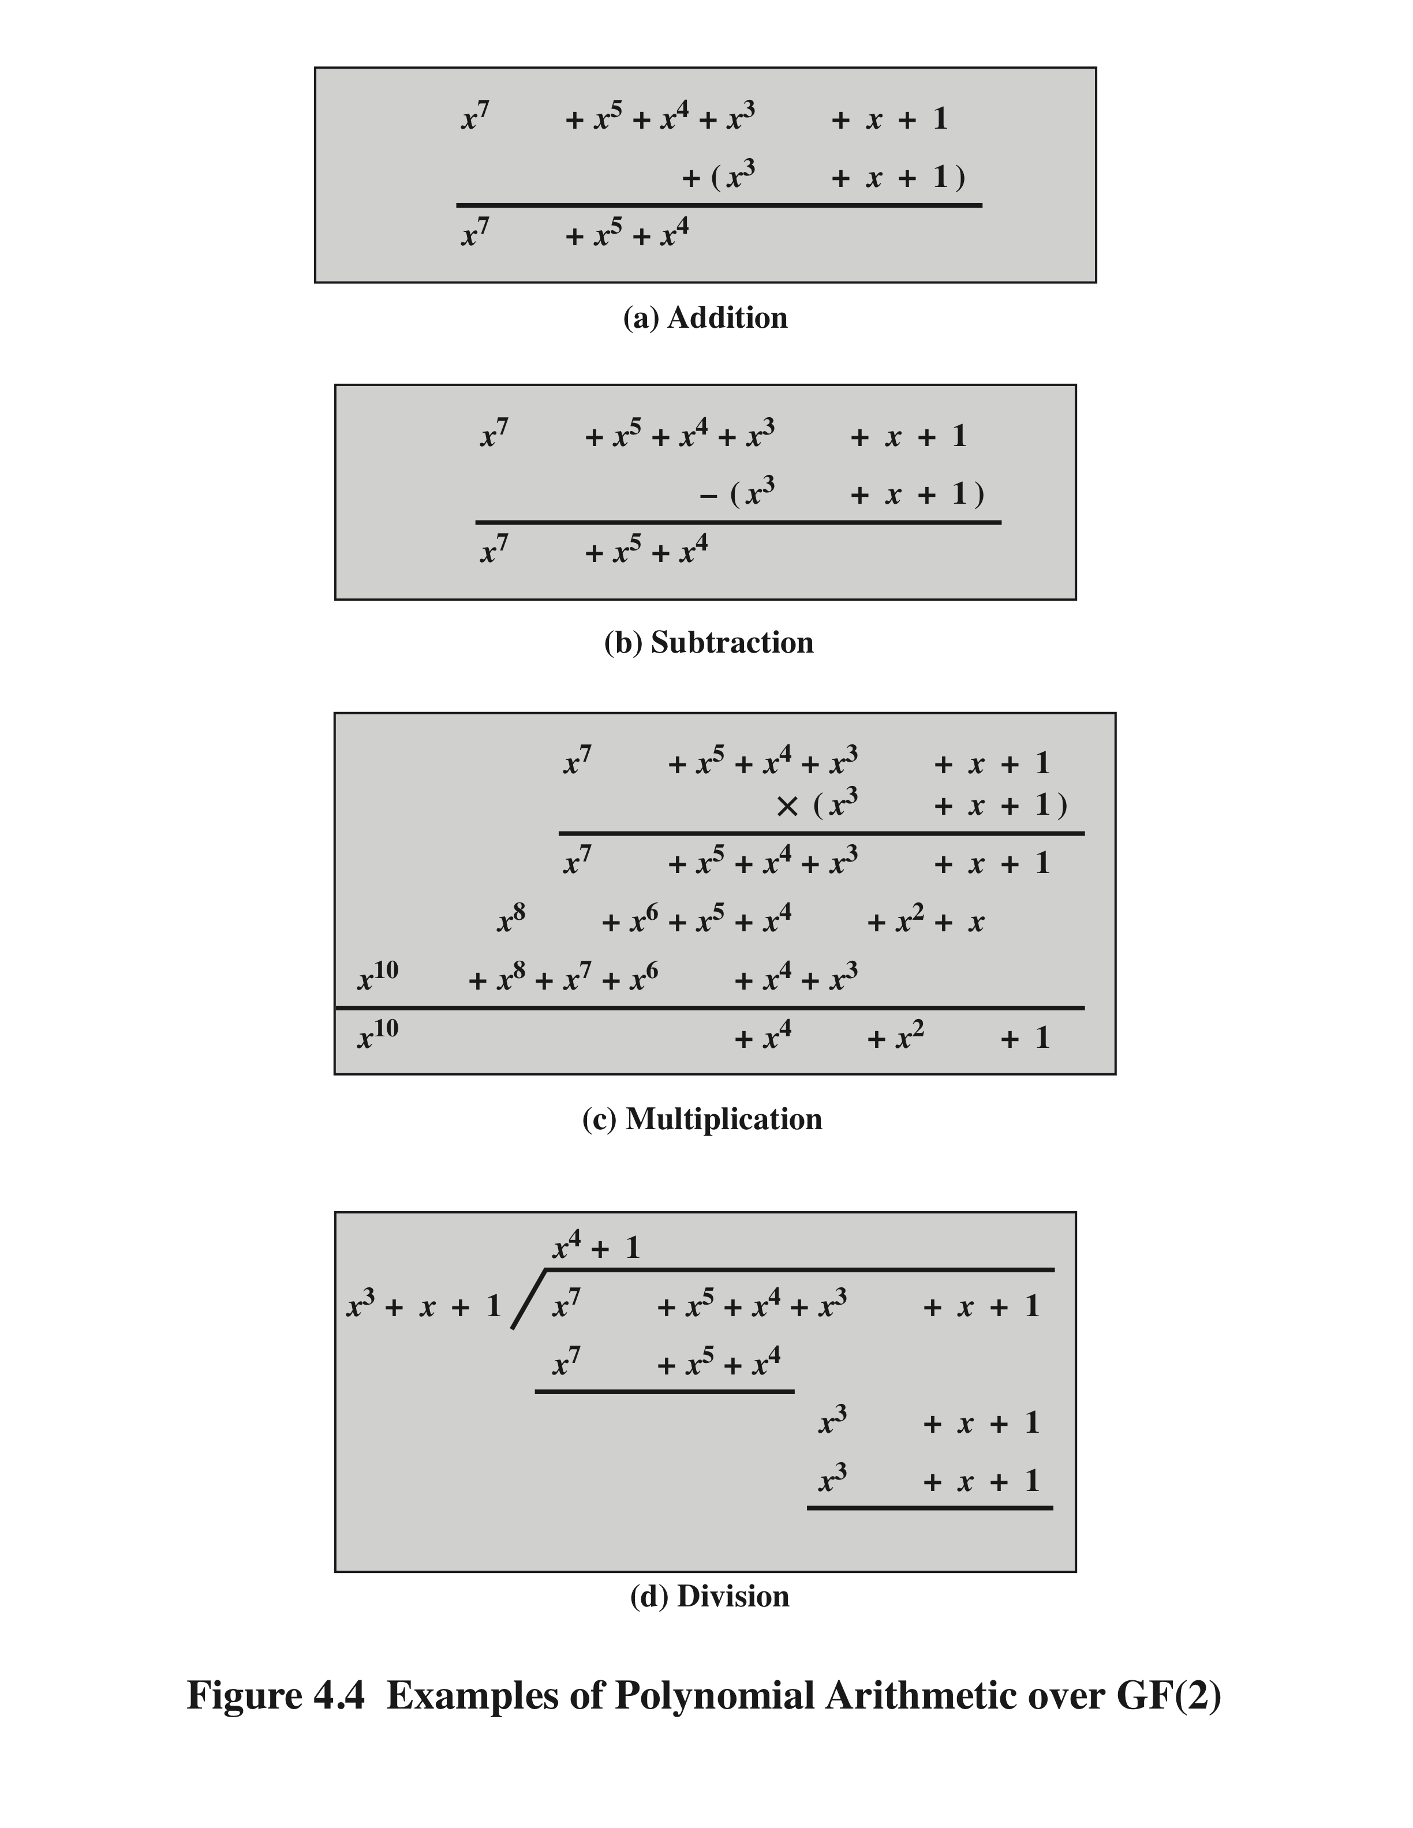
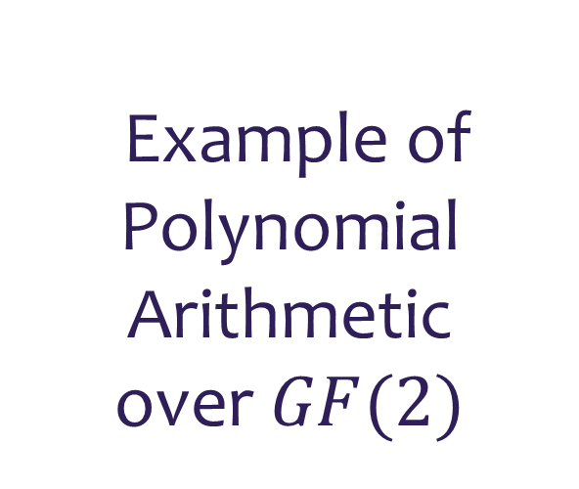
Example of Polynomial Arithmetic over $GF(2)$

Slide 32
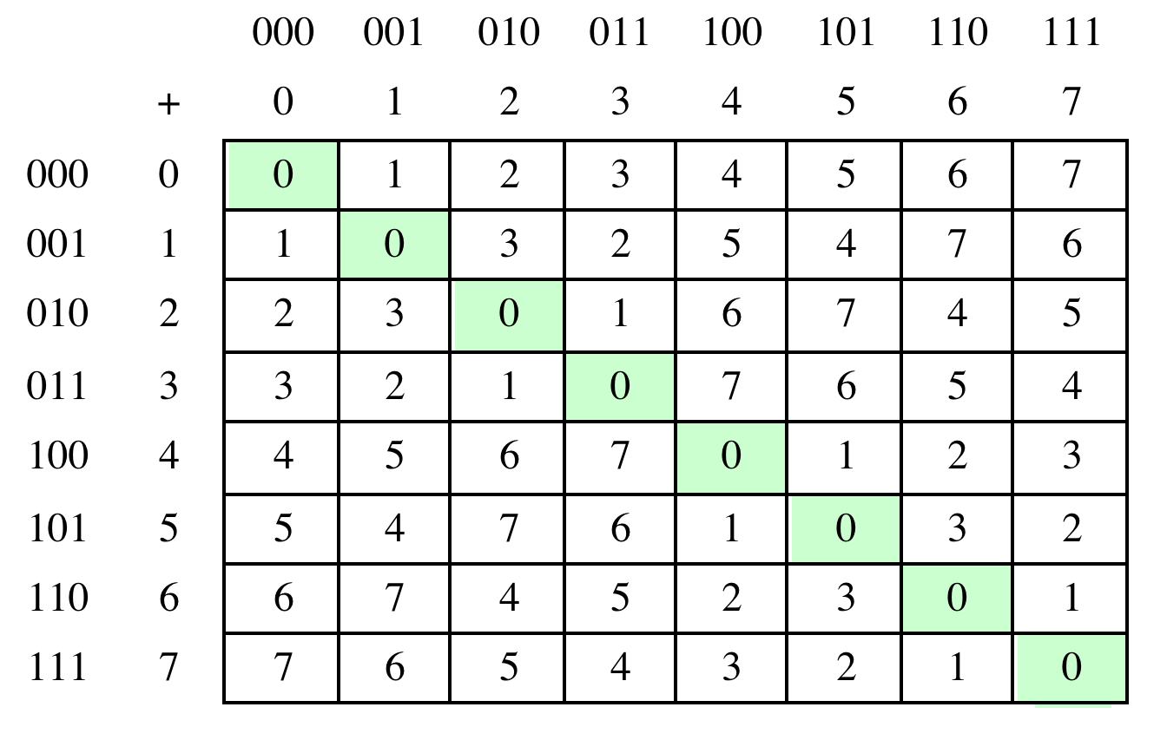

Arithmetic in $GF\left(2^{3}\right)$
(a) Addition

Slide 33
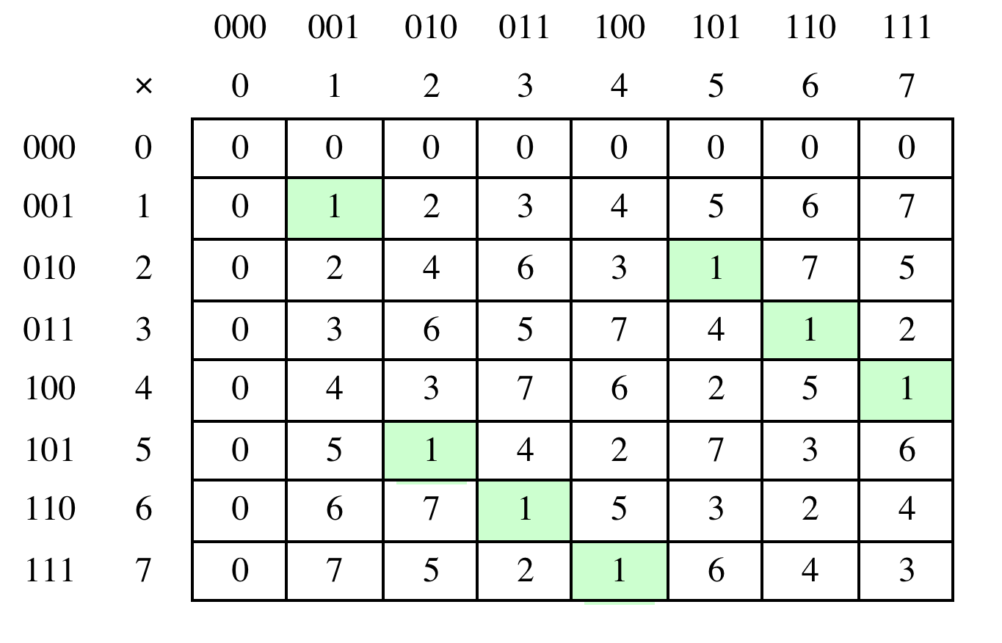
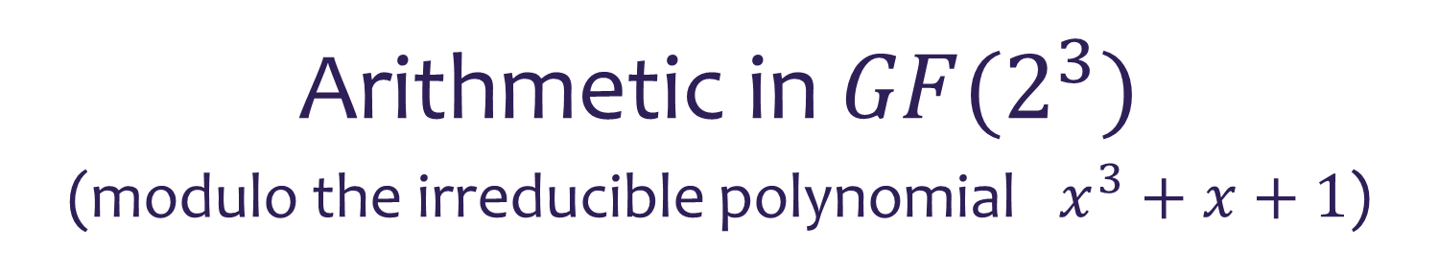
Arithmetic in $GF(2^{3})$
(modulo the irreducible polynomial $x^{3}+x+1$)
(b) Multiplication

Slide 34
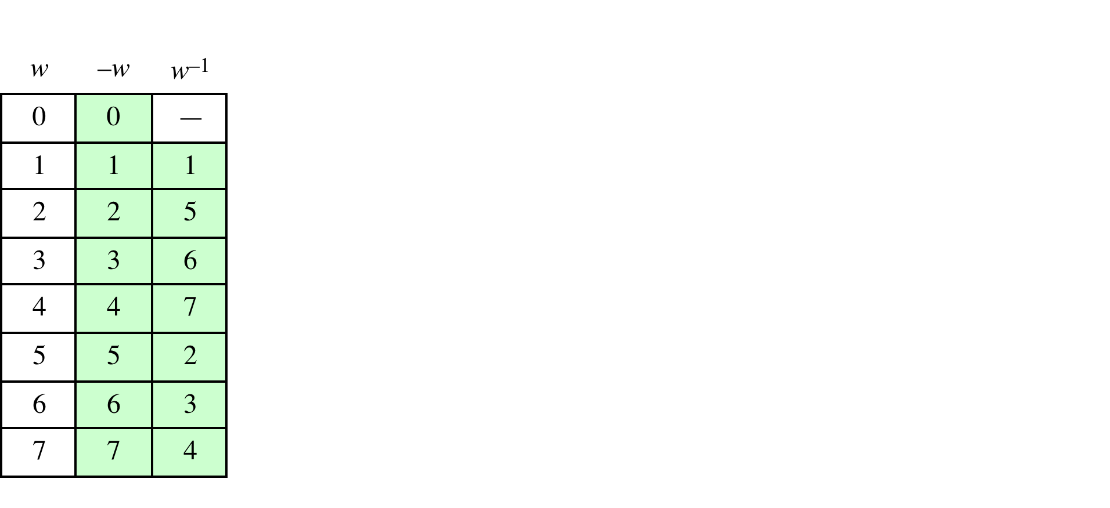
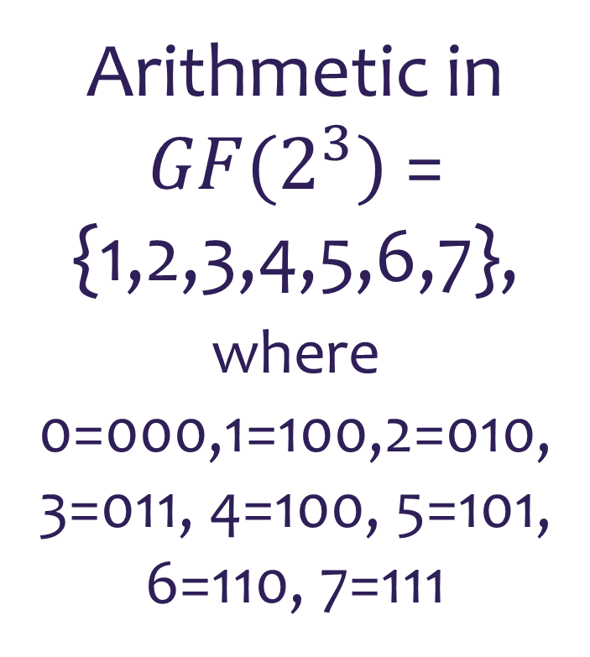
Arithmetic in
$GF(2^{3})$ =
{1,2,3,4,5,6,7}, where
0=000,1=100,2=010,
3=011, 4=100, 5=101,
6=110, 7=111

Slide 35
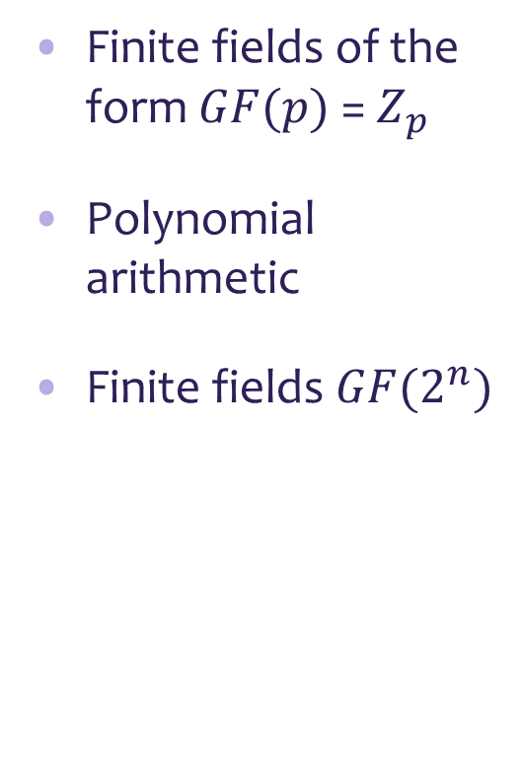
Summary
Divisibility and the division algorithm
The Euclidean algorithm
Modular arithmetic
Groups, rings, and fields
Finite fields of the form $GF(p)$ = $Z_{p}$
Polynomial arithmetic
Finite fields $GF(2^{n})$

