Slide 1
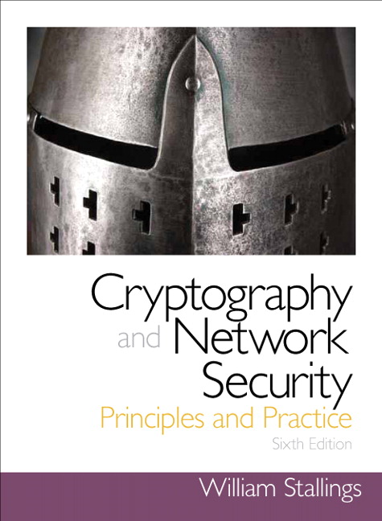
Chapter 3
Block Ciphers and the Data Encryption Standard

Slide 2
Stream Cipher
Encrypt digital data stream one bit or byte at a time
Examples:
Autokeyed Vigenère cipher
Vernam cipher
One-time pad
keystream is as long as the plaintext stream
Unconditional security
Logistical problems
Pseudorandom generators
The keystream is generated by an algorithmic procedure that both the sender and receiver can implement
Must be computationally hard to predict portions of the bit stream based on previous portions of the bit stream
The two users need only share the generating key used to produce the keystream
Keystream must be distributed to the receiver in advance via a secure channel

Slide 3
Block Cipher
A block of plaintext is treated as a whole and used to produce a ciphertext block of equal length
Typically a block size of 64 or 128 bits is used
As with a stream cipher, the two users share a symmetric encryption key
A majority of symmetric key applications use block ciphers

Slide 4
Stream Cipher and Block Cipher

Slide 5
Block Substitutions Ciphers
The key size for this block
substitutions is bounded
by $4×16$ bits
(in general $n∙2^{n}$)

Slide 6
Encryption and Decryption Tables for Block Substitution Cipher
The key size
for this block
substitution
cipher is
$4×16$ bits

Slide 7
Motivation for Feistel Cipher
A Block cipher that combines substitution & transposition ciphers
Based on a proposal by Claude Shannon to develop a product cipher that alternates confusion and diffusion functions
Transposition for diffusion
If a single bit of the plaintext is changed then roughly half of the bits of the ciphertext change. Similarly for the ciphertext.
Each bit of the ciphertext depends on several parts of the encryption key
Substitution for confusion
Makes the relationship between the statistics of the ciphertext and the key complex
The statistical structure of the plaintext is dissipated into long-range statistics of the ciphertext

Slide 8
Feistel Cipher Structure
}
{
transposition
substitution
{
Transposition
Cycle transposition
move bits 32 places
}
Substitution
Vigenère Autokey System

Slide 9
Feistel Cipher Design Features
Block size
Larger block sizes mean greater security but reduced encryption/ decryption speed
Key size
Larger key size means greater security but reduces encryption/ decryption speed
Number of rounds
Multiple rounds offer increasing security
Subkey generation algorithm
Greater complexity leads to greater difficulty of cryptanalysis
Round function $f$
Greater complexity generally leads to greater resistance to cryptanalysis
Fast software encryption and decryption
Encrypting can be embedded in applications or utility functions

Slide 10
Feistel Example
Feistel Example

Slide 11
Data Encryption Standard (DES)
Issued in 1977 by the National Bureau of Standards (now NIST) as Federal Information Processing Standard 46
The most widely used encryption scheme until the introduction of the Advanced Encryption Standard (AES) in 2001
Algorithm is referred to as the Data Encryption Algorithm (DEA)
Data are encrypted in 64-bit blocks using a 56-bit key
The algorithm transforms 64-bit input in a series of steps into a 64-bit output
The same steps, with the same key, are used to reverse the encryption

Slide 12
Data Encryption Standard (DES) structure
General description
Round Function $f$
Inner Function, expansion
Inner Function, S-boxes
Key schedule

Slide 13
DES Encryption Algorithm
56-bit key

Slide 14
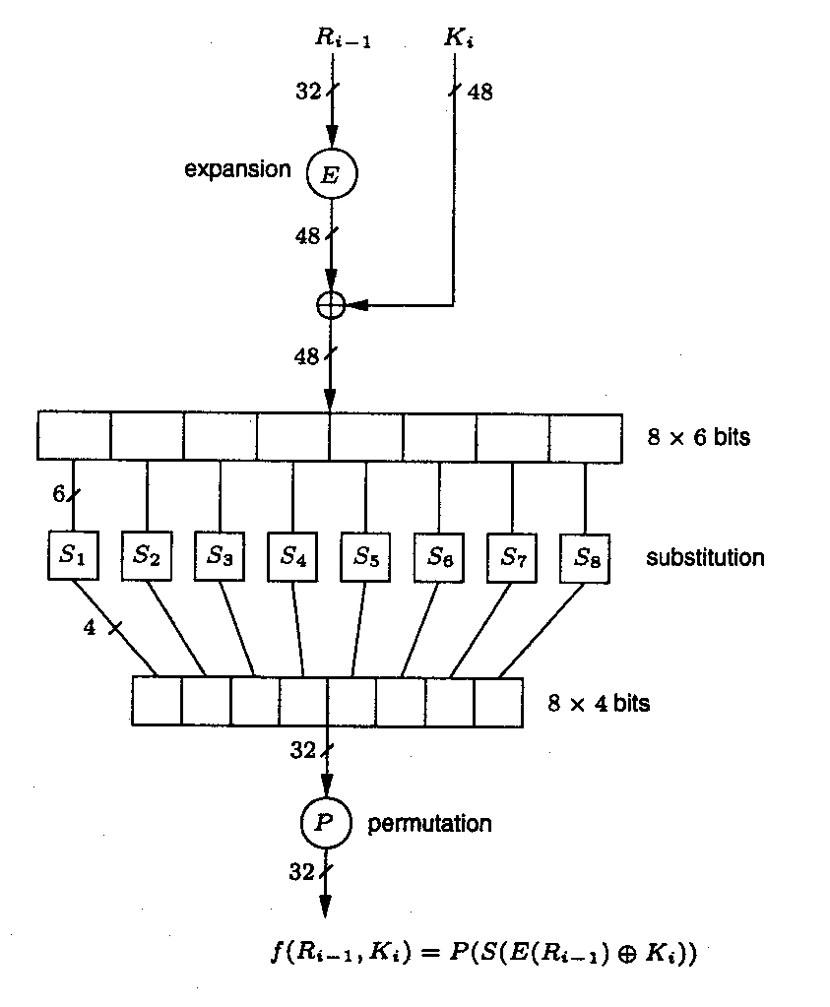
DES Round Function $f$
expansion
inner function

Slide 15
Inner Function 1, Expansion
Expand 32 bit input to 48 bits by adding a bit to the front and end of each 4 bit segment.
These bits are taken from adjacent bits.
This String
Notice several bit values are repeated: 4, 5, 8, 9, 28, 29, etc.
Becomes this String

Slide 16
Inner Function 2, Substitution S-Boxes
There are 8 different S-boxes, one for each 6-bit chunk
There are are 8 possible substitutions in each S-box
The outer 2 bits determine which substitution is used
The inner 4 bits determine which substitution is used

Slide 17
Inner Function 3, S-Box details
Use bits 1 & 6 to select the row
Bits 2-5 to select the substitution

Slide 18
Key schedule
INPUT: 56-bit key K = k₁, k₂, … , k₅₆
OUTPUT: sixteen 48-bit keys: K₁, K₂, … , K₁₆
The algorithm used for generating the key schedule combines and selects bits of K to generate the round keys.
The 56-bit key is divided into two 28-bit halves, and in each successive round both halves are rotated by 1 or 2 bits and then 48-bits are selected by using a permuted choice-- for details see Handbook of Applied Cryptography.

Slide 19
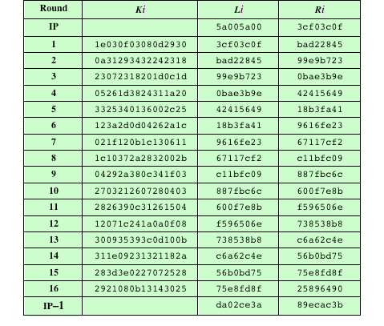
DES Example

Slide 20
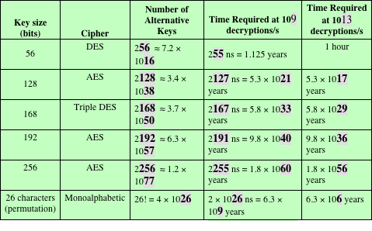
Average Time Required for Exhaustive Key Search

Slide 21
Strength of DES
Attacks faster than Brute force
Differential cryptanalysis (requires ${2}^{47}$ chosen plaintexts)
Linear cryptanalysis (requires ${2}^{47}$ known plaintexts)
Timing attacks: encryption or decryption take slightly different amounts of time for different inputs
Appears unlikely that any of these attacks will ever be successful against more powerful versions of DES such as triple DES

Slide 22
Block Cipher Design Principles: Number of Rounds
The greater,
the harder to cryptanalyze
Chosen so that known cryptanalytic efforts require greater effort than brute-force key attack
If DES had fewer rounds, then differential cryptanalysis would require less effort than a brute-force key search

Slide 23
Block Cipher Design Principles: Design of Function F
Strict avalanche criterion (SAC)
An output bit j of an S-box should change with probability 1/2 when any single input bit $i$ is inverted for all $i,j$
An output bit j of an S-box should change with probability 1/2 when any single input bit 𝑖 is inverted for all 𝑖,𝑗
Bit independence criterion (BIC)
Output bits $j,k$should change independently when any single input bit $i$ is inverted for all $i,j,k$
Output bits 𝑗,𝑘 should change independently when any single input bit 𝑖 is inverted for all 𝑖,𝑗,𝑘
The Feistel block cipher uses a round function $f$
F uses S-boxes
The more nonlinear $f$, the harder to cryptanalyze
The SAC and BIC criteria strength confusion
The key schedule should guarantee the SAC and BIC criterion for diffusion
The algorithm should have good
avalanche properties

Slide 24
Summary
Traditional Block Cipher Structure
Stream ciphers
Block ciphers
Feistel cipher
The Data Encryption Standard (DES)
Encryption
Decryption
Avalanche effect
The strength of DES
Use of 56-bit keys
Nature of the DES algorithm
Attacks
Block cipher design principles
DES design criteria
Number of rounds
Design of function F
Key schedule algorithm

