Slide 1
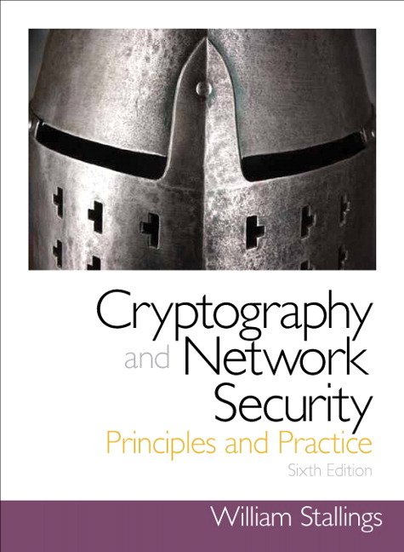
Introduction to Cryptography
Based on: William Stallings, Cryptography and Network Security

Slide 2
Chapter 11
Cryptographic Hash Functions

Slide 3
Hash Functions
A hash function H accepts a variable-length block of data M as input and produces a fixed-size hash value
  h = H(M)
  Principal object is data integrity
Cryptographic hash function
  An algorithm for which it is computationally infeasible to find either:
    (a) a data object that maps to a pre-specified hash result (the one-way property)
    (b) two data objects that map to the same hash result (the collision-free property)
Notes:
.

Slide 4
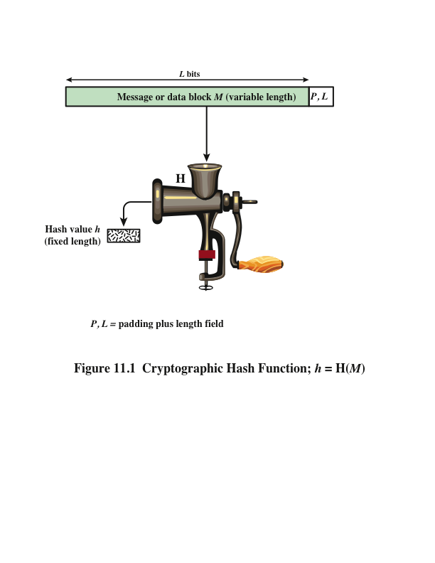

Slide 5
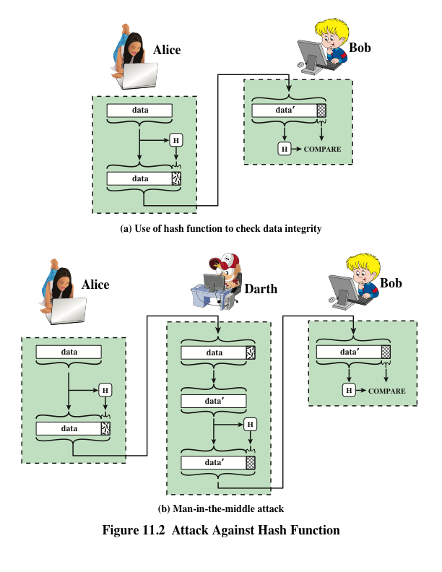

Slide 6
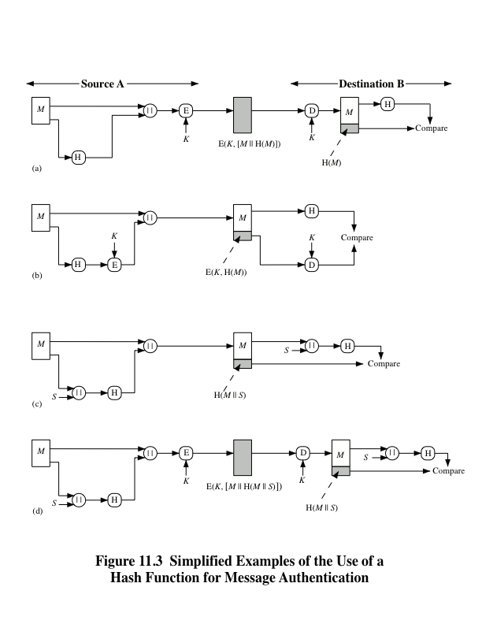

Slide 7
Message Authentication Code (MAC)
Also known as a keyed hash function
Typically used between two parties that share a secret key to authenticate information exchanged between those parties
Takes as input a secret key and a data block and produces a hash value (MAC) which is associated with the protected message
If the integrity of the message needs to be checked, the MAC function can be applied to the message and the result compared with the associated MAC value
An attacker who alters the message will be unable to alter the associated MAC value without knowledge of the secret key

Slide 8
Digital Signature
Operation is similar to that of the MAC
The hash value of a message is encrypted with a user’s private key
Anyone who knows the user’s public key can verify the integrity of the message
An attacker who wishes to alter the message would need to know the user’s private key
Implications of digital signatures go beyond just message authentication

Slide 9
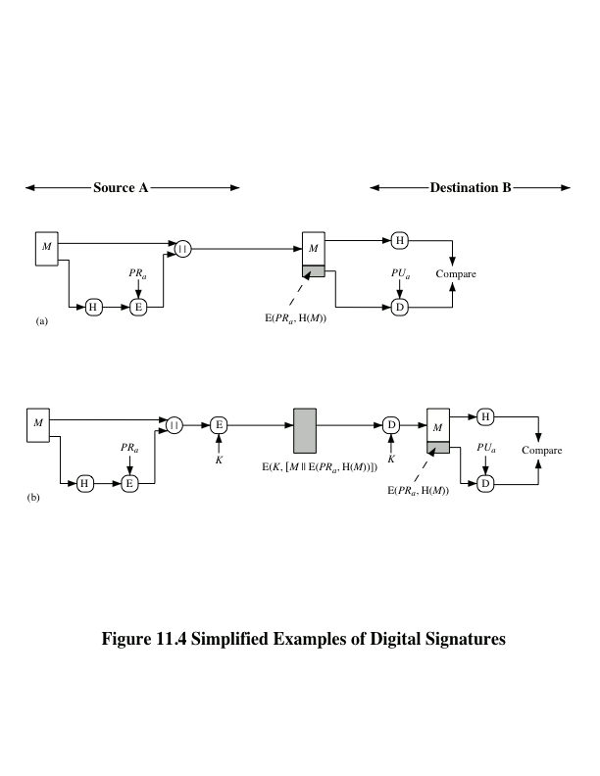

Slide 10
Other Hash Function Uses
Commonly used to create a one-way password file
When a user enters a password, the hash of that password is compared to the stored hash value for verification
This approach to password protection is used by most operating systems
Can be used for intrusion and virus detection
Store H(F) for each file on a system and secure the hash values
One can later determine if a file has been modified by recomputing H(F)
An intruder would need to change F without changing H(F)
Can be used to construct a pseudorandom function (PRF) or a pseudorandom number generator (PRNG)
A common application for a hash-based PRF is for the generation of symmetric keys

Slide 11
Two Simple Hash Functions
Consider two simple insecure hash functions that operate using the following general principles:
  The input is viewed as a sequence of n-bit blocks
  The input is processed one block at a time in an iterative fashion to produce an n-bit hash function
Bit-by-bit exclusive-OR (XOR) of every block
  C_{i} = b_{i1} xor b_{i2} xor . . . xor b_{im}
  Produces a simple parity for each bit position and is known as a longitudinal redundancy check
  Reasonably effective for random data as a data integrity check
Perform a one-bit circular shift on the hash value after each block is processed
  Has the effect of randomizing the input more completely and overcoming any regularities that appear in the input

Slide 12
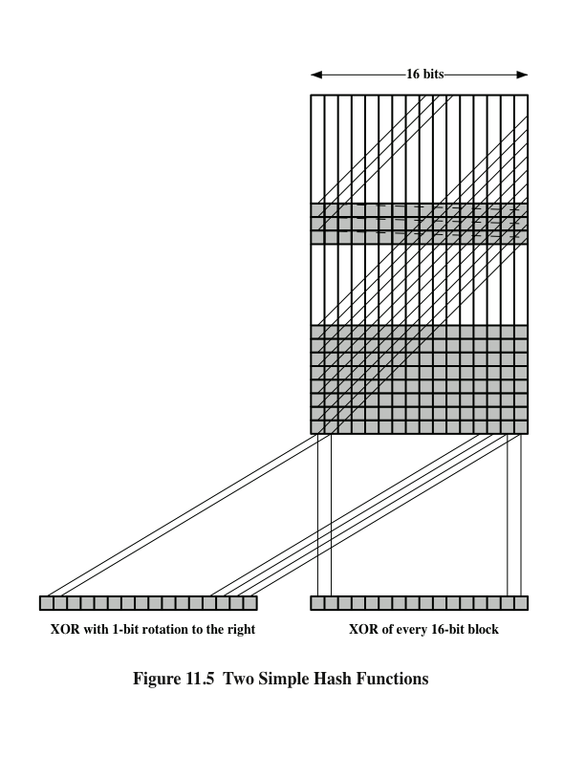
Two
Simple
Hash Functions

Slide 13
Requirements and Security
Preimage
Collision
x is the preimage of h for a hash value h = H(x)
Is a data block whose hash function, using the function H, is h
Because H is a many-to-one mapping, for any given hash value h, there will in general be multiple preimages
Occurs if we have x ≠ y and H(x) = H(y)
Because we are using hash functions for data integrity, collisions are clearly undesirable

Slide 14
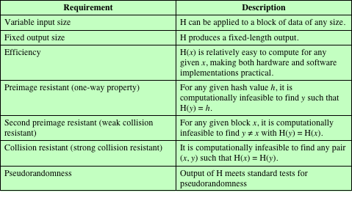
Table 11.1
Requirements for a Cryptographic Hash Function H
(Table can be found on page 323 in textbook.)

Slide 15
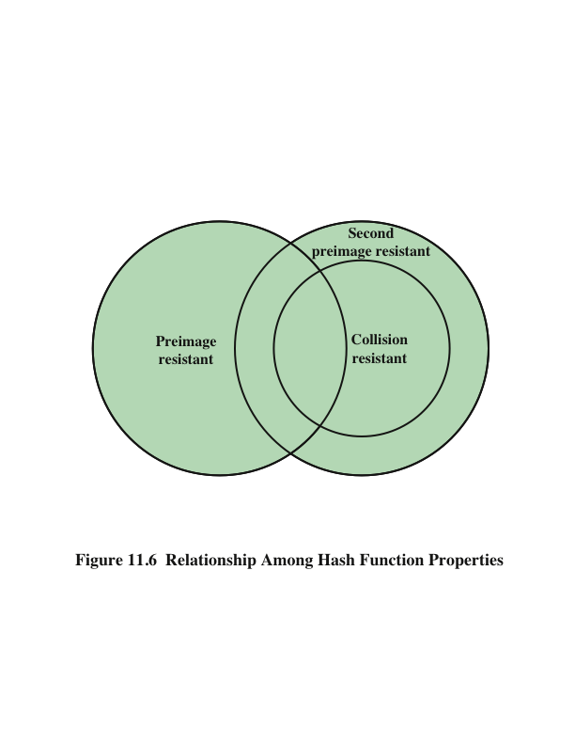

Slide 16
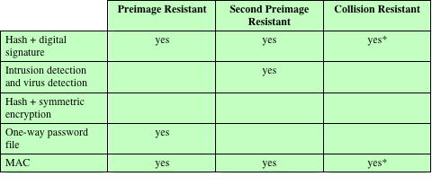
Table 11.2
Hash Function Resistance Properties Required for Various Data Integrity Applications
* Resistance required if attacker is able to mount a chosen message attack
Notes:
Table 11.2 shows the resistant properties required for various hash function
applications.

Slide 17
Attacks on Hash Functions
Brute-Force Attacks
Cryptanalysis
Does not depend on the specific algorithm, only depends on bit length
In the case of a hash function, attack depends only on the bit length of the hash value
Method is to pick values at random and try each one until a collision occurs
An attack based on weaknesses in a particular cryptographic algorithm
Seek to exploit some property of the algorithm to perform some attack other than an exhaustive search

Slide 18
Birthday Attacks
For a collision resistant attack, an adversary wishes to find two messages or data blocks that yield the same hash function
  The effort required is explained by a mathematical result referred to as the birthday paradox
How the birthday attack works:
  The source (A) is prepared to sign a legitimate message x by appending the appropriate m-bit hash code and encrypting that hash code with A’s private key
  Opponent generates 2^{m/2} variations x’ of x, all with essentially the same meaning, and stores the messages and their hash values
  Opponent generates a fraudulent message y for which A’s signature is desired
  Two sets of messages are compared to find a pair with the same hash
  The opponent offers the valid variation to A for signature which can then be attached to the fraudulent variation for transmission to the intended recipient
    Because the two variations have the same hash code, they will produce the same signature and the opponent is assured of success even though the encryption key is not known

Slide 19
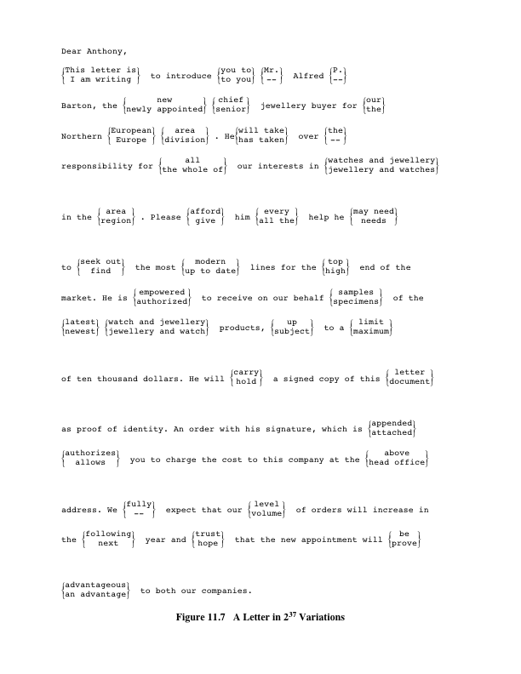
A Letter in 2³⁷
Variation
(Letter is located on page 326 in textbook)

Slide 20
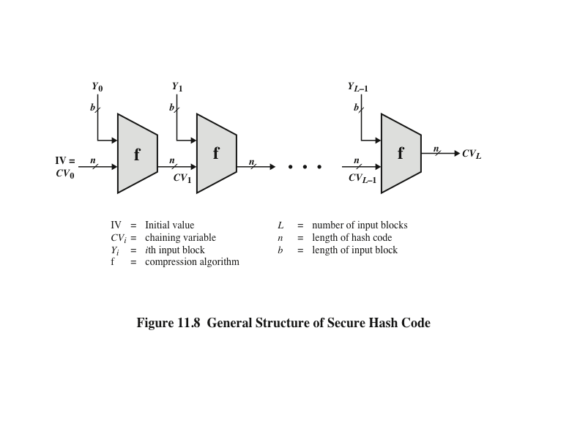

Slide 21
Hash Functions Based on Cipher Block Chaining
Can use block ciphers as hash functions
  Using H₀ initial value
  Compute: H_{i} = E(M_{i} H_{i-1})
  Use final block H_{n} as the hash value
  Similar to CBC but without a key
Resulting hash is too small (64-bit)
  Both due to direct birthday attack
  And “meet-in-the-middle” attack
Other variants also susceptible to attack

Slide 22
Secure Hash Algorithm (SHA)
SHA was originally designed by the National Institute of Standards and Technology (NIST) and published as a federal information processing standard (FIPS 180) in 1993
Was revised in 1995 as SHA-1
Based on the hash function MD4 and its design closely models MD4
Produces 160-bit hash values
In 2002 NIST produced a revised version of the standard that defined three new versions of SHA with hash value lengths of 256, 384, and 512
  Collectively known as SHA-2

Slide 23
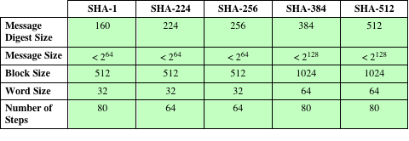
Table 11.3
Comparison of SHA Parameters
Note: All sizes are measured in bits.

Slide 24
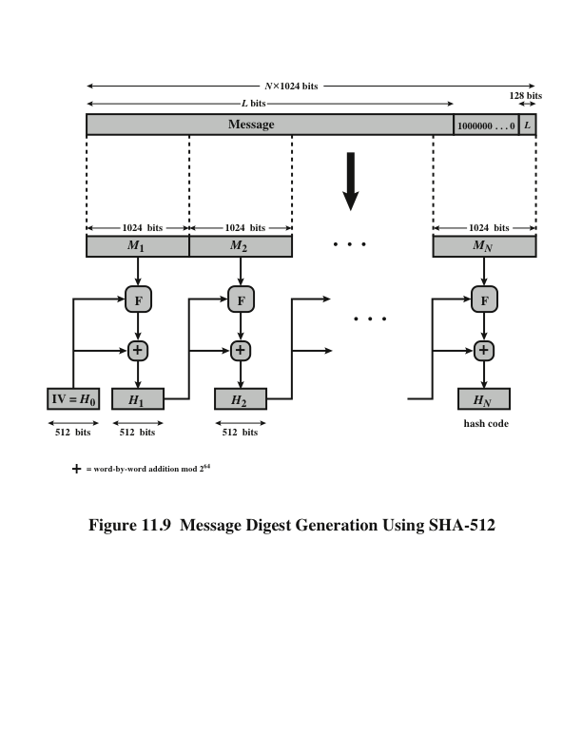

Slide 25
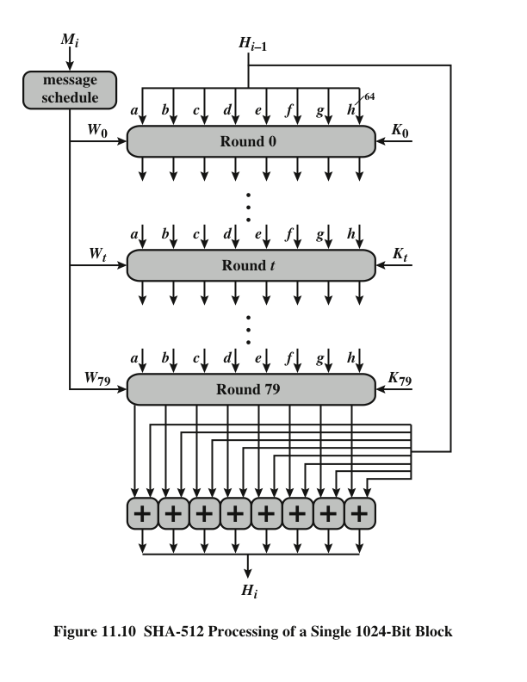
Notes:
The heart of the algorithm
is a module that consists of 80 rounds; this module is labeled F in Figure 11.9.
The logic is illustrated in Figure 11.10.

Slide 26
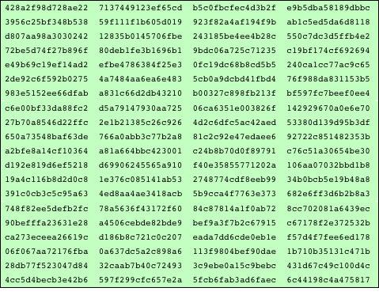
Table 11.4
SHA-512 Constants
(Table can be found on page 333 in textbook)
Notes:
The constants provide a “randomized” set of 64-bit patterns, which should
eliminate any regularities in the input data. Table 11.4 shows these constants
in hexadecimal format (from left to right).

Slide 27
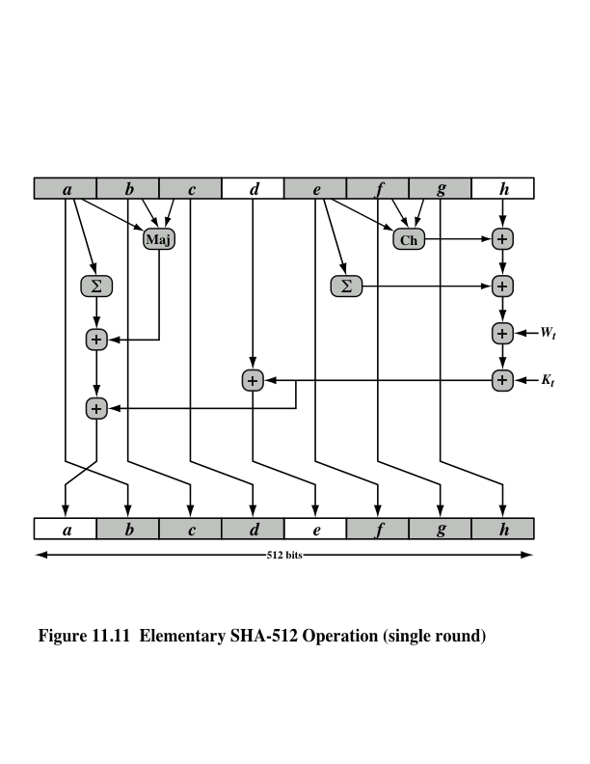
Notes:
Let us look in more detail at the logic in each of the 80 steps of the processing
of one 512-bit block (Figure 11.11).

Slide 28
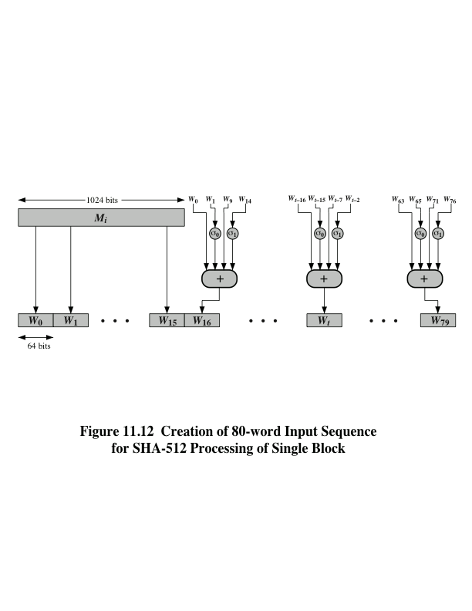
Notes:
Figure 11.12 Creation of 80-word Input Sequence for SHA-512 Processing of Single Block

Slide 29
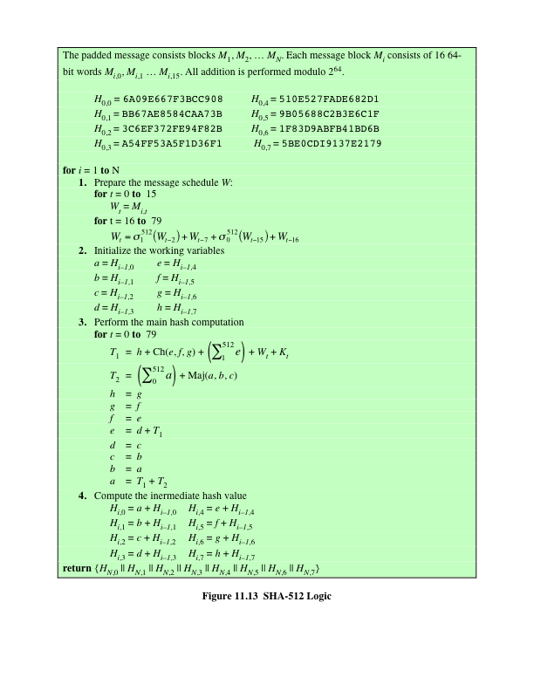
SHA-512
Logic
(Figure can be found on
page 337 in textbook)
Notes:
Figure 11.13 summarizes the SHA-512 logic.
The SHA-512 algorithm has the property that every bit of the hash code is a
function of every bit of the input. The complex repetition of the basic function F
produces results that are well mixed; that is, it is unlikely that two messages chosen
at random, even if they exhibit similar regularities, will have the same hash code.
Unless there is some hidden weakness in SHA-512, which has not so far been published,
the difficulty of coming up with two messages having the same message digest
is on the order of 2²⁵⁶ operations, while the difficulty of finding a message with
a given digest is on the order of 2⁵¹² operations.

Slide 30
SHA-3
SHA-1 has not yet been "broken”
No one has demonstrated a technique for producing collisions in a practical amount of time
Considered to be insecure and has been phased out for SHA-2
SHA-2 shares the same structure and mathematical operations as its predecessors so this is a cause for concern
Because it will take years to find a suitable replacement for SHA-2 should it become vulnerable, NIST decided to begin the process of developing a new hash standard
NIST announced in 2007 a competition for the SHA-3 next generation NIST hash function
Winning design was announced by NIST in October 2012
SHA-3 is a cryptographic hash function that is intended to complement SHA-2 as the approved standard for a wide range of applications
Notes:
As of this writing, the Secure Hash Algorithm (SHA-1) has not yet been “broken.”
That is, no one has demonstrated a technique for producing collisions in a practical
amount of time. However, because SHA-1 is very similar, in structure and in the
basic mathematical operations used, to MD5 and SHA-0, both of which have been
broken, SHA-1 is considered insecure and has been phased out for SHA-2.
SHA-2, particularly the 512-bit version, would appear to provide unassailable
security. However, SHA-2 shares the same structure and mathematical operations
as its predecessors, and this is a cause for concern. Because it will take years to find
a suitable replacement for SHA-2, should it become vulnerable, NIST decided to
begin the process of developing a new hash standard.
Accordingly, NIST announced in 2007 a competition to produce the next generation
NIST hash function, to be called SHA-3. The winning design for SHA-3
was announced by NIST in October 2012. SHA-3 is a cryptographic hash function
that is intended to complement SHA-2 as the approved standard for a wide range
of applications.
Appendix V looks at the evaluation criteria used by NIST to select from
among the candidates for AES, plus the rationale for picking Keccak, which was
the winning candidate. This material is useful in understanding not just the SHA-3
design but also the criteria by which to judge any cryptographic hash algorithm.

Slide 31
The Sponge Construction
Underlying structure of SHA-3 is a scheme referred to by its designers as a sponge construction
Takes an input message and partitions it into fixed-size blocks
Each block is processed in turn with the output of each iteration fed into the next iteration, finally producing an output block
The sponge function is defined by three parameters:
  f = the internal function used to process each input block
  r = the size in bits of the input blocks, called the bitrate
  pad = the padding algorithm
Notes:
The underlying structure of SHA-3 is a scheme referred to by its designers as a
sponge construction [BERT07, BERT11]. The sponge construction has the same
general structure as other iterated hash functions (Figure 11.8). The sponge function
takes an input message and partitions it into fixed-size blocks. Each block is
processed in turn with the output of each iteration fed into the next iteration, finally
producing an output block.
The sponge function is defined by three parameters:
f = the internal function used to process each input block
r = the size in bits of the input blocks, called the bitrate
pad = the padding algorithm

Slide 32
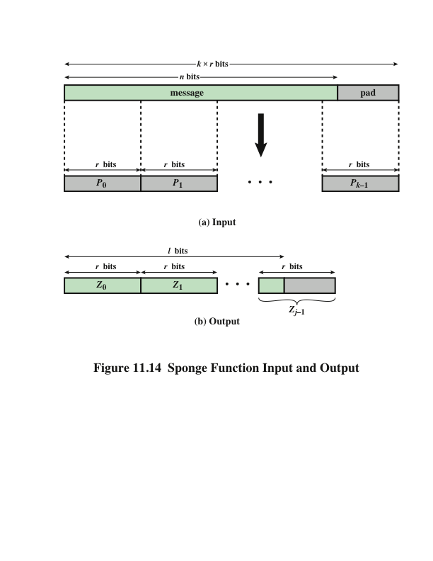
Notes:
A sponge function allows both variable length input and output, making it a
flexible structure that can be used for a hash function (fixed-length output), a pseudorandom
number generator (fixed-length input), and other cryptographic functions.
Figure 11.14 illustrates this point.
The sponge specification proposes [BERT11] proposes
two padding schemes:
• Simple padding: Denoted by pad10*, appends a single bit 1 followed by the
minimum number of bits 0 such that the length of the result is a multiple of the
block length.
• Multirate padding: Denoted by pad10*1, appends a single bit 1 followed by
the minimum number of bits 0 followed by a single bit 1 such that the length of
the result is a multiple of the block length. This is the simplest padding scheme
that allows secure use of the same f with different rates r .

Slide 33
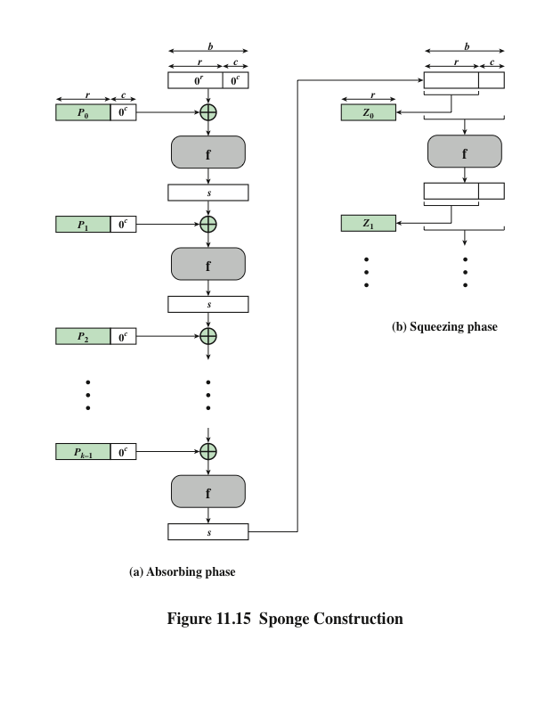
Notes:
Figure 11.15 shows the iterated structure of the sponge function. The sponge
construction operates on a state variable s of b = r + c bits, which is initialized to all
zeros and modified at each iteration. The value r is called the bitrate. This value is
the block size used to partition the input message. The term bitrate reflects the fact
that r is the number of bits processed at each iteration: the larger the value of r , the
greater the rate at which message bits are processed by the sponge construction.
The value c is referred to as the capacity . A discussion of the security implications of
the capacity is beyond our scope. In essence, the capacity is a measure of the achievable
complexity of the sponge construction and therefore the achievable level of
security. A given implementation can trade claimed security for speed by increasing
the capacity c and decreasing the bitrate r accordingly, or vice versa. The default
values for Keccak are c = 1024 bits, r = 576 bits, and therefore b = 1600 bits.

Slide 34
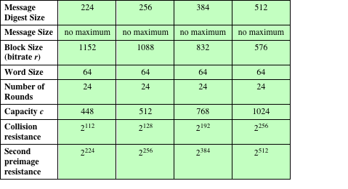
Table 11.5
SHA-3 Parameters
Notes:
Table 11.5 shows
the supported values of r and c . As Table 11.5 shows, the hash function security associated
with the sponge construction is a function of the capacity c .

Slide 35
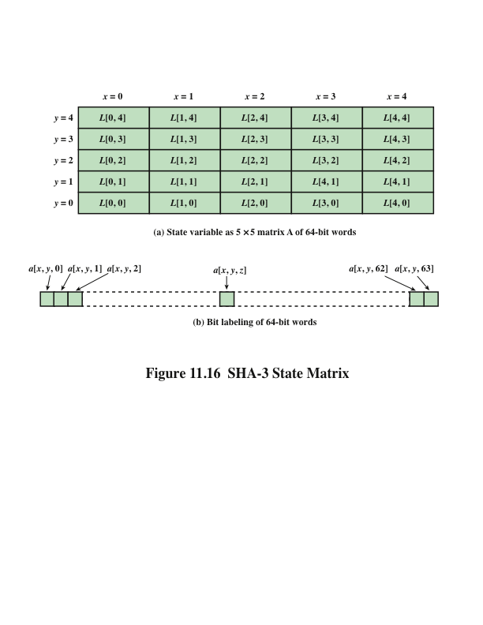
Notes:
We now examine the iteration function Keccak-f used to process each successive
block of the input message. Recall that f takes as input a 1600-bit variable s consisting
of r bits, corresponding to the message block size followed by c bits, referred to as the
capacity. For internal processing within f , the input state variable s is organized as a
5 * 5 * 64 array a . The 64-bit units are referred to as lanes . For our purposes, we generally
use the notation a [x , y , z ] to refer to an individual bit with the state array. When
we are more concerned with operations that affect entire lanes, we designate the
5 * 5 matrix as L [x , y ], where each entry in L is a 64-bit lane. The use of indices
within this matrix is shown in Figure 11.16. Thus, the columns are labeled x = 0
through x = 4, the rows are labeled y = 0 through y = 4, and the individual bits
within a lane are labeled z = 0 through z = 63.
The mapping between the bits of s
and those of a is
s [64(5y + x ) + z ] = a [x , y , z ]
We can visualize this with respect to the matrix in Figure 11.16. When treating
the state as a matrix of lanes, the first lane in the lower left corner, L [0, 0], corresponds
to the first 64 bits of s . The lane in the second column, lowest row, L [1, 0],
corresponds to the next 64 bits of s . Thus, the array a is filled with the bits of s starting
with row y = 0 and proceeding row by row.

Slide 36
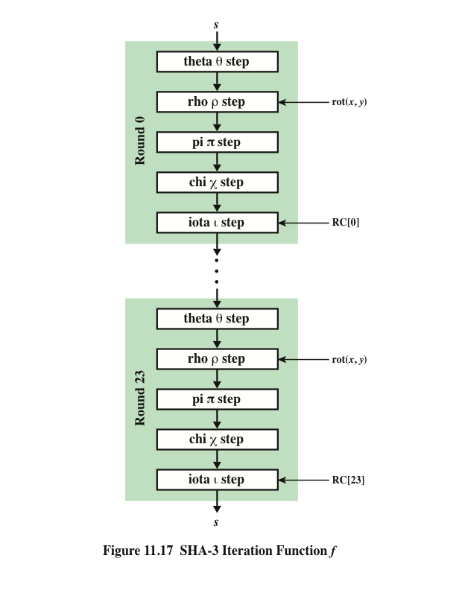
SHA-3
Iteration Function f
Notes:
The function f is executed once for each input block of the message
to be hashed. The function takes as input the 1600-bit state variable and converts
it into a 5 * 5 matrix of 64-bit lanes. This matrix then passes through 24 rounds of
processing. Each round consists of five steps, and each step updates the state matrix
by permutation or substitution operations. As shown in Figure 11.17, the rounds are
identical with the exception of the final step in each round, which is modified by a
round constant that differs for each round.

Slide 37
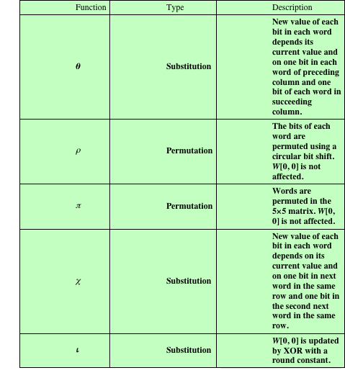
Table 11.6
Step Functions
in SHA-3
Notes:
Table 11.6 summarizes the operation of the five steps. The steps have a simple
description leading to a specification that is compact and in which no trapdoor
can be hidden. The operations on lanes in the specification are limited to bitwise
Boolean operations (XOR, AND, NOT) and rotations. There is no need for table
lookups, arithmetic operations, or data-dependent rotations. Thus, SHA-3 is easily
and efficiently implemented in either hardware or software.

Slide 38
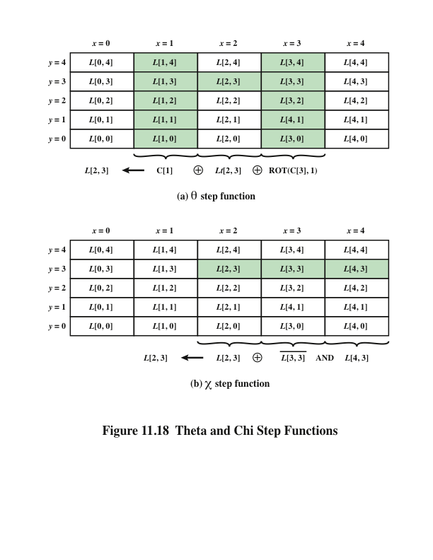
Notes:
Figure 11.18.a illustrates the operation on L [3, 2]. The same operation is performed
on all of the other lanes in the matrix.

Slide 39
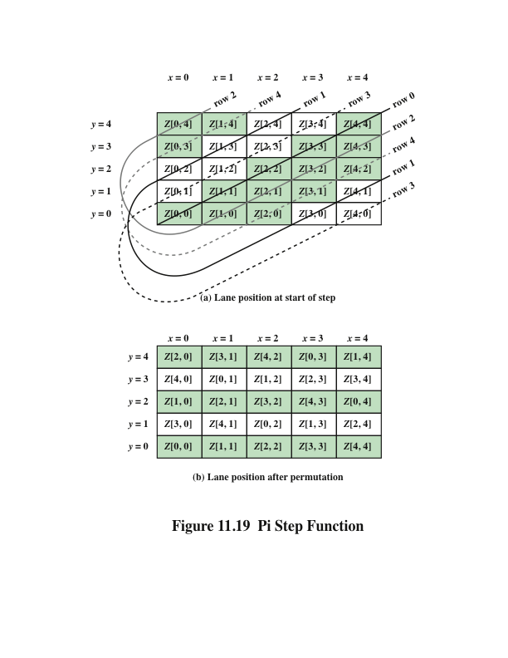
Notes:
Figure 11.19 Pi Step Function

Slide 40
Summary
Applications of cryptographic hash functions
  Message authentication
  Digital signatures
  Other applications
Requirements and security
  Security requirements for cryptographic hash functions
  Brute-force attacks
  Cryptanalysis
Hash functions based on cipher block chaining
Secure hash algorithm (SHA)
  SHA-512 logic
  SHA-512 round function
SHA-3
  The sponge construction
  The SHA-3 Iteration Function f
Notes:
Chapter 11 summary.

