Slide 1
Introduction to Cryptography
Based on: William Stallings, Cryptography and Network Security

Slide 2
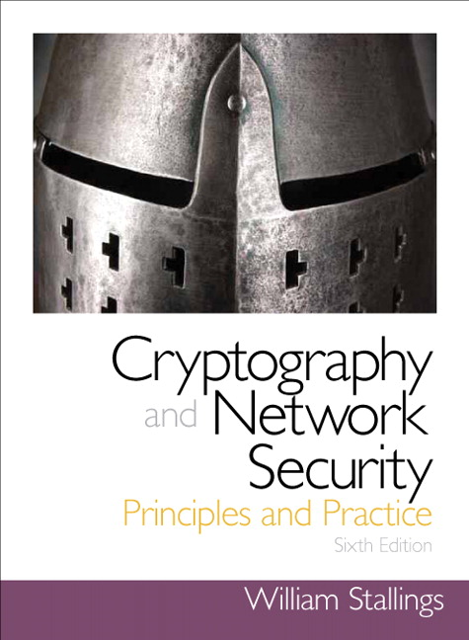
Chapter 10
Other Public-Key Cryptosystems
Notes:
This chapter begins with a description of one of the earliest and simplest PKCS: Diffie-
Hellman key exchange. The chapter then looks at another important scheme, the
Elgamal PKCS. Next, we look at the increasingly important PKCS known as elliptic
curve cryptography. Finally, the use of public-key algorithms for pseudorandom number
generation is examined.

Slide 3
Diffie-Hellman Key Exchange
First published public-key algorithm
A number of commercial products employ this key exchange technique
Purpose is to enable two users to securely exchange a key that can then be used for subsequent symmetric encryption of messages
The algorithm itself is limited to the exchange of secret values
Its effectiveness depends on the difficulty of computing discrete logarithms

Slide 5
Key Exchange Protocols
Users could create random private/public Diffie-Hellman keys each time they communicate
Users could create a known private/public Diffie-Hellman key and publish in a directory, then consulted and used to securely communicate with them
Vulnerable to Man-in-the-Middle-Attack
Authentication of the keys is needed

Slide 7
ElGamal Cryptography
Announced in 1984 by T. Elgamal
Public-key scheme based on discrete logarithms closely related to the Diffie-Hellman technique
Used in the digital signature standard (DSS) and the S/MIME e-mail standard
Global elements are a prime number q and a primitive root of q: $α$
Global elements are a prime number q and a primitive root of q: 𝛼
Security is based on the difficulty of computing discrete logarithms
(reduces to the Diffie-Hellman problem)

Slide 9
Elliptic Curve Arithmetic
Most of the products and standards that use public-key cryptography for encryption and digital signatures use RSA
The key length for secure RSA use has increased over recent years and this has put a heavier processing load on applications using RSA
Elliptic curve cryptography (ECC) is showing up in standardization efforts including the IEEE P1363 Standard for Public-Key Cryptography
Principal attraction of ECC is that it appears to offer equal security for a far smaller key size
Confidence level in ECC is not yet as high as that in RSA

Slide 10
Abelian Group
A set of elements with a binary operation, denoted by •, that associates to each ordered pair (a, b) of elements in G an element (a • b) in G, such that the following axioms are obeyed:
(A1) Closure: If a and b belong to G, then a • b is also in G
(A2) Associative: a • (b • c) = (a • b) • c for all a, b, c in G
(A3) Identity element: There is an element e in G such that a • e = e • a = a for all a in G
(A4) Inverse element: For each a in G there is an element a′ in G such that a • a′ = a′ • a = e
(A5) Commutative: a • b = b • a for all a, b in G

Slide 12
Elliptic Curves over Z_{p} & GF(2^{m})
Elliptic curve cryptography uses curves whose variables and coefficients are finite
Two families of elliptic curves are used in cryptographic applications:
Prime curves over Z_{p}
Use a cubic equation in which the variables and coefficients all take on values in the set of integers from 0 through p-1 and in which calculations are performed modulo p
Best for software applications
Binary curves over GF(2^{m})
Variables and coefficients all take on values in GF(2^{m}) and in calculations are performed over GF(2^{m})
Best for hardware applications

Slide 13
Elliptic Curves Over Z_{p}
Prime curves over Z_{p}
Use a cubic equation$x^{3}+ax+b mod p$ in which the variables and coefficients all take on values in the finite fields $Z_{p}$. Elliptic Curve $E_{23}\left(1,1\right)$is: $x^{3}+x+1 mod 23$
Use a cubic equation 𝒙^𝟑+𝒂𝒙+𝒃 𝒎𝒐𝒅 𝒑 in which the variables and coefficients all take on values in the finite fields 𝒁_𝒑. Elliptic Curve 𝑬_𝟐𝟑 (𝟏,𝟏) is: 𝒙^𝟑+𝒙+𝟏 𝒎𝒐𝒅 𝟐𝟑

Slide 14
Table 10.1
Points (other than O) on the Elliptic Curve E₂₃(1, 1)

Slide 16
Elliptic Curves Over GF(2^{m})
Use a cubic equation in which the variables and coefficients all take on values in GF(2^{m}) for some number m
Calculations are performed using the rules of arithmetic in GF(2^{m})
The form of cubic equation appropriate for cryptographic applications for elliptic curves is somewhat different for GF(2^{m}) than for Z_{p}
It is understood that the variables x and y and the coefficients a and b are elements of GF(2^{m}) and that calculations are performed in GF(2^{m})

Slide 17
Notes:
Figure 10.6 plots
the points of E₂₄ (g⁴ , 1).

Slide 18
Elliptic Curve Cryptography (ECC)
Addition operation in ECC is the counterpart of modular multiplication in RSA
Multiple addition is the counterpart of modular exponentiation
To form a cryptographic system using elliptic curves, we need to find a “hard problem” corresponding to factoring the product of two primes or taking the discrete logarithm
Q=kP, where Q, P belong to a prime curve
Is “easy” to compute Q given k and P
But “hard” to find k given Q, and P
Known as the elliptic curve logarithm problem

Slide 20
ECC Encryption/Decryption
Several approaches using elliptic curves have been analyzed
Must first encode any message m as a point on the elliptic curve P_{m}
Select suitable curve and point G as in Diffie-Hellman
Each user chooses a private key n_{A} and generates a public key P_{A}=n_{A} * G
To encrypt and send message P_{m} to B, A chooses a random positive integer k and produces the ciphertext C_{m} consisting of the pair of points:
C_{m} = {kG, P_{m}+kP_{B}}
To decrypt the ciphertext, B multiplies the first point in the pair by B’s secret key and subtracts the result from the second point:
P_{m}+kP_{B}–n_{B}(kG) = P_{m}+k(n_{B}G)–n_{B}(kG) = P_{m}

Slide 21
Security of Elliptic Curve Cryptography
Depends on the difficulty of the elliptic curve logarithm problem
Fastest known technique is “Pollard rho method”
Compared to factoring, can use much smaller key sizes than with RSA
For equivalent key lengths computations are roughly equivalent
Hence, for similar security ECC offers significant computational advantages

Slide 22
Table 10.3 Comparable Key Sizes in Terms of Computational Effort for Cryptanalysis (NIST SP-800-57)
Note: L = size of public key, N = size of private key

Slide 23
Pseudorandom Number Generation (PRNG) Based on Asymmetric Cipher
An asymmetric encryption algorithm produces apparently ransom output and can be used to build a PRNG
Much slower than symmetric algorithms so they’re not used to generate open-ended PRNG bit streams
Useful for creating a pseudorandom function (PRF) for generating a short pseudorandom bit sequence

Slide 25
PRNG Based on Elliptic Curve Cryptography
Developed by the U.S. National Security Agency (NSA)
Known as dual elliptic curve PRNG (DEC PRNG)
Recommended in NIST SP 800-90, the ANSI standard X9.82, and the ISO standard 18031
Has been some controversy regarding both the security and efficiency of this algorithm compared to other alternatives
The only motivation for its use would be that it is used in a system that already implements ECC but does not implement any other symmetric, asymmetric, or hash cryptographic algorithm that could be used to build a PRNG

Slide 26
Summary
Diffie-Hellman Key Exchange
The algorithm
Key exchange protocols
Man-in-the-middle attack
Elgamal cryptographic system
Elliptic curve cryptography
Analog of Diffie-Hellman key exchange
Elliptic curve encryption/decryption
Security of elliptic curve cryptography
Elliptic curve arithmetic
Abelian groups
Elliptic curves over real numbers
Elliptic curves over Z_{p}
Elliptic curves over GF(2^{m})
Pseudorandom number generation based on an asymmetric cipher
PRNG based on RSA
PRNG based on elliptic curve cryptography

