Slide 1
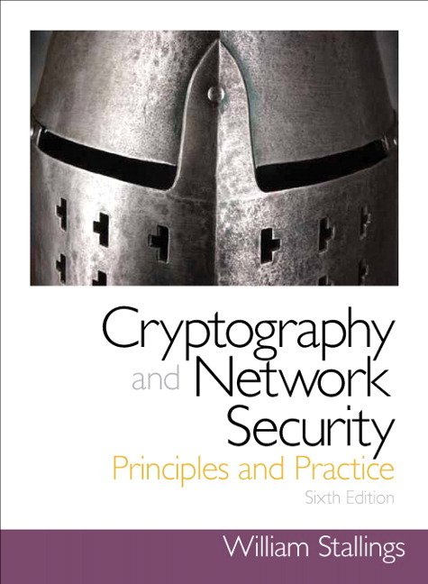
Introduction to Cryptography
Based on: William Stallings, Cryptography and Network Security.

Slide 2
Chapter 1
Overview

Slide 3
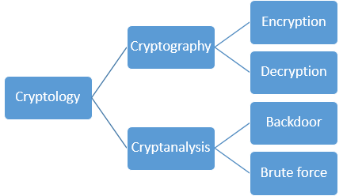
Cryptology

Slide 4
Cryptographic algorithms and protocols
Symmetric encryption
Conceal the contents of blocks or streams of data, using the same private key as used for decrypting.
Asymmetric encryption
Conceal the contents of blocks of data, using a public key. A private key is used to retrieve the contents of the blocks.
Data integrity algorithms
Protect blocks of data, such as messages, from alteration
Authentication protocols
Authenticate the identity of entities

Slide 5
Computer Security Objectives
Confidentiality
Data confidentiality
Sensitive information is not available or disclosed to unauthorized individuals
Privacy
Individuals control or influence what information may be collected and stored and by whom and to whom that information may be disclosed
Integrity
Data integrity
Information and programs are changed only in a specified and authorized manner
System integrity
A system performs its intended function in an unimpaired manner, free from deliberate or inadvertent unauthorized manipulation of the system
Availability
Systems work promptly and service is not denied to authorized users

Slide 6
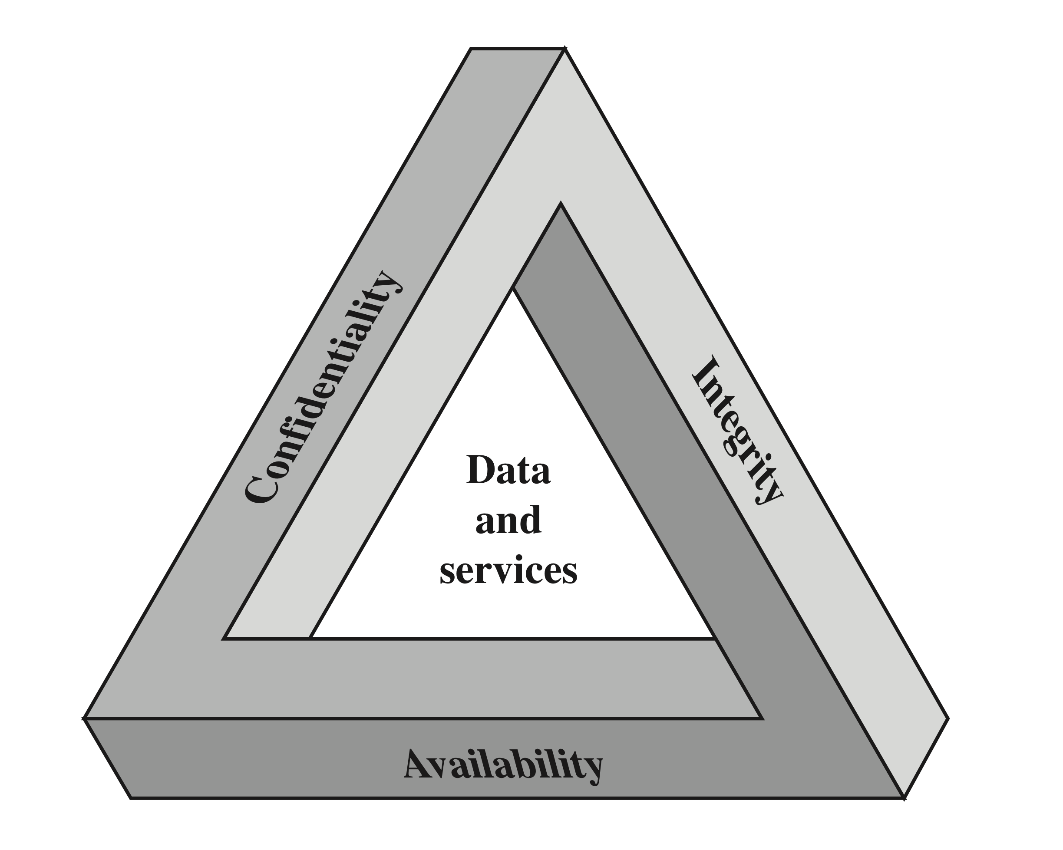
CIA Triad

Slide 7
Additional objectives:
Authenticity
Users are who they say they are and each input arriving at the system came from a trusted source
Accountability
Actions of an entity can be traced uniquely to that entity

Slide 8
Breach of Security
Levels of Impact*
High
The loss could be expected to have a severe or catastrophic adverse effect
Moderate
The loss could be expected to have a serious adverse effect
Low
The loss could be expected to have a limited adverse effect
* FIPS (Federal Information Processing Standard) PUB199

Slide 9
Security Challenges
Security is not simple
Potential attacks on the security features need to be considered
Procedures used to provide particular services are often counter-intuitive
It is necessary to decide where to use the various security mechanisms
Requires constant monitoring
Is too often an afterthought
Security mechanisms typically involve more than a particular algorithm or protocol
Security is essentially a battle of wits between a perpetrator and the designer
Little benefit from security investment is perceived until a security failure occurs
Strong security is often viewed as an impediment to efficient and user-friendly operation

Slide 10
OSI* Glossary
Security attack
  Any action that compromises the security of information or services
Security mechanism
  A process (or a device incorporating such a process) that is designed to detect, prevent, or recover from a security attack
Security service
  A processing or communication service that enhances the security of the data processing systems and the information transfers of an organization
* Open System Interoperability (International Telecommunication Union--ITU)

Slide 11
Threats and Attacks (RFC* 4949)
Threat
A potential for violation of security, which exists when there is a circumstance, capability, action, or event that could breach security.
Attack
An assault on system security that derives from a threat.
* Request For Comments (usually from the Internet Engineering Task Force).

Slide 12
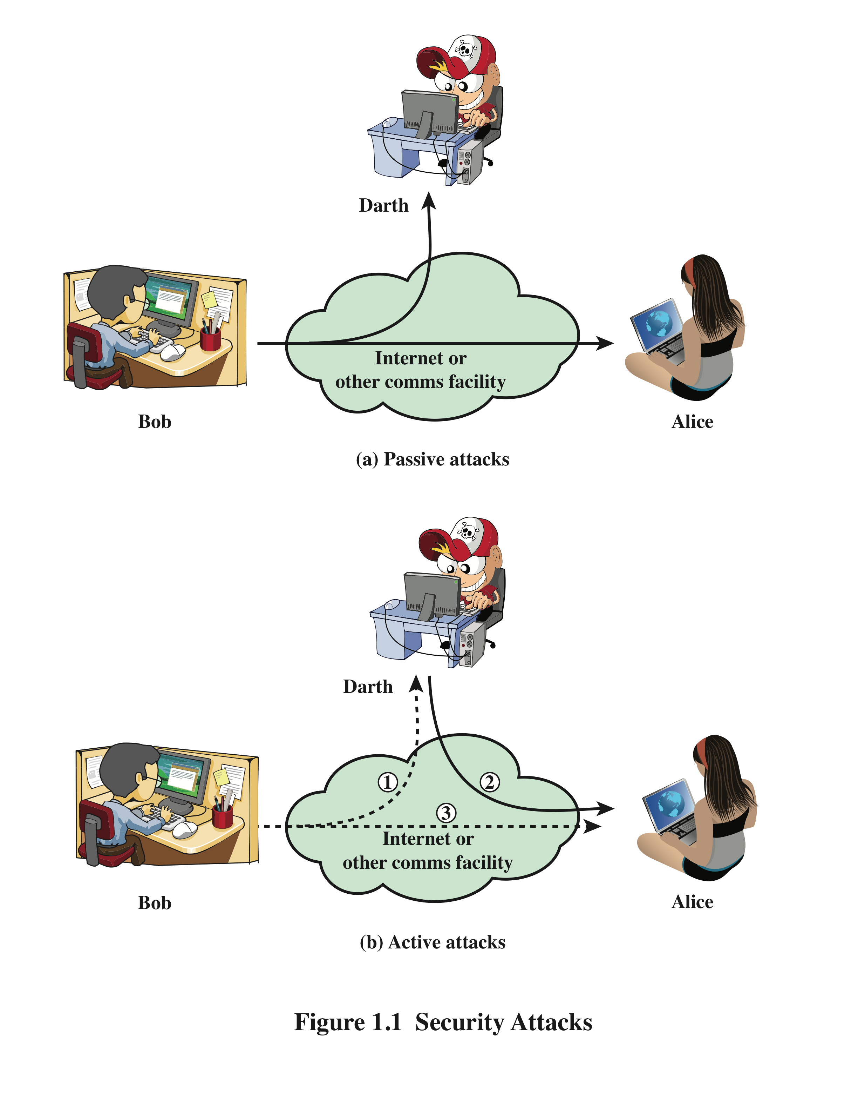
Security Attacks
A passive attack attempts to learn or make use of information from the system but does not affect system resources
An active attack attempts to alter system resources or affect their operation

Slide 13
Passive Attacks
Eavesdropping on, or monitoring of, transmissions
Two types of passive attacks:
  The release of message contents
  Traffic analysis

Slide 14
Active Attacks
Masquerade
One entity pretends to be a different entity
Replay
The passive capture of data and its subsequent retransmission
Modification of messages
A message is altered, or messages are delayed or reordered
Denial of service
Prevent or inhibit the normal use or management of communications facilities
Modification of data, disruption or creation of a false data

Slide 15
Security Services Architecture and Glossary
International Telecommunication Union (ITU)
  X.800, Security architecture for open systems interconnection
  Request for Comments
    RFC 4949 , Internet Security Glossary

Slide 16
X.800 Service Categories
Authentication
Access control
Data confidentiality
Data integrity
Nonrepudiation

Slide 17
Authentication
  Peer entity authentication: Assures the recipient that the message is from the source that it claims to be
  Data origin authentication: Assures the sender and receiver are authentic and that the connection is not interfered with

Slide 18
Access Control
Access to host systems and applications via communications links is controlled

Slide 19
Data Confidentiality
Transmitted data is protected from passive attacks
Traffic flow is protected from analysis

Slide 20
Data Integrity
Applies to single messages, a stream of messages, or selected fields within a message
Messages are received as sent with no duplication, insertion, modification, reordering, or replays

Slide 21
Nonrepudiation
The sender or receiver cannot deny a transmitted message
The receiver can prove that the sender in fact sent the message
The sender can prove that the receiver in fact received the message

Slide 22
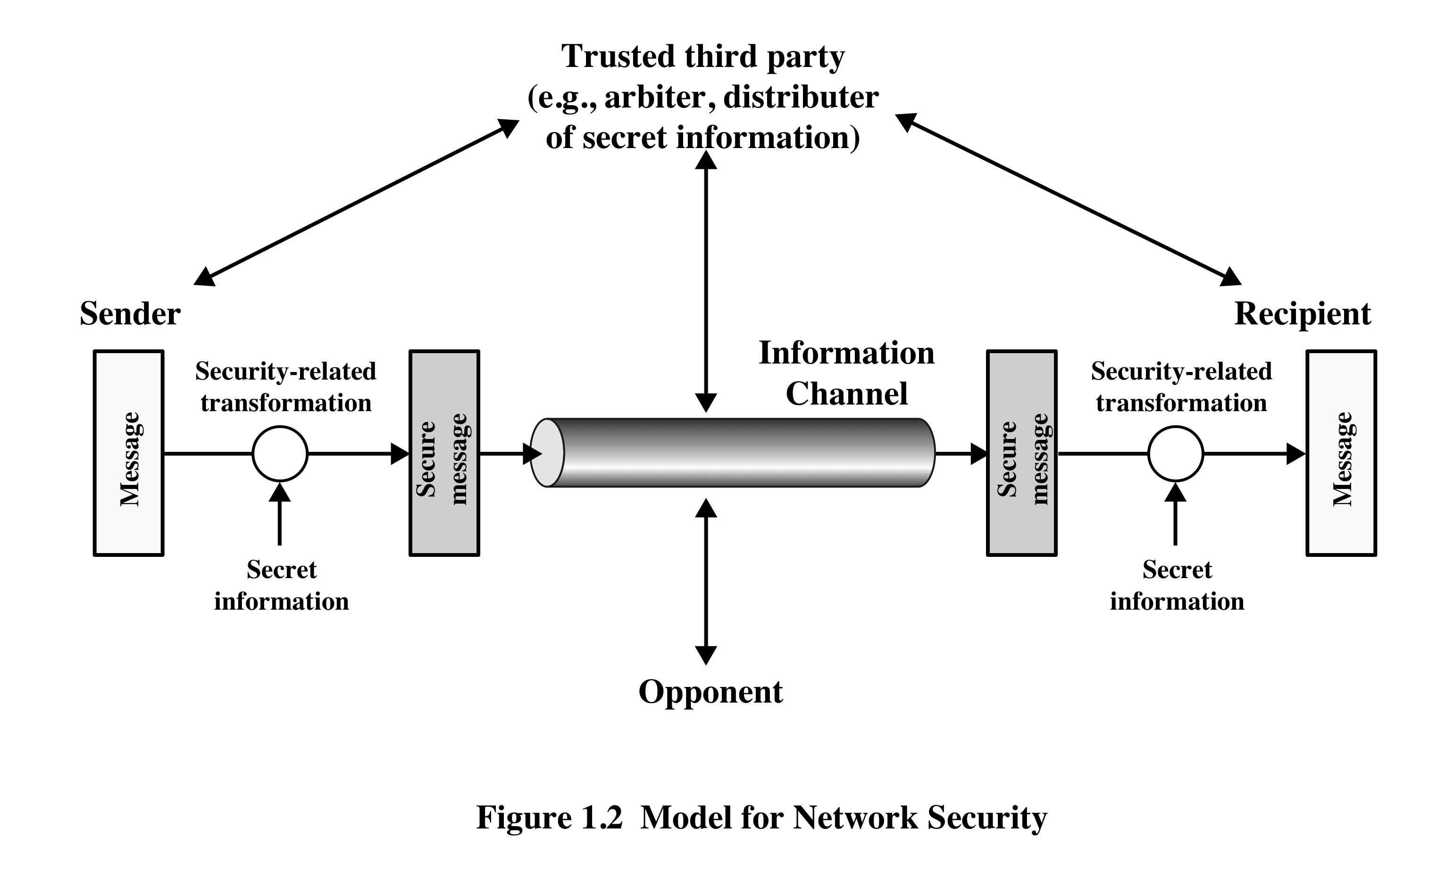
Model for Security I
Scrambled
message
Scrambled
message

Slide 23
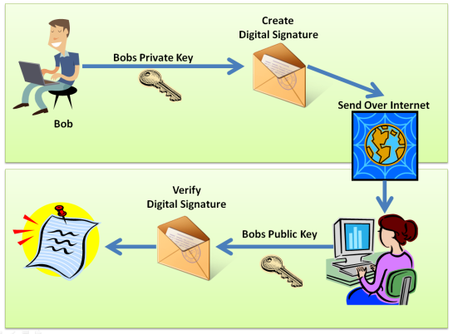

Model for Security II
same key

Slide 24
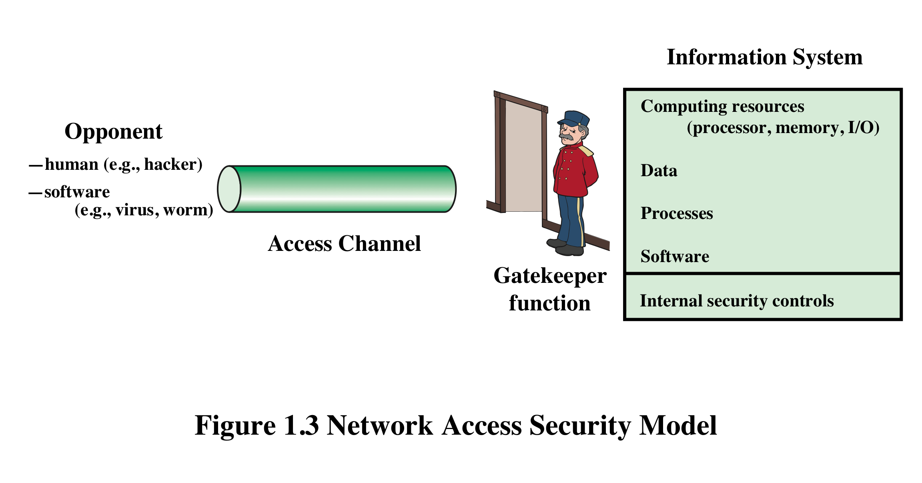
Access Control

Slide 25
Malicious Access
Placement of malware in a computer system that exploits its vulnerabilities.
Two kinds of threats:
  Information access threats
    Intercept or modify data
  Service threats
    Exploit service flaws in computers

Slide 26
Summary
Computer security concepts
Security attacks
  Passive attacks
  Active attacks
Security models
Security services
  Confidentiality
  Integrity
  Availability
  Authentication
  Nonrepudiation
  Access control

Slide 27
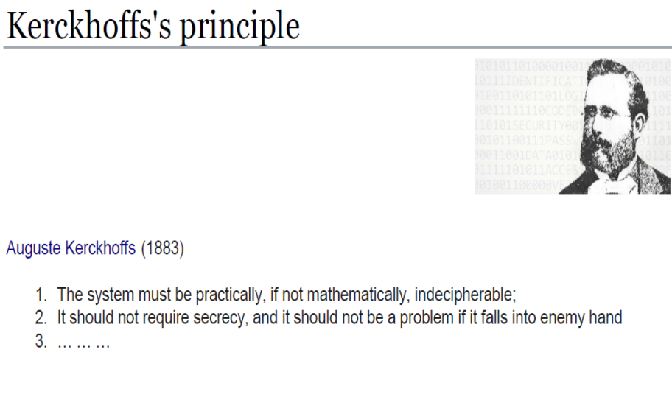
Kerckhoffs

Slide 28

Stephen Hawking
Theoretical physicist, cosmologist
[suffered from motor neuron disease]

