Slide 1
A toy example for RC4

Slide 2
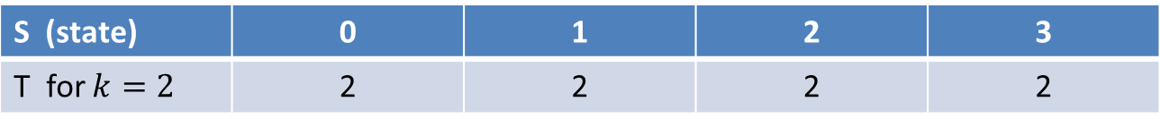
A toy example for RC4.
Initial state
/* Initialization */
for i = 0 to 3 do
S[i] = i;
T[i] = K[i mod keylen];
S (state) | 0 | 1 | 2 | 3
T for $k=2$ | 2 | 2 | 2 | 2

Slide 3
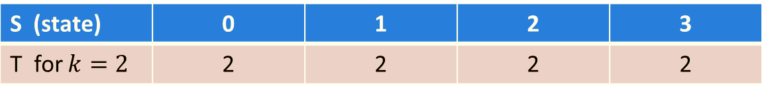
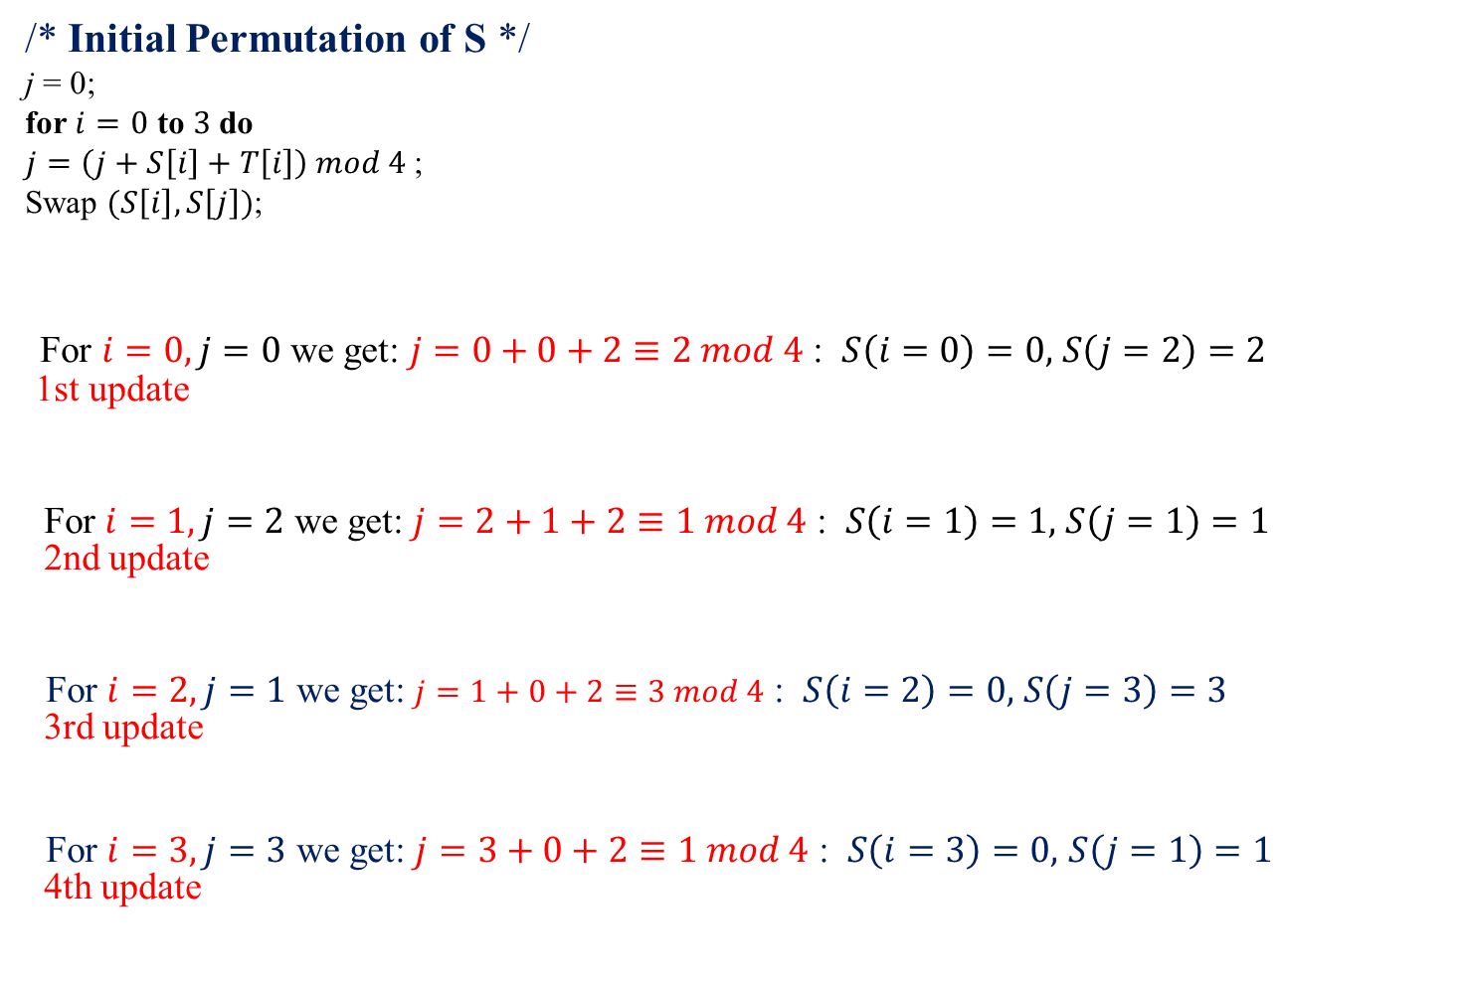
A toy example for RC4
/* Initial Permutation of S */
j = 0;
for $i=0$ to $3$ do
$j=\left(j+S\left[i\right]+T\left[i\right]\right) mod 4$;
Swap $(S\left[i\right],S\left[j\right])$;
For $i=0, j=0$ we get: $j=0+0+2≡2 mod 4$ : $S\left(i=0\right)=0,$ $S\left(j=2\right)=2$
1st update
For $i=1, j=2$ we get: $j=2+1+2≡1 mod 4$ : $S\left(i=1\right)=1,$ $S\left(j=1\right)=1$
2nd update
For $i=2, j=1$ we get: $j=1+0+2≡3 mod 4$ : $S\left(i=2\right)=0,$ $S\left(j=3\right)=3$
3rd update
For $i=3, j=3$ we get: $j=3+0+2≡1 mod 4$ : $S\left(i=3\right)=0,$ $S\left(j=1\right)=1$
4th update
State $S$ $(i=0)$ | 2 | 1 | 0 | 3
State $S$ $(i=1)$ | 2 | 1 | 0 | 3
State $S$ $(i=2)$ | 2 | 1 | 3 | 0
State $S$ $(i=3)$ | 2 | 0 | 3 | 1

Slide 4

A toy example for RC4
/* Stream Generation */
i, j = 0;
while (true)
j = (j + S[i]) mod 4;
i = (i + 1) mod 4;
Swap (S[i], S[j]);
t = (S[i] + S[j]) mod 4;
k = S[t];
For $i=0, j=0$: $j=0+2≡2 mod 4$, $i=1;$ $S\left(i=1\right)=0,$ $S\left(j=2\right)=3.$
Update, compute $t=3$ and output $S\left[3\right]=1$
For $j=2, i=1$: $j=2+3≡1 mod 4$, $i=2;$ $S\left(i=2\right)=0,$ $S\left(j=1\right)=3.$
Update compute $t=3,$and output $S\left[3\right]=1$
For $j=1, i=2$: $j=1+3≡0 mod 4$, $i=3;$ $S\left(i=3\right)=1,$ $S\left(j=0\right)=2.$
Update compute $t=3,$and output $S\left[3\right]=2$
State $S$ | 2 | 3 | 0 | 1
State $S$ | 2 | 0 | 3 | 1
State $S$ | 1 | 0 | 3 | 2

Slide 5
Another RC4 Example
Instead of the full 256 bytes, we use 8 x 3-bits.
So the state vector S is 8 x 3-bits.
We will operate on 3-bits of plaintext at a time since S can take the values 0 to 7, represented as 3 bits.
Assume we use a 4 x 3-bit key: K = [1 2 3 6].
Assume plaintext P = [1 2 2 2] .

Slide 6
K = [1 2 3 6], P = [1 2 2 2]
The first step is to generate the initial permutation
1. Initialize the state vector S and temporary vector T.
  S is initialized by setting: S[i] = i, and T is initialized using the key K, repeated as necessary.
S= [0 1 2 3 4 5 6 7]
T = [1 2 3 6 1 2 3 6]

Slide 7
S = [0 1 2 3 4 5 6 7]
T = [1 2 3 6 1 2 3 6]
2. Now perform the initial permutation on S.
j = 0;
for i = 0 to 7 do
j = (j + S[i] + T[i]) mod 8
Swap(S[i],S[j]);
end
For i = 0: j
=
=
(0 + 0 + 1) mod 8
1
Swap(S[0],S[1]);
S = [1 0 2 3 4 5 6 7]

Slide 8
S = [1 0 2 3 4 5 6 7]
T = [1 2 3 6 1 2 3 6]
j = 0;
for i = 0 to 7 do
j = (j + S[i] + T[i]) mod 8
Swap(S[i],S[j]);
end
For i = 1: j = 1+0+2=3
Swap(S[1],S[3])
S = [1 3 2 0 4 5 6 7];
For i = 2: j = 3+2+3 $≡0$mod 8
Swap(S[2],S[0]);
S = [2 3 1 0 4 5 6 7];
For i = 3: j = 0+0+6=6;
Swap(S[3],S[6]);
S = [2 3 1 6 4 5 0 7];
For i = 4: j = 6+4+1 $≡3$mod 8
Swap(S[4],S[3])
S = [2 3 1 4 6 5 0 7];

Slide 9
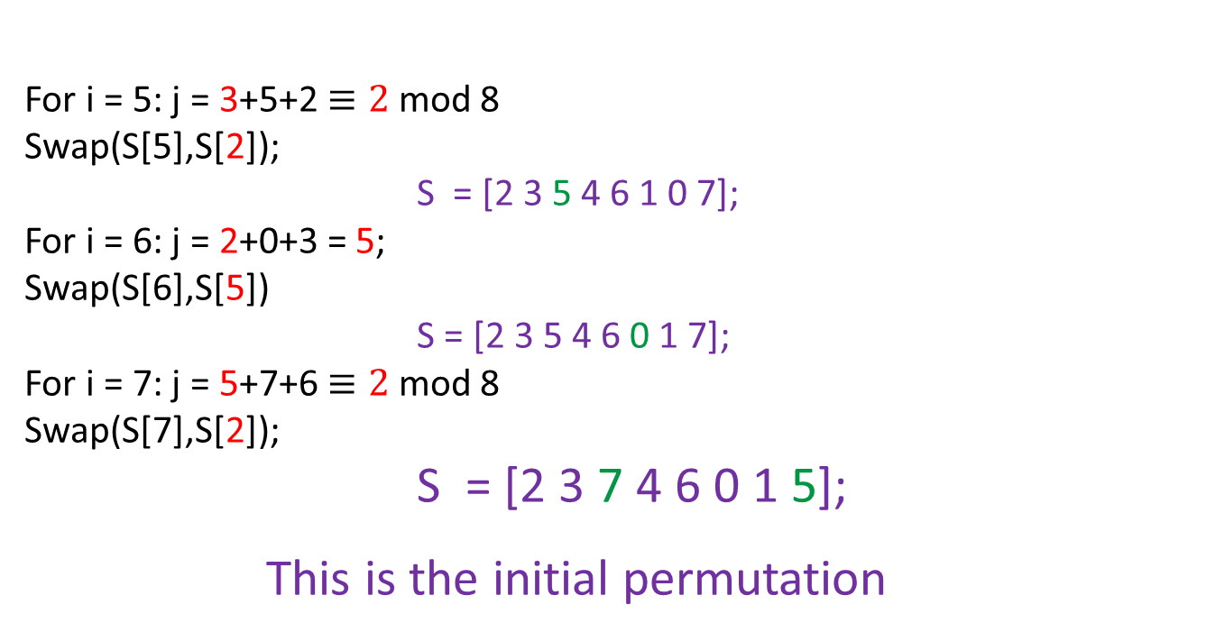
S = [2 3 1 4 6 5 0 7];
T = [1 2 3 6 1 2 3 6]
j = 0;
for i = 0 to 7 do
j = (j + S[i] + T[i]) mod 8
Swap(S[i],S[j]);
end
For i = 5: j = 3+5+2 $≡2$mod 8
Swap(S[5],S[2]);
S = [2 3 5 4 6 1 0 7];
For i = 6: j = 2+0+3 = 5;
Swap(S[6],S[5])
S = [2 3 5 4 6 0 1 7];
For i = 7: j = 5+7+6 $≡2$mod 8
Swap(S[7],S[2]);
S = [2 3 7 4 6 0 1 5];
This is the initial permutation

Slide 10
3. Now generate 3-bits at a time, k = S[t], that we XOR with each 3-bits of plaintext P = [1 2 2 2] to produce the ciphertext C.
The 3-bits k are generated as follows:
i, j = 0; while (true) {
i = (i + 1) mod 8;
j = (j + S[i]) mod 8; Swap (S[i], S[j]);
t = (S[i] + S[j]) mod 8; k = S[t]; }
First iteration:
S = [2 3 7 4 6 0 1 5];
i = (0 + 1) mod 8 = 1
j = (0 + S[1]) mod 8 = 3, Swap(S[1],S[3])
S = [2 4 7 3 6 0 1 5];
t = (S[1] + S[3]) mod 8 = 7, k = S[7] = 5
Since P = [1 2 2 2], the first 3-bits of the ciphertext are:
5 XOR 1 = 101 XOR 001 = 4

Slide 11
P = [1 2 2 2] S = [2 4 7 3 6 0 1 5]; i=1, j = 3, C =[4 . . . ]
i, j = 0; while (true) {
i = (i + 1) mod 8;
j = (j + S[i]) mod 8; Swap (S[i], S[j]);
t = (S[i] + S[j]) mod 8; k = S[t]; }
Second iteration:
S = [2 4 7 3 6 0 1 5]
i = (1 + 1) mod 8 = 2
j = (3 + S[2]) mod 8 = 2, Swap(S[2],S[2])
S = [2 4 7 3 6 0 1 5];
t = (S[2] + S[2]) mod 8 = 6, k = S[6] = 1
Second 3-bits of ciphertext are: 1 XOR 2 = 001 XOR 010 = 011 = 3

Slide 12
P = [1 2 2 2] S = [2 4 7 3 6 0 1 5]; i=2, j = 2, C =[4 3 . . ]
Third iteration:
i = (2 + 1 ) mod 8 = 3
j = (2 + S[3]) mod 8 = 5 Swap(S[3],S[5])
S = [2 4 7 0 6 3 1 5];
t = (S[3] + S[5]) mod 8 = 3, k = S[3] = 0
Third 3-bits of ciphertext are: 0 XOR 2 = 000 XOR 010 = 010 = 2
Final iteration:
S = [2 7 4 0 6 3 1 5]; i=3, j=5, C = [432.]
i = (3+ 1) mod 8 = 4
j = (5 + S[4]) mod 8 = 3 Swap(S[4],S[3])
S = [2 7 4 6 0 3 1 5]
t = (S[4] + S[3]) mod 8 = 6, k = S[6] = 1
Last 3-bits of ciphertext are: 1 XOR 2 = 001 XOR 010 = 011 = 3

Slide 13
So to encrypt the plaintext stream
P = [1 2 2 2]
with key
K = [1 2 3 6]
using the simplified RC4 stream cipher we get
C = [4 3 2 3].
In binary:
P = 001 010 010 010,
K = 001 010 011 110 and
C = 100 011 010 011

