Slide 1
Internet + Wireless+ Mobile technologies

Slide 2
Introduction
Internet+Wireless+Mobile =
  Going on-line anywhere, anytime and using multiple devices
  New opportunities, services
Ubiquitous
  Anywhere, any time
  Convenient, instant connectivity
Very personal
  Device owner has an exclusive access to the contents/services
  Service providers know who the owner is
Varied users, usage contexts
  Anybody
  Location and context-sensitive apps and services

Slide 3
What drives these technologies
High mobile phone penetration
Convergence of the Internet and the mobile devices
Improvements in technology: transition from 1st to 2nd, 3rd, 4th and 5th generation mobile broadband.
Declining prices: device, service prices
Explosion of e-commerce

Slide 4
Applications
Current applications
  On-line transactions
  On-line purchases
  On-the-go entertainment
  A wireless office
  Migration from PC-centric to multi-device models

Slide 5
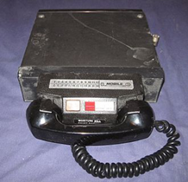
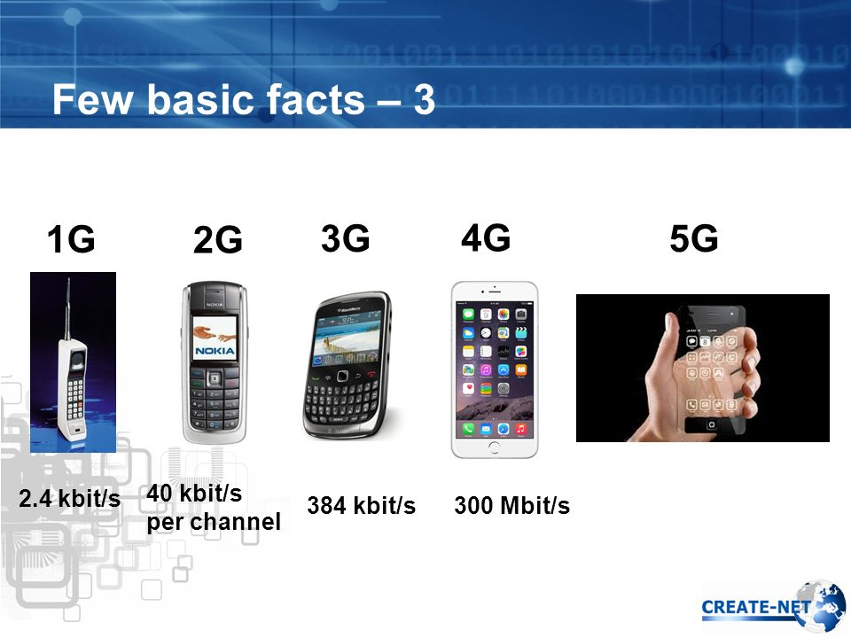
Mobile Phone Evolution
0G
20 Gbit/s

Slide 6
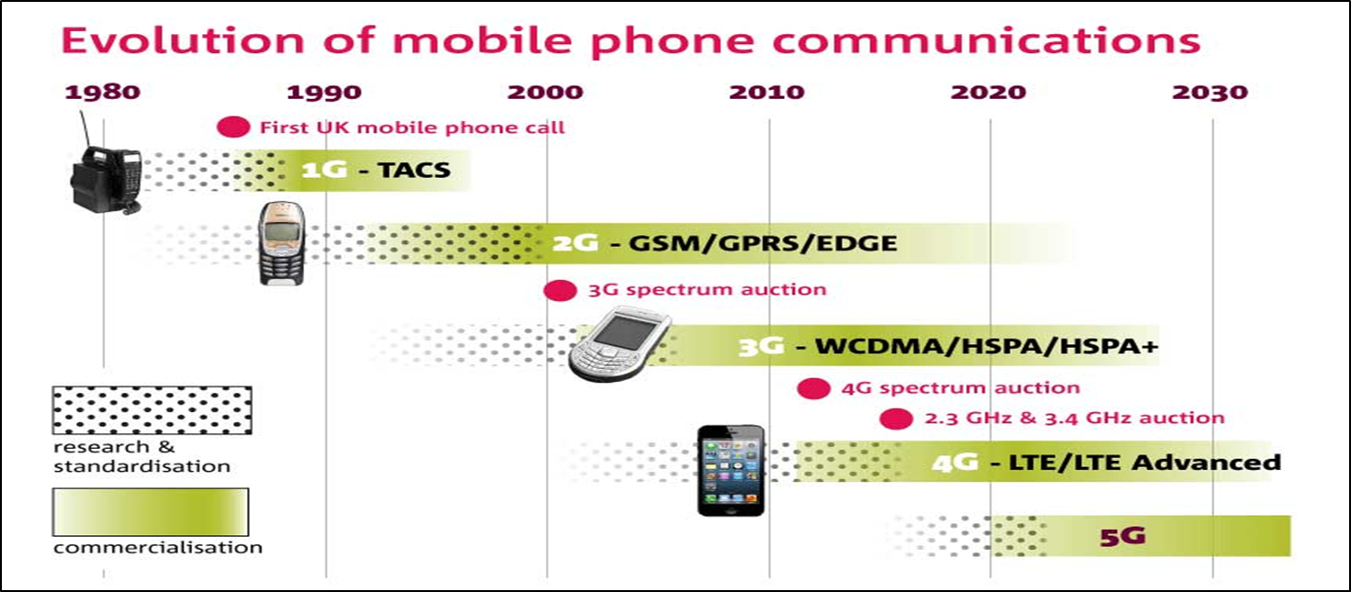
Mobile Phone Evolution
Glossary
TACS: Total Access Communication System
GSM/GPRS/EDGE: Global System for Mobile Communications / General Packet Radio Services/ Enhanced Data for GSM evolution
WCDMA/HSPA/HSPA+: Wide-band Code Division Multiple Access/High Speed Packet Access
LTE: Long Term Evolution

Slide 7
Mobile Technology Evolution: from 0G to 5G
0G, Zero Generation: pre-cellular analogue technology, typically mounted on cars.
1G, analogue cellular technology: Total Access Communication System (TACS)
2G, adapted for digital cellular phones: Global System for Mobile (GSM) communication
2.5G: umbrella term for technologies designed to add 3G capabilities to existing cellular networks. Combines enhanced technologies:
  GPRS: General Packet Radio Services (packet-switching)
  EDGE: Enhanced Data Rates for GSM Evolution
3G: send/receive data & multimedia content up to 7x times faster.
4G: send/receive data/multimedia up to 10x faster
5G: send/receive data/multimedia up to 20x faster
Wireless devices
  Digital cellular phones
  Two-way pagers, laptops,...

Slide 8
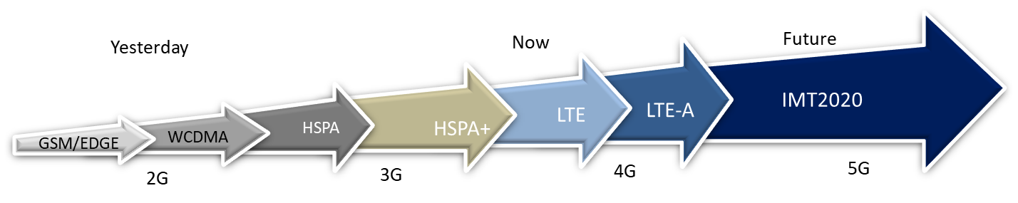
Mobile Networks Evolution
Glossary
GSM/EDGE: Global System for Mobile communications/Enhanced Data for GSM evolution
WCDMA: Wide-band Code Division Multiple Access
HSPA: High Speed Packet Access
HSPA+: Evolved High Speed Packet Access
LTE: Long Term Evolution
LTE-A: Long Term Evolution-Advanced:
IMT2020: International Mobile Telecommunications for 2020

Slide 9
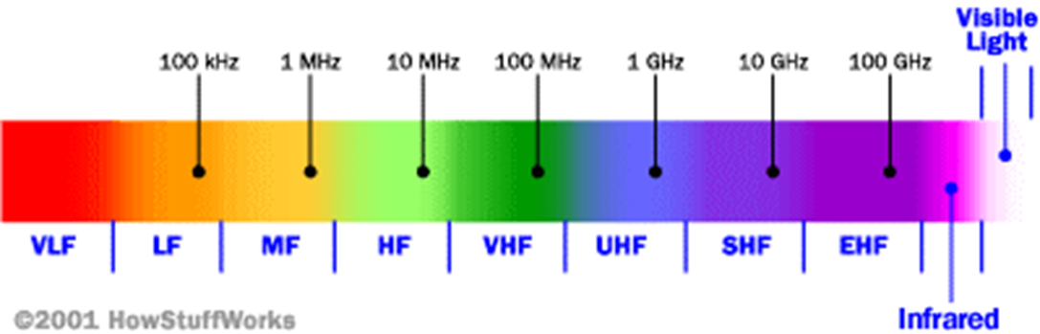
Cellular Network Frequency Range
Cellular network/telephony is a radio-based technology; radio waves are electromagnetic waves
Signals are in the 850 MHz, 900 MHz, 1800 MHz, and 1900 MHz frequency bands
Cell phones operate in this narrow frequency range

Slide 10
Characteristics of Wireless Devices
Ubiquitous interactivity
  Personal: handy, available at all times
  User identity: the device carries its user identity
  Distinctly personal: can be tracked to an individual.
Location aware
  Tracks where the user is physically, as long as the wireless device is on (using GPS)

Slide 11
Current Limitations of Devices & Services
Huge investment needed for infrastructure
Service is still relatively expensive
Limited bandwidth restricts the amount of data that can be sent over the wireless network as well as the speed
Wireless devices still have smaller memory capacity and less powerful processors than desktop computers
Small screen, keyboard: usability, navigation problems
Rapidly developing standards
Security (viruses, tapping, hacking)
However, wireless technology is growing rapidly

Slide 12
Multiple Access Problem
Base Stations (BS) need to serve many mobile terminals at the same time (both downlink and uplink)
All mobiles in a cell need to transmit to the BS.
We need a multiple access scheme, and must address
  Interference among different senders and receivers
  Cellular technology uses, instead of wires (e.g. copper or coaxial cables):
  a multiple access radio system
  wireless channels: between users/terminals and wireless networks

Slide 13
Challenges for Wireless Channels
Frequency assigned to wireless communication is limited
Explosive growth of demand
Optimize the use of the assigned frequency band so that multiple users can gain simultaneous accesses
Technology manipulates four dimensions:
  Space (SDMA) [“everyone talks quietly so that only their neighbors can hear”]
  Frequency (FDMA) [“everyone talks in a different room to prevent interference”]
  Time (TDMA) [“everyone takes turns to talk”]
  Code (CDMA) [“everyone speaks in a different language”]
[MA = multiple access, D = division, S = space, F = frequency, T = time, C = code]

Slide 14
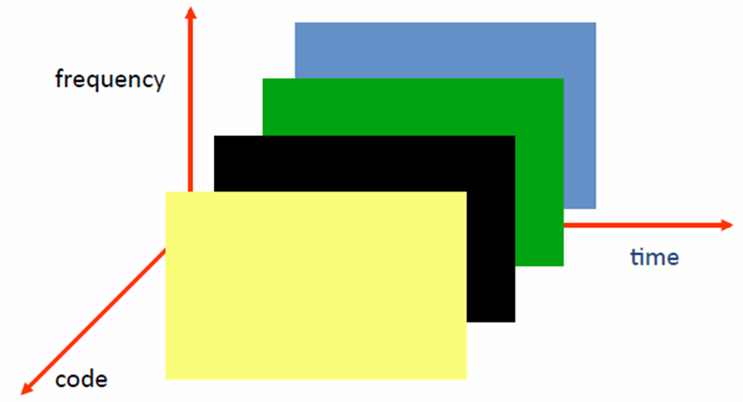
Multiple Access Schemes FDMA, TDMA, CDMA
Frequency Division Multiple Access
  Each channel uses a different frequency bandwidth
Time Division Multiple Access
  Assign a frequency band for multiple channels by slicing time slots; each channel uses certain time slots
Code Division Multiple Access
  Assign a large frequency band for multiple channels; calls are split into packets that are tagged with identifying codes

Slide 15
SDMA -Space Division Multiple Access
Frequency bandwidth is re-used
A covered area is divided into many small cells
A channel (frequency band) in one cell is re-used by a different user in another cell as long as there is enough separation between the two cells to minimize interference

Slide 16
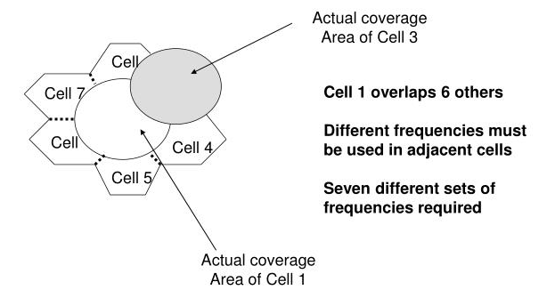
Cell Clusters, for Space Division

Slide 17
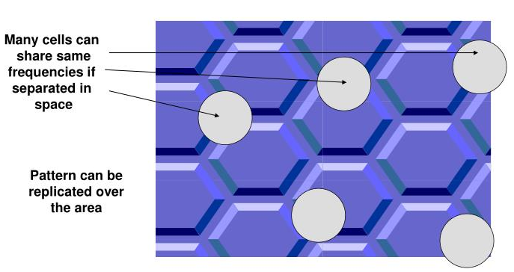
SDMA

Slide 18
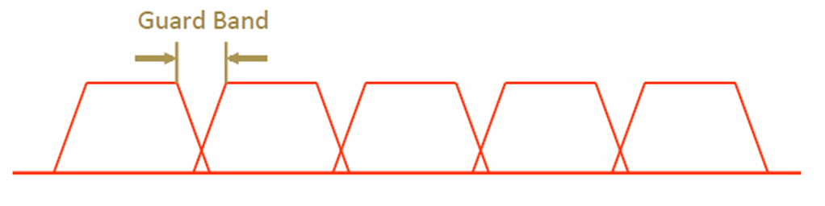

Frequency Division Multiple Access
Each mobile is assigned a separate frequency channel for the duration of the call
Sufficient guard band is required to prevent adjacent channel interference
Usually, mobile devices will have one downlink frequency band and one uplink frequency band
Different cellular network protocols use different frequencies

Slide 19
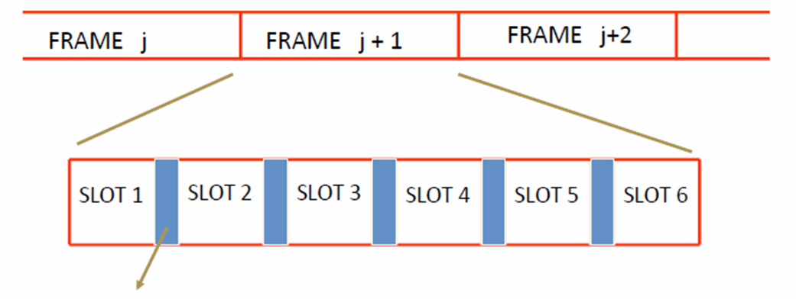
Time Division Multiple Access
Guard time – signal transmitted by mobile terminals at different locations do no arrive at the base station at the same time
Time is divided into slots and only one mobile device transmits during each slot
Each user is given a specific slot.

Slide 20
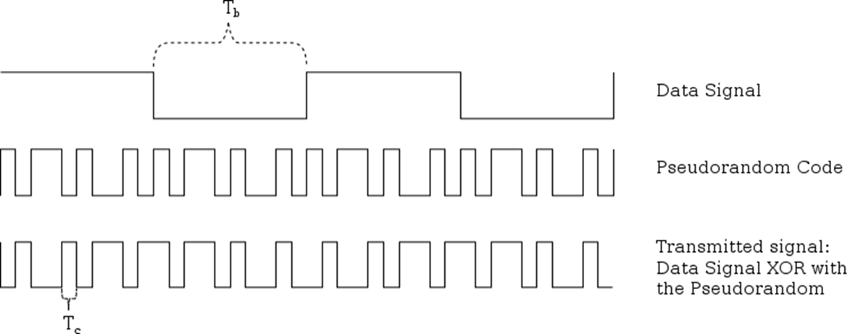
Code Division Multiple Access
Pulse duration of data signal
Orthogonal among users
Pulse duration of spread spectrum
Uses spread spectrum multiple access technology
Use of orthogonal codes to separate different transmissions
Each symbol (bit) is transmitted as a large number of bits using the user specific code – Spreading
Bandwidth occupied by the signal is much larger than the information transmission rate
But all users use the same frequency band together

Slide 21
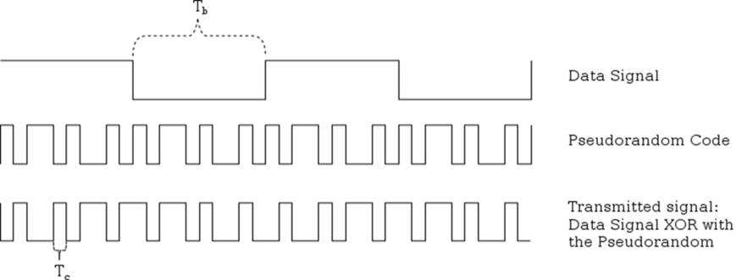

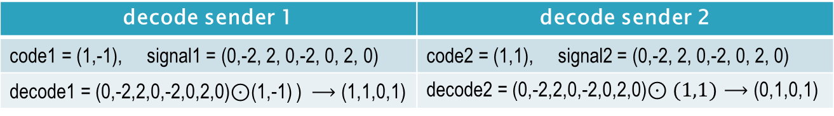
Code Division Multiple Access, example
Each user is assigned a code, say $v=(1,−1)$
If the data is $\left(1,1,0,1\right)$ this is first encoded to $\left(1,1,−1,1\right).$
The transmitted symbols are then:
$\left(1,1,−1,1\right)⊗\left(1,−1\right)=\left(1,−1,1,−1,−1,1,1,−1\right).$
raw signal: $(0,−2, 2, 0,−2, 0, 2, 0)$
encode sender 1 | encode sender 2
code1 = (1,-1), data1 = (1,1,0,1) | code2 = (1,1), data2 = (0,1,0,1)
encode1 = (1,-1, 1,-1,-1, 1, 1,-1) | encode2 = (-1,-1, 1, 1,-1,-1, 1, 1)
decode sender 1 | decode sender 2
code1 = (1,-1), signal1 = (0,-2, 2, 0,-2, 0, 2, 0) | code2 = (1,1), signal2 = (0,-2, 2, 0,-2, 0, 2, 0)
decode1 = (0,-2,2,0,-2,0,2,0)$⊙$(1,-1) ) $⟶$ (1,1,0,1) | decode2 = (0,-2,2,0,-2,0,2,0)$⊙(1,1)$ $⟶$ (0,1,0,1)

Slide 22
 | S | e | n | d | e | r |  | 1 |  |  | s | e | n | d | e | r |  | 2
Data | 1 | 1 | -1 | 1 |  |  |  |  |  |  | -1 | 1 | -1 | 1
spread code | 1 | -1 |  |  |  |  |  |  |  |  | 1 | 1
spreaded signal | 1 | -1 | 1 | -1 | -1 | 1 | 1 | -1 |  |  | -1 | -1 | 1 | 1 | -1 | -1 | 1 | 1
combined signal | 0 | -2 | 2 | 0 | -2 | 0 | 2 | 0
convention
2
1
radio signal 0
-1
-2
Decoding
spread code 1
0
-1
multiply for signals | 0 | 2 | 2 | 0 | -2 | 0 | 2 | 0 |  |  | 0 | -2 | 2 | 0 | -2 | 0 | 2 | 0
take average | 1 |  | 1 |  | -1 |  | 1 |  |  |  | -1 |  | 1 |  | -1 |  | 1
bit 1 = 1 (V), bit 0=-1 (V)

Slide 23

Question: With 5G and beyond technologies there will be a
significant increase in mobile communications. Can this excessive use of radio waves be harmful?
Answer: Don’t know. However the signals transmitted are very weak.
GPS signals:
The signals from GPS satellites are exceptionally weak.
They are sometimes compared to the strength of a 40 watt light bulb on the moon as seen from the earth.

Slide 24
Code Division Multiple Access
Often in FDMA+CDMA format
Considered most efficient; creates a capacity that is triple that of comparable TDMA
Generally CDMA >TDMA >FDMA

Slide 25
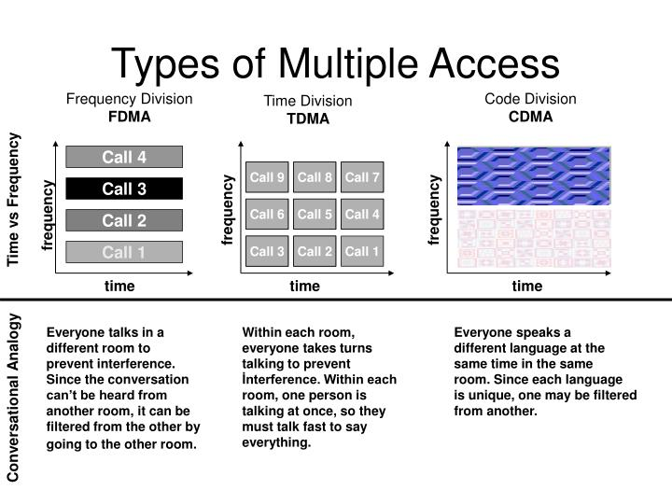

Slide 26
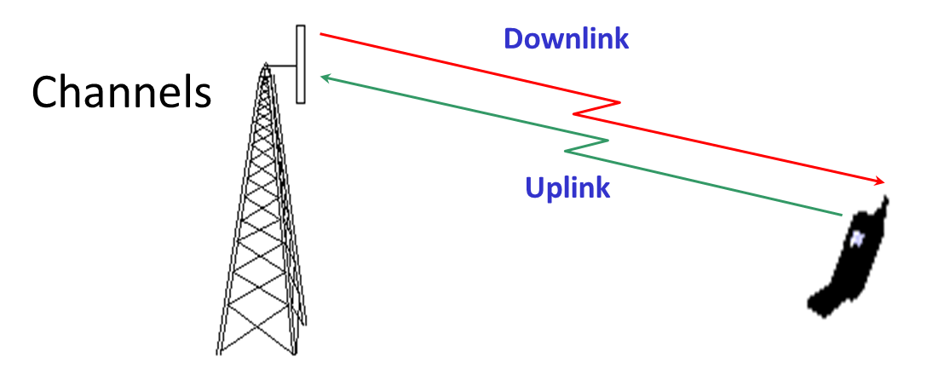
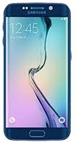
Global System for Mobile Communication Channels
BTS
MS
MS
Physical Channel: Each timeslot on a carrier is referred to as a physical channel
Logical Channel: Variety of information is transmitted between the MS (Mobile Station) and BTS (Base Transceiver Station).
We have different types of logical channels:
  Traffic channel
  Control channel

Slide 27
Global System for Mobile Communications (GSM) Channels
BCCH, Broadcast Control Channel: downlink channel that contains detailed network and cell specific information such as:
  Frequency used by the cell and its neighboring cells
  Frequency HSN (Hopping Sequence Number)
  Max output power allowed in the cell, etc
RACH, Random Access Channel: uplink channel with a random signal
AGCH, Access Grant Channel: downlink channel in reply to the RACH
SDCCH, Stand Alone Dedicated Control Channel: bi-directional channel used for
  System signaling
  Call setup
  Authentication
  Location Update, etc

Slide 28
GSM Frequencies
Originally designed on 900MHz range, now also available on 800MHz, 1800MHz and 1900 MHz ranges.
Separate Uplink and Downlink frequencies
  One example channel on the 1800 MHz frequency band, where RF carriers are spaced every 200 MHz
UPLINK FREQUENCIES
DOWNLINK FREQUENCIES
1710 MHz
1785 MHz
1805 MHz
1880 MHz
UPLINK AND DOWNLINK FREQUENCY SEPARATED BY 95MHZ

Slide 29
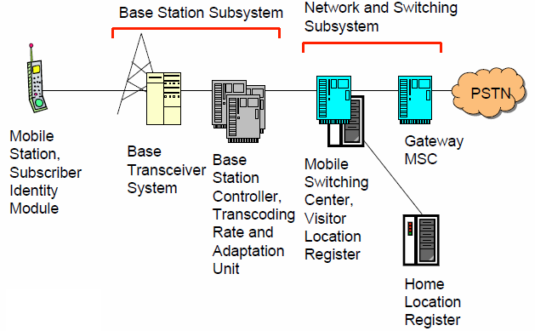
GSM Architecture
Public Switched
Telephone Network
Glossary: MS, MSSIM, BTS, BSC, MSC, VLR, GMSC, HLR, PSTN

Slide 30
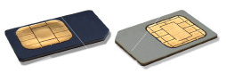
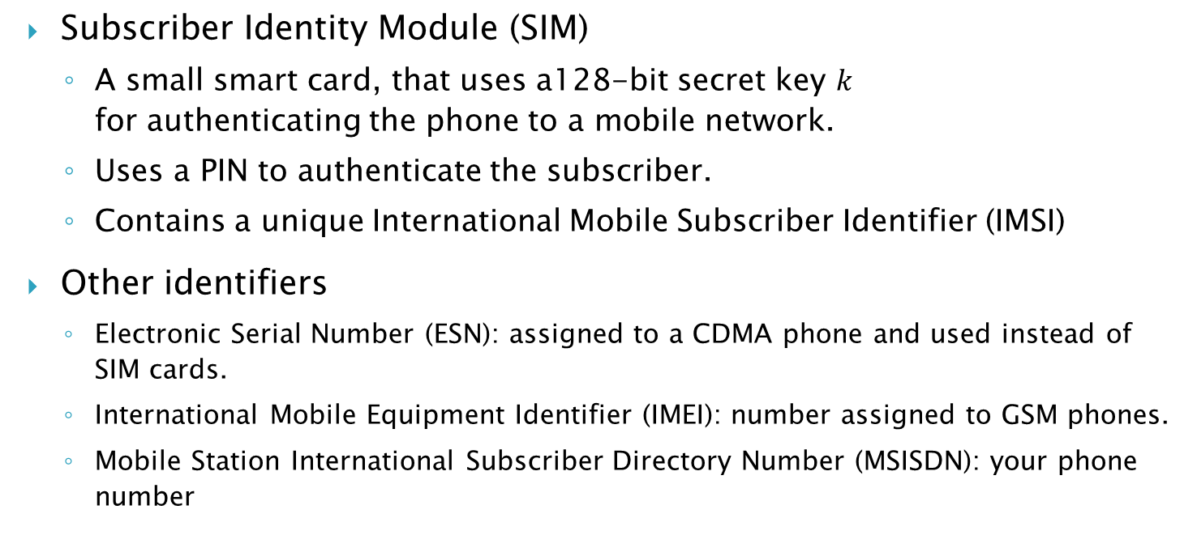
Subscriber Module and Identifiers
Subscriber Identity Module (SIM)
  A small smart card, that uses a128-bit secret key $k$ for authenticating the phone to a mobile network.
  Uses a PIN to authenticate the subscriber.
  Contains a unique International Mobile Subscriber Identifier (IMSI)
Other identifiers
  Electronic Serial Number (ESN): assigned to a CDMA phone and used instead of SIM cards.
  International Mobile Equipment Identifier (IMEI): number assigned to GSM phones.
  Mobile Station International Subscriber Directory Number (MSISDN): your phone number

Slide 31
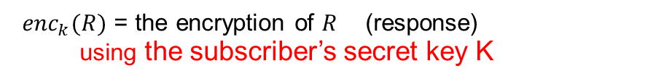
GSM Challenge-Response Protocol
The MS transmits its IMSI to a local BTS.
If the IMSI matches a subscriber’s record, then BTS transmits a 128-bit random number R.
R is encoded by the cellphone with the subscriber’s secret key k stored in the SIM card using a proprietary encryption algorithm (A3) and the ciphertext is sent back to BTS.
The BTS performs the same computation, using its stored value of the subscriber’s secret key k. If the two ciphertexts match, the cellphone is authenticated.
IMSI (the phone’s ID) = (this phone’s ID)
$R$ = a 128-bit random number (challenge)
${enc}_{k}(R)$ = the encryption of $R$ (response)
using the subscriber’s secret key K

Slide 32
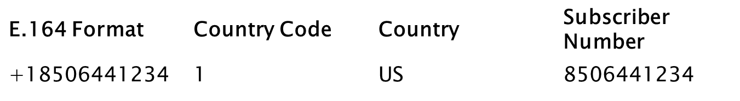
Global Title (GT), E.164 identifiers
GT is an address used for routing signal messages in communication networks (similar to the host name on Internet applications).
GT has a variety of formats, specified by a format parameter.
A numbering plan indicator describes the numbering used for GT.
The type of number indicates the scope of the address value and is used by the routing system to determine the correct network system to direct the message.
E.164 is an ITU recommendation for a public telecommunication numbering plan.
E.164 formatting of numbers (up to 15 digits)
[+] [country code] n [subscriber number including area code]

Slide 33
Global System for Mobile Signaling Overview
GSM signaling defines the communication between the MS and the communication network
GSM signaling is based on the Open Systems Interconnect (OSI) model
The MS Controller uses ITU’s Signaling System 7 (SS7) protocol for signal processing

Slide 34
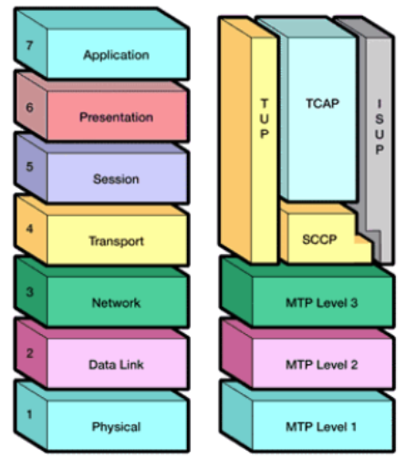
SS7 Protocol Stack Levels
The hardware and software functions of the SS7 protocol are divided into functional abstractions called “levels’.
These levels map loosely to the Open System Interconnect (OSI) 7-layer model defined by ISO.
The Message Transfer Part (MTP) is divided into 3 parts.
  MTP1= physical (includes channels: high speed E1, voice/data DS1)
  MTP2 = electrical (ensures end-to-end transmission)
  MTP3 = functional (ensures message routing)
Glossary:
TUP = Telephone User Part
TCAP = Transaction Capabilities Application Part
SCCP = Signaling Connection Control Part
ISUP = ISDN User Part
OSI Reference Model SS7 Protocol Stack

Slide 35
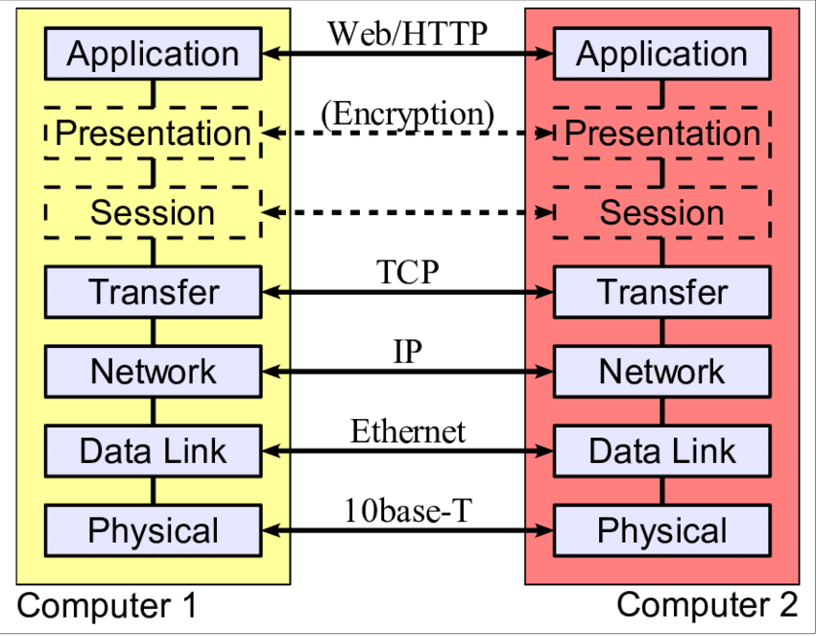
coaxial cable
twisted pair

Slide 36
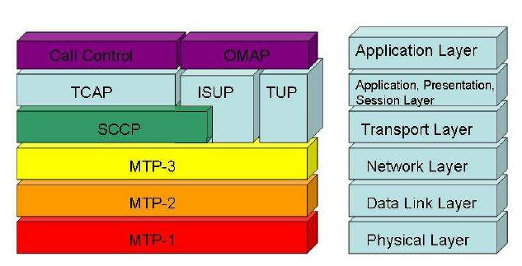
Message Transfer Part
  MTP1= physical (includes channels: high speed E1, voice/data DS1)
  MTP2 = electrical (ensures end-to-end transmission)
  MTP3 = functional (ensures message routing)
TCAP = Transaction Capabilities
Application Part
ISUP = ISDN User Part
TUP = Telephone User Part
SCCP = Signaling Connection
Control Part

Slide 37
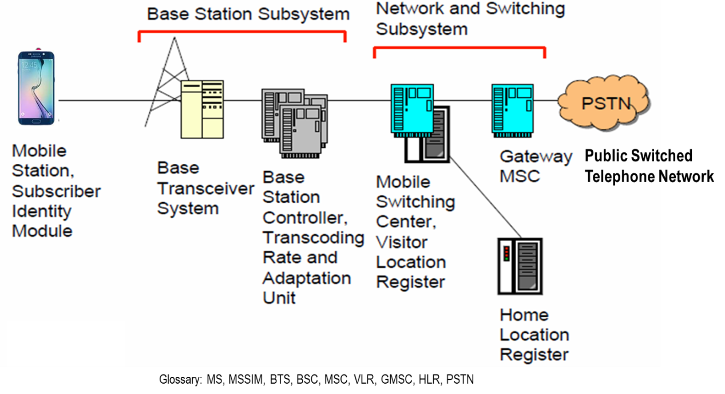
Base Station Management Application Part (BSMAP)
BSMAP supports all Radio Resource Management & Facility Management procedures between the BS and MSC
BSMAP messages and call control/mobility messages are used to establish a connection for an MS between the BS and perform functions at the BS and MSC.
Some BSMAP procedures are triggered or result in Radio Resource (RR) messages.
BBTSM is the interface between BTS and BCS (Abis interface)
The Call Control (CC) protocol is one of the protocols used at the Connection Management (CM) sub-layer to manage entities, each one using its own Mobility Management (MM) connection.
The MM sub-layer is used to support user mobility between terminals.
Abis

Slide 38

Base Station Subsystem
Base Transceiver System (BTS)
  Controls several transmitters
  Each transmitter has 8 time slots, some used for signaling, on a specific frequency
Base Station Controller (BSC)
  Controls the channel (time slot) allocation implemented by the BTS’s
  Manages the handovers within BSS area
  Knows which mobile stations are within the cell and informs the MSC/VLR
Transcoding Rate and Adaptation Unit (TRAU)
  Performs coding between the 64kbps pulse code modulation (PCM coding used in the backbone network and the 13 kbps coding used for the Mobile Station (MS)

Slide 39
Network and Switching Subsystem
The backbone of a GSM is a telephone network with additional cellular network capabilities
Mobile Switching Center (MSC)
  An typical telephony exchange (ISDN exchange) which supports mobile communications
Visitor Location Register (VLR)
  A database that contains the location of active MS
Gateway Mobile Switching Center (GMSC)
  Links the system to a Public Switched Telephone Network (PSTN) and other operators
Home Location Register (HLR)
  Contain subscriber information, including authentication information in Authentication Center (AuC)
Equipment Identity Register (EIR)
  International Mobile Station Equipment Identity (IMEI) codes for e.g., blacklisting stolen phones

Slide 40
Home Location Register
One database per operator
Contains all the permanent subscriber information
  MSISDN (Mobile Subscriber ISDN number = the telephone number of the subscriber)
  IMSI, the International Mobile Subscriber Identity: a 15 digit code used to identify the subscriber
    It incorporates a country code and operator code
  IMSI code is used to link the MSISDN number to the subscriber’s SIM (Subscriber Identity Module)
  Charging information
  Services available to the customer
Also the subscriber’s present Location Area Code, which refers to the MSC, which can connect to the MS.

Slide 41
Location Updates
The cells overlap and a mobile station can ‘see’ several BTS’s
The MS monitors the identifier of the BS Controller (BSC) that controls the cells
When the MS reaches a new BSC’s area, it requests a location update
The update is forwarded to the Mobile Switching Center (MSC), entered into the Visitor Location Register (VLR)
The old BSC is notified and an acknowledgement is passed back

Slide 42
Handoff (Handover)
When a call is in process, the changes in location need special processing
Within a BSS, the BSC, which knows the current radio link configuration (including feedbacks from the MS), prepares an available channel in the new BTS
The MS is told to switch over to the new BTS
This is called a hard handoff
In a soft handoff, the MS is connected to two BTS’s simultaneously

Slide 43
Roaming
When a MS enters another operators network, it can be allowed to use the services of this operator
There are operator-to-operator agreements and contracts
The MS is identified by the information in the SIM card and the identification request is forwarded to the home operator
The Home Location Register (HLR) is updated to reflect the MS’s current location

Slide 44
Glossary
ITU: International Telecommunication Union
IMT-2000: International Mobile Telecommunications 2000, an ITU initiative aimed at harmonizing the various efforts under way to create 3G networks
CDMA2000: an implementation of wideband CDMA backed by USA for 3G
WCDMA, Wide-band CDMA: a 3G network type supported by EU and Japan; also known as UMTS (universal mobile telecommunications service)
CDMA2000 and WCDMA share basic CDMA technology.
SMS: short message service, a means of conveying messages up to 160 characters long to and from GSM cell phones

Slide 45
Mobile business (M-business)
E-business using wireless devices with internet access
New possibilities for commerce beyond internet access
Enormous potential in many areas (B2C, B2B)
Currently B2C wireless apps are more rapidly emerging

Slide 46
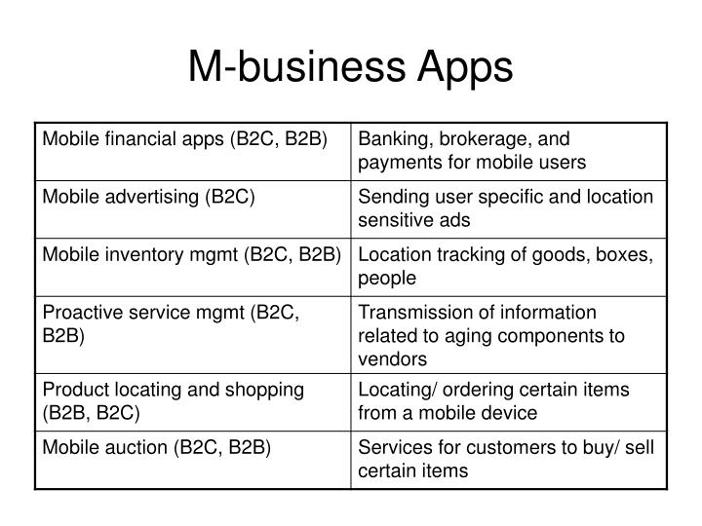
M-business Applications

Slide 47
Location-aware Apps
Vehicle tracking
  Automatic vehicle location (AVL)
  Rapidly dispatching taxis, ambulances, police vehicles, trucks
  Navigating optimal routing in unfamiliar geographical areas or heavy traffic
  Tracking cargo, delivery, baggage, giving customers more accurate info

Slide 48
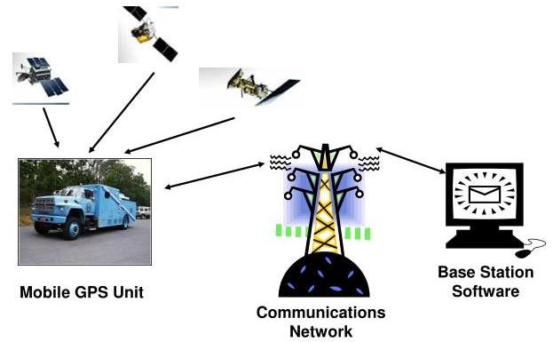
Automatic Vehicle Location

Slide 49
Shopping, product location, etc
Provide ads for shoppers, promotional events, price alerts at a shopping mall
Locate and compare products using a DB containing info on products, locations of stores, and distance from the users’ current location
  Allowing shoppers to buy on-line using a mobile device
Mobile retailing, ticketing and reservation

Slide 50
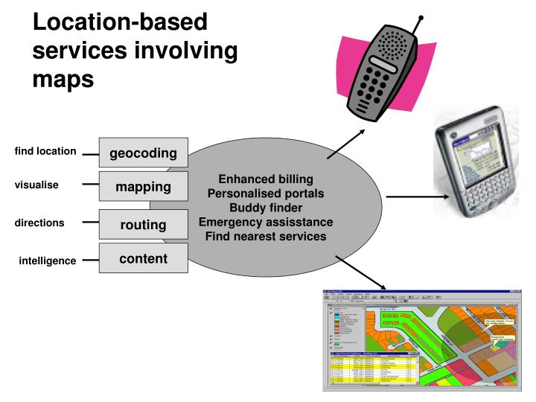

Slide 51
Location-aware Applications
E-911 (Enhanced 911)
  Mandates wireless carriers to provide location-identification capabilities that enable rescuers to locate 911 callers
  Designed to improve emergency response time
  Interest increased after 9/11, earthquakes, etc.
  Can be used for rescuing people in a disaster area
Firemen, emergency crew, doctors, patients assistance
  Firemen in a building under fire (automatic warning signal for oxygen remaining)
  Sending doctors vital signs of patients in critical situations
  Patients with Alzheimer’s: exact location, the location of the nearest police station and contact information for family members

Slide 52
Telematics (or Telemetry)
Integration of
  Wireless communications
  Vehicle monitoring systems and location devices
Diverse apps for cars
  Remote vehicle diagnostics
    Install GSM chip sets in cars to monitor performance and provide an early warning message to the manufacturer indicating what problem is occurring
  Emergency breakdown service
  Multimedia services and m-commerce on the dashboard

Slide 53
Bluetooth
Wireless technology for short-range, high-speed voice and data communication between a variety of mobile digital devices
Conceived by Ericsson in 1994
  Open specification to encourage cross-platform capabilities for wireless devices
Bluetooth Characteristics
  Uses radio frequency band (2.4 GHz) available worldwide, for global compatibility
  Lower power (1 milliwatt) making it suitable for small, battery-operated devices
  Data transfer capability between devices: 10–100 meter range, bandwidth 1-2 Mbps
  Supports up to 8 devices in a network
  Built-in security (encryption, authentication)
  Non line-of-sight: penetrating walls and avoiding obstacles

Slide 54
Wireless Fidelity (Wi-Fi)
Increasingly popular networking standard for wireless LANs in homes/offices
  Provides broadband Internet access to PCs and laptops within a few hundred feet of a Wi-Fi base station in hot-spots where people can log onto wireless networks
Technical standard IEEE 802.11 for wireless LAN
  802.11b: popular standard, speed up to 11 Mbps at 2.4GHz band, typically 500k-1Mbps
  802.11a: speed up to 54 Mbps at 5GHz band (less congested, less interference)
  802.11g: up to 54 Mbps at 2.4GHz band (extension of 802.11b)
Some concerns
  Security, interference (micro-wave ovens, garage doors), network slow-down
  Network hopping: can share a connection with other people (free-riders), hard to monitor unauthorized uses
  Cannot maintain a connection outside the range of the hot spot
Can be complementary to 3G-4G wireless
  Seamless roaming between Wi-Fi hot spots and cellular network

Slide 55
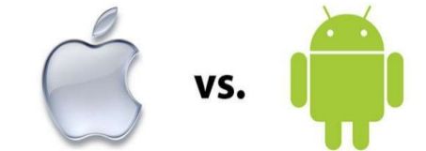
iOS vs Android
iOS: the OS used by Apple devices such as iPhone and iPad
Android: a Linux based OS used by everyone else.

Slide 56
Comparison
 | iOS | Android
Source model | Closed, with open source components. | Open source
OS family | OS X, Unix (Objective-C, Swift code) | Linux (Java)
Customizable | Limited unless jailbroken | Can change almost anything
Open source | Kernel is not open source | Kernel, GUI, standard apps
Security | Most users will never encounter a problem with malware because they don’t go outside the Play Store for apps | Android software patches are available, but manufacturers tend to lag behind in pushing out updates
File transfer | iTunes for media files. Photos (out) via USB | Easier than iOS. USB port and Android File Transfer and USB port for Photos
Multitasking | Stable and exclusive platform: fixed set of tools, clear potential and boundaries | Very versatile and dynamic . Poor battery performance
Internet browsing | Mobile Safary | Google Chrome
Voice commands | Siri | Google Now, Assistant
Rooting, bootloaders, and jailbreaking | Complete control over is not available. | Access and complete control over device is available and bootloader can be unlocked
Stores | Apple store only (unless jailbroken) | Google ply + several others

Slide 57
OS Upgrades
iOS:
  Apple disallows old devices to update →permanently vulnerable to easy attacks
  ~90% run one of the two latest versions
Android OS:
  Millions of phones under contract cannot be updated
  0.4% run the latest version

Slide 58
Security
iOS: | Android
Access control, isolation, web security | Access control, isolation, web security
Encryption | Encryption
Permission-based access control. Dialog box at run time | Permission-based access control. Static list in manifest. User presented with list at installation time
Geolocation, Auto Erase | Geolocation
 | Wild West app marketplace. Nearly any app allowed to market
 | Android-specific malware

Slide 59
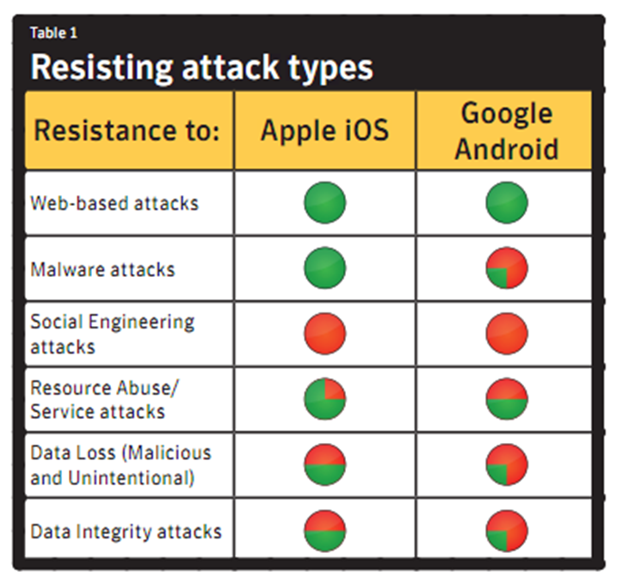
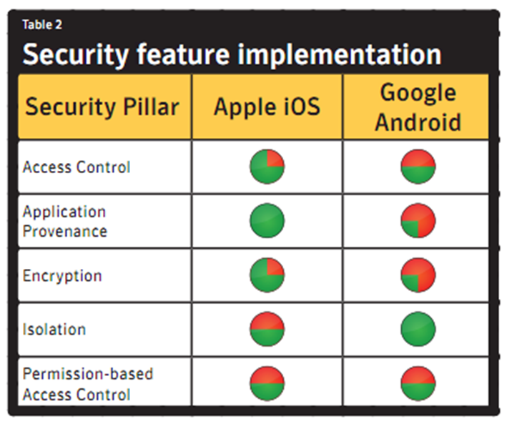
Security

Slide 60
iOS Reported Vulnerabilities
The Common Vulnerabilities and Exposures (CVE) program exposes and catalogue software and firmware vulnerabilities
Symantec Corporation also reports software vulnerabilities.
CVE reported that over 510 iOS vulnerabilities were discovered during 2010-2017 in its various versions.
Most of these vulnerabilities were lower severity.
Symantec reported that the average time taken to patch vulnerabilities was 12 days from the time it was reported.
A few iOS vulnerabilities were more severe and allowed an attacker to take administrator control of cellphones.
Although iOS has had a high number of reported vulnerabilities the DHS reported that <1% of malware attacks targeted iOS devices in 2015.

Slide 61
Some Android vulnerabilities
DoS vulnerability
  Exploited either by an installed malicious app, or a crafted website
Overflow
  Phone is apparently dead, unable to make calls
Memory corruption
  Affects executables even with preotections suchs as ASLR, Stack Guard, SE Linux
XSS
  Adversary steals credentials by injecting malicious code into webpages accessed by the phone

Slide 62
Some Android vulnerabilities
Directory Traversal
  Allows attackers to perpetrate a path traversal attack for accessing read/write files and view restricted files inside internal storage.
Http Response Splitting
  Happens when data penetrates web applications through an entrusted source like an http request. The attacker passes malicious data to a vulnerable application.
Bypass Something
  The attacker can bypass the phone’s lockscreen by entering a long string of random characters into the password file while the camera app is active. This causes the phone to crash (and bypasses the need for a correct password).

Slide 63
Some Android vulnerabilities
Gain Information/Gain Privilege
  Android device fails to perform adequate boundary checks user-supplied data. So that attackers can exploit this vulnerability by executing arbitrary code within the context of the affected device for getting credentials & personal information of the user.
Cross Site Request Forgery (CSRF)
  Web browser applications store cookies which are used to maintain credentials of the user. In this attack, the user is tricked by submitting forged request using the cookies which store credentials associated with the browser applications.
File Inclusion
  File inclusion on the web server at the time of application installation. vulnerability allows an attacker to include precreated file, usually through a script

Slide 64
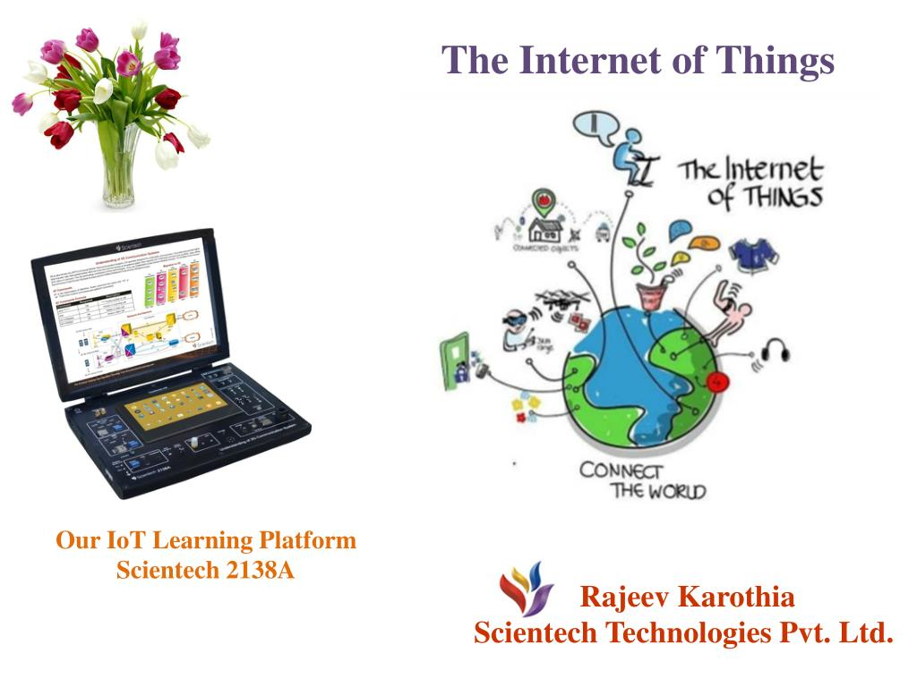
…of Everything !

