Slide 1
Git workflows for IESP

Slide 2
Outline
Relationships of repositories
Global view
Individual developer view
Developer work cycle
Alternate, refereed model
Initial set-up
Handling Web2Py updates
What else?

Slide 3
Keep it simple
Compared to Android workflow

Slide 4
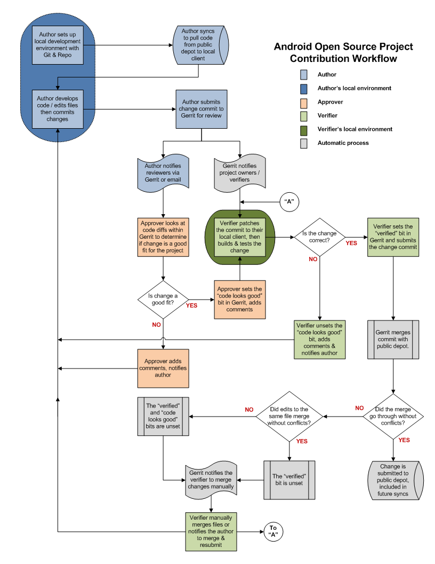
Android Git Workflow
http://source.android.com/submit-patches/workflow

Slide 5
Relationships of repositories
Including repositories for handling Web2Py updates

Slide 6
Web2Py distribution site
/home/git/web2py
/home/git/iesp
web2py
web2py
web2py
iesp
Personal computer
sis.cs.fsu.edu
web2py
/home/www/vhosts/iesp.cs.fsu.edu
web2py
iesp
uncommitted changes
iesp
etc.
etc.
Etc.
iesp.cs.fsu.edu

Slide 7
Individual developer view
Can ignore repositories used to roll in Web2Py updates.

Slide 8
/home/git/iesp
web2py
iesp
Personal computer
sis.cs.fsu.edu
web2py
/home/www/vhosts/iesp.cs.fsu.edu
web2py
iesp
iesp
etc.
etc.
Etc.
iesp.cs.fsu.edu

Slide 9
Normal developer workflow
Requires a bit of trust in one another

Slide 10
/home/git/iesp
web2py
sis.cs.fsu.edu
/home/www/vhosts/iesp.cs.fsu.edu
web2py
etc.
etc.
Etc.
iesp.cs.fsu.edu

Slide 11
git clone ssh://baker@sis.cs.fsu.edu/home/git/iesp
(called from personal computer)
/home/git/iesp
web2py
Personal computer
sis.cs.fsu.edu
web2py
/home/www/vhosts/iesp.cs.fsu.edu
web2py
etc.
etc.
Etc.
iesp.cs.fsu.edu

Slide 12
/home/git/iesp
web2py
Personal computer
sis.cs.fsu.edu
web2py
/home/www/vhosts/iesp.cs.fsu.edu
web2py
iesp
etc.
etc.
Etc.
iesp.cs.fsu.edu
local uncommitted changes

Slide 13
git commit
(called from personal computer)
/home/git/iesp
web2py
Personal computer
sis.cs.fsu.edu
web2py
/home/www/vhosts/iesp.cs.fsu.edu
web2py
iesp
etc.
etc.
Etc.
iesp.cs.fsu.edu

Slide 14
git push
(called from personal computer)
/home/git/iesp
web2py
iesp
iesp
Personal computer
sis.cs.fsu.edu
web2py
/home/www/vhosts/iesp.cs.fsu.edu
web2py
iesp
etc.
etc.
Etc.
iesp.cs.fsu.edu

Slide 15
git pull
(called from iesp.cs.fsu.edu)
/home/git/iesp
web2py
iesp
iesp
Personal computer
sis.cs.fsu.edu
web2py
/home/www/vhosts/iesp.cs.fsu.edu
web2py
iesp
iesp
iesp
iesp
etc.
etc.
Etc.
iesp.cs.fsu.edu

Slide 16
Initial set-up
Already done

Slide 17
Web2Py distribution site
web2py
sis.cs.fsu.edu

Slide 18
Web2Py distribution site
download web2py.zip
/home/git/web2py.zip
web2py
sis.cs.fsu.edu

Slide 19
Web2Py distribution site
unzip web2py.zip
/home/git/web2py
web2py
web2py
sis.cs.fsu.edu

Slide 20
Web2Py distribution site
git clone web2py iesp
/home/git/web2py
/home/git/iesp
web2py
web2py
web2py
“origin” link
sis.cs.fsu.edu

Slide 21
git clone /home/git/iesp iesp.cs.fsu.edu
/home/git/web2py
/home/git/iesp
web2py
web2py
web2py
Web2Py distribution site
sis.cs.fsu.edu
/home/www/vhosts/iesp.cs.fsu.edu
web2py
iesp.cs.fsu.edu

Slide 22
git clone /home/git/iesp iesp.cs.fsu.edu
/home/git/web2py
/home/git/iesp
web2py
web2py
web2py
Web2Py distribution site
sis.cs.fsu.edu
/home/www/vhosts/iesp.cs.fsu.edu
web2py
local uncommitted changes
etc.
etc.
Etc.
iesp.cs.fsu.edu

Slide 23
Web2Py updates
Will need to be done periodically by someone

Slide 24
Web2Py distribution site
/home/git/web2py
/home/git/iesp
web2py
web2py
web2py
sis.cs.fsu.edu
/home/www/vhosts/iesp.cs.fsu.edu
web2py
iesp.cs.fsu.edu

Slide 25
Web2Py distribution site
/home/git/web2py
/home/git/iesp
web2py
web2py
web2py
sis.cs.fsu.edu
new release of Web2Py
/home/www/vhosts/iesp.cs.fsu.edu
web2py
iesp.cs.fsu.edu

Slide 26
Web2Py distribution site
download, unzip, and copy/tar
/home/git/web2py
/home/git/iesp
web2py
web2py
web2py
sis.cs.fsu.edu
uncommitted changeds
/home/www/vhosts/iesp.cs.fsu.edu
web2py
iesp.cs.fsu.edu

Slide 27
Web2Py distribution site
git commit
/home/git/web2py
/home/git/iesp
web2py
web2py
web2py
web2py
sis.cs.fsu.edu
/home/www/vhosts/iesp.cs.fsu.edu
web2py
iesp.cs.fsu.edu

Slide 28
Web2Py distribution site
git pull
/home/git/web2py
/home/git/iesp
web2py
web2py
web2py
web2py
web2py
web2py
sis.cs.fsu.edu
or
git fetch
git rebase
/home/www/vhosts/iesp.cs.fsu.edu
web2py
iesp.cs.fsu.edu

Slide 29
Web2Py distribution site
/home/git/web2py
/home/git/iesp
web2py
web2py
web2py
web2py
web2py
web2py
sis.cs.fsu.edu
git pull
or
git fetch
git rebase
/home/www/vhosts/iesp.cs.fsu.edu
web2py
web2py
iesp.cs.fsu.edu

Slide 30
An alternate developer workflow
Introduces a repository gatekeeper

Slide 31
git clone /home/git/iesp ~/iesrepo
/home/git/iesp
web2py
iesp
web2py
~/iesprepo
iesp
sis.cs.fsu.edu
Developer keeps personal repository on server, readable by other team members.

Slide 32
git clone ssh://baker@sis.cs.fsu.edu/iesrepo
/home/git/iesp
web2py
iesp
web2py
~/iesprepo
iesp
Personal computer
sis.cs.fsu.edu
web2py
iesp

Slide 33
git commit
/home/git/iesp
web2py
iesp
web2py
~/iesprepo
iesp
Personal computer
sis.cs.fsu.edu
web2py
iesp
local changes

Slide 34
git push
(from personal computer)
/home/git/iesp
web2py
iesp
web2py
~/iesprepo
iesp
Personal computer
sis.cs.fsu.edu
web2py
iesp

Slide 35
git pull from developer’s repository
(by gatekeeper)
/home/git/iesp
web2py
iesp
web2py
~/iesprepo
iesp
Personal computer
~gatekeeper/iesp
web2py
web2py
iesp
iesp
iesp
sis.cs.fsu.edu

Slide 36
git push to /home/git/iesp
(by gatekeeper)
/home/git/iesp
web2py
iesp
iesp
web2py
~/iesprepo
iesp
Personal computer
~gatekeeper/iesp
web2py
web2py
iesp
iesp
iesp
sis.cs.fsu.edu

Slide 37
Are there use cases have we missed?

