Slide 1
Git : Part 2 Checkout, Add, Commit
These slides were largely cut-and-pasted from http://excess.org/article/2008/07/ogre-git-tutorial/ , with some additions from other sources. I have deleted a lot from the cited tutorial, and recommend that you listen to the entire tutorial on line, if you can.

Slide 2
Topics
Review
Creating an empty repository
Adding file changes to it
Committing the changes
Git naming conventions for commits
Git commands for getting information about a repository

Slide 3
Review
Core git concepts

Slide 4
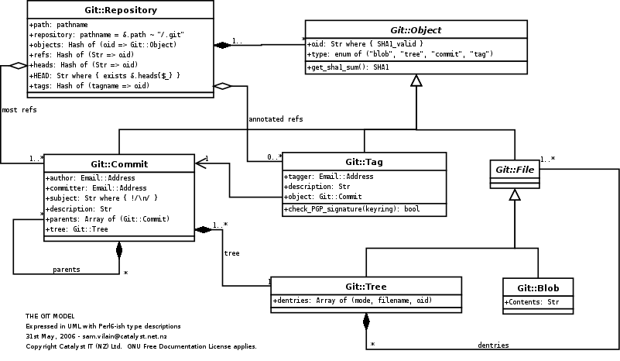
Git object model
http://utsl.gen.nz/talks/git-svn/git-model.png
Notes:
The component clases of the Git object model, as a UML class diagram.

Slide 5
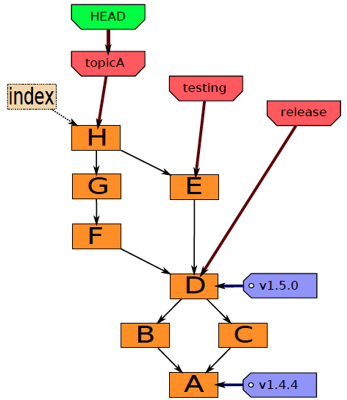
Git components
Index
“staging area”
what is to be committed
http://edgyu.excess.org/git-tutorial/2008-07-09/intro-to-git.pdf

Slide 6
Local Operations
Repository (.git directory)
Index (staging area)
Working directory
checkout the project
add (stage) files
commit

Slide 7
Git transport commands
http://osteele.com/images/2008/git-transport.png

Slide 8
Git init, add, commit
Using basic local operations to work on a single branch.

Slide 9
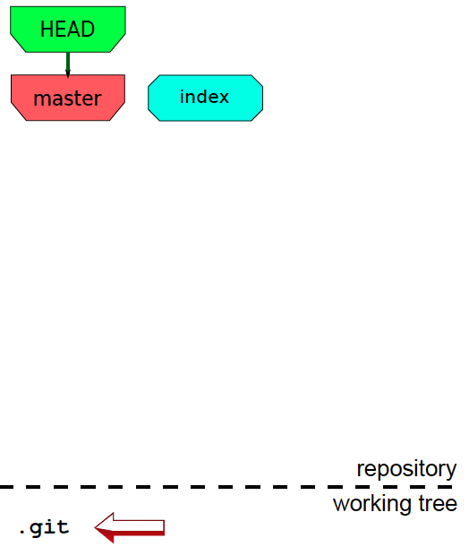
Bootstrap
mkdir project
cd project
git init
http://edgyu.excess.org/git-tutorial/2008-07-09/intro-to-git.pdf

Slide 10
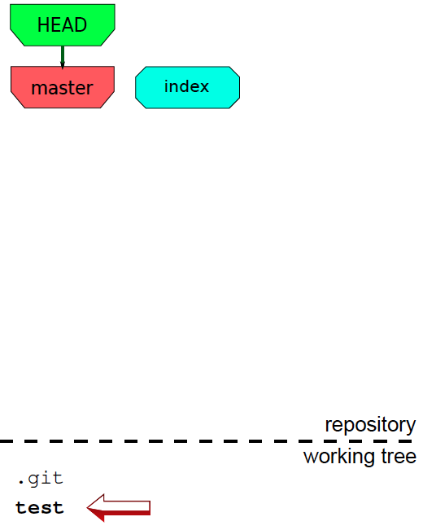
Work
touch test
http://edgyu.excess.org/git-tutorial/2008-07-09/intro-to-git.pdf
Notes:
As you work you modify, create, and delete files.

Slide 11
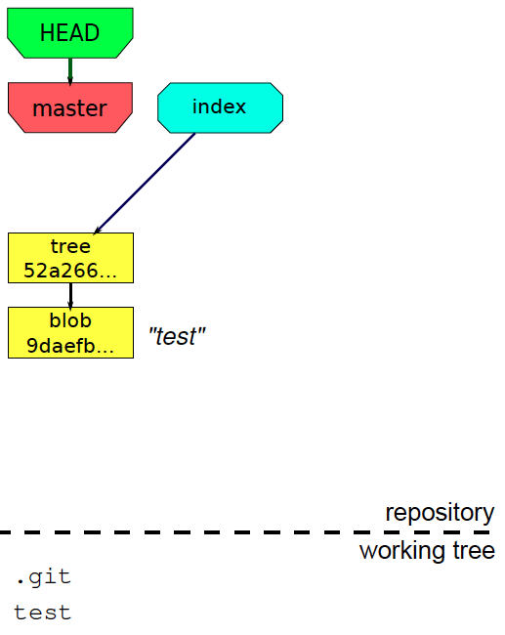
Stage
touch test
git add test
http://edgyu.excess.org/git-tutorial/2008-07-09/intro-to-git.pdf

Slide 12
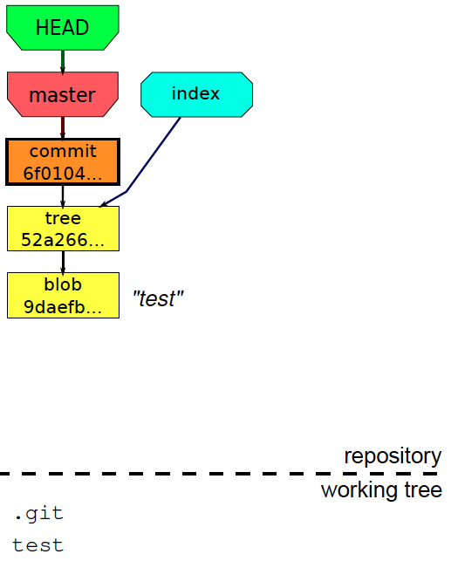
Commit
touch test
git add test
git commit –m”test”
http://edgyu.excess.org/git-tutorial/2008-07-09/intro-to-git.pdf

Slide 13
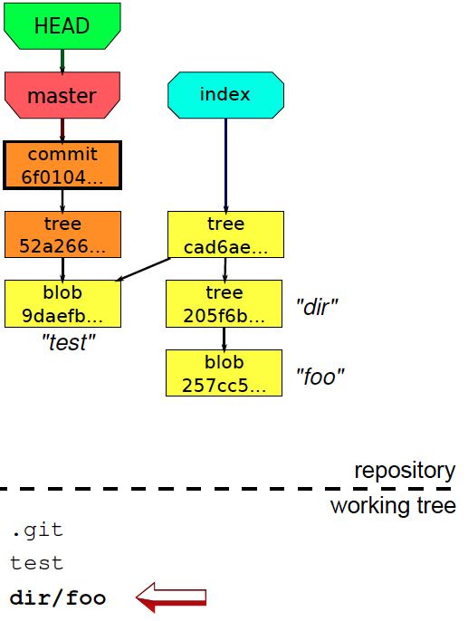
Work & Stage
touch test
git add test
git commit –m”test”
mkdir dir
echo “foo” > dir/foo
git add dir/foo
http://edgyu.excess.org/git-tutorial/2008-07-09/intro-to-git.pdf

Slide 14
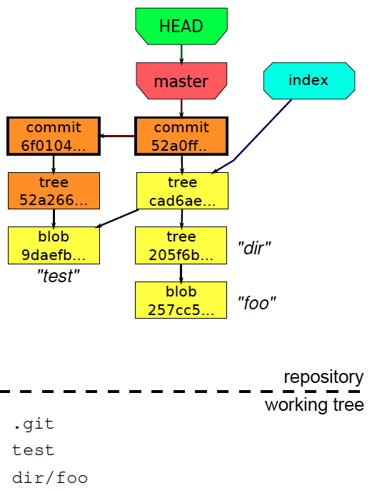
Commit again
touch test
git add test
git commit –m”test”
mkdir dir
echo “foo” > dir/foo
git add dir/foo
git commit –m”foo”
http://edgyu.excess.org/git-tutorial/2008-07-09/intro-to-git.pdf

Slide 15
Naming
How to refer to a commit

Slide 16
A commit can be identified by
full hash
short hash
tag
local branch
remote branch
message
checkout
last fetch
previous head
…
6bb1270ffb60cbfef87266d2d4b44abe4218d9c68
6bb127
V1.5.6.1
master
origin/master
“:/some text:
HEAD
FETCH_HEAD
ORIG_HEAD

Slide 17
Other naming methods
HEAD^, HEAD^^, …
MASTER^, MASTER^^, …
HEAD~1, HEAD~2, …
@{yesterday}, or HEAD@{yesterday}
branchname@{June.1}
master@{3}
HEAD
B
A
HEAD^

Slide 18
Getting information
See the state of your repository, and review the history.

Slide 19
git status
Shows what is
Staged
Unstaged
Untracked

Slide 20
git diff
git diff
index vs. working files
git diff –staged
HEAD vs. index
git diff HEAD
HEAD vs. working files
git diff <commit1> <commit2>

Slide 21
git show
git show
summarizes the last commit
git show –stat
shows just the statistics
git show –name-status
shows status
Can apply to any commit
git show HEAD
git show master^^
…
Or to a file
git show HEAD:file

Slide 22
git log
Shows history of changes
Can apply to any single commit or range
git log
git log tag..branch
git log HEAD~10..
git log ~10
Or attributes of commits, etc. etc.
git log --since=“May 1” –until=“June 1”
git log --author=fred
git log --grep-”commit.*message.*text”
…

Slide 23
git grep
git grep –e “pattern” -- some/file
git grep –e “pattern” branch -- some/file

Slide 24
Viewing references
Named
Refer to commits
Can be moved
3 basic types:
Tags
Local branches
Remote branches

Slide 25
Tags
To list tags: git tag –l
web2py1.74.11
web2py1.74.9
web2py1.75.2
Or look at the files in .git/refs/tags/

Slide 26
Local branches
To list them: git branch –l
branch1
branch2
* master
Or look at files in .git/refs/heads/

Slide 27
Remote branches
To see them: git branch –r
origin/HEAD -> origin/master
origin/master
origin/update
Or look at files in .git/refs/remotes/

