Slide 1
Git
Preliminary version – to be updated some day, I hope.
Slides constructed from http://excess.org/article/2008/07/ogre-git-tutorial/ , Dr Sara Stoecklin’s notes in SCM, and other sources.

Slide 2
Git
A collection of tools developed by Linux kernel group for SCM
Now used by several other groups, and apparently growing in popularity
Actually implements a replicated versioned file system
Can be used to implement a variety of software configuration management models and workflows

Slide 3
Git Flavor
A collection of many tools
Evolved from scripts
Suited to a C programmer’s mentality
Everything is exposed and accessible
Need to understand the underlying model
Very flexible
You can do anything the model permits
Including shooting yourself in the foot

Slide 4
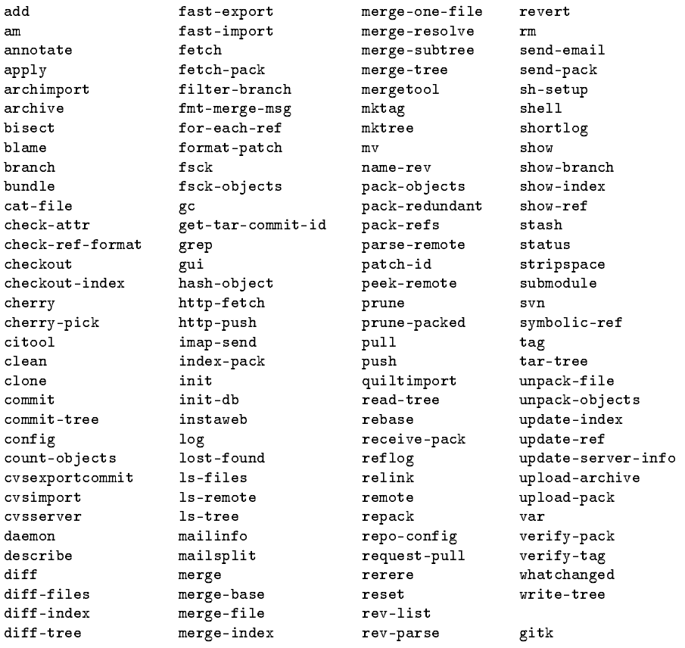
Git has a lot of commands

Slide 5
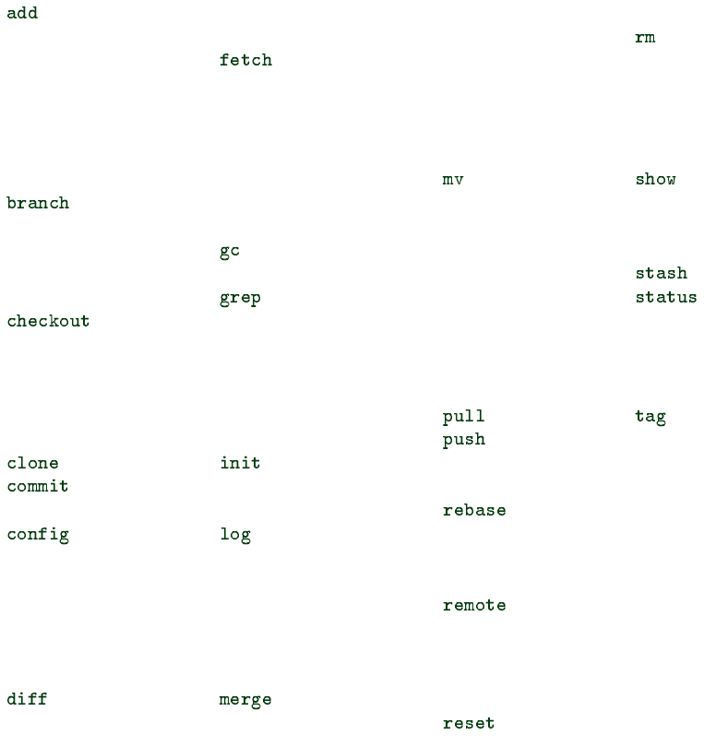
but you can get by with a subset for everyday use

Slide 6
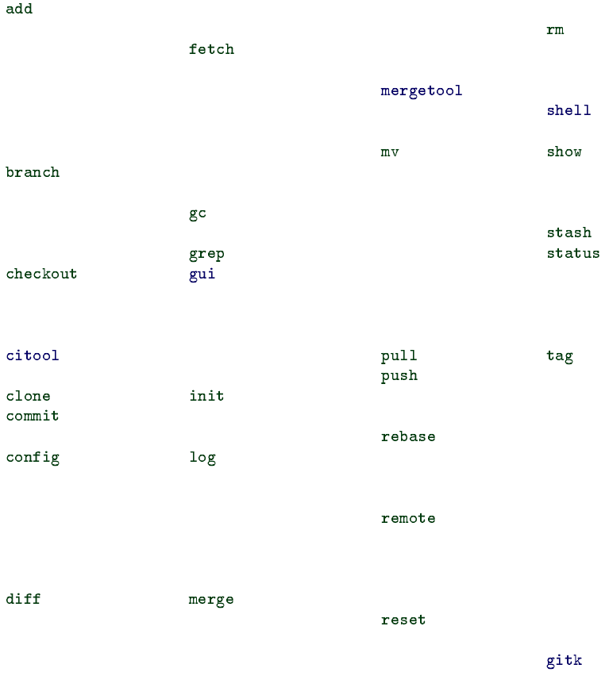
and maybe a few more gui tools
gitk
mergetool
gui
citool
shell

Slide 7
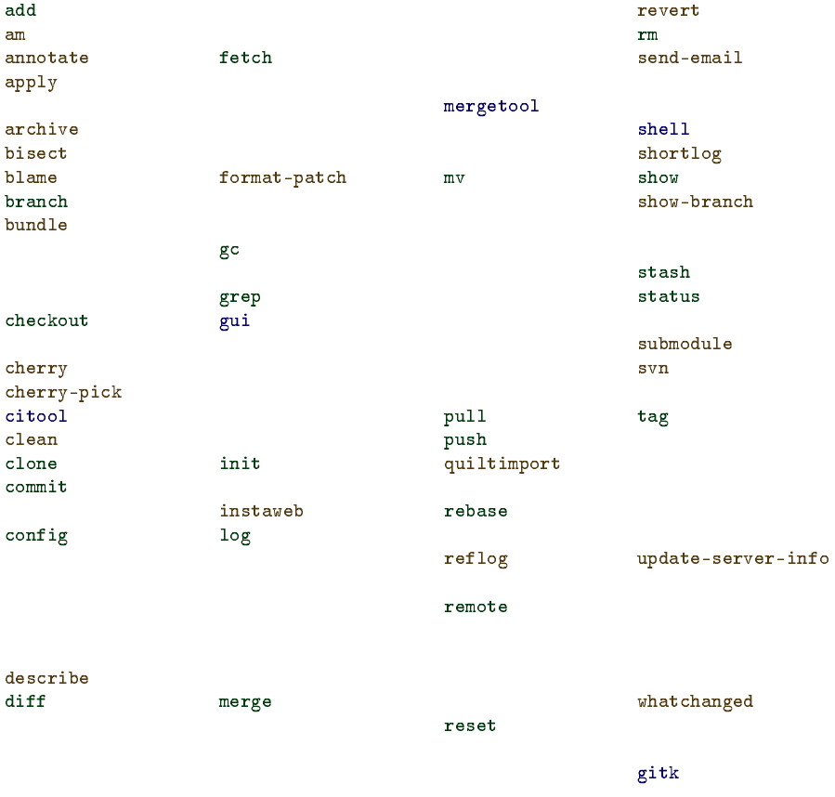
or maybe a few more occasionally

Slide 8
Groups of Git operations
Setup and branch-switching
init, checkout, switch branch
Modification
add, delete, rename, commit
Getting information
status, diff, log
Create reference points
tag, branch

Slide 9
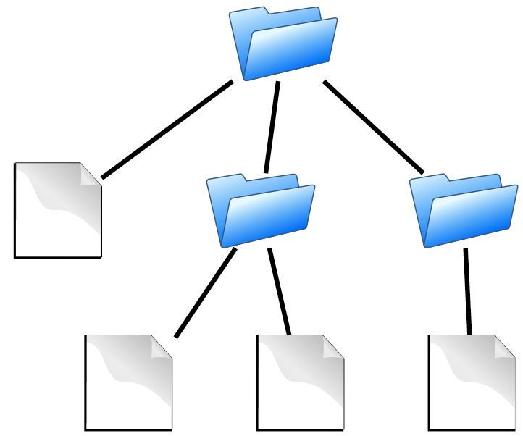
Source code
contains
Directories
Files
is the substance of a software configuration

Slide 10
Repository
Contains
files
commits
records history of changes to configuration

Slide 11
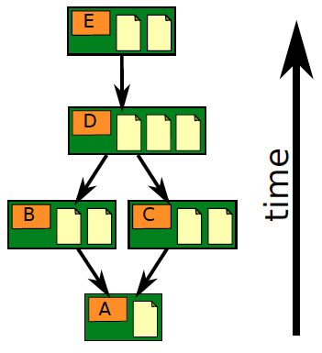
Repository
Contains
files
commits
ancestry relationships

Slide 12
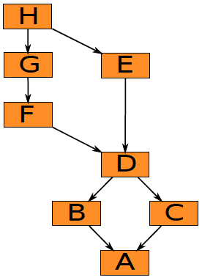
Ancestry relationships
form a directed acyclic graph (DAG)

Slide 13
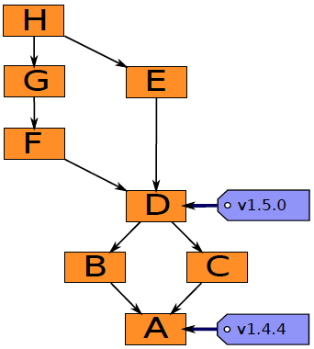
Ancestry graph features
Tags
identify versions of interest
including “releases”

Slide 14
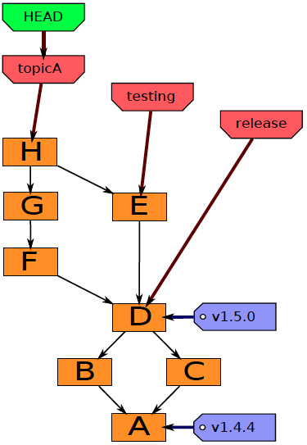
Ancestry graph features
HEAD
is current checkout
usually points to a branch

Slide 15
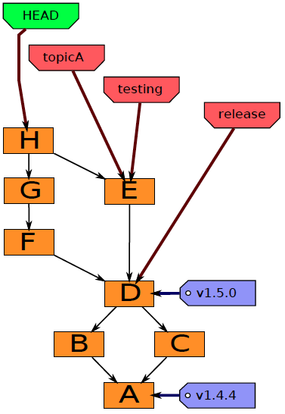
Head may point to any commit
In this case it is said to be detached.

Slide 16
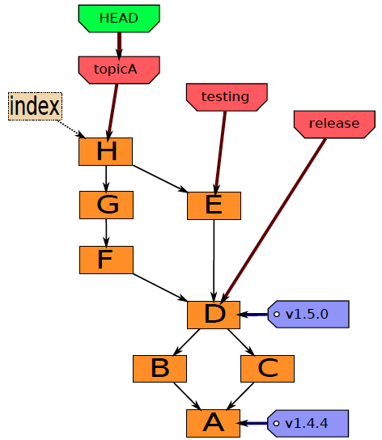
Git components
Index
“staging area”
what is to be committed

Slide 17
Working directory, Index, and Repository
Three top-level abstractions

Slide 18
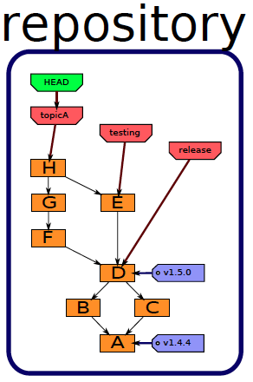
History

Slide 19
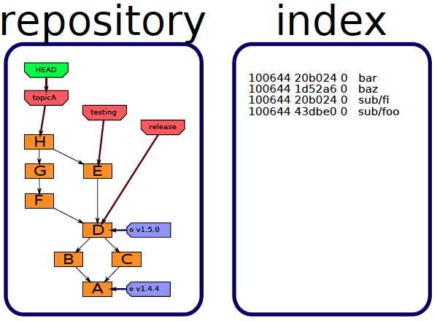
Staging area

Slide 20
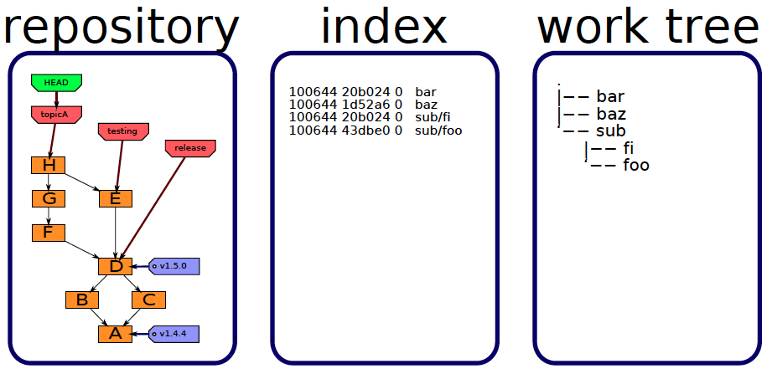
Files you edit

Slide 21
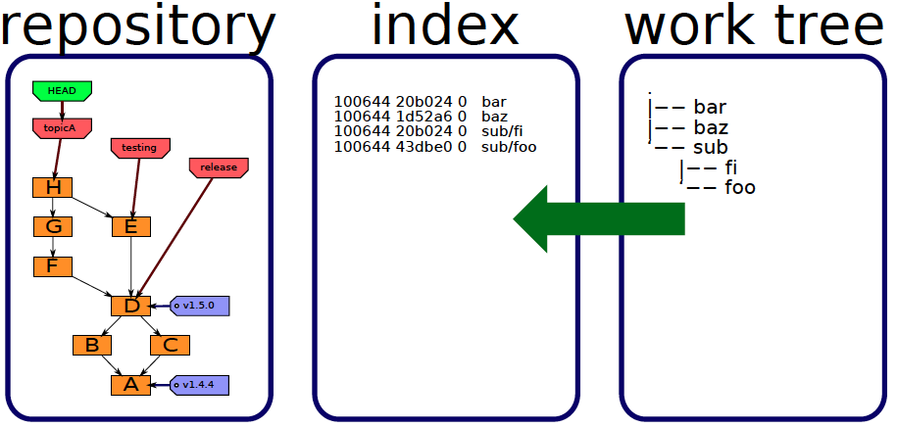
Staging
add
add, remove, rename

Slide 22
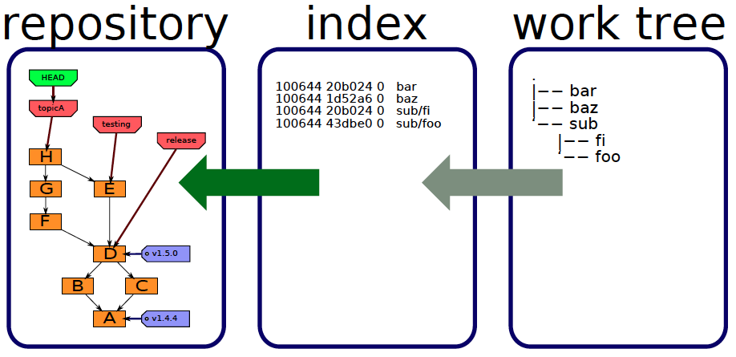
Committing
commit
commit

Slide 23
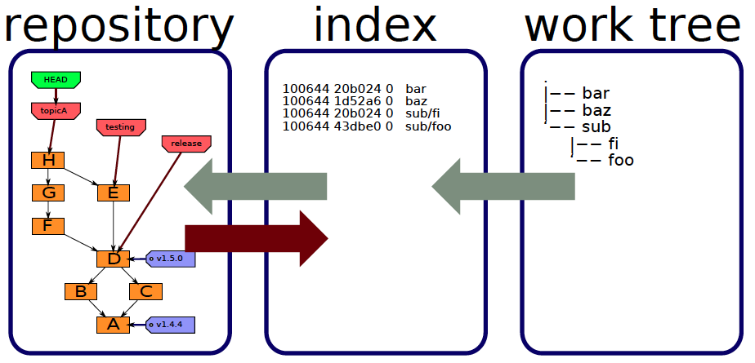
Reading tree
checkout
checkout, read-tree, reset

Slide 24
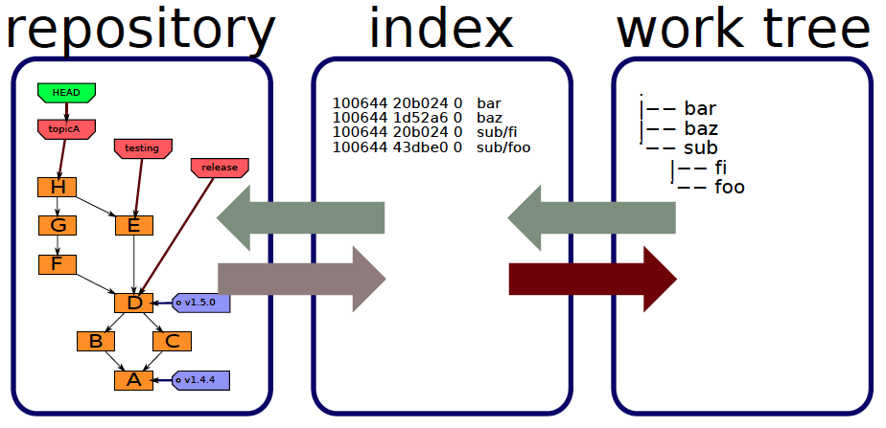
Checking out
checkout
checkout, checkout-index, reset

Slide 25
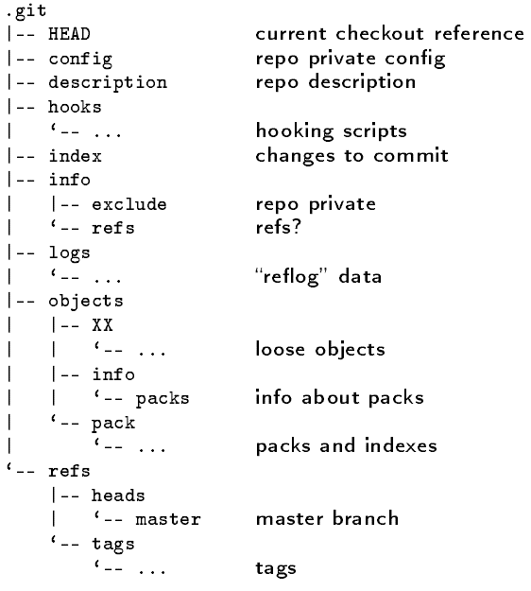
The repository
Notes:
The repository is stored in the subdirectory .git of the working directory.

Slide 26
Repository files
.git/config
.git/description – used by gitweb
.git/info/exclude – files to ignore

Slide 27
.git/objects
|-- 23
| ‘-- d4bd826aba9e29aaace9411cc175b784edc399
|-- 76
| ‘-- 49f82d40a98b1ba59057798e47aab2a99a11d3
|-- c4
| ‘-- aaefaa8a48ad4ad379dc1002b78f1a3e4ceabc
|-- e7
| ‘-- 4be61128eef713459ca4e32398d689fe80864e
|-- info
| ‘-- packs
‘-- pack
|-- pack-b7b026b1a0b0f193db9dea0b0d7367d25d3a68cc.idx
‘-- pack-b7b026b1a0b0f193db9dea0b0d7367d25d3a68cc.pack
loose

Slide 28
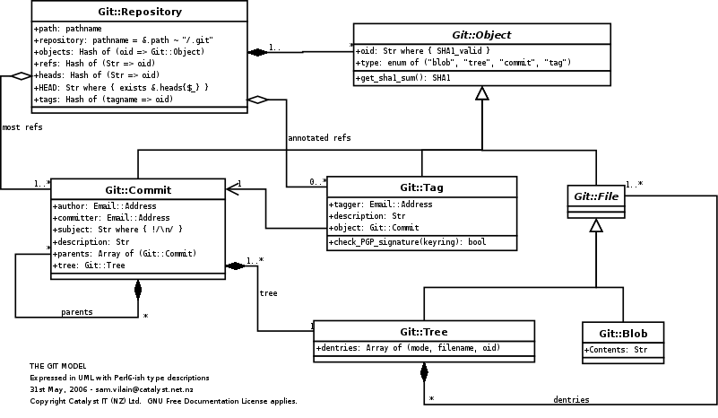
Git object model
Notes:
The component clases of the Git object model, as a UML class diagram.

Slide 29
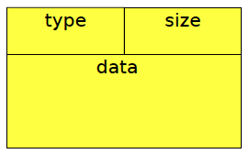
Repository object naming convention
“content addressable” (hashed)

Slide 30
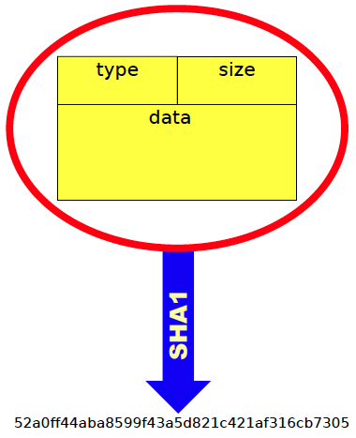
Data values determine hash

Slide 31
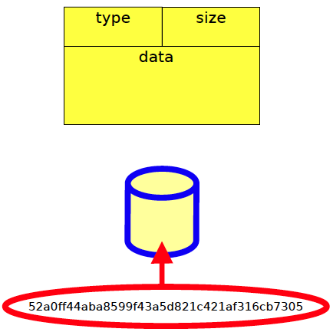
Hash value is filename

Slide 32
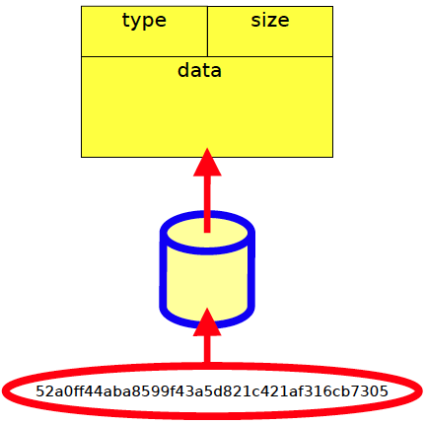
File contains data

Slide 33
Object types
Blobs
Trees
Commits
Tags

Slide 34
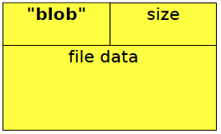
Blobs

Slide 35
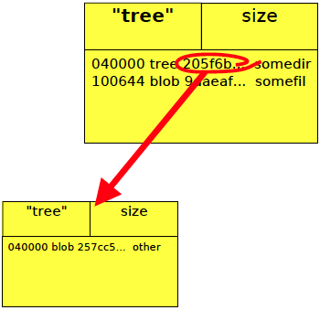
Trees

Slide 36
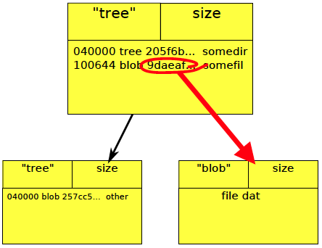
Trees

Slide 37
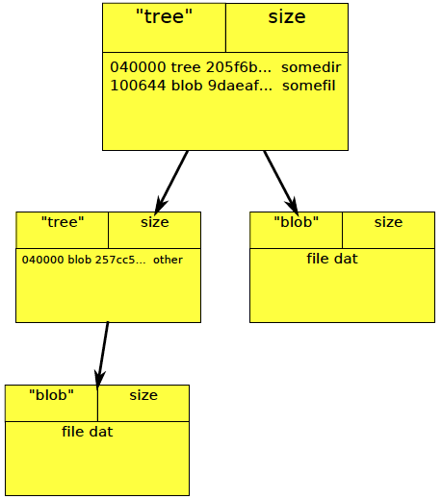
Trees

Slide 38
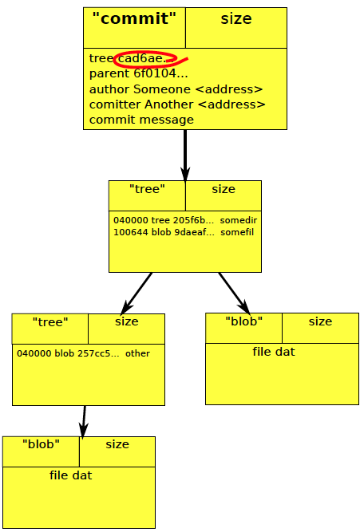
Commits

Slide 39
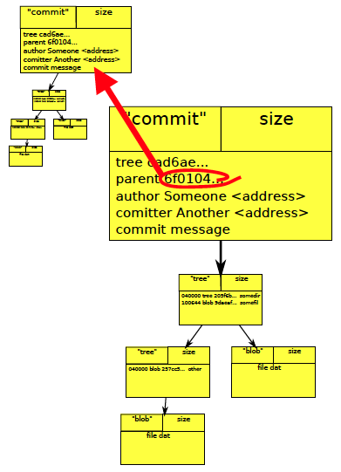
Commits

Slide 40
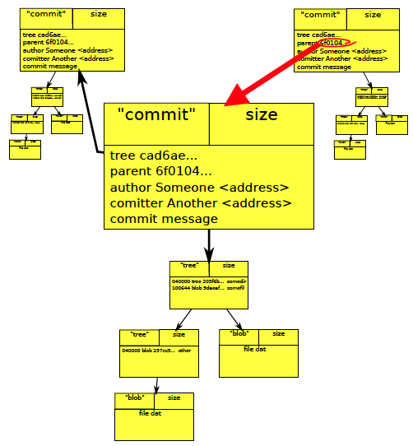
Commits

Slide 41
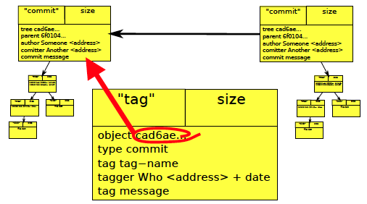
Commits

Slide 42
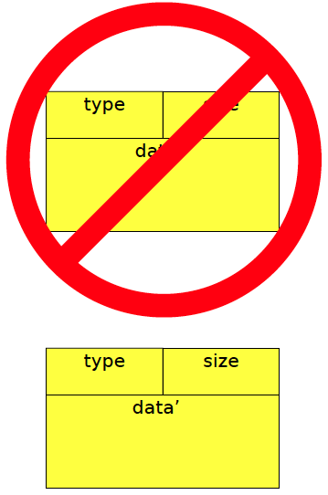
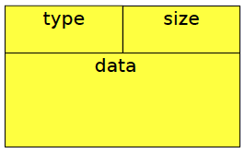
Objects are immutable

Slide 43
Basic command format
git <options> <command> <options>

Slide 44
Online help
list of common commands
git help
Brief per-command help
git command –h
man pages
man git-<command>
git help <command>
git <command> --help

Slide 45
Configuration
$HOME/.gitconfig
git config –global user.name “Ted Baker”
git config –global user.email baker@cs.fsu.edu
git config –global color.pager true
git config –global cour.ui auto

Slide 46
A typical developer story
Showing how various commands are used, in context.

Slide 47
Working on branches
Start with some tree
git checkout –b bug-fix
git commit –a –m”B”

Slide 48
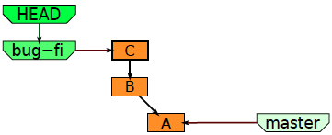
Continue making changes
git commit –a –m”C” –b

Slide 49
Decide to try out a “wicked” alternate idea.
git checkout –b wicked master

Slide 50
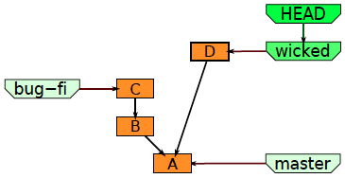
Do some work on this alternate branch.
git commit –a –m”D”

Slide 51
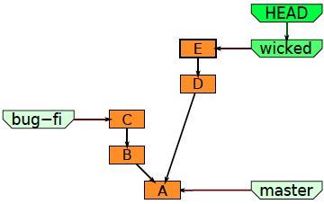
And some more work.
git commit –a –m”E”

Slide 52
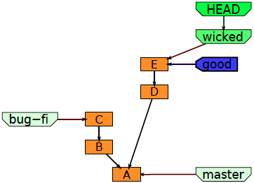
You have gotten to a good point.
git tag –a –m”got somewhere” good

Slide 53
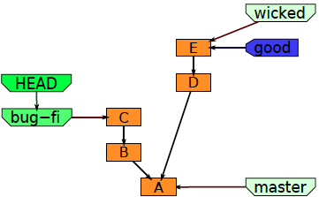
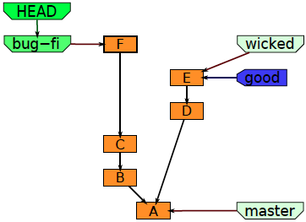
Manager asks about the bug
git checkout bug-fix
git commit –a –m “F”
So you go back to work on it some more

Slide 54
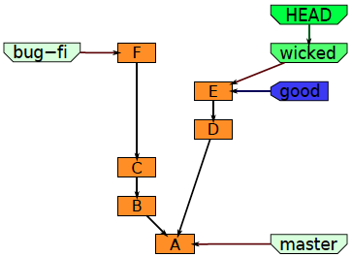
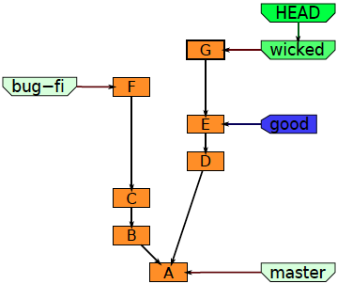
But your mind is elsewhere
git checkout wicked
so you finish off the wicked feature
git commit –a –m”G”

Slide 55
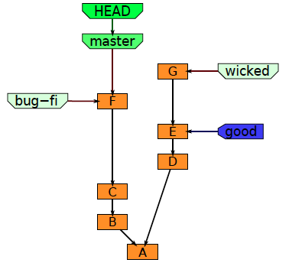
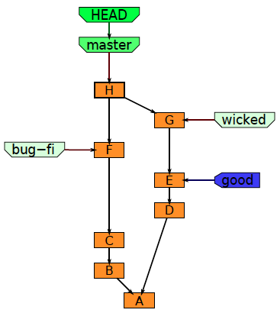
Then merge in the new feature.
git merge wicked

Slide 56
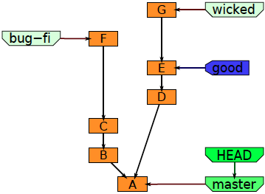
First advance the the master to include the bug fix.
git reset --hard bug-fix

Slide 57
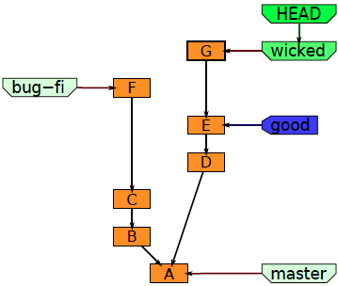
Bug fix and wicked new feature are both done, so it’s time to merge.
git checkout master

Slide 58
Another story
This set of slides has not yet been completely transcribed from the original web tutorial.

Slide 59
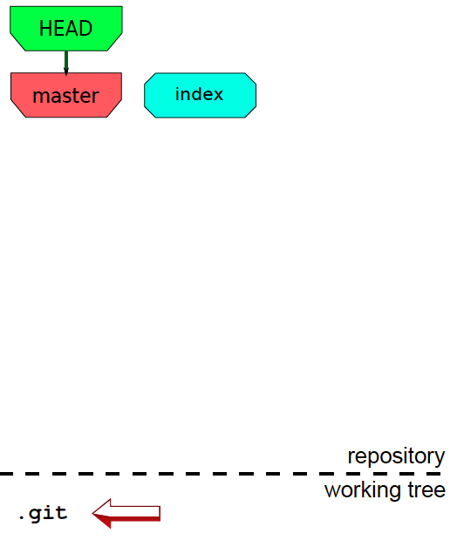

Slide 60
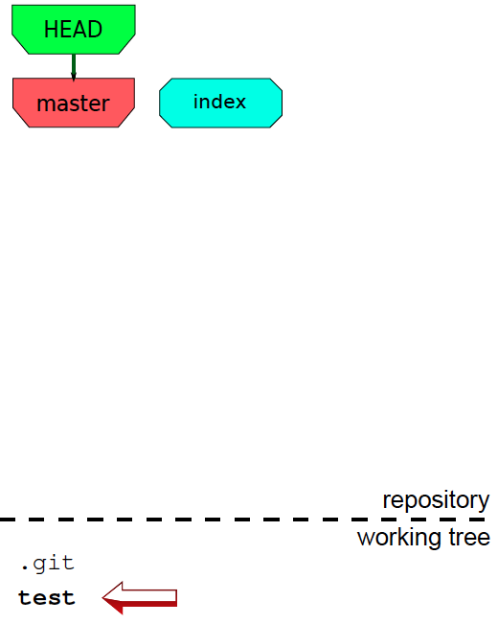

Slide 61
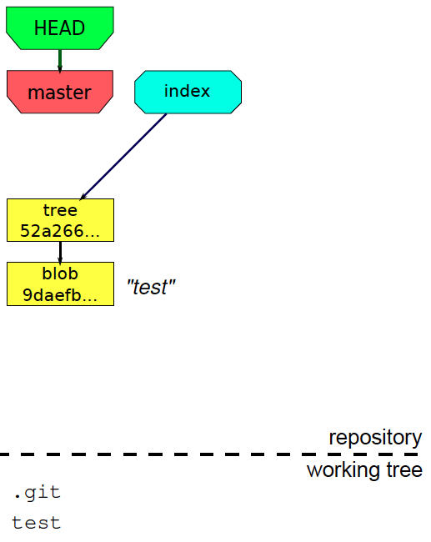

Slide 62
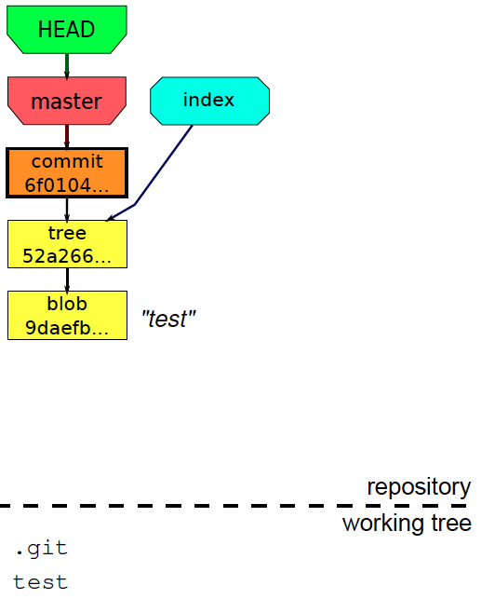

Slide 71
Nice diagrams
Some helpful diagrams collected from the Web.

Slide 74
Git transport commands

Slide 75
A Git workflow

