Slide 1
Software Configuration Management
Slides derived from Dr. Sara Stoecklin’s notes and various web sources.

Slide 2
What is SCM?

Slide 3
SCM goals
Manage the changes to documents, programs, files, etc.
Track history
Identify person responsible for each change, and reasons
Recover (roll back to) previous versions as necessary
Maintain sets of compatible versions of files (configurations)

Slide 4
Several related concepts & terms
Source code vs. configuration management
both called SCM
Revision control ≈ version control
Web content management
Work flows

Slide 5
Definition according to Wiki
Configuration management is the management of features and assurances through control of changes made to hardware, software, firmware, documentation, test, test fixtures and test documentation of an system, throughout the development and operational life of a system.
Source Code Management or revision control is part of this.

Slide 6
Definition According to Dennis
Configuration and change management is the tracking of the state of the artifacts (hardware, software, firmware, documentation, test, test fixtures and test documentation of an system) throughout the development of a system.

Slide 7
Configuration Management Defined
The management and control of all any changes made to any and all features of the software development activity. This includes hardware, software, documentation, and firmware.
Configuration management can be done with a tool. These tools range in price from $0 to $400,000. It depends on how many features you wish to manage and how well you want to manage them.

Slide 8
Why do we care?
Remember Apollo 13.
If a change needs to be made to ANY artifact then when you put them all together again you had better make it right. Suppose you have a programming error and need to change it, recompile and use that software.
What version of the hardware did you use for the original? What version of the OS, DB, compiler? What version of the file management software? All that should be the same to recompile. So we must manage.

Slide 9
Why do we care?
Suppose we change requirements and get a new use case diagram. Do other things have to change? Will we have more actors, attributes, screen?. So even when the documentation of the system changes as it evolves, we must track that, too.

Slide 10
What are the artifacts?
Hardware – ANY hardware that is used by the system.
Software – system software (OS, DB, Compiler, etc), supporting software (sorters, mergers, utilities), application software (you wrote or you use).
Firmware – ANY firmware used by the system.
Documentation – deliverables for development, documentation maintained for the operation of the system, etc.

Slide 11
Configuration Management Includes
Change management - of changes to the specifications of a potential software system
Documentation management –of all documentation including defects, specification, testing, purchasing, emails, memos, agendas…every single documentation detail
Hardware/firmware configuration management - of all the hardware and firmware.
Source code management –of changes to the source code including the application code, operating system, compilers, utilities, database management system, communication system, middleware, etc.

Slide 12
Configuration Management Standards
e.g.
IEEE Std. 828-1998 IEEE Standard for Software Configuration Management Plans
ANSI/EIA-649-1998 National Consensus Standard for Configuration Management
MIL-STD-973 Military Standard for Configuration Management[1] (cancelled, but still good reference)
GEIA Standard 836-2002 Configuration Management Data Exchange and Interoperability

Slide 13
Source Code Management
One of the important parts of configuration management
For any development project you need to have a SCM plan
SCM is closely connected with team workflow
Workflow defines how SCM is done
How tools are used

Slide 14
Complicating factors for SCM
Multiple versions
Multiple branches (e.g., development, bug fix, old releases)
Multiple authors
Concurrent activities
Geographical distribution
Disk crashes, human errors

Slide 15
SCM Model Differences
Centralized vs. Distributed
Pushed vs. pulled updates
Handling of concurrent updates
Atomic commit operations (transactions)
File locking
Version merging

Slide 16
There are many SCM tools
RCS
CVS
Subversion (svn)
Git
Mercurial (hg)
Bazaar (bzr)
… many more

Slide 17
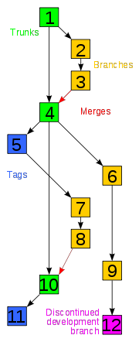
Key terms and concepts
File vs. configuration
Version/revision numbers
Timestamps
Releases
Repository
Working copy, or sandbox
Baseline/trunk/mainline/master
Branches/forks
Change list or patch

Slide 18
More terms and concepts
“Checkout” has multiple meanings
Get local working copy (or make it visible?)
Locked, or not?
Configuration versus file
Export/import
Commit
Conflict (superficial, or deep)
Merge
Tags

Slide 19
Centralized vs. distributed SCM models

Slide 20
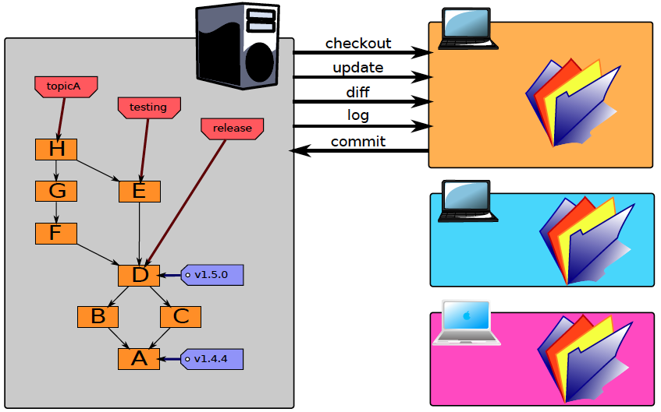
Centralized SCM
Operations require server
single point of failure
bottleneck
http://edgyu.excess.org/git-tutorial/2008-07-09/intro-to-git.pdf

Slide 21
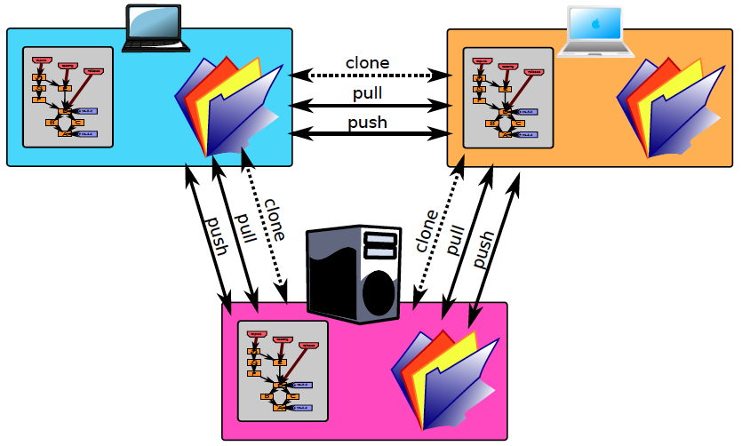
Decentralized SCM
Anyone can be a server
http://edgyu.excess.org/git-tutorial/2008-07-09/intro-to-git.pdf

Slide 22
How decentralized SCM works.

Slide 23
Start with a global repository

Slide 24
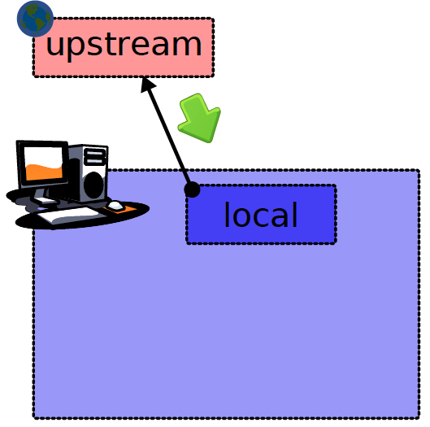
Clone it

Slide 25
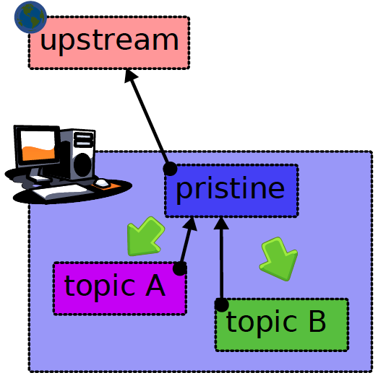
Can make cheap local clones via links
http://edgyu.excess.org/git-tutorial/2008-07-09/intro-to-git.pdf

Slide 26
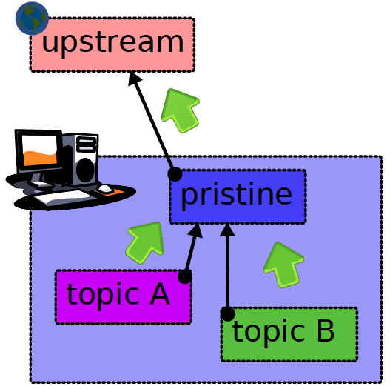
Changes can be pushed back upstream
http://edgyu.excess.org/git-tutorial/2008-07-09/intro-to-git.pdf

Slide 27
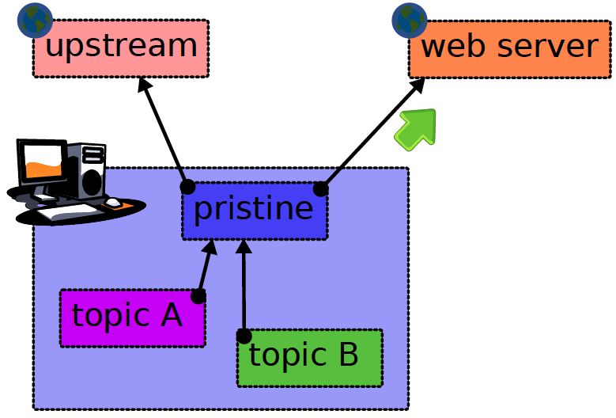
published to web
http://edgyu.excess.org/git-tutorial/2008-07-09/intro-to-git.pdf

Slide 28
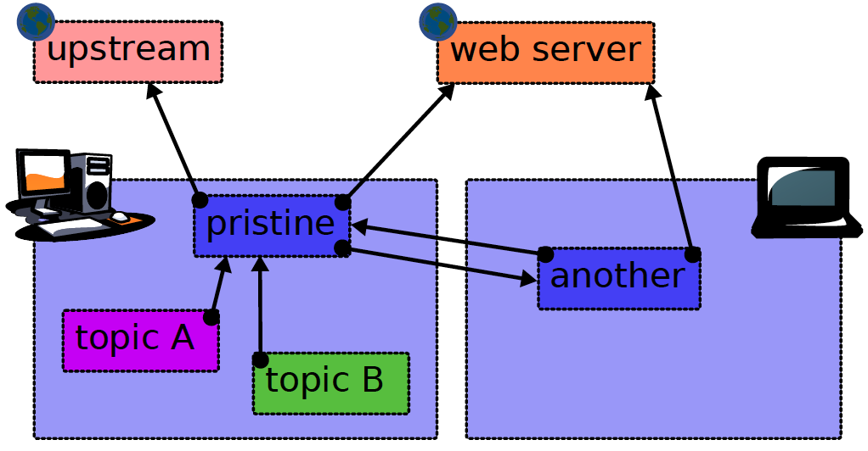
or shared with trusted peers
http://edgyu.excess.org/git-tutorial/2008-07-09/intro-to-git.pdf

Slide 29
Benefits of decentralization
Non-intrusive micro-commits
Detached operation (off net)
No single point of failure
Backups are trivial
Very flexible
... ?

Slide 30
Problems with decentralization
No “locking”
No single authoritative version
Relies on clock synchronization
Requires greater discipline, imposed by team workflow rules

Slide 31
Example workflow models
Suitable for use with Git or other distributed SCM tool.

Slide 32
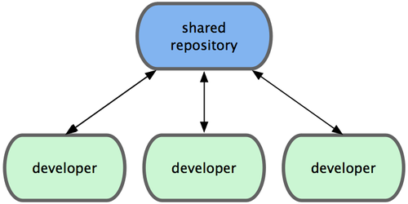
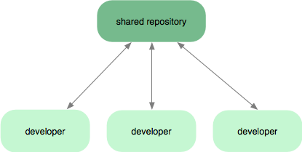
Agile workflow
All developers are equal, all push changes to same repository.
Repository is always up to date with the current “wave front”.
tp://progit.org/book/ch5-1.html
Notes:
This assumes that all developers are peers.
Advantages include continual integration, and elimination of bottlenecks that might be caused by a gatekeeper for the shared repository.
The shared repository may contain multiple working branches, as illustrated two slides down..

Slide 33
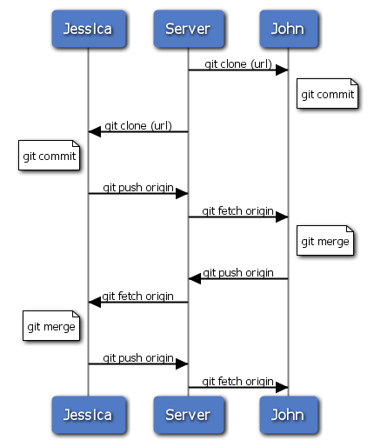
UML Sequence Diagram
for an Agile team.

Slide 34
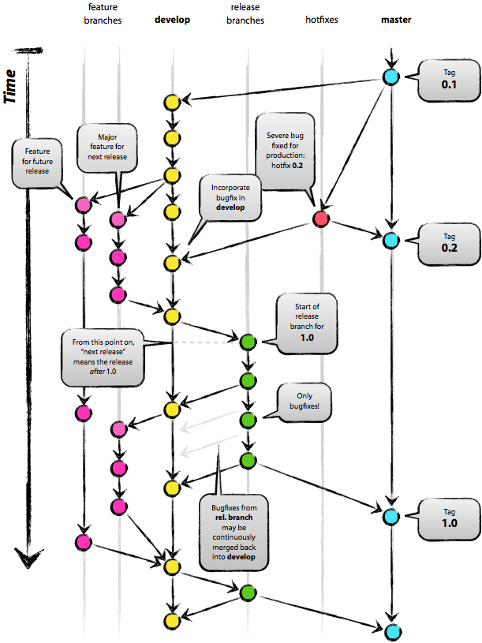
Agile workflow
http://nvie.com/wp-content/uploads/2009/12/Screen-shot-2009-12-24-at-11.32.03.png
Notes:
See separate slides, detailing this branching workflow, which is intended for a single shared repository.

Slide 35
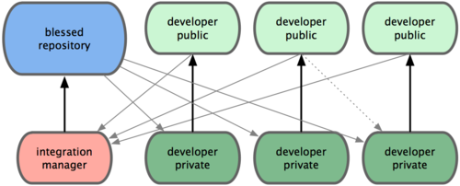
Managed repository
Only one person can push changes to the blessed repository.
Means less chance for accidents, but we now have a bottleneck.
.
tp://progit.org/book/ch5-1.htm
Notes:
This could be adapted to an Agile team by having a “virtual” integration manager. That is, there may be several team members who are trusted to perform this function, who jump in to perform it as needed.

Slide 36
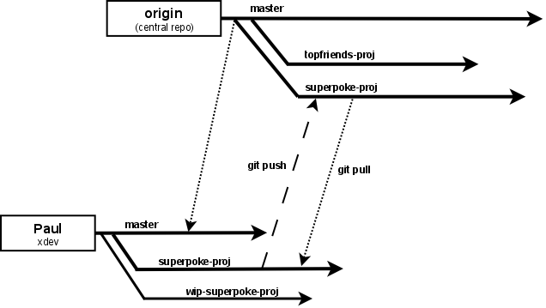
An alternate way of sharing a repository, using branches.
http://agentdero.cachefly.net/unethicalblogger.com/images/basic_slide_workflow.png
Notes:
This suggests an alternate way of sharing, with a single repository (instead of each developer having a separate published repository). Instead each developer may maintain his/her own branch or branches within a single repository. Integration with the main branch can be limited to one person who is the designated Integration Manager. Problems with this and all methods that put the onus of integration one person include: (1) the integrator can become a bottleneck; (2) if there are integration problems, the integration manager may not be the best qualified to resolve them (not being the author of the code that is causing the problem). The integration manager will end up passing the problem back to the author. This means further delay.

Slide 37
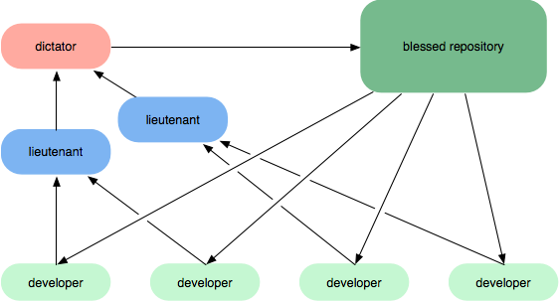
Linux-like hierarchical model
https://codebeamer.com/cb/displayDocument/workflow-c.png?object_comment_id=529&history=false&notification=false

Slide 38
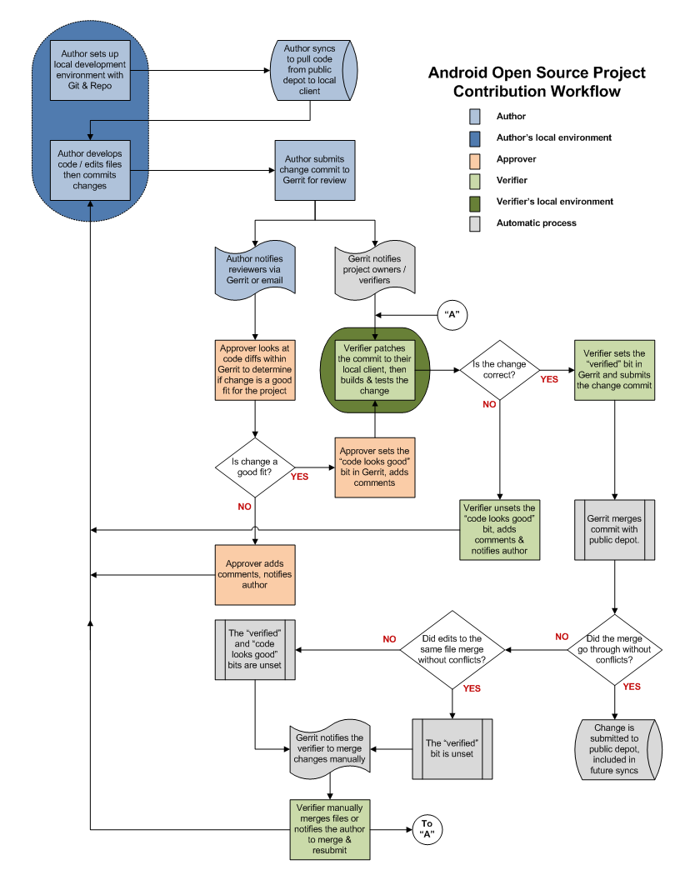
Android Git Workflow
http://source.android.com/submit-patches/workflow
Two kinds of review, verification by multiple testers before admission to repository.

Slide 39
In this course
If you use an IDE such as VB Studio or Eclipse then you can use a SCM plug-in
Several are available.
However, if you are not using an IDE you will need to use command-line operations, scripts, or a separate GUI tool for version control.
For Spring 2010 we will use Git.
So, you will need to learn it.
During your career you will probably need to learn and use several others.

