Slide 1
SDN & Security
Security as an App (SaaA) on SDN
New app development framework: FRESCO
FRESCO: Modular Composable Security Services for Software-Defined Networks by Seugwon Shin, Phillip Porras, Vinod Yegneswaran, Martin Fong, Guofei Gu, Mabry Tyson, NDSS 2012
New security enforcement kernel: FortNOX
A security enforcement kernel for OpenFlow networks by Philip Porras, Seungwon Shin, Vinod Yegneswaran, Martin Fong, Mabry Tyson, and Guofei Gu, ACM HotSDN, August 2012

Slide 2
Problems of Legacy Network Devices
Too complicated
Control plane is implemented with complicated S/W and ASIC
Closed platform
Vendor specific
Hard to modify (nearly impossible)
Hard to add new functionalities
Source: G. Gu, et al, Texas A&M &SRI

Slide 3
Software Defined Networking (SDN)
Three layer
Application layer
Application part of control layer
Implement logic for flow control
Control layer
Kernel part of control layer
Run applications to control network flows
Infrastructure layer
Data plane
Network switch or router
SDN architecture from ONF

Slide 4
OpenFlow Architecture
OpenFlow Switch specification
application
OpenFlow Switch
OpenFlow
Protocol
PC
SSL
Secure
Channel
controller
sw
A controller application
can enforce any flow rules
to network switches
hw
Flow
Table
From openflow tutorial

Slide 5
Unique opportunity with SDN
Everything is controlled through the logically centralized network OS
Can introduce security mechanism here!
Think of NFV

Slide 6
Killer Applications of SDN?
Reducing Energy in Data Center Networks (load balancing)
WAN VM Migration
…
How about security?
We are going to talk about this, more specifically:
Security as an App (SaaA)
Security as a Service (SaaS)
Source: G. Gu, et al, Texas A&M &SRI

Slide 7
Software App Store Today
7

Slide 8
Security as an App
SDN naturally has an application layer
Security functions can be apps on top of SDN/
networking OS
Firewall
Scan detection
DDoS detection
Intrusion detection/prevention
…
Why SaaA?
Cost efficiency
Easy deployment/maintenance
Rich, flexible network control
Source: G. Gu, et al, Texas A&M &SRI

Slide 9
Challenges and New Contributions
It is not easy to develop security apps
FRESCO: a new app development framework for
modular, composable security services
It is not secure when running buggy/vulnerable/ multiple security apps (e.g., policy conflict/bypass)
FortNOX: a new security enforcement kernel
Source: G. Gu, et al, Texas A&M &SRI

Slide 10
FRESCO: Framework for Enabling Security Controls in OpenFlow networks

Slide 11
What is FRESCO?
A new framework
Enables to compose diverse network security functions easily (bycombining multiple modules)
Enables to create own network security functions easily (without requiring additional H/Ws – openflow provides all necessary functionality)
Enables to deploy network security functions easily and dynamically (without modifying the underlying network
architecture)
Enable to add more intelligence to current network
security functions
Source: G. Gu, et al, Texas A&M &SRI

Slide 12
Source: G. Gu, et al, Texas A&M &SRI

Slide 13
FRESCO – Overall Operation
Create
Modules
Load Modules
Run
Modules
Monitor OpenFlow switches
Answer from NOX
Notify NOX of loading FRESCO modules
Source: G. Gu, et al, Texas A&M &SRI

Slide 14
FRESCO application layer
FRESCO have a number of internal NOX python security modules.
Developers use the FRESCO script language to instantiate and defined the interactions between the modules – security application.
FRESCO security application is triggered by input events.

Slide 15
FRESCO Modular Design
event
parameter
action
input
output
Module
key
values
F-DB instance
Source: G. Gu, et al, Texas A&M &SRI

Slide 16
FRESCO development environment
Script-to-module translation:
Script-to-module translation – abstracting the implementation complexities of producing OF controller extension.
Database management – collects network and switch state information to be shared by all security apps.
Event management – notifies an instance about the occurrence of predefined events.
Instance execution – authenticated to run with authority granted at registration.

Slide 17
FRESCO resource controller
Make sure the resources (flow table entry) are available at switches
Evict flow table entry if necessary
Two functions
Switch monitor
Garbage collection – clean up flow table.

Slide 18
FRESCO – Script Language
Goal
Define interfaces, actions, and parameters
Connect multiple modules
Similar to C/C++ function, start with { and end with }
Format
Instance name (# of input) (# of output)
denotes the module name and the number of input and output variables
INPUT: a₁,a₂,
denotes input items for a module a_{n} may be set of flows, packets or integer
values
OUTPUT: b₁,b₂,
denotes output items for a module b_{n} may be set of flows, packets or integer
values
PARAMETER: c₁,c₂,
denotes configuration values of a module c_{n} may be real numbers or strings
EVENT: d₁,d₂,
denotes events that will be delivered to a module d_{n} may be any predefined
string
ACTION : condition ; action,
denotes actions that will be performed based on condition
Source: G. Gu, et al, Texas A&M &SRI

Slide 19
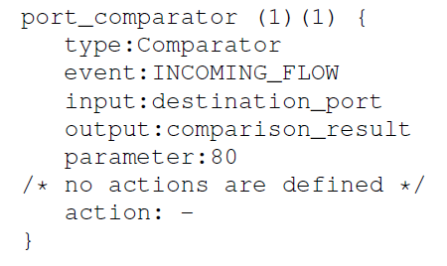
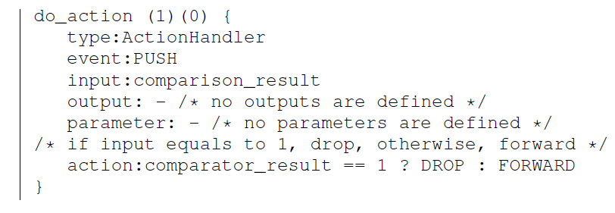
An working example

Slide 20
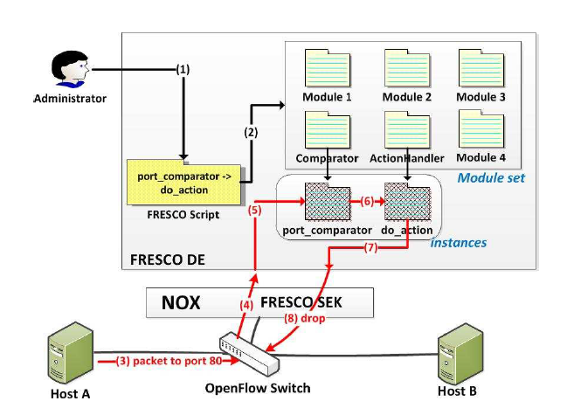
Running the script

Slide 21
A working example
Reflector net – detect an active malicious scanner, and reprogram the switch data plan to redirect the scanner’s flow into a remote honeynet.

Slide 22
Simple Working Example: Reflector Net
do_redirect (2) (0) {
TYPE: ActionHandler
EVENT:PUSH
INPUT:SRC_IP, scan_result
OUTPUT: -
PARAMETER: -
ACTION: scan_result == 1? REDIRECT: FORWARD
/* if scan_result equals 1, redirect; otherwise, forward */
}
find_scan (1) (2) {
TYPE: ScanDetector
EVENT:TCP_CONNECTION_FAIL
INPUT: SRC_IP
OUTPUT: SRC_IP, scan_result
PARAMETER: 5
ACTION: -
/* no actions are defined */
}
Module 1
Module 2
Source: G. Gu, et al, Texas A&M &SRI

Slide 23
More …
Tarpits
White Holes
Scan detector
P2P detector (P2P Plotter)
Botnet detector (BotMiner)
…
Over 90% reduction in lines of code compared with their standard implementations
Already include more than 16 commonly reusable modules (expending over time)
Source: G. Gu, et al, Texas A&M &SRI

Slide 24
FortNOX: A Security Enforcement Kernel for OpenFlow
Source: G. Gu, et al, Texas A&M &SRI

Slide 25
New Threat
SDN apps can compete, contradict, override one another, incorporate vulnerabilities
Worst case: an adversary can use a vulnerable and deterministic SDN app to control the state of all SDN switches in the network
Source: G. Gu, et al, Texas A&M &SRI

Slide 26
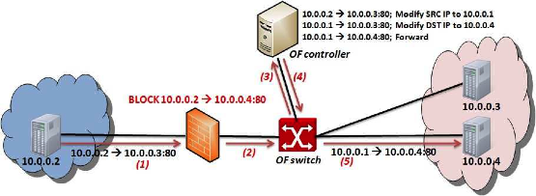
SDN/OpenFlow Evasion Scenario: enforcement challenge
.
Dynamic Flow Tunneling
Source: G. Gu, et al, Texas A&M &SRI

Slide 27
Prerequisites for a Secure OpenFlow Platform
Must be resilient to
Vulnerabilities in OF applications
Malicious code in 3rd party OF apps
Complex interaction that arise between OF app
interactions
State inconsistencies due to switch garbage collection or policy coordination across distributed switches
Sophisticated OF applications that employ packet
modification actions
Adversaries who might directly target our security
services to harm the network
Source: G. Gu, et al, Texas A&M &SRI

Slide 28
FORNOX
NOX+non-bypassable policy-based flow rule enforcement.
Once a flow rule is inserted to FortNOX by a security application, no peer OF application can insert flow rules that conflict with the rule.
Role-based authorization
Rule conflict detection
Security directive translation
Source: G. Gu, et al, Texas A&M &SRI

Slide 29
Classic NOX Architecture
PY OF
Apps
Python SWIG
Native C
OF Apps
Send_OpenFlow_Command()
NOX
Source: G. Gu, et al, Texas A&M &SRI

Slide 30
FortNOX Architecture
Native C
OF Apps
Separate
Process
Security Apps
PY OF
Apps
OF IPC Proxy
Actuator
Python SWIG
Directive Translator
IPC Interface
Aggregate Flow Table
FT_Send_OpenFlow_Command
Operator Rules
Role-based Source Auth
State Table Manager
OF Mod Commands
Add (conflict enforced)
Modify (conflict enforced)
Delete (priority enforced)
SECURITY Rules
Conflict Analyzer
OF App Rules
Switch Callback Tracking
FortNOX
Switch Callback tracking
Source: G. Gu, et al, Texas A&M &SRI

Slide 31
Role based source authentication
Human administrator (high priority)
Security applications
Non-security OF applications (low)
Roles implemented with a digital signature scheme.

Slide 32
Conflict detection/resolution
Alias set rule reduction
Rules are converted into an internal representation called alias reduced rules
Resolution
Based on the priority of the rule.

Slide 33
Summary of FortNOX
FortNOX – A new security enforcement kernel for OF
networks
Role-based Authorization
Rule-Authentication
Conflict Detection and Resolution
Security Directive Translation
“A Security Enforcement Kernel for OpenFlow Networks”. HotSDN’12
Source: G. Gu, et al, Texas A&M &SRI

