Slide 1
Middlebox, SDN and NFV
  Middlebox
  NFV (Middlebox Virtualization) and SDN
  ClickOS – a software-based virtual middlebox platform.

Slide 2
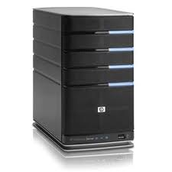
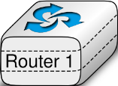
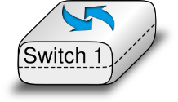
The Idealized Network
Application
Application
Transport
Transport
Network
Network
Network
Datalink
Datalink
Datalink
Datalink
Physical
Physical
Physical
Physical
Notes:
The view of the network as taught in schools look ssomething like this: end systems with a network in between containing switches and routers. Pretty simple.

Slide 3
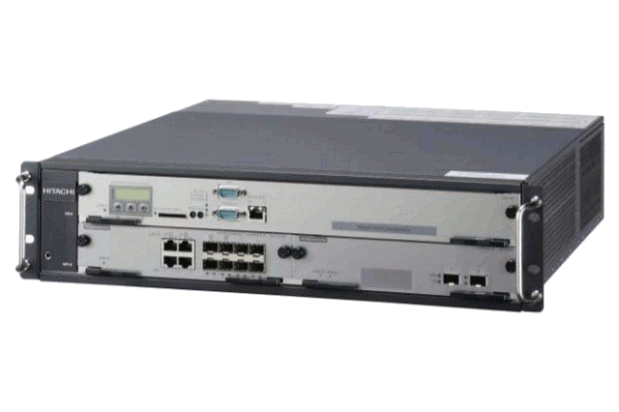
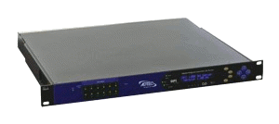
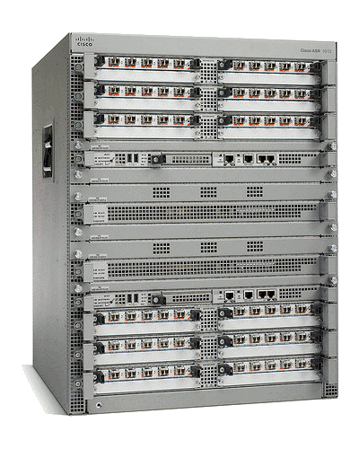
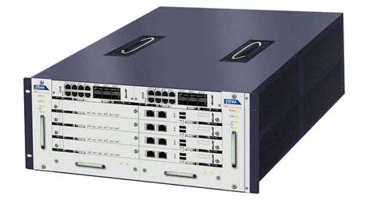
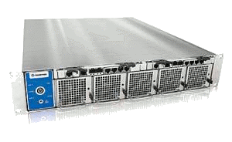
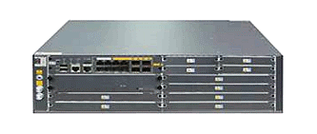
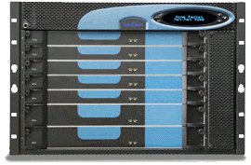
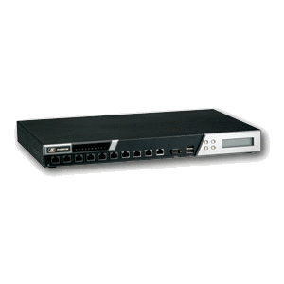
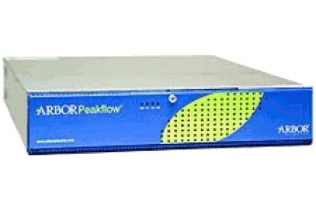
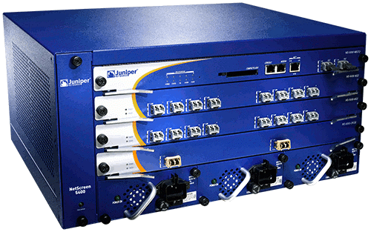
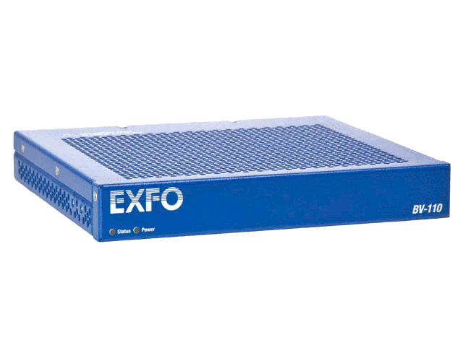
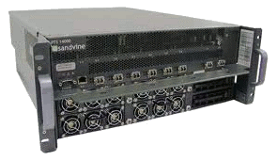
A Middlebox World
ad insertion
WAN accelerator
BRAS
transcoder
session border
controller
IDS
carrier-grade NAT
load balancer
DDoS protection
firewall
DPI
QoE monitor
Middleboxes: hardware-based network appliances. Now a
fundamental part of Today’s operational networks.
Notes:
But as we all know the reality is quite different. Middleboxes are commonplace in today’s networks, as many middleboxes as routers/switches. They are useful for many reasons: security (firewalls, Intrusion detection systems), monitoring (DPI, QoE monitors), traffic shaping (load balancers, rate limiters), address exhaustion (NATs), performance optimization (WAN accelerators, transcoders, caches, proxies) and others of a more dubious nature like this ad insertion box.

Slide 4





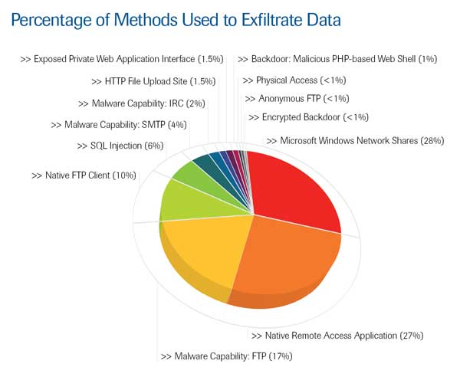

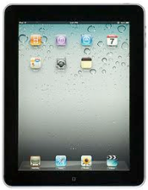


Need for Network Evolution
New applications
Evolving
threats
Policy
constraints
Performance, Security
New devices

Slide 5
Network Evolution today: Middleboxes!
Type of appliance | Number
Firewalls | 166
NIDS | 127
Media gateways | 110
Load balancers | 67
Proxies | 66
VPN gateways | 45
WAN Optimizers | 44
Voice gateways | 11
Total Middleboxes | 636
Total routers | ~900
Data from a large enterprise:
>80K users across tens of sites
Just network security
$10 billion
(Sherry et al, SIGCOMM’ 12)

Slide 6
There are many middleboxes!
Survey across 57 enterprise networks
(Sherry et al, SIGCOMM’ 12)

Slide 7
Things to keep in mind about middleboxes
A middlebox is any traffic processing device except for routers and switches.
Why do we need them?
  Security
  Performance
Deployments of middlebox functionalities:
  Embedded in switches and routers (e.g., packet filtering)
  Specialized devices with hardware support of SSL acceleration, DPI, etc.
  Virtual vs. Physical Appliances
  Local (i.e., in-site) vs. Remote (i.e., in-the-cloud) deployments
They can break end-to-end semantics (e.g., load balancing)

Slide 8
Hardware Middleboxes - Drawbacks
Expensive equipment/power costs
Difficult to add new features (vendor lock-in)
Difficult to manage
Cannot be scaled on demand (peak planning)
Network Function Virtualization: turn these middleboxes
into software-based virtualized entities.
Notes:
Obviously middleboxes are very useful, but they come with a number of problems: the most dedicated st clear one is price but it certainly not the only one; another issue is that is difficult to add new features; once you buy a cisco box for example you are stuck with them; they are difficult to manage, often requiring specialized personnel for each type of middlebox. Hardware middleboxes cannot be scaled on demand nor can they be shared among different tenants, and it is hard for new players to enter the market.
(pause)

Slide 9
Middlebox, SDN and NFV
  Middlebox
  NFV (Middlebox Virtualization) and SDN
  ClickOS – a software-based virtual middlebox platform.

Slide 10
Middlebox Virtualization
Virtual network function (VNF):
  software implementation of a network function capable of running over NFV infrastructure
Advantage of NFV
  use standard COTS hardware (e.g., high volume servers, storage)
    reduces CAPEX and OPEX
  fully implement functionality in software
    reducing development and deployment cycle times, opening up the R&D market
  consolidate equipment types
    reducing power consumption
  optionally concentrate network functions in datacenters
    obtaining further economies of scale and enabling rapid scale-up and scale-down

Slide 11
Potential VNFs
Potential Virtual Network Functions (from NFV ISG whitepaper)
Switching elements:
  Ethernet switch, Broadband Network Gateway, CG-NAT, router
Mobile network nodes:
  HLR/HSS, MME, SGSN, GGSN/PDN-GW, RNC, NodeB, eNodeB
Residential nodes: home router and set-top box functions
Tunnelling gateway elements: IPSec/SSL VPN gateways
Traffic analysis: DPI, QoE measurement
QoS: service assurance, SLA monitoring, test and diagnostics
NGN signaling: SBCs, IMS
Converged and network-wide functions:
  AAA servers, policy control, charging platforms
Application-level optimization:
  CDN, cache server, load balancer, application accelerator
Security functions: firewall, virus scanner, IDS/IPS, spam protection

Slide 12
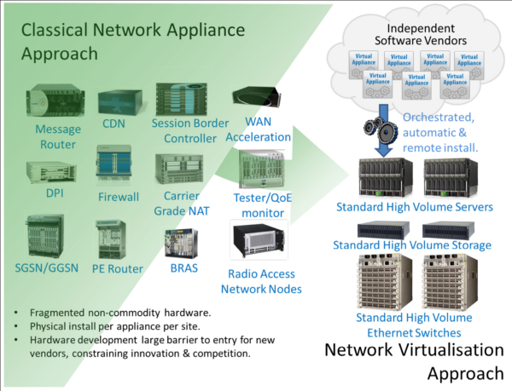
Potential VNFs (Cont’d)

Slide 13
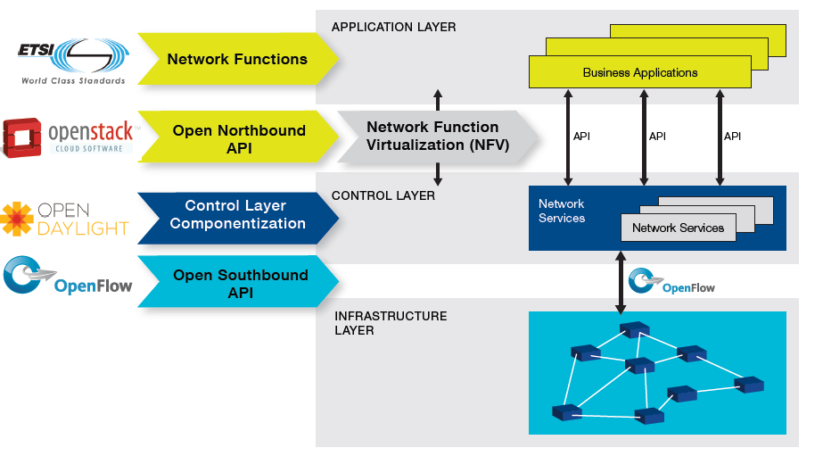
SDN and NFV map

Slide 14
SDN and NFV challenges
Leverage and adapt cloud technologies to implement NFV
Fixed configurations: using general purpose infrastructure to perform customized tasks.
Realize the function, but not the reduced management. Manually intensive management
Rapid growh of IP end points
Network end point mobility
Elasticity: VNFs are created, adjusted, and destroyed.
Multi-tenancy

Slide 15
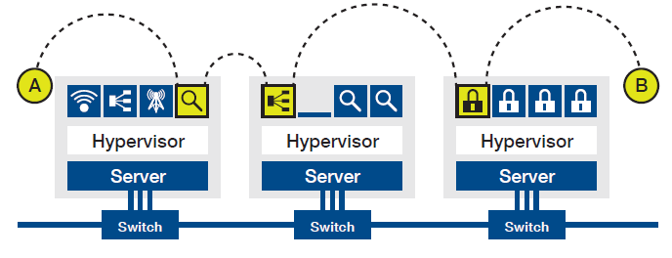
NFV Use Cases
Virtual network function forwarding graph
  Monitoring VNF, load balancing VNF, firewall VNF
  To add a new VNF, a virtual machine can be instantiated and forwarding graph updated.

Slide 16
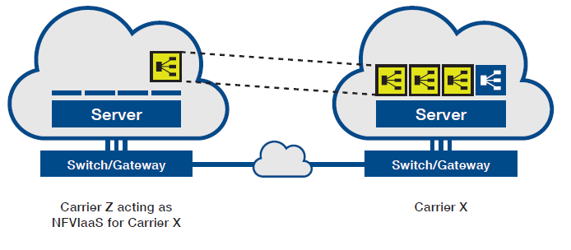
NFV Use Case Example
NFV infrastructure as a service (NFV IAAS)
  An open and multi-vendor environment to maximize the choice and reduce CapEx costs.

Slide 17
OpenFlow-enabled SDN: a Flexible NFV Networking Solution

Slide 18
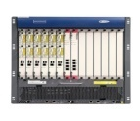


NFV High Level Architecture
OSS / BSS: (operation/Business Support)
NFV Scope
Virtualized Network Functions (VNFs)
NFV Management and
Orchestration (MANO)
Service
End-Points
(End-users,
Other Services)
VNF
VNF
VNF
VNF
NFV Infrastructure (NFVI)
Virtual Infrastructure
Virtual Computing
Virtual Storage
Virtual Networking
Physical Infrastructure
Other Networks
Compute
Storage
Network

Slide 19
ETSI NFV Reference Architecture
NFV Management and Orchestration
Main NFV reference points
Os-Ma
Orchestrator
OSS/BSS
Se-Or
Other reference points
Service and Infrastructure Requirements
Or-Vnfm
Execution reference points
EMS 1
EMS 2
EMS 3
Ve-Vnfm
VNF
Manager(s)
VNF 1
VNF 2
VNF 3
Or-Vi
Vn-Nf
Vnfm-Vi
NFVI
Virtual Computing
Virtual Storage
Virtual Network
Virtualised
Infrastructure
Manager(s)
Nf-Vi
Virtualisation Layer
Vi-Ha
Hardware resources
Computing
Hardware
Storage
Hardware
Network
Hardware
Notes:
End to end architecture view starting to form.
Recent Outcome on Bonn meeting (Last NFV meeting)
A lot of ground still needs to be covered on interface definitions and functional layout

Slide 20
Middlebox, SDN and NFV
  Middlebox
  NFV (Middlebox Virtualization) and SDN
  ClickOS – a software-based virtual middlebox platform.

Slide 21
Shifting Middlebox Processing to Software
Can share the same hardware across multiple users/tenants
Reduced equipment/power costs through consolidation
Safe to try new features on a operational network/platform
But can it be built using commodity hardware while still achieving high performance?
Notes:
So clearly moving these middleboxes in software and in “the cloud” would certainly solve most of these issues. Problem is whether this software middleboxes can be built in commodity hardware while still achieving high performance as seen by the hardware middleboxes.
(pause)
We believe so, and thats what we propose with ClickOS. In one sentence, ClickOS is a MiniOS based virtual machine that runs Click modular router software.

Slide 22

From Thought to Reality - Requirements
Fast Instantiation
Small footprint
Isolation
Performance
Flexibility
ClickOS
30 msec boot times
5MB when running
provided by Xen
10Gb/s line rate*
45 μsec delay
provided by Click
* for most packet sizes
Notes:
Our goal is to build a versatile, high performance software middlebox platform on commodity hardware. Such a platform must satisfy a set of requirements: Fast instantiation, should be able to instantiate middlebox processing quickly, and allow quick adaptation to network conditions; Small footprint, in order to potentially run hundreds of middleboxes; Isolation of both CPU, memory and ability to accommodate a wide range of OSes/software packages, to by hosted by the operator or untrusted third parties; Performance, should be able to cope with HW offerings and scale on demand; Flexibility, should cover a wide range of middlebox processing;
ClickOS fullfills all of those: it boots on 30 millseconds; only requires 5 MB of RAM to run; Isolation: we base our work on Xen since its support for paravirtualization; has line-rate for almost all packet sizes; adds 45 microseconds of delay, and covers a wide range of packet processing with Click;

Slide 23
ClickOS
Developing a software middlebox over commodity OS like Linux is hard.
  Nothing to use except for network connectivity
Want to use some OS that is good for building software routers
  Click is such a system
ClickOS: tiny Xen-based virtual machine that runs Click

Slide 24
Middlebox and Click Elements

Slide 25
What's ClickOS ?
domU
ClickOS
Click runs on Linux as
A process or kernel module
apps
Click
guest
OS
mini
OS
paravirt
paravirt
Work consisted of:
  Build system to create ClickOS images (5 MB in size)
  Emulating a Click control plane over MiniOS/Xen
  Reducing boot times (roughly 30 milliseconds)
  Optimizations to the data plane (10 Gb/s for almost all pkt sizes)
  Implementation of a wide range of middleboxes
Notes:
In Xen, a virtual machine consists of: a paravirtualization layer, a guest OS and applications on top. In the case of ClickOS, we use MiniOS as the guest OS. . MiniOS runs on a single core, it has a single memory space, no processes, and a cooperative scheduler. On top of MiniOS, we run Click and we call the whole thing ClickOS. We want to eliminate all the clutter from a generic operating system, and decrease to the bare minimum necessary to packet processing.
Our work/contributions include:
- A generic build system in order to generate ClickOS XEN virtual machines. We also used it to build other applications on top of MiniOS.
- Emulating a Click control plane for MiniOS (there is not a command line in MiniOS that can be used to control Click).
- Doing optimizations to reduce ClickOS boot times down to 30 miliseconds
- Finally optimizations to the data plane to achieve line-rate for almost all packet sizes. Applying these optimizations to other guest OSes such as Linux;
- And implementation of a wide range of middleboxes;
I will focus on the last two items which we think it has higher contribution.

Slide 26
What support does Click need from the OS?
We want to minimize the OS too!
Support needed:
  Driver support for different types of network interfaces
    Problematic, but Xen has a good solution for this.
  Basic memory management to allocate different data structures, packets, etc --- miniOS
  A simple scheduler that can switch between Click element code and interrupts --- miniOS

Slide 27
ClickOS architecture
Optimized Xen network IO subsystem, tailor-made middlebox VM based on Click
Tools to build and manage the ClickOS VMs

Slide 28
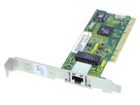
Xen Networking analysis and optimization
Driver Domain (or Dom 0)
ClickOS Domain
netback
Xen bus/store
netfront
Click
NW driver
OVS
vif
Event channel
FromDevice
ToDevice
Xen ring API
(data)
300* Kp/s
225 Kp/s -tX
8Kp/s -rx
28
Notes:
So let me talk to you in a little bit more detail about how Xen’s I/O subsystem works. First, we have a NIC, in our case a 10Gb intel NIC. Then the Domain-0 has a network driver for it, for instance the ixgbe driver. This network driver is attached to a software switch, say the Linux bridge or openvswitch. To the switch we attach a virtual interface called VIF, which is managed by the netback driver. The netback driver connects to the netfront driver over a XEN ring API. Event channels are used for notifications and the xenbus used for control/initialization.
Finally, we created two new elements called FromDevicet and ToDevice that Click can interact with the netfront driver.
So the goal is to reach 10Gb/s, meaning 813,000 packets per second for maximum sized packets all the way up to 14.8 Mp/s for min-sized ones, as the table shows.
The problem is that when we first put all of this together there were several important performance bottlenecks. For instance, openvswitch could only 300 Kpps; the netback driver and VIF 350 Kpps and 225 Kpps for the MiniOS netfront driver, when we put everything together.

Slide 29
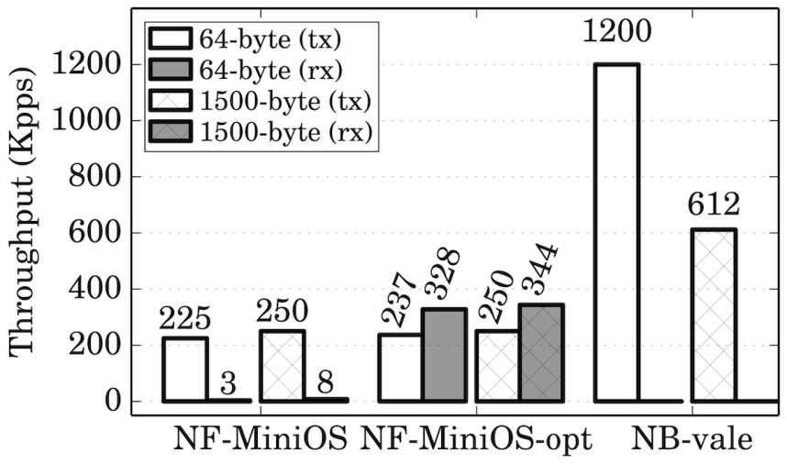
Optimizing Network I/O – Backend Switch
Driver Domain (or Dom 0)
ClickOS Domain
NW driver
(netmap mode)
netback
netfront
Click
OVS
Xen bus/store
VALE
Event channel
FromDevice
port
ToDevice
Xen ring API
(data)
Reuse Xen page permissions (frontend)
Introduce VALE[1] as the backend switch
Increase I/O requests batch size
[1] VALE, a switched ethernet for virtual machines, ACM CoNEXT'2012
Luigi Rizzo, Giuseppe Lettieri
Universita di Pisa
Notes:
Moving forward after careful analysis we start optimizing. We first started by reusing grants in the frontend. Grants consists off a table with the page and the permissions of a target domain. These are now done at initialization time instead of a per packet basis. This optimization led us to increase the rate by 40x. Afterwards we changed the backend switch, to introduce VALE software switch.
Furthermore we added support for bigger I/O rings, which let us batch more packets in the XEN ring.
Applying all of these changes, results were actually good, getting 2.7x improvement for maximum-sized packets and 4.2x for minimum sized packets.

Slide 30
Optimizing Network I/O
Notes:
The next optimization was replacing the XEN I/O rings with the netmap ring. We map all the memory regarding a VALE port all the way to the guest. The netmap buffers are also mapped to the guest, so that we don't need the expensive copy between domain.
We also applied another technique in which we call it asynchronous operation, whereas TX and RX operation happens by maintaining a private copy of the control datastructures when backend is processing packets.
The backend has a bit higher memory requirements, altough still very small. Overall to reach the high rate we only require to map a total of 4 MB to the guest. Although we gain major improvements with this new network backend, we also break other guests support. To show that our optimizations do apply to other guests we also implemented a Linux netfront driver compatible with this new backend.

Slide 31
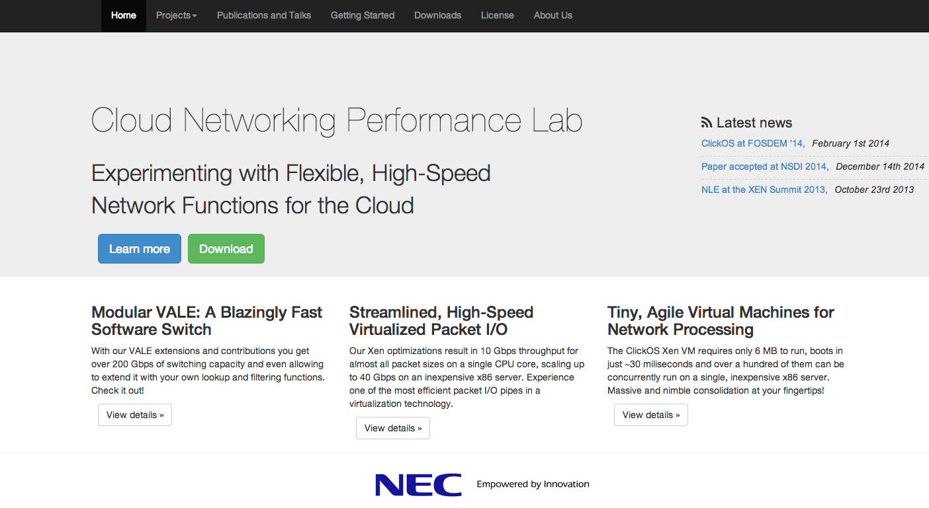
It's Open Source!
Checkout
  ClickOS, Backend Switch, Xen optimizations and more!
  Github ( )
  Tutorials
  Better performance!
Notes:
Introducing Netmap API for virtual machines, breaks the XEN guests such as the Linux one. We are modifying the Linux netfront so that it benefits from our performance improvements.
We are also investigating ways of chaining middleboxes together on the same server in an efficient manner.

Slide 32
Conclusions
Virtual machines can do flexible high speed networking
ClickOS: Tailor-made operating system for network processing
  Small is better: Low footprint is the key to heavy consolidation
  Memory footprint: 5MB
  Boot time: 30ms
32

